Slide 1

LECTURE 2
Quantitative Assessment of Information
Units of information • Hartley • Shannon • Entropy

Slide 2
Plan of the lecture
• Warm-up game: how many questions?
• Messages and notifications — what is information?
• R. Hartley, 1928: information can be measured
• Derivation of Hartley's formula I = log₂N
• C. Shannon, 1948: alternative choice and selective cascade
• Shannon's entropy H = −Σ pᵢ·log₂ pᵢ
• Coding messages: why rare symbols get long codes
• Practice tasks + final quiz

Slide 3
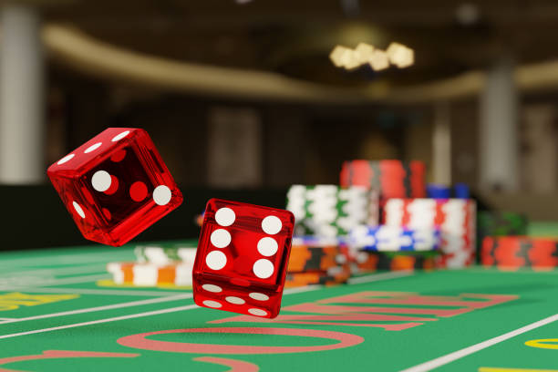
Two types of messages
Does time matter?
• Time-dependent message — its value changes with delay:
  – lottery ticket, weather forecast, storm warning
  – limiting case — notification: bell, clock, siren
  – ALL information is in the moment the signal arrives
• Shannon message — sequence of signs chosen with constant probabilities:
  – probability pᵢ of sign Zᵢ does not change over time
  – sender = random stationary process (source of messages)
  – the sign itself is known — the news is WHICH sign was chosen

Slide 4
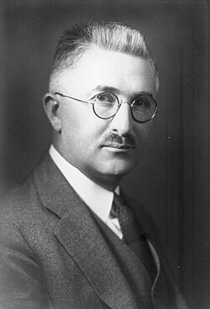
Ralph Hartley, 1928
"Information allows quantitative assessment"
• Electrical engineer, Bell Labs
• Paper "Transmission of Information" (1928)
• Combinatorial, set-theoretic approach:
  – a set of N elements, one is selected
  – before selection — uncertainty
  – after selection — uncertainty is removed
• Soviet contribution: Kolmogorov, Kharkevich, Stratonovich
  – (archive finds: Kolmogorov, 1938 — classified work!)

Slide 5
Hartley's two requirements
• 1. Monotonicity
  – 1 element → choice is predetermined → I = 0
  – 2 elements → minimal uncertainty → minimal I
  – the more elements, the more information received
• 2. Additivity
  – two independent sources with N₁ and N₂ messages
  – combined source: N = N₁ · N₂
  – but information must add up: I = I₁ + I₂
• Which function turns multiplication into addition?
  – → THE LOGARITHM

Slide 6
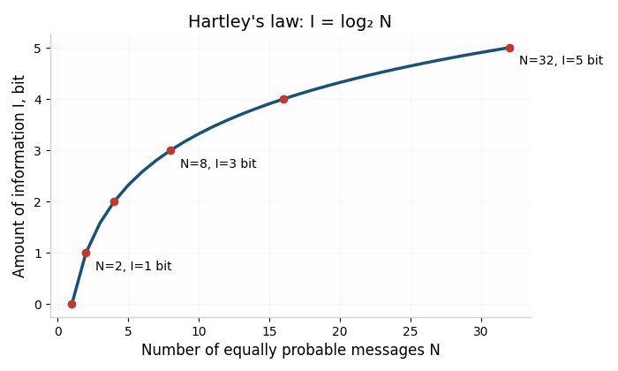
Why exactly log₂?
i binary digits → N = 2ⁱ numbers
i digits | 1 | 2 | 3 | 4 | … | i
N = 2ⁱ | 2 | 4 | 8 | 16 | … | 2ⁱ
I, bit | 1 | 2 | 3 | 4 | … | i
• The amount of information in a binary number = number of its digits
• Doubling the length doubles I, although N grows as N₁²
• Bit = answer to one alternative choice (yes/no)

Slide 7
Hartley's formula
N equally probable messages
I = log₂ N [bit]
• N = 1 → I = 0 ✔
• N = N₁·N₂ → I = I₁ + I₂ ✔ (log of a product)
• Special case: N = 2ᵏ → I = k bits
• Task: a card is drawn from a 32-card deck. How much information is needed to know the card?

Slide 8
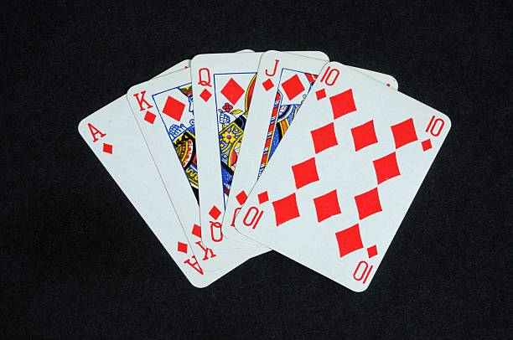
Solution: 32-card deck
• N = 32 = 2⁵
• I = log₂ 32 = 5 bits
• = 5 binary questions are enough:
  – "Is it a red suit?" — "Is it a face card?" — ...
• Another example: roulette with N outcomes → I = log₂N
• Problem for you: how many bits for one dice throw?

Slide 9
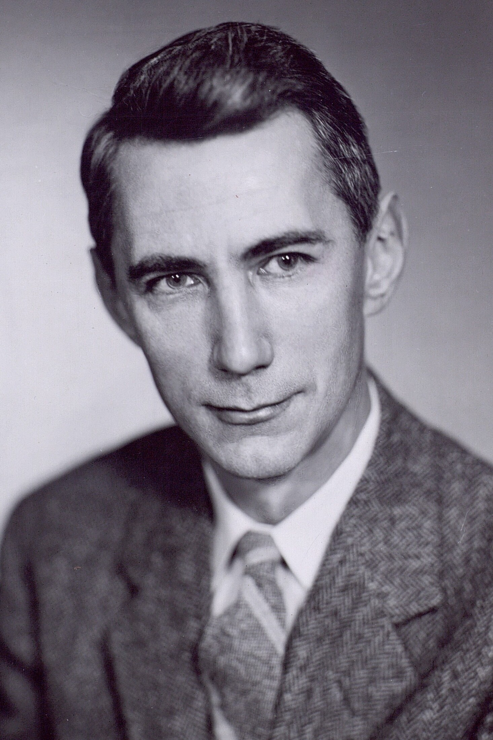
Claude Shannon, 1948
"A Mathematical Theory of Communication"
• Father of information theory (and juggling robots 🎪)
• Elementary act — alternative choice between 2 signs (0/1)
• = 1 bit
• Signs have DIFFERENT probabilities pᵢ
  – frequent sign → fewer questions → less information
  – rare sign → more questions → more information
• Selection cascade: split the set into equally probable halves

Slide 10
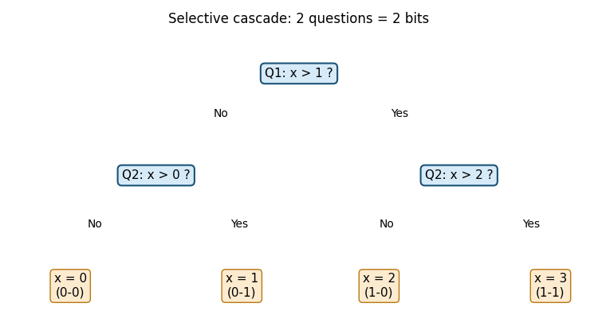
Selective cascade
Guessing a number from 0 to 3
• Each answer = 1 bit
• 2 questions remove all uncertainty
• H = 2 bits for 4 equally probable numbers
• Game: think of a number 1–100 — how many questions do you need?

Slide 11
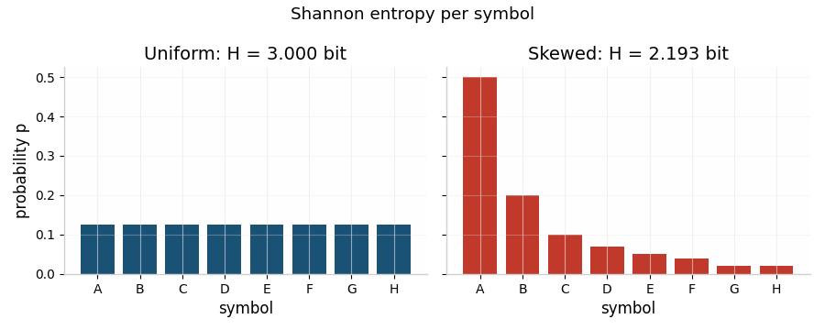
Shannon's entropy
average information per sign
H = − Σᵢ pᵢ · log₂ pᵢ [bit/sign]
• pᵢ — probability of the i-th sign
• = average number of binary questions per sign
• = average length of the binary code word
• = entropy of the message source
• For equally probable signs: H = log₂ N → we return to Hartley!

Slide 12
Task: coin toss
p₁ = p₂ = 0.5
H = −0.5·log₂0.5 − 0.5·log₂0.5 = 1 bit
• One binary question: "Heads?" — enough
• A fair coin gives exactly 1 bit per toss

Slide 13
Optimal binary coding
• Frequent letters → short codes, rare → long
• Fano condition: no code word is a prefix of another
• Average length ≈ H = 2.875 bits
• This is how ZIP, JPEG, MP3 work (Huffman, arithmetic coding)
• Live demo: we build a code for the phrase "TO BE OR NOT TO BE"
letter | p(letter) | code | length
a | 1/4 | 00 | 2
e | 1/4 | 01 | 2
f | 1/8 | 100 | 3
c | 1/8 | 101 | 3
b | 1/8 | 110 | 3
d | 1/16 | 1110 | 4
g | 1/16 | 1111 | 4

Slide 14
Units of information
unit | definition | value
1 bit | one binary choice | log₂ 2
1 dit (hartley) | decimal unit | log₁₀ N
1 nat | natural unit | ln N
1 byte | 8 bits | 256 states
• Conversions: 1 bit ≈ 0.301 dit; 1 bit ≈ 0.693 nat
• Message of k signs: I = k · H [bit]
• Example: 1000 equiprobable letters → H = log₂… compute!

Slide 15
Amount of information vs volume
primary and secondary alphabet
I = k · H Q = k · l_avg
• I — real information (depends on the primary alphabet, probabilities)
• Q — volume of information (depends on the code, secondary alphabet)
• Maximum load: l_avg = H → Q = I
• In all other cases: I < Q — code is redundant
• Redundancy protects against errors (e.g. human language ≈ 50%)!

Slide 16
Practice — solve in pairs (10 min)
• 1. How many bits are in one throw of an 8-sided die?
• 2. A source sends letters A,B,C with p = 1/2, 1/4, 1/4. Find H.
• 3. The word MAMA has alphabet {M, A}. Find H and I for the word.
• 4. How many bits do you need to transmit one of 1000 equiprobable messages? At least?
• 5. Trick question: "Yesterday I learned 1 bit of information and my friend learned 2. Who learned more?"

Slide 17
Final quiz "Who wants to be an informationaire?"
• Q1: I = log₂N — what does N mean?
• Q2: Why is information additive but the number of messages multiplicative?
• Q3: Which message has more information: frequent or rare?
• Q4: What is the entropy of a source with one possible sign?
• Q5: When does the code length equal H?
• Q6: Name three real systems where entropy coding is used.

Slide 18

Summary
• Information can be measured (Hartley, 1928; Shannon, 1948)
• Hartley: I = log₂ N — equally probable events
• Shannon: H = −Σ pᵢ log₂ pᵢ — any probabilities
• Entropy = average number of yes/no questions = average code length
• Information I = k·H, volume Q = k·l_avg, I ≤ Q
• Homework: problems 1–5 from the practice slide + read about Huffman coding

