Slide 1



Travel Experts Website Prototype Overview
MOHB - Team1
Bade-Adebowale Kehinde, Hazem Hegazy,
(Terry) Soktheary Mao, Darya Ostapenko

Slide 2
We are here today to …
Demonstrate the prototype of Travel Experts Website
Collect your feedback
Explain the next phase

Slide 3


Prototype, why?
Project progress update
Know where we are in the project
Make sure that we are on the right track
It is not too late for changes

Slide 4
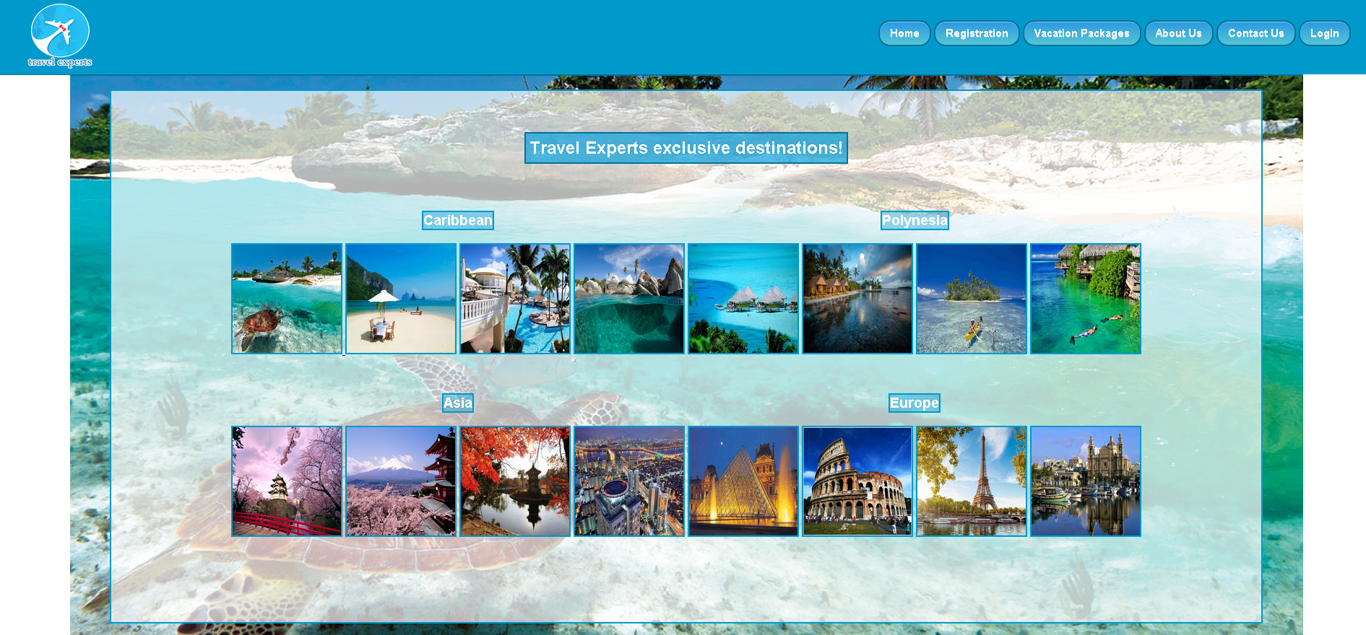
Graphical Design

Slide 5


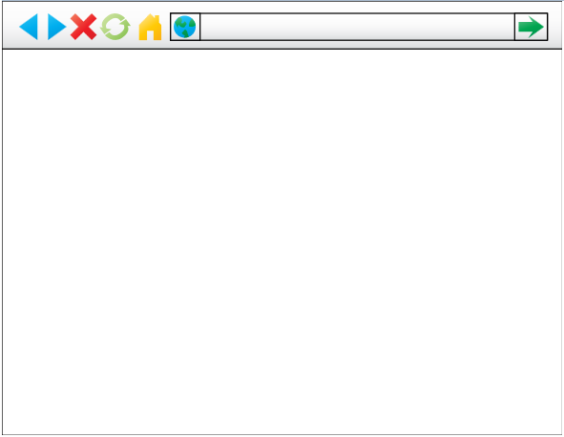
Prototype Components
Travel Experts Agent
Browsing Travel Experts Website
Happy Travel Experts Customer
Feeding and maintain the website database
www.travelexperts.ca

Slide 6
Prototype Components
Desktop application, used by the agents to administer the data stored on the database.
Centralized database to store the data.
Website application, used by the customer.

Slide 7
Microsoft Technologies
Desktop application: Microsoft C#.NET
Database: SQL Server database
Web application: Microsoft ASP.NET

Slide 8
Prototype Components
Agents Application
Suppliers screen
Products screen
Packages screen

Slide 9
Prototype Components
Website
Registration page
Packages page
Booking page
Contact page

Slide 10

Next Phase
Upon ensuring we are meeting all the client’s requirements and there are no changes to be implemented, we are going to move to the next step which will include the finalization of the prototype.

