Slide 1

ORIENTATION ON HUMAN RESOURCE POLICIES

Slide 2
DOST-CAR Organizational Structure
Office of the Regional Director
Regional Director
Administrative Assistant III
Planning Officer
MIS Officer

Slide 3
Technical Services
Technology Transfer and Commercialization
Small Enterprise Technology Upgrading (SETUP)
Packaging and Labeling Services
Technical Consultancy Services

Slide 4
Disaster Risk Reduction Management
Regional Science and Technology
Promotion
Regional Standards & Testing Laboratory

Slide 5
Field Operations
PSTC Abra
PSTC Apayao
PSTC Benguet
PSTC Ifugao
PSTC Kalinga
PSTC Mountain Province

Slide 6
Finance and Administrative Services
Accounting
Budgeting
Cashiering
Property and Supply
Human Resource
General Services

Slide 7
Human Resource Policies
Attendance
Monthly Performance Output Report
Pass Slip
Travel Order Signatories
CSC Flexi-time Policy
No Noon Break Policy
Others

Slide 8
ATTENDANCE
Daily Time Record
Ensure accurate logging of time ins and outs in the logbook;
DTRs of Contract of Service Employees in the Regional Office are to be initialed by the immediate supervisor and to be signed by the division chief;
DTRs of Contract of Employees in the centers are to be signed by the PSTD/ OIC;
Submit (2) copies with complete and approved attachments to HR: one set for HR file and one set for the Cashier
Documents: signed semi-monthly performance output, approved pass slip, and approved TO
* Please do not attach unapproved documents.

Slide 9
Monthly Performance Output Report
Documentation of semi- monthly accomplishments

Slide 10
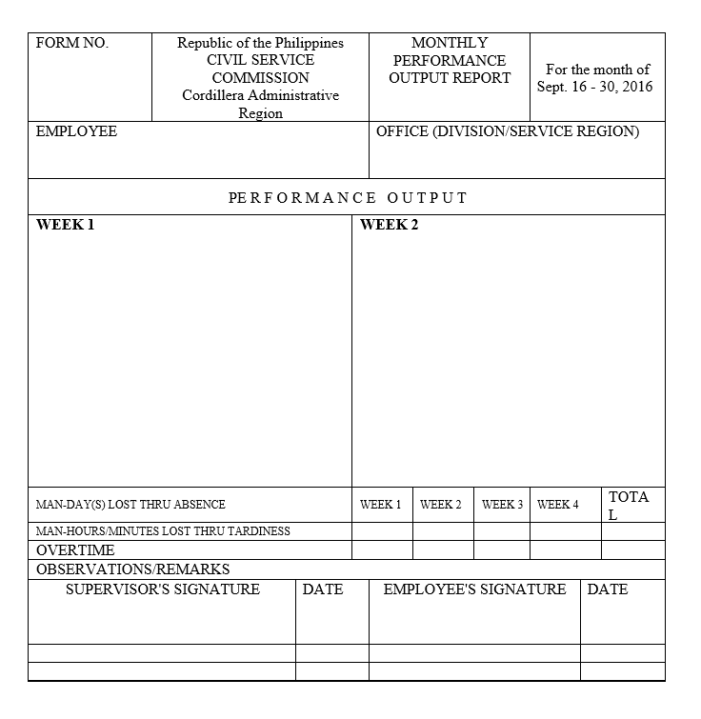

Slide 11
Submission Date of DTRs
 | Cut –off Date | Date of Submission
RO Contract of Service Staff | 1-15 16- 28/29/30/31 | Immediately after each period
Centers’ Contract of Service Staff | 1-15 16-28/29/30/31 | Three working days after each period
Notes:
Failure to do so would affect the preparation of the payroll.

Slide 12
PASS SLIP
To be filled-out in case of official errands
To be filled out if you go out of the office for a maximum of four (4) hours for official purpose.

Slide 13
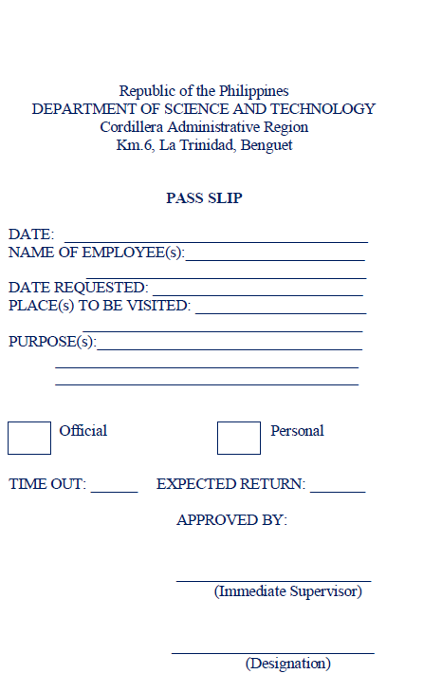

Slide 14
Travel Order
Must be filled-out when requested to go on official travel
Must have been approved before traveling
Travel | Recommending Authority | Approving Authority
Within the Province |  | PSTDs
Within Cordillera Administrative Region | Division Chief | Regional Director
Outside Cordillera Administrative Region | Regional Director | ASEC. Urdujah A. Tejada Assistant Secretary and Program Manager for Countryside Development

Slide 15
CSC Flexi-time Policy
Standard working hours is 8:00am to 12:00 noon and 1:00 pm to 5:00 pm
Flexi-time may time-in for work anytime from 7:01am to 9:30 am without incurring tardiness, so long as they have to complete the required eight-hour work hours for the day.
For every Monday of the month flexi-time shall be suspended.

Slide 16
No Noon Break Policy
Front-liners such as the Office of the Regional Director, Regional Standards and Testing Laboratory (RSTL), Scholarship Section, Cashiering Section and the Provincial Science and Technology should make sure that there is staff present from 12:00nn to 1:00pm.

Slide 17
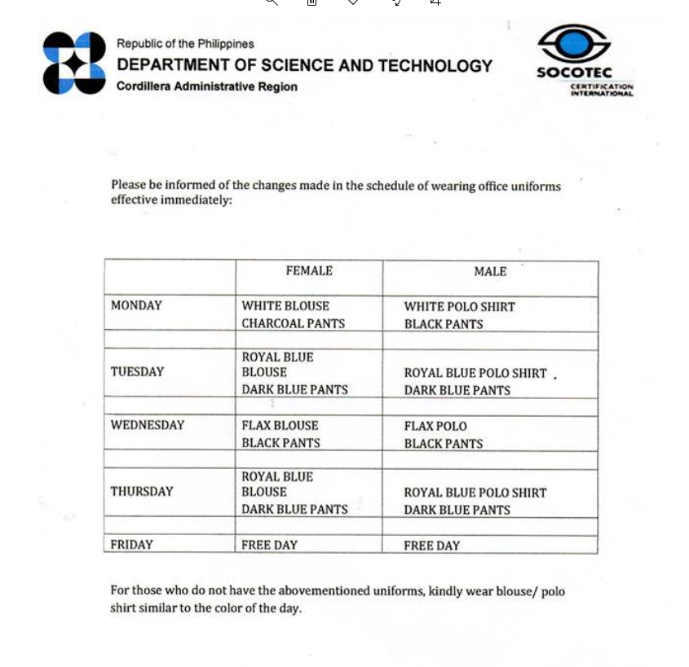
Reminders:
Wearing of Company IDs at all times while inside the premises of DOST-CAR
Wearing of Uniform

Slide 18


