Slide 1
Fraud Detection

Slide 2
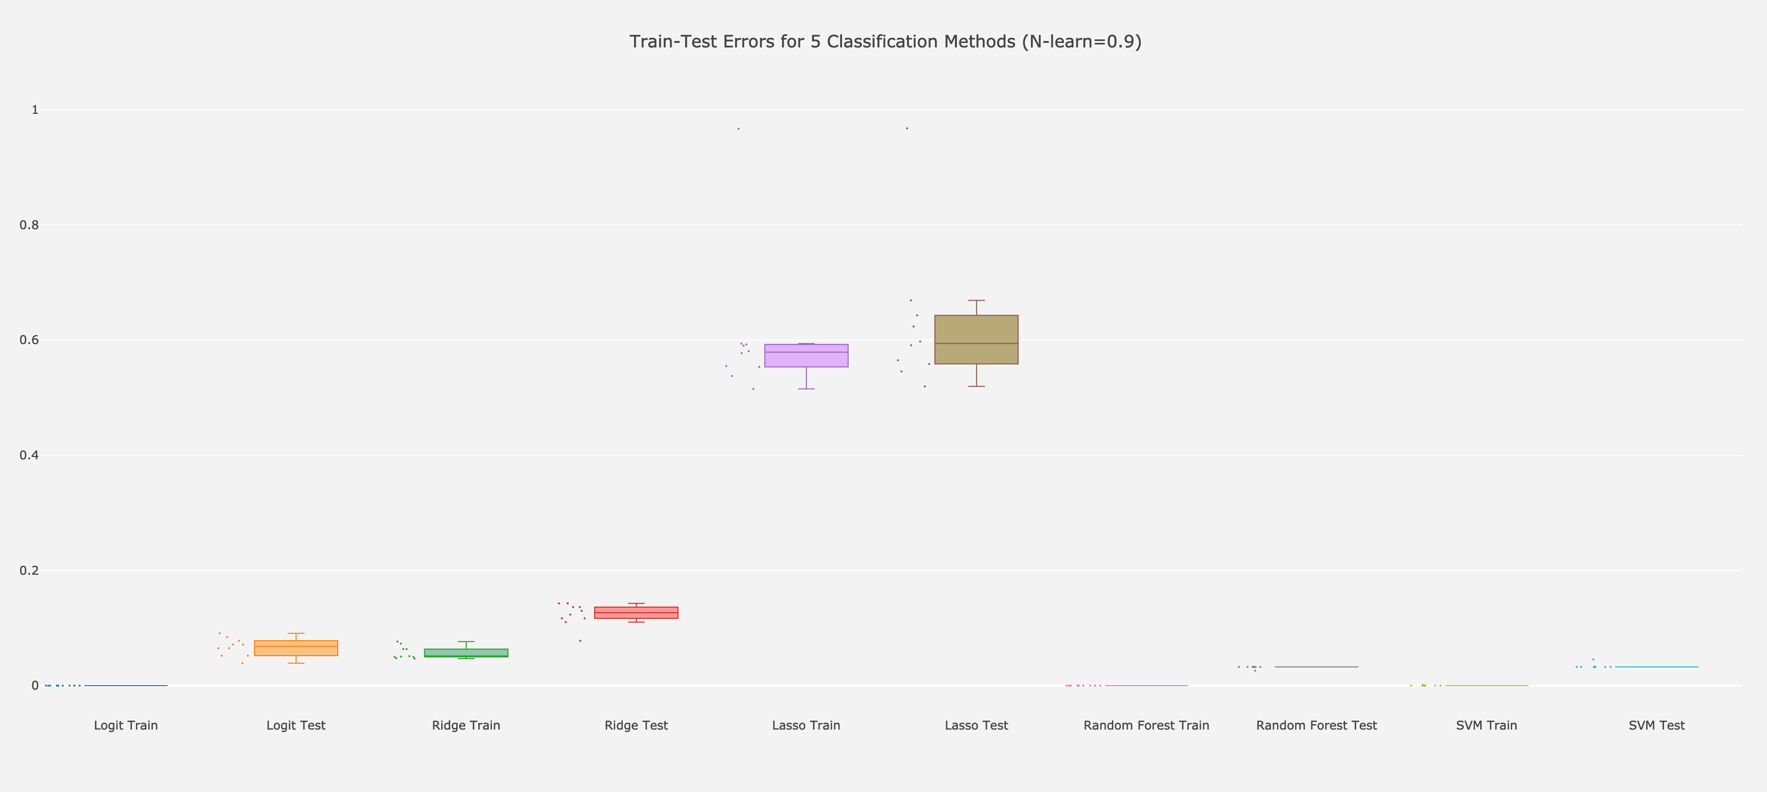

Slide 3
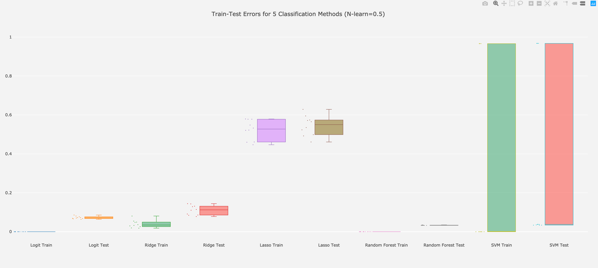

Slide 4




Slide 5



Slide 6



Slide 7


Slide 8
