Slide 1

Investigating the contributions of narrowband gamma and broadband gamma to positive and negative BOLD
Presenter: Dorottya Hetenyi
Responsible PI: Stephen Mayhew
V2.00 16/08/2019

Slide 2

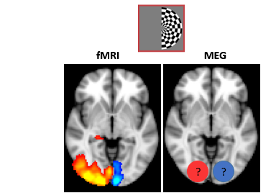
Background
MEG: sensitive to synchronous neuronal signals
fMRI: sensitive to the average level of local neuronal activity
positive BOLD (PBR)
negative BOLD (NBR)
Ogawa et al., 1990
Shmuel et al., 2002; Boorman et al.,2010
relationship between PBR and increased gamma activity?
Logothetis, 2001; Niessing et al., 2005; Magri et al., 2012
relationship between NBR and decreased gamma activity?
Shmuel et al., 2006; Boorman et al., 2015
evidence about complexity of the relationship
Muthukumaraswamy & Singh, 2007; Winawer et al., 2013
Butler et al., 2017; Hermes et al., 2017
PBR
NBR

Slide 3
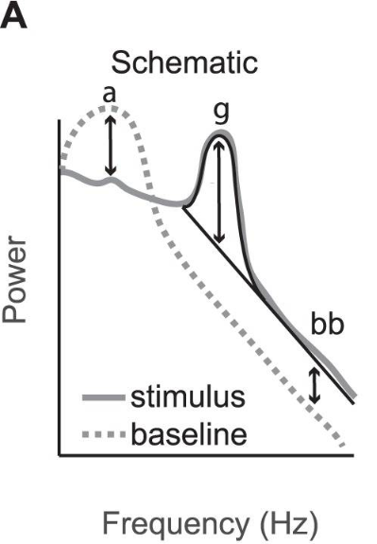
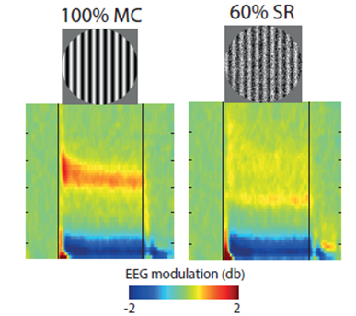
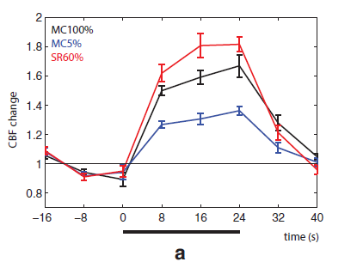
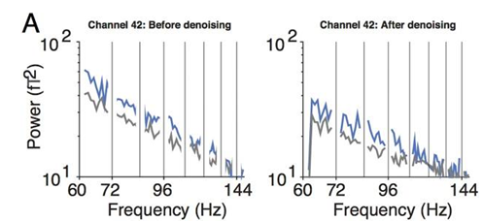
More specific details of NBG vs BBG
a = alpha
g = NBG
bb = BBG
100
80
60
40
20
frequency (Hz)
both hemifield stimulus
blank screen
Narrowband Gamma (NBG) 30-60Hz
Broadband Gamma (BBG) 50-200Hz
Kupers et al., PLoS One 2018
Hermes et al., PloS Biol 2017
Butler et al., Journal of Neuroscience 2017

Slide 4
Research Questions / Aims
replicating and extending Kupers et al., 2018
using unilateral visual stimuli to induce BBG and NBG (and alpha/beta) responses, lateralised in visual cortex
fMRI: stimulus elicit → contralateral increase (PBR) and ipsilateral decrease (NBR)
MEG: gamma oscillation → associated with PBR
alpha/beta power decrease (and gamma?) → NBR
NBG and BBG separation

Slide 5
Experimental Paradigm
3 sensory tasks to induce NBR
black/white checkerboard
16Hz
2x2 conditions:
- R / L visual field stimulation
- high 80% or low 40% contrast
black/white grating
3cpd, drift frequency 6Hz
2x2 conditions:
- R / L visual field stimulation
- high 100% or low 60% spatial randomisation
auditory detection task
1kHz beeps at 6Hz with 0,1,2 deviant +/- 50Hz tones
MEG
visual tasks: 2 runs, 6s ‘on’, 6s ‘off’, 40 trials, 8mins each
auditory task: 1 run, 6s ‘on’, 6s ‘off, 40 trials, 8mins
fMRI
visual tasks: 2 runs, 6s ‘on’, 15s ‘off’, 20 trials, 7mins each
auditory task: 1 run, 6s ‘on’, 15s ‘off’, 20 trials, 7mins

Slide 6
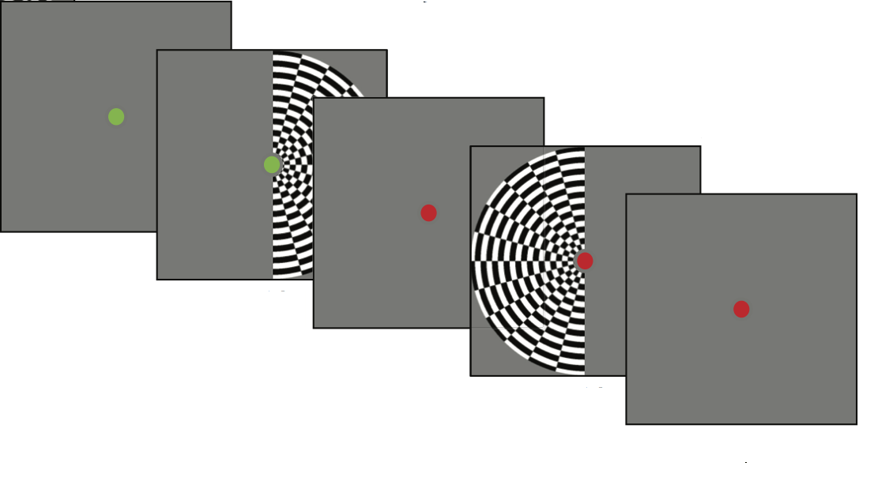
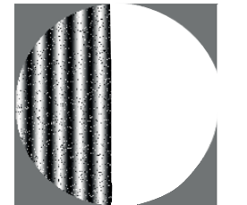
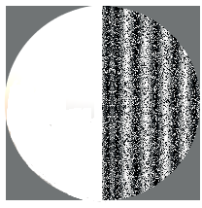
Time (s)
high contrast 80%
spatially randomised grating
low contrast 40%
6 sec ‘on’
low - 60%
high - 100%
6 sec ‘off’
40x
Kupers et al., PLoS One 2018, modified
Butler et al., Journal of Neuroscience 2017, modified

Slide 7
MEG Session Protocol
Initial setup time - 5 mins
Coil registration/head-shape/eye-tracker calibration-15mins
Session – 60 mins
Sampling rate -1000Hz, Gantry position, upright 60
12 subjects
Checkerboard
run1 – 8 mins
run2 – 8 mins
Grating
run1 – 8 mins
run2 – 8 mins
Auditory
run1 – 8 mins

Slide 8
MRI Session Protocol
60 mins per subject, same 12 subjects as MEG
Initial setup time -15mins
Full head coverage
Multiband 6 sequence, TR=1000ms, TE=38ms, voxel size 2.4mm isotropic
T1 anatomical (MPRAGE) – 5mins
BOLD checkerboard
run1 – 7mins
run2 – 7mins
BOLD grating
run1 – 7mins
run2 – 7mins
BOLD auditory
run1– 7mins
Notes:
the order of MEG and fMRI sessions acquisitions across subjects will be randomised

Slide 9
Data Analysis
MEG: noise-pool data cleaning (PCA)
100 identified MEG sensors: noise-pool
LCMV beamforming
fMRI: GLM
regressor of interests: active and control periods
nuisance regressors: cardiorespiratory data
pseudo t-statistical maps
contralateral gamma ERS and ipsilateral alpha/beta ERD to the visual stimulus are reflected as PBR and NBR
Kupers et al., PLoS One 2018
Notes:
We will look at extracted time-courses of gamma oscillations in the deactivated regions whether any long-latency reductions can be observed in the surrounded area of the activated regions. The power of individual NBG of participants will be compared to the amplitude changes (relative to baseline) of the PBR

Slide 10
Outcomes
fMRI
activation (PBR) in the contralateral hemisphere (right)
deactivated regions (NBR) ipsilateral hemisphere (left)
MEG
contralateral visual cortex activation - increased gamma oscillation
ipsilateral visual cortex deactivation - decreased alpha/beta activity
NBG - higher contrast-level (80%)
BBG - higher spatially randomised grating (100%)

