Slide 1


Network Theory in Risk Assessment
Using the Bow-Tie Method
Notes:
Slidexxx,TransitionDuration,ClickForNext (Boolean True/False), Gender of voice (Male/Female),Text to say
Slide001,0,True,Female,"Let us look at Network Theory in Risk Assessment. We will be doing so using the Bow-Tie method."

Slide 2
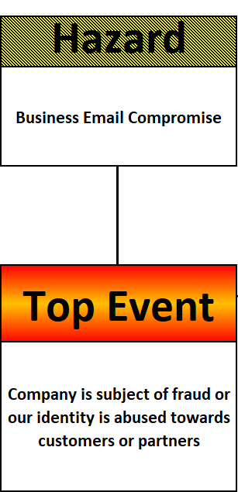
Notes:
Slidexxx,TransitionDuration,ClickForNext (Boolean True/False), Gender of voice (Male/Female),Text to say
Slide002,0,False,Female,"The Bow-Tie method starts with a look at a Hazard that can lead to an Event."

Slide 3
Notes:
Slidexxx,TransitionDuration,ClickForNext (Boolean True/False), Gender of voice (Male/Female),Text to say
Slide003,0,False,Female,"In this run-through of the model we look at Business E-mail Compromise that leads to fraud."
Slide003,0,False,Female,"The fraudsters could target our company or our customers or partners."

Slide 4
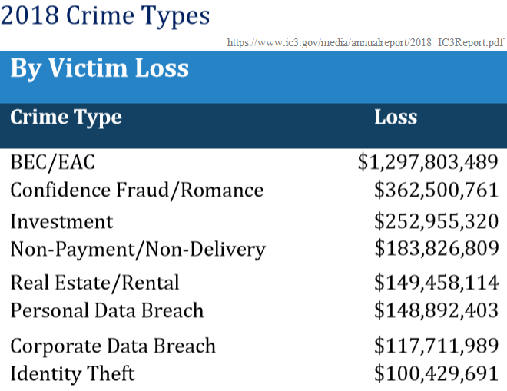
Notes:
Slidexxx,TransitionDuration,ClickForNext (Boolean True/False), Gender of voice (Male/Female),Text to say
Slide004,0,False,Female,"The 2018 Internet Crime Report had the combination of Business Email Compromise and Email Account Compromise listed at the very top."
Slide004,0,False,Female,"The reported Victim Loss was the incredible amount of 1.3 Billion US dollars."

Slide 5
Thanks for watching.
Notes:
Slidexxx,TransitionDuration,ClickForNext (Boolean True/False), Gender of voice (Male/Female),Text to say
Slide016,5,False,Female,"Thanks for watching!"

