Slide 1

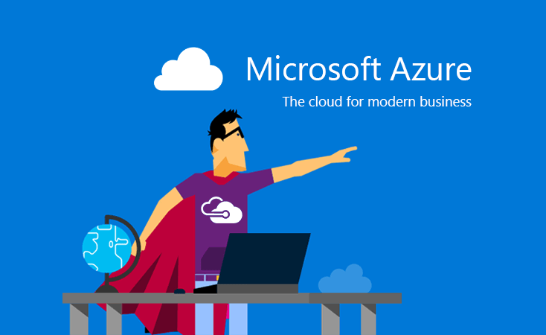


2018 AZURE BOOTCAMP
Cloud Architecture Workshop
WAGNER ALVES
SOLUTIONS ARCHITECT
Currently working as solutions architect on the digital transformation of the House of Oireachtas (the Irish parliament) representing as consultant the IT company Version1.
twitter.com @keyrox
linkedin.com/in/keyrox
github.com/keyrox
br.wagner.alves@outlook.com
Lets trend! … #GlobalAzure
Wagner Alves
http://www.github.com/keyrox/azurequest
2018 Azure Boot Camp
br.wagner.alves@outlook.com
www.azurebootcampdublin.com

Slide 2
Resilient and Scalable
Cloud Environment
This quest will lead us to build a cloud environment for a real world application using different services and resources of the Azure cloud platform.
This application will be ready for fail recovery, redundancy, synchronism, backup, geo-replication, and scalable for cost optimization.
Secure and Monitored
We will secure the application using different strategies for end users and for api access and management. We will also implement different models of performance insights, logging, alerts and monitoring.
Azure Quest
TO DESIGN, BUILD AND IMPLEMENT
Wagner Alves
http://www.github.com/keyrox/azurequest
2018 Azure Boot Camp
br.wagner.alves@outlook.com
www.azurebootcampdublin.com

Slide 3

Why Azure?
What are we solving?
Isn’t that expensive?
Wagner Alves
http://www.github.com/keyrox/azurequest
2018 Azure Boot Camp
br.wagner.alves@outlook.com
www.azurebootcampdublin.com

Slide 4
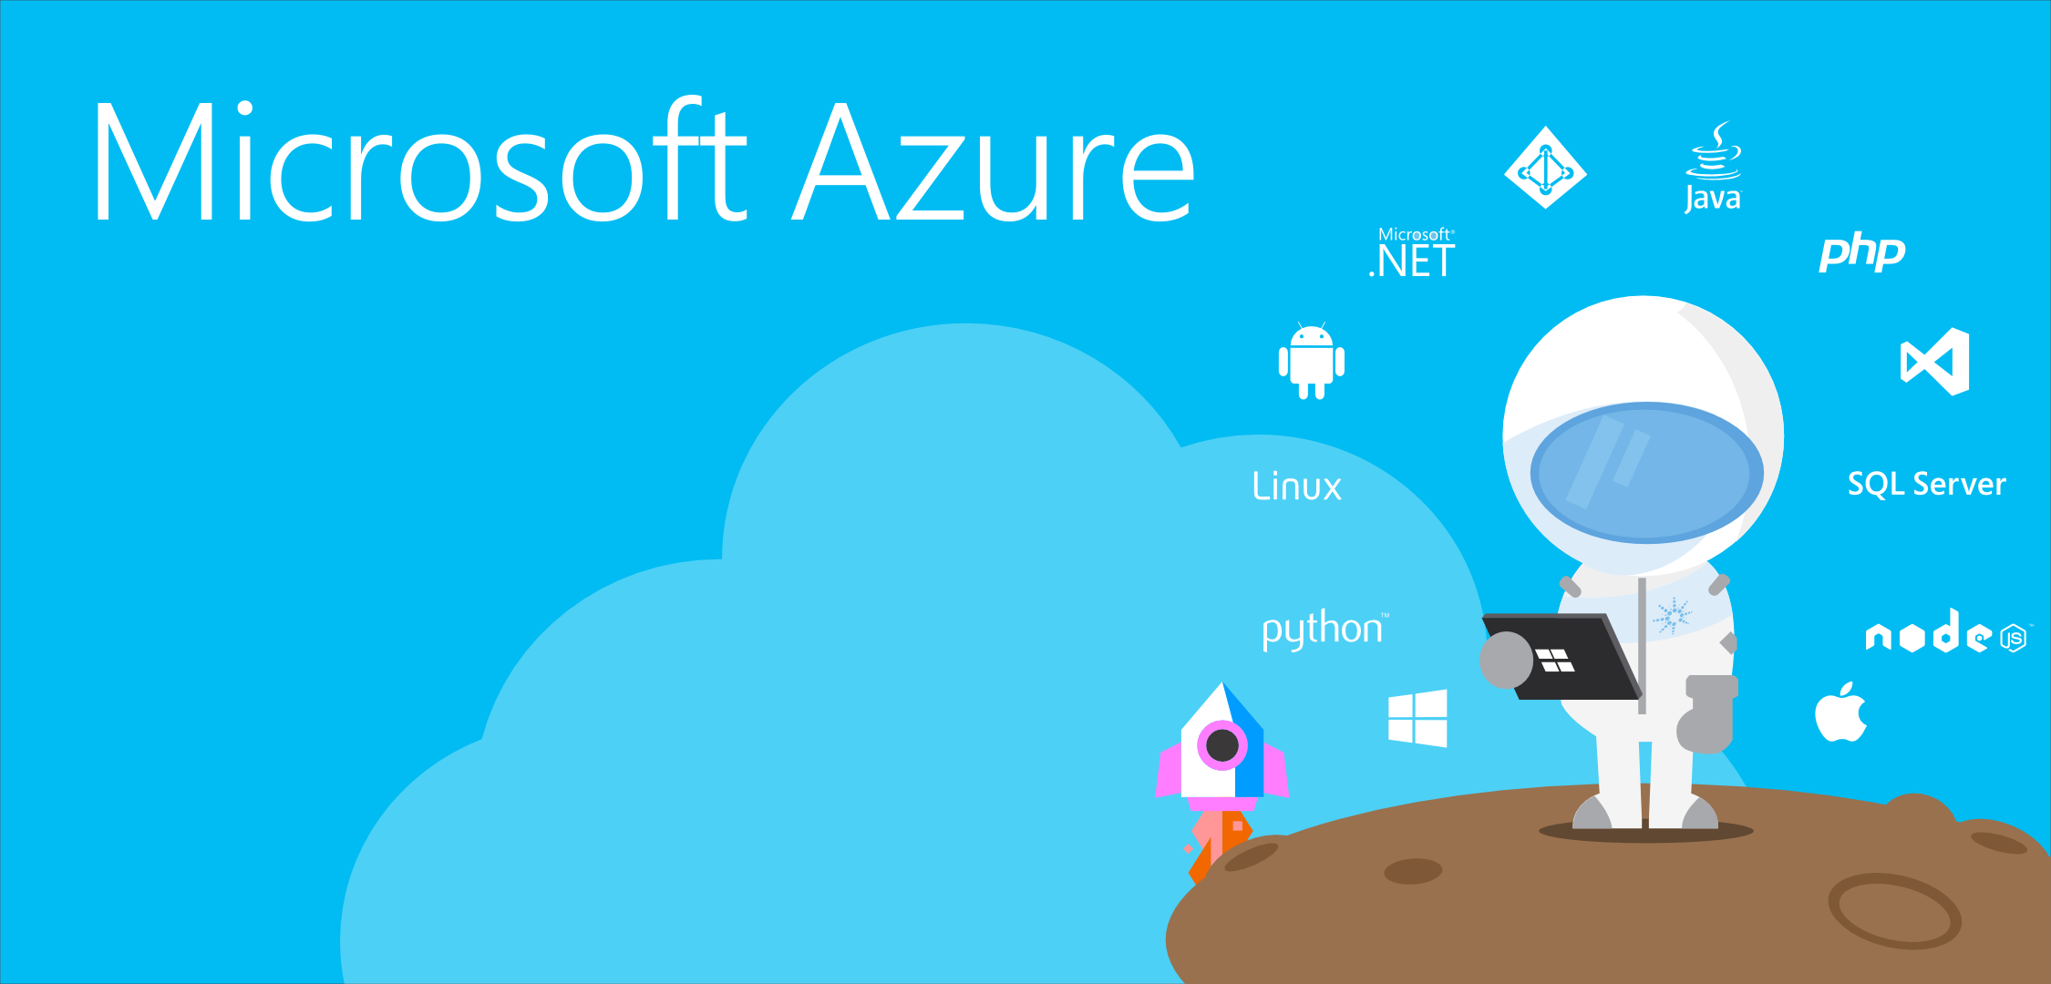
<GET READY />
Access to a active subscription?
Checked the source from GitHub?
Laptop is ready with VS 2017?
Wagner Alves
http://www.github.com/keyrox/azurequest
2018 Azure Boot Camp
br.wagner.alves@outlook.com
www.azurebootcampdublin.com

Slide 5

User authorization will manage app access and api calls trough the environment
01
02
Users will be able to change the status of the tasks and get notified about the changes
Application:
Changes on the status of the task send notification email messages to the users
Task Management
04
03
The app allow users to create tasks, as well as delete and change the status.
Wagner Alves
http://www.github.com/keyrox/azurequest
2018 Azure Boot Camp
br.wagner.alves@outlook.com
www.azurebootcampdublin.com

Slide 6





Authorize
Users and
Services
Scalable
Geo
Distributed
Manage
Task Records
(CRUD)
Resilient
Capabilities
Notify changes by Email
Monitorable
Wagner Alves
http://www.github.com/keyrox/azurequest
2018 Azure Boot Camp
br.wagner.alves@outlook.com
www.azurebootcampdublin.com

Slide 7










Cloud
Designing
Wagner Alves
http://www.github.com/keyrox/azurequest
2018 Azure Boot Camp
br.wagner.alves@outlook.com
www.azurebootcampdublin.com

Slide 8

<Lets Design />
Wagner Alves
http://www.github.com/keyrox/azurequest
2018 Azure Boot Camp
br.wagner.alves@outlook.com
www.azurebootcampdublin.com

Slide 9




Communication between app and service must be secured
Authentication realized in form of a login page.
Secrets from resources must be secure stored and retrieved
services and resources access
User Access
Web App
Service Access
Web API
Key Vault
Resources
App browser access
Internal and External Resources Secure Authorization
Web Application hosted as a service
Web API for resource access hosted as service
Wagner Alves
http://www.github.com/keyrox/azurequest
2018 Azure Boot Camp
br.wagner.alves@outlook.com
www.azurebootcampdublin.com

Slide 10
<Lets Design />
Wagner Alves
http://www.github.com/keyrox/azurequest
2018 Azure Boot Camp
br.wagner.alves@outlook.com
www.azurebootcampdublin.com

Slide 11

6
Queue Triggers Function
1
Authentication
8
7
Notification Delivery
Notification Processing
5
Notification Enqueue
3
Task Management
2
User Information
4
Task & Notification Storage
Wagner Alves
http://www.github.com/keyrox/azurequest
2018 Azure Boot Camp
br.wagner.alves@outlook.com
www.azurebootcampdublin.com

Slide 12
<Lets Design />
Wagner Alves
http://www.github.com/keyrox/azurequest
2018 Azure Boot Camp
br.wagner.alves@outlook.com
www.azurebootcampdublin.com

Slide 13

WEB APPLICATIONS
DATASOURCES
Web Applications must be monitored for performance evaluation, availability and exception tracking.
Data sources must be monitored for performance, availability, resilience and quota.
MONITORING
We need to have the ability to monitor and get insights of our environment
WEB SERVICES
SERVICE INTEGRATIONS
Web Applications must be monitored for performance evaluation, availability and exception tracking.
External integrations must be monitored for availability, performance, resilience and quota.
Wagner Alves
http://www.github.com/keyrox/azurequest
2018 Azure Boot Camp
br.wagner.alves@outlook.com
www.azurebootcampdublin.com

Slide 14
<Lets Design />
Wagner Alves
http://www.github.com/keyrox/azurequest
2018 Azure Boot Camp
br.wagner.alves@outlook.com
www.azurebootcampdublin.com

Slide 15






Solution
Evaluation and Analysis
Geo-Distributed
Resilient
Availability sets, zones and regions
Every public service and storage containers
Monitored
Scalable
Every service is individually and collective scalable
Monitoring and error detecting/alerting strategies
Secured
As a Service
Interface, service communication and secret key management
The application and api is distributed individually as a service
Wagner Alves
http://www.github.com/keyrox/azurequest
2018 Azure Boot Camp
br.wagner.alves@outlook.com
www.azurebootcampdublin.com

Slide 16

<What’s your challenge? />
Wagner Alves
http://www.github.com/keyrox/azurequest
2018 Azure Boot Camp
br.wagner.alves@outlook.com
www.azurebootcampdublin.com

Slide 17
<Thank you! />
Continue here:
https://azure.microsoft.com/en-us/training/
Wagner Alves
http://www.github.com/keyrox/azurequest
2018 Azure Boot Camp
br.wagner.alves@outlook.com
www.azurebootcampdublin.com

Slide 18







A BIG thank you to Dublin Sponsors!

Slide 19





A BIG thank you to the 2018 Global Sponsors!

Slide 20

XBOX & OTHER PRIZES… FILL IN THE FORM!
https://aka.ms/azurebootcampireland

