Slide 1
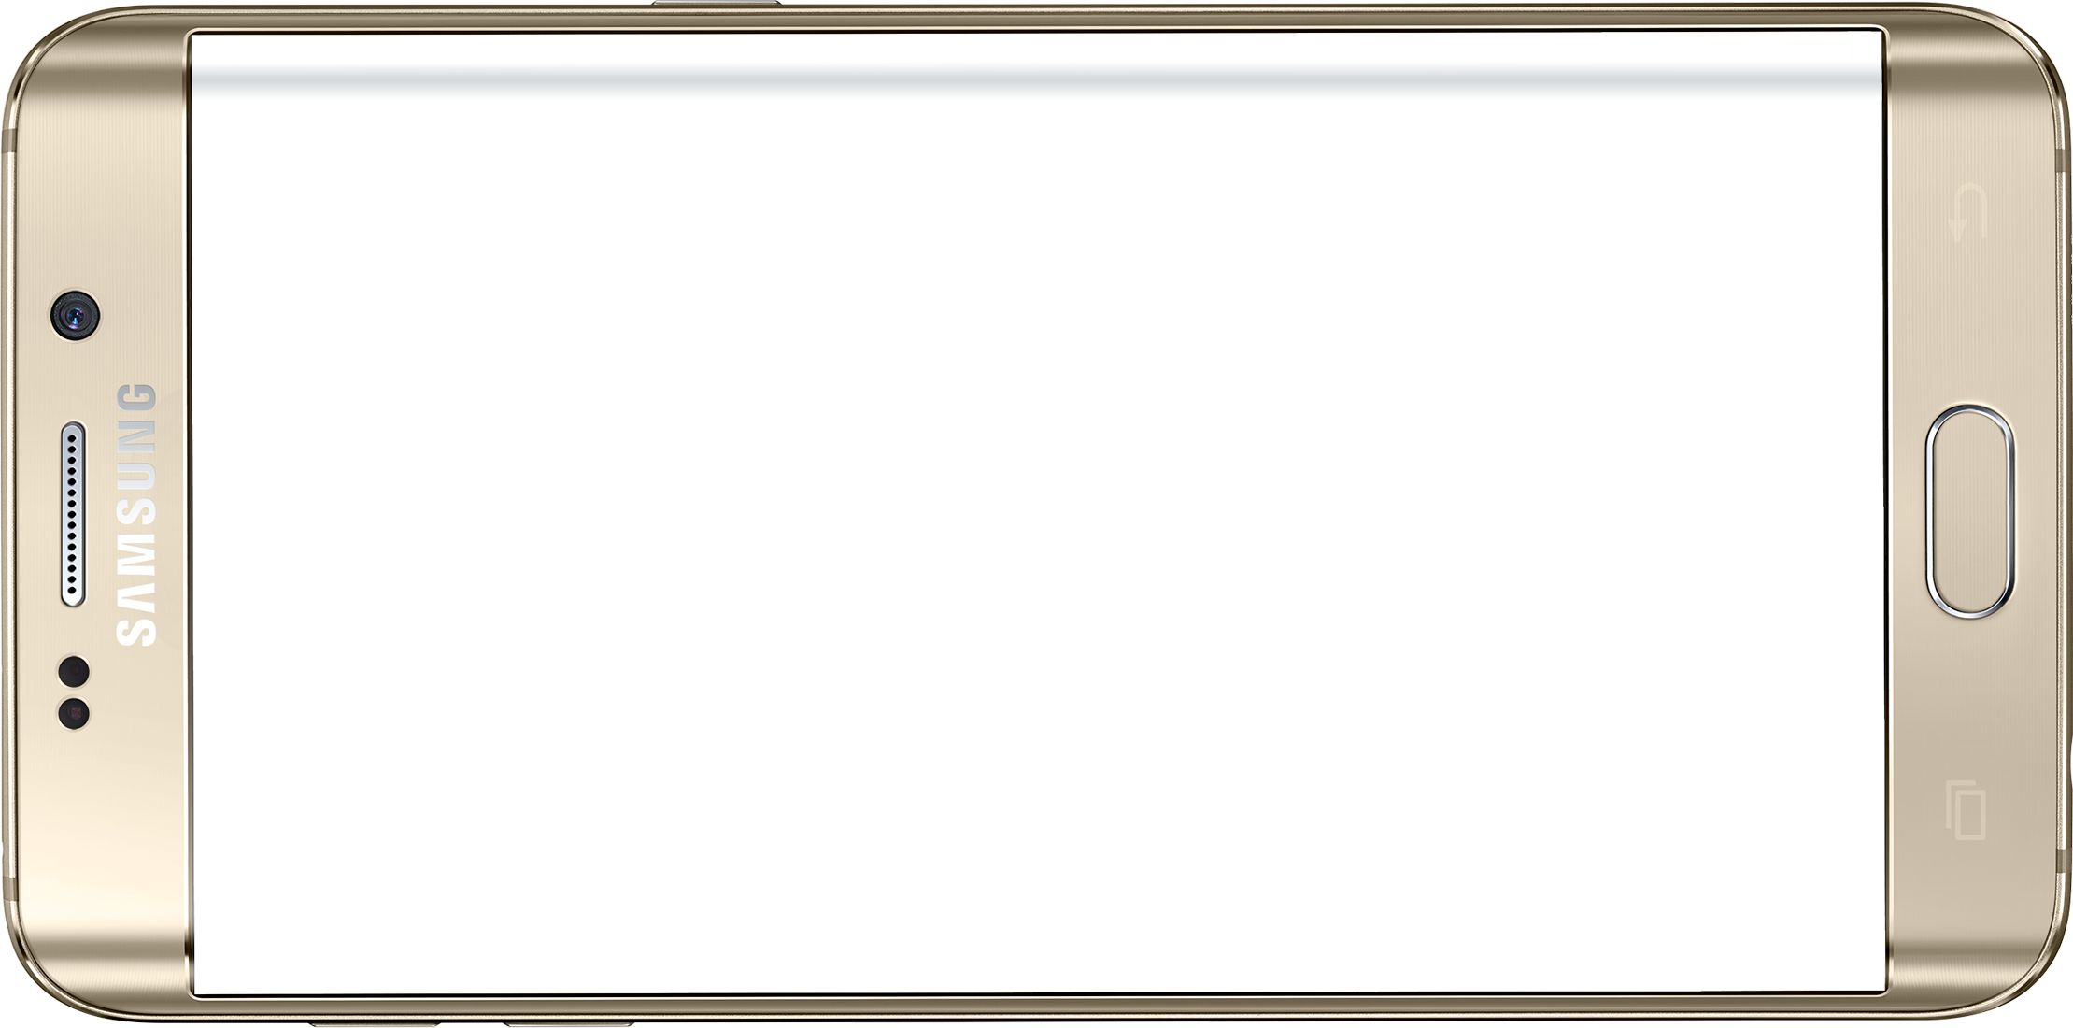
The blue lines represent notches on a 360° compass
The orange line will be dynamically drawn whenever the User has the screen on. It uses data retrieved from the device’s gyroscope to determine its position.
We could implement a gesture system:
A 2-finger tap or a double-tap stops and starts calibration
On start, the orange line will stay perfectly horizontal while the user gets into their static exercise position
Once in position, they’ll double-tap again to make this the “in position” position
I think the “stop” gesture should not be a 1-tap so that the user is less likely to accidentally calibrate into the wrong position.
Swipe the screen
Stops the exercise and returns to the Planned Exercises List Activity
This is only for premature stopping when the user wants to move to a different exercise
Start/Complete exercise
Once calibrated, the user can 1-tap the screen to start the exercise right away or:
The App will intelligently sense when the user is in position and start timing
Maybe we could also display a timer on the screen if the user keeps it on
Once the user has done the planned number of sets for this exercise, the App will automatically return them to the Planned Exercises List
For exercises that occupy both arms like a plank position:
We could implement a timer + audio cue. Give the user 3 seconds to get into position, giving an audible countdown, then a “gyroscope calibrated” audio cue
Once calibrated, the user should tap the screen to start a rep. The phone should give a countdown and issue some beeps to let the user know a rep is done and allow them to rest. They can tap the screen again to begin the next rep.
If the user turns the screen off to (or if they are operating the device in Battery Saver Mode) this UI should stop rendering, storing its state in a Bundle to be used to recreate the Activity when the screen is turned back on
In this screen-off mode, we should use audio cues to indicate these states:
Rep Started
Rep Completed
Set Completed
On set completion, the App should turn on the screen to allow the user to pick the next exercise and recalibrate the gyroscope
* Colors not final
Notes:
Frame Image Source: https://www.pngwing.com/en/free-png-bmquu

Slide 2
Notes:
Compass template

