Slide 1

Your Stats
Wall Sit Duration
Reps
Sets
00:01:00
3
1
Add Exercise
Start Exercise
Notes:
Main Screen

Slide 2

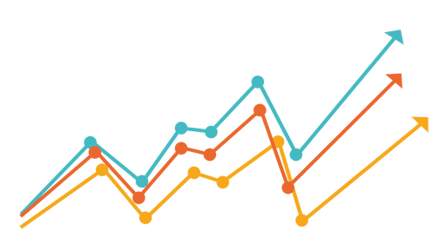
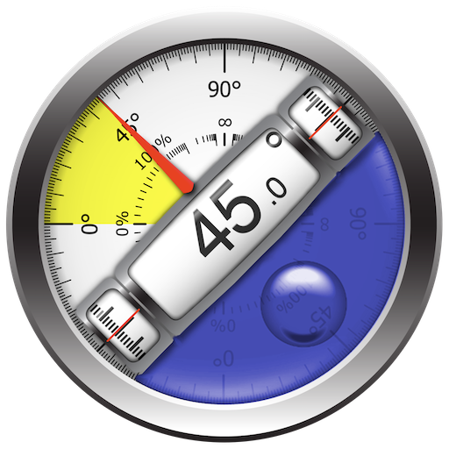





Notes:
Settings Icon from https://www.cleanpng.com/png-gear-icon-gears-png-file-114545/
History Icon from https://www.cleanpng.com/png-line-chart-graph-of-a-function-3376066/
Calibration Icon from https://www.cleanpng.com/png-bubble-levels-inclinometer-android-tool-2734554/
Home Icon from https://www.cleanpng.com/png-website-house-home-world-wide-web-computer-icons-h-607084/

Slide 3


Latest Achievement
Pushup Milestone
Notes:
Alternate album views
Awards from https://www.cleanpng.com/png-gold-silver-and-copper-transparent-rosettes-set-24482/
Stickman from https://pngset.com/download-free-png-nohnc

Slide 4
Set: 1 of 3
Rep: 2 of 3
Notes:
Calibration Screen

Slide 5
Calibration Screen Cutouts
Calibrate with Audio Cues
Finish
Restart
Level/Gyroscope Bar
3

