Slide 1

Mobile & Responsive Web Development (RWD)
Abhishek Jain

Slide 2
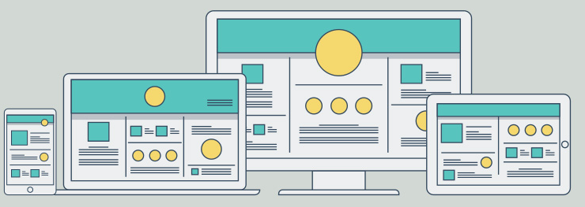

RESPONSIVE WEB DESIGN
WHAT IS RESPONSIVE WEB DESIGN
WHY RESPONSIVE WEB DESIGN IS IMPORTANT
WHERE AND WHEN TO USE RWD
MOBILE FIRST
ADAPTIVE VS RESPONSIVE
WHAT IS THE DESIGN PROCESS
HOW TO IMPLEMENT RESPONSIVE WEB DESIGN
FEEDBACK
THANK YOU
Your Website Beautifully Displayed
on all Devices, Mobile, Tablet, Desktop, and Smart Watch
2

Slide 3
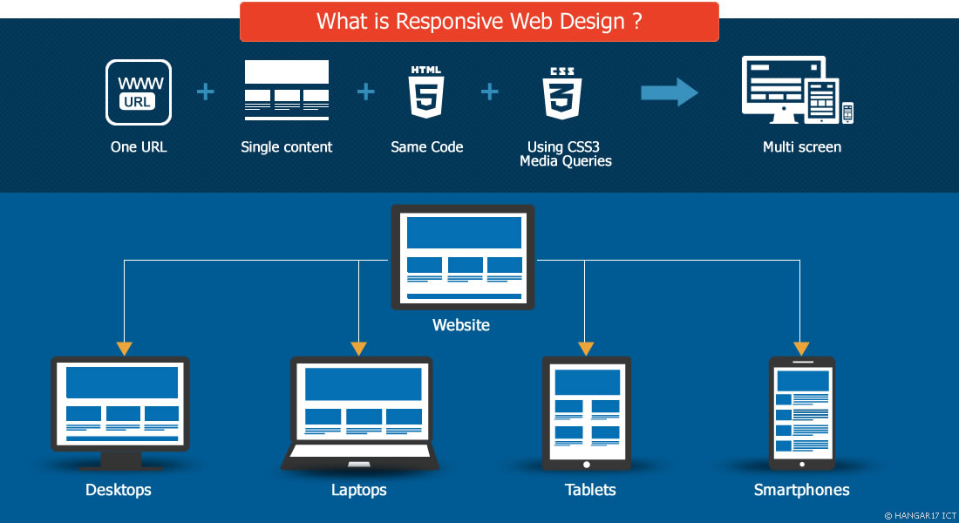
c
WHAT IS RESPONSIVE WEB DESIGN
Responsive web design refers to a website designed to adapt to whatever device a visitor is using. If a visitor opens a website on their laptop, the design reads one way. When the visitor opens the same website on their tablet or phone, the design automatically adjusts to be resized, reframed, and easy to read on the new screen dimensions.

Slide 4






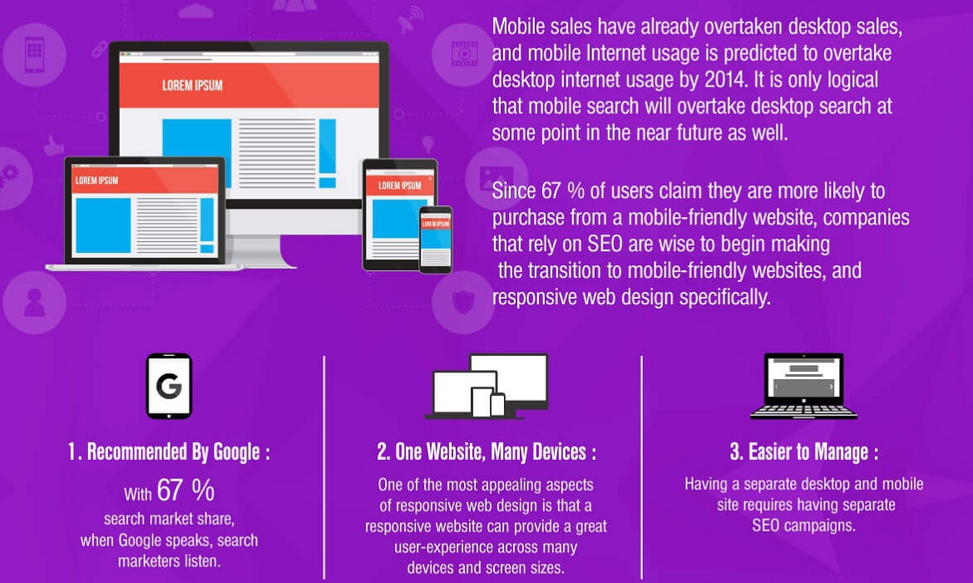
WHY SHOULD YOU CONSIDER [RWD]
SAVE MONEY
SAVE TIME
IMPROVE SEO
INCREASE PERFORMANCE
SUPPORT MORE
BROWSERS
SUPPORT MORE
DEVICES
Without Responsive design, your users may not be getting an optimized experience, and statistics are showing that it DOES make a difference.
Google Loves It
Enhanced User Experience
Cost and Time Effective
Improved SEO
Increased Conversion and Sales
Needs Only One SEO Campaign
It Will Adapt to Future Devices
Easy to Manage
Excellent User Experience

Slide 5
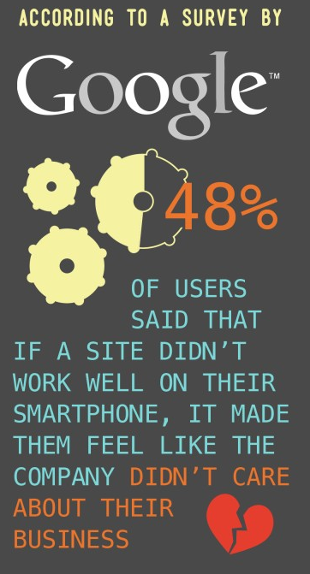
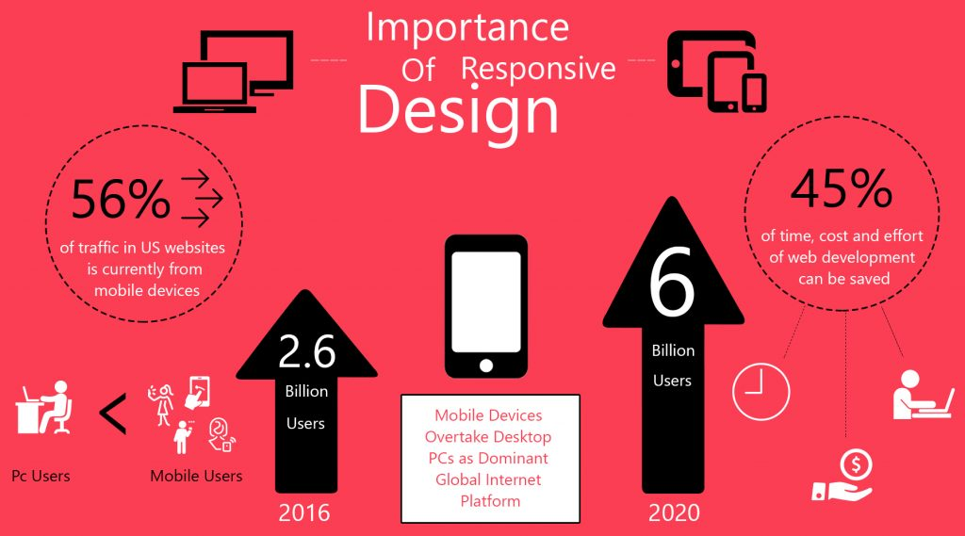
A RECENT STATISTICS SHOWS THAT
2018
2020

Slide 6
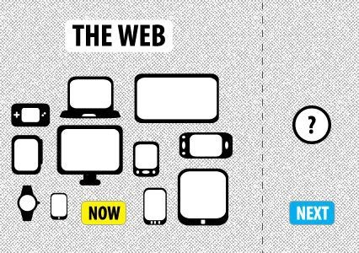

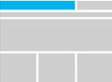


WHERE DOES IT WORK ?
A RESPONSIVE WEBSITE SHOULD BE BUILT TO WORK ACROSS ALL DEVICES.
When implemented, Responsive Web Design can work to FUTURE-PROOF your site, and adapt to device that haven’t even been create yet.
ONE URL
SINGLE CONTENT
ONE CODE
MEDIA QUERIES
Responsive design targets the width of each user's web browser to determine how much space is available and how it should display the website. Breakpoints are set up to allow us to target ranges that define specific displays. For example, you generally see breakpoints for phones, tablets, and desktops.

Slide 7
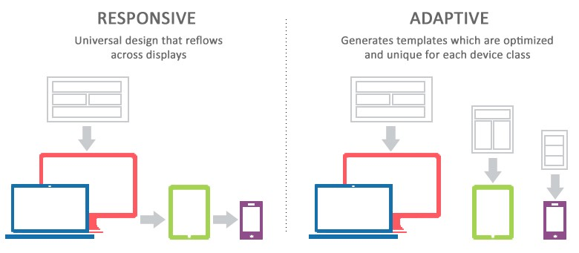
RESPONSIVE vs ADAPTIVE
While we frequently use the term “responsive web design,” technically “responsive web design” is a specific subset of adaptive design–which is the more accurate term for a site whose design adjusts and changes based on the capabilities of the viewing device.
ADAPTIVE
Server use HTML, which is pre-selected for different devices with different screen size.
Information is pre-selected and only specific device based information will be displayed.
Templates are optimized for each device.
RESPONSIVE
Devices are detecting by “media queries”. Flexible grid and images are sized correctly to screen of devices.
All content is downloading whether it is used or not.
One template for all devices.

Slide 8

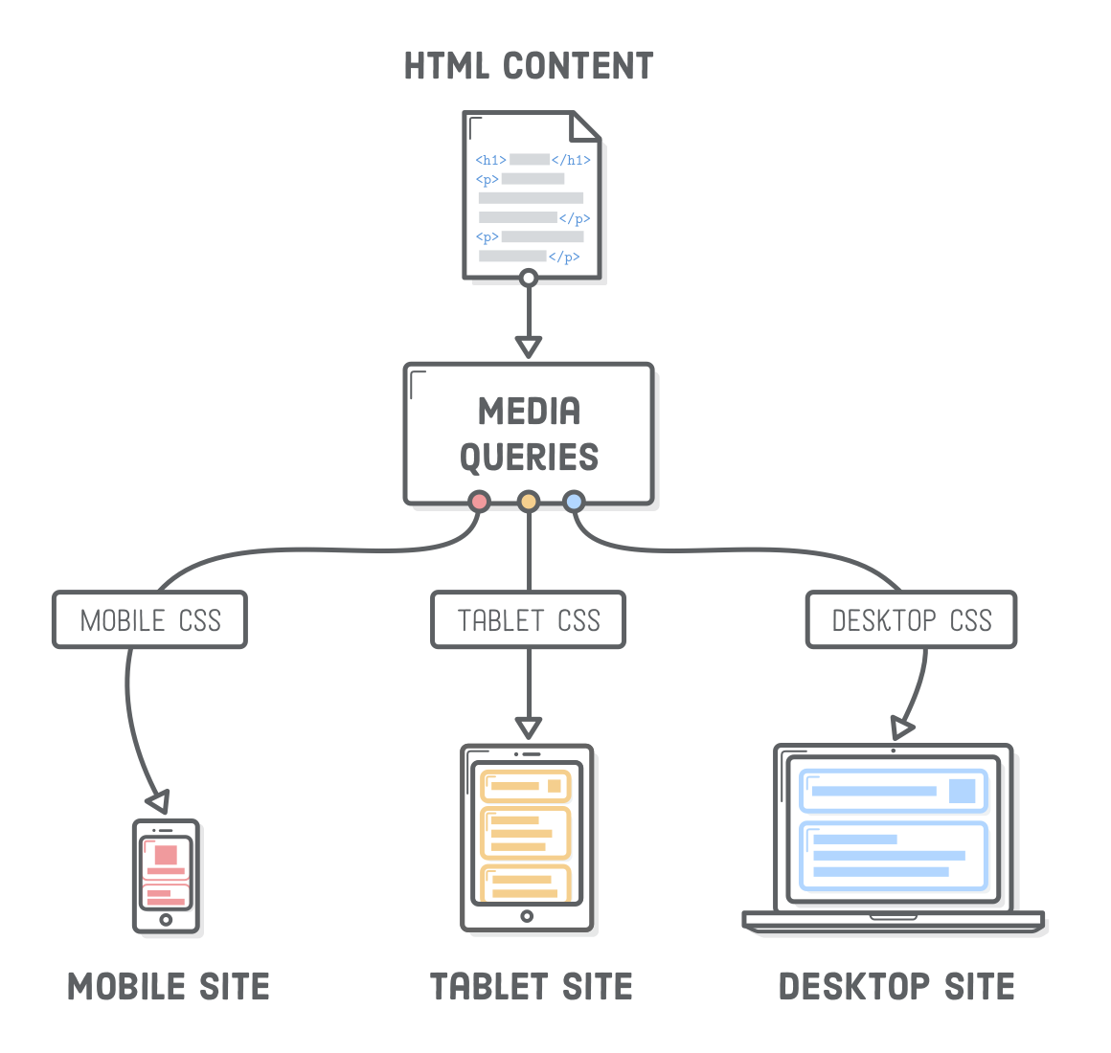
HOW [RWD] BUILT?
Responsive Design requires designers and developers to rethink their approach. Designers must consider optimization of visual elements to account for variations in screen size. Developers must consider how the latest browsers handle media queries, as well as optimizing media for sociability and load time.
Think Content First
Mobile First
Adjustable Grid
Adjustable Images
Use SVG’s
Select Devices
Choose Best Framework
A FLEXIBLE, GRID-BASED LAYOUT
Allows content to expand and contract fluidly, based on percentages
FLEXIBLE IMAGES & MEDIA
Video and images can scale to adapt to their surroundings
CSS3 MEDIA QUERIES
Media queries allow for smoothing over the cracks in the layout when they emerge

Slide 9





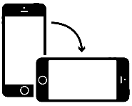
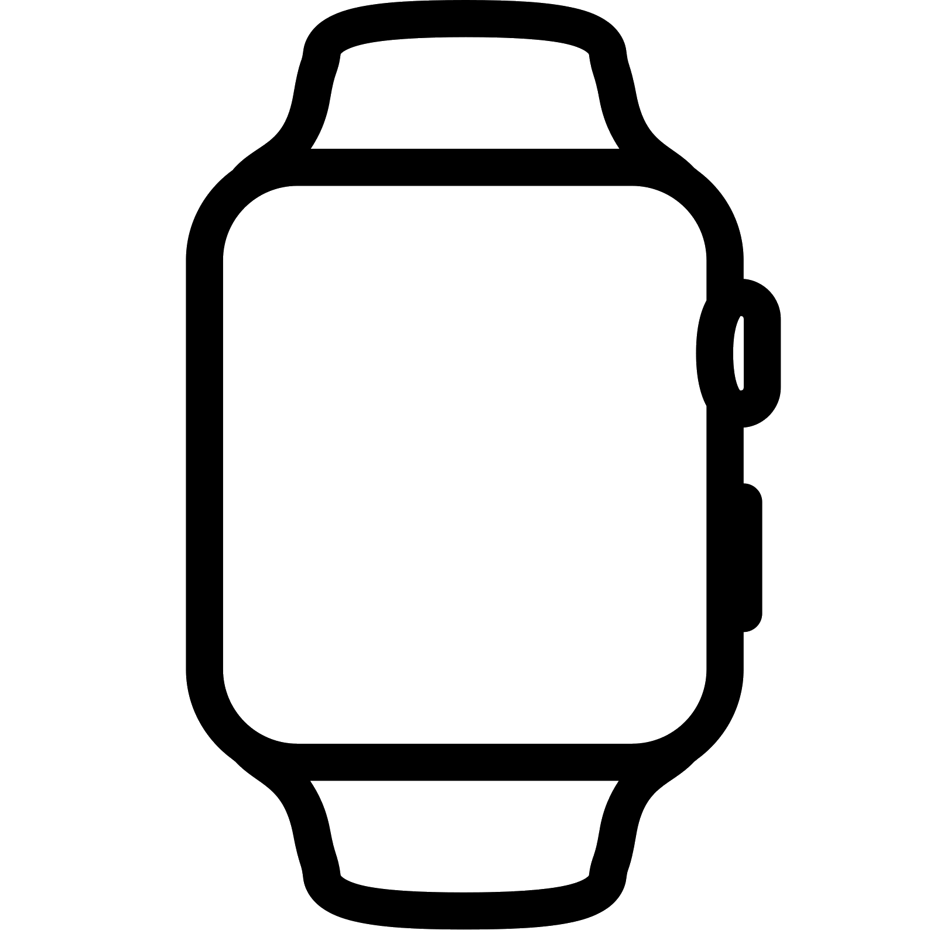

Responsive design is not about ‘designing for mobile’. But it’s not about ‘designing for the desktop’, either. Rather, it’s about adopting a more flexible, device-agnostic approach
Ethan Marcotte author of Responsive Web Design
Let’s start building responsive web
One
Website
Television
Desktop/Laptop
Tablets
Mobiles
Watches
UNKNOWN

Slide 10
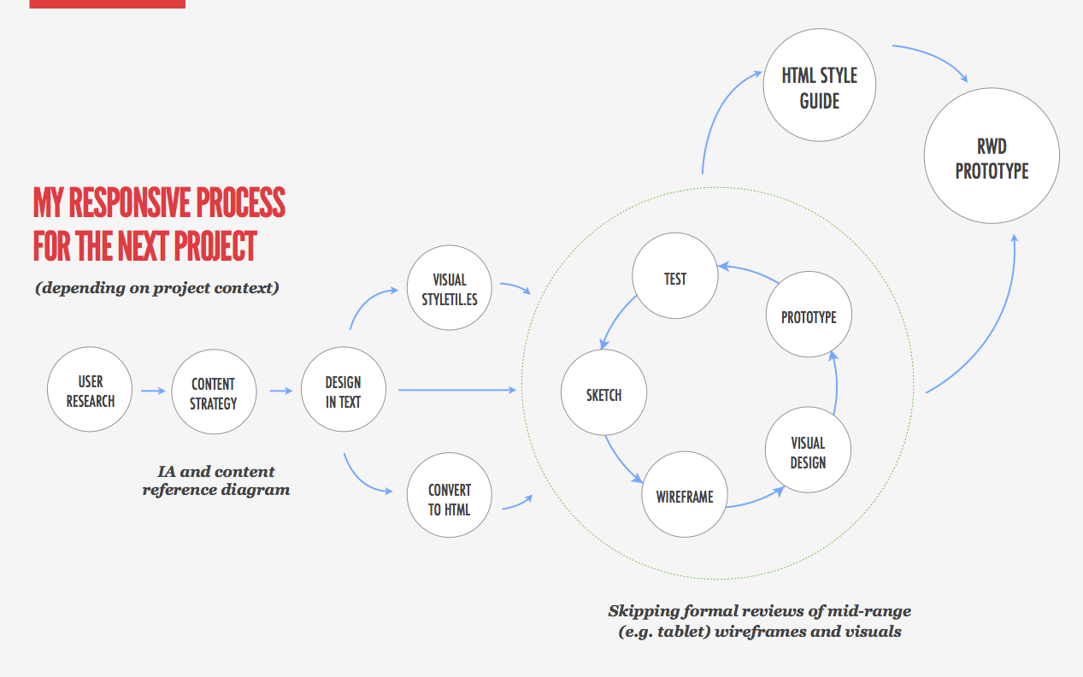
RESPONSIVE WEB DESIGN WORKFLOW
In general, it is not required to wireframe every single page view. It is important to know the content of the website so that there is a clear idea of what the website and user is trying to achieve.
User
Planner, UX
Content Strategy
Planner, UX, Visual, Tech
Iterative Design & Development
UX, Visual, Tech
Prototype Handover
UX, Visual Tech
HTML Style Guild
UX, Tech,
RWD Deployment
Tech

Slide 11
[RWD] CONTENT STRAGEGY
Prioritize Content in a Clear Hierarchy
You can create good experiences without knowing the content. What you can’t do is create good experiences without knowing your content structure.
Everything starts with the content. What do you need to say? Who are you trying to reach? What do they need to accomplish?
Website design, and especially responsive design, should be built from the content out. Use these strategies to ensure that you have all the information you need to deliver the best possible project.
Prioritizing content is essential in responsive web design. When the real estate of a desktop browser page shrinks to hand-held size, content gets jumbled. A wide, multi-column webpage is squeezed into a single-column mobile page. If the website is not designed correctly, some of the most important content can end up at the bottom of the page, requiring a long (too long) scroll to reach.
Assigning priority levels to content creates will create a structure that assures your most important content rises to the top. Create a content hierarchy by identifying content according to tiers. This identification should ideally occur in the marketing or copywriting teams, and be communicated clearly to the designers and project managers. This collaboration will lead to a design that preserves the content hierarchy for mobile viewers.

Slide 12
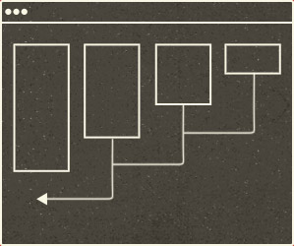
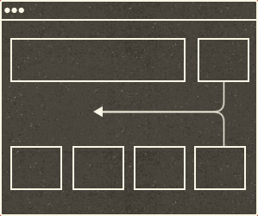
[RWD] CONTENT COREOGRAPHY
We can begin to choreograph content proportional to screen size, serving the best possible experience at any width.
Take a 4 column site at full width: as the view narrows, 4 will become 3, then 2, and 1. The most common solution is to stack them on top of each other in chunks (fig. a). Simple enough, but what happens if the first column is really tall? Is the content in column 2 less important than all of the content in 1? It probably is for something like a full-length article, but I can’t help but think that in some cases, this method throws off the hierarchy.
FIG. A
Another approach could be to interdigitate content by folding elements into each other as the view narrows (fig. b). In real terms, what happens if a main column is a tall grid full of product thumbnails, and the sidebar features a coupon or promotion? When those columns are combined, it might be nice to slide the promo in between two product rows instead of shuffling that important piece to the bottom of the main column.
FIG. B

Slide 13
[RWD] CONTENT COREOGRAPHY
What I’ve described above are really two separate problems:
Source order. In a single-column layout, blocks of content will display in the same order as they’re located in the HTML structure. Unfortunately, the best source order for one layout isn’t necessarily the best source order for another.
Intermixing content. Instead of having to drop entire columns of content below one another, we’d like to mix blocks of content from the different columns in the single-column layout.
The first issue has some technical solutions on the way, one of which is just about here. The second issue will require that we change our thinking in how we develop layouts.
FIG. A
FIG. B

Slide 14
[RWD] CONTENT COREOGRAPHY
Solving the Source order problem.
In time, there will be several solutions to the source-order issue, in the form of new CSS specifications. Depending on which browsers you need to support and what you’re willing to do to support them, one of those specifications may already be here.
Three specifications that we’ll likely find ourselves using in the future are:
a) “Flexbox,” b) “Regions,” c) “Grid Layout.”
Solving The Intermixing Content Problem
Unlike the source-order problem, the issue of intermixing content across columns doesn’t have a technical solution. It’s up to us, and, ultimately, it means we need to wrap content in fewer HTML containers.

Slide 15
[RWD] FLEXIBLE, GRID-BASED LAYOUT
Grid systems help designers and developers to make fully responsive websites, eliminating
the frustration of flicking between browsers looking for alignment errors
https://developers.google.com/web/fundamentals/design-and-ux/responsive/patterns?hl=en

Slide 16
The Anatomy of a RWD
Media queries can be used to do more than patch broken layouts: with proper planning, we can begin to choreograph content proportional to screen size, serving the best possible experience at any width.
— Trent Walton
"There is no Mobile Web. There is only The Web, which we view in different ways. There is also no Desktop Web. Or Tablet Web"
- Stephen Hay

Slide 17

WHAT IS RESPONSIVE WEB DESIGN

Slide 18
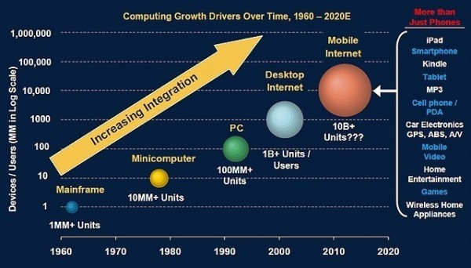
ORIGIN OF RESPONSIVE WEB DESIGN
Around the late 2000s, web designers faced some new challenges when smartphones started to dominate. An explosion of different devices hit the market, with the first-generation iPhone leading the way. Web designers were facing cross-compatibility problems when building websites.
They had to deal with inconsistencies with window width, screen resolution, different input devices, and numerous other idiosyncrasies that took forever to fix.
In response to this problem, the open source community of software engineers and designers got together to create a set of standards to achieve better cross compatibility. Those standards helped shaped best industry practices, which include responsive design.
Collectively, these methods and specifications are known as responsive web design. The actual term “responsive web design” was coined by Ethan Marcotte on his blog, A List Apart, in 2010.

Slide 19
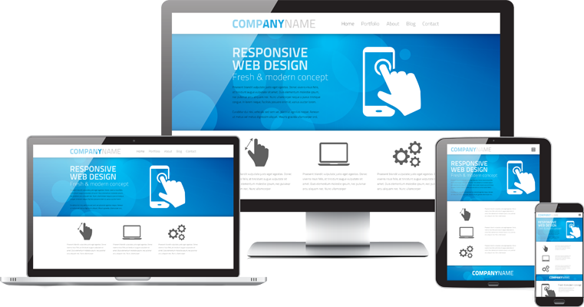
Why– Why Responsive Web Designing is Important
https://www.nepsolweb.com/responsive-website-design-and-development/
https://www.keycdn.com/blog/benefits-of-responsive-web-design/
http://www.h17ict.com/en/responsive-webdesign
https://dynomapper.com/blog/19-ux/272-how-to-wireframe-a-responsive-website-design
https://internetingishard.com/html-and-css/responsive-design/
https://medium.com/bliblidotcom-techblog/adaptive-atau-responsive-web-design-f138bfebdd97
https://www.proficientict.com/insights/responsive-website-what-why-and-how/
http://www.cre8ivelabs.com/blog/important-make-website-responsive/
https://www.nobledesktop.com/presentation/rwd#/2
https://www.onlinedesignteacher.com/2015/01/css3-media-queries-for-responsive_81.html

Slide 20
Thank You!

