Slide 1
SC1015 Mini-Project: Mobile Price Dataset
Leong Hong Yi, Lim Jun Hern, Lim Wei Lun

Slide 2
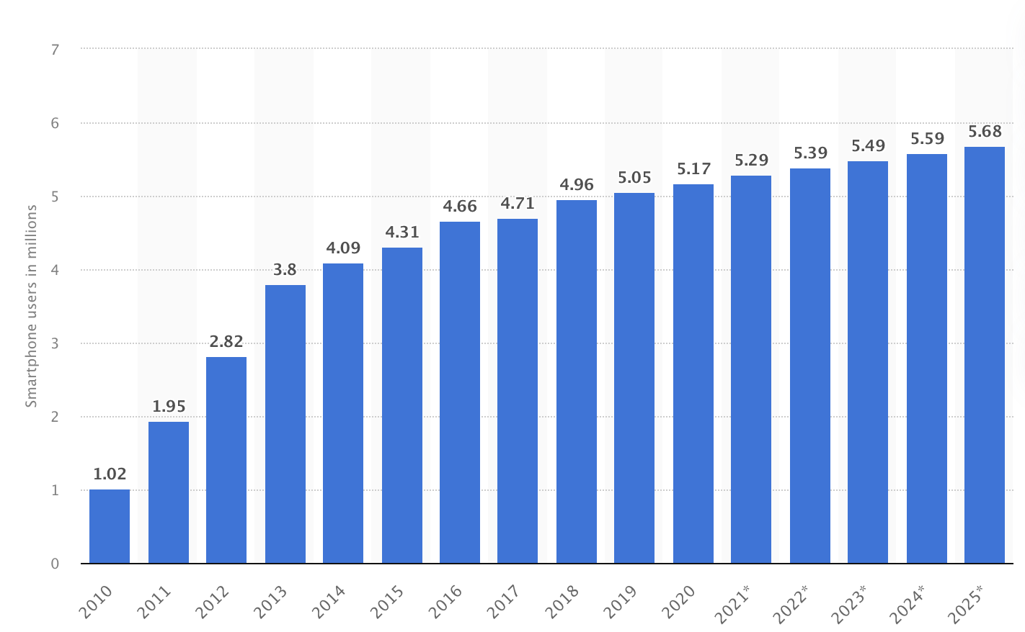
Number of smartphone users in Singapore
https://www.statista.com/statistics/494598/smartphone-users-in-singapore/

Slide 3
Practical Motivation
Buyers not familiar with the market price
What price is considered as reasonable?
How to choose a mobile phone for potential buyers with reasonable price?

Slide 4


Data Collection
Excluded IOS devices as most of them are unreasonably expensive
Dataset from Kaggle, scraped by Manish KC, from flipkart
https://www.kaggle.com/datasets/manishkc06/mobile-price-prediction
20 Variables before pre-processing, with 459 data

Slide 5
How can we predict the mobile price using the given features?

Slide 6
Data Preprocessing
01
02
CLEANING DATASET
SPLIT THE COLUMNS
03
04
ERROR CORRECTION
REARRANGE THE COLUMNS

Slide 7

Exploratory Data Analysis

Slide 8
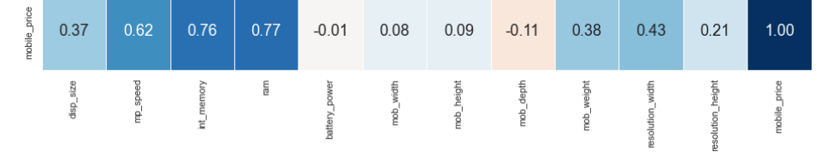

Bi-Variate Exploration
High Correlation with mobile_price
mp_speed: 0.62
int_memory: 0.76
ram:0.77

Slide 9

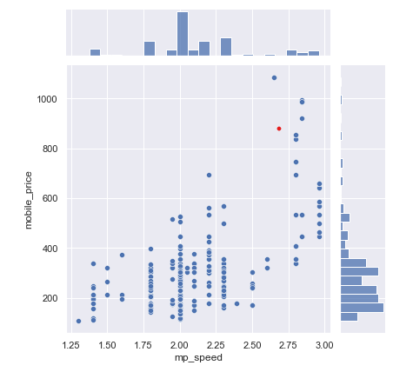
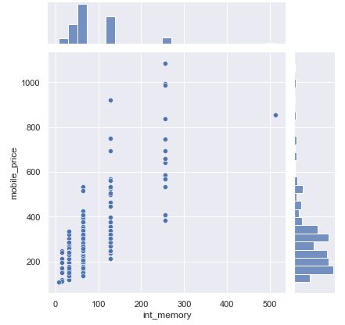
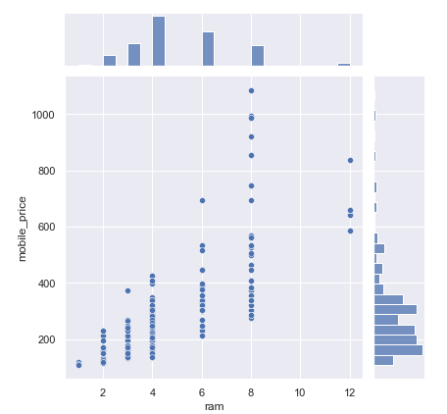
High Correlation with mobile_price
mp_speed: 0.62
int_memory: 0.76
ram: 0.77

Slide 10
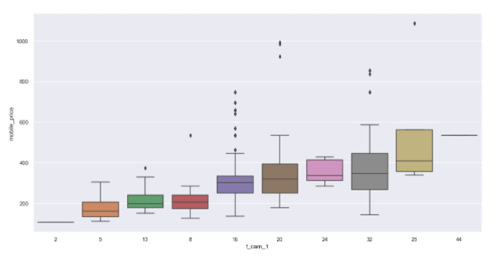

High Correlation with mobile_price
Distinct partition and distribution of median
Higher Pixels of camera:
Higher cost production
Better photo quality
f_cam_1

Slide 11
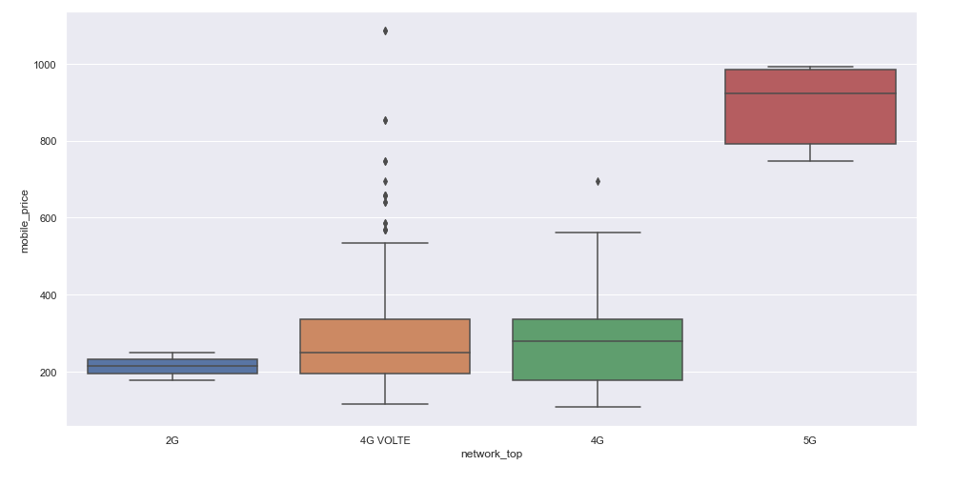
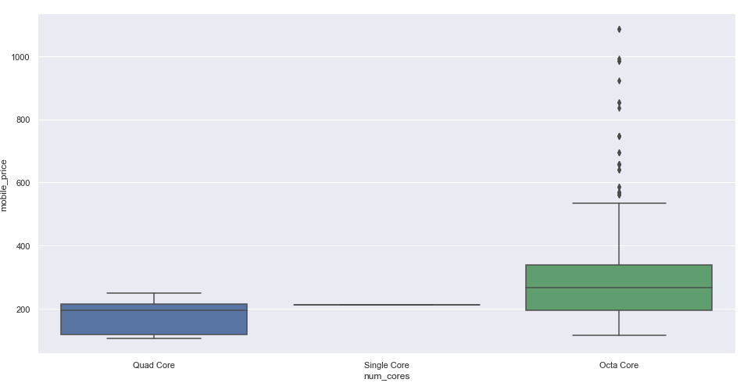
High Correlation with mobile_price
non-5G
Network_top:
5G vs non-5G
5G
Octa Core
non-Octa Core
Num_cores:
Octa Core Vs non-Octa Core

Slide 12
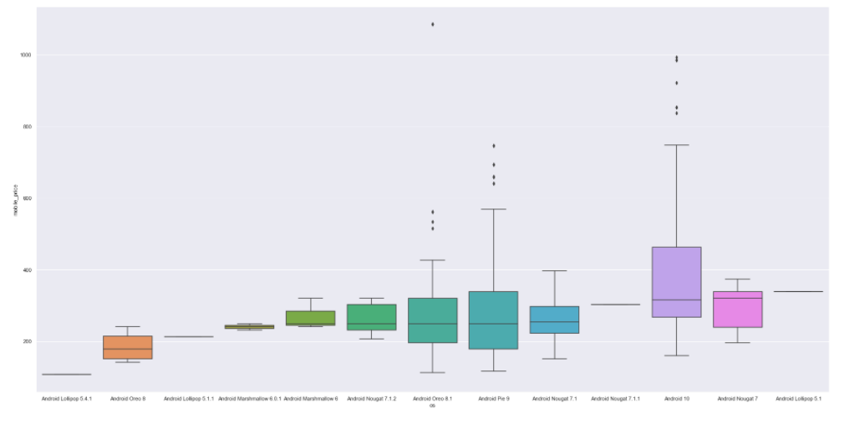
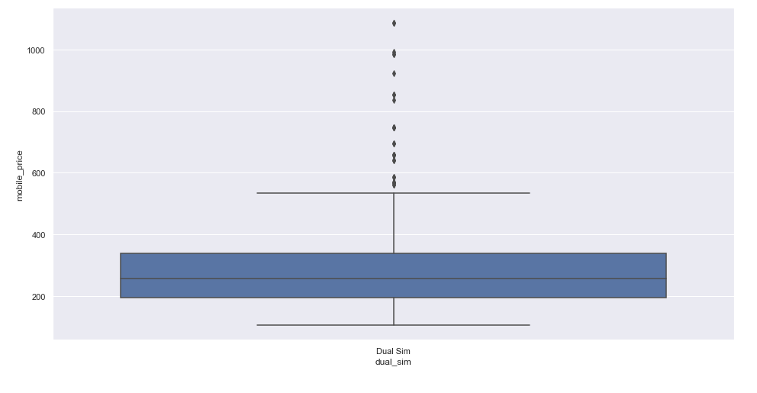

No/weak Correlation with mobile_price
OS
Close median values
dual_sim
Single class

Slide 13
Feature Engineering
Replace Null Values
Remove columns
One-Hot Encoding
Remove Outliers
Feature Selection

Slide 14
Machine Learning
Linear Regression
Random Forest Regressor
Gridsearch

Slide 15
BEFORE
FEATURE SELECTION

Slide 16

Linear Regression
Linear approach for modelling
The performance was okay, but not excellent

Slide 17
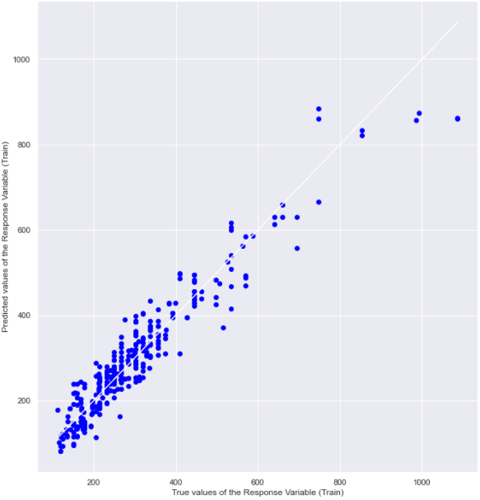
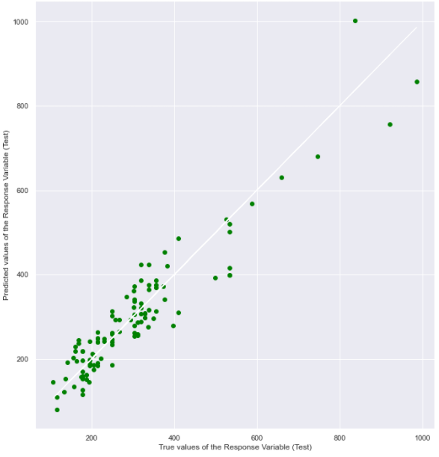
Goodness of Fit of Model: Test Dataset
R^2 : 0.8840
MSE : 2831.9093
Goodness of Fit of Model: Train Dataset
R^2 : 0.9121
MSE : 2128.2988

Slide 18

Random Forest Regressor
Supervised learning algorithm that uses ensemble learning method for regression
Better performance than linear regression model
Estimators: 1500
Depth: 5

Slide 19
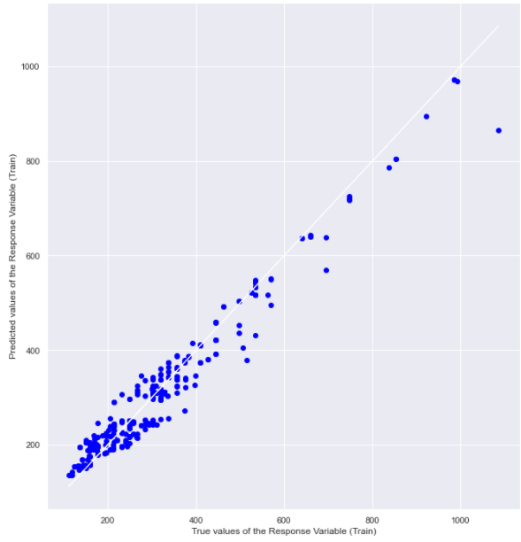
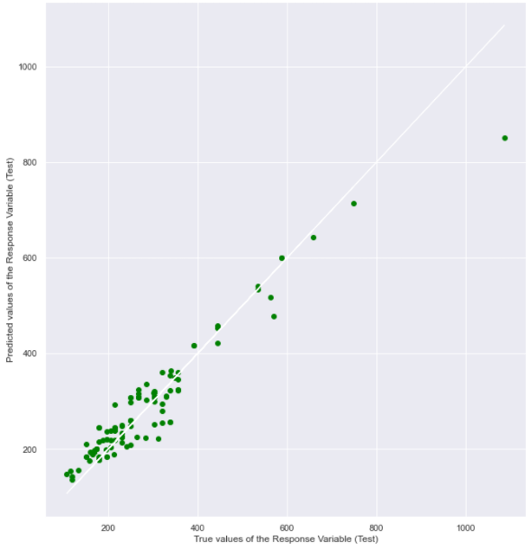
Goodness of Fit of Model: Test Dataset
R^2 : 0.9156
MSE : 1644.1514
Goodness of Fit of Model: Train Dataset
R^2 : 0.9512
MSE : 1256.8879

Slide 20
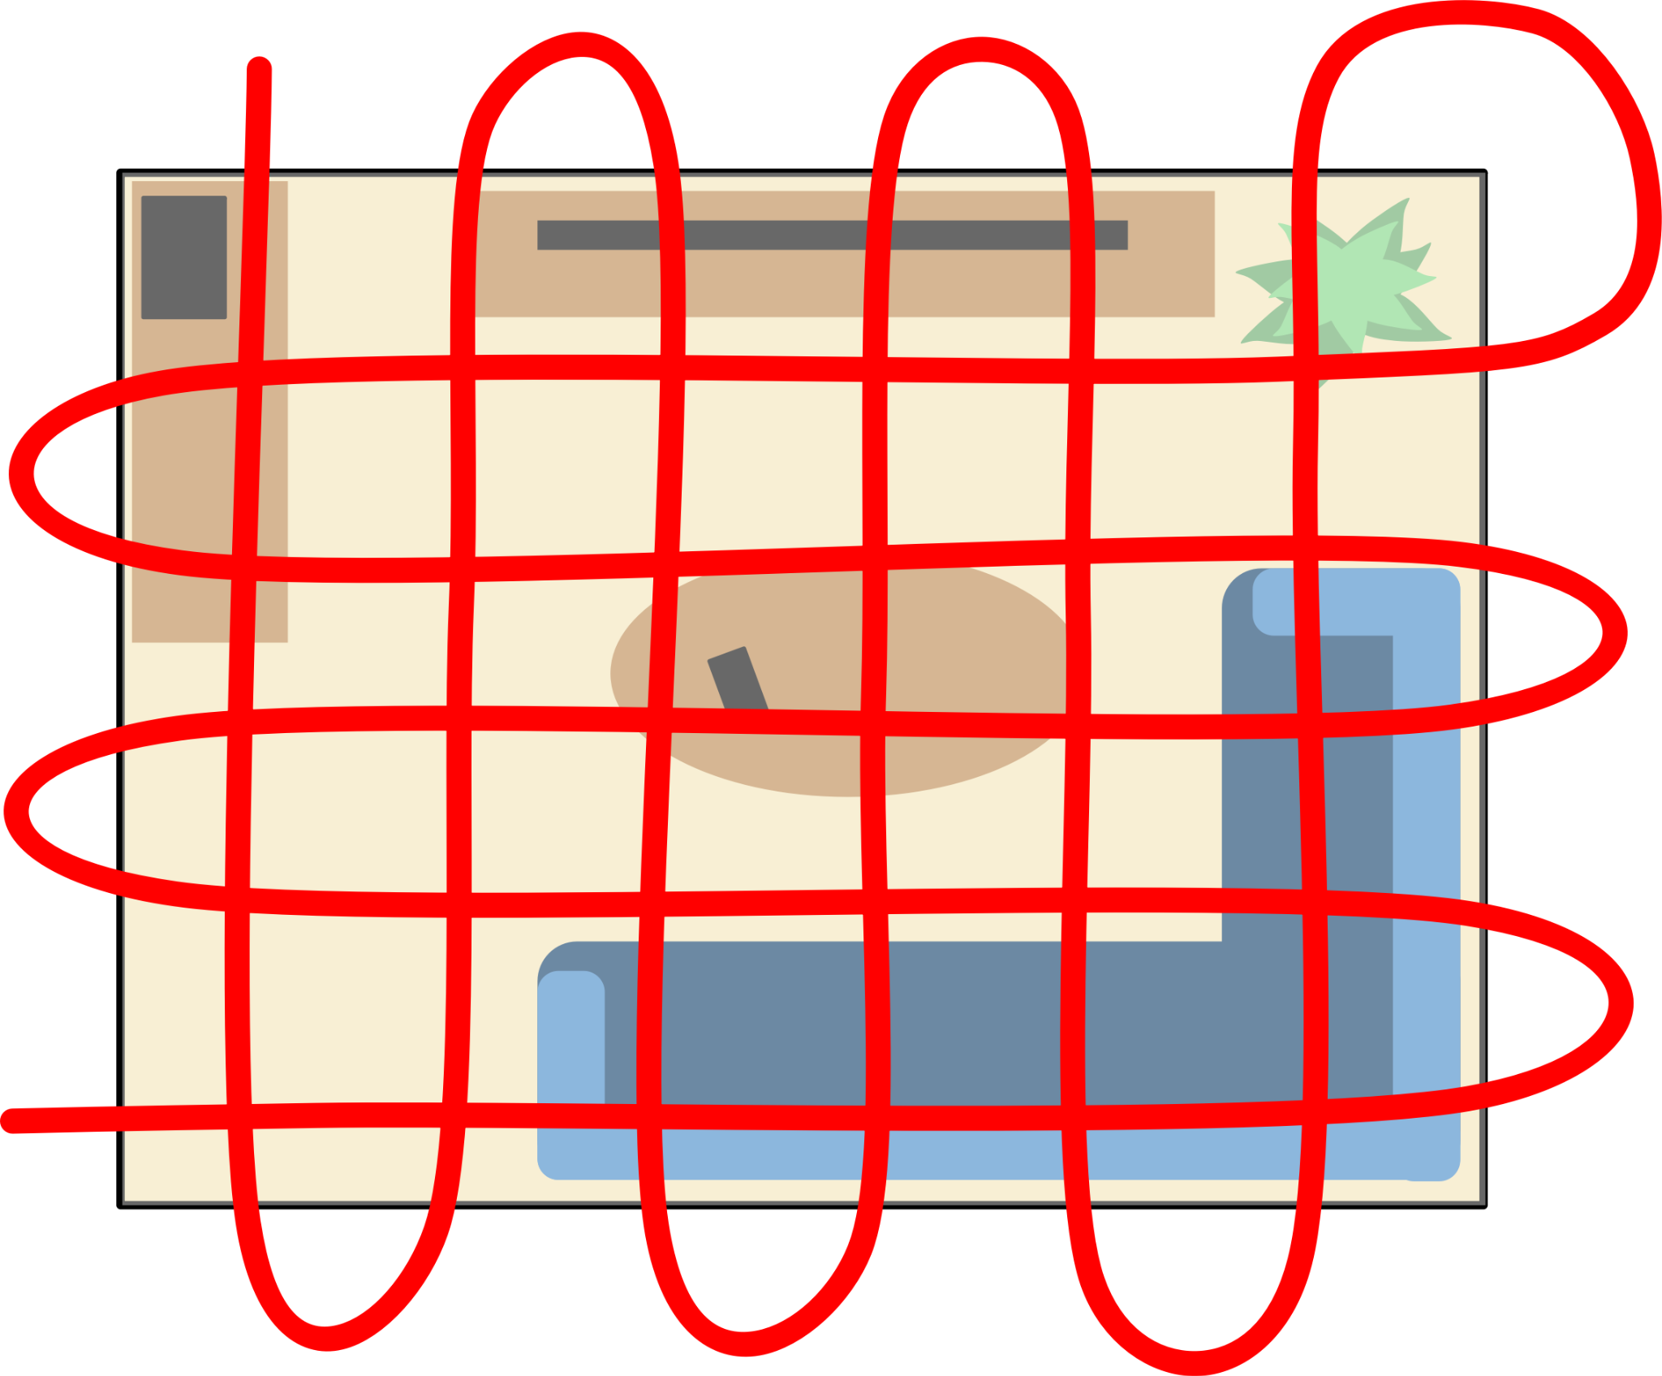
Gridsearch
Find the best hyperparameters
5 folds
Use R^2 for score
Range of estimators: 800-1800 (inclusive), with increment of 100
Range of depth: 7-12, with increment of 1

Slide 21
Gridsearch
Best Estimator:
Estimators: 1100
Depth: 9
Best Score: 0.9075
Better performance compared to previous model

Slide 22

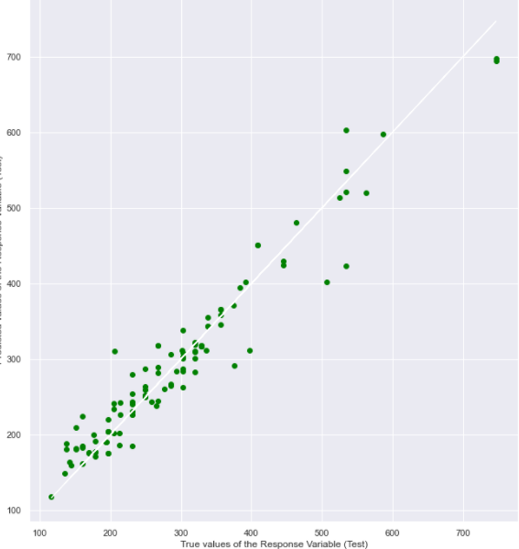
Goodness of Fit of Model: Test Dataset
R^2 : 0.9320
MSE : 1007.1283
Goodness of Fit of Model: Train Dataset
R^2 : 0.9900
MSE : 274.5719

Slide 23
AFTER
FEATURE SELECTION

Slide 24
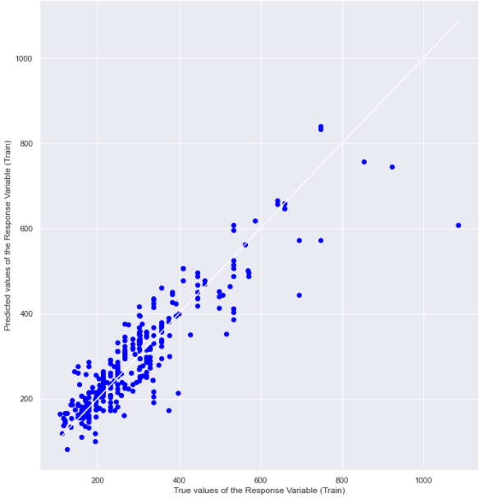
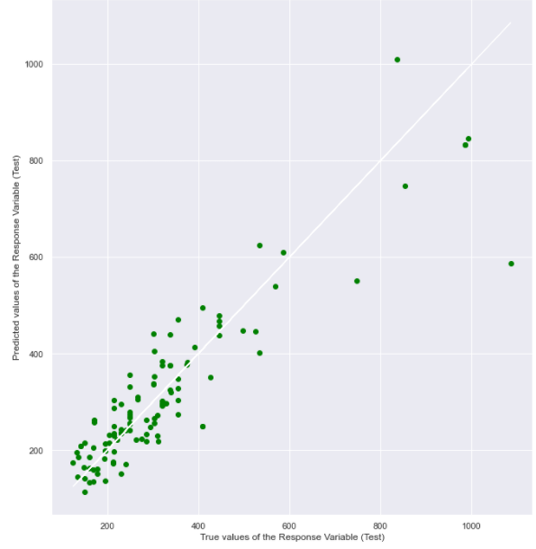
Linear Regression
Performance decreased significantly
Test Dataset
R^2 : 0.8166
MSE : 6519.3949
Train Dataset
R^2 : 0.8186
MSE : 3684.4688

Slide 25
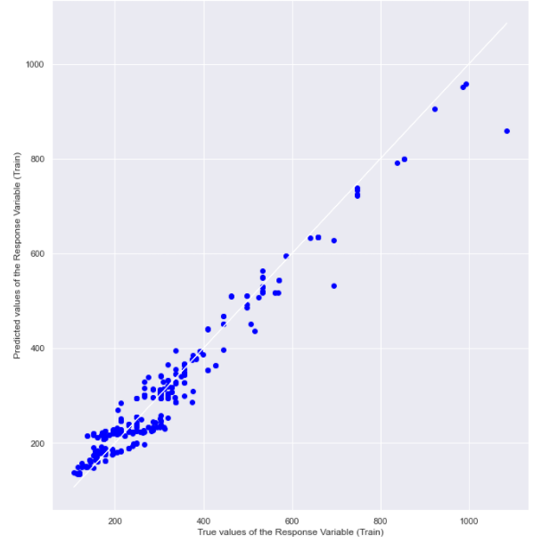
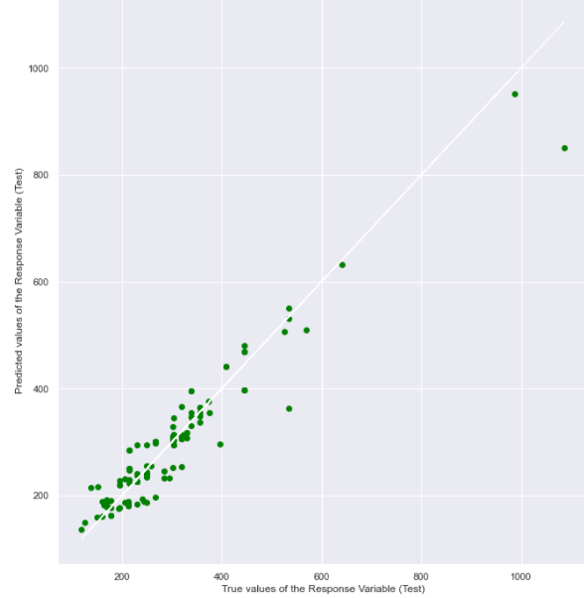
Random Forest Regressor
Similar performance as before feature selection, with same hyperparameter
Test Dataset
R^2 : 0.9100
MSE : 1822.6258
Train Dataset
R^2 : 0.9516
MSE : 1238.8074

Slide 26
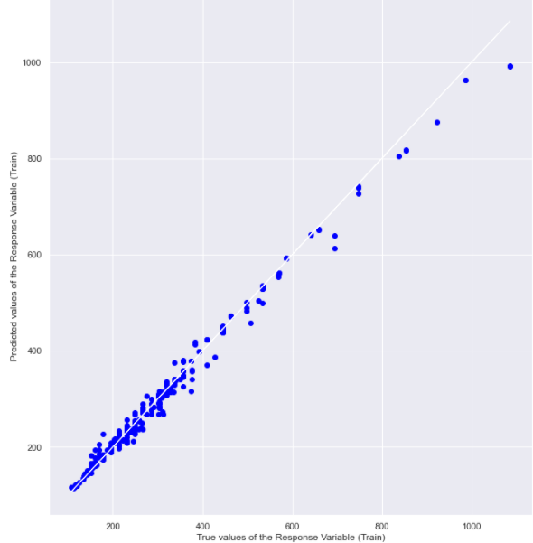
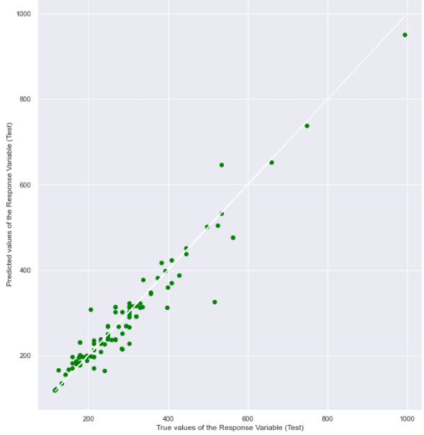
GridSearch
Best estimators: Depth=10, Estimators = 1100
Better best score
Similar performance
Test Dataset
R^2 : 0.9319
MSE : 1307.3858
Train Dataset
R^2 : 0.9898
MSE : 265.6157

Slide 27
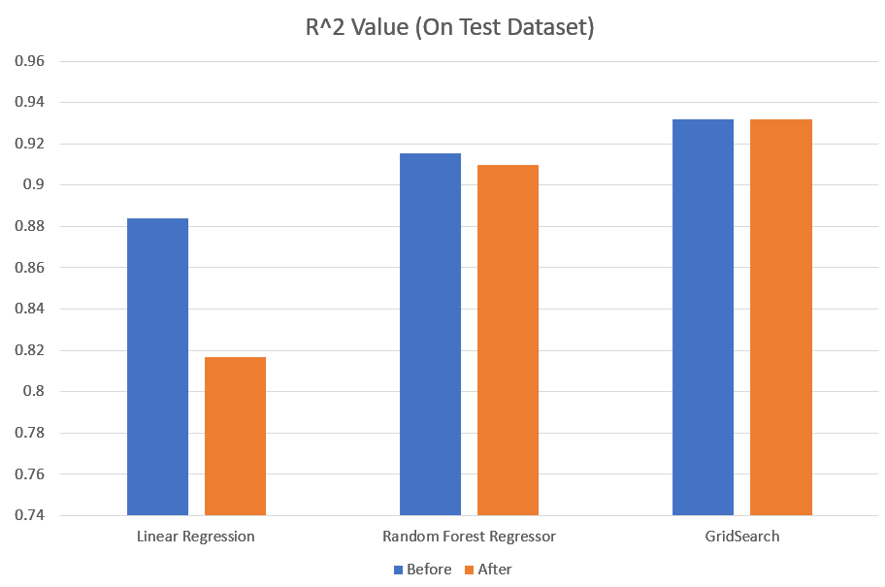
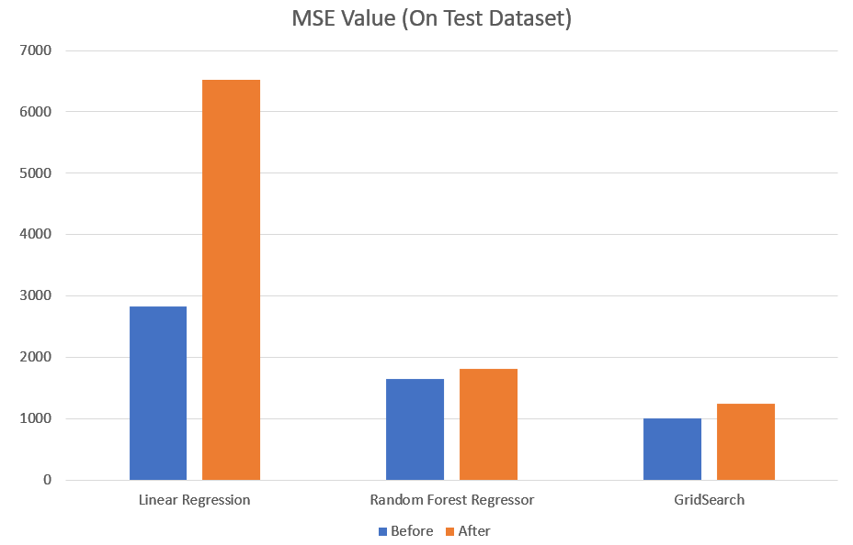
Comparison
Linear Regression Model has the worst performance
Our previous assumptions during the EDA are mostly correct

Slide 28
What we Learned
Regular Expression
One-Hot Encoding
Random Forest Regression
Gridsearch

Slide 29
DATA DRIVEN INSIGHTS

Slide 30

Data Driven Insights
0.57
0.59
-0.57
-0.62
ram
int_memory
mob_height
mob_depth
mp_speed
mp_speed
mob_width
mob_width
Data misalignment
Avoid bottleneck issues
-1
0
1

Slide 31
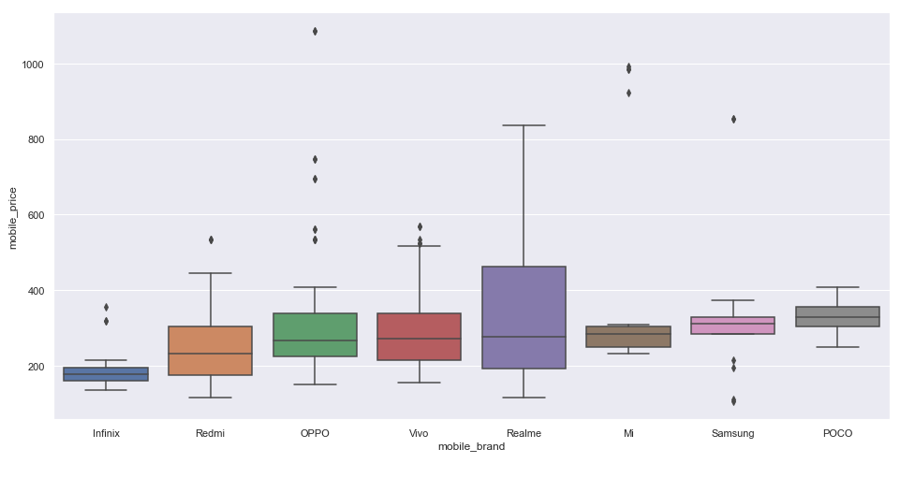
Mobile_brand VS mobile_price

Slide 32



Data Driven Insights
Expensive Spectral:
Large
Average Speed
Slow
Speed
Fast Speed

Slide 33



Data Driven Insights
Cheap Spectral:

Slide 34

Recommendations
Can be used as pricing system for businesses selling new phone models

Slide 35

Recommendations
Prioritise smartphone features according to lifestyle choices
For power users, recommend best value phone with battery capacity as priority
Recommend popular phone models for users with similar needs

Slide 36
Thank you!
Leong Hong Yi
Lim Jun Hern
Lim Wei Lun

