Slide 1
BSE in the US
APHIS Investigation and Response
FDA TSE Advisory Committee
February 12, 2004
Lisa A. Ferguson, DVM
Senior Staff Veterinarian
USDA, APHIS, Veterinary Services

Slide 2
BSE Timeline
12/9/03 – index cow arrives at WA slaughter plant, sampled as a non-ambulatory (downer) animal
12/23/03 – presumptive positive BSE test results reported from NVSL
12/23/03 – Epidemiologic investigation begins
12/25/03 - Confirmation of BSE positive diagnosis
12/30/03 – USDA Secretary Veneman announces additional safeguards to be initiated by APHIS and FSIS.
1/12/04 – USDA Secretary makes declaration of extraordinary emergency providing additional authorities and funding for response (effective on 1/6/04)
2/9/04 – Active field investigation closed out
Notes:
Because the cow had no neurological signs at slaughter it was not withheld from the human food chain; however, high-risk material was diverted out of the human food supply.

Slide 3
BSE Index Case - Diagnosis
Presumptive positive diagnosis at NVSL was based on
  immunohistochemistry
  histopathologic examination
The positive diagnosis was confirmed at the BSE reference laboratory in Weybridge, England. Samples from the index cow were hand carried to this laboratory where the BSE diagnosis was confirmed on 12/25/03.

Slide 4
BSE Index Case
Holstein dairy cow, 6 ½ years at slaughter
Sent to slaughter due to calving complications
Tested at slaughter because of non-ambulatory status, no CNS signs observed
Trace back investigation determined cow was born into a herd in Alberta, Canada
Moved into U.S. as part of dispersal sale in 2001
Initially went to Mattawa, WA dairy finishing herd (9/01)
Resided in Mabton, WA dairy herd since 10/01

Slide 5
BSE Index Case (continued)
The index cow has had four offspring over her lifetime, three calves since entering the U.S.
  A heifer calf born in Canada
  A stillborn calf born in 2001
  A heifer calf in born in 2002 (was in the index herd)
  A bull calf born in 2003 – moved to a bull calf raiser in Sunnyside, WA

Slide 6
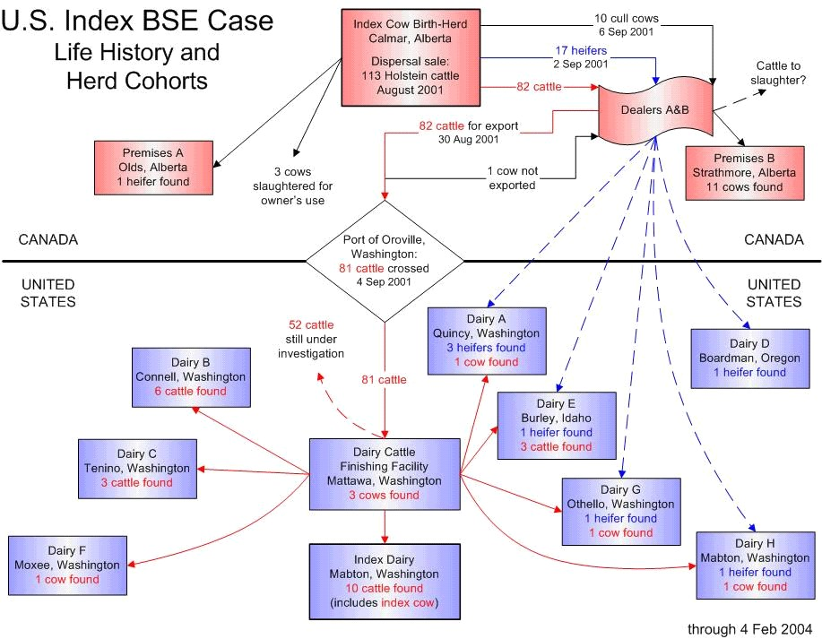

Slide 7
“At Risk” Animals Located
“At risk” animals = 81 animals from herd in Canada
  One of the 81 is the positive cow
  9 – index herd, Mabton, WA (131 euthanized)
  3 - Tenino, WA (4 euthanized)
  6 - Connell, WA (15 euthanized)
  1 - Quincy, WA (18 euthanized)
  3 - Mattawa, WA (39 euthanized)
  1 – Moxee, WA (15 euthanized)
  3 – Burley, ID (7 euthanized)
  1 – Othello, WA (3 euthanized)
  1 – Mabton, WA (3 euthanized)
February 9, 2004

Slide 8
BSE investigation
Of the shipment of 81 animals from the Canadian birth herd:
  29 accounted for (including index cow)
  Normal culling practices – estimate between 17 to 36 of the 81 might still be alive
OIE guidelines – animals born within one year (before or after) of a BSE affected animal considered higher risk
  25 of the shipment of 81 were in this category
  14 accounted for (including index cow)
  Normal culling practices – estimate that 11 of the 25 might still be alive

Slide 9
BSE investigation
Total of 704 animals depopulated
  449 – bull calf premises
  255 – animals of interest
    28 were part of the original 81
    220 could have been part of the original 81
    7 were part of additional group of 17 heifers from Canadian herd of origin

Slide 10
Other parts of investigation
FSIS - Class II voluntary recall of meat initiated on 12/24/03
  Includes 10,410 pounds
  Includes all 20 animals slaughtered on the same day as index cow
FDA – investigation of rendered product/feed
  Over 2,000 tons of rendered protein disposed of
  Facilities in compliance with feed regulations

Slide 11
International Review Subcommittee
Delivered to Secretary’s Advisory Committee for Foreign Animal and Poultry Diseases – February 4, 2004
Commended the US on the open and transparent manner in which the investigation was conducted
North American “indigenous BSE”

Slide 12
International Review Subcommittee
Investigation recommendations:
  Comprehensive epi investigation, conforms to international standards
  suggested all relevant information had been obtained and recommended concluding investigation
  Tracing and recall of MBM effective and appropriate
  Tracing and recall of meat consistent with WHO recommendation

Slide 13
International Review Subcommittee
Policy recommendations
  Specified risk materials
    remove from human and animal feed
    Recognized that FSIS interim rule (from cattle >30 months) removes highest risk tissues
    Recommend extending definition, cattle > 12 months of age
  Non-ambulatory cattle
    Maintain access for surveillance samples

Slide 14
International Review Subcommittee
Surveillance
  Test all cattle > 30 months in targeted high risk population (CNS signs, fallen stock, non-ambulatory animals, emergency slaughter, etc..) for one-year period
  Testing of all cattle slaughtered for human consumption unjustified
  Random sample of slaughter cattle >30 months could be considered to encourage reporting at the farm level
  Adopt rapid screening tests, decentralize laboratory facilities

Slide 15
International Review Subcommittee
Feed restrictions
  Recommend all SRM excluded from all animal feed
  Recommend all mammalian and poultry protein be excluded from ruminant feed
Traceability
  Animal identification system
Education

Slide 16
BSE – Targeted Surveillance
Non-ambulatory animals
Dead stock
Field CNS Cases and on-farm suspects
Veterinary Diagnostic Laboratory data
Public health laboratories
CNS condemns at slaughter and other antemortem condemns in certain categories

Slide 17
Surveillance goals
Surveillance at a level sufficient to find 1 case per 1 million adult cattle, 95% confidence
Based on estimates of targeted high risk population
  Non-ambulatory – 195,000
  Broader estimate, including deads and other condemns – 600,000
Adult cattle population – 45 million

Slide 18
Surveillance goals
FY 02 and FY 03 – goal was 12,500
  Based on estimate of non-ambulatory animals as targeted population (195,000)
FY 04 – goal is at least 40,000
  Based on broader estimate of targeted population (600,000)
  Statistical calculation is 38,462 samples necessary, rounded up to 40,000

Slide 19
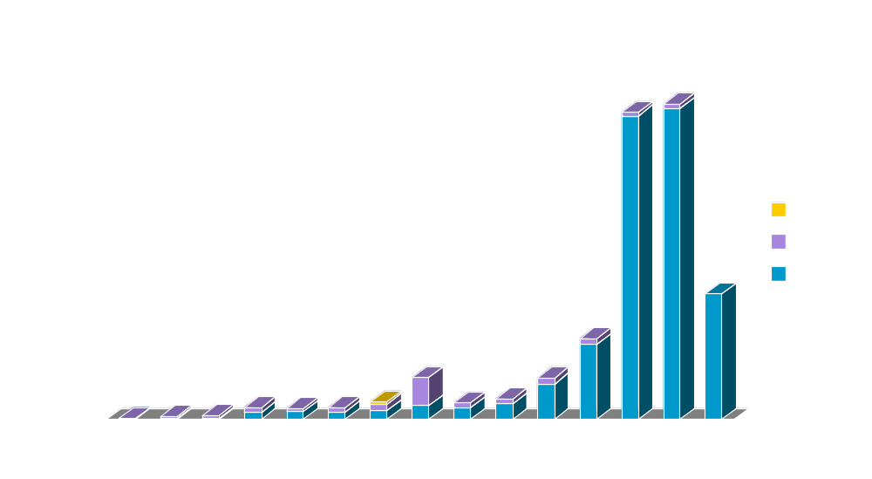
BSE Surveillance –
May 1990 – FY2004 (thru 12/31/2003)
20,543
19,990
5272
8,150
2713
2681
175
1143
1080
1302
40
736
692
744
251

Slide 20
Surveillance:
US Regions
NW
NC
NE
SW
C
E
SC
SE
Notes:
Surveillance of free ranging cervids.

Slide 21
US Regional Goals
BSE Surveillance (through 12/31/03)
 | FY01 Goal | FY01 | FY02 Goal | FY02 | FY03 Goal | FY03 | FY04 Goal | FY04
NW | 564 | 695 | 1,205 | 2,224 | 1,205 | 781 | 4832 | 489
SW | 466 | 564 | 1,976 | 2,753 | 1,976 | 3,645 | 4172 | 470
C | 766 | 332 | 1,590 | 2,356 | 1,590 | 2,628 | 6640 | 1403
SC | 734 | 872 | 1,509 | 1,810 | 1,509 | 1,690 | 6380 | 1251
NC | 606 | 620 | 2,561 | 3,780 | 2,561 | 5,620 | 5180 | 1990
NE | 462 | 805 | 2,140 | 2,190 | 2,140 | 2,595 | 3912 | 1004
E | 312 | 401 | 363 | 1,381 | 363 | 514 | 2644 | 507
SE | 644 | 953 | 1,005 | 3,156 | 1,005 | 2,800 | 5580 | 1030

Slide 22
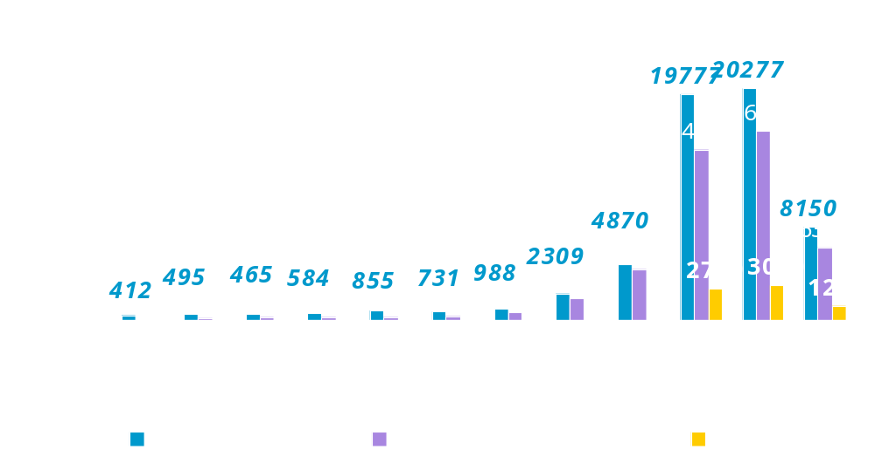
Surveillance: NVSL Bovine Brain Submissions FY 93-04
(through 12/31/03)

Slide 23
Future policy changes
Evaluating International Review Subcommittee recommendations
Considering range of options on surveillance
In the interim, still committed to maintaining FY04 goal as stated, until further decisions are made
Working with states, industry, and others to maintain access to targeted population

