Slide 1


Standard Energy Audit Manual for
Government Buildings
Presentation at workshop on Energy Efficient Procurement
September 20, 2005
IIEC
Technical support by Sudnya Industrial Systems Pvt. Ltd.

Slide 2
Standard Energy Audit Manual
Present problem
  Widely different quotes
  Widely different scopes
  Widely different quality of analysis
  Time lost in comparison/ clarification
  Work assigned to lowest bidder resulting in
    Narrow scope
    Indifferent work
    Reports cannot be basis for an Implementation Plan
  Energy Usage Remains High

Slide 3
Expected Benefits
Standardised scope
Quality Audits
Speed of moving from Tender to Report
Saving of Time and Cost
Confidence in the Reports
Leading to Implementation
Facilitating Benchmarking of Energy Use

Slide 4
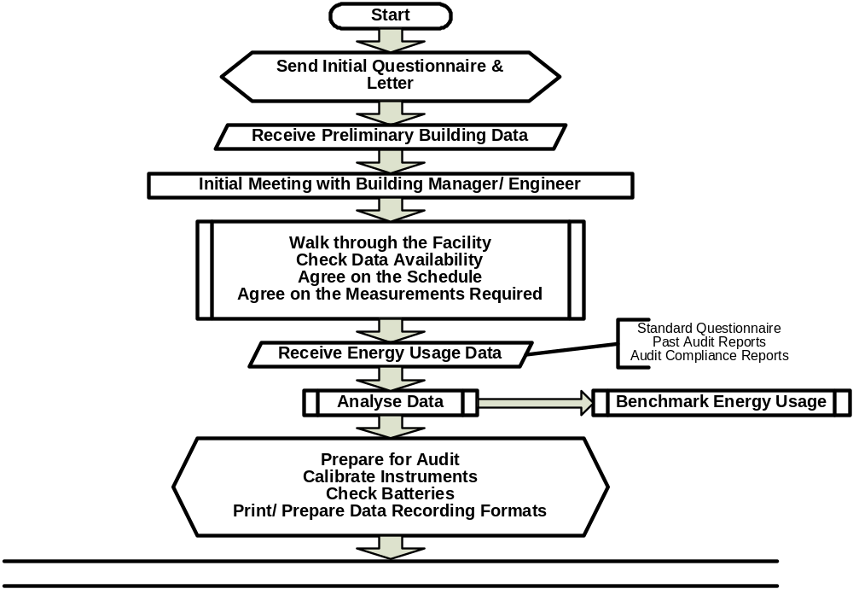
Flowchart

Slide 5
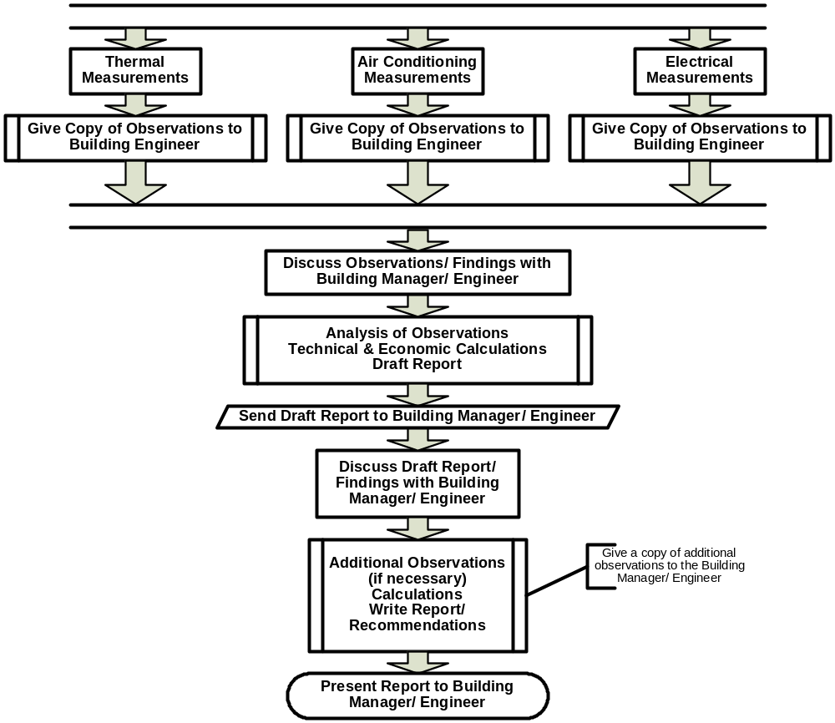
Flowchart (continued)

Slide 6
Organisation of the Manual
All processes have two aspects
  Managerial
  Technical
Managerial
  Overall Process
  Key Performance Parameters
  What is required from the Building Manager
  What to Expect
Technical
  Technical/ Engineering Aspects of Audits

Slide 7
Table of Contents
Energy Auditing
  Lighting
  Transportation
  Building Envelop
  Air Conditioning
  Motors
  Maximum Demand Management
  Electricity Distribution
  Water Heating
  Compressed Air
  Boiler & Steam Systems
  Fuel Shift
  Cogeneration
  Water Usage
  Effluent Treatment
References
Introduction
  Background
  Purpose
  Organisation of this Manual
Management of Energy Audits
  Types of Energy Audits
  The Energy Audit Process
Key Performance Parameters
Measurement
Calculation Procedures
Cost Benefit Analysis
Recommendation
Report Formats
Benchmarking
Appendix: Key Performance Parameters

Slide 8
Key Performance Parameters
Key Performance Parameters for each major area of Energy Use, e.g.
  Lighting
  Air conditioning
  Pumping
  Transportation / Lifts

Slide 9
Standard Procedures
For Audit of Each Area
  Key Parameters
  Standard Audit Procedure
  Instruments to be used
  Measurements
  Data Recording Formats
  Calculation Procedures
  Evaluation
  Report Format

Slide 10
List of Technical Interventions
Lighting
  Outdoor
  Indoor
Transportation
Building Envelop
Air Conditioning
  Chillers
  AHUs
  CW/ ChW Pumping
  Cooling Towers
  Package/ DX/ Split Units
Pumping Systems
  System Improvement
  Pump Improvement
Motors
Maximum Demand Management
Electricity Distribution
Water Heating
Compressed Air
  Usage
  Distribution
  Control
Boiler & Steam System
  Distribution
  Generation
Fuel Shift & Cogeneration
Water Usage
Effluent Treatment

Slide 11
Benchmarking of Energy Use
Historical
  Are we performing better today than we were yesterday/ last week/ last month/ last year?
External
  How is our performance related to that of others in similar situations?
  How do we compare with the average?
  How do we compare with the best?
Can we do better?
How much?

Slide 12
Thank you!
Felix Gooneratne, Team Leader – ECO II, IIEC
Mahesh Patankar, Sr. Project Manager, IIEC
Shishir Athalye, Consultant, IIEC

