Slide 1

NATIONAL CANCER INSTITUTE
DIAGNOSTIC IMAGING PROGRAM

Slide 2



National Institutes of Health
National Cancer Institute
Diagnostic Imaging Program

Slide 3
Diagnostic Imaging Program: Update
Money
Organizational comments
Current Programs
Future Plans
Concluding comments

Slide 4
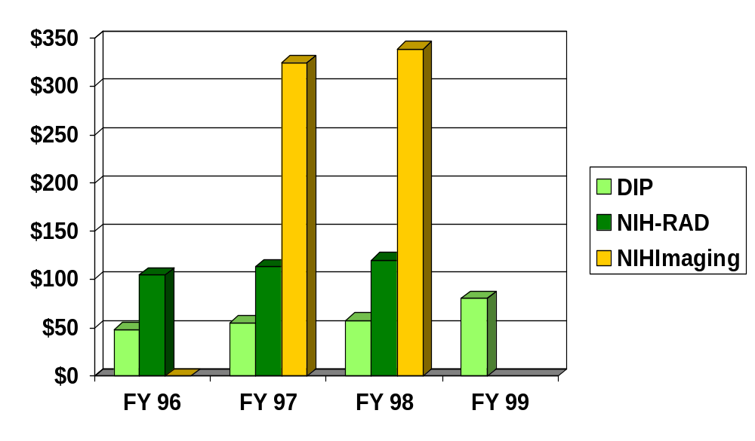
NIH Funding for Imaging
$Millions

Slide 5
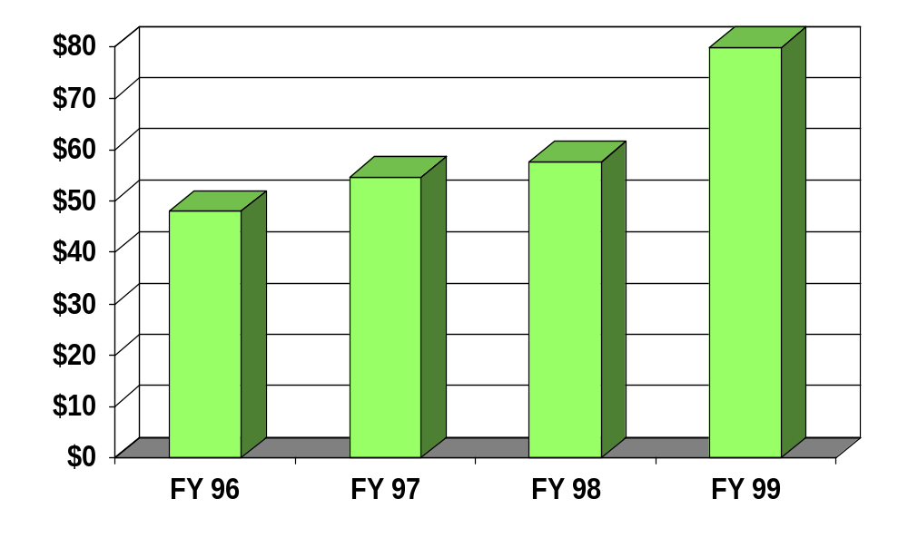
DIP Grant Funding
$M

Slide 6
NCI
Division of Cancer Treatment and Diagnosis
(DCTD)
Cancer
Diagnosis
Program
(CDP)
Develop-
mental
Therapeutics
Program
(DTP)
Cancer
Therapy
Evaluation
Program
(CTEP)
Radiation
Research
Program
(RRP)
Diagnostic Imaging Program(DIP)
Diagnostic
Imaging
Branch
Functional
Imaging
Branch
Image-guided
Therapy
Branch
Office of
Imaging
Technology

Slide 7
Organization
10 FTE’s
  D Sullivan, L Clarke, J Hoffman, A Menkens, B Croft, M Torres, J Smith, L Cooley, S Bowles, L Banh
3 Part-time
  E Staab, J Tatum, C Langlotz
Further expansion is space limited

Slide 8
Positions available
(of importance to imaging)
NCRR Director of Bioengineering
NHLBI Program Director
NCI Scientific Review Administrator

Slide 9
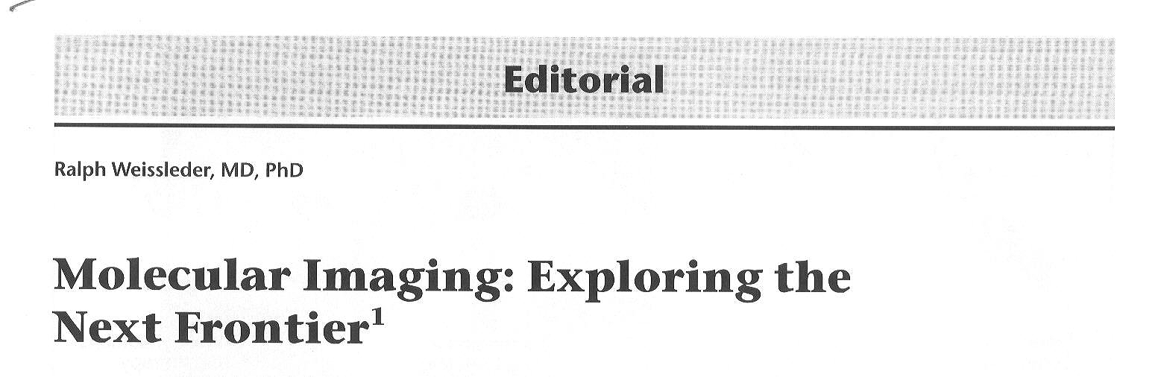
Radiology 1999; 212:609-614

Slide 10
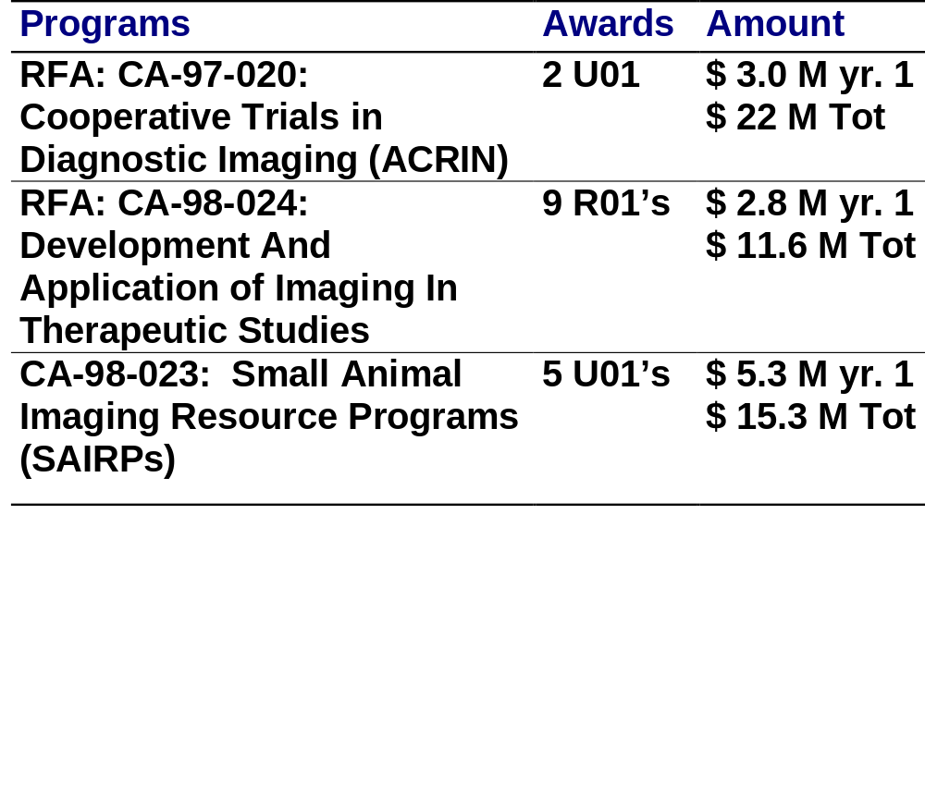
Recent Programs

Slide 11
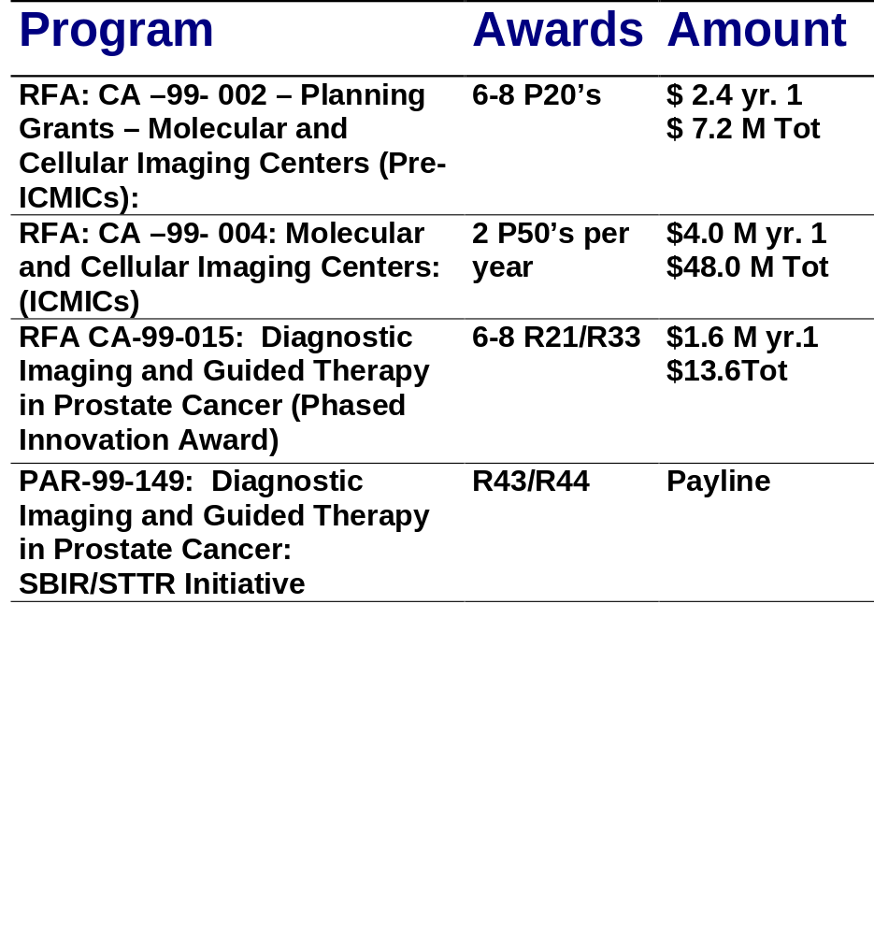
Current Programs(1)

Slide 12
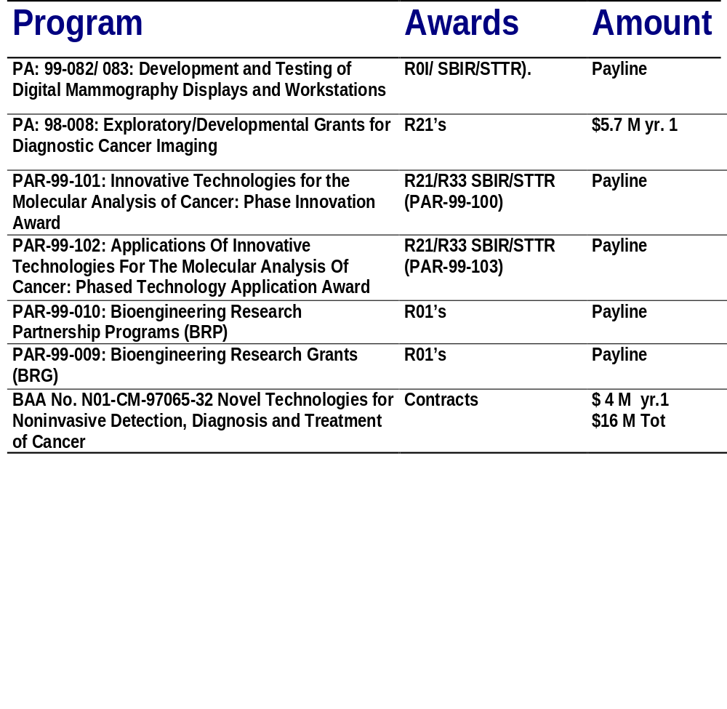
Current Programs(2)

Slide 13
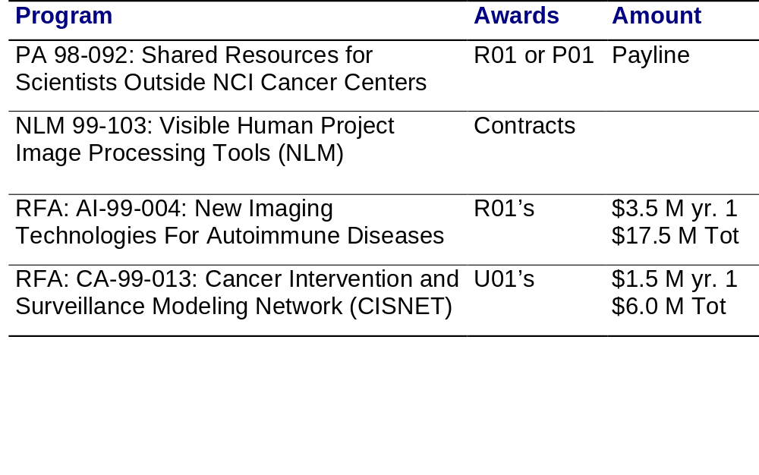
Collaborative Programs

Slide 14
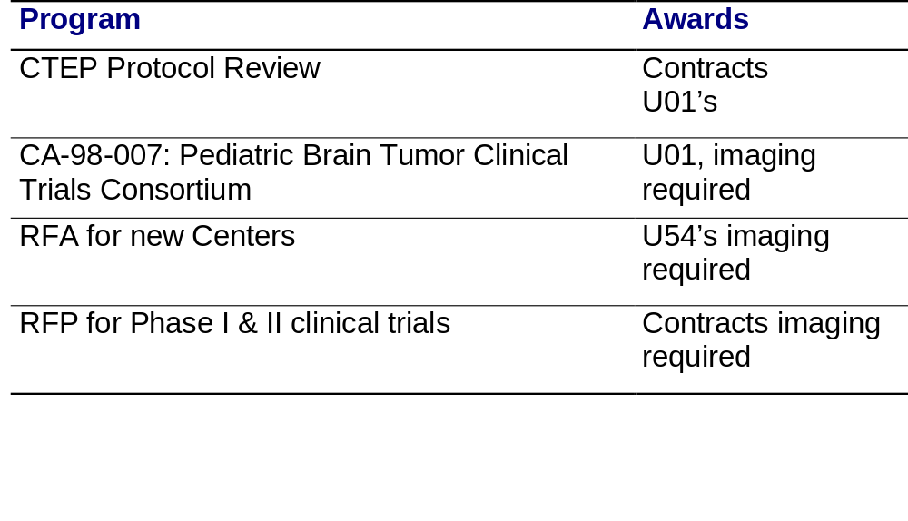
CTEP Collaborative Programs

Slide 15
DIP Standards Activities
DICOM / Working Group on Clinical Trials Data
RSNA - IHE / RSNA - image archive collaborations
Structured reporting collaborations: DICOM, SNOMED, ACR, RSNA
Image database standards: RFA

Slide 16
NCI - Imaging Industry Relations Forum
Clear description of HCFA decision rules
Policy for conditional coverage of emerging imaging technologies
Re-evaluation of FDA policies, esp. re: tracers or procedures of low risk
Assure full range of NCI support mechanisms for imaging science.

Slide 17
NCI Training Activities

Slide 18
R 25
Cancer Education and Career Development Program

Slide 19
R 25 Cancer Education and Career Development Program
Multidisciplinary
Institutional award
Salary support for PI and core faculty
Trainee salary up to $75,000
Research support up to $20,000 per trainee
5 yr. grant, renewable
8% indirect

Slide 20
K07 / K08 / K23
K 07 Epidemiology
(limited use by radiology)
K 08 Clinician: Bench science
(limited use by radiology)
K23 Clinician: Patient-oriented (hands-on; obtain consent form)
(no imaging applications yet)
Salary $75,000/ Research $30,000

Slide 21
T32 Training Grants - Imaging
From 1/97-10/99 (6 NCI deadlines)
• 54.2% of T32 applications submitted to NCI were funded
• 6.5% of applications submitted were imaging-related
• 57.1% of imaging-related T32s
were funded

Slide 22
T32 Training Grants - Imaging
Yrs PI Title
24 Kuhl, David Cancer Research Training in Nuclear Medicine
17 Wagner, Henry Res. Training in Use of Tracer Principles in Oncology
14 Brady, Thomas Nuclear Magnetic Research
10 Zerhouni, Elias Research Training in Oncology Imaging
7 Glazer, Gary Advanced Techniques for Cancer Imaging
5 Clouse, Melvin Deaconess Research Training in Cancer Radiology
4 Baum, Stanley Training in Innovative Cancer Imaging Technologies
3 Hawkins, Randall Research Training in Diagnostic Oncology
2 Wehrli, Felix Training in Quantitative Magnetic Resonance Imaging
23 Hoffman, Edward Research Training in Biomedical Physics
23 Bedford, Joel Radiological Sciences Basic to Cancer Research
21 DeLuca, Paul U.W. Radiological Sciences Training Program
18 Alpert, Nathaniel Postgraduate Program in Radiological Science
10 Doi, Kunio Research Training in Medical Physics

Slide 23
Research Training Grant Information
Call Brian Kimes
301 496 8537
email:
bk34t@nih.gov

Slide 24
Future Plans - Devices
Proposed PA: R21/R33 for imaging technology development
RFP for ultrasound research interface
RFA for spiral CT image database
Proposed program to support production of beta units for clinical trials
Proposed additional Centers with technology development component

Slide 25
Future Plans - Pharmaceuticals
(Imaging agents)
Pharmaceutical categories of interest:
  1. Non-PET tracers
  2. PET tracers
  3. Bulk agents (pharmacologic effect)
  4. Radiolabeled therapeutic agents (non-sealed-source agents)

Slide 26
Future Plans - Pharmaceuticals
(Imaging agents)
Proposed program to support development of novel imaging probes.
Proposed program to support R & D necessary for IND, and provide supply needed for clinical trials.

Slide 27
Concluding Comments
Molecular imaging is future priority
DIP funding increased 40 %
More applications lead to more funding
Patient accrual needs attention
Rewards for team science need attention
Think R25 for research training grants

Slide 28
Sources of NCI imaging information to public
Website: URL = www.nci.nih.gov/dip/
Email Newsletter

Slide 29
Handouts available
URLs of interest
Training program information
Copy of Acad Rad article: Radiologic Sciences Research in the Next Century
DIP Newsletter
Everything you ever wanted to know …
Cancer information pamphlets

