Slide 1

System Inspections
2002-FDA adopted System approach to doing GMP inspections
  Domestic and foreign establishments
  Applies to human and animal drugs products
  Covers products and or processes that are representative of all profile classes.

Slide 2
System Inspections
Quality
Facilities and Equipment
Materials
Production
Packaging/Labeling
Laboratory Controls
Notes:
The systems roughly parallel the GMP regulations

Slide 3
Advantages of this approach
Decreased time in facility
Ability to assess compliance of all profile classes based on covering a limited number of systems
Enable FDA to maintain an audit role rather than QA.
Information for the firms in compliance could result in fewer pre-approval inspections.
Notes:
In plant time was negatively impacting industry and FDA.

Slide 4
Inspectional approach
Full inspection- at least 4 systems
Abbreviated- at least 2 systems
  Quality System must be done under each approach
  Investigator has option to switch gears as necessary

Slide 5
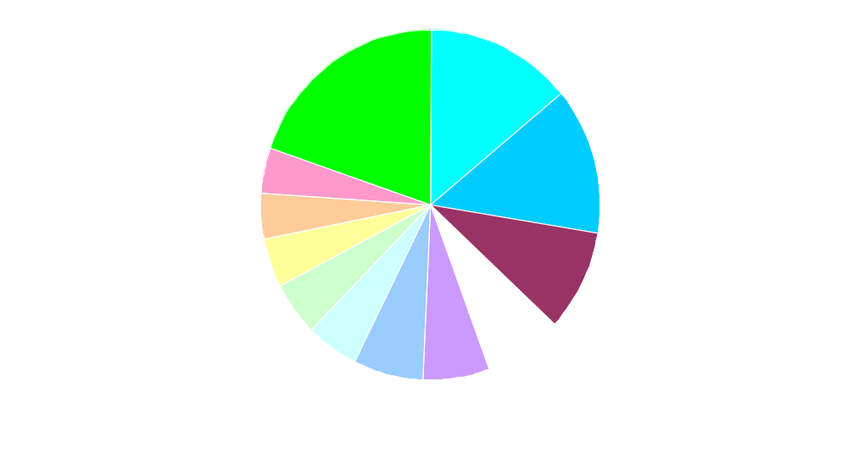
Foreign Inspections by Country in FY 2004
Notes:
Ireland 4% United Kindgom 7%
Spain 4% China 7%
Switzerland 4% Italy 10%
Japan 5% Germany 14%
France 5% India 14%
Canada 7% Others 19%

Slide 6
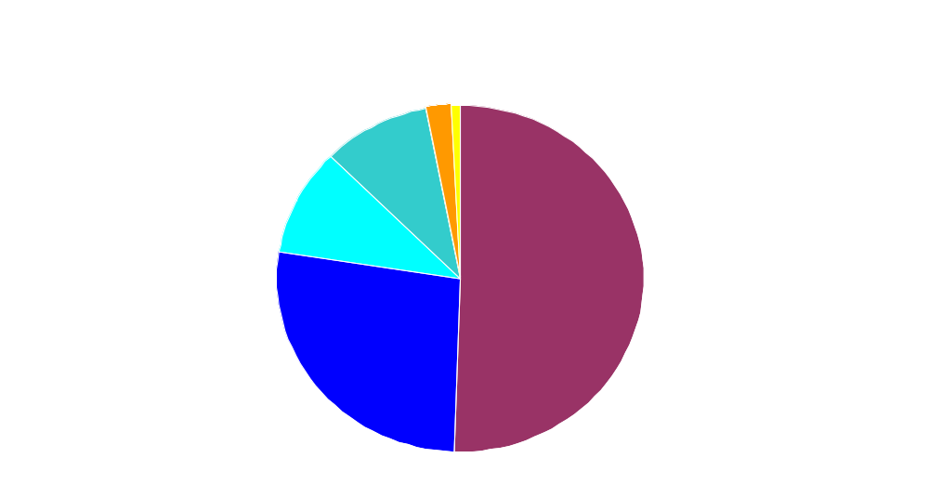
Foreign Inspection in FY 2004 by Firm Type
Notes:
Micronizer 1%
Control Lab 2%
Both API and Dose form establishments 9%
Intermediates 10%
Straight Dose Form 27%
API 51%

Slide 7
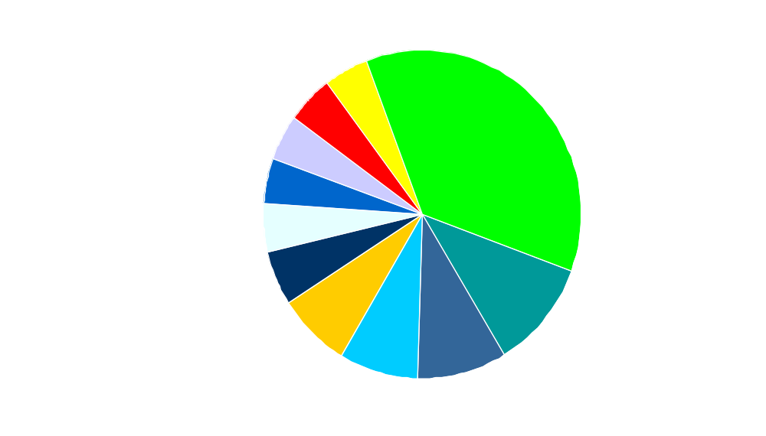
GMP Deficiencies for Foreign Dosage Manufacturers in FY 2004

Slide 8
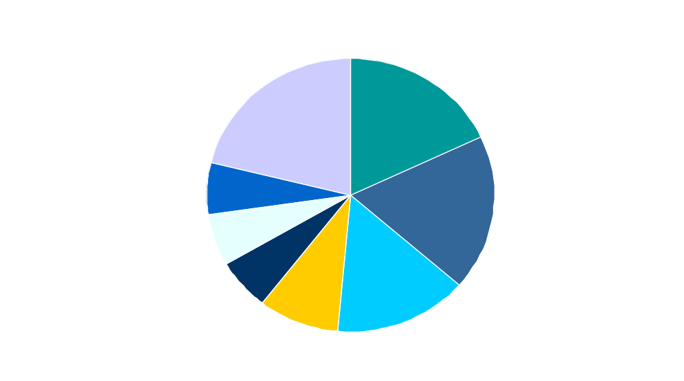
GMP Deficiencies in API/Dosage Manufacturers in FY 2004

Slide 9
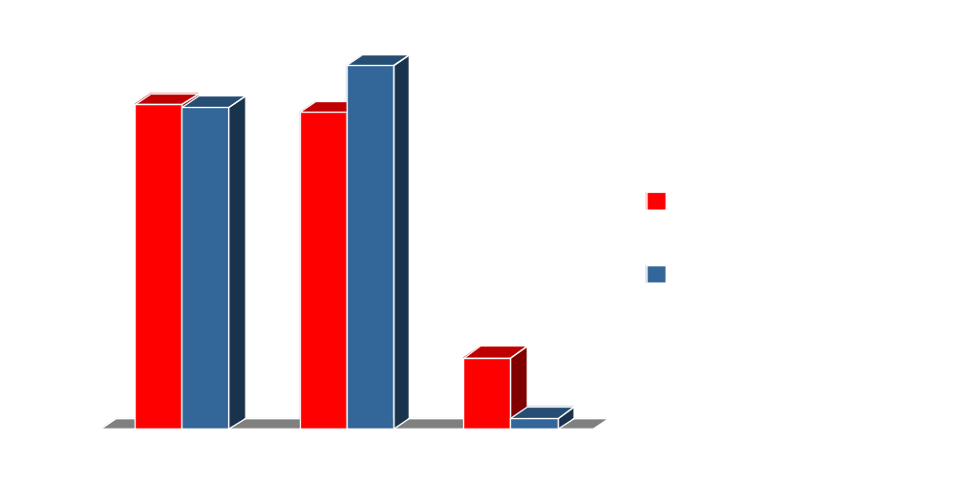
EIR Classifications of Foreign Manufactures in FY 2004

Slide 10
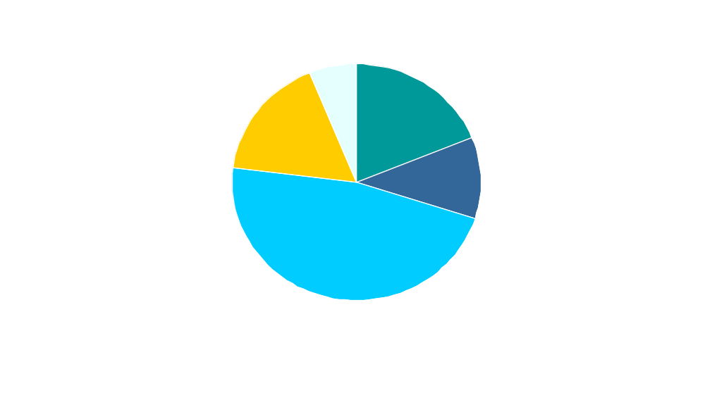
Most Common GMP Deficiencies by System – Domestic Inspections for 2004/5
Notes:
1/1/04 to 3/18/05
785 Inspections (Excluding API)
1974 Top 30 Observations
Quality: 937 Lab: 371 Materials: 109
Prod.: 210 Facil/Equip: 347 Pkg/Lab: 0

Slide 11
Domestic inspections: 1/2004 thru 3/2005
785 Inspections (Excluding API)
Top 30 Observations (1974)
  Quality: 937
  Laboratory: 371
  Facilities/Equipment: 347
  Production: 210
  Materials: 109
  Packaging/Labeling: 0
Notes:
Inspections included finished dose form manufacturers, intermediate product manufacturers, control laboratories, and “others”. API are excluded from the list.
During this time 785 inspections that were captured in FDA’s Turbo EIR were done. It is necessary for me to note that not all inspections may be captured in Turbo for a variety of legitimate reasons- IT network failure aka computer system “crash”, logistical issues with the program, foreign inspection reports, etc.
In looking at the data and to give you a better perspective of the bigger picture: there were in all 4548 total observations and for our discussion today, we’ll only look at the top 30 most cited deficiencies.

Slide 12
FDA-483 Citations
21 CFR Primary
Reference Deficiency System
1 | 211.22(d) | The responsibilities & procedures applicable to the QC unit are not in writing or fully followed. | Quality
2 | 211.100(b) | Written production & process control procedures are not followed in the execution of production & process control functions &/or documented at the time of performance. | Production
3 | 211.25(a) | GMP training is not conducted on a continuing basis &/or with sufficient frequency to assure employees remain familiar with cGMP requirements applicable to them. | Quality
3 | 211.25(a) | Employees are not given training in the particular operations they perform as part of their function, cGMPs, &/or written procedures required by cGMPs. | Quality
Notes:
Most of you have heard of TURBO EIR. Turbo EIR is an automated reporting system for FDA-483 and EIRs. All FDA-483s and reports for both human and vet. firms are entered into Turbo EIR, with the exception of those for API manufacturers and some foreign manufacturers.
From Turbo EIR, I trended FDA-483 items cited nationwide since January 1/2004. The most frequently cited deficiencies pertained to the Quality System. In the next set of slides I’ve listed the top 30 deficiencies nationwide by CFR reference, the specific deficiency and the primary system that the deficiency falls under.
Fourteen of the top 30 pertain to the Quality System, 6 pertain to the Laboratory System and 6 to the Facilities & Equipment system, 2 pertain to the Production System and 2 pertain to the Materials system. None in the top 30 pertained to Labeling and Packaging system.
The #1 citation—the most frequently cited deficiency was for failure of the QC unit to have written procedures describing their responsibilities or failure of the QC unit to follow their procedures. NOTE: the deficiency is a PROCEDURAL one. Frequency of occurrence- 144 times.
Second most cited deficiency- A PROCEDURAL DEFICIENCY OCCURRED 117 TIMES.
The 3rd citation appeared 49 times and 77 times for the
The 4rd most frequently cited deficiency pertains to validation. Frequency= 108 times

Slide 13
FDA-483 Citations cont.
21CFR Reference Deficiency Primary System
4 | 211.110(a) | Control procedures are not established which monitor the output &/or validate the performance of those manufacturing processes that may be responsible for causing variability in the characteristics of IP material & the drug product. | Quality
5 | 211.188 | Batch production & control records are not prepared for each batch of drug product produced &/or do not include complete information relating to the production & control of each batch. | Production

Slide 14
FDA-483 Citations cont.
21 CFR Primary
Reference Deficiency System
6 | 211.160(b) | Lab. controls do not include the establishment of scientifically sound & appropriate specs., standards, sampling plans, &/or test procedures designed to assure that components, containers, closures, in-process materials, labeling &/or drug products conform to appropriate standards of identity, strength, quality & purity. | Laboratory
7 | 211.165(a) | Testing & release of drug products for distribution do not include appropriate laboratory determination of satisfactory conformance to the final specs. &/or identity & strength of each AI prior to release. | Laboratory
8 | 211.100(a) | There are no written procedures for production & process controls designed to assure that the drug products have the identity, strength, quality, & purity they purport or are represented to possess. | Quality
Notes:
The 5th and 6th most frequently cited observation involved the laboratory
The 7th pertains to the lack of written procedures for production and process controls. Again a PROCEDURAL Deviation. Frequency= 80

Slide 15
FDA-483 Citations cont.
21 CFR Primary
Reference Deficiency System
9 | 211.68(a) | Routine calibration, inspection &/or checking of automatic, mechanical &/or electronic equipment is not performed according to a written program designed to assure proper performance. | Facilities & Equip- ment
10 | 211.67(b) | Written procedures are not established &/or followed for the cleaning & maintenance of equipment used in the manufacture, processing, packing or holding of a drug product. | Facilities & Equip- ment
11 | 211.192 | There is a failure to thoroughly review any unexplained discrepancy &/or the failure of a batch or any of its components to meet any of its specifications whether or not the batch has been thoroughly distributed. | Quality
Notes:
The 8th deviation involves Facilities/Equipment system [frequency = 79]. Without looking at the Specifically portion of the citations it is difficult to say if the deviation is the lack of having a written procedure or program or failure to follow the written program.
No. 9 frequency = 77. It pertains to lack of operator training.
No 10 frequency = 77. this citation is a Procedural deviation.
The 9th and 19th pertains to the lack of operator training or the infrequency of GMP training.
The 11th pertains to poor investigations.

Slide 16
FDA-483 Citations cont.
21 CFR Primary
Reference Deficiency System
12 | 211.192 | Drug product production & control records are not reviewed/approved by the QC unit to determine compliance with all established, approved written procedures before a batch is release or distributed. | Quality
13 | 211.166(a) | There is no written testing program designed to assess the stability characteristics of drug products. | Lab.
14 | 211.198(a) | Procedures describing the handling of all written & oral complaints regarding a drug product are not established, written &/or followed. | Quality
15 | 211.80(a) | Written procedures are lacking which describe in sufficient detail the receipt, identification, storage, handling, sampling, testing, approval &/or rejection of components &/or drug product containers &/or closures. | Materials
Notes:
The 12th pertains to the lack of review/approval of Batch and control records.
# 14th & 28th pertain to poor complaint investigations or the lack of or inadequacy of procedures for evaluating complaints.

Slide 17
FDA-483 Citations, cont.
21 CFR Primary
Reference Deficiency System
16 | 211.67(a) | Equipment/utensils are not cleaned, maintained &/or sanitized at appropriate intervals to prevent malfunction &/or contamination that would alter the safety, identity, strength, quality or purity of the drug product. | Facilities & Equip-ment
17 | 211.165(e) | The accuracy, sensitivity, specificity &/or reproducibility of test methods have not been established &/or documented. | Lab.
18 | 211.180(e)(2) | Written procedures are not established &/or followed for evaluation done at least annually & including provisions for a review of complaints, recalls, returned or salvaged drug products &/or investigations conducted for each drug product. | Quality
Notes:
The 18th and 21st pertain to APRs. There are no procedures for APRs or the procedures were not followed.
The 19th deficiency pertains to

Slide 18
FDA-483 Citations, cont.
21 CFR Primary
Reference Deficiency System
19 | 211.84(d) (2) | Reports of analysis from component suppliers are accepted in lieu of testing each component for conformity with all appropriate written specs., without performing at least one specific identity test on each component &/or establishing the reliability of the supplier’s analyses through appropriate validation of the supplier’s test results at appropriate intervals. | Materials
20 | 211.180(e) (1) | Written procedures are not established &/or followed for evaluations conducted at least annually to review records associated with a representative number of batches, whether approved or rejected. | Quality
21 | 211.67(b) | Written procedures for cleaning & maintenance fail to include assignment of responsibility, maintenance & cleaning schedules, description in sufficient detail of methods, equipment & materials used, description in sufficient detail of the methods | Facilities & Equip-ment

Slide 19
FDA-483 Citations, cont.
21CFR ref. Deficiency System
21 cont. | 211.67 (b) | of disassembling & reassembling equipment as necessary to assure proper cleaning & maintenance, instructions for removal or obliteration of previous batch identification, instructions for protection of clean equipment from contamination prior to use &/or parameters relevant to the operation. | Facilities & Equip-ment
22 | 211.160 (b)(4) | Calibration of instruments, apparatus, gauges &/or recording devices is not done at suitable intervals in accordance w/ an established written program &/or w/ provisions for remedial action in the event accuracy &/or precision limits are not met. | Facilities & Equip-ment
23 | 211.63 | Equipment used in the manufacture, processing, packing or holding of drug products is not of appropriate design, of adequate size &/or suitably located to facilitate operations for its intended use &/or cleaning & maintenance. | Facilities & Equip-ment

Slide 20
FDA-483 Citations, cont.
21 CFR Primary
Reference Deficiency System
24 | 211.100(a) | Written procedures are not drafted, reviewed & approved by the appropriate organizational units &/or reviewed & approved by the QC unit. | Quality
25 | 211.22(a) | There is no quality control unit. | Quality
26 | 211.160(a) | Established specifications, standards, sampling plans, test procedures &/or laboratory control mechanisms are not followed &/or documented at the time of performance. | Lab.
27 | 211.198(a) | Procedures describing the handling of written & oral complaints related to drug products are not written or followed or are deficiently written or followed. | Quality
28 | 211.194(a)(8) | Laboratory records do not include the initials or signature of a second person showing that the original records have been reviewed for accuracy, completeness &/or compliance with established standards. | Lab.
Notes:
The 24th is for failure of the QC unit to review & approve written procedures.
The 25th is for the lack of a quality unit.

Slide 21
FDA-483 Citations, cont.
21 CFR Primary
Reference Deficiency System
29 | 211.192 | Written records of investigations into unexplained discrepancies & the failure of a batch or any of its components to meet specifications do not always include the conclusions & follow-up. | Quality
Notes:
The 30th most frequently cited deficiency is for failure of investigations to include conclusions and follow-up.
As is evident by this trend analysis, more problems are found in the Quality System. Again, this is a system that will be evaluated during every inspection. Based on this fact and this trend analysis, I would strongly encourage you to look at your Quality Unit to ensure its been given the authority and responsibility to do its job, and to ensure it’s operating in compliance with the requirements in the regulations.

