Slide 1
Is There Cyclical Bias in Bank Holding Company Risk Ratings?
DIR Seminar: October 4, 2006
First draft: June, 2005
Second draft: September, 2006
Comments Welcome and Appreciated!
Timothy J. Curry, FDIC
Gary S. Fissel, FDIC
Gerald A.Hanweck, FDIC & George Mason University.
*The views expressed are those of the authors and do not necessarily reflect those of the FDIC or its staff..

Slide 2
“The ideal is to “rate through the cycle” there is no point in assigning high ratings to a company in enjoying peak prosperity if that performance level is expected to be only temporary. Similarly, there is no need to lower ratings to reflect poor performance as long as one can reliably anticipate that better times are just around the corner”.
Standard and Poor’s: Corporate Ratings Criteria
(2002, p.41)

Slide 3
“Supervisory ratings should be revised whenever there is strong evidence that the financial condition or risk profile of an institution has significantly changed…It is important that supervisory ratings reflect a current assessment of an institution’s financial condition and risk profile”
(FRB BHC Supervision Manual)
[Section 4070.3,1999. p.1]

Slide 4
Research Questions
This paper studies the influence of the state of the business cycle on regulator assigned bank holding company (BOPEC) risk ratings
We assess whether risk ratings exhibit cyclical bias by empirically testing whether the state of the U.S. economy is an important determinant of risk ratings after accounting for firm specific factors
We also attempt to differentiate between cyclical influences and secular trends (ratings drift)

Slide 5
Why is potential bias in rating assignments an issue over the business cycle?
Disposition of regulators toward risk during expansions and contractions may be asymmetrical over the business cycle; more at stake for regulators in economic downturns; banking supervisors have been more vigilant during downturns (Syron,1991)
A distinction is often made between recessions and expansions, as there is an apparent asymmetry between these two phases of the cycle. The onset of a recession tends to be a rapid, but the recession itself is short-lived. By contrast expansions develop slowly and are much longer in duration. Thus, it is plausible that these two phases of the cycle might have a different impact on the behavior of regulators, with recessions having a particular strong impact due to their virulent nature.

Slide 6

Why is potential bias in ratings assignment an issue over the business cycle? (con’t)
A body of literature involving private-sector rating agencies shows that risk ratings may not be independent of business cycle movements-- after controlling for risk
Experience from the real estate boom in during the 1980s in New England followed by the bust years led to claims of an asymmetrical application of bank supervision: too lax during the boom years and too draconian in the later years producing a “credit crunch” in early 1990s

Slide 7

“Given that credit judgments by both bankers and regulators ultimately reflect human sentiments it can be expected that to some extent, the overly optimistic expectations of the 1980s, may be replaced by the overly pessimistic expectations in the 1990s.

Slide 8
With respect to regulators,… I believe the more valid criticism relates to how we reacted to the boom of the 1980s, and whether we should not have done more to dampen it, rather than to the degree of overreaction that has occurred since. ...I do believe a shift in regulatory sentiment about some New England institutions may have occurred that while understandable or even appropriate on a case-by-case basis, may have been perverse for the economy as a whole.”
Richard F. Syron
President, Federal Reserve Bank of Boston
(May 8, 1991)

Slide 9
Why is potential bias in rating assignments an issue over the business cycle? (con’t)
A casual observation of risk ratings suggest that there is a high degree of co-movement with the business cycle
The data suggest that during recessions, rating changes are far more likely to be downgrades; just the reverse for upswings
This is to be expected and does not necessarily imply supervisory bias however

Slide 10
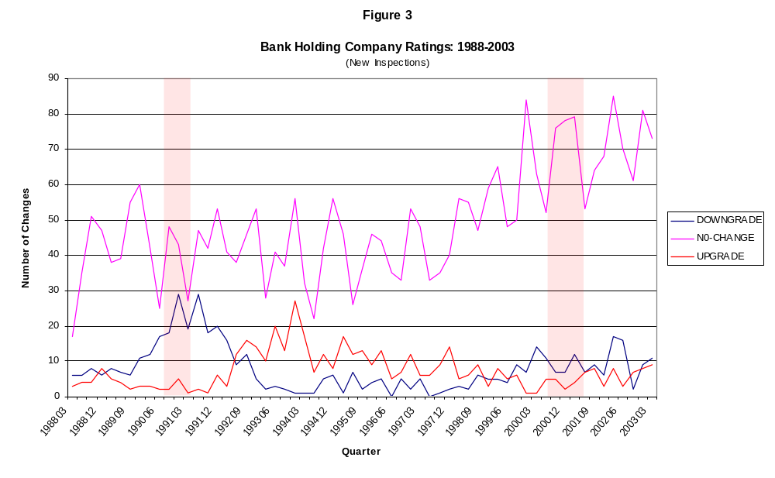

Slide 11
Why is this an important policy issue ?
Asymmetric behavior in examination ratings has implications for capital requirements, bank lending behavior and economic activity (Peek and Rosengren, 1995a,b,c)
Basel II: Risk-based Framework
-risk sensitive capital requirements will increase (decrease), when bank and supervisory estimates of default risk increases (decreases); the concern that the new capital accord may exacerbate business fluctuations is acknowledged by the Basel Committee on Bank Supervision and others; Altman and Saunders (2001); Borio, Furfine and Lowe (2001)
Stringency issue after FDICIA: have ratings standards changed?
This is an empirical issue with policy making implications, and thus, worthy of further investigation!!

Slide 12
Business Cycles and Credit Default Risk
Empirical studies indicate that credit quality deteriorates and the probability of default rises during recessions:
-(Fama, 1986); (Wilson, 1997); find cyclical probabilities of default (PD’s);
-Altman and Brady (2001); Allen and Saunders (2003): there is a relationship between the correlation of default rates and loss in the event of default in the business cycle
-Nickel (2000); Bangia et al. (2002); they link default rates and macroeconomic variables; document the empirical significance of the pro-cyclicality of credit quality changes by showing that estimated credit losses are much higher in a contraction relative to an expansion phase
-Fama and French (1989); Chen (1991); Stock and Watson (1989); find a correlation between credit spreads on debt instruments and business cycle conditions

Slide 13
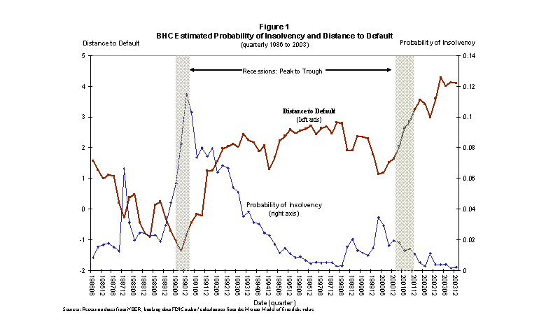

Slide 14
Business Cycles and Credit Ratings
Altman and Kao (1992); rating changes tend to exhibit serial correlation; a downgrade is more likely to be followed by a subsequent downgrade them by an upgrade
Lando and Skodeberg (2002); rating changes are not independent
Lucas and Lonski (1992); Moody’s ratings show that the number of firms downgraded has increasingly exceeded the number of firms upgraded over time, suggesting that either the quality of firms has declined over time or that rating standards have become more stringent
Blume, Lim, and Mackinlay (1998); credit ratings have on average become worse through time, conditional on a set of variables that proxy for the financial and business risk; thus credit ratings have become more stringent overtime
D’Amato and Furfine (2003); they find no evidence that S&P’s credit ratings are unduly influenced by the business cycle; however, when the sample is restricted to only investment-grade firms and to only initial ratings and rating changes, they find evidence of cyclicality.
Berger, Kyle and Scalise (2001); bank examiners were tougher during the credit crunch period (1989-1992) than during the 1993 to 1998 period.

Slide 15
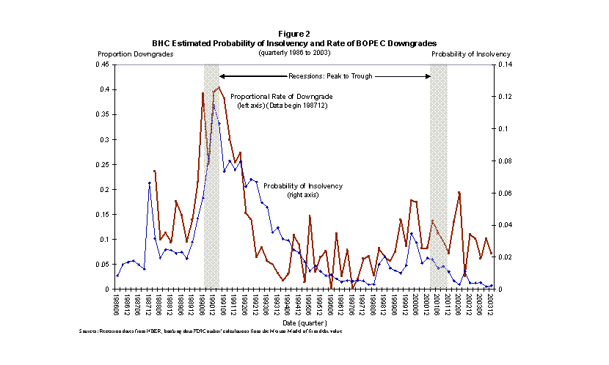

Slide 16
Hypotheses
I. BHC risk ratings are independent of business cycle movements
II. BHC risk ratings have not become more stringent since FDICIA

Slide 17
DATA and SAMPLE
Quarterly Y-9C BHC financial reports
Confidential BOPEC ratings
Center for Research on Security Prices (CRSP)
Bureau of Economic Analysis; Federal Reserve, OMB
Years: 1986-2003
786 publicly traded bank holding companies
4,104 new ratings (BOPEC)
499 downgrades;461 upgrades; 3,144 no-changes;

Slide 18
Methodology
Analysis is based on a model of a ratings determination that takes into account factors that measure financial risk of firms in addition to indicators of macro-economic conditions
Ordered logistic model

Slide 19

Methodology (Con’t)
Total Sample period modeled:
1986:Q2-2003:Q4
Four sub-periods modeled:
1986:Q2-1991:Q2 (recessionary)
1991:Q3-1995:Q4 (recovery)
1996:Q1-2000:Q3 (expansionary)
2000:Q4-2003:Q4 (recessionary)

Slide 20
Methodology (Con’t)
Use in-sample model to generate out-of-sample forecasts
NAIVE Classification Assumption:
Out-of-Sample exam ratings are based on In-Sample exam ratings.
Out-of-sample predictions vs. actual ratings to test for cyclical bias and stringency

Slide 21
Ordered Logit Model
BOPECit=α1 + α2 + β1Firm Sizeit-1
+ Σ βj (FinancialVariablesit-1)
+ Σ βj (Market Variablesit-1)
+ Σ βj (Supervisory Variablesit-1)
+ Σ βj (Macro Variablesit-1, t-3)) + eit

Slide 22
Regression Model
Probability of a BOPEC Downgrade _{t} = a1 + a2 +
Time Trend _{t} +
FINANCIAL ACCOUNTING VARIABLES
b1 (Log of total assets) _{t-1} +
b2 (Equity/total assets) _{t-1} +
b3 (Return on assets) _{t-1} +
b4(Liquidity/total assets) _{t-1} +
b5 (Total deposits>$100m) _{t-1} +
b6 (Loans past due>90/total assets) _{t-1} +
b7 (Non-accrual loans/total assets) _{t-1} +
b8(Loan loss reserves/total assets) _{t-1} +
b9(Charge-offs/total assets) _{t-1} +
b10(Loan provisions/total assets) _{t-1} +
MARKET VARIABLES
b11(Distance to default) _{t-1} +
b12 (Probability of default) _{t-1} +
b13(Market excess returns) _{t-1} +
b14(Coefficient of variation in price) _{t-1} +
b15(Market capitalization to book equity) _{t-1} +
b16(Quarterly turnover in shares) _{t-1} +

Slide 23
Regression Model (continued)
SUPERVISORY VARIABLES
b17 (Prior BOPEC1) _{t-1} +
b18 (Prior BOPEC2) _{t-1} +
b19(Prior BOPEC3) _{t-1} +
b20(Prior BOPEC4) _{t-1} +
b21(Problem bank) _{t-1} +
b22 (Inspection age) _{t-1} +
MACRO VARIABLES
b23(Treasury yield spread) _{t-3} +
b24(Corporate yield spread) _{t-1} +
b25(GDP Gap) _{t-1} + error term _{t}

Slide 24
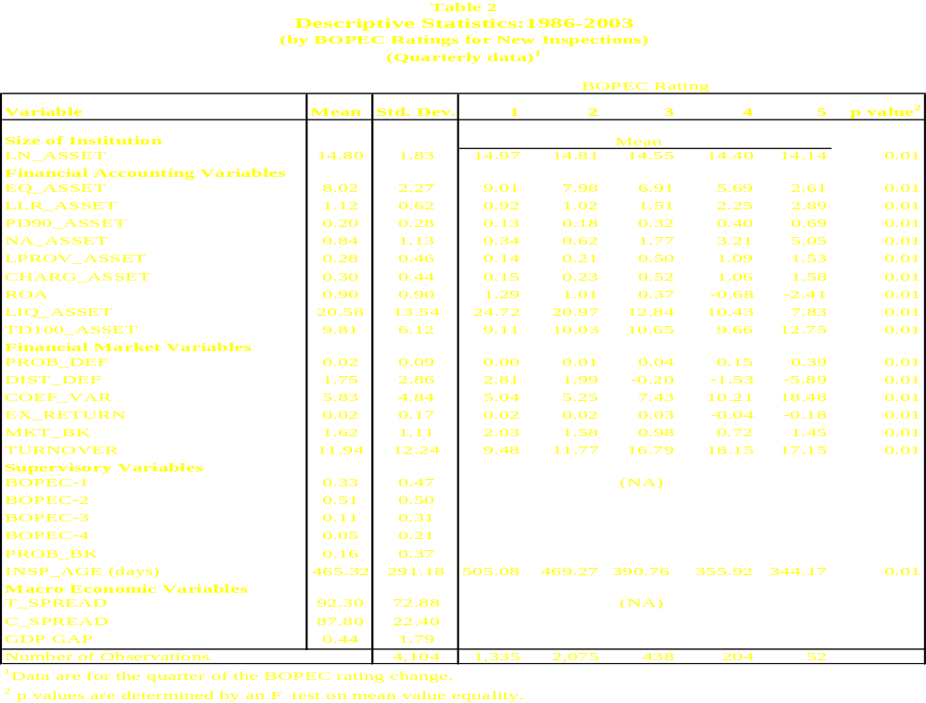

Slide 25
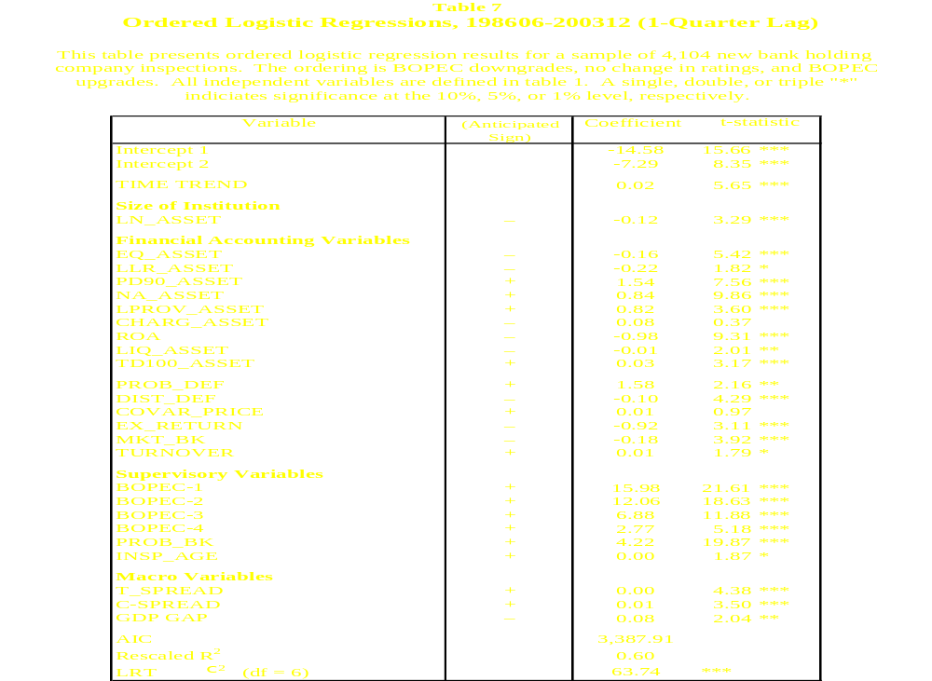

Slide 26
Table 8, Panel B
OUT-OF-SAMPLE CLASSIFICATION TESTS
How to read the classification tables:
B. Naive Panel |  |  |  | DIFFERENCES (ACTUAL - NAIVE)
In-Sample Period |  | Out-Sample Period |  | Downgrade % Difference¹ | No Change % Difference¹ | Up-grade % Difference¹
Cycle-to-Cycle Forecast
Recessionary: 198606-199106 |  | Recovery: 199109-199512 |  | expect Negative value | ? | expect Positive value
 |  |  |  | -11.84 *** | -2.55 ** | 14.40 ***
¹Binomial proportion tests are used to identify the statistical significance of the differences. *,**, and *** indicate significance at the 10, 5, and 1 percent levels, respectively.

Slide 27
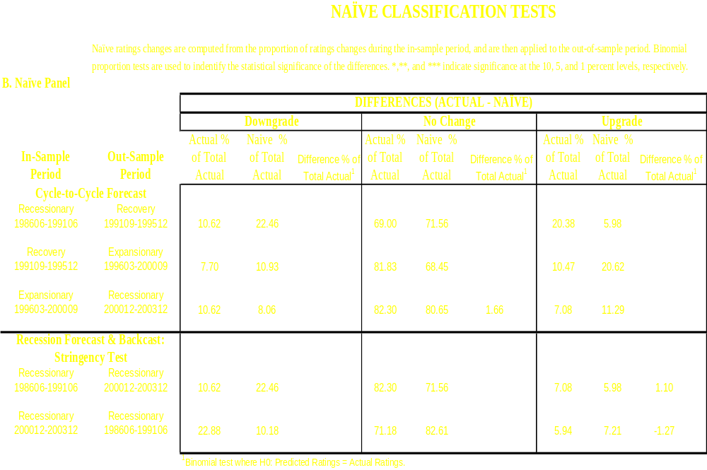

Slide 28
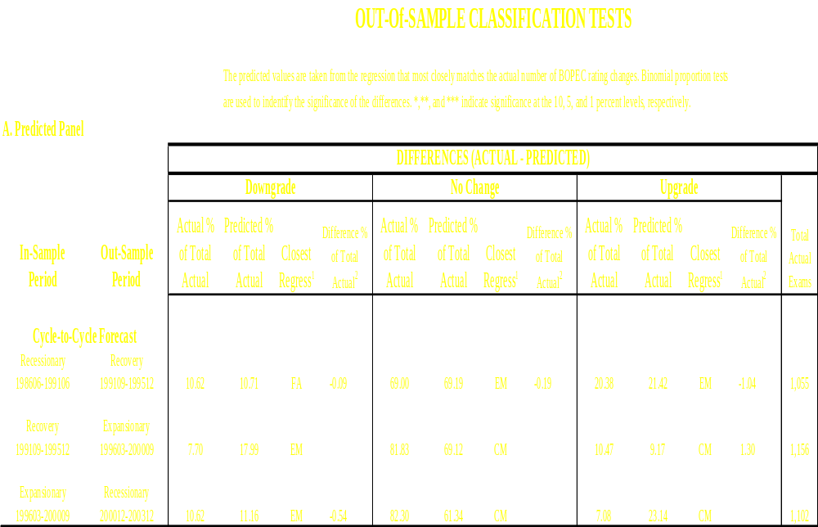
(1) FA represents the Financial Accounting regression model, EM represents the Equity Market regression model, and CM represents the Combined regression model.
(2) Binomial test where H0: Predicted Ratings = Actual Ratings.

Slide 29
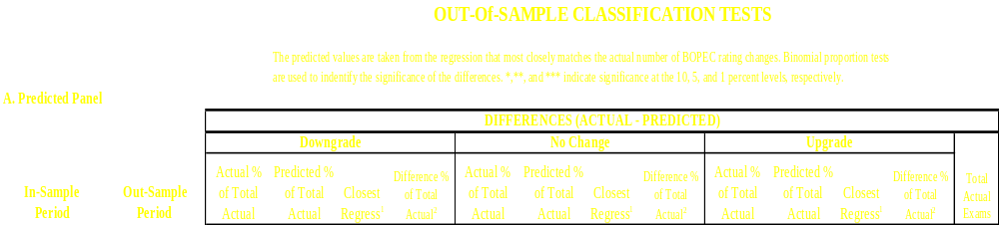
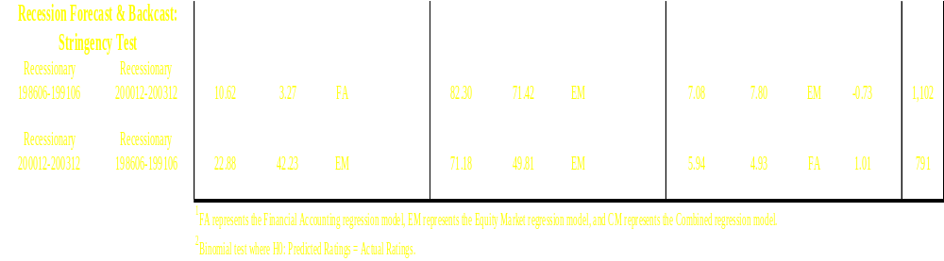

Slide 30
Conclusions
Out-of-sample results show some limited, but no systematic or widespread evidence of cyclical bias in regulator assigned BHC risk ratings during the1986-2003 period. In only two out of six cases (downgrades and upgrades) was there evidence of bias
Results show a heavy regulator inertia against changing ratings. The model consistently under predicts the number of “no changes” in ratings assigned
There is stronger evidence of a secular trend (ratings drift) in examination standards becoming more stringent over the period of the study

