Slide 1

HelpfulMED: Creating a Knowledge Portal for Medicine
NSF DLI-2 All-Project Meeting
Stratford-upon-Avon, UK, June 12-13, 2000
Hsinchun Chen, Ph.D.
McClelland Professor of MIS
Director, Artificial Intelligence Lab
University of Arizona
Member, Arizona Cancer Center
Senior Research Scientist, NCSA
Acknowledgments:
NSF, NLM, NCI, NCSA
(DLI-2 Project: “High-Performance Digital Library Classification Systems: From Information Retrieval to Knowledge Management”)

Slide 2


The Medical Information Gap
Heterogeneous
Medical
Literature Databases
and the Internet
Medical
Professionals
& Users
TOXLINE
CancerLit
EMIC
MEDLINE
Current Information
Interfaces
Hazardous
Substances
Databank

Slide 3
Research Questions
How can linguistic parsing and statistical analysis techniques help extract medical terminology and the relationships between terms?
How can medical and general ontologies help improve extraction of medical terminology?
How can linguistic parsing, statistical analysis, and ontologies be incorporated in customizable retrieval interfaces?

Slide 4
Previous Work:
Linguistic Parsing and
Statistical Analysis

Slide 5
Benefits of Natural Language Processing
Noun compounds are widely used across sub-language domains to describe concepts concisely
Unlike keyword searching, contextual information is available
Relationship between a noun compound and the head noun is a strict conceptual specification.
  “breast” and “cancer” vs. “breast cancer”
  “treatment” and “cancer” vs. “treatment of cancer”
Proper nouns can be captured
(Anick and Vaithyanathan, 1997)

Slide 6
Natural Language Processing: Noun Phrasing
Appropriate level of analysis: Extraction of grammatically correct noun phrases from free text
Used in other domains, noun phrasing has been shown to improve the accuracy of information retrieval (Girardi, 1993; Devanbu et al., 1991; Doszkocs, 1983)
Cooper and Miller (‘98) used noun phrasing to map user queries to MeSH with good results

Slide 7
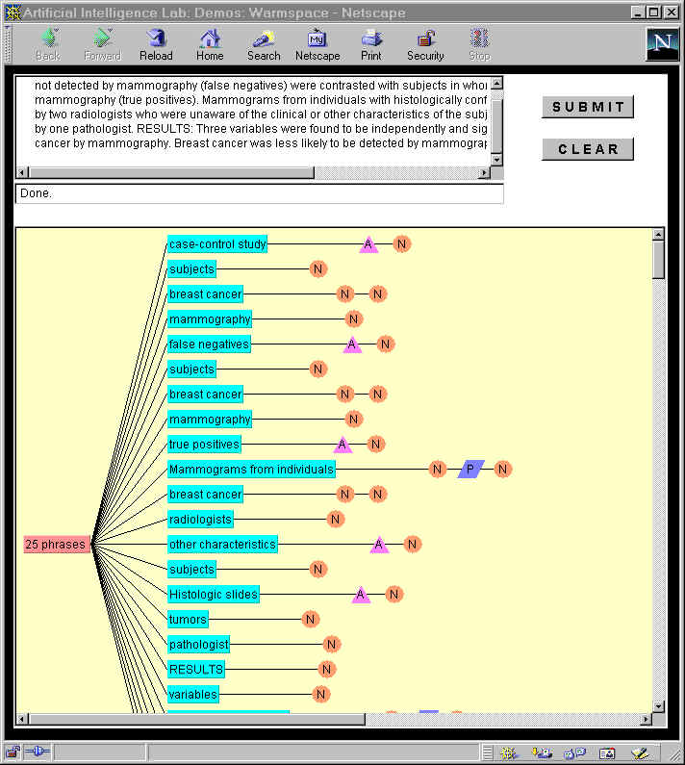
Arizona Noun Phraser
NSF Digital Library Initiative I & II Research
Developed to improve document representation and to allow users to enter queries in natural language

Slide 8
Arizona Noun Phraser: Three Modules
Tokenizer
  Takes raw text and generates word tokens (conforms to UPenn Treebank word tokenization rules)
  Separates punctuation and symbols from text without affecting content
Part of Speech (POS) Tagger
  Based on the Brill Tagger
  Two-pass parser, assigns parts of speech to each word
  Uses both lexical and contextual disambiguation in POS assignment
  Lexicons: Brown Corpus, Wall Street Journal, Specialist Lexicon
Phrase Generation
  Simple Finite State Automata (FSA) of noun phrasing rules
  Breaks sentences and clauses into grammatically correct noun phrases

Slide 9
Arizona Noun Phraser
Results of Testing (Tolle & Chen, 1999)
The Arizona Noun Phraser is better than or comparable to other techniques (MIT’s Chopper and LingSoft’s NPtool)
Improvement with Specialist Lexicon
The addition of the Specialist Lexicon to the other non-medical lexicons slightly improved the Arizona Noun Phraser’s ability to properly identify medical terminology

Slide 10
Creating Knowledge Sources: Concept Space (Automatic Thesaurus)
Statistical Analysis Techniques:
  Based on document term co-occurrence analysis, weights between concepts establish the strength of the association
  Four steps: Document Analysis, Concept Extraction, Phrase Analysis , Co-occurrence Analysis
Systems:
  Bio-Sciences: Worm Community System (5K, Biosys Collection, 1995), FlyBase experiment (10K, 1994)
  DLI: INSPEC collection for Computer Science & Engineering (1M, 1998)
  Medicine: Toxline Collection (1M, 1996), National Cancer Institute’s CancerLit Collection (1M, 1998) and National Library of Medicine’s Medline Collection (10M, 2000)
  Other: Geographical Information Systems, Law Enforcement
Results:
  Alleviate cognitive overload, improve search recall

Slide 11
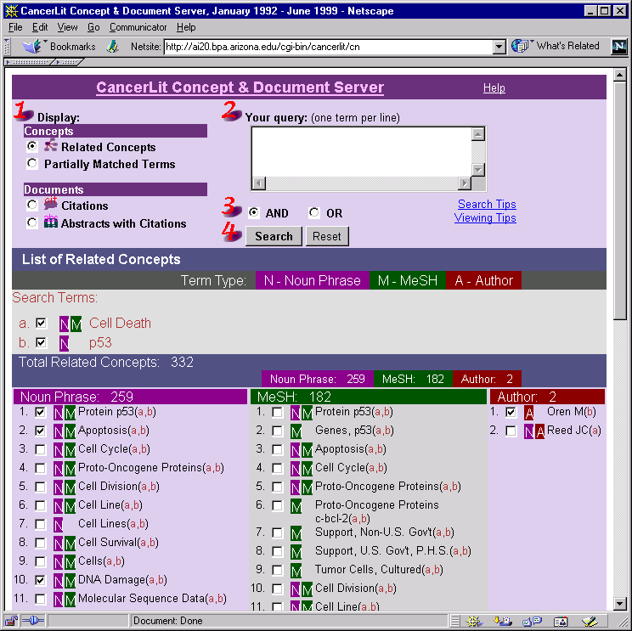
Supercomputing to Generate Largest Cancer Thesaurus
The computation generated Cancer Space, which consists of 1.3M cancer terms and 52.6M cancer relationships.
The approach: Object-Oriented Hierarchical Automatic Yellowpage (OOHAY) -- the reverse of YAHOO!
Prototype system available for web access at: ai20.bpa.arizona.edu/cgi-bin/cancerlit/cn
Experiments for 10M Medline abstracts and 50M Web pages under way

Slide 12
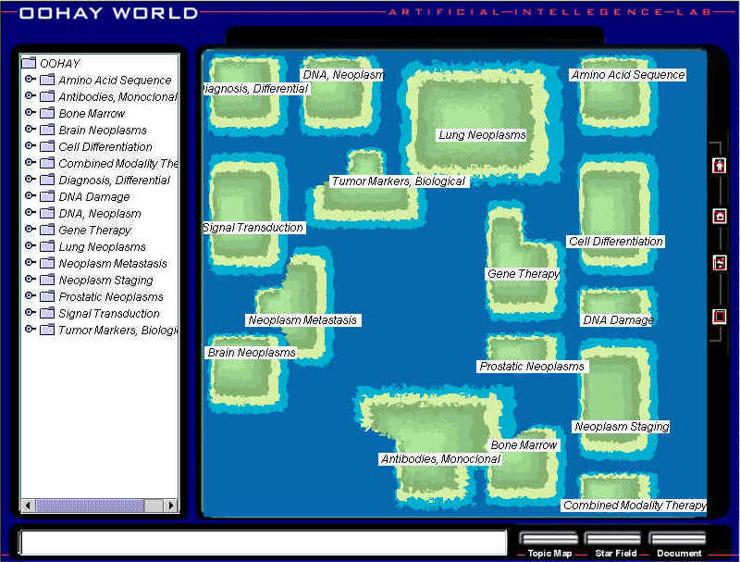
“NCSA capability computing helps generate largest cyber map for cancer fighters…”
High-Performance Computing for Cyber Mapping
The Arizona team, used NCSA’s 128-processor Origin2000 for over 20,000 CPU-hours.
Cancer Map used 1M CancerLit abstracts to generate 21,000 cancer topics in a 5-layer hierarchy of 1,180 cancer maps.
The research is part of the Arizona OOHAY project funded by NSF Digital Library Initiative 2 program.
Techniques: computational linguistics and neural network text mining

Slide 13
Medical Concept Mapping:
Incorporating Ontologies (WordNet and UMLS)

Slide 14
Incorporating Knowledge Sources: WordNet Ontology
Princeton, George A. Miller (psychology dept.)
95,600 different word forms, 57,000 nouns
grouped in synsets, uses word senses
used to extract textual contexts (Stairmand, 1997), text retrieval (Voorhees, 1998), information filtering (Mock & Vermuri, 1997)
available online: http://www.cogsci.princeton.edu/~wn/

Slide 15
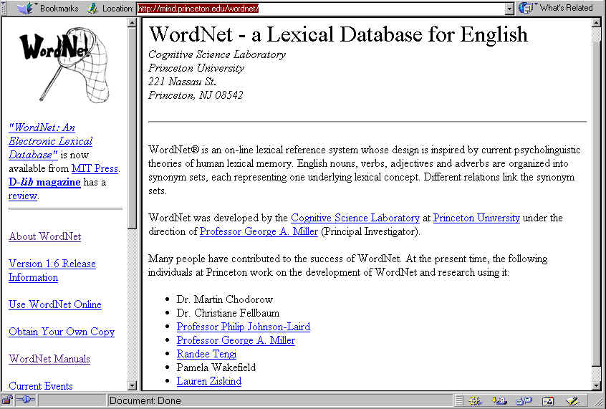
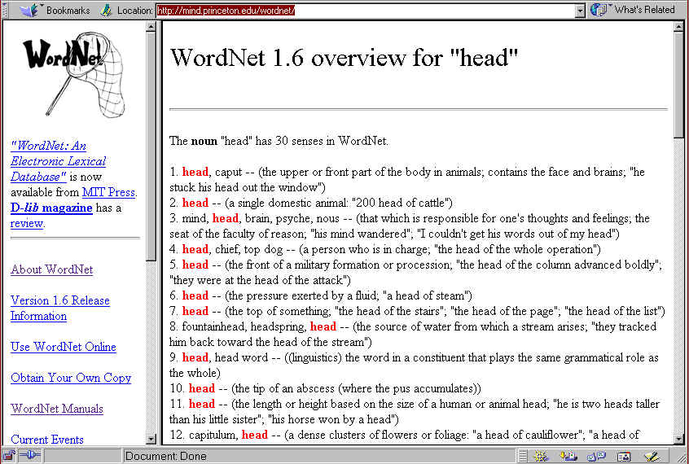
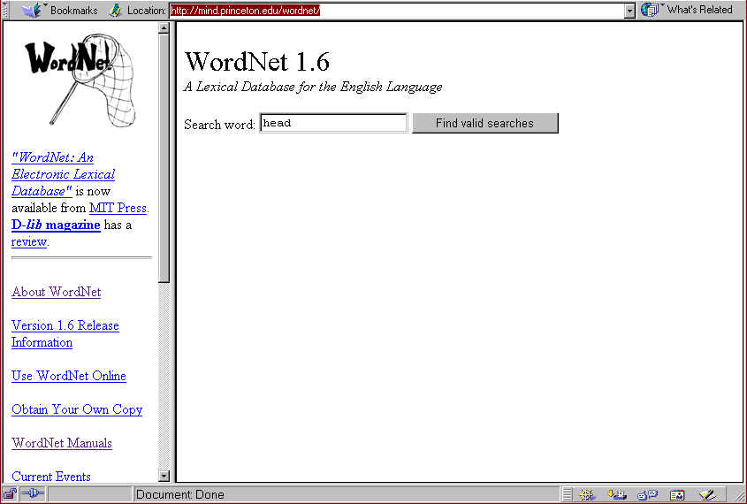
Noun: 30 senses
Verb: 6 senses
Adjective: 2 senses

Slide 16
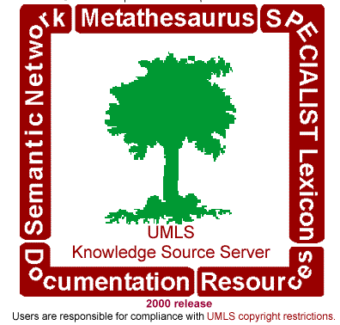
Incorporating Knowledge Sources: UMLS Ontology
Unified Medical Language System (UMLS) by the National Library of Medicine (Alexa McCray)
1986 - 1988: defining the user needs and the different components
1989-1991: development of the different components: Metathesaurus, Semantic Net, Specialist Lexicon
1992 - present: updating & expanding the components, development of applications
available online: http://umlsks.nlm.nih.gov/

Slide 17
UMLS Metathesaurus (2000 edition)
730,000 concepts, 1.5 M concept names
60+ vocabulary sources integrated
15 different languages
organization by concept, for each concept there are different string representations

Slide 18
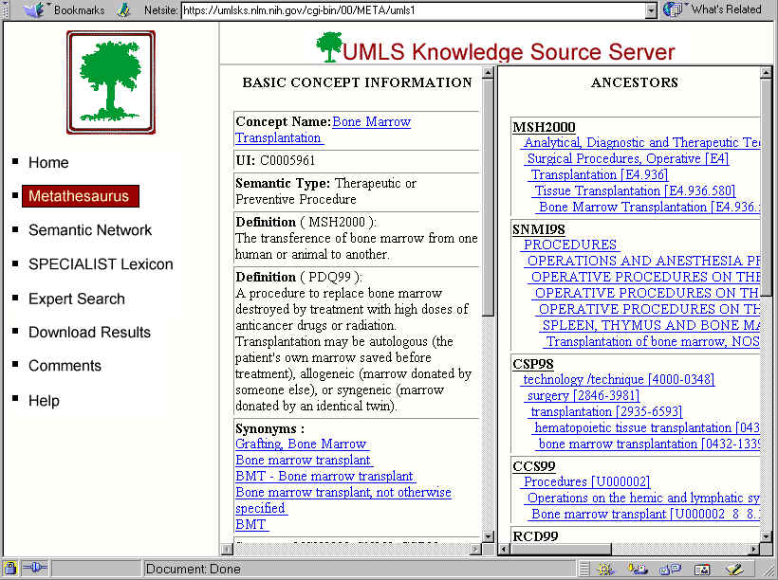
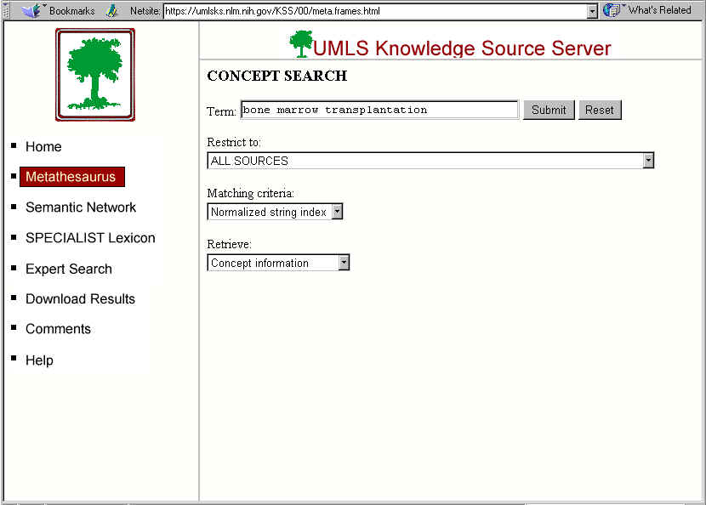
UMLS Metathesaurus (2000 edition)

Slide 19
UMLS Semantic Net (2000 edition)
134 semantic types and 54 semantic relations
metathesaurus concepts → semantic net
relations between types, not between concepts
Semantic Type:
Pharmacologic Substance
(105,784 concepts)
Semantic Type:
Sign or Symptom
(4,364 concepts)
treats
is a
is a
- aspirin
- heroin
- diuretics
- …….
- aphasia
- aspirin allergy
- headache
- …….
treats
treats ?

Slide 20
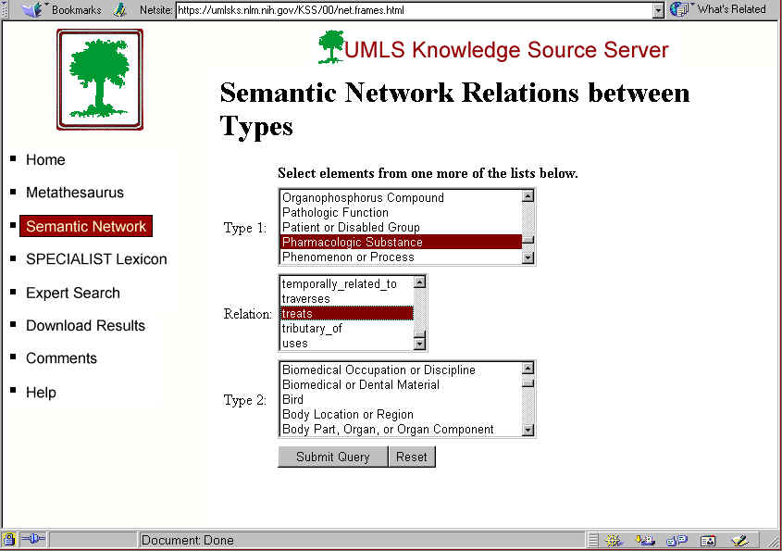
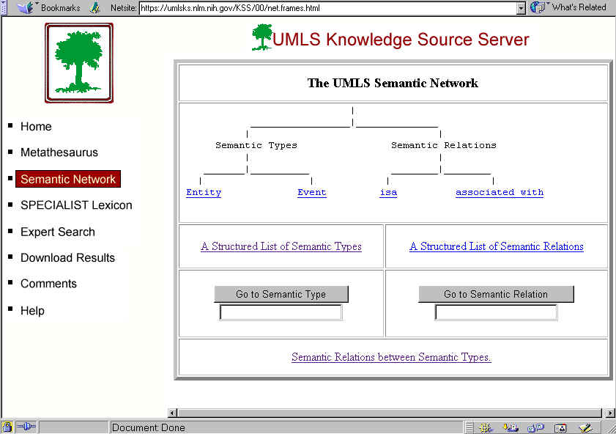
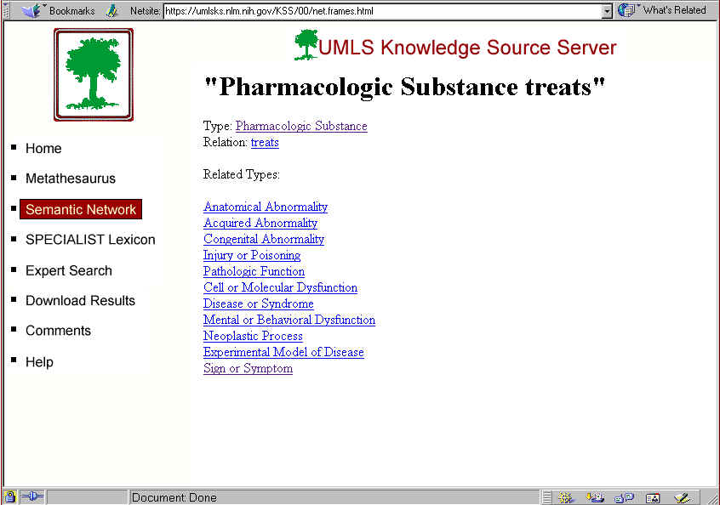
UMLS Semantic Net (2000 edition)

Slide 21
UMLS Specialist Lexicon (2000 edition)
A general English lexicon that includes many biomedical terms
130,000+ entries
each entry contains syntactic, morphological and orthographic information
no different entries for homonyms

Slide 22
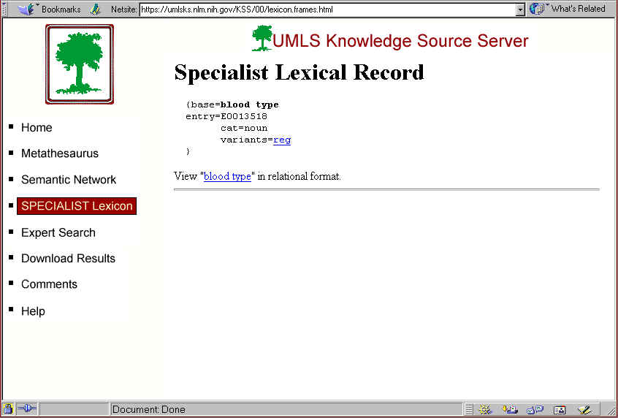
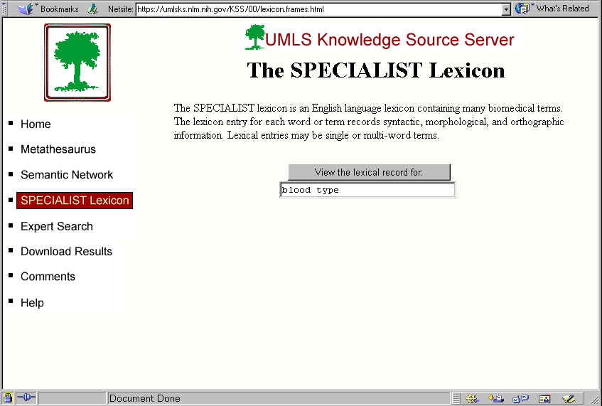
UMLS Specialist Lexicon (2000 edition)

Slide 23
Ontology-Enhanced Concept Mapping:
Design and Components
Input Query
Y
Natural Language
Natural Language Component
N
Query Terms
Noun Phrases
AZ Noun Phraser
Specialist
Lexicon
Y
Use WordNet
Synonyms provided by WordNet and UMLS Metathesaurus
N
Term Set
Synonyms
WordNet
Y
Use MetaThesaurus
N
Term Set
Synonyms
MetaThesaurus
Related Concepts provided by Concept Space and limited with Deep Semantic Parsing (based on UMLS Semantic Net)
Y
Concept
Space
Use Concept Space
N
Unlimited Concepts
N
Use SemNet
Y
Term Set
Limited Concepts
DSP
Semantic
Net

Slide 24
Synonyms
WordNet
  Return synonyms if there is only one word sense for the term
  E.g. “cancer” has 4 different senses, one of them is:
    Cancer, Cancer the Crab, fourth sign of the Zodiac
UMLS Methathesaurus
  find the underlying concept of a term and retrieve all synonyms belonging to this concept
  E.g. term = tumor ⇒ concept = neoplasm
    synonyms:
      Neoplasm of unspecified nature NOS | tumor <1> | Unspecified neoplasms | New growth | [M]Neoplasms NOS | Neoplasia | Tumour | Neoplastic growth | NG - Neoplastic growth | NG - New growth | 800 NEOPLASMS, NOS |
    filtering of the synonyms (personalizable for each user): filter out the terms
      tumor <1> | [M]Neoplasms NOS | NG - Neoplastic growth | NG - New growth | 800 NEOPLASMS, NOS |

Slide 25
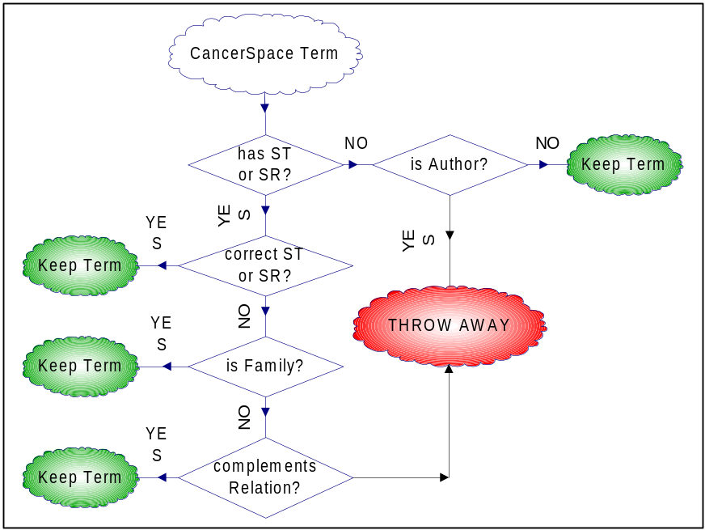
Related Concepts
Retrieve related concepts for all search terms from Concept Space
Limit related concepts based on Deep Semantic Parsing
  (by means of the UMLS Semantic Net)
Deep Semantic Parsing - Algorithm
Step 1: establish the semantic context for each original query (find the semantic types and relations of the search terms)
Step 2: for each related concept, find if it fits the established context
Step 3: reorder the final list based on the weights of the terms (relevance weights from CancerSpace)
Step 4: select the best terms (highest weights) from the reordered list

Slide 26
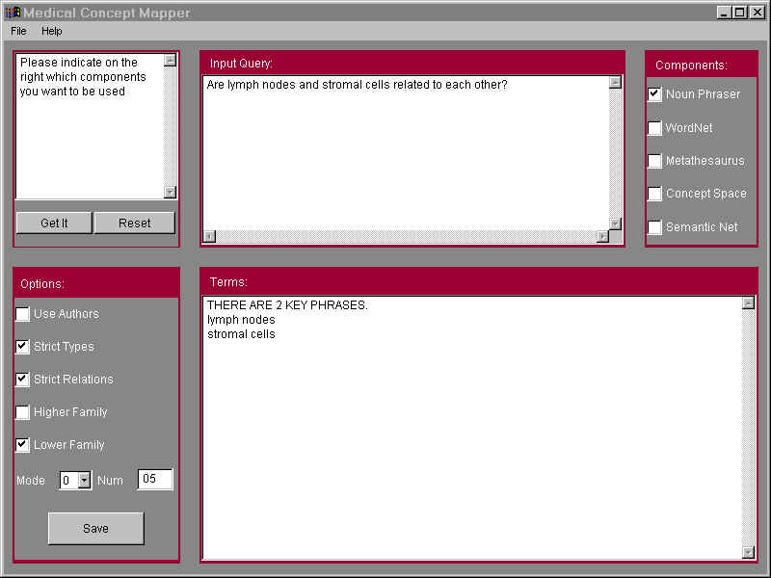
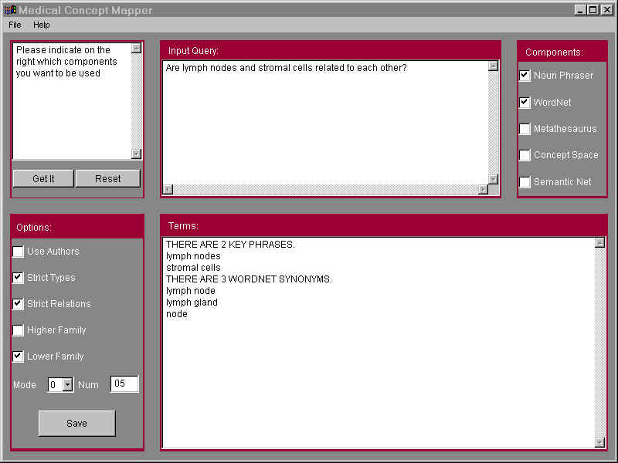
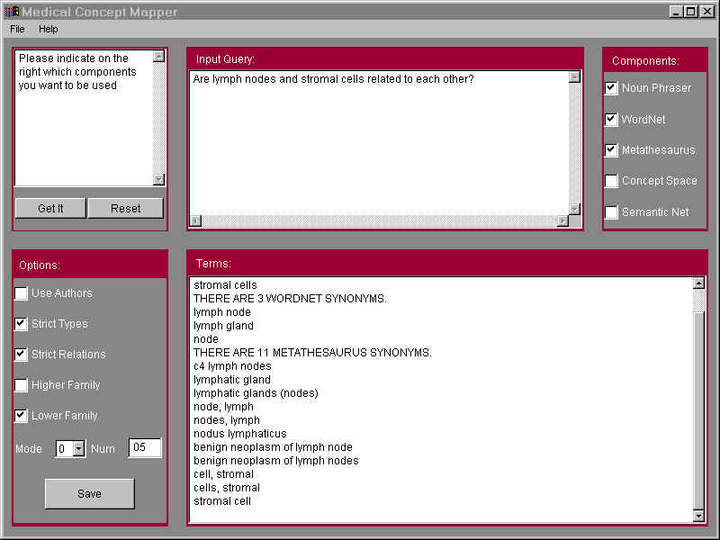
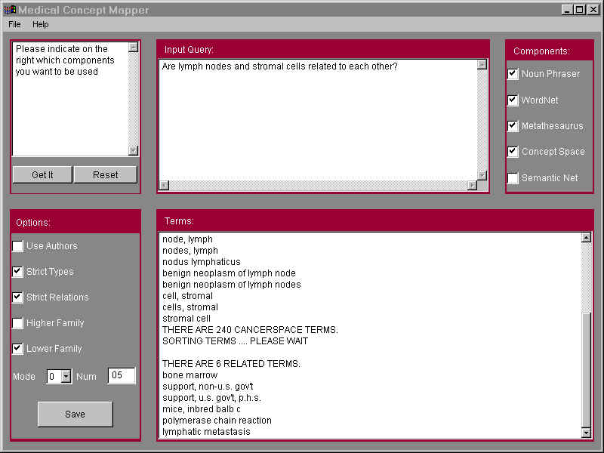
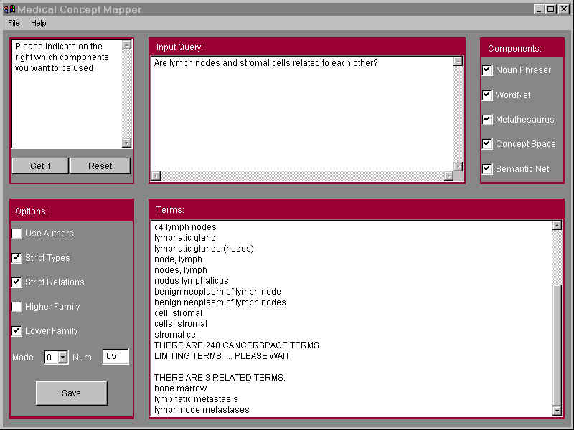
Are lymph nodes and stromal cells related to each other?
Concept Space Terms
(unfiltered):
bone marrow
support, non-U.S. gov’t
support, U.S. gov’t
mice, inbred balb c
polymerase chain reaction
lymphatic metastasis
Natural Language Query
Metathesaurus Synonyms:
c4 lymph node
lymphatic gland
...
stromal cell
Concept Space Terms
(filtered by Semantic Net):
bone marrow
lymphatic metastasis
lymph node metastases
WordNet Synonyms:
lymph node
lymph gland
node
Extracted terms:
lymph nodes
stromal cells

Slide 27
Medical Concept Mapping:
User Validation

Slide 28
User Studies
Study 1: Incorporating Synonyms
Study 2: Incorporating Related Concepts
Input:
  30 actual cancer related user-queries
Input Method:
  Original Queries
  Cleaned Queries
  Term Input
Golden Standards:
  by Medical Librarians
  by Cancer Researchers
Recall and Precision:
  based on the Golden Standards

Slide 29
Example of a Query
Original Query: “What causes fibroids and what would cause them to enlarge rapidly (patient asked Dr. B and she didn’t know)”
Cleaned Query: “What causes fibroids and what would cause them to enlarge rapidly?”
Term input: “fibroids”

Slide 30
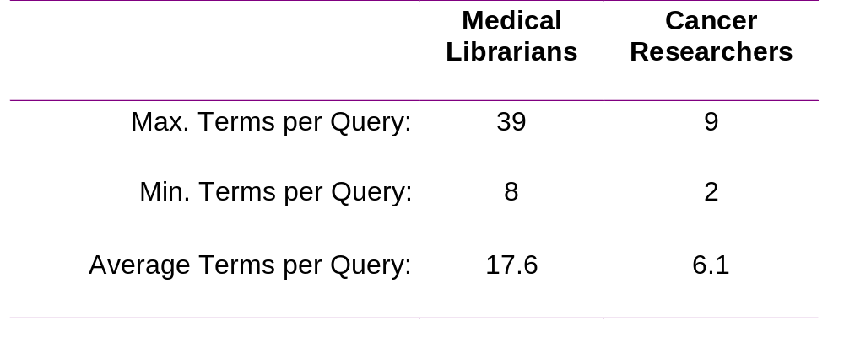
Golden Standards

Slide 31
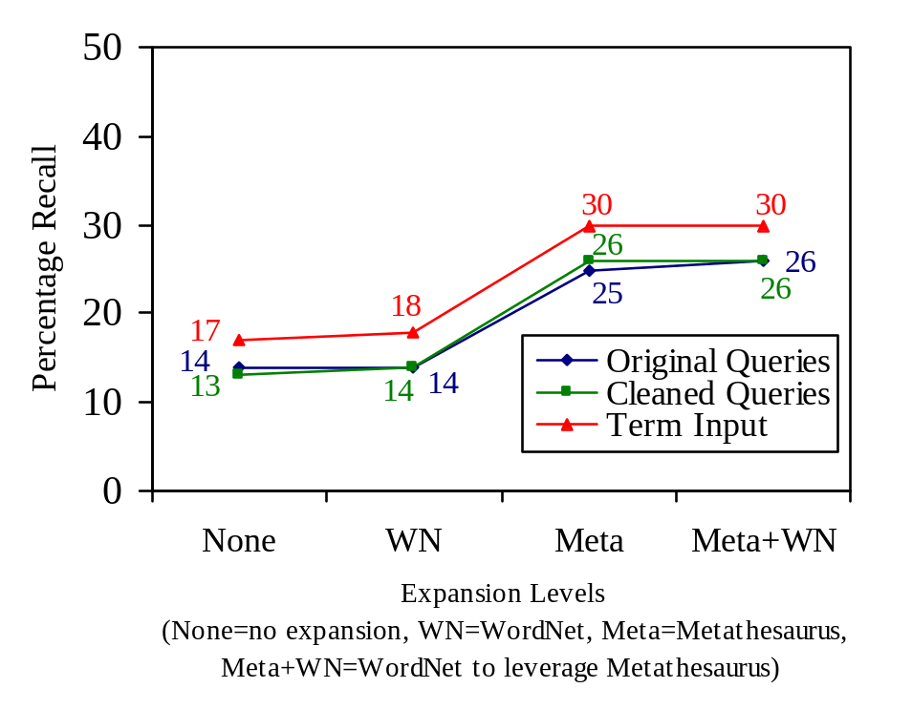
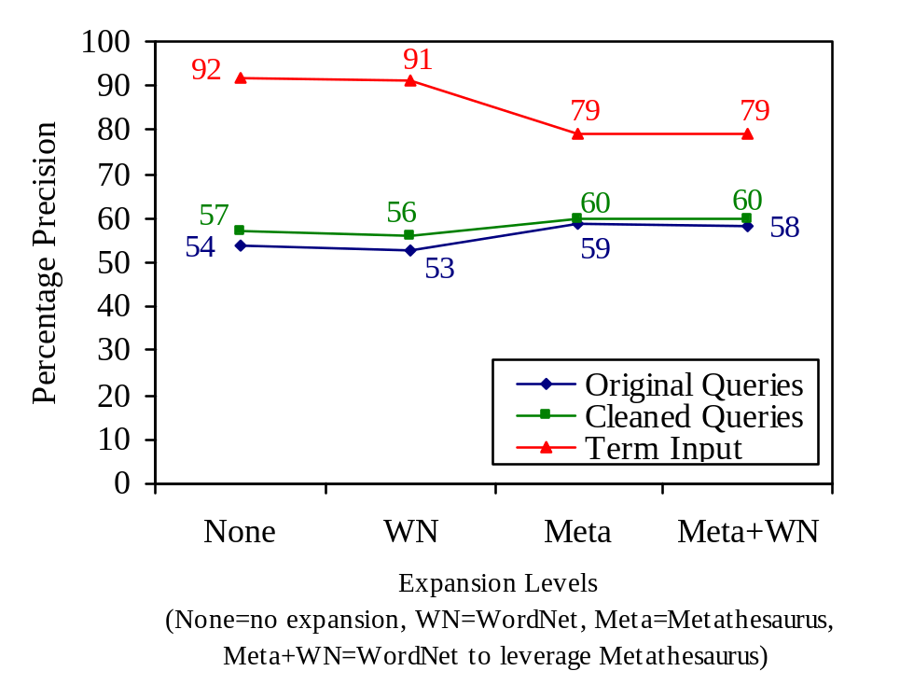
User Study 1: Medical Librarians - Synonyms
Recall
Precision
Adding Metathesaurus synonyms doubled Recall without sacrificing Precision.
WordNet had no influence.

Slide 32
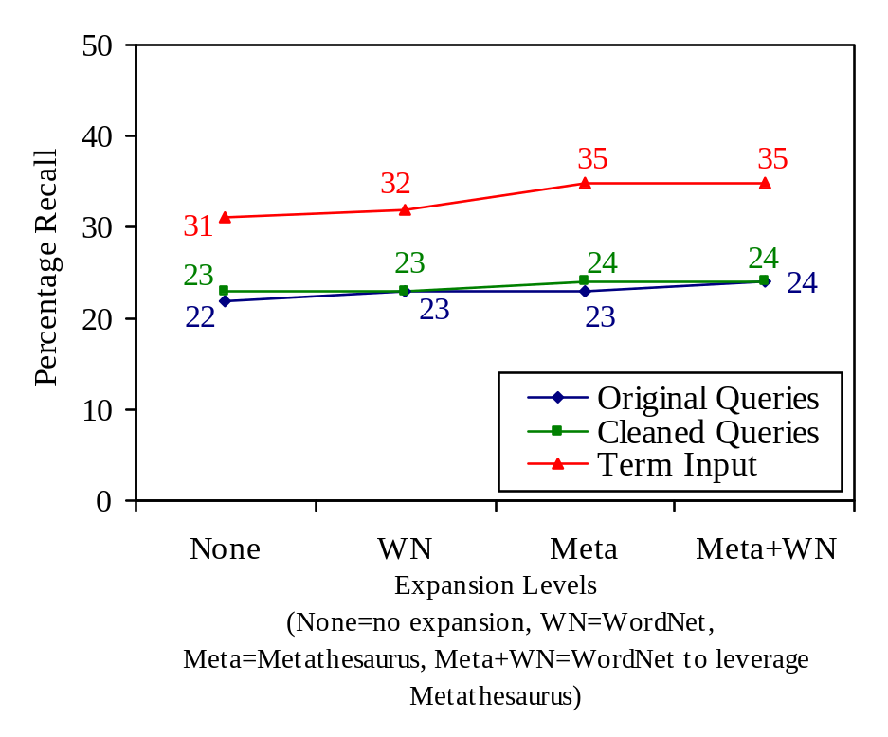
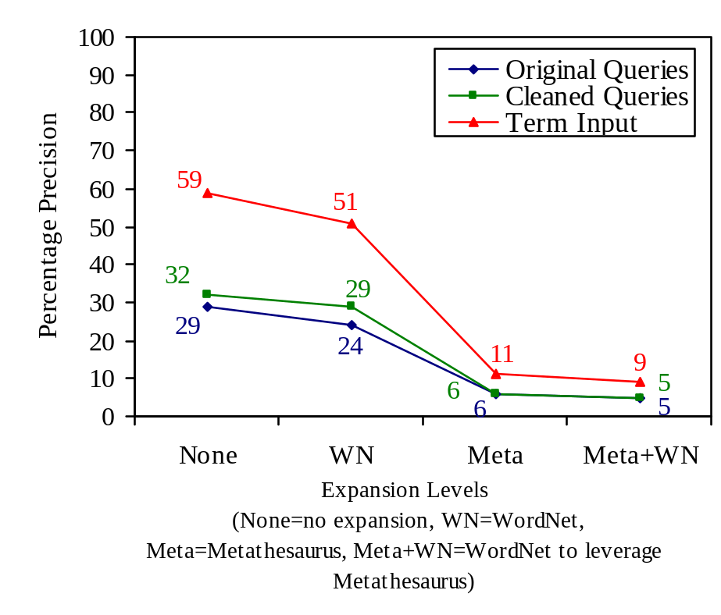
User Study 1: Cancer Researchers - Synonyms
Recall
Precision
Adding Synonyms did not improve Recall, but it lowered Precision.

Slide 33
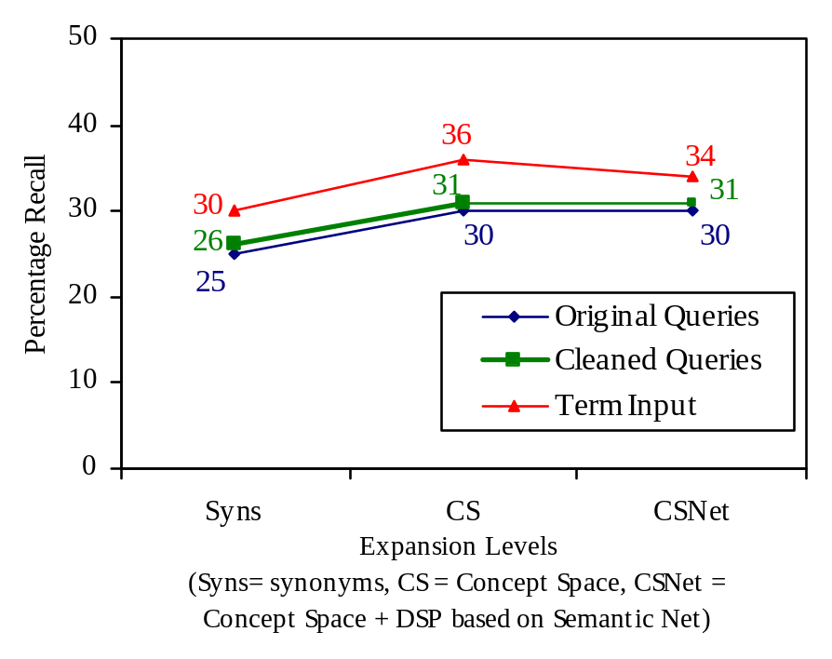
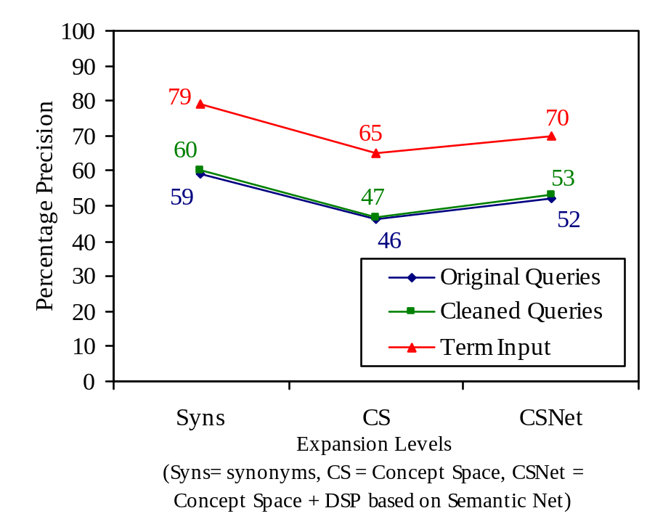
User Study 2: Medical Librarians - Related Concepts
Recall
Precision
Adding Concept Space terms increased Recall.
Precision did not suffer when Semantic Net was used for filtering.

Slide 34
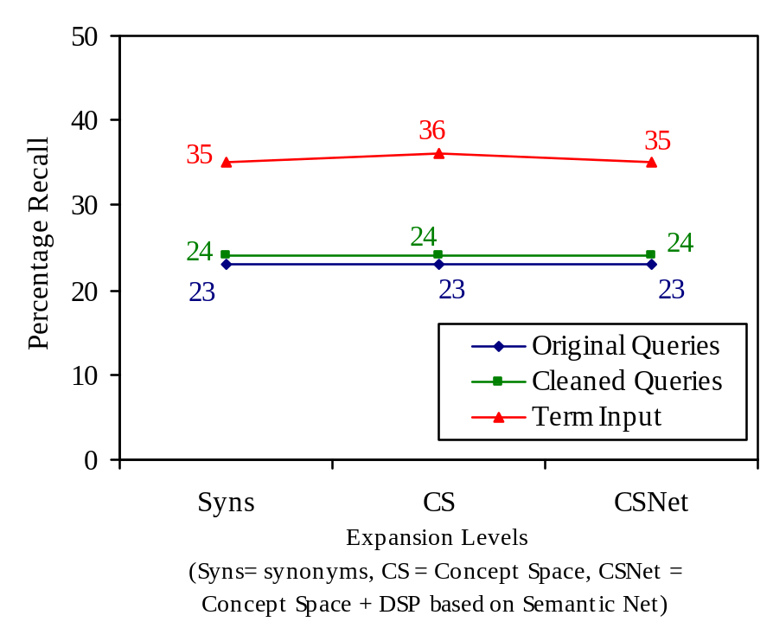
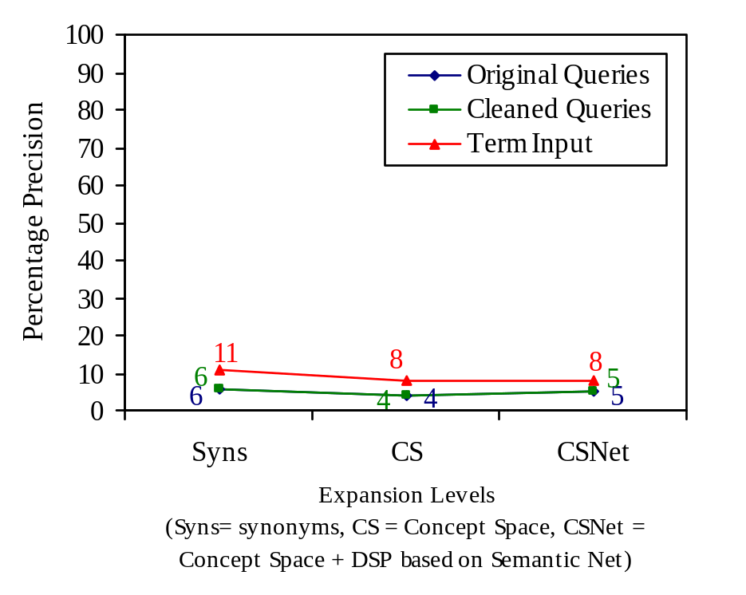
User Study 2: Cancer Researchers - Related Concepts
Recall
Precision
Adding Concept Space had no effect on Recall or Precision.

Slide 35
Conclusions of the User Studies
There was no difference in performance for Original and Cleaned Natural Language Queries
Medical Librarians:
  provided large Golden Standards
  14% of the terms could be extracted from the query
  adding synonyms and related concepts doubled recall, without affecting precision
Cancer Researchers:
  provided very small Golden Standards
  22% of the terms could be extracted from the query
  adding other terms did not increase recall, but lowered precision

Slide 36
System Developments:
HelpfulMED

Slide 37
HelpfulMED on the Web
Target users: Medical librarians, medical professionals, advanced patients
One Site, One World
Medical information is abundant on the Internet
No Web-based service currently allows users to search all high-quality medical information sources from one site

Slide 38
HelpfulMED Functionalities
Search among high-quality medical webpages, updated monthly (350K, to be expanded to 1-2M webpages)
Search all major evidence-based medicine databases simultaneously
Use Cancer Space (thesaurus) to find more appropriate search terms (1.3M terms)
Use Cancer Map to browse categories of cancer journal literature (21K topics)

Slide 39
Medical Webpages
Spider technology navigates WWW and collects URLs monthly
UMLS filter and Noun Phraser technologies ensure quality of medical content
Web pages meeting threshold level of medical phrase content are collected and stored in database
Index of medical phrases enables efficient search of collection
Search engine permits Boolean queries and emphasizes exact phrase matching

Slide 40
Evidence-based Medicine Databases
5 databases (to be expanded to 12) including:
  full-text textbook (Merck Manual of Diagnosis and Therapy)
  guidelines and protocols for clinical diagnosis and practice (National Guidelines Clearinghouse, NCI’s PDQ database)
  abstracts to journal literature (CancerLit database, Americal College of Physicians’ journals)
Useful for medical professionals and advanced consumers of medical information

Slide 41
HelpfulMED Cancer Space
Suggests highly related noun phrases, author names, and NLM Medical Subject Headings
Phrases automatically transferred to “Search Medical Webpages” for retrieval of relevant documents
Contains 1.3 M unique terms, 52.6 M relationships
Document database includes 830,634 CancerLit abstracts

Slide 42
HelpfulMED Cancer Map
Multi-layered graphical display of important cancer concepts supports browsing of cancer literature
Document server retrieves relevant documents
Presents 21,000 topics of documents in 1180 maps organized in 5 layers

Slide 43
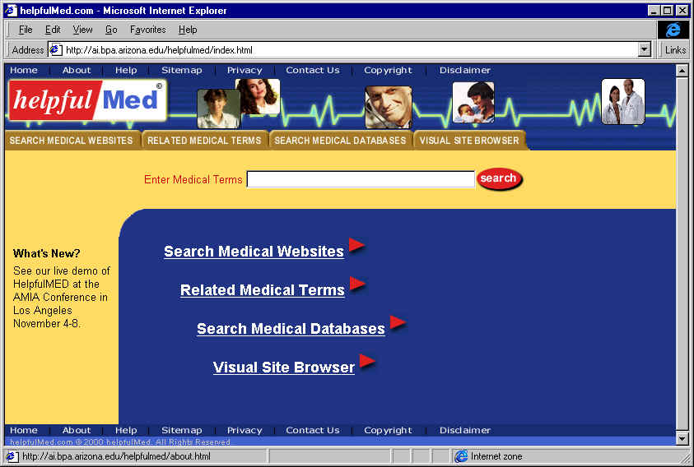
HelpfulMED Web site
http://ai.bpa.arizona.edu/HelpfulMED

Slide 44
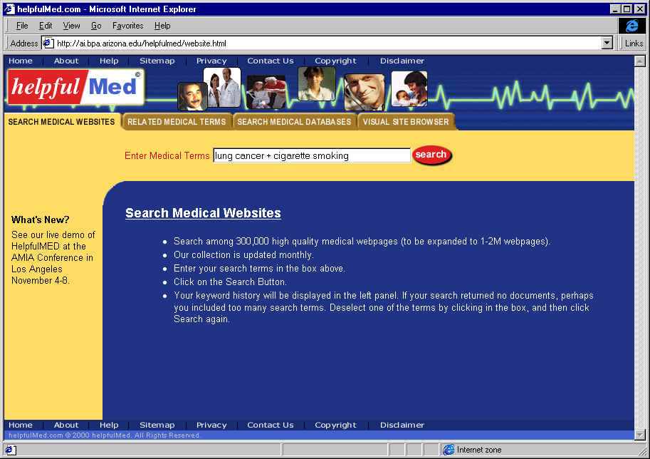
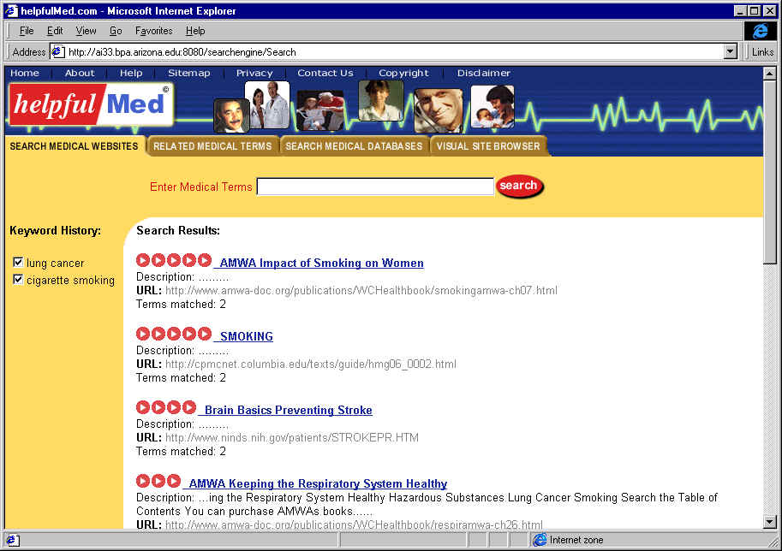
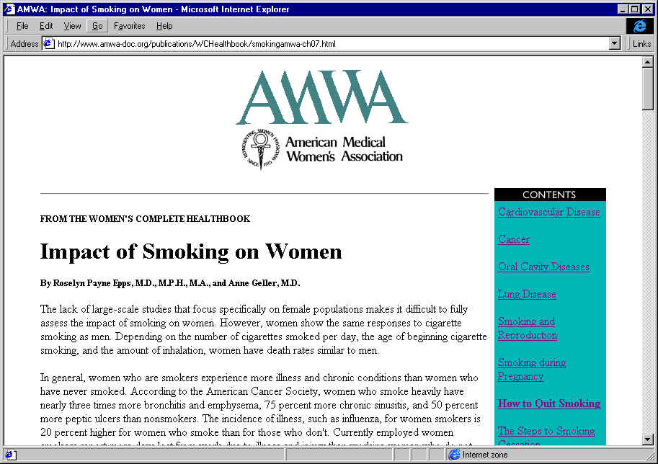
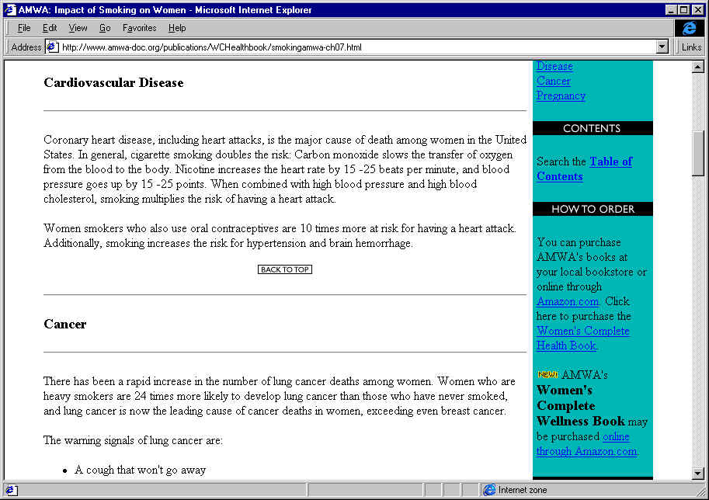
HelpfulMED Search of Medical Websites

Slide 45
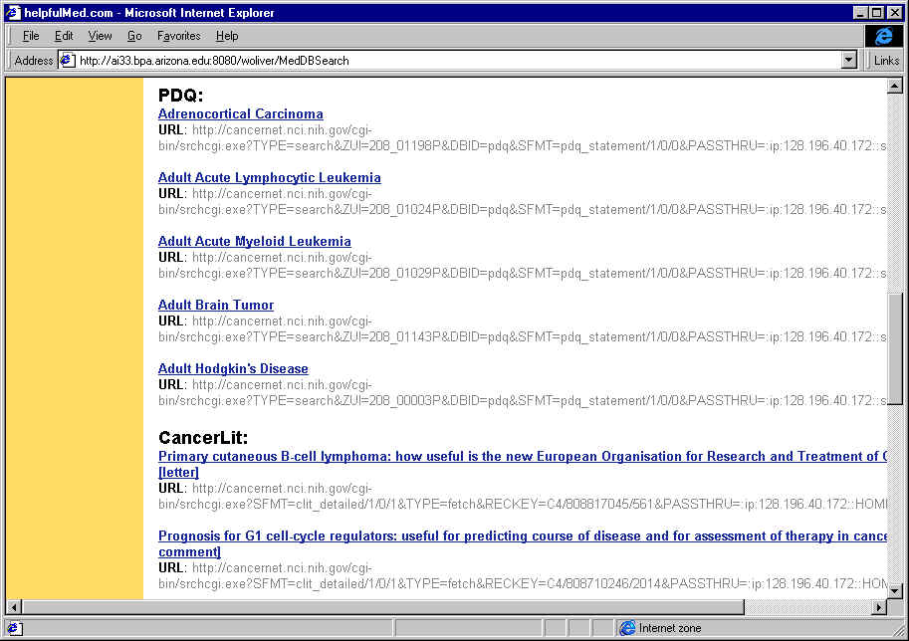
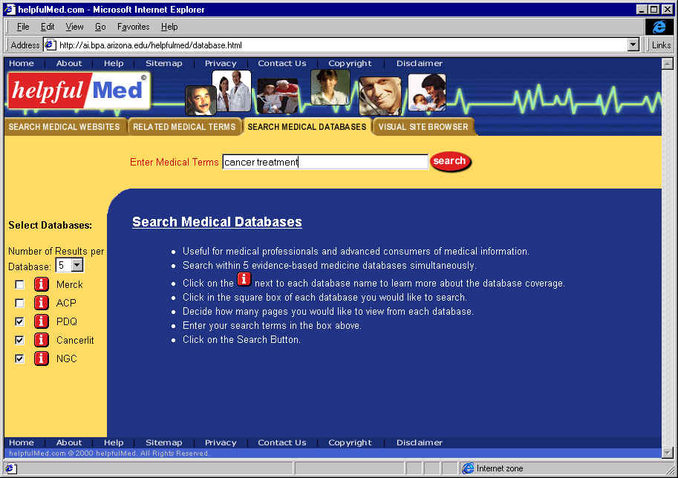
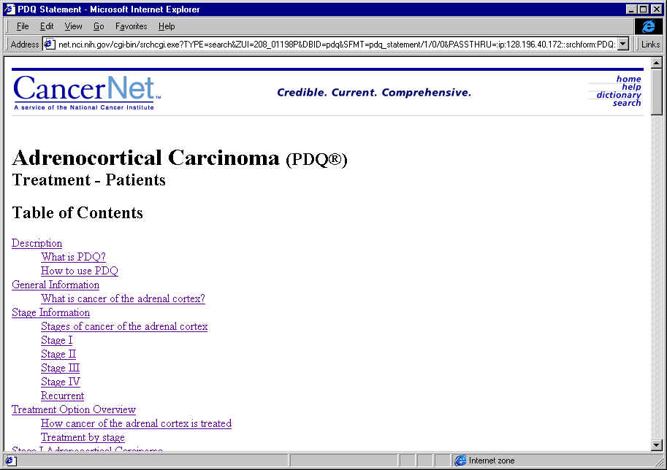
HelpfulMED search of Evidence-based Databases
What does database cover?
Search which databases?
How many documents?
Enter search term

Slide 46
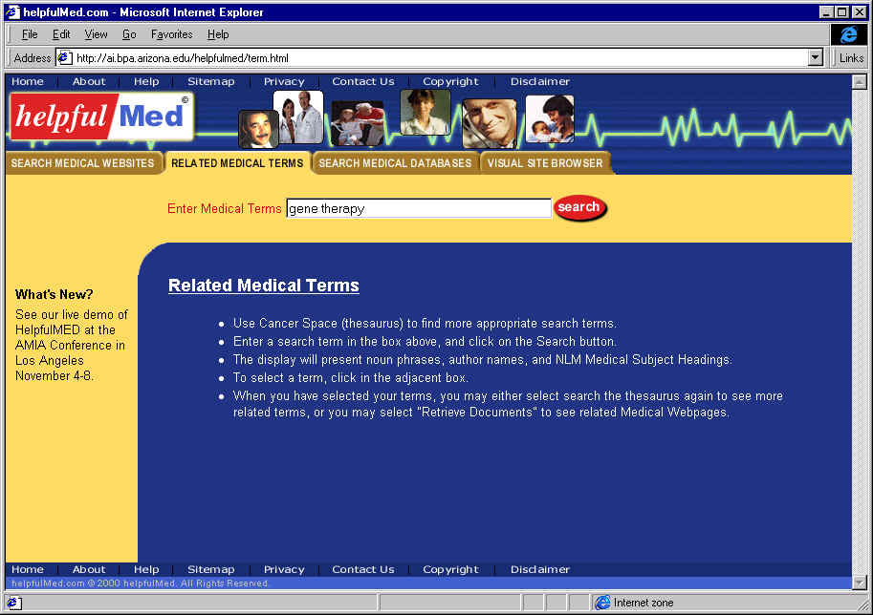
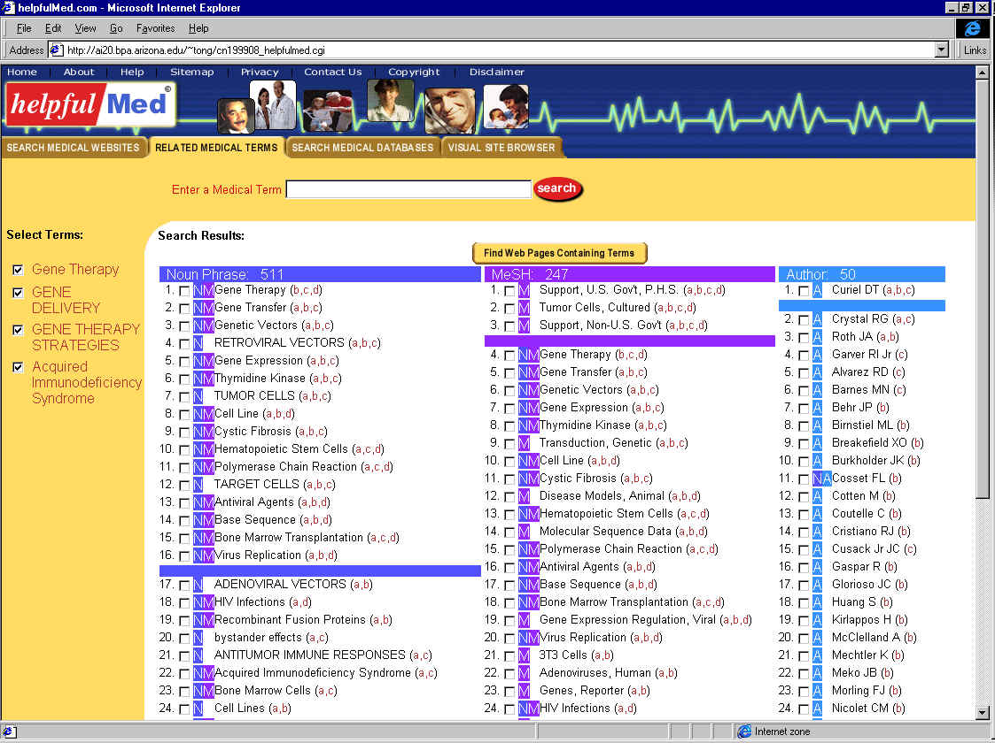
Consulting HelpfulMED Cancer Space (Thesaurus)
Enter search term
Select relevant search terms
New terms are posted
Search again...
Or find relevant webpages

Slide 47
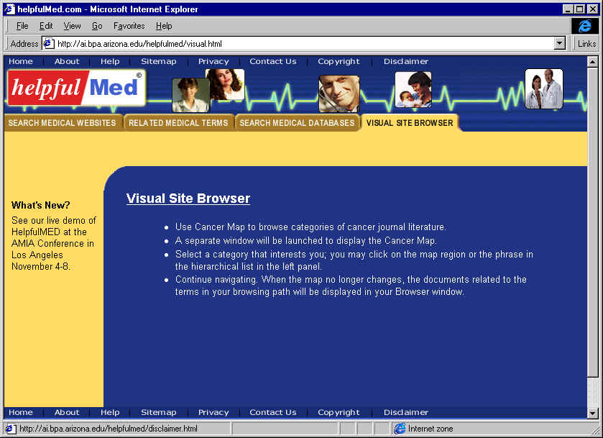
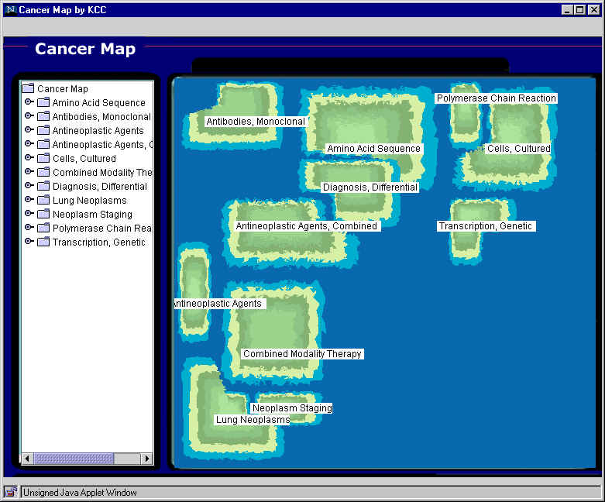
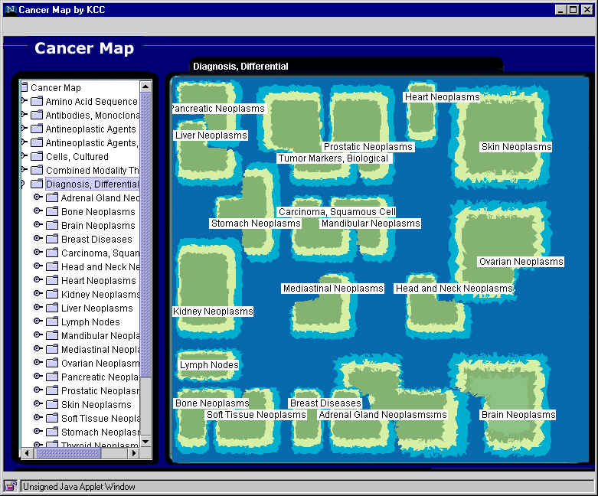
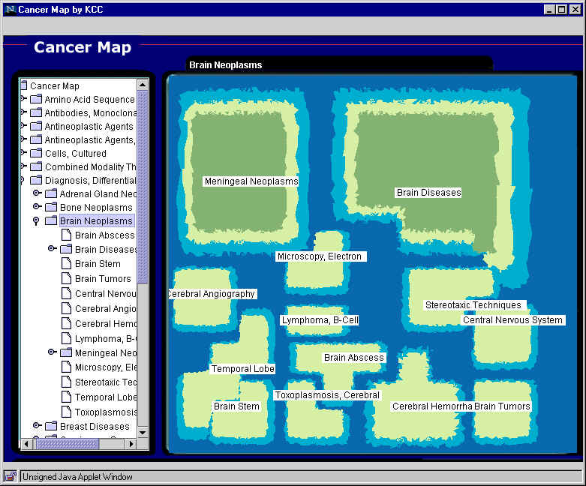
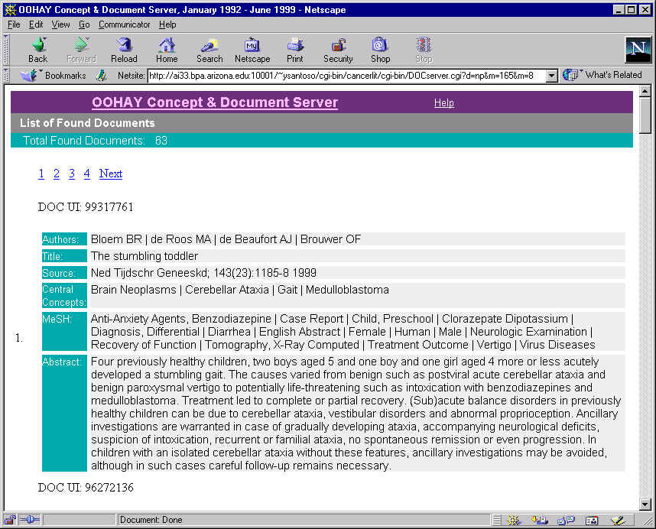
Browsing HelpfulMED Cancer Map
1
Visual Site Browser
2
Top level map
3
Diagnosis, Differential
4
Brain Neoplasms
5
Brain Tumors

Slide 48

For Project Information:
http://ai.bpa.arizona.edu
(hchen@bpa.arizona.edu)
For HelpfulMED Demos:
http://ai.bpa.arizona.edu/HelpfulMED

