Slide 1
FGDC Framework and Metadata Survey
Results and Recommendations
Steven D. Prager
Department of Geography
University of Wyoming
Jeffrey Hamerlinck
Shawn Lanning
Wyoming Geographic Information Science
University of Wyoming

Slide 2
Project Scope
Training Materials for Framework Standards
Base and Hydrography Standards – Completed
Governmental Boundaries, Transportation Base, Transportation Roads – In Progress
White Paper on Best Management Practices for Integrating Framework Principles into Higher Education Curricula
Informed by Framework Survey
Broadened to Address other Standards Issues

Slide 3
Survey Overview
Total Questions: 41
Total Respondents: 141
Total Valid Reponses: 86-132 depending on question – 101 average valid responses.
Respondents represented both US and international concerns.
Of 101 respondents who provided information on location, 83 were in the US, 18 were OCONUS.
OCONUS respondents included Canada, Spain, India and others.
Notes:
This is a note on Slide#3

Slide 4
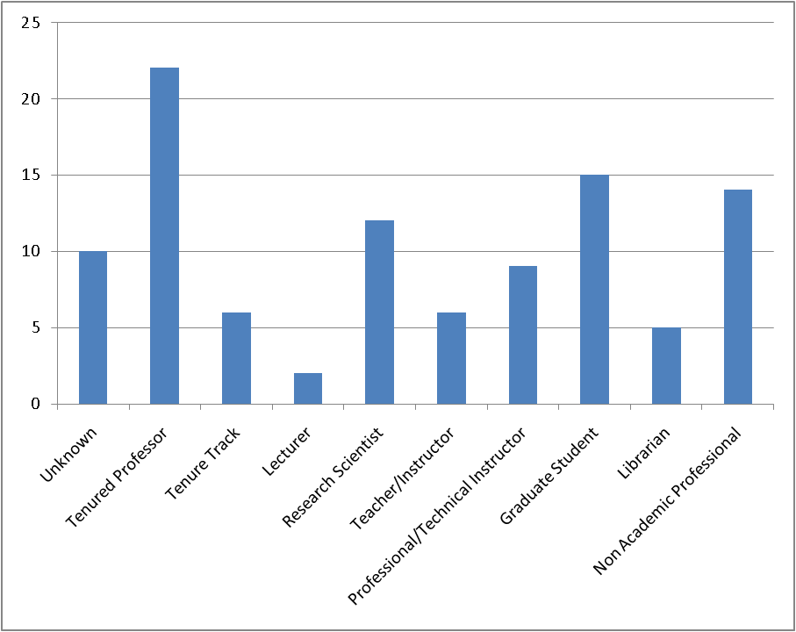
Overview: Demographic Information

Slide 5
Respondent Institutional Role
Responses: 132

Slide 6
Institutional Type (inc. Degree Programs)
Responses: 110
Reponses of “other” that did not fit in one of the above included a GIS certificate program, a library, and K-12.

Slide 7
Where is GIS&T taught?

Slide 8
Importance of Metadata in Curriculum
34% of respondents indicate issues regarding general metadata concepts have an important or very important role in GIS&T curriculum within their organizations (n=101).
Respondent Average: 2.50
76% of respondents indicate that metadata should have an important or very important role in general GIS&T curriculum.
Respondent Average: 5.02
These are statistically significantly different.
Interpretation: suggests a discrepancy between practice and theory.
(Scoring: Very Important 2, Important or Somewhat Important, 1, Not Important, 0)
Notes:
Scoring:
Very Important 2
Important, Somewhat Important 1
All others, 0

Slide 9
Importance of SDI in Organizational Curriculum
n=91,
Reported % is the number of respondents who selected important or very important.

Slide 10
General Importance of SDI in Curriculum
n=89, 91, 90
Reported % is the number of respondents who selected important or very important.

Slide 11
Metadata versus SDI
The general importance of metadata relative to other SDI concepts is significantly different.
Interpretation: on a general level metadata are viewed as more important than SDI, NSDI and GSDI.
The organizational/curricular importance of metadata is not significantly different than general SDI concepts but is significantly different than NSDI or GSDI.
Interpretation: spatial data infrastructure receives curricular attention on par with metadata in spite of the differences in perceived relative importance.

Slide 12
Familiarity with Framework Concepts
58% of respondents report 5 or more years of awareness of SDI concepts (n=88).
45% of respondents report 5 or more years of using SDI concepts in day-to-day activities (n=86).
76% of respondents indicate somewhat or greater familiarity with Framework (n=91).

Slide 13
Framework Theme Familiarity

Slide 14
More on Framework
Respondents are statistically consistent with regard to expressing general familiarity with Framework and corresponding familiarity with Framework Base Standard and Framework Themes.
Respondents who expressed greater importance with regard to SDI concepts were more likely to indicate familiarity with Framework concepts than were respondents who indicated lower SDI importance.
Interpretation: more sophisticated users are more likely to have knowledge of Framework concepts.

Slide 15
Demographics of Framework Familiarity
One of our original hypotheses is that respondents from government and business (Non Academic Professionals) would have greater familiarity with Framework that members of the academic community. Though additional analysis is required, the above results suggest that the opposite is true.
Position | Framework Familiarity Score | Number
Lecturer | 2.00 | 2
College Teacher/Instructor (non-research) | 1.50 | 6
Research Scientist | 1.25 | 12
Professional/Technical Instructor | 1.22 | 9
Tenure Track | 1.17 | 6
Graduate Student | 1.13 | 15
Tenured Professor | 0.95 | 22
Non Academic Professional | 0.93 | 14
Unknown | 0.60 | 10
Librarian | 0.60 | 5
(The Framework Familiarity Score is the average familiarity level across Framework Base and Themes. A score of 2 indicates very familiar or familiar, a score of 1 indicates somewhat familiar and 0 indicates unfamiliar.)

Slide 16
Benefits of Standards
38% of respondents indicate they regularly or often derive benefits from standards for teaching (n=86).
62% of respondents indicate they regularly or often derive benefits from standards for research (n=86).
77% of respondents indicate they would be somewhat willing or very willing to participate in geospatial standards development (n=87).
Over 90% of respondents indicate standards are very important for data development, data transfer and interoperability (n=88).

Slide 17
Perceptions Regarding Who Benefits

Slide 18
Summary Conclusions
The survey was a success!
A higher response rate would have been nice, but we can still draw some interesting conclusions.
Cross tabulation and correlation analysis yield some very interesting insights.
However, we still have more to learn when comparing government or business users versus academic users.
Respondents generally appeared to have some modicum of understanding of Framework.
This may be, in part, due to self-selection. However, it bodes well that as many people expressed familiarity as did.
General observation:
Some of these concepts (e.g., NSDI) have become so common place that they are almost invisible. Though it would be a challenge to demonstrate statistically, there is some possibility that people benefit more than they actually realize.

Slide 19
Next Steps
ESRI Education User Conference Paper
August 2008
Recommendations
Develop a concise “value proposition”
Continue online training initiative
Strategic outreach to academic community
Special sessions or workshops at national and regional meetings
AAG
NCGE
Direct involvement in community efforts
UCGIS Body of Knowledge
Proactively engage colleges and universities
In class presentations (student engagement is clearly important!)
Promotion of online resources
Participation/creation of virtual seminars

