Slide 1
Integrated Asset Management (IAM) Project
Final Blueprint Review
January 12, 2005

Slide 2
Agenda Topics
Day One Presenter Time
Welcome/Introductions Pam Cucarola 8:00-8:10
Jeff Sutton
Agency Business Process Design
  Overview Dale Hupp 8:10-8:30
  Plan Corky Knowles 8:30-8:55
  Acquire Nik Zurkin 8:55-9:25
  Maintain Steve Smith 9:25-9:55
Break 9:55-10:05
  Dispose Paul Pinaula 10:05-10:30
  Finance Management Kevin Candee 10:30-11:00
  Aircraft Operations Gary Humphrey 11:00-11:20
Lunch 11:20-12:20
Information Delivery Joan Brewer 12:20-12:40
Initial Scope Document Updates Dale Hupp 12:40-1:40
Break 1:40-1:50
Open Whitepaper Topics 1:50-4:00
  Use of HR to support IAM Requirements Toni Mayor 1:50-2:05
  Document Management Terry Langley 2:05-2:20
  Bar Coding Terry Langley 2:20-2:35
  GIS Steve Smith 2:35-2:50
  Aircraft Crew Scheduling/Accuracy/Flight Records Gary Humphrey 2:50-3:05
  Emissions Management Toni Mayor 3:05-3:20
  Transportation Glenn Harris 3:20-3:35
  RFID Terry Langley 3:35-3:50
Dinner 4:00-5:30
Steering Committee Executive Session 5:30-7:30

Slide 3
Agenda Topics
Day Two Presenter Time
Welcome Pam Cucarola 8:00-8:05
Change Management – Workstream Topics Kathey Nabors 8:05-8:25
Solution Components Stephanie Kennedy 8:25-8:40
Conversion Inventory Dave West 8:40-8:55
Agency Interface Inventory Dale Hupp 8:55-9:10
SAP Organizational Hierarchy Stephanie Kennedy 9:10-9:30
Technology IPT Brian Kirchhoff 9:30-9:45
Integration Project Office – QA/IV&V Joint Effort Amy Stapleton 9:45-10:00
Kevin Hunt
IAM Implementation Planning Recap Dale Hupp 10:00-10:15
Break 10:15-10:25
Risk & Issue Assessment Terry Whaley 10:25-10:55
Summary of Open Issues Dale Hupp 10:55-11:25
Wrap Up Pam Cucarola 11:25-11:30
Lunch 11:30-12:30
Final Executive Session 12:30-1:30
Results of Executive Session 1:30-2:00

Slide 4
Welcome/Meeting Objectives

Slide 5
Objectives for Today
Review of the detailed outcomes from Blueprint
Gain approval to move forward with the Realization Phase
  Understand broadly the activities that have been performed
  Provide feedback to the IAM Project Steering Committee Chair as to the readiness of the project to move forward into the Realization Phase for Release 1

Slide 6
IAM Agency Business Process Review
Lifecycle Area

Slide 7
Agency Business Process
Review: Team Approach
NASA Baseline
Understanding
Pass 1
Requirements Gathering and Fit Analysis
(Agency Requirements)
Pass 2
Requirements Gathering and Fit Analysis
(Asset Specific)
Pass 1
Gap Assessment and Closure Approach
Pass 2
Gap Assessment and Closure Approach
Preliminary Blueprint
Pass 1
Implementation and Roll-out Approach
Pass 2
Implementation and Roll-out Approach
Pass 1
Tech Arch Assessment
Pass 2
Tech Arch Assessment
Change Management
(Stakeholder & Communication Management, End User Roles, Training)

Slide 8
Agency Business Process
Review: Process Metrics
Process Name | Sub-Processes | Blueprint Activity Sheets* | High-level Performance Objectives (Level 3 Requirements)
Plan | 4 | 16 | 57
Acquire | 19 | 98 | 66
Maintain | 5 | 159 | 66
Dispose | 3 | 17 | 48
Finance | 13 | 41 | 44
A/C Operations | 4 | 14 | 47
Totals | 48 | 345
* Activity Sheets in Blueprint were developed to capture the team’s notes on any unique business rules, functional organization needs or open issues; this documentation will be utilized and expanded during Realization

Slide 9
Agency Business Process
Review: Proposed Level 4 Requirements
Of the original 1123 requirements the team started with, 927 still exist. The functional organizations added an additional 596
Process requirements support the functional organization in the following manner:
 | Total | Plan | Acquire | Maintain | Dispose | Finance | Aircraft Operations | Other / General
Process | 793 | 72 | 347 | 218 | 57 | 51 | 16 | 32 CF
Data | 496 | Items don’t align with just one area and therefore, have been tied to solution component(s) or source(s)
Reports | 147
White Paper | 77 | 0 | 0 | 0 | 0 | 0 | 0 | 77
Total | 1513 | 72 | 347 | 218 | 57 | 51 | 16 | 109
 | Total | Plan | Acquire | Maintain | Dispose | Finance | Aircraft Operations | Other / General
Process Total | 793 | 72 | 347 | 218 | 57 | 51 | 16 | 32 CF
Facilities | 476 | 64 | 209 | 99 | 34 | 49 | 0 | 21
Logistics | 573 | 58 | 320 | 74 | 46 | 43 | 0 | 32
Environment | 466 | 64 | 238 | 64 | 40 | 37 | 0 | 23
Aircraft | 551 | 58 | 211 | 169 | 35 | 40 | 16 | 22

Slide 10
IAM Agency Business Process Review
Plan

Slide 11




Agency Business Process
Review: Plan
Definition
  The development of any asset project from its initial identification through final execution and transfer to operations and maintenance
  A project includes any activity, large or small, that requires overall planning for proper control and asset valuation
  The project development addresses the technical, schedule and cost definition ensuring that these three aspects remain consistent and equivalent
  Plan includes participation by stakeholders (internal or external) at all stages of development
  Projects may originate from internal or external sources, including maintenance projects and projects for asset disposal, as well as new asset related projects
Page <number>

Slide 12
Agency Business Process
Review: Plan
  Components:
    4 Sub-Processes with 16 supporting Activity Sheets*
    Supports 57 High-Level Performance Objectives (Level 3 Requirements)
    Proposes 72 Functional Requirements (Level 4 Requirements)
      Facilities Support – 64
      Logistics Support – 58
      Environment Support – 64
      Aircraft Support - 58
* Activity Sheets in Blueprint were developed to capture the team’s notes on any unique business rules, functional organization needs or open issues; this documentation will be utilized and expanded during Realization
Page <number>

Slide 13
Agency Business Process
Review: Plan
  Plan Assumptions
    Funding exists for the planning phase prior to project/program approval
    Simple projects will move quickly through the process passing through unneeded steps. This also holds true for projects that are sent back to “Identify Need” at a step later in the process.
    Planning is a continuous process. Therefore, all potential loops with the workflow have not been mapped.
    Many Processes within the planning workflow are not linear. Many are parallel and some overlap.
    Environmental mitigation plans include Aircraft, Logistics, Environmental and Facilities
    Planning is a team effort and the team includes customers and stakeholders
    Clarifications are addressed/resolved within all procedural and approval decision blocks
Page <number>

Slide 14
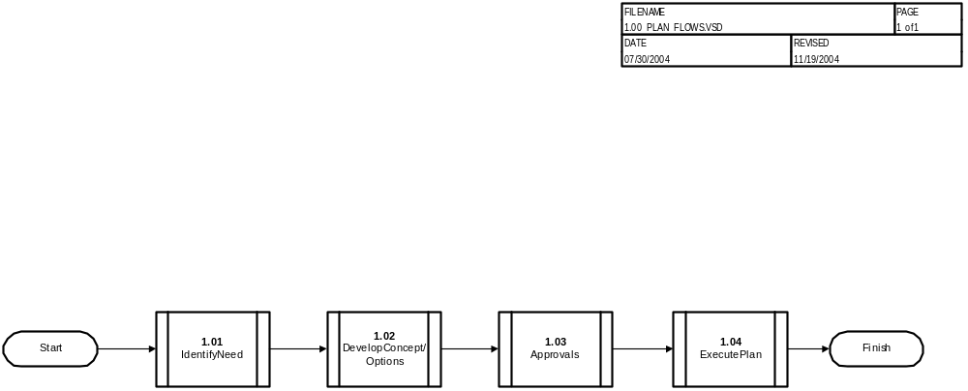
Agency Business Process
Review: Plan Process Model

Slide 15
Agency Business Process
Review: Plan
Sub-processes (Business Functions) identified to date:
  1.1 Identify Need
    Customers provide administrative requirements, which undergo a sanity check. The appropriate POC conducts an initial investigation, followed by a management review.
  1.2 Develop Concept/Options
    Functional requirements are identified. Then options are identified and evaluated. An option is selected and undergoes a preliminary evaluation.
  1.3 Approvals
    The selected option is reviewed and approved by NASA and external entities, as required. Review and approval entities typically vary by project.
  1.4 Execute Plan
    The program/project manager obtains funding and develops acquire plan & strategies, operations & maintenance plan & strategies and dispose strategy. The strategies and plans are handed off to the appropriate sub-process for finalization and implementation.
Page <number>

Slide 16
Agency Business Process
Review: Plan
Change Impact
  Major / primary business changes (improvements or tradeoffs) noted to date:
    Automation of Process
    Formalization of the planning process
    Enables NASA to standardize the planning process across the different business initiatives
    Provides a single, common source of information, e.g., Forms, Reports, and organizations that may be involved in the planning process
    Some centers plan today, others do not; this may or may not be an increase in workload
    Manager’s responsibilities as it relates to approval will be greater
  Touch points: The Plan Process touch points are not applicable to every type, size, and source of funding for a specific project. Touch points will only be activated for specific application to a project need.
    Core Financial - multiple touch points including budget execution.
    PMII - All of the plan process work can be utilized by PMII. The re-write of NPR 7120 will probably affect asset accountability for IAM Planning and PMII.
    CMM - Plan process can have ties to CMM during project schedule development, project cost definition, development of bid package's, project execution and project acceptance.
Page <number>

Slide 17
Agency Business Process
Review: Plan
Change Impact continued-
  Budget Formulation – This SAP activity can be used in concurrence with the “approval cycle” for CofF and Environmental projects (POP). Budget Formulation can also be used by NASA customers for facility construction outside CoF (paying customers) in the “obtain funding cycle”.
Open Items
  I02405 - Sensitive Information: How will sensitive projects (e.g. aircraft black projects) be handled in the system?
    Assigned to Agency Process IPT Lead
Page <number>

Slide 18
IAM Agency Business Process Review
Acquire

Slide 19
Agency Business Processes Review: Acquire
Definition
  Acquire encompasses obtaining and managing assets or services including: requirements and source determination, vendor selection, order processing and follow-up, goods receipt and inventory management.
  Components:
    19 Sub-Processes with 98 supporting Activity Sheets*
    Supports 66 High-Level Performance Objectives (Level 3 Requirements)
    Proposes 347 Functional Requirements (Level 4 Requirements)
      Facilities Support – 209
      Logistics Support – 320
      Environment Support – 238
      Aircraft Support - 211
* Activity Sheets in Blueprint were developed to capture the team’s notes on any unique business rules, functional organization needs or open issues; this documentation will be utilized and expanded during Realization

Slide 20
Agency Business Processes Review: Acquire
  Assumptions
    NASA will acquire assets and services internally whenever practical, in support of the FAR requirements
    SAP will enable unique approval processes as needed by Center
    and / or acquisition type
    SAP will enable milestone payments including verification of progress to date
    Environmental requirements for handling, transporting, warehousing and labeling will be managed throughout the asset life-cycle
    Users will have the capability to verify that Environmental requirements have been met and performed by authorized persons (ex. Explosives, aviation life support systems, bonded storage, serviceability tag, standby stock)

Slide 21
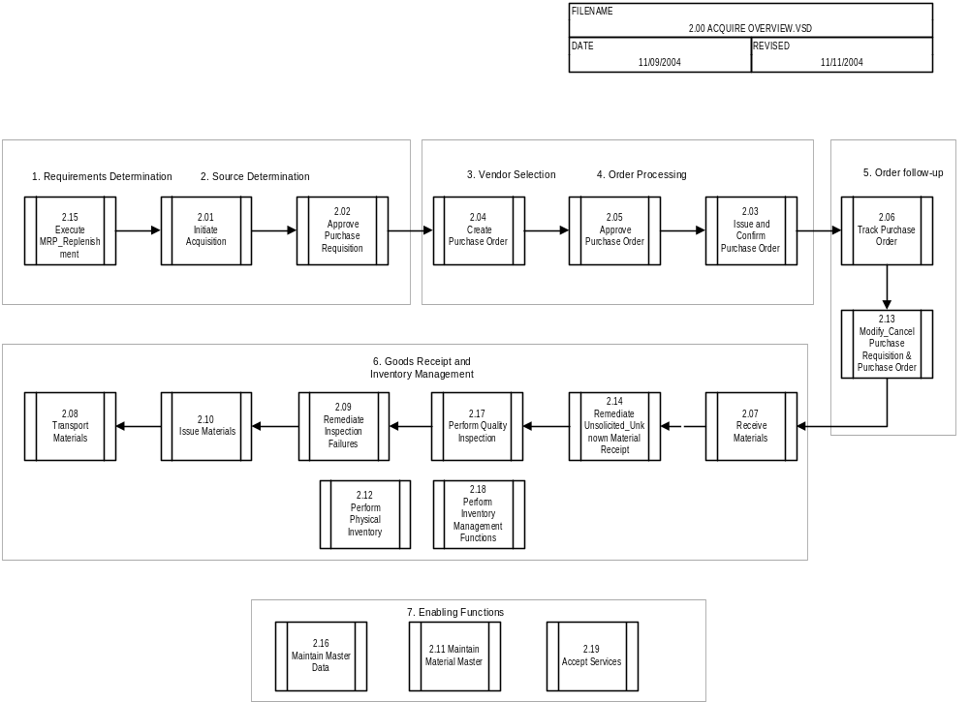
Agency Business Process
Review: Acquire Process Model

Slide 22
Agency Business Processes Review: Acquire
Sub-processes (Business Functions) identified to date:
  2.01 Initiate Acquisition – Request an asset or service, determine the source of acquisition and generate a Purchase Requisition
  2.02 Approve Purchase Requisition – Obtain appropriate approvals for the Purchase Requisition
  2.03 Issue and Confirm Purchase Order – Send the approved Purchase Order to the selected vendor
  2.04 Create Purchase Order – Generate a Purchase Order from a Purchase Requisition
  2.05 Approve Purchase Order – Obtain appropriate approvals for a Purchase Order
  2.06 Track Purchase Order – Track Purchase Order status from the vendor
  2.07 Receive Materials – Process goods receipts including basic inspection (count and condition)

Slide 23
Agency Business Processes Review: Acquire
Sub-processes (Business Functions) identified to date (continued):
  2.08 Transport Materials – Transport assets within the center or off site
  2.09 Remediate Inspection Failures – Perform corrective actions when received goods fail inspections
  2.10 Issue Materials – Release materials from inventory to users
  2.11 Maintain Material Master – A process for managing Material Master data
  2.12 Perform Physical Inventory – Counting the materials that are carried in inventory
  2.13 Modify/Cancel Purchase Requisition/Purchase Order – Make appropriate modifications to Purchase Requisitions or Purchase Orders as dictated by interaction with customers and vendors

Slide 24
Agency Business Processes Review: Acquire
Sub-processes (Business Functions) identified to date (continued):
  2.14 Remediate Unsolicited/Unknown Material Receipt – Process receipts that do not have a matching Purchase or Transfer Order
  2.15 Execute MRP/Replenishment – Determine quantity required to replenish inventory
  2.16 Maintain Master Data – Directs updates to the appropriate Master Data process
  2.17 Perform Quality Inspection – Determine conformance to specifications, safety and mission assurance
  2.18 Perform Inventory Management Functions – Set up warehouse bins, transfer balances between inventory items, and monitor shelf life expiration dates
  2.19 Accept Services – Perform acceptance for services and any deliverables related to that service

Slide 25
Agency Business Processes Review: Acquire
Change Impact
  Major / primary business changes (improvements or tradeoffs) noted to date:
    Improved Agency-wide Visibility and Enhanced Stewardship of Assets – Provides for improved financial / inventory reporting, the ability to determine condition, location, quantity on-hand, consumption history, cost, value, etc.
    Improved Data Integrity – Provides single data repository for all transactional and master data.
    Improved Environmental Management – Provides the ability identify, track and control Environmental relevant assets while in inventory.
    Improved Environmental Management – Improved asset life-cycle management for handling, transporting, warehousing and labeling
    Improved audit trails – Provides more accurate information to support audits.
    Reduction of Data Reconciliations – Because of the integrated nature of the system and improved data integrity the requirement to perform data reconciliations will be reduced.
    Competency Center Support – Because of increased functionality, expanded use of master data and increased user base a larger support effort will be required.
    Change Management – There will be reluctance by Users to a new way of doing business.
    Shifting Workload – More emphasis will be placed on the creation of the Purchase Requisition (e.g. master data). This should lessen once users become familiar with the process and learn the shortcuts in the system and will also translate into a work reduction when processing receipts.

Slide 26
Agency Business Processes Review: Acquire
Change Impact (continued)
  Touch points / association with existing production capability or other IFMP modular project
    Core Financial Overlap - Performed an analysis of overlap and gaps with the Core Financial Purchasing process with the objective of developing a unified process that supports the existing users and IAM requirements
    CMM – Coordination will be required as CMM develops NASA processes and requirements. As goods or services are required from the vendor, ‘IAM’ purchase orders are created with reference to the contract. In such a design, the contract is integrated with the resulting requisitions and purchase orders, which are in turn integrated with Funds Management, Finance, and Controlling.

Slide 27
Agency Business Processes Review: Acquire
Open Items
  I02310 - Use of the SAP Material Master & Maintenance of the SAP Material Master
    White Paper has been submitted for review by IAM Project Management
  I02339 - Bank Card Processing Under IAM
    White Paper has been submitted for review by IAM Project Management
  I02341 - Use of Purchasing Documents to Acquire Materials/Assets
    White Paper has been submitted for review by IAM Project Management
  I02329 – Transportation & Traffic Management
    White Paper has been submitted for review by IAM Project Management
  I02400 - Use of Outline Agreements at NASA
    White Paper has been submitted for review by IAM Project Management
  I02408 - Material Tracking and Consumption
    White Paper has been submitted for review by IAM Project Management
  I02418 - The applicability of Bar Coding and RFID in support of business processes
    White Paper is in the process of being refined for submission for review by IAM Project Management

Slide 28
IAM Agency Business Process Review
Maintain

Slide 29
Agency Business Processes Review: Maintain
Definition
  Maintain encompasses the activities that keeps NASA's assets available for operation in the functional manner required. The Maintain process includes:
    Identifying assets that require maintenance
    Identifying maintenance required (Planned and Unplanned)
    Authorizing maintenance based on visible Budget
    Planning the maintenance
    Scheduling the maintenance
    Execution and Completion of maintenance
    Maintenance Performance Reporting

Slide 30
Agency Business Processes Review: Maintain
  Components:
    5 Sub-Processes with 159 supporting Activity Sheets*
    Supports 66 High-Level Performance Objectives (Level 3 Requirements)
    Proposes 218 Functional Requirements (Level 4 Requirements)
      Facilities Support – 99
      Logistics Support – 74
      Environment Support – 64
      Aircraft Support - 169
* Activity Sheets in Blueprint were developed to capture the team’s notes on any unique business rules, functional organization needs or open issues; this documentation will be utilized and expanded during Realization
Notes:
Reliability / Availability / Maintainability (RAM) of SAP system – will go to lower level of detail on flows in realization

Slide 31
Agency Business Processes Review: Maintain
  Assumptions
    Quality Management is built into the process and supported by the solution
    Environmental, Health, Safety monitoring is built into the process and supported by the solution
    Integrated Qualification Management will be available to support the assigning of work to proper individuals
    Utilize NASA’s Reliability Centered Maintenance (RCM) philosophy to reduce the amount of Reactive Maintenance
    IAM Maintenance solution is available to Contractors
    Scheduled and communicated maintenance of SAP environment to minimize downtime during working hours and operational impact
Notes:
Reliability / Availability / Maintainability (RAM) of SAP system – will go to lower level of detail on flows in realization

Slide 32
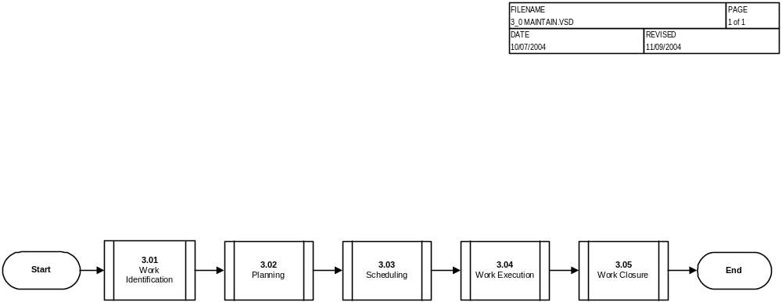
Agency Business Process
Review: Maintain Process Model

Slide 33
Agency Business Processes Review: Maintain
Sub-processes (Business Functions) identified to date:
  3.01 Work Identification – Identification, recognition and induction of maintenance to be performed.
  3.02 Planning – The documentation of procedures and identification of resources (materials, tools and personnel) required to perform the maintenance task. Funds Availability, EHS and QA requirements are also identified
  3.03 Scheduling – Coordinated Long term and short term work load sequencing of Identified maintenance candidates.
  3.04 Work Execution – Set up, performance and completion of maintenance.
  3.05 Work Closure – Closing the maintenance Item. Including documentation/verification of Tasks, Man hours, Material, Quality Assurance and cost settlement.

Slide 34
Agency Business Processes Review: Maintain
Change Impact
  Major / primary business changes (improvements or tradeoffs) noted to date
    Standardized maintenance procedures for all asset classes managed and maintained in the IAM solution
    Integrated Single Source of Information for maintenance and history
    Visibility of available funding
    Visibility of Materials
    Improved Management and Customer visibility of Maintenance execution
  Touch points / association with existing production capability or other IFMP modular project
    Core Financial touch point for cost settlement when maintenance work orders are closed.
    Core Financial touch point for funds availability prior to maintenance scheduling and execution
    PMII touch point likely for Technical WBS Structure and Project Profiles for maintenance projects.

Slide 35
Agency Business Processes Review: Maintain
Open Items
  I02393 - Track and Validate Qualifications/Training
    White Paper has been submitted for review by IAM Project Management
  I02393 - Record employee health and safety issues
    White Paper has been submitted for review by IAM Project Management
  I02393 - Record environmental hazards and liabilities
    White Paper has been submitted for review by IAM Project Management
  I02418 - The applicability of Bar Coding and RFID in support of business processes
    White Paper is in the process of being refined for submission for review by IAM Project Management
  I02419 - The applicability of Document Management in support of business processes
    White Paper is in the process of being refined for submission for review by IAM Project Management
  I02407 – IAM Solution Reliability and Availability
    Assigned to Agency Process IPT Lead
  I02408 – Material Tracking and Consumption
    White Paper has been submitted for review by IAM Project Management
  I02409 – EH&S Implementation for Releases
    White Paper has been submitted for review by IAM Project Management
  I02423 –The Use of GIS in Support of Business Processes
    White Paper has been submitted for review by IAM Project Management

Slide 36
IAM Agency Business Process Review
Dispose

Slide 37
Agency Business Process Review: Dispose
Definition
  Dispose involves utilization, donation, sales, abandonment, destruction, or disposal of assets, materials and wastes resulting in removal from agency financial records
  Components:
    3 Sub-Processes with 17 supporting Activity Sheets*
    Supports 48 High-Level Performance Objectives (Level 3 Requirements)
    Proposes 57 Functional Requirements (Level 4 Requirements)
      Facilities Support – 34
      Logistics Support – 46
      Environment Support – 40
      Aircraft Support - 35
* Activity Sheets in Blueprint were developed to capture the team’s notes on any unique business rules, functional organization needs or open issues; this documentation will be utilized and expanded during Realization

Slide 38
Agency Business Process Review: Dispose
  Assumptions associated with process
    Approval to dispose of material/assets takes place before this process begins.
    Hazardous/Radioactive/Biohazardous waste post disposal tracking and documentation is required.
    NASA sales can take place in the form of sealed bids, on-line, auctions, retail spot bids, and negotiated sales.
    Bids and sales prices can be posted at various stages in the sales process.
    Hazardous waste generator or Environmental makes hazardous waste determination. (what it is and where is it to go)
    Receive and inspection process validates condition code.
    Reutilization can take place at any time.

Slide 39
Disposal Process Architecture
Hierarchy of NASA Asset/Material Disposal
(Personal Property, Hazardous Waste/Materials, Real Property, Aircraft, Firearms, Artifacts, etc.)
Reutilization
Screening for use within NASA/Agency (Smithsonian Museum per NPR 4310.1) as an inventory function
Acquire Process 2.01
Maintain Process 3.04.40
Asset/Material
Ready for
Disposition
Approved by:
Program or User
HQ/External Relations
Environmental/Safety/Health
Plan, Acquire,
Maintain and Operate
IAM
Modules
Asset/Material
Receive/Inspect
Physical Count
Condition Code
Digital Pictures
Appropriate paperwork/signatures
Disposal
Disposal Process 4.0
Disposal process must comply
with appropriate laws and
regulations such as CFR, FAR,
NPR/NPD, etc.
Utilization
Yes
Screening for transfer to another Federal agency
No
Donation
Yes
Asset/Material
removed from
Agency Finance record
Screening for transfer to eligible organizations
No
Disposal Process 4.11
Sales
Yes
Disposition to general public
No
Abandonment,
Destruction, &
Disposal
Yes
File/Archived
Reports
Compliance Documents
Disposal Process 4.13

Slide 40
Agency Business Process Review: Dispose
Sub-processes (Business Functions) identified to date
  4.0 Dispose
    Starts with Asset/material ready for disposal, i.e. on disposal warehouse receiving dock, storage yard receiving dock, etc., and Agency-wide reutilization screening completed
    Includes utilization screening through Federal agencies and donation screening through State and other eligible donees
  4.11 Sales
    Includes sale to the general public if no request for utilization/donation received
  4.13 Abandonment, Destruction and Disposal
    Includes abandonment/destruction if no sale finalized
    Includes pickup and disposition of waste

Slide 41
Agency Business Process Review: Dispose
Change Impact
  Major / primary business changes (improvements or tradeoffs) noted to date:
    Improved visibility of excess property allows NASA to acquire assets and services internally whenever practical thus eliminating the need for reutilization as a dispose function
    Standardized disposal processes across the agency provides consistency in measuring results and promotes improved process efficiency
    Integrates disposal of hazardous materials/wastes as part of standardized asset life cycle tracking
    Requires enhancements to interfaces between NASA and external screening/selling agencies
    Appropriately allocates expenses associated with readying material/assets for disposal, internal incineration, demilitarization, etc. to the responsible cost center
    Change/modification of skill mix: More workers may require computer training and skills in order to perform new tasks required by IAM
    “Blue collar” workers may require computer skills to access system
    Possible changes to union workers and contracts
  Higher-skilled employees (e.g., scientists) may be required to perform tasks like inputting data
  Touch points / association with existing production capability or other IFMP modular project
    NASA-conducted sales of surplus property needs to overlap with Accounts Receivable process in Core Financial to eliminate the need for manual posting of receivables
Open Items
  None

Slide 42
IAM Agency Business Process Review
Finance

Slide 43
Agency Business Process Review: Finance Management
Definition
  Finance tracks the lifecycle costs/valuation of NASA capital assets
  Finance determines the valuation of Operating Materials and Supplies (OM&S)
  Finance includes integration points with the following IAM sub-processes:
    Inventory Management
    Material Acquisition
    Warehouse Management
    Planning
    Maintenance
    Disposal

Slide 44
Agency Business Process Review: Finance Management
  Components:
    13 Sub-Processes with 41 supporting Activity Sheets*
    Supports 44 High-Level Performance Objectives (Level 3 Requirements)
    Proposes 51 Functional Requirements (Level 4 Requirements)
      Facilities Support – 49
      Logistics Support – 43
      Environment Support – 37
      Aircraft Support - 40
* Activity Sheets in Blueprint were developed to capture the team’s notes on any unique business rules, functional organization needs or open issues; this documentation will be utilized and expanded during Realization

Slide 45
Agency Business Process Review: Finance Management
  Assumptions
    Finance assumes that assets include:
      Warehoused materials
      Equipment assets
      Capital assets
    Finance assumes that the above assets include:
      NASA-owned/ NASA-held property
      NASA-owned/ Contractor-held property

Slide 46
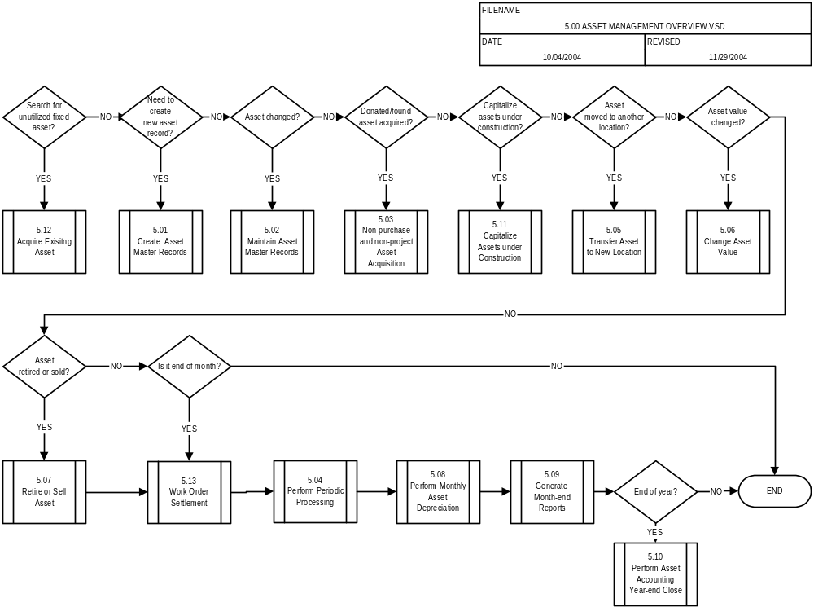
Agency Business Process
Review: Finance Process Model

Slide 47
Agency Business Process Review: Finance Management
Sub-processes (Business Functions) identified to date:
  5.01 Create asset master records - This flow addresses how to establish a unique record for each capitalized or accountable property item at the time of acquisition.
  5.02 Maintain asset master records - This flow describes how to update the unique record for capitalized or accountable property.
  5.03 Non-purchase and non-project asset acquisition - This flow addresses found-on-station, donation, and sample fixed assets.
  5.04 Perform periodic processing - This flow describes the month-end closing process.
  5.05 Transfer asset to new location - This flow describes the financial accounting for fixed asset transfers.
  5.06 Change asset value - This flow addresses the process for asset write-ups / write-downs due to unexpected changes in value.

Slide 48
Agency Business Process Review: Finance Management
Sub-processes (Business Functions) identified to date (continued):
  5.07 Retire or sell asset - This flow describes the process for writing off the value of an asset at the time of sale, abandonment, or destruction.
  5.08 Perform monthly asset depreciation - This flow describes the steps for processing the monthly depreciation.
  5.09 Generate month-end reports - This flow covers the steps for generating month-end asset accounting reports.
  5.10 Perform asset accounting year-end close - This flow describes the steps for closing the Asset Accounting module at the end of the fiscal year.
  5.11 Capitalize asset under construction - This flow covers the settlement of costs to either WIP or fixed assets.
  5.12 Acquire existing asset - This flow provides the details of the asset re-utilization process.
  5.13 Work order settlement - The flow describes the settlement of costs from a work order to the final cost receiver.

Slide 49
Agency Business Process Review: Finance Management
Change Impact
  Major / primary business changes (improvements or tradeoffs) noted to date:
    Each valuated material is linked to the general ledger, so that an increase or decrease in that material generates automatic updates to the general ledger.
    As materials are issued to projects, work orders, or cost centers, the value of the material issued posts an automatic entry to the general ledger account for expense, facilitating reporting both by cost object and by general ledger account.
    Material and labor costs can be tracked by the work order number and settled to the related project or cost center.
    Material and labor costs associated with the acquisition of a capital asset can be transferred to WIP and to final asset accounts through an automated process without losing the audit trail.
    Each asset master record operates as a sub-ledger of a capital asset general ledger account.

Slide 50
Agency Business Process Review: Finance Management
  Major / primary business changes (improvements or tradeoffs) noted to date:
    Postings to the asset master record generate automatic updates to the associated capital asset general ledger account.
    Automatic postings facilitate capital asset and disposal reporting.
    Each asset master record is configured with a set of data that determines depreciation postings, enabling depreciation of the individual capital asset as opposed to group depreciation.
    Depreciation per asset enables more accurate reporting of capital assets.
    The depreciation run is automated and results in postings on a per asset basis.
    Integration of the IAM modules with the Core Financial modules in SAP offers NASA the opportunity to:
      Improve data integrity between financial and other functional areas
      Reduce reconciliation activities
      Eliminate manual processes for property financial reporting
      Better support clean audit opinions

Slide 51
Agency Business Process Review: Finance Management
  Touch points / association with existing production capability or other IFMP modular project
    Core Financial - The Core Financial project put in place a month-end process which closes the modules implemented. As the SAP footprint is expanded, the month-end close process will be extended to include the additional modules.
    PMII - The PMII project will determine the way NASA projects will be structured and the hierarchy in which costs will be posted. SAP WBS elements are designed to serve as cost holders. In capital projects, the costs stored against each WBS element are used to create and valuate WIP and final assets arising from the project. Thus, the WBS element created in the Project Systems module gives direct rise to a capital asset created in the Asset Accounting module.

Slide 52
Agency Business Process Review: Finance Management
  Touch points / association with existing production capability or other IFMP modular project
    CMM – Coordination will be required as CMM develops NASA processes and requirements. As goods or services are required from the vendor, ‘IAM’ purchase orders are created with reference to the contract. In such a design, the contract is integrated with the resulting requisitions and purchase orders, which are in turn integrated with Funds Management, Finance, and Controlling.

Slide 53
Agency Business Process Review: Finance Management
Open Items
  I02309 - Inventory Valuation - addresses what inventory valuation method should be used and which inventory should be treated as valuated.
    White Paper has been submitted for review by IAM Project Management
  I02390 - Fixed Assets vs. Inventory Valuation - addresses when it is appropriate to follow an inventory process with respect to property and when it is appropriate to follow a capital assets process.
    White Paper has been submitted for review by IAM Project Management
  I02319 - Fixed Asset Re-utilization and Disposal - addresses what process should be used for the reutilization of capital assets.
    White Paper has been submitted for review by IAM Project Management
  I02426 – Guidance is requested involving Enhanced use Leasing impact on capital asset/real property valuation when private funds are expended to improve or change the use of an asset which is subsequently returned to the government.
    Issue assigned to IAM HQ Functional Leadership Team
  I02429 – Bench stock under $75,000 is currently not recorded as inventory per NPR4100.1D. It would be preferable to include these values in order to state WIP and final assets correctly.
    Issue assigned to IAM HQ Functional Leadership Team

Slide 54
IAM Agency Business Process Review
Aircraft Operations

Slide 55
Agency Business Process Review: Aircraft Operations
Definition
  Aircraft Operations includes Flight Scheduling, Flight Currency, Flight Records, Airfield Management and Sorties where some aspects are unique to NASA
    NASA Flight Operations has the requirement to provide integrated Flight Scheduling (FS), Flight Currency (FC) and Flight Records (FR) to operate 25 Research and Development Aircraft, 52 Program Support Aircraft and 8 Mission Management Aircraft at eight different centers. Three of the eight centers also conduct Airfield Management (AM) functions. The integration of these four elements FS,FR, FC and AM is the impetus for ensuring that Aircrews are qualified and current, and that Aircraft are scheduled in concert with maintenance/mission objectives.
    The integration of FS, FR, FC and AM’s functions provides operations support for the scheduling of flights, airspace and Aircrews. This functionality assures aircrews meet the currency requirements for the assigned mission and that the airspace has no conflicts. The data gathered from Sorties is utilized to drive maintenance and FR/FC update requirements.

Slide 56
Agency Business Process Review: Aircraft Operations
  Components:
    4 Sub-Processes with 14 supporting Activity Sheets*
    Supports 47 High-Level Performance Objectives (Level 3 Requirements)
    Proposes 16 Functional Requirements (Level 4 Requirements)
      Facilities Support – 0
      Logistics Support – 0
      Environment Support – 0
      Aircraft Support – 16
    Development
      All processes and functional requirements developed from the 14 top management/IAOP (Intercenter Aircraft Operations Panel) Agency requirements
* Activity Sheets in Blueprint were developed to capture the team’s notes on any unique business rules, functional organization needs or open issues; this documentation will be utilized and expanded during Realization

Slide 57
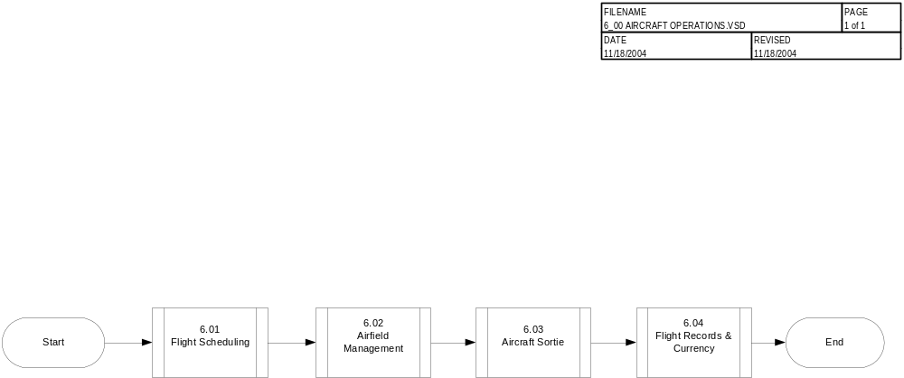
Agency Business Process
Review: Aircraft Operations Process Model

Slide 58
Agency Business Process Review: Aircraft Operations
Sub-processes (Business Functions) identified to date (continued):
  All centers utilize the following sub-processes
    Flight scheduling – Flight request, aircrew currency verification and aircraft & aircrew scheduling & assignment
    Flights (sortie) –Mission type parameters and classification selection, aircrew preflight and acceptance of aircraft
    Flight currency – Aircrew records and currency management and updating
  Three centers KSC, ARC and GSFC / WFF all also involve Airfield Management responsibilities
    Airfield management - Flight schedule receipt, consolidation, deconflict and approval

Slide 59
Agency Business Process Review: Aircraft Operations
Change Impact
  Major / primary business changes (improvements or tradeoffs) noted to date:
    Improve cross-functional sharing of data and create new, integrated business processes
    Provide timely data concerning the condition of mission critical assets so that real time assessments affecting safety and reliability can be accomplished
    Establish Agency capability to track the validity of asset operators and maintainers with regard to currency of training, operational hours, and certifications
    Support “One NASA” by electronically linking the dispersed workforce with an integrated solution that allows for collaborative work
  Touch points / association with existing production capability or other IFMP modular project
    Core Financial Upgrade is required to be in place to achieve Aircraft’s proposed functional requirements

Slide 60
Agency Business Process Review: Aircraft Operations
Open Items
  Flight Safety / Flight Critical Software development quality assurance processes
      NPD 8700.1B and NASA-STD-8739.8 Certify the safety and operational readiness of flight hardware/software, mission-critical support equipment, hazardous facilities/operations, and high-energy, ground-based systems through formal review processes
      “Aircraft Operations” software is required to certify an aircraft as airworthy and the aircrew as current and qualified
    I02308 - Define Independent Validation and Verification (IV&V) Requirements
      Assigned to Agency Process IPT Lead
    I02354 - Define Safety and Mission Assurance SMA Requirements
      Assigned to Agency Process IPT Lead
  I02322 - Define Operations vs. Maintenance
    Initial guidance from the HQ Functional Leadership Group limits the “operations” scope to 3 specific Aircraft functions
      Crew Currency
      Crew Scheduling
      Flight Scheduling
    Assigned to Agency Process IPT Lead

Slide 61
Information Delivery

Slide 62
Redefine Reporting
Change the Paradigm from Reporting to Information Delivery
Desire is not to deliver a printed report but INFORMATION that supports the business and management process
  Design Information Delivery components to support the New Processes and Management Information Needs
  Process drives the Information Delivery component
  New Processes will drive new Information Delivery requirements
  New Processes may eliminate old reporting requirements

Slide 63
Goals Accomplished During Blueprint
Consolidated set of IAM Standard Information Delivery Requirements that will support the new IAM Processes
  “As is” reports/forms consolidated into a single set of standard requirements that will be available for all centers (IAM Standard Information Delivery Requirements)
  Baselined set of requirements that will satisfy and be supported by the new IAM Processes within the SAP solution
  Intent was NOT to replicate all existing Center Reports/Forms within SAP (R/3 or BW)
  Questioned the need for existing reports based on new processes
  Initial focus was on operational level Information Delivery requirements
    Note: We will address Management Level requirements during Realization

Slide 64
Blueprint Approach
Information Delivery Team
  Received an inventory of current center reporting requirements
  Divided inventory by Functional Area
  Eliminated any obvious duplicates
  Reviewed inventory and consolidated “similar” reports
  Validated inventory against functional requirements list
    Reduced the reporting requirements from approximately 340 to 145 during the analysis/validation of the inventory received from the centers
  Validated inventory against process flows
  Established Information Delivery Tiger Team to include representatives from the Process Team

Slide 65
Blueprint Approach
Information Delivery Tiger Team Members identified by Process IPT Lead
Conducted workshops during Blueprint with the Information Delivery Tiger Team
  Eliminated any obvious duplicates by functional area and across centers
  Evaluated the “As Is” reporting requirements and determined continued need based on the new “To Be” processes
    Reduced the over 2000 reports/forms received from the centers to 186 Information Delivery requirements
  Determined if any additional Information Delivery components were required based on the new processes
  Mapped Information Delivery Requirements to sub-processes and Level 3 requirements
  Evaluated SAP Standard Reports to determine which Information Delivery requirements they will satisfy

Slide 66
Blueprint Approach
Information Delivery Tiger Team Workshops (cont.)
  Drafted an inventory of the initial consolidated list of “To Be” Agency Information Delivery components
    Assigned an “ID” to each
    Established “To Be” Information Delivery component Name
    Captured “To Be” Information Delivery description, including information regarding how the Information Delivery component is to be used
    Associated “To Be” Information Delivery component inventory to the “To Be” sub-process mapping
    Associated “As-Is” report(s) or form(s) to the “To Be” inventory
      Can be more than one existing report or form

Slide 67
Results of Blueprint Activities
IAM Information Delivery Requirements will be satisfied by one of the following:
  SAP Standard Reports
  SAP Custom Developed Reports
  BW Custom Developed Queries
Initial review has been made to determine if Information Delivery Requirements can be met with standard SAP Reports or if they will need to be Custom Developed (excluding SAP Form Templates)
  30% Custom
  70% Standard SAP
During Realization Phase, Information Delivery Tiger Team (Subset of Current Process Team based on requirements within scope of each release) will further evaluate the standard SAP Reports to determine if they will adequately satisfy the requirement

Slide 68
Proposed IAM Standard Information Delivery Requirements
Aircraft Requirements
  15 Information Delivery components
    Release 3 – 1 Custom/14 SAP
Aircraft/Logistics Requirements
  9 Information Delivery components
    Release 1 – 1 SAP
    Release 2 – 5 SAP
    Release 3 – 3 SAP
Flight Operations Requirements
  19 Information Delivery components
    Release 3 – 19 Custom
General SAP Form Template Requirements
  38 Forms
    Release 1 - 10 forms
    Release 2 – 15 Forms
    Release 3 – 13 Forms

Slide 69
Proposed IAM Standard Information Delivery Requirements
Finance Requirements
  1 Information Delivery component
    Release 2 - 1 Custom
Facilities Requirements
  19 Information Delivery components
    Release 2 - 6 Custom/13 SAP
Logistics Requirements
  98 Information Delivery components
    Release 1 – 9 Custom/61 SAP
    Release 2 – 13 Custom/13 SAP
    Release 3 – 1 Custom/1 SAP
Environmental Requirements
  25 Information Delivery components
    Release 1 – 1 Custom/3 SAP
    Release 2 – 1 SAP
    Release 3 – 5 Custom/15 SAP

Slide 70
Proposed IAM Standard Information Delivery Requirements by Appropriate Releases
Release 1
  75 Information Delivery Components
    13% Custom
    87% SAP
  10 SAP Form Templates
Release 2
  52 Information Delivery Components
    38% Custom
    62% SAP
  15 SAP Form Templates
Release 3
  59 Information Delivery Components
    44% Custom
    56% SAP
  13 SAP Form Templates

Slide 71
Identification of Management Information Needs
Information Delivery Team will work with the Center Functional Managers to obtain an inventory of Management Level Information Delivery (reporting) requirements
  Management Level requirements will require identification of an “owner” and additional team members with Management Level skill sets to support Realization Phase Activities
    Need to identify the INFORMATION needed to support Management Level requirements early during the development effort to avoid expensive rework
  Will require assistance from HQ Functional Owners to confirm requirements
    Identify HQ POC
    Identify Center Functional Managers
  Requirements will be packaged into the appropriate Releases
  Will require support from Release 1 Information Delivery Tiger Team members to review and clarify if the new processes will support Management Level Information Delivery requirements

Slide 72
Team Responsibilities
Information Delivery Tiger Team (including resources that can represent the Management Information needs)
  Determine the Consolidated set of Preliminary IAM Standard Information Delivery Requirements including the Management Information requirements
  Support the development of Functional /Technical Designs and testing of the Information Delivery components
  Provide input into the development of documentation (Training Materials, Job Aides, Testing documentation, etc)
  Provide input into the Decision Tree Process that determines where each Information Delivery component is best suited for development (Forms will be developed in SAP)
    SAP - real-time or transactional
    BW - Data integration across modules, and or slice and dice analytical capability
  Responsible for validating the Agency configuration and Information Delivery solutions Including job aides and training materials

Slide 73
Team Responsibilities
Competency Center is responsible for the development and deployment of Information Delivery solutions
  Business Warehouse (BW) Team responsible for developing the BW solution to support the agreed upon information delivery requirements
  SAP ABAP Team responsible for developing the SAP solution to support the agreed upon information delivery requirements
  Quality Assurance Team responsible for:
    Documenting the Functional Designs
    Linking Functional Design to Information Delivery Requirements
    Assisting with development of Test Plans

Slide 74
Initial Scope Document Update

Slide 75
IAM Initial Scope Document Update
Initial Scope Document will be updated to reflect results of the Blueprinting Phase.
Some functional drivers require clarification to facilitate measurement for Benefits Realization.
Narrative needs clearer language in order to distinguish project’s scope boundaries e.g. maintenance vs. operations, project planning vs. Project Management Information Improvement (PMII) Project.
Impacts of Agency Program Management Council decisions concerning the IFM Program may impact IAM Project scope and/or timeline.
Final affects of IAM Project Steering Committee decisions on Project White Papers need to be incorporated.

Slide 76
Initial Scope Document Implementation Issues
ISSUE 1 : Contractor use of the IAM solution for government owned, personal property (equipment and material). This includes Stores Stock, Program Stock, Standby Stock, and Work in Progress (WIP), and inactive storage.
Plan for resolution remains unchanged through blueprinting process. Applies to government owned, contractor held property, under on-site contracts, during Releases 1 and 2.
Recommend incorporation into scope document narrative.

Slide 77
Initial Scope Document Implementation Issues
ISSUE 2/2a : Reporting of capitalized assets held by contractors/Contractor Held Property. Issue #102422
  Financial
    Lack of integration between the property systems & the Standard General Ledger results in the need for manual Standard General Ledger updates.
    Detailed records do not exist to permit capitalization and depreciation of fixed assets at the line item level.
    Inability to record cost of Work in Process (Assets Under Construction).
    Inability to associate funding to a specific asset.
  Maintenance
    No detailed maintenance records (history) are available.
    Inability to estimate deferred maintenance costs.

Slide 78
Initial Scope Document Implementation Issues
ISSUE 2/2a : Reporting of capitalized assets held by contractors/Contractor Held Property. Issue #102422
  Inventory Controls
    Transfer of property is not available in a timely manner.
    No visibility to current/accurate availability, location and status.
    Inability to screen for reutilization.
    Inventory is not properly valuated.
  Reporting
    Time consuming/labor intensive.
    The current 1018 and 533 reports are too high-level (summary).
    Difficult to achieve full and timely reporting compliance.
    Contractor-provided reports/data are potentially inaccurate.

Slide 79
Initial Scope Document Implementation Issues
ISSUE 2/2a : Reporting of capitalized assets held by contractors/Contractor Held Property. Issue #102422
The selected solution should support NASA’s functional business requirements:
  Ability to value assets and/or materials.
  Ability to capture cost and transfer to Work in Process.
  Ability to capitalize, depreciate and retire fixed assets.
  Ability to track and locate assets and/or materials.
  Ability to specify and audit relevant material/asset safety and/or special handling requirements.
  Ability to specify and manage maintenance activities.
  Ability to provide timely, accurate and useful agency-wide standardized reporting.
  Ability to comply with external standards.

Slide 80
Initial Scope Document Implementation Issues
ISSUE 2/2a : Reporting of capitalized assets held by contractors/Contractor Held Property. Issue #102422
  Option 1 : Require contractors to use SAP to manage NASA owned inventory/assets once title to them has passed to NASA.
  Option 2: Develop interfaces from existing contractor inventory management systems to NASA’s SAP system.
  Option 3: Develop a standard NASA SAP interface design for all contractors and require them to provide all required master and transactional data in that format.
  Option 4: Hybrid - Require some contractors to use SAP and develop a standard NASA SAP interface design for the other contractors.

Slide 81
Initial Scope Document Implementation Issues
ISSUE 2/2a : Reporting of capitalized assets held by contractors/Contractor Held Property. Issue #102422
  Additional Considerations
    FAR Clause Rewrite for Government Contract Property will impact the direction of this issue
  Recommended Next Steps
    Continue to monitor FAR Clause Rewrite
    Hold discussions among OCFO, Asset Management and Procurement leadership
    Continue to evaluate issue with final conclusion prior to Release 2 Blueprint
    NASA Contract Property Meeting scheduled for January 18-19, 2005 at KSC

Slide 82
Initial Scope Document Implementation Issues
ISSUE 3 : Implementation strategy for IAM: functional, Agency wide deployments vs. Center by Center rollouts; use of Pilots; concurrent rollouts; combination of the above.
Recommendation is Multi-release approach with location-based rollouts
  Three functional releases
  Rollouts will be a combination of Agencywide deployments and location-based phased deployments
  Use of Pilots is not envisioned at this time
Recommend incorporation into scope document narrative.

Slide 83
Initial Scope Document Implementation Issues
ISSUE 4 : Management of software and software licenses within the IAM solution
No requirements specific to the management of software and software licenses were identified during the blueprinting process.
Issue can be raised again during the mini-blueprint at the start of Release 2.
Recommend incorporation into scope document and logging an issue for Release 2 mini-blueprint to ensure it is addressed at that time.

Slide 84
Initial Scope Document Implementation Issues
ISSUE 5 : Contractor use of the IAM solution
Plan for resolution remains unchanged through blueprinting process. Contracts that currently use Government-owned systems will convert to the IAM solution. Contracts that use Contractor-owned systems may continue to use these systems if conversion to the IAM solution would cause a significant cost increase to the program(s) they support, or significant disruption of program objectives.
Recommend incorporation into scope document narrative.

Slide 85
Initial Scope Document Implementation Issues
ISSUE 6 : Definition and Sponsorship of Requirements for Expansion of Project Systems Utilization to Satisfy Program/Project Management Needs
Initiation of the Project Management Information Improvement (PMII) Project occurred since drafting of the Initial Scope Document. This project will encompass the redefinition and implementation of the FCS (Financial Coding Structure) WBS with a product oriented or technical WBS structure in SAP (Core Financial). It will also address incorporation and implementation of tools (bolt-on) for Planning & Scheduling, Data Analysis, EVM Analysis, and Management Reporting with the business (Core Financial or IFMP) system.
IAM scope will encompass project definition, set-up, and execution to support the identification, tracking, and management of NASA relevant assets (whether purchased, manufactured, or fabricated). Primarily, construction of facilities, environmental site remediation, and research aircraft.
Recommend incorporation of this clarification in the scope document.

Slide 86
Open White Paper Topics

Slide 87
Resolution Process
Focus of today’s discussion will be on those White Papers that require resolution prior to the end of the IAM Blueprint Phase
  Impact to scope
Several topics identified during the IAM Blueprint phase have been documented and included on the Whitepaper Tracking list (p. 88 – 89) but do not require resolution for Blueprint phase completion
  Detailed information on these items is included in the Back-Up section and the full whitepaper is attached to the corresponding issue in the project Issue Management Database
  Each will be fully resolved and reviewed during the applicable Realization Phase utilizing a Cross-Functional Integration concept that will fully vet the topics across all impacted communities

Slide 88
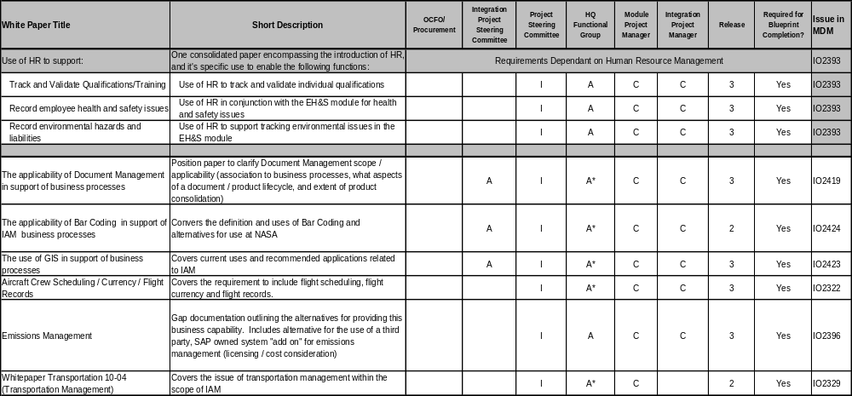
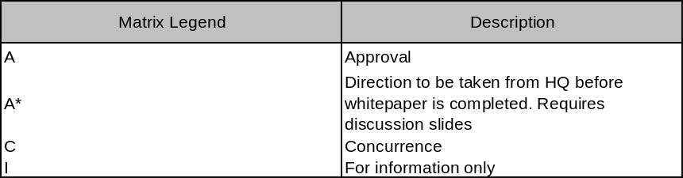
Process IPT
White Paper Status (1 of 2)

Slide 89
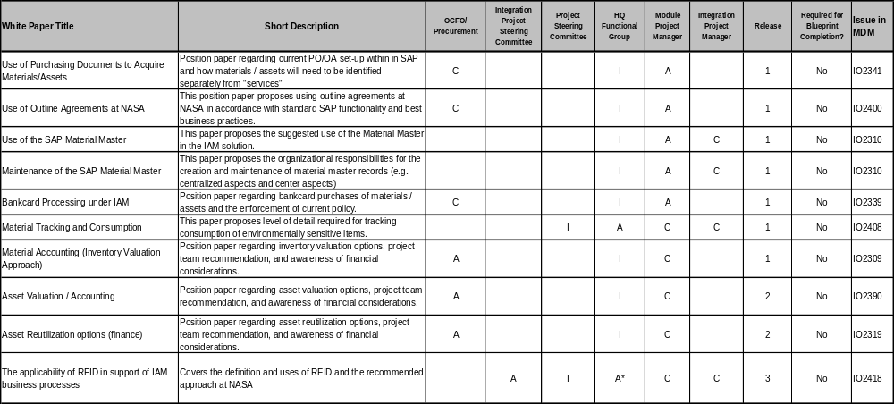
Process IPT
White Paper Status (2 of 2)

Slide 90
White Paper Review:
Use of HR to Support IAM Requirements
Definitions
  The HR Mini Master is a term to reflect a subset of full SAP HR components that can be used for the purposes of qualification management. HR Mini Master does not include other components such as employee benefits, employee payroll, but does include the information components listed below:
    Personnel Administration (employee name and number)
    Organizational Structure (Employee assigned work area(s))
    Personnel Development (employee qualification, certifications)
    Training and Event Management (Tracking expiration of qualification, certifications)

Slide 91
White Paper Review:
Use of HR to Support IAM Requirements
Background
  Managing NASA’s assets in accordance with the Agency’s procedures and the regulatory environment requires a qualified and skilled workforce. Meeting this objective requires the ability to:
    Provide the ability to track and validate what training and other special requirements apply to employees to perform their roles or assigned work.
    Track the validity of asset operators and maintainers with regard to currency of training or other elements which are required to perform their roles or assigned work.
    Enhance the ability to record and respond to incidents and disasters by providing accurate information about the facilities, conditions, people, assets and materials at the affected locations.
Alternatives
  Alternative 1: Implementation of HR Mini Master to enable and fulfill undecided functional requirements.
  Alternative 2: Do not implement the HR Mini Master

Slide 92
White Paper Review:
Use of HR to Support IAM Requirements
Recommended Solution
  Alternative 1: Implementation of HR Mini Master to enable and fulfill undecided drivers and requirements/processes.
    Rationale / Benefit:
      The key benefit of HR Mini Master integration is reducing operating costs & increasing efficiency. The benefit is realized through reducing administration, improving business processes and reducing transaction costs.

Slide 93
White Paper Review:
Document Management
Definitions
  SAP Easy Document Management – Product providing advanced document management capabilities
Background
  The processes that compose Integrated Asset Management generate many documents. In addition, many external documents are needed during the execution of these processes. The ability to utilize and manage these attached documents is critical. A solution is needed to provide accessibility, version control, security, etc. Examples of the types of documents include: technical documents, schematics, manufacturing specifications, maintenance instructions, etc.
Alternatives
  Alternative 1: Utilize SAP Document Management
  Alternative 2: Implement an enterprise Document Management System

Slide 94
White Paper Review:
Document Management
Recommended Solution
  Alternative 1: Utilize SAP Document Management
    Rationale/Benefit
      Utilization of an integrated component of SAP supports integrated processes. SAP Easy Document provides document access to non-SAP users. Scope is not expanded beyond the needs of the IAM project.
  Initial Guidance from HQ Functional Leadership
    Confirmed the scope of Document Management within the IAM Project to include the ability to attach, view, and search published documents. Scope of Document Management within the IAM Project does not include document generation.

Slide 95
White Paper Review:
Bar Code
Definitions
  SAP Auto-ID infrastructure – Standard SAP-supplied software to facilitate the use of Automatic Identification and Data Collection technologies such as bar codes.
Background
  Bar coding is a technology for automating data collection. It speeds data collection while providing accuracy and data integrity. It is a proven technology with many applications. It is considered the most cost-effective technology in the automated identification and data collection industry. This technology is in use across the Agency. The NASA Equipment Management System (NEMS) is the primary agency system identified as utilizing bar codes.
Alternatives
  Alternative 1: Release 1 Scope - Implement SAP Auto-ID infrastructure for bar coding. Facilitate the use of center-specific bar coding applications with center-specific interfaces. Release 2 Scope - Implement Agency-wide solution to replace NEMS bar coding functionality.
  Alternative 2: Release 2 Scope – Implement SAP Auto-ID infrastructure for bar coding. Implement Agency-wide solution to replace NEMS bar coding functionality.

Slide 96
White Paper Review:
Bar Code
Recommended Solution
  Alternative 1: Release 1 Scope - Implement SAP Auto-ID infrastructure for bar coding. Facilitate the use of center-specific bar coding applications with center-specific interfaces. Release 2 Scope - Implement Agency-wide solution to replace NEMS bar coding functionality.
  Rationale/ Benefit
      Utilization of existing hardware
      Less training
      No loss of automation
HQ Functional Leadership Team provided the following initial guidance
  Use of existing center bar code applications will be supported as Center specific interfaces
  Beginning with replacement of NEMS, agency standards for bar coding will be developed and standardized processes will be implemented for any new bar code applications
  Follow up actions received
    More details on SAP standards for bar coding are needed
    Determine impact of deploying more advanced bar code technologies as the emerging standard on existing Center applications
    Need to make full use of bar coding technology
    A data call is being conducted to identify the use of bar coding technology across the agency

Slide 97
White Paper Review:
GIS
Definitions
  Geospatial Information System - is a computerized database management system used for the capture, storage, retrieval, analysis, query and display of spatial (locationally defined) data. GIS software provides computer generated displays of information and can link to underlying data stored in traditional (e.g., tables) electronic databases. It includes all of the following:
    Geographic Information System (GIS) – generally supports mapping, spatial analysis, and associated management of data for large areas. [Typical software: ESRI ArcGIS, MapInfo]
    Computer Aided Design and Drafting (CADD) – CADD is used in Engineering and Architectural designs for facilities and supporting systems. It facilitates efficient creation of drawings for these types of efforts. [Typical software: AutoCAD, Intergraph]
    Computer Aided Facility Management (CAFM) – generally supports display and management of buildings and their systems, based on CADD graphics. [Typical software: Facility Center, Archibus]

Slide 98
White Paper Review:
GIS
Background
  GIS is a tool which uses spatial data in a visual display to establish links with assets record information represented by that spatial data
  Powerful Queries/Analyses GIS
  Operational Cost Savings can total millions of dollars
    0.25 Hours of Travel Time Saved/Day
    x 85 Techs on Avg in the Routine Maintenance
    Workforce per Center
    x 235 Avg Available Workdays Per Year
    x 10 Major Centers in the Agency
    x $60 Avg Cost for Maintenance Skilled
    Workforce Per Hour
    $2,966, 250.00 Average Annual Savings
  Other Agencies are realizing advantages through GIS technology
  Differing GIS capabilities exist at many NASA Centers. These include:
    Space Utilization
    Environmental
    Master Planning
    Underground Utilities
    Real Property
  Uses for GIS are only limited by the creativity of the operator

Slide 99
White Paper Review:
GIS
Alternatives
  Alternative 1: No GIS in the IAM environment
  Alternatives 2: Full GIS: Use GIS to employ all of the applications in the GIS Requirements list
  Alternative 3: Establish an Agency-wide baseline for the GIS capabilities to be integrated with IAM
Recommended Solution
  Alternative 3: Establish an Agency-wide baseline for the GIS capabilities to be integrated with IAM
    Rationale
      Using GIS to provide accurate and easily maintained asset locations, maps, and querying capability, will advance NASA’s business process operations, and provide a state-of-the-art decision-making tool for management
    Benefit
      This alternative offers NASA the opportunity to establish a baseline GIS capability for the Agency that enhances the current GIS capacity at the lesser developed centers, but does not impair what more developed center currently have in place
HQ Functional Leadership Team provided the following follow up actions:
  To successfully manage scope, cost, and risk to the IAM implementation, the minimum IAM business routine data queries for GIS use will be defined
  Implementation cost and risk will be assessed based upon the minimum set of IAM business applications for GIS use

Slide 100
White Paper Review:
Aircraft Crew Scheduling/ Currency/Flight Records
Definitions
  Qualifications: Formal training completed with certification for a specific aircraft or a specific crew assignment such as First Pilot, Co-Pilot, Instructor Pilot, Flight Engineer, Flight Simulation Engineer, etc.
  Flight Currency: That status of flight experience completed by the aircrew within an elapsed time interval (days, months, years) or the number of training events accomplished within a fiscal period. (Quarter, Month, Year).
  Flight Records: The complete records of all NASA flight events for the life of the aircrew, including aircraft type, tail number, departure site and time, destination site and time, number of landings, training accomplished, etc.

Slide 101
White Paper Review:
Aircraft Crew Scheduling/ Currency/Flight Records
Background
  Decide which of multiple alternatives can best fulfill NASA’s requirements to integrate Flight Scheduling, Flight Currency and Flight Records with aircraft maintenance/mission objectives
  NASA Flight Operations has the requirement to provide integrated Flight Scheduling (FS), Flight Currency (FC) and Flight Records (FR) to operate 25 Research and Development Aircraft, 52 Program Support Aircraft and 8 Mission Management Aircraft. The integration of these three elements FR, FC and FS, with aircraft maintenance and the specific configuration of the aircraft to which a crew member is assigned, is required to ensure that Aircrews are qualified and current in their assigned aircraft and crew position, and that aircraft are scheduled in concert with maintenance/mission objectives.

Slide 102
White Paper Review:
Aircraft Crew Scheduling/ Currency/Flight Records
Alternatives
  Alternative 1: Investigate SAP Version 5.0 or next version of SAP Aerospace & Defense (A&D)/Defense Force Public Sector (DFPS) Sector Version
  Alternative 2: COTS Alternative
  Alternative 3: GOTS alternative-NAMIS FRC/FSA modules with a developed interface
  Alternative 4: Conduct Business as usual

Slide 103
White Paper Review:
Aircraft Crew Scheduling/ Currency/Flight Records
Recommended Solution
  Alternative 3: Deploy the existing NAMIS Flight Scheduling, Records, and Currency Applications as the IAM solution and develop interface
    Rationale/Benefit:
      This alternative provides the quickest and simplest solution for the Aircraft module requirements for aircraft and aircrew scheduling, flight records, and crew currency management
      Already in place for JSC which flies nearly 80% of the Agency’s sorties and employs nearly 80% of the Agency’s aircrew
      System is tested and proven and runs on common Agency standard technology
      JSC’s contractor team is in place with sufficient scope on the contract to support Agency wide deployment
Additional impacts to be assessed
  Need additional information on SAP alternative
  Additional data points required on recommended alternative
    Integration requirements and cost
    Sustaining Support implications
    NAMIS FRC/FSA Agency deployment roles and responsibilities, cost, and timeline

Slide 104
White Paper Review:
Emissions Management
Definitions
  SAP xApp - Certified SAP modules that are provided by SAP business partners
Background
  Emissions are planned, permitted or accidental releases into the air, water or soil.
  The scope of emissions management includes:
    Compliance assurance
      Clean Water Act
      Resource Conservation and Recovery Act
      Clean Air Act
      Superfund Amendments and Reauthorization Act
    Requirements definition
    Emissions characterization
    Estimation and measurement
    Controls and tracking
    Management and reporting

Slide 105
White Paper Review:
Emissions Management
Alternatives
  Alternative 1: Implement SAP xApp Emissions Management (SAP xEM)
  Alternative 2: Business as Usual
    Emissions reporting is done at the Center level.
    Notification to operations and maintenance is done manually with no workflow for constraining and operating sources of emission within permit parameters
Recommended Solution
  Alternative 1: SAP xApp Emission Management (SAP xEM)
    Maximizes the efficiency and effectiveness of NASA’s emission compliance programs
    Enhances compliance
Initial Guidance from HQ Functional Leadership Team
  Given current budget challenges within Corporate G&A and Center G&A, any increases to the current scope of the IAM Project will not be pursued at this time

Slide 106
White Paper Review:
Transportation
Background
  To facilitate a decision to include transportation and traffic management within the scope of the Integrated Asset Management (IAM) Project
    Transportation and traffic management (T&TM) is integral to NASA logistics and can be high-profile, high-risk
    Tasks can range from moving spacecraft to foreign countries to delivering stores stock
    Five Centers during FY04 shipped 2 million lbs. at a cost of $1.8 million
Alternatives
  Alternative 1: Continue IAM implementation without transportation and traffic management capabilities
  Alternative 2: Implement a transportation system imported from another Federal agency
  Alternative 3: Implement the transportation and traffic management capabilities in SAP

Slide 107
White Paper Review: Transportation
Recommended Solution
  Alternative 3: Implement the transportation and traffic management capabilities in SAP
    Rationale / Benefit
      Allows for the highest degree of integration of asset management of any of the alternatives
      For spacecraft and instruments built and transported “in-house”, can provide traceability of parts from purchasing and assembly to transport and launch
      Implementation contractor is already in place
      Can provide for cost reductions of 15 percent and productivity improvements of up to 40 percent
Initial Guidance from HQ Functional Leadership Team
  Given current budget challenges within Corporate G&A and Center G&A, any increases to the current scope of the IAM Project will not be pursued at this time

Slide 108
White Paper Review:
RFID
Definitions
  RFID – Radio Frequency identification is a method of remotely storing and retrieving data using devices called RFID tags. An RFID tag is small object, such as an adhesive sticker, that can be attached to or incorporated into a product. RFID tags contain antennae to enable them to receive and respond to radio-frequency queries from an RFID transceiver. RFID is also called dedicated short range communication (DSRC).
Background
  Radio Frequency Identification (RFID) is a method of remotely storing and retrieving data using devices called RFID tags. An RFID tag is a small object, such as an adhesive sticker, that can be attached to or incorporated into a product. Tags can be either active or passive. Read/write range is based on the radio frequency utilized. Standards for this technology are still evolving. Three centers (DFRC, JSC, SSC) indicated the use of RFID on an Implementation Planning data call.
  Several mandates, in the private and government sectors, are driving applicability in the supply chain. The IAM project has established a link to NASA Headquarters (Code JG) to keep informed of the developing GSA bulletin regarding RFID.
Alternatives
  Alternative 1: Implement RFID technology in accordance with GSA Bulletin
  Alternative 2: Do not implement RFID until the technology is more mature

Slide 109
White Paper Review:
RFID
Recommended Solution
  Alternative 1: Implement RFID technology in accordance with GSA Bulletin
    Advantages
      Compliance with GSA directive
      Process efficiencies received by utilizing technology
    Disadvantages
      Risk of failure
      Cost
    Rationale/Benefit
      The five functions outlined in GSA Bulletin are some of the most common applications of this technology. Mandates in the private and government sectors are driving the development of technology standards as well as reducing the cost to implement RFID. The IAM project will participate in the Agency effort to interpret and develop a plan for utilization across the Agency.
HQ Functional Leadership Team provided the following initial guidance
  Given the immaturity and today’s high cost of this technology, RFID will not be pursued at this time
  IAM Scope document will note this clarification and rationale

Slide 110
BACK UP INFORMATION

Slide 111
Agency Business Process
Review: Level 3 Requirements
ID # | High-level Performance Objectives (Level 3 Requirements) | Plan | Acquire | Maintain | Dispose | Finance | Aircraft Ops
1 | Eliminate numerous disparate systems that require users to enter redundant data into multiple databases. | X | X | X | X | X | X
2 | Create environment to integrate business processes and improve data integrity. | X | X | X | X | X | X
3 | Create common reporting structures to provide asset visibility across the Agency | X | X | X | X | X | X
4 | Create an Agency-wide, integrated Materials Management capability (e.g. purchasing, warehousing, inventory management) that supports plant maintenance, fabrication, research, infrastructure services, chemical management, and aircraft operations. Includes an MSDS (material safety data sheet) database. | X | X | X | X | X | X
5 | Facilitate inter-center requisitioning to reduce repetitive procurements. | X | X | X | X | X | X
6 | Within warehousing management optimize material flow and storage processes that support various space condition requirements (temperature, humidity, electrostatic discharge). | X | X | X |  | X | X
7 | Ensure integration of quality management into all materials management processes. |  | X | X |  |  | X
8 | Enhance Agency-wide visibility and tracking of an asset(s) to increase reutilization of assets via internal screening of excess assets. | X | X | X | X | X | X
9 | Establish processes that promote the increase of inter-center transfers and loans and reduce unnecessary procurements. | X | X | X |  | X | X

Slide 112
Agency Business Process
Review: Level 3 Requirements
ID # | High-level Performance Objectives (Level 3 Requirements) | Plan | Acquire | Maintain | Dispose | Finance | Aircraft Ops
10 | Maximize use of external interfaces so that NASA can capitalize on Agency visibility and meet mandatory reporting requirements. | X | X | X | X | X | X
11 | Create an automated system that houses all facets of component maintenance, serialized tracking, and calibration e.g. assemblies and subassemblies of e.g. aircraft, facilities, test equipment, and motor vehicles. | X | X | X | X | X | X
12 | Eliminate reporting issues resulting from inconsistent formats. Eliminate data redundancies, thus improving the quality and consistency of management information. | X | X | X | X | X | X
13 | Create Agency-wide integrated management of motor vehicles that would include parts tracking, license plate tracking, and maintenance tracking & reporting. | X | X | X | X | X | X
14 | Improve cross-functional sharing of data and create new, integrated business processes. | X | X | X | X | X | X
15 | Establish formal life cycle management of assets that leads to enhanced reliability and maintainability. |  | X | X | X | X
16 | Create access to highly visible, real time information about the condition of the asset and its location, value, and the status of predictive, planned and/or emergency maintenance/repair/replace requirements. | X | X | X | X | X | X
17 | Provide timely data concerning the condition of mission critical assets so that real time assessments affecting safety and reliability can be accomplished. | X | X | X | X | X | X
18 | Establish Agency capability to track the validity of asset operators and maintainers with regard to currency of training, operational hours, and certifications. |  | X | X | X | X | X

Slide 113
Agency Business Process
Review: Level 3 Requirements
ID # | High-level Performance Objectives (Level 3 Requirements) | Plan | Acquire | Maintain | Dispose | Finance | Aircraft Ops
19 | Create capability for asset managers to fulfill their duties to provide support to individual mission requirements (e.g. Bill of Materials, Kits, Engineering Changes, Fabrication). |  | X | X |  |  | X
20 | Institute formal configuration management of assets throughout the asset's life cycle |  | X | X |  |  | X
21 | Create the capability to support multiple configurations based on research demands (e.g. military vs. civilian aircraft), and substantial variance from Original Equipment Manufacturer (OEM) configurations. |  | X | X |  |  | X
22 | Create seamless processes in order to share operational and cost data used by other organizations, such as Finance. | X | X | X | X | X | X
23 | Establish data warehouse for storage of data supporting asset records (e.g. permits, engineering changes, safety notices, warranties). | X | X | X | X | X | X
24 | Create processes that integrate with Core Financial to establish and maintain asset values contained in general ledger accounts for NASA PP&E which is both government-held and contractor-held. | X | X | X | X | X
25 | Create asset records that establish and maintain original cost, accumulated depreciation, and net asset value. | X | X | X | X | X
26 | Establish capability to calculate and assign depreciation cost to each capitalized asset consistent with FASAB guidance | X | X | X | X | X
27 | Establish asset tracking in all life cycle phases, cradle to grave, including asset specific liabilities. | X | X | X | X | X

Slide 114
Agency Business Process
Review: Level 3 Requirements
ID # | High-level Performance Objectives (Level 3 Requirements) | Plan | Acquire | Maintain | Dispose | Finance | Aircraft Ops
28 | Enable project managers and property custodians to track costs to specific occurrences and actions (e.g. Cannibalization, Modifications, Activation, Work in Progress, Repair, Depreciation). Requires management of costs at the line item level. This will facilitate improved asset control, valuation, and management. | X | X | X | X | X
29 | Provide the capability to extract performance metrics that measure throughput/output within asset processes in order to identify trends and inefficiencies. | X | X | X | X | X
30 | Maximize use of state of the art techniques e.g. (Geo-spatial Information Systems), radio frequency tags, scales, scanners for bar code technology, and palm held devices) in the performance of asset tracking. | X | X | X | X | X
31 | Manage assets held in inventory utilizing mandatory requirements in JFMIP "Inventory, Supplies, and Materials Systems Requirements" | X | X | X | X | X
32 | Manage PP&E utilizing mandatory requirements for JFMIP "Property Management Systems Requirements". | X | X | X | X | X
33 | Establish space management of facilities utilizing GIS (Geo-spatial Information Systems). |  | X | X |  | X
34 | Create the ability to track who owns the asset and how it is used, to more accurately determine charge-back costs based on utilization |  | X | X |  | X
35 | Support on- and off-site tracking and record keeping for hazardous waste disposal, solid waste disposal, and material recycling activities. | X | X | X | X | X
36 | Provide the capability to determine long-term costs (e.g., end-of-life disposal liabilities) of asset ownership. | X | X | X | X | X

Slide 115
Agency Business Process
Review: Level 3 Requirements
ID # | High-level Performance Objectives (Level 3 Requirements) | Plan | Acquire | Maintain | Dispose | Finance | Aircraft Ops
37 | Establish and maintain needs determination for acquisitions supporting inventory, repair, or production/fabrication. | X | X | X | X |  | X
38 | Establish and maintain forecasting and replenishment via the Economic Order Quantity. | X | X | X | X | X
39 | Utilize Supply Chain Management to develop integrated solutions to support Agency fabrication, maintenance, research, and infrastructure services that will reduce acquisition lag times and costs associated with such delays. | X | X | X | X | X
40 | Unify data between resource requirements, finance, and other requisite systems to fully exploit the utilization of supply chain management. | X | X | X | X | X | X
41 | Establish the capability for centralized commodity management or materials and reparable components. | X | X | X | X | X | X
42 | Create asset records that display highly visible information about the condition of the asset, mishap reporting and investigation documentation, and the status of predictive, planned and emergency maintenance requirements. | X | X | X |  |  | X
43 | Create workflow that automatically issues work orders for assets (e.g. aircraft, motor vehicles, facilities) based on planned or predictive data, or unscheduled work. | X | X | X |  | X | X
44 | Establish Agency capability to perform Master Site Planning utilizing GIS. | X | X | X | X | X | X

Slide 116
Agency Business Process
Review: Level 3 Requirements
ID # | High-level Performance Objectives (Level 3 Requirements) | Plan | Acquire | Maintain | Dispose | Finance | Aircraft Ops
45 | Establish Agency capability to perform Project Management for multiyear projects e.g. facilities construction, environmental remediation sites. Organize around Planning, Design, and Construction, and Activation phases for construction projects, and environmental regulatory requirements for remediation activities. | X | X | X | X | X | X
46 | Establish Agency capability to maintain asset management data on collateral equipment located within a user-defined area/plant. | X | X | X | X | X | X
47 | Establish capability to record and track deferred maintenance against facilities. | X | X | X | X | X | X
48 | Establish Agency wide Maintenance, Repair, and Overhaul (MRO) capability in the areas of Maintenance Engineering, Spares Management, Maintenance Planning, and Operations Management. Supports assets such as buildings, structures, motor vehicles, aircraft, spacecraft, machinery, etc. | X | X | X | X | X | X
49 | Establish uniform tracking of both hazardous/controlled materials and the assets consumed during operation including the capability for the calculation of usage data, inventory levels and restriction usage. | X | X | X | X | X | X
50 | Provide the capability to extract performance metrics that demonstrate compliance with federal and state laws. | X | X | X | X
51 | Increase visibility to identify inefficiencies and impacts, thus reducing overall use, and controlling release and disposal. | X | X | X | X

Slide 117
Agency Business Process
Review: Level 3 Requirements
ID # | High-level Performance Objectives (Level 3 Requirements) | Plan | Acquire | Maintain | Dispose | Finance | Aircraft Ops
52 | Provide access to data on a project's work breakdown structure (WBS), with the capability to track hours and costs (resources) against the WBS. | X | X | X |  |  | X
53 | Record corrective actions identified during asset inspections and track them to closure. | X | X | X |  |  | X
54 | Create a system that will track parts/materials requisitions and sharing of associated hardware between end items. | X | X | X
55 | Use best practices (e.g., asset bar coding, electronic signatures, electronic connection to vendors) to meet or exceed delivery times resulting from current processes. | X | X | X | X |  | X
56 | Leverage web interfaces, in conjunction with handheld devices and wireless networks, to enable Agency-wide remote access to information needed for asset maintenance, utilization, and management | X | X | X | X |  | X
57 | Provide asset users and owners the capability to readily access any data that they need, and are authorized to have. | X | X | X | X |  | X
58 | Enhance room/move coordination by providing real-time update capabilities to asset records. | X | X | X |  |  | X
59 | Enhance the capability to respond to unscheduled events, incidents, and disasters by providing near real-time access to accurate information about the facilities, conditions, people, assets, and materials present at the affected locations. Record employee health and safety issues and environmental hazards and liabilities associated with the assets or locations where the incidents occurred. | X | X | X | X |  | X

Slide 118
Agency Business Process
Review: Level 3 Requirements
ID # | High-level Performance Objectives (Level 3 Requirements) | Plan | Acquire | Maintain | Dispose | Finance | Aircraft Ops
60 | Enhance visibility of current and historical asset data to facilitate rapid Agency-wide dissemination of information on breakthrough solutions, best practices, lessons learned, and frequently asked questions. | X | X | X | X |  | X
61 | Establish the capability to gather data and information to prepare external reports (e.g., reports to EPA, GSA, DOE, OMB, and others.) | X | X | X | X | X | X
62 | Optimize employee's time by using single point of data entry, thereby eliminating redundant data entry and processes. | X | X | X | X |  | X
63 | Support "One NASA" by electronically linking the dispersed workforce with an integrated solution that allows for collaborative work. | X | X | X |  |  | X
64 | Empower employees to make direct on-line requests and receive expedited approval. |  | X | X |  |  | X
65 | Increase portability of knowledge, skills, and abilities by standardizing processes across NASA Centers and installations. | X | X | X |  |  | X
66 | Provide the ability to track and validate what training, personal protective equipment, health surveillance, and other special requirements apply to employees by virtue of their roles, assigned work, or exposure to hazards. |  | X | X |  |  | X
 | Totals | 57 | 66 | 66 | 48 | 44 | 47

Slide 119
White Paper Topics for Resolution During Applicable Realization Phase

Slide 120
White Paper Review:
Use of Purchasing Documents to Acquire Material/Assets
Definitions
  Purchasing Documents – document involved in the purchasing process such as Purchase Orders and Outline Agreements.
Background
  At NASA today purchasing documents containing only service line items are utilized to purchase both services and materials, including fixed assets. With the implementation of IAM, there are new business requirements that need to be taken into account.
  The Core Financial use of the purchasing module in SAP is financial in nature and primarily used to record obligations. As such, the majority of purchasing documents for large acquisitions at NASA only contain service line items. These documents do not contain line items for the deliverables that are acquired under the contract.
  Under the proposed design for IAM, which utilizes the SAP material master, continued use of this practice will negate several of the capabilities that should be delivered.
Alternatives
  Alternative 1 - Operate using the existing Core Financial process where purchasing documents recorded in SAP do not reflect the deliverables of the contract. Manual entry of goods receipt and receipt of assets will be required.
  Alternative 2 - Enter purchasing documents in SAP that reflect the deliverables of the contract. This approach will apply to both new and existing documents.
  Alternative 3 - Enter new purchasing documents in SAP that reflect the deliverables of the contract. For existing purchasing documents, criteria should be developed to define which documents should be converted to reflect the deliverables being acquired.

Slide 121
White Paper Review:
Use of Purchasing Documents to Acquire Material/Assets
Recommended Solution
  Alternative 3 - Enter new purchasing documents in SAP that reflect the deliverables of the contract. For existing purchasing documents, criteria should be developed to define which documents should be converted to reflect the deliverables being acquired.
    Rationale/Benefit
      By implementing this alternative, NASA will be able to accurately receive, valuate and report on items purchased as part of the contract. This alternative realizes the benefits derived from IAM that satisfy the business case and functional drivers.
      In addition, this will result in the ability to support the level of detail required for maintenance, project and cost management. This follows the SAP standard business process and adheres to recommended best business practice.

Slide 122
White Paper Review:
Use of Outline Agreements at NASA
Definitions
  Purchasing Documents – document involved in the purchasing process such as Purchase Orders and Outline Agreements.
  Outline Agreement - An outline purchase agreement is an agreement between a purchasing organization and a vendor for the supply of materials or the performance of services.

Slide 123
White Paper Review:
Use of Outline Agreements at NASA
Background
  At NASA the current Core Financial configuration of the SAP system utilizes the SAP outline purchase agreement to represent only a few types of NASA contracts. These include Blanket Purchasing Agreements, Basic Ordering Agreements and Indefinite Delivery/Indefinite Quantity. With the implementation of IAM, there are new business requirements that need to be taken into account.
  The current process for capturing incremental funding actions involves adding lines to an existing purchase order without linking funds to specific contract deliverables. This reduces the ability to accurately track funding and costing.
  A decision is needed to determine if the use of outline agreements at NASA might be expanded to include additional types of contracts that currently utilize the SAP purchase order to represent the contract.
Alternatives
  Alternative 1 - Continue with the current Core Financial process involving use of outline purchase agreements limited to BOA’s, BPA’s, and ID/IQ contracts. Continue to use purchase orders to capture the majority of NASA’s contract information in SAP.
  Alternative 2 - Use the SAP outline purchase agreement for all contracts at NASA. Users should create release orders with reference to a contract rather than continually adding new lines to an existing Purchase Order. Use SAP purchase orders only for limited scope and short-term purchases.
  Alternative 3 - Hybrid – For all contracts, use outline agreements where appropriate. It will be necessary to develop the criteria used to identify which documents should be entered as or converted to an outline agreement.

Slide 124
White Paper Review:
Use of Outline Agreements at NASA
Recommended Solution
  Alternative 3 - Hybrid – For all contracts, use outline agreements where appropriate. It will be necessary to develop the criteria used to identify which documents should be entered as or converted to an outline agreement.
    Rationale/Benefit
      The expanded use of the outline agreement at NASA more closely follows standard SAP business process design as well as best business practice.
      Because of the integrated nature of SAP the value chain is impacted when core functionality is under-utilized.
      In order to manage the supply chain in SAP, NASA will need to structure its purchasing documents at the level required to support the related business functions.
      Continued use of a single purchase to capture the details described above will likely result in the purchase order reaching the 999 line item limitation. The use of standard SAP functionality for outline agreements and release orders mitigates this problem.

Slide 125
White Paper Review:
Use of the SAP Material Master
Definitions
  Material Master - The SAP material master is an organization’s main source of material-specific data. It is the central database record of information on a material (such as descriptions, inventory levels, units of measure, environmental data, etc.).
Background
  The use of the SAP material master represents the opportunity to more definitively identify items that are being purchased and to track inventory. This decision also has impacts / implications for definition/set-up and maintenance of the material master data. A management decision is needed regarding the extent that material masters will be used -- how these are defined, what business parameters or guidelines will be used, and what organizational group(s) will be involved in the set-up and maintenance.
Alternatives
  Alternative 1 - Material master usage in SAP will not be expanded.
  Alternative 2 - The material master will be utilized for all activities in SAP.
  Alternative 3 - The material master will be utilized in cases not involving one time purchases. At NASA it should be utilized for the following:
    Items that NASA procures internally and externally.
    Items that NASA produces in-house (including waste streams).
    All items that NASA keeps in inventory.
    This alternative includes routine services and excludes services acquired through major contracts and are not of a routine and/or repetitive nature.

Slide 126
White Paper Review:
Use of the SAP Material Master
Recommended Solution
  Alternative 3 - The material master will be utilized in cases not involving one time purchases.
    Rationale/Benefit
      The current Core Financial design uses the material master in a very limited capacity. The recommendation for IAM is to use the material master to take advantage of the extensive capabilities it provides. Due to the additional business requirements and processes (as defined in the blueprint phase) the use of material masters for IAM should be expanded at NASA. Expanded use of the material master conforms to standard SAP and supports best business practices and the business case for IAM.

Slide 127
White Paper Review:
Maintenance of the SAP Material Master
Definitions
  Material Master - The SAP material master is an organization’s main source of material-specific data. It is the central database record of information on a material (such as descriptions, inventory levels, units of measure, environmental data, etc.).
Background
  The use of the SAP material master represents the opportunity to more definitively identify items that are being purchased and to track inventory. This decision also has impacts / implications for definition/set-up and maintenance of the material master data. A management decision is needed regarding the extent that material masters will be used -- how these are defined, what business parameters or guidelines will be used, and what organizational group(s) will be involved in the set-up and maintenance.
Alternatives
  Alternative 1 - The material master is maintained centrally.
  Alternative 2 - The material master is maintained locally by the departments that own the data that comprise the material master.
  Alternative 3 - Create and maintain the basic material master data centrally and allow local maintenance of center-specific data (e.g., purchasing view, inventory and storage views, sales and distribution views, etc.)

Slide 128
White Paper Review:
Maintenance of the SAP Material Master
Recommended Solution
  Alternative 1 - The material master is maintained centrally.
    Rationale/Benefit
      Best Practice dictates that the material master should be controlled centrally. This will help maintain data integrity and reduce or eliminate redundant or incorrect data. The benefits derived from the system are directly dependant upon the accuracy and integrity of the data. Therefore, it is imperative that the accuracy and integrity of the data must be protected.
      There are tools and techniques available within SAP to streamline and automate parts of the process. The process can be managed through the use of Service Level Agreements (SLAs) to minimize the cycle time required.
      This supports the “One NASA” concept.

Slide 129
White Paper Review:
Bankcard Processing under IAM
Definitions
  Fixed Asset – SFFAS #6 defines fixed assets to be tangible assets that (1) have an estimated useful life of 2 or more years, (2) are not intended for sale in the ordinary course of business, and (3) are intended to be used or available for use by the entity. This property, which meets the capitalization threshold, is recorded in the PP&E accounts of the Standard General Ledger and is expensed over its useful life through the use of depreciation entries.

Slide 130
White Paper Review:
Bankcard Processing under IAM
Background
  The Bankcard process lacks important safeguards and allows users to circumvent formal approval and inventory processes. For example, the Bankcard software does not require users to record critical information from Bankcard holders with regard to their purchases (safety data, hazardous material designation, etc.). With the implementation of IAM, there are new business requirements that need to be taken into account.
Alternatives
  Alternative 1 - Utilize the existing Core Financial bankcard process as-is and enforce policy through management controls. These controls include monitoring using various reports on a daily basis (or more frequently), if desired.
  Alternative 2 - Strictly utilize SAP functionality to record purchases made using bankcards.
  Alternative 3 - Items that are inventory-controlled, fixed assets, hazardous, sensitive and/or trackable should be purchased using the to-be acquisition process (and not purchased using the bankcard software). It is anticipated that there will be occasions where a user will utilize a bankcard to purchase an item that should have gone through the to-be acquisition process (in SAP). These occasions are likely to be for emergencies where the to-be acquisition process cannot meet the required delivery date. For these emergency purchases manual procedures will be required to capture the relevant detail in SAP.

Slide 131
White Paper Review:
Bankcard Processing under IAM
Recommended Solution
  Alternative 3 - Items that are inventory-controlled, fixed assets, hazardous, sensitive and/or trackable should be purchased using the to-be acquisition process (and not purchased using the bankcard software). Rationale / Benefit
    Rationale/Benefit
      Selection of alternative 3 will provide NASA with the benefits of not having to modify the existing bankcard process or its associated interfaces with SAP. In addition, it will provide required controls for those items that are inventory-controlled, fixed assets, hazardous, sensitive and/or trackable, etc.
      This alternative suggests the cases where Bankcard usage is appropriate. The selection of this alternative is not intended to impact the trend towards increased use of Bankcards at NASA or within the federal government. This alternative aims to achieve regulatory compliance.

Slide 132
White Paper Review:
Material Tracking and Consumption
Background
  NASA currently tracks consumption of environmentally relevant materials at the point of utilization. The purpose of this paper is to identify the options available to accomplish this within the IAM project, as well as conforming to specific Federal requirements to report inventory for hazardous materials that exceed 10,000 lbs or extremely hazardous substance (EHS) that exceed 500 lbs or the threshold planning quantity (TPQ) whichever is less.
    For example, when materials are issued to the R&D laboratories the unused materials are not returned to inventory as this is impractical. Materials are stored in the lab until consumed and the consumption may not occur within the EH&S reporting periods.
Alternatives
  Alternative 1: Inventory tracking of environmentally relevant materials with warehouse/location/bin hierarchy and goods issue transaction volume appropriate to center environmental reporting requirements.
  Alternative 2: Receipt of chemicals directly to R&D labs without inventory tracking.

Slide 133
White Paper Review:
Material Tracking and Consumption
Recommended Solution
  Alternative 1: Inventory tracking of environmentally relevant materials with warehouse/location/bin hierarchy and goods issue transaction volume appropriate to center environmental reporting requirements.
    The decision to implement this recommendation has an impact to the R&D labs for the responsibility to maintain chemical inventory.
    The design of the inventory warehouse/location/bin hierarchy is critical for chemical management tracking. Extending the hierarchy and the transactional responsibility to the R&D labs is an organizational change.
  Rationale / Benefit:
    Provides full visibility of inventory for compliance reporting
    Consumption is recorded at point of goods issue.
    Full visibility to materials for work in process
    Enables environmental and safety compliance.

Slide 134
White Paper Review:
Finance Definitions
Definitions
  Inventory (OM&S) – SFFAS #3 defines operating materials and supplies as tangible personal property to be consumed in normal operations.
  Valuated inventory – Those operating materials and supplies that are recorded on the balance sheet when received.
  Non-valuated inventory – Those operating materials and supplies that are recorded as an expense when received.
  Fixed Asset – SFFAS #6 defines fixed assets to be tangible assets that (1) have an estimated useful life of 2 or more years, (2) are not intended for sale in the ordinary course of business, and (3) are intended to be used or available for use by the entity. This property, which meets the capitalization threshold, is recorded in the PP&E accounts of the Standard General Ledger and is expensed over its useful life through the use of depreciation entries.
  Depreciation – SFFAS #6 defines depreciation as the process of expensing a capitalized asset over its useful life.
  Capitalization threshold - NASA defines property as meeting the capitalization threshold if it has a value $100,000 or more at acquisition and has a useful life of two or more years, except for internal-use software, which must have an acquisition value of $1,000,000 or more.
  Work in Process (WIP) – A balance sheet account that stores the value of property under construction prior to its being placed in service.

Slide 135
White Paper Review:
Finance Definitions
Definitions
  Asset Master – Each capitalized asset is recorded on an asset master record, which has a unique number, descriptive data, capitalization date and value, and depreciation keys. The asset master serves as a sub-ledger to the associated PP&E account in the general ledger, and is referenced each time the value of the asset is changed.
  Net realizable value – The net realizable value of a capitalized asset is the value which one could expect to obtain for the property if it were offered for sale on the open market.
  SFFAS #3 and #6 – The Federal Accounting Standards Advisory Board issues accounting concepts and standards for the federal government. Statement of Federal Financial Accounting Standard (SFFAS) #3 is related to inventory and SFFAS #6 is related to the treatment of PP&E. (Other SFFAS documents do not apply to the whitepapers under consideration.)
  Program Stock – Material acquired by direct purchase for a program or project.
  Project Stock – Material acquired for a project, placed in restricted stock, and recorded as valuated inventory on the balance sheet .
  Rotable Spares - Those parts which are routinely exchanged for other parts during the maintenance and refurbishment cycle.

Slide 136
White Paper Review:
Material Accounting (Inventory Valuation Approach)
Background
  Inventory Valuation – Addresses what inventory valuation method should be used and which inventory should be treated as valuated.
Alternatives
  Alternative 1: Expense all material and carry non-valuated inventory
  Alternative 2: Receive all material to valuated inventory
  Alternative 3: Project Stock option
  Alternative 4: Mixed Method

Slide 137
White Paper Review:
Material Accounting (Inventory Valuation Approach)
Recommended Solution
  Alternative #4: Mixed methods of valuation
    Rationale / Benefit:
      Allows maximum flexibility for treatment of inventory valuation.
      Consumption can be posted when goods are removed from inventory/ OM&S, except for rotables treated as depreciable assets.
      Inventory/operation materials and supplies can be tracked using goods movements.
      Program stock can be controlled through goods movements while valuated on the balance sheet in WIP.
      Rotable spares can be controlled through goods movements while valuated on the balance sheet as fixed assets.
      NASA can make a good faith declaration of assets held.
      Costs of high-dollar rotable spares with a useful life of two years or more can be depreciated over time.

Slide 138
White Paper Review:
Asset Valuation / Accounting
Background
  Fixed Assets vs. Inventory Valuation – Addresses when it is appropriate to follow an inventory process with respect to property and when it is appropriate to follow a fixed assets process.
Alternatives
  Alternative 1: Record material meeting the capitalization threshold as valuated inventory upon receipt, transfer value to WIP, and then to fixed assets
  Alternative 2: Record material meeting the capitalization threshold as fixed assets upon goods receipt, and record the same property as non-valuated inventory to facilitate warehouse movements
  Alternative 3: Mixed solution

Slide 139
White Paper Review:
Asset Valuation / Accounting
Recommended Solution
  Alternative #3: Mixed Solution
    Rationale / Benefit:
      Enables costing to work orders, projects, and cost centers of materials upon issue from inventory
      Enables expensing of program stock and movement to WIP within the financial period of receipt without sacrificing warehouse control
      Enables consistency with auditor requirements for capitalization and depreciation of rotable spares
      Meets diverse requirements and facilitates both warehouse control and costing

Slide 140
White Paper Review:
Asset Reutilization Options (Finance)
Background
  Fixed Asset Re-utilization and Disposal – Addresses what process should be used for the reutilization of fixed assets.
Alternatives
  Alternative 1: Retire fixed asset and receive the used property into valuated inventory
  Alternative 2: Retain fixed asset record and receive the used property into non-valuated disposal inventory
  Alternative 3: Write off the asset and receive into non-valuated inventory
  Alternative 4: Retain valuated asset record and transfer the asset if it is needed by another NASA project or center.

Slide 141
White Paper Review:
Asset Reutilization Options (Finance)
Recommended Solution
  Alternative 4: Retain valuated asset record and transfer the asset if it is needed by another NASA project or center.
      Place asset on available list by marking a custom indicator on the asset master for reutilization/disposal status
      If reutilization takes place, perform asset transfer
      If asset is not reutilized, write down the asset to net realizable value, receive the property into excess and obsolete non-valuated inventory, and follow ordinary procedures for inventory disposal
    Rationale / Benefit:
      This is the normal SAP functionality
      Avoids sudden and expensive write-offs
      Complies with SFFAS #6

