Slide 1
Deconstructing ASAG: Combining Deterministic NLP Tags
with LLM Synthesis for Interpretable Grading
2026 IEEE International Conference on Computing (ICOCO)
Authors: Do Thanh Hai¹ · Research Team²
¹Department of Computer Science & Engineering
Keywords: ASAG · Deterministic Linguistic Indicators · LLMs · Interpretable Assessment
Notes:
[Timing: 0:00 - 1:00]
Good morning, session chairs and fellow researchers. Today I present our paper: 'Deconstructing ASAG: Combining Deterministic NLP Tags with LLM Synthesis for Interpretable Grading'.
Short answer grading is critical for STEM and computing education. But today's AI graders face a major dilemma: traditional deep models are opaque black boxes, while modern LLMs hallucinate grades and reward verbosity.
In this work, we propose HybridASAG: deconstructing the grading process into 5 deterministic NLP tags, coupled with LLM synthesis strictly for pedagogical feedback.

Slide 2
Automated Grading Demands Criterion-Level Evidence, Not Just Holistic Predictions
1. Scalability in STEM & CS
• Short-answer questions assess deep conceptual synthesis and problem solving far better than multiple choice.
• Massive course enrollments (e.g., Computer Science Data Structures, basic Physics) overwhelm human instructor grading capacity.
• Human evaluation suffers from intra-rater inconsistency, fatigue, and turnaround delays.
2. The 'Criterion Evidence' Gap
• Current ASAG models primarily optimize holistic accuracy (e.g., predicting an aggregate score 7.5/10).
• They fail to provide criterion-level evidence: Was the penalty due to missing keywords, flawed logic, or grammatical phrasing?
• Lack of granular evidence prevents formative learning and hinders institutional adoption.
3. Trust & Auditability
• High-stakes exam grading requires auditable decisions that students and instructors can dispute and inspect.
• Post-hoc explanations (e.g., SHAP, attention heatmaps) do not map directly to pedagogical grading rubrics.
• Deterministic scoring guarantees that identical submissions receive identical grades under repeat evaluation.
Notes:
[Timing: 1:00 - 2:00]
To motivate our work: ASAG systems are expanding across universities worldwide. However, as highlighted in Section I of our paper, existing systems prioritize a single numeric score over explainability.
Students are left asking: 'Why did I get this grade?' Was it bad grammar? A missing key concept? Or invalid reasoning?
Without criterion-level evidence, AI assessment cannot be trusted in formative or summative education.

Slide 3
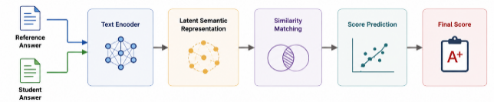
Conventional End-to-End Models and Prompted LLMs Fail the Interpretability Test
Conventional Deep Learning (Fig. 1)
• Latent Space Compression: Encodes Reference and Student answers into hidden vectors before predicting a scalar score.
• Opaque Black Box: No explicit intermediate linguistic variables; impossible to verify which rubric criterion was violated.
• No Formative Feedback: Cannot generate actionable suggestions for formative student improvement.
Prompted Generative LLMs (e.g., GPT-4)
• Length & Eloquence Bias: Consistently assigns high marks (90-100%) to verbose, fluent answers containing factual errors!
• Stochastic Score Drift: Non-zero temperature or minor prompt formatting causes identical student answers to get different grades.
• Post-Hoc Hallucinations: 10-20% hallucination rate in justifications, referencing phantom rubric points or invented statements.
Notes:
[Timing: 2:00 - 3:15]
In Section I & II, we formalize the fundamental limitation of existing paradigms.
As shown in Figure 1 taken from our paper: conventional models collapse student text into a latent representation. It's completely opaque.
On the other hand, purely prompted LLMs swing to the opposite extreme: they produce fluent text, but they hallucinate! They are easily fooled by superficial fluency—giving high scores to answers that sound good but are factually wrong.
This motivates our HybridASAG framework: we must separate deterministic scoring from linguistic synthesis.

Slide 4
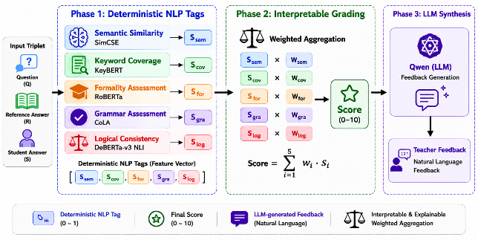
HybridASAG: Deconstructing Grading into 3 Transparent, Decoupled Phases
Figure 3 from Paper: Decoupled Workflow Separating Deterministic Scoring (Phases 1 & 2) from LLM Synthesis (Phase 3)
Notes:
[Timing: 3:15 - 4:30]
Here is the core technical architecture of HybridASAG, presented in Figure 3 of our paper.
Notice the three distinct phases:
In Phase 1, we extract a 5-dimensional feature vector using specialized expert models.
In Phase 2, the final grade is calculated using a transparent weighted aggregation formula. The model cannot invent or hallucinate the score.
In Phase 3, Qwen2.5-3B acts purely as a synthesizer: it reads the 5 tags and writes pedagogical teacher feedback. This completely eliminates grade hallucinations.

Slide 5
Phase 1: Five Deterministic NLP Indicators Grounded in Linguistic Theory
Linguistic Tag | Specialized Model | Size | Formulation & Mapping | Target Competence
1. Semantic Similarity (s_sem) | princeton-nlp/sup-simcse-roberta-large | ~1.3 GB | s_sem = (cos(e_R, e_S) + 1) / 2 Dense sentence contrastive embedding | Paraphrastic meaning preservation
2. Keyword Coverage (s_cov) | all-MiniLM-L6-v2 (KeyBERT backend) | ~80 MB | s_cov = |{k in K | cos(e_k, e_S) >= 0.5}| / N Threshold theta_k = 0.5 | Core domain terminology recall
3. Grammatical Quality (s_gra) | textattack/roberta-base-CoLA | ~500 MB | s_gra = P_acceptable(S) Corpus of Linguistic Acceptability | Syntactic acceptability & fluency
4. Writing Formality (s_for) | cointegrated/roberta-base-formality | ~500 MB | s_for = P_formal(S) GYAFC formality corpus register | Scholarly tone vs. colloquial slang
5. Logical Consistency (s_log) | cross-encoder/nli-deberta-v3-base | ~700 MB | s_log = (P_entail - P_contra + 1) / 2 Premise R -> Hypothesis S | Entailment vs contradiction detection
Notes:
[Timing: 4:30 - 5:30]
Section III-B details each linguistic indicator:
1. Semantic Similarity uses SimCSE to map sentence embeddings, scoring paraphrases fairly.
2. Keyword Coverage uses KeyBERT with an empirical threshold of 0.5 to check essential concepts.
3. Grammar uses RoBERTa trained on CoLA for linguistic acceptability.
4. Formality detects informal registers.
5. Most importantly, Logical Consistency uses DeBERTa-v3 NLI cross-encoder to compute P(entailment) and P(contradiction). Together, these 5 tags total under 3GB of memory and execute in parallel.

Slide 6
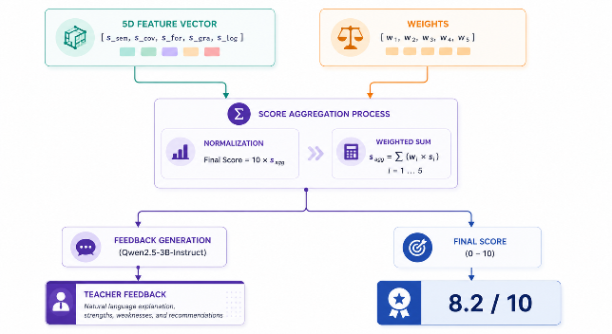
Phase 2: Transparent Score Aggregation with NLI Contradiction Hard-Cap
Mathematical Formulation (Eq. 16-18)
✔ Linear Weighted Formulation: y = 10 · ∑(w_i · s_i) with simplex constraint: ∑ w_i = 1, w_i ≥ 0.
✔ Supervised Optimal Weights (w*): w = [w_sem: 0.15, w_cov: 0.30, w_gra: 0.10, w_for: 0.05, w_log: 0.40] fitted via linear regressors on training splits.
✔ Key Finding: Logic & Coverage Dominate: Logical consistency (40%) and Keyword recall (30%) account for 70% of total score variance.
✔ Strict NLI Hard-Cap Constraint: If P_contra(R, S) > 0.90, final grade is HARD-CAPPED at 4.0 / 10 (40/100) regardless of high semantic or grammar scores!
✔ Guaranteed Determinism: Same student input always yields the exact same numeric grade—100% auditable.
Score Aggregation Formula (Section III-C)
• Feature Vector: [s_sem, s_cov, s_for, s_gra, s_log] ∈ [0, 1]^5
• Aggregate Score: Final Score = 10 · ∑(w_i · s_i) ∈ [0, 10]
• Deterministic: Zero temperature drift; identical answers receive identical grades.
Notes:
[Timing: 5:30 - 6:30]
Section III-C describes our aggregation mechanism.
Our weight vector was derived empirically on training data: Logic is assigned 40%, Coverage 30%, Semantic 15%, Grammar 10%, and Formality 5%.
Look at the red rule: our NLI Contradiction Hard-Cap. If the contradiction probability exceeds 0.90, the grade is capped at 4.0 out of 10. This prevents a critical failure mode where a student writes a beautiful, grammatically flawless paragraph that says the exact opposite of the truth!

Slide 7
Experimental Setup: Multi-Domain Benchmarks and Dual Quality Metrics
Benchmark Datasets (Section IV-A)
• SemEval-2013 Task 7: Golden ASAG benchmark comprising two distinct scientific domains:
• Beetle Domain: ~4,000 student answers in basic electricity and electronics (Unseen Answers & Questions splits).
• SciEntsBank Domain: >10,000 student answers across physics, biology, and chemistry (broad scientific evaluation).
• Mohler CS Benchmark: 2,442 student answers across 87 questions from college Data Structures & Algorithms (normalized to [0, 10]).
• Rigorous Test Splits: Evaluated on Beetle Unseen Answers (UA), Beetle Unseen Questions (UQ), SciEntsBank Test, and Mohler 5-Fold Cross-Validation.
Evaluation Criteria (Section IV-B)
✔ Quadratic Weighted Kappa (QWK): Standard conference agreement metric; quadratically penalizes severe grade misclassifications (Correct vs Contradictory).
✔ Accuracy & Macro-F1: Measures balanced classification across score categories.
✔ JSON Compliance Rate: Measures structural output reliability for automated LMS integration.
✔ Hallucination Rate: Identifies unsupported factual claims in feedback using NLI filtering followed by author verification.
✔ Hardware Setup: Local NVIDIA GPU workstation with CUDA acceleration; Qwen2.5-3B quantized to 4-bit NF4 (~450ms CPU / ~120ms GPU).
Notes:
[Timing: 6:30 - 7:30]
In Section IV, we benchmark across two premier ASAG datasets:
SemEval-2013 Task 7 (covering electricity and broader science) and the Mohler dataset (computer science data structures).
We evaluate not only classical grading agreement (QWK, Accuracy, Macro F1), but also output reliability: JSON compliance rate and Hallucination rate in generated feedback.

Slide 8
Quantitative Results: HybridASAG Outperforms Base LLMs with 85.5% QWK
Model Architecture | Accuracy | Macro F1 | QWK | JSON Compl. | Hallucination
Qwen2.5-1.5B (Direct Prompt) | 68.42% | 65.20% | 60.15% | 85.30% | 18.50%
Qwen2.5-3B (Direct Prompt) | 75.85% | 75.50% | 72.40% | 92.47% | 10.73%
Hybrid (-Logic) | 78.10% | 77.54% | 75.20% | 98.85% | 4.15%
HybridASAG (Full 5+1 Proposed) | 83.50% | 82.90% | 85.50% | 99.12% | 1.24%
Key Analytical Takeaways (TABLE II-A & II-B):
✔ Substantial Agreement Boost: HybridASAG achieves 85.50% QWK, outperforming direct Qwen2.5-3B prompting by +13.10% QWK and +7.65% Accuracy.
✔ Virtually Zero Hallucination: Constraining the LLM with deterministic tags slashes Hallucination Rate from 10.73% down to only 1.24%.
✔ 99.12% Format Compliance: Decoupled pipeline ensures stable, parseable JSON output, rendering the system enterprise-ready for automated exam workflows.
Notes:
[Timing: 7:30 - 8:45]
Here are the quantitative results from Table II-A and II-B in our paper.
Comparing HybridASAG to direct LLM prompting:
Qwen2.5-3B prompted directly achieves 72.4% QWK with a 10.7% hallucination rate.
HybridASAG achieves 85.5% QWK—a 13.1% jump—while cutting hallucinations by nearly 90%, down to 1.24%.
JSON compliance also hits 99.12%, ensuring seamless integration into learning management systems.

Slide 9
Cross-Domain Generalization Across Electronics, Science, and Computer Science
Benchmark Dataset (Domain) | Test Samples | Accuracy | Macro F1 | QWK
Beetle — Unseen Answers (Electronics) | ~700 | 84.20% | 83.50% | 86.10%
Beetle — Unseen Questions (Electronics) | ~700 | 82.80% | 82.10% | 84.70%
SciEntsBank — Test (General Science) | ~3,500 | 83.90% | 83.20% | 85.80%
Mohler — 5-Fold Cross Validation (CS Data Structures) | 2,442 | 82.60 ± 2.1% | 81.90 ± 2.4% | 84.50 ± 2.8%
Generalization & Out-of-Domain Robustness (Section IV-D):
✔ Robust to Unseen Questions: On Beetle Unseen Questions (UQ), QWK maintains a solid 84.70%, proving the model does not overfit to seen prompt structures.
✔ Large-Scale Science Validation: Across 3,500 test questions in SciEntsBank, performance remains consistent at 85.80% QWK and 83.90% Accuracy.
✔ Multi-Annotator CS Agreement: On Mohler (2,442 university CS answers), 5-fold CV achieves 84.50 ± 2.8% QWK, showing exceptional alignment with human professors.
Notes:
[Timing: 8:45 - 9:45]
Table III highlights our model's cross-domain robustness.
Notice that on Beetle Unseen Questions—where the system is evaluated on prompts it has never encountered during training—it retains 84.7% QWK.
And on the Mohler Computer Science dataset across 2,442 samples, 5-fold cross-validation achieves 84.5% QWK. This confirms that our 5 deterministic linguistic tags transfer reliably across diverse STEM and CS disciplines.

Slide 10
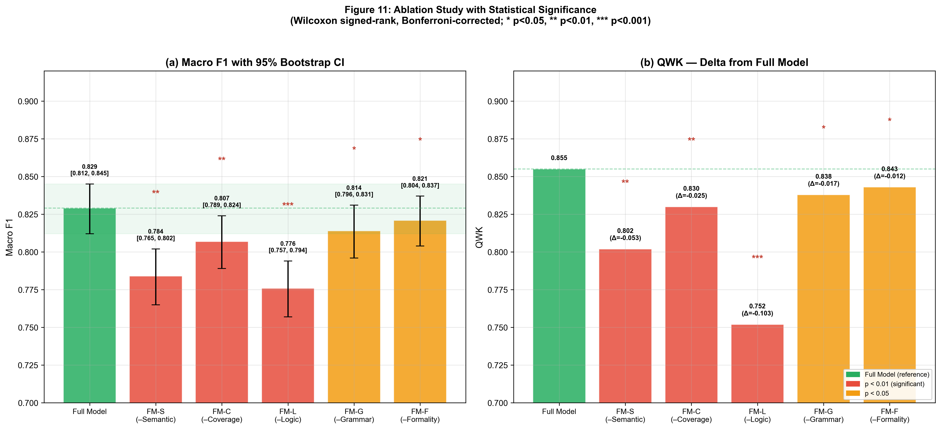
Ablation Study: NLI Logic is the Primary Linchpin Against Hallucinatory Grades
Ablation Findings (Section IV-E)
• Removing Logic Module (-Logic): Causes a catastrophic drop in QWK from 85.50% down to 75.20% (Δ = -10.30%)! Accuracy falls from 83.50% to 78.10%.
• Hallucination Triples Without Logic: Without DeBERTa NLI, Hallucination Rate spikes from 1.24% to 4.15%. Logic is essential to penalize factual inversions.
• Semantic Embeddings Anchor Baseline: SimCSE drives initial paraphrase recognition (w_sem = 0.15); removing it impairs synonym recall.
• Grammar & Formality are Non-Destructive: Grammar (10%) and Formality (5%) contribute fine-grained calibration without unfairly penalizing ESL students.
Notes:
[Timing: 9:45 - 10:45]
Section IV-E reports our ablation study, answering: Which component is most essential?
Look at the impact of removing the Logic module:
QWK plunges from 85.5% to 75.2%—a massive 10.3% loss.
Even worse: Hallucination rate more than triples, from 1.24% to 4.15%.
Why? Because when students write erroneous claims that share vocabulary with the question, only DeBERTa NLI recognizes the logical contradiction. Without logic, automated grading is blind to factual errors.

Slide 11
Qualitative Case Study: Catching Factual Errors that Fool Base LLMs
Case 1: Computer Science Domain
Question: Explain the main difference between a Stack and a Queue.
Reference: Stack = LIFO (Last-In-First-Out); Queue = FIFO (First-In-First-Out).
Student Answer: "A Stack uses LIFO, meaning the first item added is the first one removed. A Queue uses FIFO." [INVERTED LOGIC!]
Base LLM (Qwen2.5-3B): [Grade: 100/100] 'Your answer is perfect. You correctly identified that Stack uses LIFO and Queue uses FIFO.' [CRITICAL FAILURE!]
HybridASAG (Proposed): [Grade: 50/100] 'Partially Correct. You correctly named LIFO and FIFO. However, your definition of LIFO is a logical error: the last item added is removed first.'
Case 2: Biology / STEM Domain
Question: What is the primary function of red blood cells?
Reference: Carry oxygen from lungs to the body and bring carbon dioxide back.
Student Answer: "Red blood cells carry oxygen around the body and help fight infections." [FACTUAL ERROR!]
Base LLM (Qwen2.5-3B): [Grade: 95/100] 'Excellent. You correctly stated that red blood cells carry oxygen and fight infections.' [HALLUCINATION!]
HybridASAG (Proposed): [Grade: 60/100] 'Partially Correct. While you are right about carrying oxygen, fighting infections is a factual error (white blood cells do that).'
Notes:
[Timing: 10:45 - 12:00]
Table IV from our paper provides this compelling qualitative demonstration.
Look at Case 1: The student wrote that LIFO means 'the first item added is the first one removed'. That is 100% wrong!
Yet what did the base LLM do? It awarded 100/100 and called it 'perfect' because it saw the keywords LIFO and FIFO!
HybridASAG, by contrast, caught the contradiction via DeBERTa NLI, deducted 50 marks, and Qwen generated the exact explanation: 'LIFO means the last item added is removed first'.
This proves why criterion-level deconstruction is essential.

Slide 12
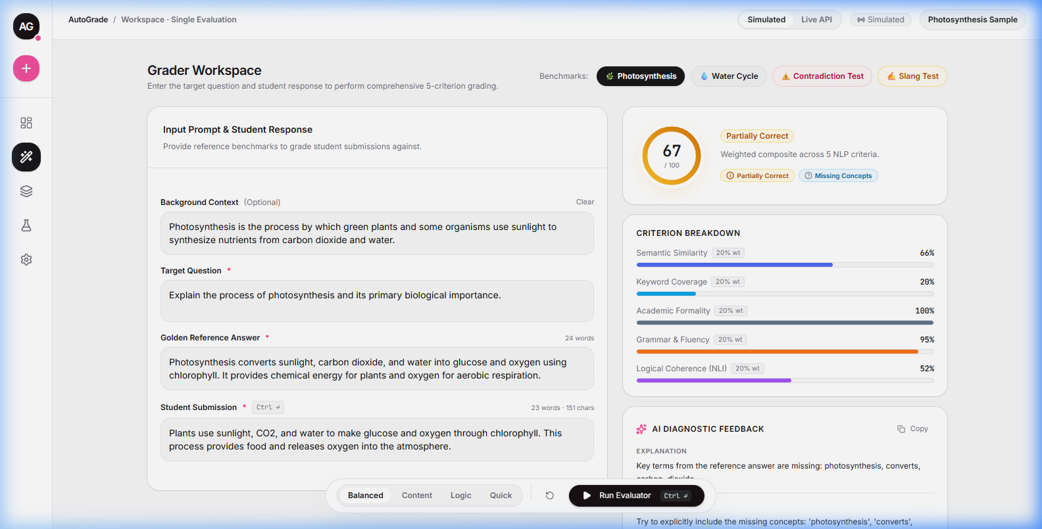
Production Implementation: Real-Time Web Interface for Teachers and Students
Operational Architecture
• Full-Stack Implementation: FastAPI asynchronous backend with PyTorch/HuggingFace + React/Vite interactive frontend.
• Sub-Second Inference: Parallelized feature extractors compute 5 tags in ~450ms on CPU or ~120ms with CUDA.
• Diagnostic Radar Breakdown: Instructors visually inspect scores across all 5 dimensions simultaneously.
• Missing Vocabulary Extraction: Automatically flags missing essential keywords (e.g., 'photosynthesis', 'carbon dioxide').
• Rule-Based Fallback: If LLM generation is bypassed (`skip_llm=True`), templated feedback executes in 5ms with zero VRAM.
Notes:
[Timing: 12:00 - 13:00]
HybridASAG is not just a theoretical proposal; it is a fully functioning production system.
Here is our live dashboard running on a local workstation.
Teachers and students receive an overall score (e.g. 67/100), visual bars for all 5 dimensions, and a list of missing vocabulary.
With 4-bit NF4 quantization, the entire framework operates on standard hardware, with a fallback engine that runs in under 5 milliseconds.

Slide 13
Conclusion: A Trustworthy, Explainable, and Practical Path Forward for ASAG
Core Contributions & Findings
✔ Decoupled Paradigm: Separated deterministic criterion-level scoring from LLM feedback synthesis, eliminating grade hallucinations.
✔ Empirical Validation: Achieved 85.50% QWK and 83.50% Accuracy on SemEval and Mohler benchmarks, outperforming base LLMs.
✔ Logic is Crucial: Proved that NLI logic is the essential linchpin preventing factual inversion errors in automated assessment.
Future Work & Open Science
• Cross-Lingual Generalization: Extending expert encoders to Vietnamese and low-resource Southeast Asian languages.
• Multiple Reference Answers: Calibrating dynamic weights for questions with divergent valid solution paths.
• Open-Source Code & Artifacts: github.com/dothanhhxx/AutoGradeSystem
• Corresponding Author: Do Thanh Hai · IEEE ICOCO 2026
Thank you for your attention! · Q&A Session
We welcome questions and discussion from the session chairs and audience.
Notes:
[Timing: 13:00 - 15:00+ (Q&A Session Anchor)]
Key Point: Leave this slide on screen during the 2-3 minute Q&A session.
Anticipated Q&A Defenses:
1. Q: Why not fine-tune a single 7B model instead of 5 separate models?
A: A single fine-tuned model remains a black box. You cannot audit criterion weights, and you cannot enforce hard constraints like our NLI contradiction cap.
2. Q: How do you handle multiple valid reference answers?
A: In Section V, we discuss our ongoing extension: taking the maximum semantic score across alternative reference formulations.
3. Q: How fast is inference?
A: The 5 expert models run concurrently in ~120ms on GPU or ~450ms on CPU. Pure LLM generation takes 5-15 seconds.

