Slide 1
Full text search and other things… (based on Elasticsearch)
Maciej Kowalski
National Information Processing Institute

Slide 2

Text search engines?
Imagine a bunch of documents:
How to find ones with particular phrase inside?

Slide 3
Inverted Index
It is the basis of every search algorithm. Each index entry is a word (or term, it depends how you divide it) and a list of document where that particular word is located (possibly with locations within that document).
D1) I love you
D2) Love is blind
D3) Blind justice
word | documents
i | (1, 1)
love | (1, 2), (2, 1)
you | (1, 3)
is | (2, 2)
blind | (2, 3), (3, 1)
justice | (3, 2)
More: https://xlinux.nist.gov/dads/HTML/invertedIndex.html

Slide 4
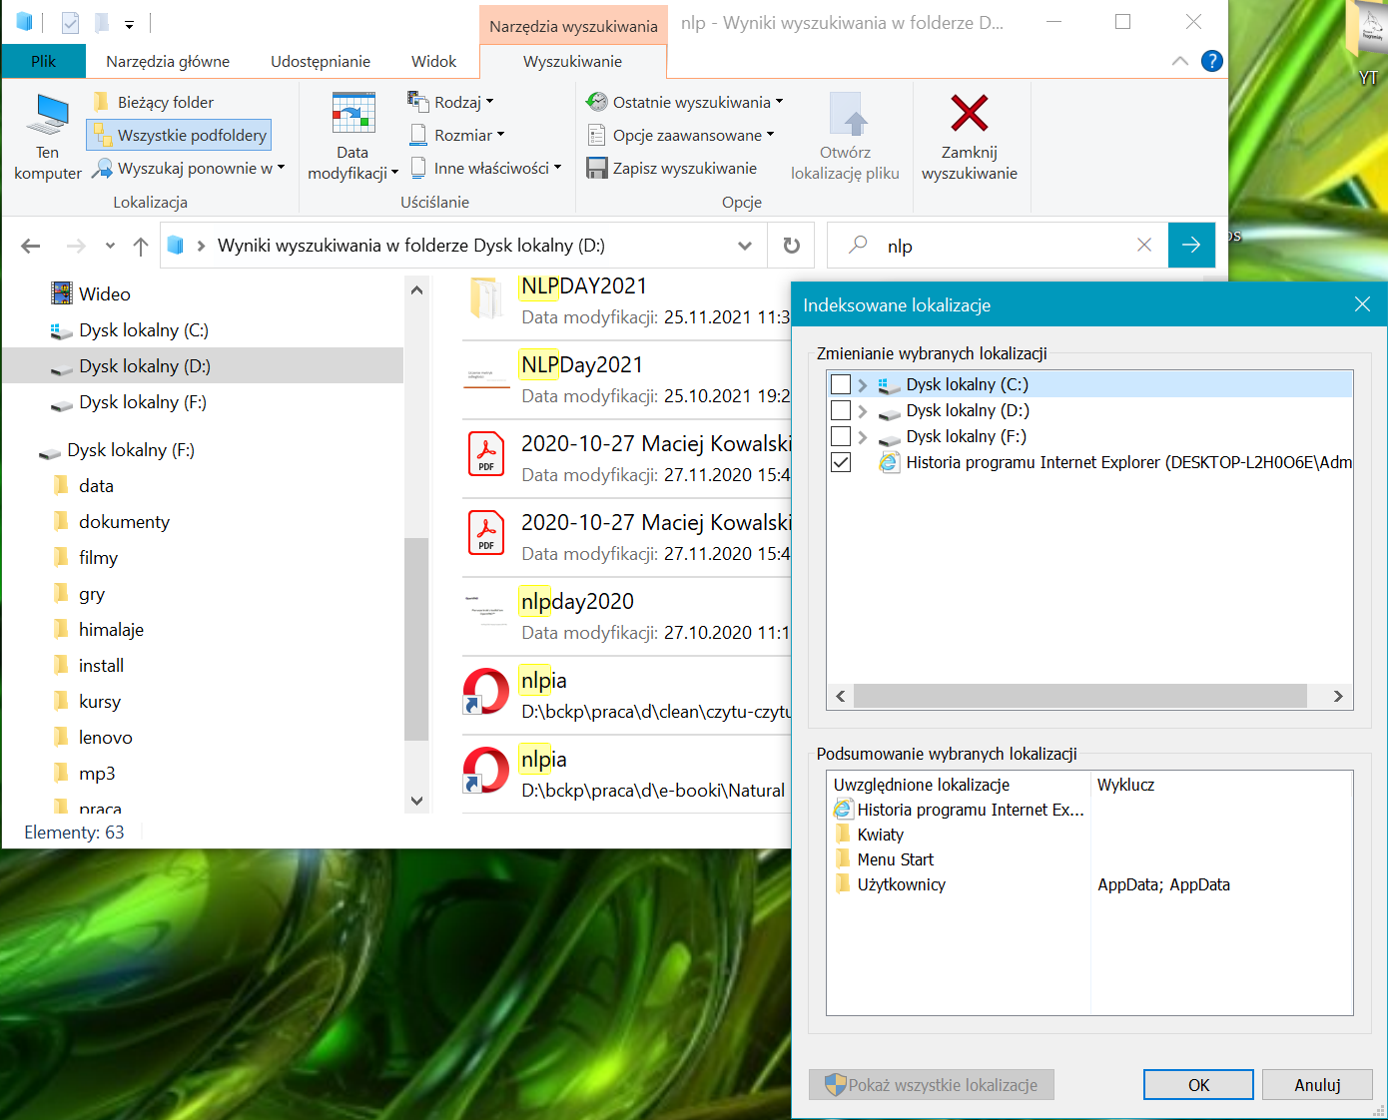




Text Search Engines?

Slide 5

Elasticsearch
Used as Search Engine in Uniform Antiplagiarism System (JSA),
Distributed (can contain multiple nodes – a cluster, which makes whole infrastructure fault-tolerant),
Managed by REST API (can be accessed through a web browser).

Slide 6

Kibana
Provides Web UI for accessing and managing your Elasticsearch cluster,
Can be used for document analysis and visualization.

Slide 7
Resources
Elasticsearch: https://www.elastic.co/downloads/elasticsearch
Kibana: https://www.elastic.co/downloads/kibana
europarl files
apache logfile
data loading tool
dictionary data: https://github.com/hunspell
additional resources on github: https://github.com/dotjabber/spinaker-elasticsearch

Slide 8
Thank you
Maciej Kowalski
National Information Processing Institute

