Slide 1
Lubrication Strategy Follows Criticality
Why lubrication is preventive maintenance
There is no single right answer — spend where it counts
If roughly 80% of failures trace back to contaminated or degraded oil, then every lubrication action counts as preventive maintenance — not housekeeping.
The same logic as heart health: diet and a blood test every six months cost very little. Surgery does not.
Equipment character
What to specify
Cheap, easy to replace, not critical
A basic lubricant is enough
Spare held on board, quick swap
Standard grade
The six functions of a lubricant
Stern tube, thruster — costly, hard to reach, expensive downtime
Specify the best available
Reduce friction
Reduce wear
Prevent corrosion
Remove heat
Criticality — not price — sets the specification.
Remove contaminants
Transmit fluid power
Classified as Internal - This content is proprietary information intended for employees and partners only.

Slide 2
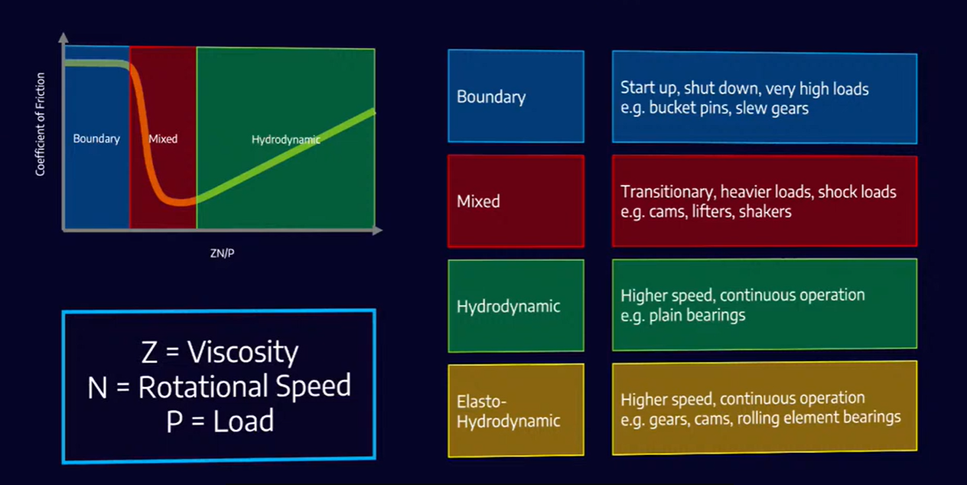
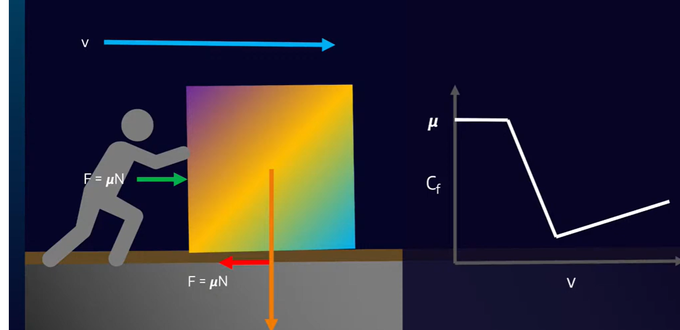
Friction and the Four Lubrication Regimes
Stribeck curve
The intuition
Friction against ZN/P, and where each regime shows up on board
Push a block across concrete and friction is highest before it moves — and barely depends on speed.
Add a lubricant and friction drops sharply. Keep raising the speed and it climbs again, the way a ship has to push aside more water the faster it goes: now the oil itself is what must be sheared.
Slow and heavily loaded → higher viscosity, so the film forms sooner.
Classified as Internal - This content is proprietary information intended for employees and partners only.

Slide 3
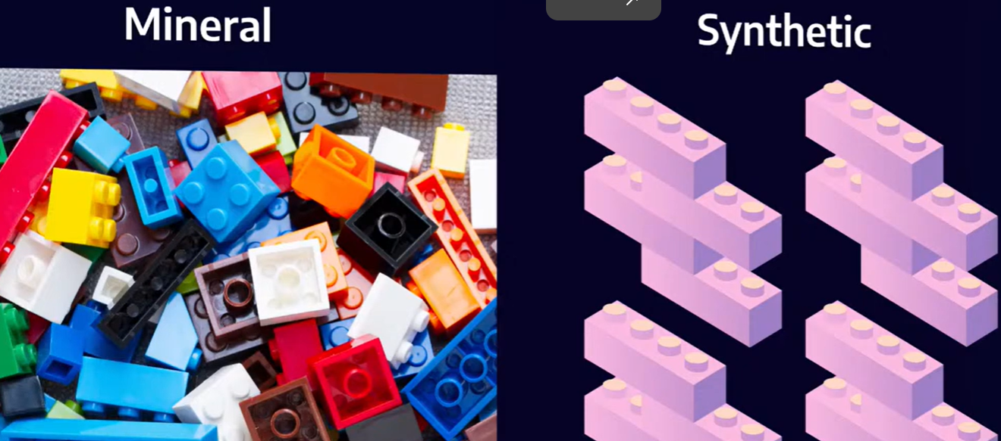
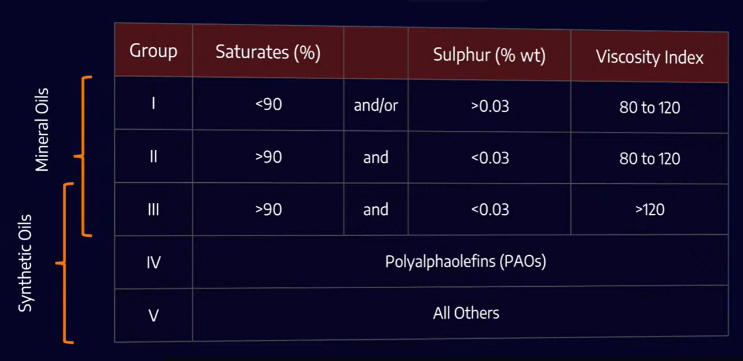
Base Oils — Mineral and Synthetic
Two ways to make a base oil
API base oil groups
Mineral — refined from crude oil. A box of mixed Lego: many shapes, many sizes, whatever the barrel gave you.
Synthetic — known molecules assembled into the structure you actually want.
Group III is sold as synthetic in most markets, but it is still refined mineral stock — synthetic in name.
Group IV (PAO) is the workhorse synthetic — gears and some compressors.
Group V is everything that fits nowhere else, which does not make it better.
Viscosity Index = how much the oil thins as it heats. Higher VI, flatter response.
Classified as Internal - This content is proprietary information intended for employees and partners only.

Slide 4
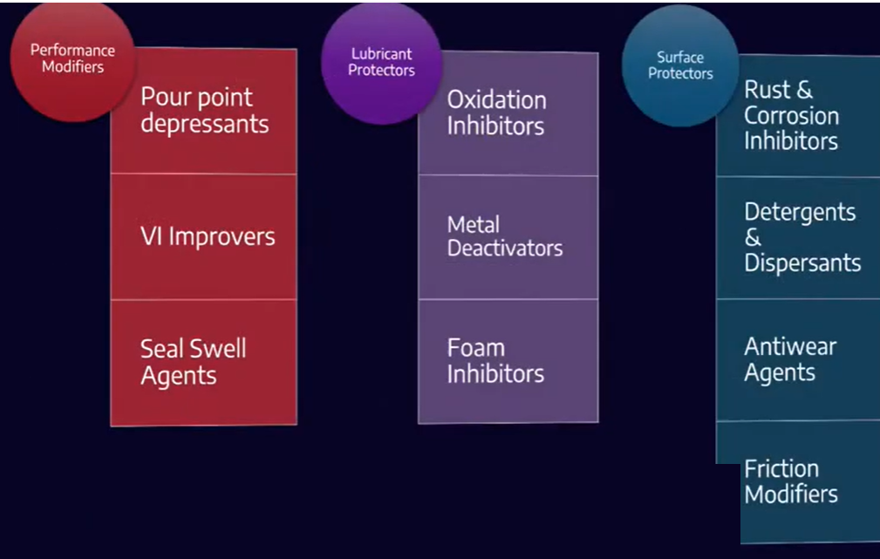
Additives, Viscosity and Grease
Additive families
The three properties that matter most
1
Viscosity
2
Viscosity against temperature
3
Viscosity against pressure
Kinematic viscosity is the figure normally quoted; ISO VG is the grading standard.
Grease = base oil + thickener + additives
Think of a sponge holding water. Squeeze it and water comes out; release it and the sponge takes the water back.
The thickener matrix holds the base oil until the bearing turns and load comes on. The oil is pushed out, and it is the base oil that does the lubricating.
Additives are the most expensive part of the blend — do not pay for what the application does not need.
Open to atmosphere
More oxidation inhibitor
Heavily loaded
Extreme pressure (EP)
Consistency is graded by worked penetration (NLGI). NLGI 2 is the general multipurpose grade.
Hydraulic pump
Antiwear (AW)
Compressor, turbine
R&O — rust and oxidation
Classified as Internal - This content is proprietary information intended for employees and partners only.

