Slide 1


AGENDA
Notes:
Good morning, and thank you for your time.
What I want to share today is what we are seeing in bunker fuel claims this year, and what it means for your ships.
The short version is this. Claims are up about 50 percent. But the bigger change is not the number — it is that fuel which passes the test can still stop a ship.
I will show you the data first, then three real cases, then what we can do about it. About 20 minutes, and please stop me any time.

Slide 2
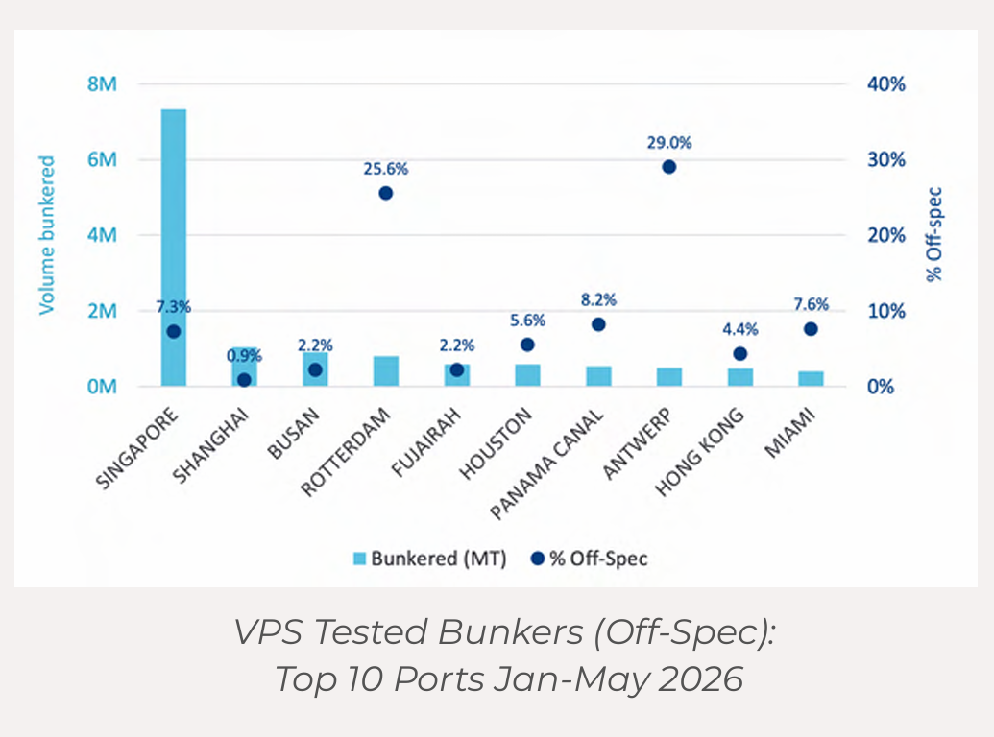
Where the Claims Came From — Ports and Off-Spec Rates
Where the bad-fuel claims came from
The chart shows the bunker claims recorded in the first five months of 2026, placed at the port where the ship actually took the fuel (stem location).
The risk is spread across the world rather than sitting in one region. That simply follows global supply patterns.
Singapore, Houston and the ARA ports (Amsterdam, Rotterdam, Antwerp) show many cases, but these are also the ports that sell the most fuel.
This data counts quality problems only. It does not count how much fuel was delivered, so more cases does not mean a higher risk rate.
Ports with the highest off-spec rate
VPS tests every sample, whatever the result. Antwerp came out at 25.6% off-spec and Rotterdam at 29.0% — the highest anywhere.
Singapore, the largest bunker port in the world, was 7.3%. That is below the global average of 8.8% as of May 2026.
Notes:
Let us start with where the problems are.
Every dot on this map is a claim, placed at the port where the ship actually took the fuel. The first thing to notice is that the risk is everywhere. It is not one bad region.
Now, one warning about reading this map. Singapore, Houston and the ARA ports look busy — but they also sell far more fuel than anywhere else. This data counts problems, not volume. So a lot of dots does not mean a bad port.
The right-hand figures are the fair comparison, because VPS tests every sample. Antwerp is 25.6 percent off-spec and Rotterdam 29 percent. Singapore is 7.3 percent — below the world average of 8.8.
So if you bunker in North West Europe, plan for a higher chance of an off-spec result.

Slide 3
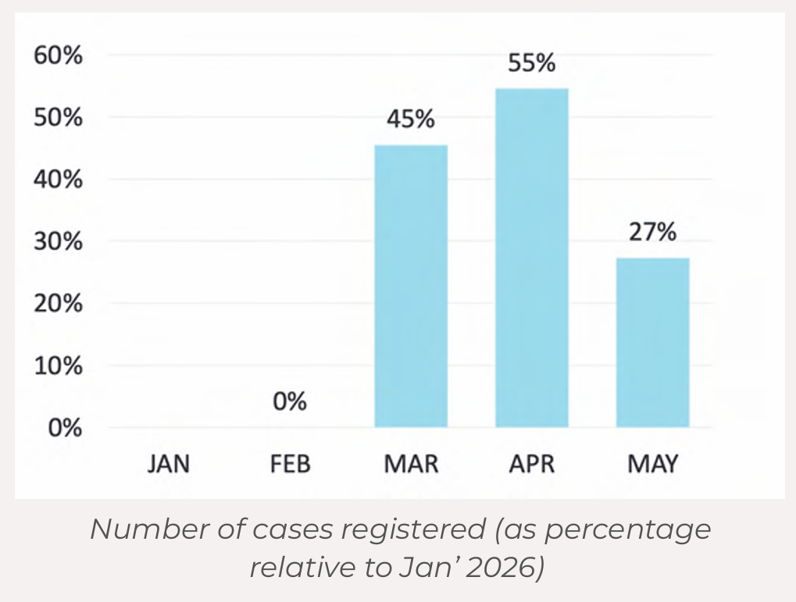
Bunker Claims Jan–May 2026 — More Cases, More Complex
About 70 fuel quality claims were recorded from January to May 2026 — roughly 50% more than the same period last year.
Most of the increase came in March to May, the same months the Middle East conflict escalated.
We cannot say the conflict is the direct cause. But supply chain disruption and market pressure clearly raised the fuel quality risk.
Refineries have adjusted their crude slates and production. Off-spec results for TSP (sediment) and Al+Si (cat fines) have gone up as a result.
Higher feedstock and bunker prices have pushed suppliers to use more cutter stock, which can pull fuel quality down.
Ships lying idle in the region for long periods also face more fuel degradation. FAME (UCOME) biofuel is the most sensitive to long storage.
Notes:
Here is the trend.
About 70 claims in five months. Around 50 percent more than last year.
And look at the timing. Most of the rise came in March to May — the same months the Middle East conflict escalated.
I want to be careful here. We cannot prove the conflict caused it. But we can see what changed. Refineries adjusted their crude slates and their output. Off-spec results for sediment and cat fines went up. And with feedstock prices higher, suppliers used more cutter stock to hold the price — which pulls quality down.
One more point that matters if any of your ships are waiting in the region. Fuel sitting in a tank for a long time degrades, and biofuel blends degrade fastest. If you have a ship idle out there, check that stock.

Slide 4
Claim and ISO standard
Claims by insurance cover
Most bunker quality claims are disputes between owner and charterer.
That is because the charterer normally buys and supplies the fuel.
It becomes a Hull & Machinery claim only when the engine is actually damaged.
Among the serious casualties Gard handled in 2026, none was confirmed to be caused directly by bad fuel.
But several ships did lose the ability to move. In coastal or busy waters that is a serious safety risk.
Notes:
A quick word on who ends up paying, because it surprises people.
Most of these claims are not insurance claims at first. They are contract arguments between owner and charterer. That is simply because the charterer usually buys the fuel.
It only becomes a Hull and Machinery claim when the engine is actually damaged.
The good news for 2026 is that Gard found no serious casualty caused directly by bad fuel this year.
The less good news is that several ships lost the ability to move. If that happens in a narrow channel or a busy anchorage, it is no longer a fuel problem. It is a safety problem.

Slide 5
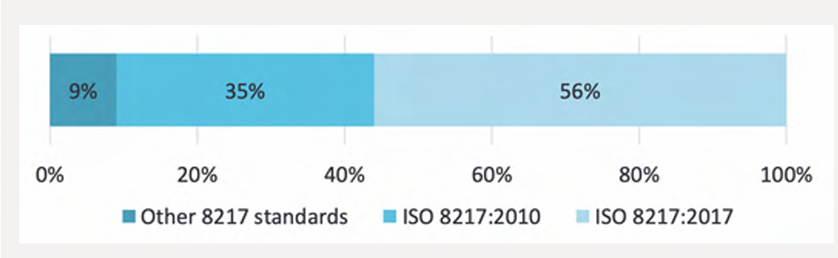
The Limits of ISO 8217, and Clause 5
Claims split two ways
Clause 5 — what you have to prove
Share
Type
1
Show the harmful substance is there — standard tests are not enough, so GC-MS or similar analysis is needed.
60%
A Table 2 parameter is itself off-spec (TSP, cat fines). In many of these, other harmful substances were suspected as well.
2
Show that the substance actually harmed the machinery or safety.
3
So the key is causation, not simply detection.
40%
Table 2 passed in full, but other problem substances were alleged.
ISO 8217:2024 Annex B states that where a factual cause-and-effect link between a chemical and an operational problem can be established, the fuel is treated as not meeting the standard.
Trial consumption or fuel treatment can also prove it in practice, but it carries operational risk and needs careful records.
Passing Table 2 is a starting point, not proof that the fuel is fit for use.
Notes:
This is the slide I would ask you to remember.
Look at the split on the left. Sixty percent of claims are what you expect — a test parameter is off-spec. Sediment, cat fines, that kind of thing.
But forty percent are fuels that passed every single Table 2 test and still caused a problem.
Forty percent. That is the gap the standard does not cover.
For those cases we rely on Clause 5, and the three steps on the right are what you have to prove. Not just that a substance is present, but that it actually caused harm. Standard tests will not find it — you need GC-MS or similar.
The helpful development is at the bottom. ISO 8217:2024 now says clearly that if you can establish cause and effect, the fuel has not met the standard.
So the message is simple: passing Table 2 is where you start, not where you finish.

Slide 6
Fuel Types and Off-Spec Rates
Which fuel types the claims came from
More than 85% of the bunker claims in the first five months of 2026 involved VLSFO. Cases involving LSMGO and HSFO were far fewer.
That follows the market. Since the global sulphur cap came in during 2020, VLSFO has been the main marine fuel.
There is a technical reason too. VLSFO is usually a blend of several components, so its composition varies a lot and unexpected chemical contaminants are more likely.
Quality disputes can happen with any grade, but VLSFO carries the largest quality risk in the market today.
VPS off-spec data (Jan–May 2026)
Worldwide, 8.8% of fuels failed at least one test parameter.
By fuel type — VLSFO 8.7% · HSFO 8.5% · Distillates 8.8% · ULSFO 28.8% · Biofuel 0.4%
The interesting point: almost all claims come from VLSFO, yet biofuel has the lowest off-spec rate of all.
ISO 8217 alone cannot judge fuel quality
The ISO standard only shows part of the picture.
Recent cases passed every ISO 8217 test and still caused serious problems on board.
Where fuel has been cut with other blend stock, chemicals that Table 2 does not test for can still affect performance.
Finding those substances needs extra analysis such as GC-MS.
Notes:
Now, which fuels are we actually talking about.
Over 85 percent of claims involve VLSFO. Partly that is just market share — it has been the main fuel since the sulphur cap in 2020.
But there is a real technical reason too. VLSFO is a blend of several components, so what is inside varies from stem to stem, and unexpected chemicals are more likely.
Then look at the off-spec table, because two numbers stand out.
ULSFO is 28.8 percent. If you trade in emission control areas, that needs separate attention.
And biofuel is 0.4 percent — the lowest of all. That surprises most people. Biofuel tests very clean. Its risks are in storage and handling, not on the test certificate.
The last block is the same message as before, stated plainly: ISO 8217 on its own cannot tell you whether a fuel is safe.

Slide 7
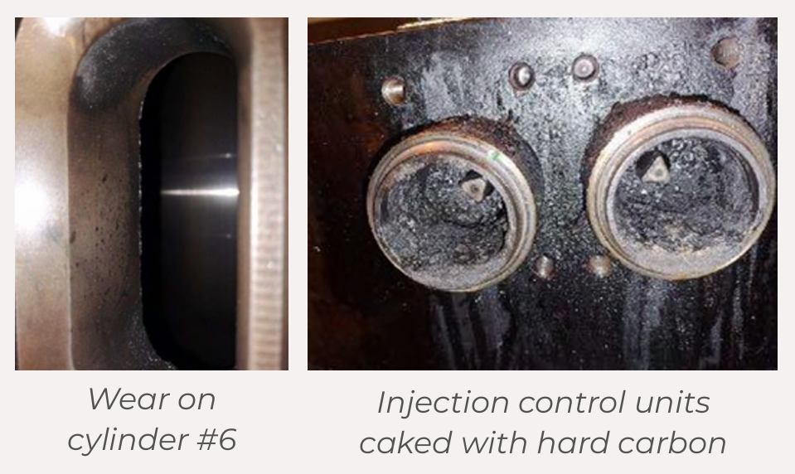
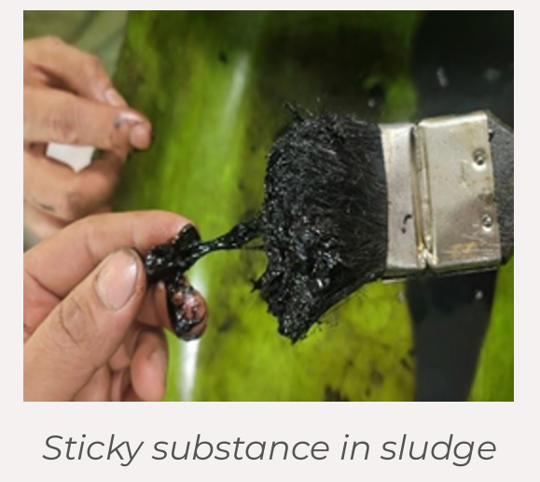
What Actually Happened — Three Cases
Case 1 — Antwerp VLSFO (ISO 8217:2005)
Case 2 — Singapore VLSFO
Key points (Case 1)
Passing ISO 8217 Table 2 does not mean the fuel is safe. This fuel met the spec, yet the engine was damaged and the main engine stopped.
Clause 5 is what matters. An organic acid — not listed in the spec table — caused the damage.
What counts is whether harmful substances are present, not whether the fuel passed the test list.
Extra analysis such as GC-MS may be needed. Standard ISO tests found nothing; the extra analysis found the cause.
A fuel problem can grow into a major operational problem — drifting, towage, cargo transhipment and heavy repair cost.
Key points (Case 2)
On-spec fuel can still cause operating problems. This VLSFO met the spec, but the fuel system filters blocked badly.
Further analysis found Cardol and Resorcinol above 22,000 ppm — substances that Table 2 does not test for.
Filter clogging is an immediate operational risk. The generator fuel filters blocked, and the main engine auto back-wash filter could not keep up.
Main engine fuel pressure then dropped to a dangerous level.
Sometimes removing the fuel beats carrying on with it. The owner debunkered the whole stem.
Notes:
Let me make this real with two cases.
Case one, Antwerp. The fuel met the spec. Then two cylinder units overheated, the piston rings seized, and the main engine was finished. The ship drifted for three days, was towed for four, declared general average, transhipped the cargo, and spent four weeks in repair. About half a million dollars.
The cause was organic acid — over 6,000 parts per million. It is not in the test list, so the standard tests found nothing. Only the extra analysis found it.
Case two, Singapore. Again on-spec. This time the filters blocked faster than the back-wash unit could clean them, and main engine fuel pressure fell to a dangerous level.
The extra analysis found Cardol and Resorcinol above 22,000 parts per million.
The owner made the right call and debunkered the whole stem. Sometimes getting the fuel off the ship is cheaper than living with it.

Slide 8

What Actually Happened — Three Cases
Case 3 — ULSFO + B30 (CNSL)
Key points (Case 3)
1. CNSL contamination can cause serious machinery damage — fuel injectors and pumps were found damaged.
2. A fuel problem can cost the ship its propulsion — the main engine would not start.
3. The problem can appear late — about two days after switching to that tank.
4. It happened while preparing to take the pilot on board, which makes it a serious operational risk.
5. Investigation pointed to poor-quality fuel with CNSL contamination as the main cause.
Symptoms seen again and again
Symptom
Where
Filters and purifiers block fast
Auto back-wash filter, purifier
Sticky sludge and carbon deposits
Injector tips, injection control units
Wear, scratches, overheating
Plungers, piston rings, liners
→ Once the symptoms show, damage is already under way. Watching for the early signs is the key.
Notes:
Case three is the one I would ask you to pay closest attention to, because it involves biofuel.
The ship was on a blend of ULSFO and B30 made with CNSL — cashew nut shell liquid. About two days after switching to that tank, while drifting and waiting for the pilot, the main engine would not start.
The injectors and pumps were damaged. The surveyor put it down to poor fuel quality and CNSL contamination.
Two things to take from this. First, the problem came two days after the switch, not immediately — so a good first day proves nothing. Second, this is a fuel type the industry is actively promoting as an alternative. It can work, but only with the right checks before you burn it.
The table on the right is your early warning list. Filters blocking fast, sticky sludge, wear on plungers. If your crew reports any of these, treat it as a fuel problem and take samples immediately — because by the time you see the symptom, the damage has already started.

Slide 9
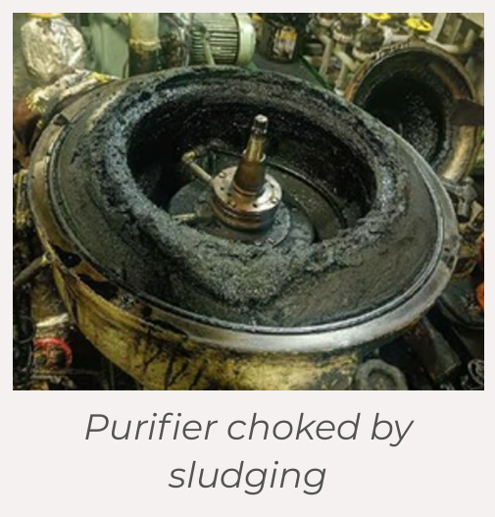
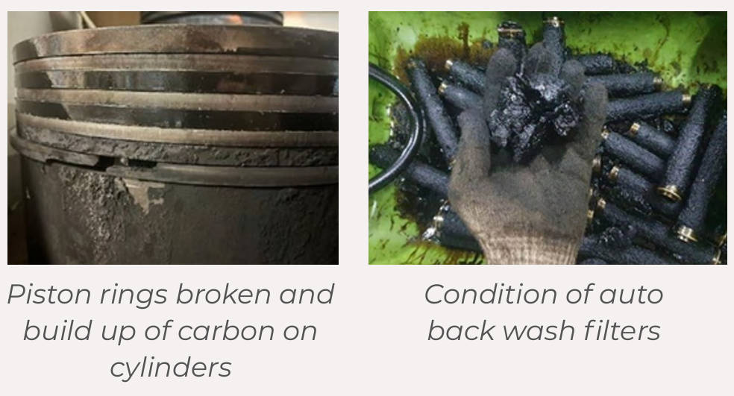
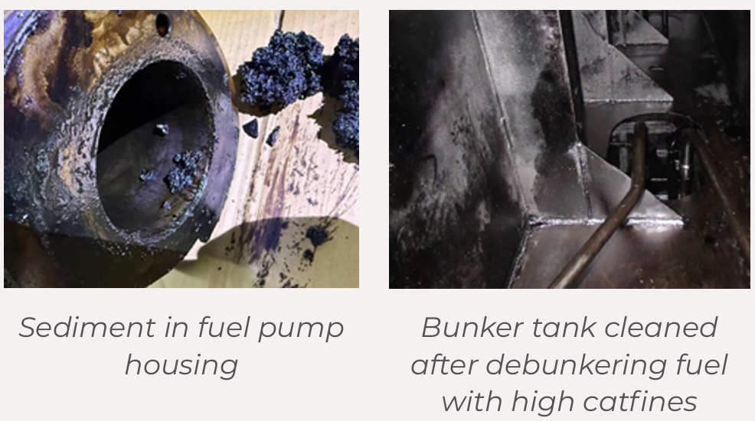
Other claims
Notes:
These are photographs from other claims this year.
I will not go through them one by one. I just want you to see what this actually looks like when it reaches the engine room.
The point of showing them is this: every one of these started as a fuel that somebody believed was acceptable.

Slide 10
Breaking the Rules Stops the Ship Immediately
Sulphur — 12.86% of all claims
Quantity disputes — MFM now required in ARA
Key points
1. Excess sulphur breaks MARPOL. Over 2% was measured in VLSFO.
2. Non-compliant fuel stops the ship at once — the bunker tanks were sealed and could not be used.
3. Debunkering and tank cleaning are expensive. The tanks must be cleaned once the fuel is removed.
4. If it is found after redelivery, owner and charterer end up arguing over who pays.
5. Report to the authorities as soon as non-compliance is confirmed. Port State Control can check that this was done.
Issue
What happened
Figures do not match
About 60 tonnes short of the BDN
No chance to verify
Manual sounding of the barge was refused
Calibration status
MFM calibration certificate 16 months old
The authorities have made clear they will not step into commercial disputes. Their role is only to say whether the MFM deviation is significant and whether the system was operated correctly.
Everything after that is for the parties to settle — which makes the checks done on board that much more important.
Flash point — 4.11% of all claims
Under SOLAS II-2 Reg.4, fuel used on board must have a flash point of at least 60 °C. Below that, the whole stem has to be debunkered.
SOLAS change, January 2026 — the BDN must now state the measured flash point, or confirm it is 70 °C or above.
Notes:
Now the regulatory side, where the consequences are immediate.
Sulphur is nearly 13 percent of all claims. In one case China MSA measured over 2 percent in VLSFO, sealed the tanks, and the ship could not use that fuel until it was removed and the tanks cleaned. And because the charter had already been redelivered, owner and charterer then had to argue about who paid for all of it.
Flash point is about 4 percent. Below 60 degrees, the whole stem comes off. No discussion.
There is a change worth noting in the box at the bottom left. Since January this year, the Bunker Delivery Note has to show the actual flash point value, or confirm it is 70 degrees or above. That gives you something to check before you accept the fuel.
On the right, quantity. In ARA the mass flow meter is now mandatory. In this case the ship was 60 tonnes short, the surveyor was refused a manual sounding, and the meter's calibration certificate was 16 months old.
And note what the authorities said: they will not settle commercial disputes. They only confirm whether the meter deviated and whether it was used properly. Everything else is down to what your people recorded on board.

Slide 11
When On-Spec Fuel Still Fails — Clause 5
When Table 2 is on-spec but problems still happen: applying Clause 5
The harder cases are fuels that meet every Table 2 limit and still cause operational problems.
ISO 8217 Clause 5 covers exactly this. It says a fuel can be unsuitable for use even when it technically meets the Table 2 limits.
The big hurdle for anyone relying on Clause 5 is proving causation.
(You have to show the problem came from the characteristics of the fuel.)
Key points
1. Detecting a contaminant is not enough — you must prove it caused the problem.
2. Causation matters most. Proving “this caused it” beats proving “this was detected”.
3. Table 2 tests alone may not be enough — GC-MS or similar may be needed.
4. An actual use trial can be strong evidence, but it carries operational risk and needs full records.
5. ISO 8217:2024 accepts a Clause 5 breach once causation is established.
Notes:
This slide goes one level deeper into Clause 5, because it is where most claims are won or lost.
The rule itself is reasonable. A fuel can be unsuitable for use even when it meets every number in Table 2.
The difficulty is proof. Finding the contaminant is the easy half. You then have to show it caused the damage — and that is a much higher bar.
Three practical implications. Table 2 testing on its own may not be enough, so budget for GC-MS when something looks wrong. An actual use trial can be powerful evidence, but only if it is documented properly. And ISO 8217:2024 will accept the claim once causation is established.
In short: collect the evidence early, because you cannot recreate it later.

Slide 12
Five Takeaways
1. Passing ISO 8217 Table 2 does not guarantee the fuel is safe to use.
Fuel that passes the tests can still block filters and damage the fuel system.
So never judge fuel risk on spec compliance alone.
2. Managing chemical contaminants under Clause 5 matters more and more.
Substances such as Cardol and CNSL are not covered by Table 2, yet they can stop the ship.
Use GC-MS or similar analysis when you need to check for hidden risk.
3. Poor fuel is an operational risk, not just a quality issue.
It leads to engine damage, loss of propulsion, delay, debunkering and PSC detention — and to real cost.
4. When a dispute starts, sample handling and joint testing decide the outcome.
Proving the sample is representative and reliable is the core of any claim.
Fingerprinting analysis and a clear, agreed test procedure show who is responsible.
5. Owners and charterers have to work together.
Fuel selection, sampling, testing and problem response all need both sides.
Stopping poor fuel before it is supplied and used is the most effective risk management of all.
Notes:
Let me pull it together into five points.
One. Passing the spec does not mean the fuel is safe. Do not judge risk on compliance alone.
Two. Chemical contaminants under Clause 5 are becoming the bigger issue. Cardol, CNSL — none of them appear in Table 2.
Three. Bad fuel is not a quality issue. It is an operational one. Engine damage, lost propulsion, delay, debunkering, detention — and real money.
Four. When a dispute starts, sampling and joint testing decide it. Proving your sample is representative is the whole game. Agree the test procedure before you need it, not after.
Five, and this is the one I would leave with you. Owners and charterers have to work this together. Selection, sampling, testing, response. Stopping bad fuel before it comes on board is far cheaper than proving whose fault it was.

Slide 13
SSA Biofuels FAQ 2026 — Guide for FAME Blends
Nine things to watch
Storage — four things to monitor
Item
What happens
Indicator
What it tells you
Storage ageing
Sludge forms if the fuel is not used in time
Oxidation stability
The most direct sign of ageing
Cold-weather wax
Wax forms in cold trades — check heating capacity
FAME content
Falls when esters break down or the blend is diluted
Microbial growth
Water and oxygen let biofilm form
Acid value
Rises as free fatty acids form
Compatibility
Unstable when mixed with other fuels — clean the tank
Water content
Rises with moisture and speeds up oxidation
Corrosion
Auto-oxidation makes the fuel more corrosive
The rules are simple — keep the fuel about 10 °C above the pour point, use it within three months, and re-test it if it is stored for long.
GCMD's Project LOTUS stored B24 on board for six months: the acid value rose but stayed within ISO 8217 limits.
Seals and gaskets
Rubber degrades — check fuel system materials
Lube oil
Some engines need a different lubricating oil
Solvent effect
Lifts old tank deposits and blocks the filters
Energy and viscosity
More fuel for the same voyage — pump capacity limit
Fresh in, fresh out — first in, first out is the best defence.
Notes:
Last slide, and this looks ahead rather than back.
The Singapore Shipping Association updated its Biofuels FAQ this year. If you are moving to biofuel blends, this is the practical guide.
The left table is the nine things to watch. I would highlight three.
The solvent effect — biofuel dissolves the old deposits already in your tank, so filters block heavily right after the first switch. That is old dirt, not new fuel. Clean the tank first.
Seals and gaskets — FAME attacks rubber. Check the fuel system materials before the first stem, not after a leak.
And cold weather — wax forms in the tank, so confirm you have the heating capacity for the trade.
The right side is storage, and it is simple. Ten degrees above pour point, use it within about three months, and re-test if it sits longer. Note that three months is a rule of thumb, not a hard limit — GCMD stored B24 on board for six months and it stayed inside the ISO limits.
Fresh in, fresh out. Keep the stock turning and most of these problems never start.
That is everything from me. Happy to take questions.

