Slide 1
Notes:
(0)
(0) : 10
Total – 48 – 10: 38

Slide 2


Microservices architecture with .NET Core, Docker containers, and Azure
BRK3175
Cesar de la Torre
Principal Program Manager
.NET Product Group
Microsoft Corp.
@cesardelatorre
cesardl@microsoft.com

Slide 3
What’s new in .NET Microservices since IGNITE 2017?
IGNITE 2017
  Implement microservices patterns with .NET Core and Docker (Cesar de la Torre)
  Link: https://channel9.msdn.com/events/Ignite/Microsoft-Ignite-Orlando-2017/BRK3317
IGNITE 2018
  Microservices architecture with .NET Core, Docker containers, and Azure (Cesar de la Torre)
  Today! – Updates on microservices patterns on .NET Core 2.1
Complementary sessions! ☺
Notes:
(0)

Slide 4
Agenda
Agenda
Updates on .NET Core 2.1 “wave” related to services
ASP.NET Core 2.1 SignalR Hub microservices (Demo)
HttpClientFactory and integration to Polly (Demo)
Updates on Microservices Patterns
Main patterns for Microservices overview
API Gateways with Ocelot (Demo)
Orchestrators in Azure
AKS (Azure Kuberentes Service) (Demo)
Azure Dev Spaces (for Kuberentes) (Demo)
(BONUS!) Infusing AI & Machine Learning to your microservices!

Slide 5
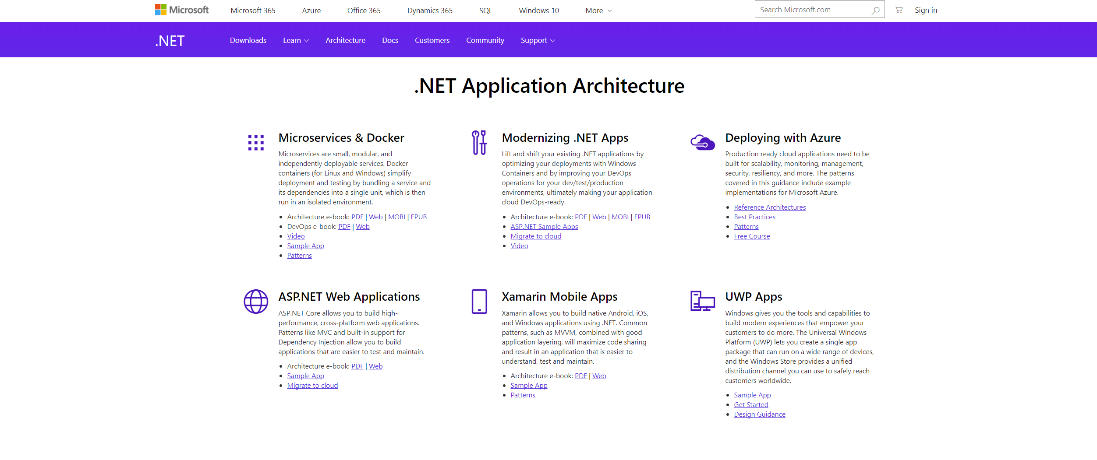

.NET Application Architecture Center
https://www.microsoft.com/net/learn/architecture or http://dot.net/architecture
Notes:
Modernizing Existing .NET Apps – specify this

Slide 6
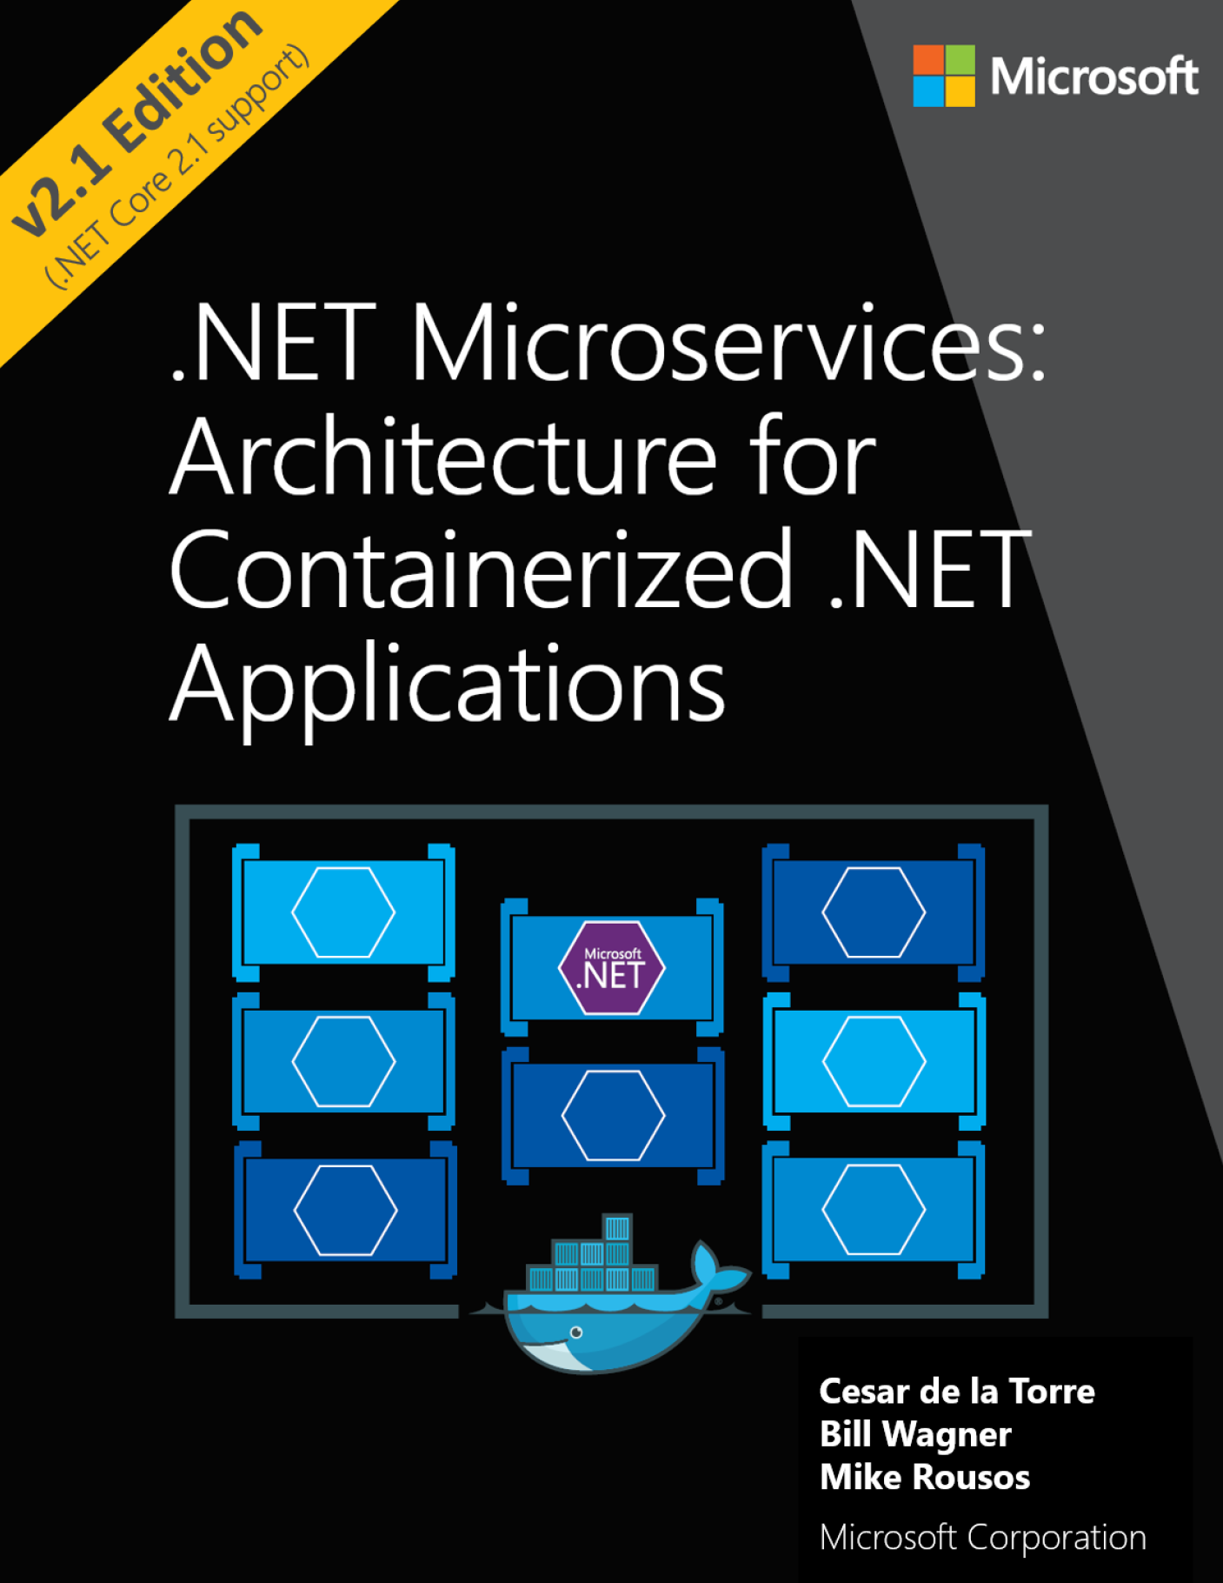
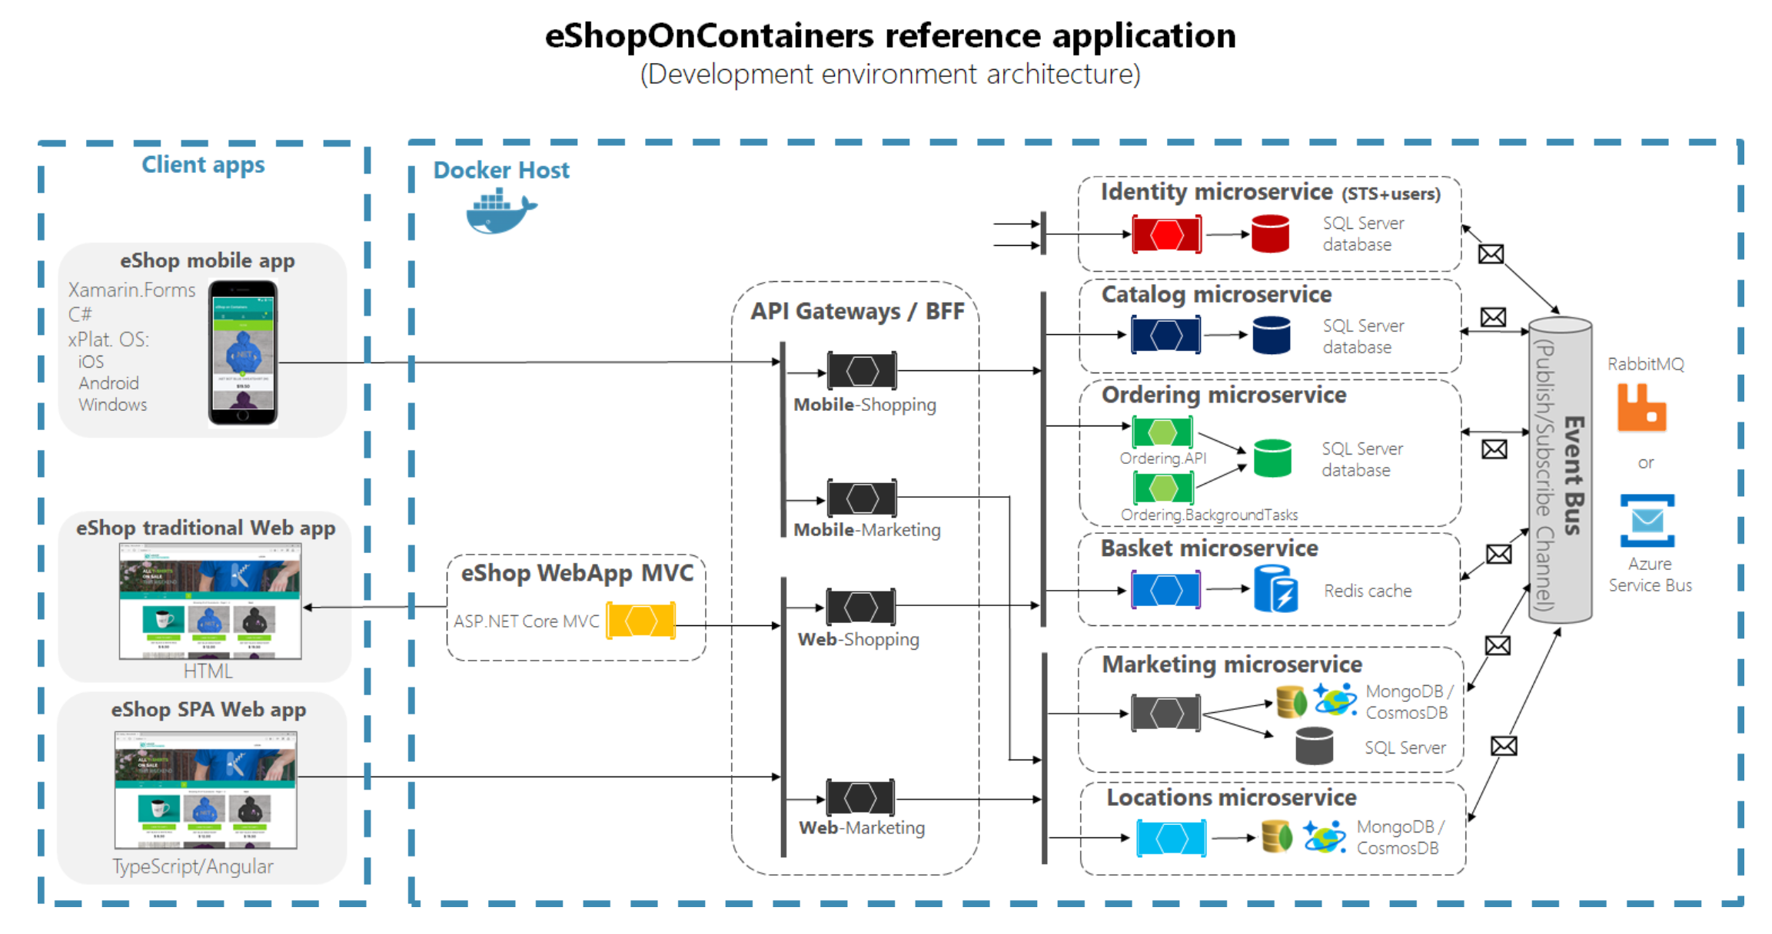
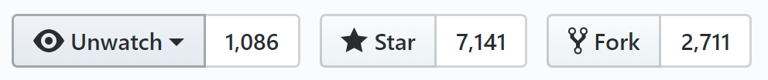
Guide/eBook and sample apps on microservices architecture
eBook/Guide
eShopOnContainers: Reference microservices application
Intended for .NET developers and solution architects
Prescriptive guidance on Microservices implementation with .NET Core and Docker
https://aka.ms/microservicesebook
https://github.com/dotnet-architecture/eShopOnContainers

Slide 7
Microservices Architecture
Notes:
(0)

Slide 8
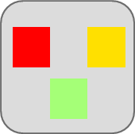
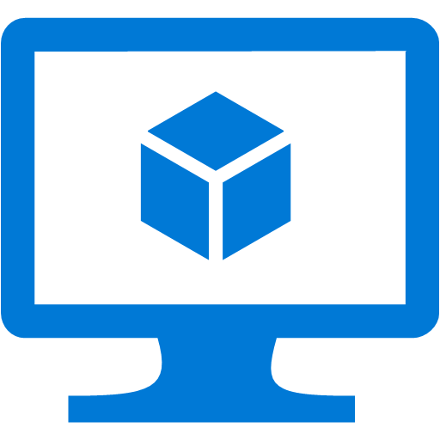
Traditional application approach
Microservices application approach
A traditional application has its functionality within a few processes componentized with layers and libraries
Scales by cloning the app on multiple servers/VMs
App 1
A microservice application segregates functionality into separate smaller services
Scales out by deploying each service independently with multiple instances across servers/VMs
App 1
App 2
Independent deployment of microservice
Coarse-grained density of apps/services
Fine-grained density of services
Need to deploy the full application

Slide 9
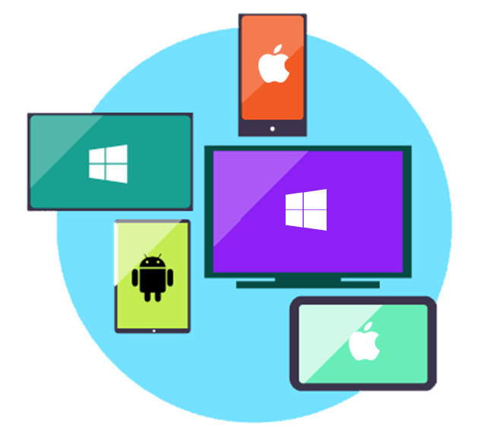


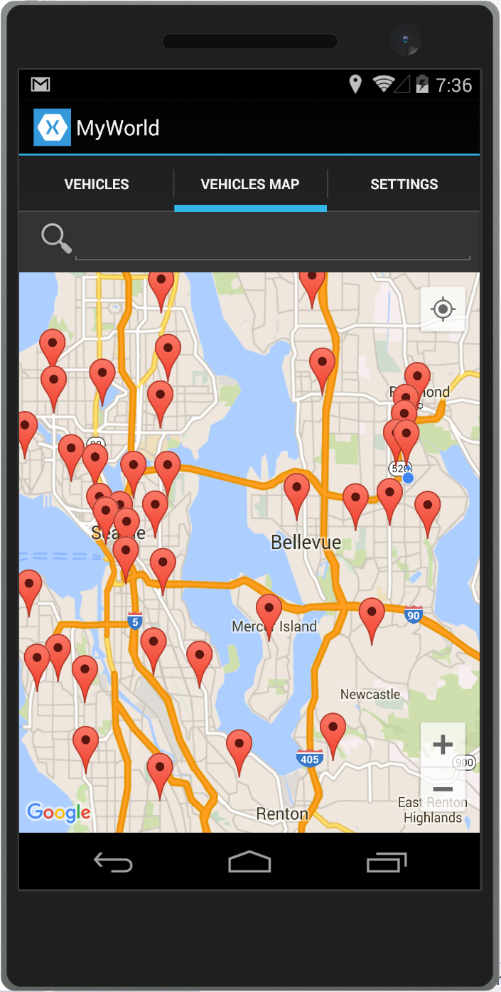
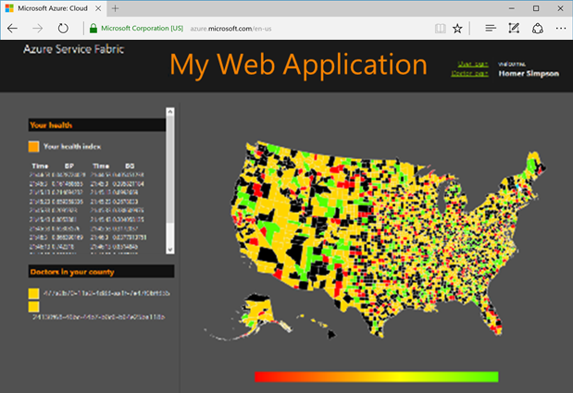



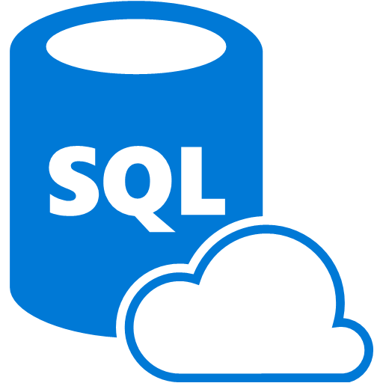
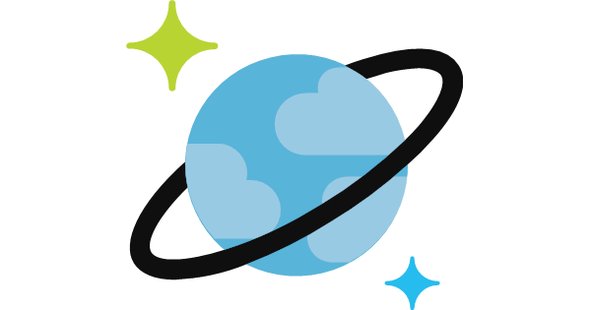
Traditional application approach
Data in Microservices approach
Single monolithic database
Tiers of specific technologies
Graph of interconnected microservices
State/data typically scoped to the microservice
Remote Storage for cold data
Web tier
Services tier
Desktop & Mobile
apps
Cache doesn’t help much for massive data ingress (Events, IoT, etc.)
Web apps
Cache tier
Microservices
Database servers are usually the bottleneck
SQL DB
or
No-SQL
Stateful service
SQL
[…]
No-SQL
[…]
Data tier
Monolithic Databases are shared across services.
Each microservice owns its model/data!

Slide 10
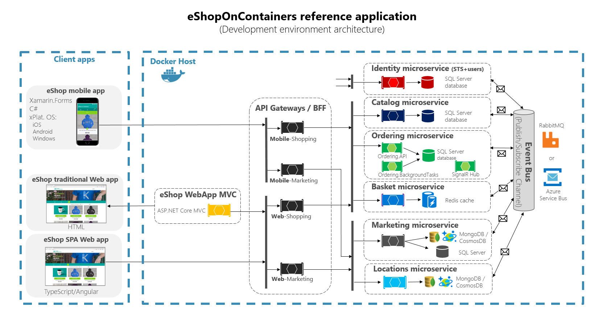
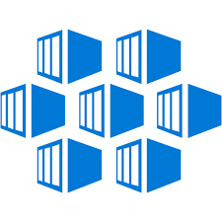
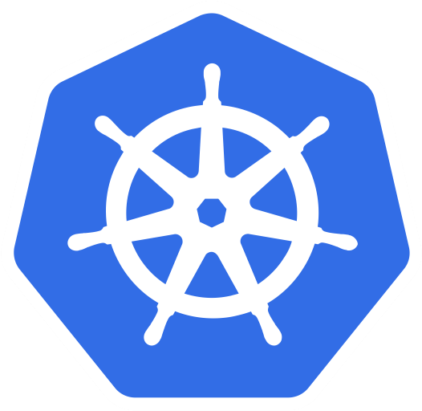
.NET Core 2.1
https://github.com/dotnet-architecture/eShopOnContainers
AKS

Slide 11


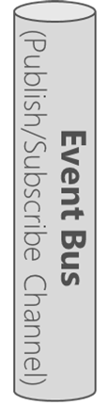

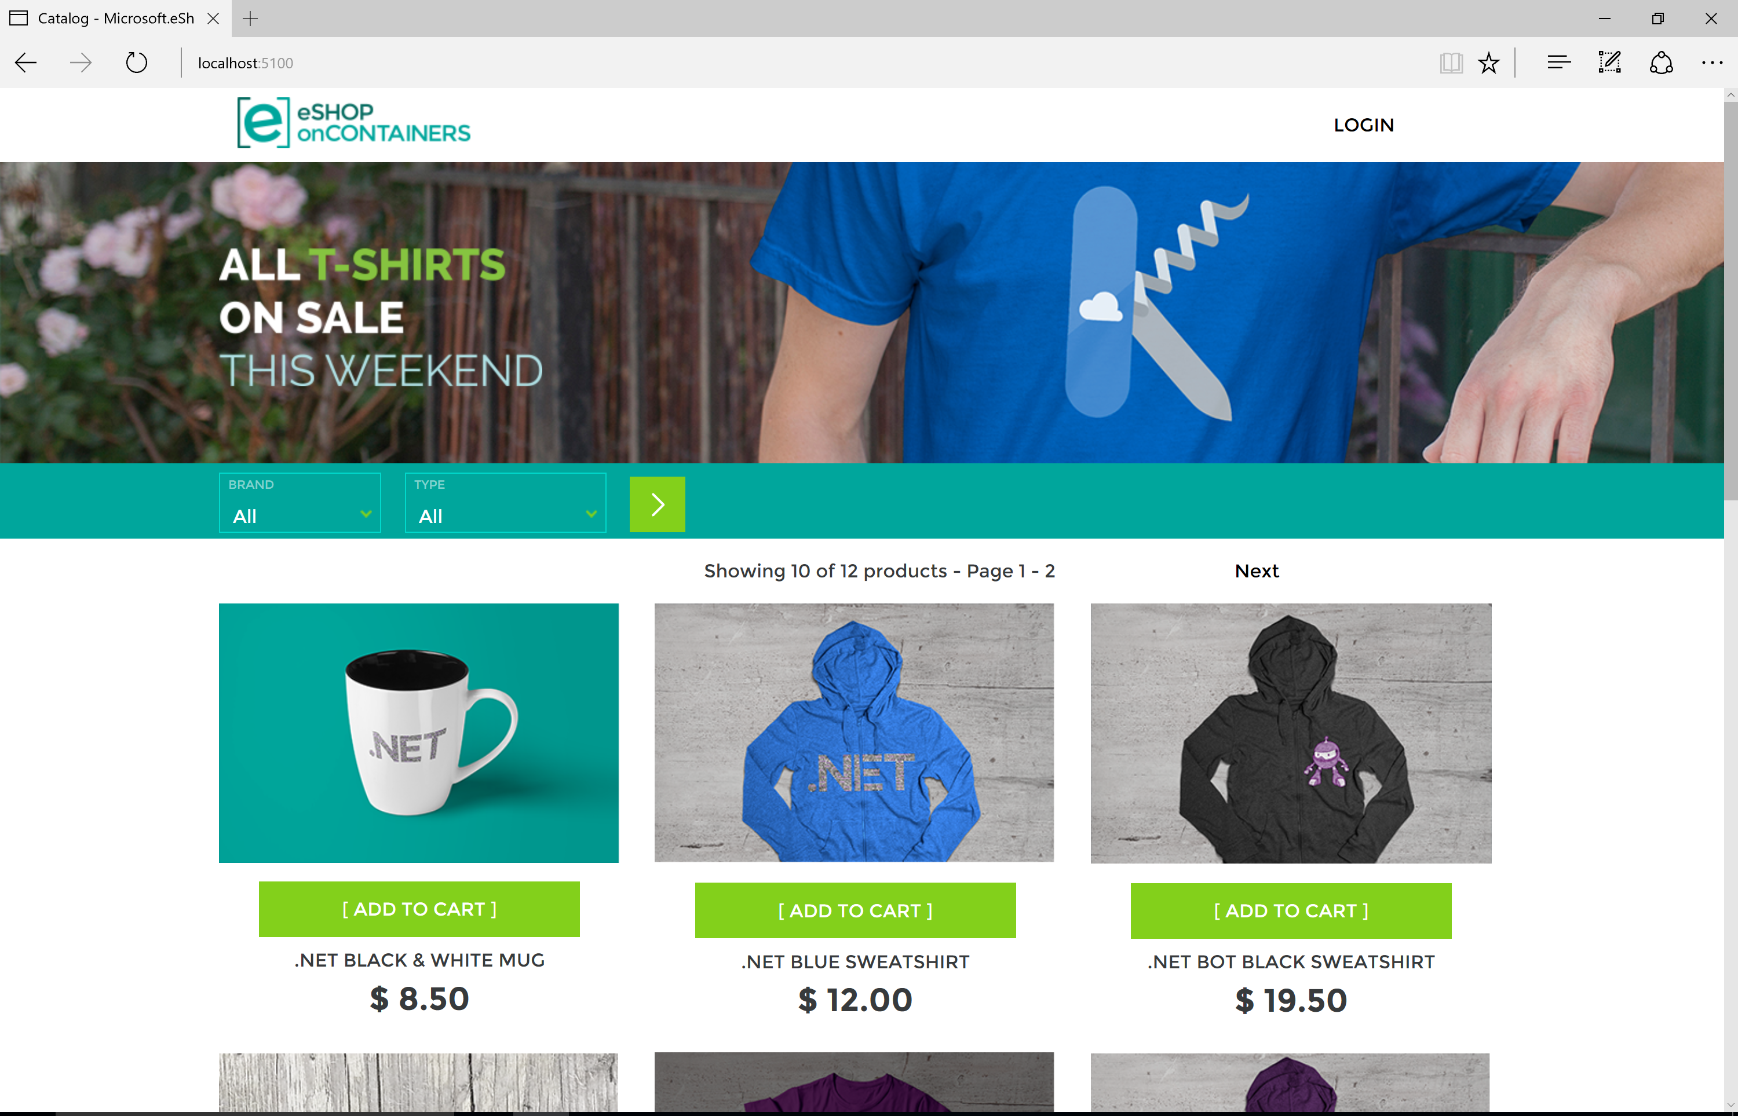
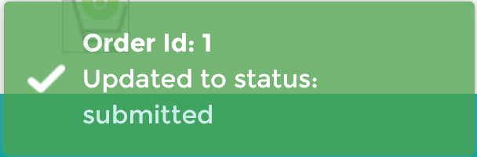

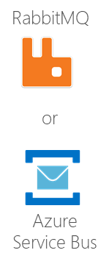
Using SignalR for pushing real-time information
New! Released in
ASP.NET Core 2.1
SignalR traffic (Push)
Push
real-time
information
Ordering
microservice
Client
Web app on browser
SignalR
JavaScript
client library
Push/broadcast
WebSockets / Http
Publish
Event
(Order-State-change-to-XXX)
SignalR traffic (Push)
WebSockets or
Http-Polling
Subscribed
SignalR Hub
HTML
Web traffic
HTTP
ASP.NET Core
MVC or Razor app
Broadcast to many JS or .NET clients
Notes:
Application connects to service via a connection string
Service response includes access token & URL for client connections
Clients send negotiate request to app which returns access token & URL
https://github.com/aspnet/SignalR/blob/dev/specs/TransportProtocols.md#post-endpoint-basenegotiate-request
Client connects to service using access token & URL from app
Service relays messages from server to clients and clients to server
Available Transports
WebSockets, "transferFormats": [ "Text", "Binary"
ServerSentEvents, "transferFormats": [ "Text"
LongPolling, "transferFormats": [ "Text", "Binary"
Deployment:
Container/Orchestrator
Azure SignalR Service (As part of App Service)

Slide 12
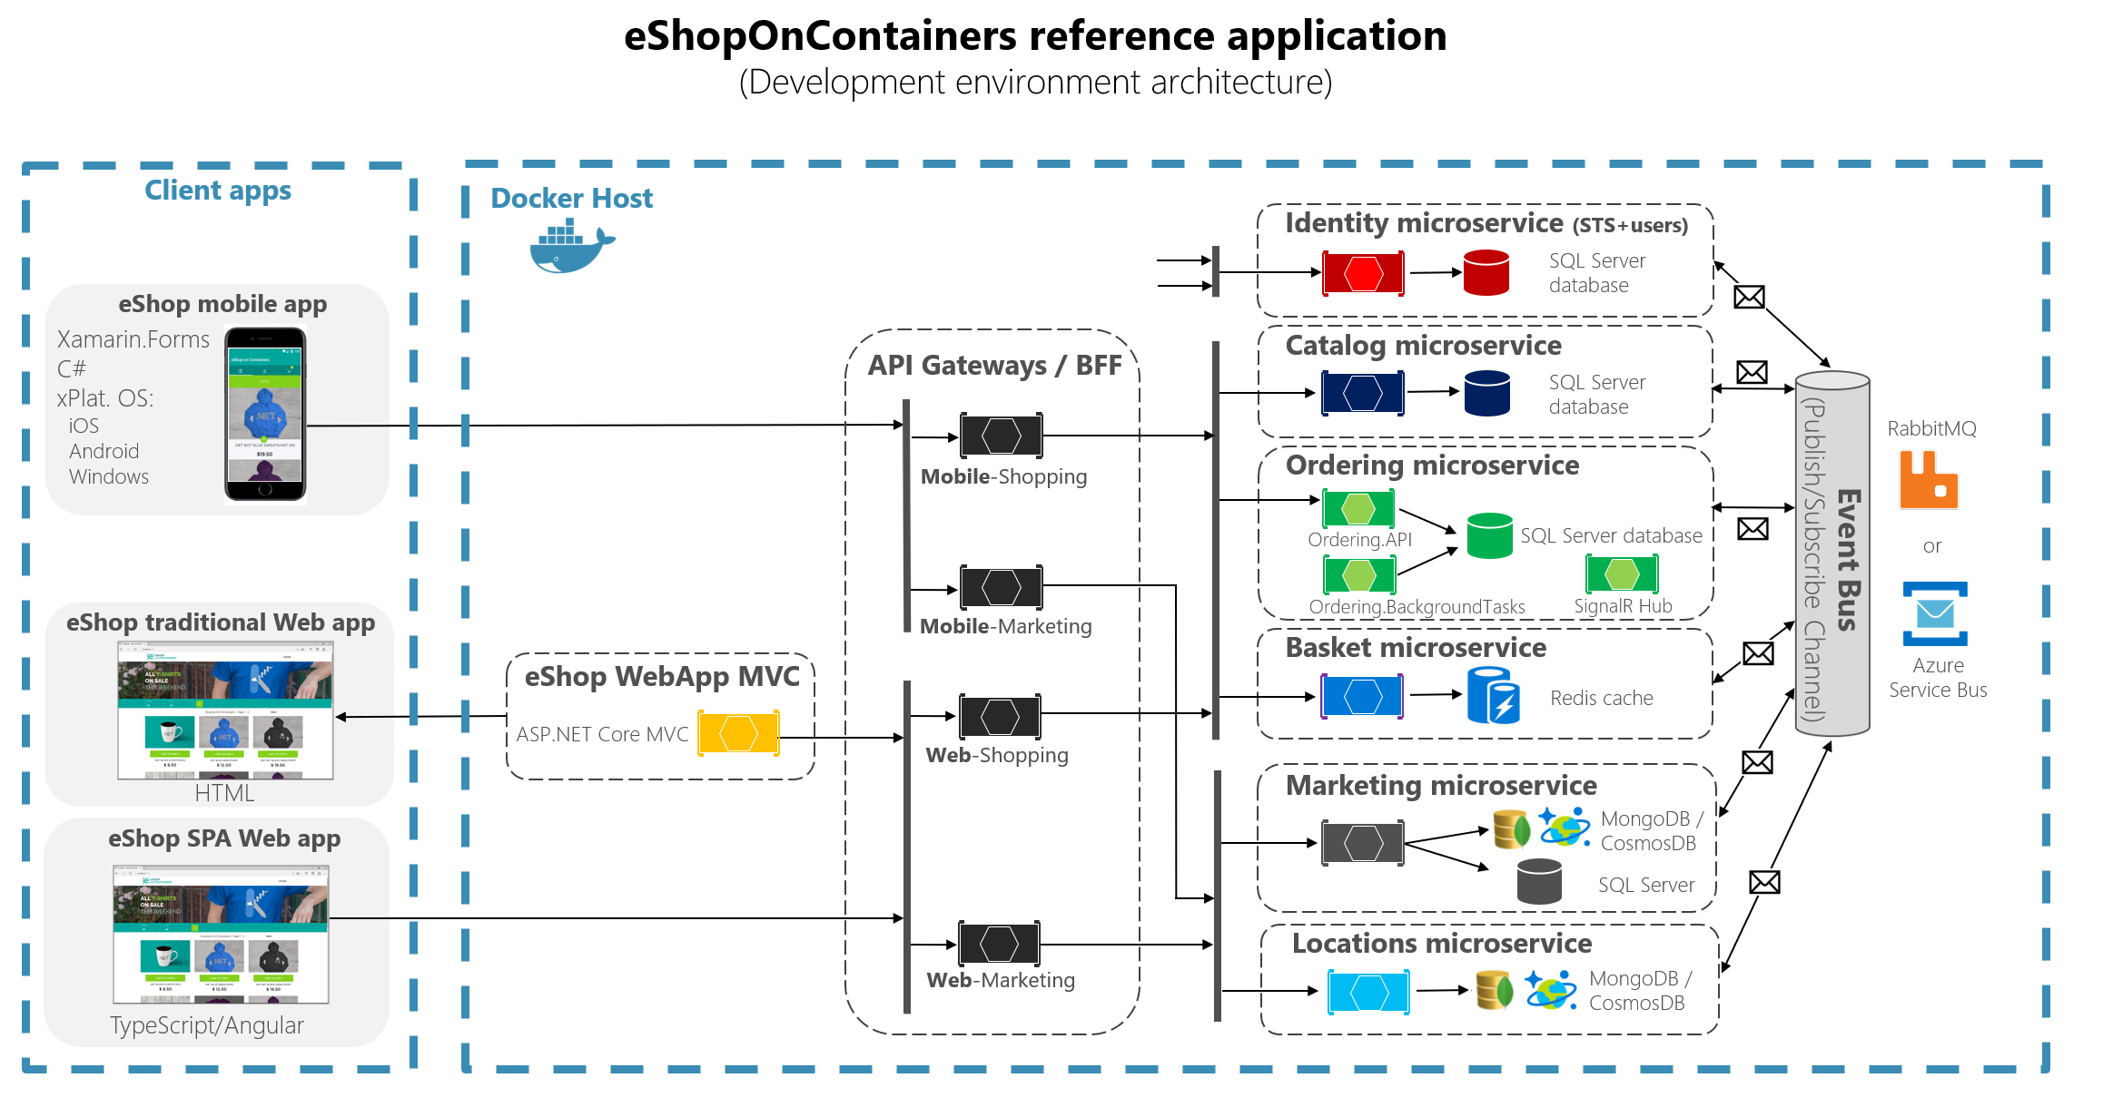
Demo 1
(1)
eShopOnContainers Microservices and Docker Containers
End-to-end solution overview in Visual Studio
VS 2017:
Solution’s projects
Docker-compose.yml
Helm charts for K8s
Run:
Run app creating Order and SignalR notifications
Notes:
(0)

Slide 13
Key patterns for microservices
Notes:
(0)

Slide 14
Key patterns for Microservices
Async. pub/subs communication (Event Bus)
Health checks
Resilient cloud applications:
  Retries with exponential backoff plus Circuit breaker with new HttpClientFactory
API Gateway vs. Direct communication
  API Gateways implementation with Ocelot
Orchestrators: Scale-out & devs collaboration
  AKS, Azure Dev Spaces, etc.
…
See content and demos from
my IGNITE 2017 session here
+ Basics on Docker containers
Today’s
focus
Today’s
focus
Today’s
focus

Slide 15
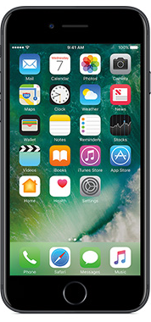
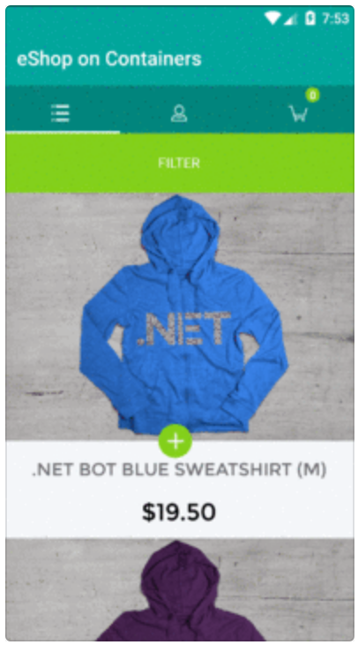
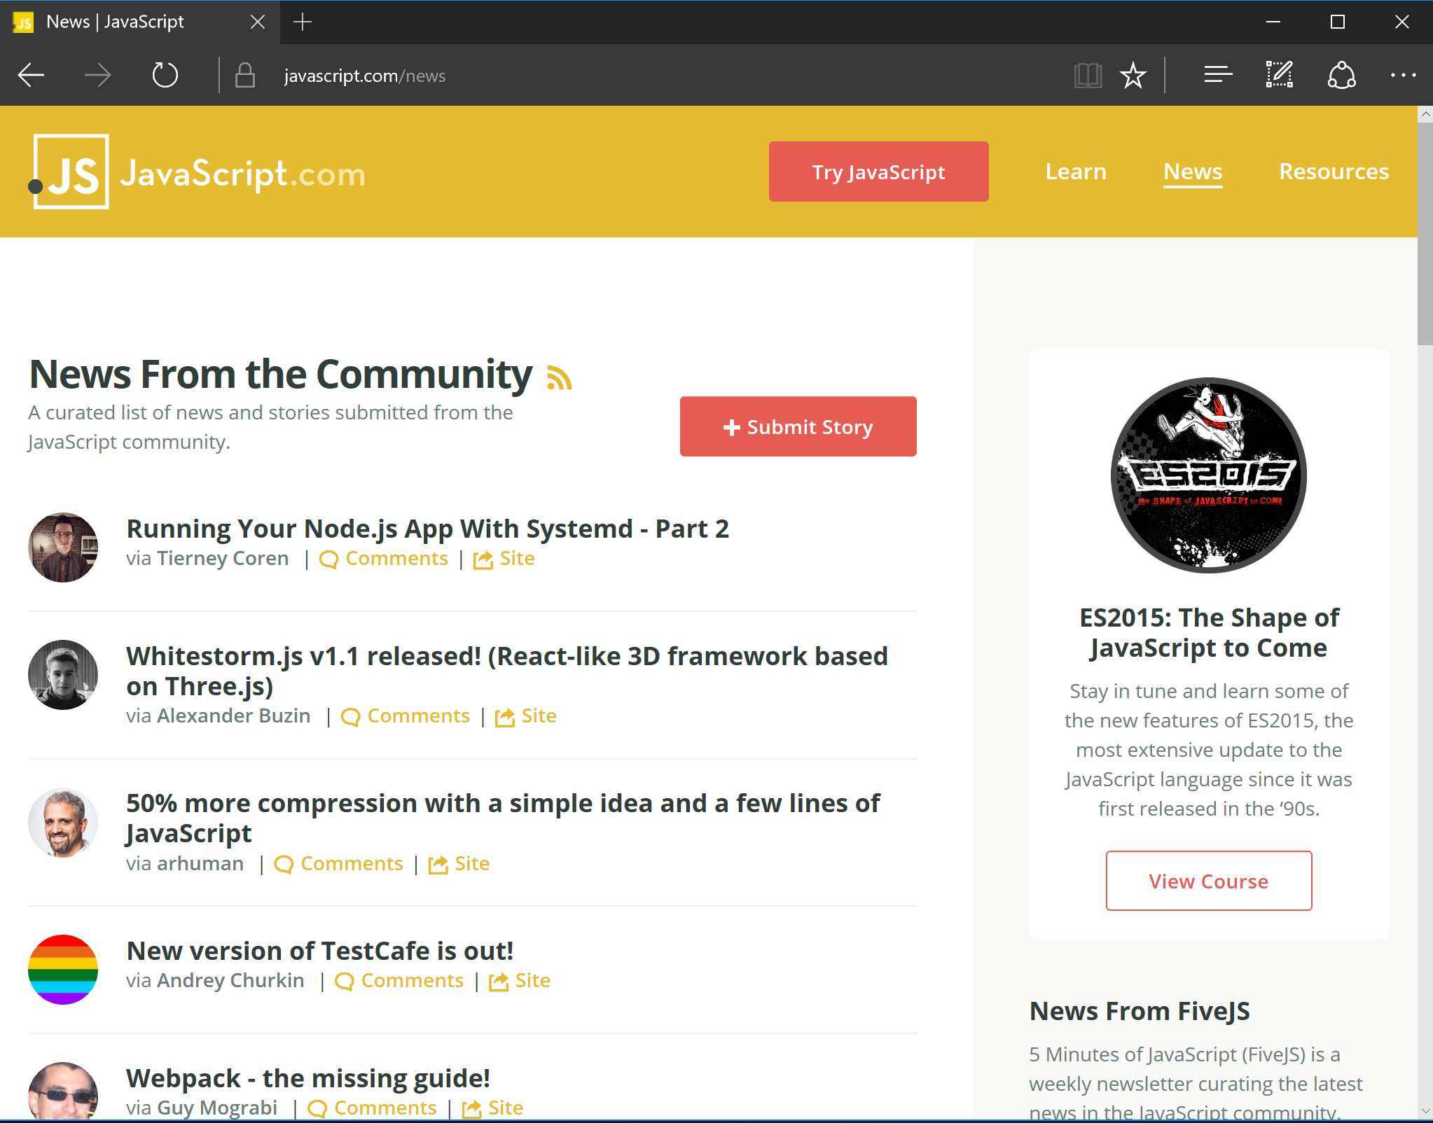
Building resilient cloud applications
Client Mobile App
Back end
Microservice 1
JSON
Web API
Container
Client SPA WebApp
API Gateway
Microservice 2
ASP.NET Core
Web API
Web API
With
Retries with exponential backoff & Circuit-Breakers
JSON
HTTP
Container
Container
Request/Response
JavaScript/Angular.js
HTTP
Request/Response
Microservice 3
Web API
Traditional WebApp
Client WebApp MVC
Container
Browser
Implement resilient communication
ASP.NET Core MVC
Container
Implement resilient communication
HTML
HTML
Notes:
Need to handle Transient faults
Today's cloud-based and microservice-based applications often depend on communicating with other systems across an unreliable network. Such systems can be unavailable or unreachable due to transient faults such as network problems, timeouts, subsystems being offline, under load, or otherwise non-responsive.
Failure will happen – Especially transient failure in the cloud
If you assume things will fail, you’re prepared for reality
It’s not a matter of avoiding failure, it’s preparing for what to do when things fail
Building reliable systems embraces failure and provides for alternative paths

Slide 16
Retries with exponential backoff
Back end
Microservice 1
Web API
API Gateway
Microservice 2
ASP.NET Core
Web API
Web API
Retry 3
Success!
Retry 1
Retry 2
HTTP
Microservice 3
Request/Response
Web API
Client WebApp MVC
ASP.NET Core MVC
Container

Slide 17
Retries with exponential backoff
+ circuit breaker
Back end
Microservice 1
Web API
API Gateway
Microservice 2
Retry 4!
Open Circuit!
ASP.NET Core
Web API
Web API
Retry 1
Retry 3
Retry 2
HTTP
Microservice 3
Request/Response
Web API
Client WebApp MVC
ASP.NET Core MVC
Container
Respond with
Controlled Exception

Slide 18


Resilient Http: HttpClient factory + Polly
New! Release in
ASP.NET Core 2.1
.NET Core 2.1
HttpClientFactory
Policies
+
https://github.com/App-vNext/Polly

Slide 19
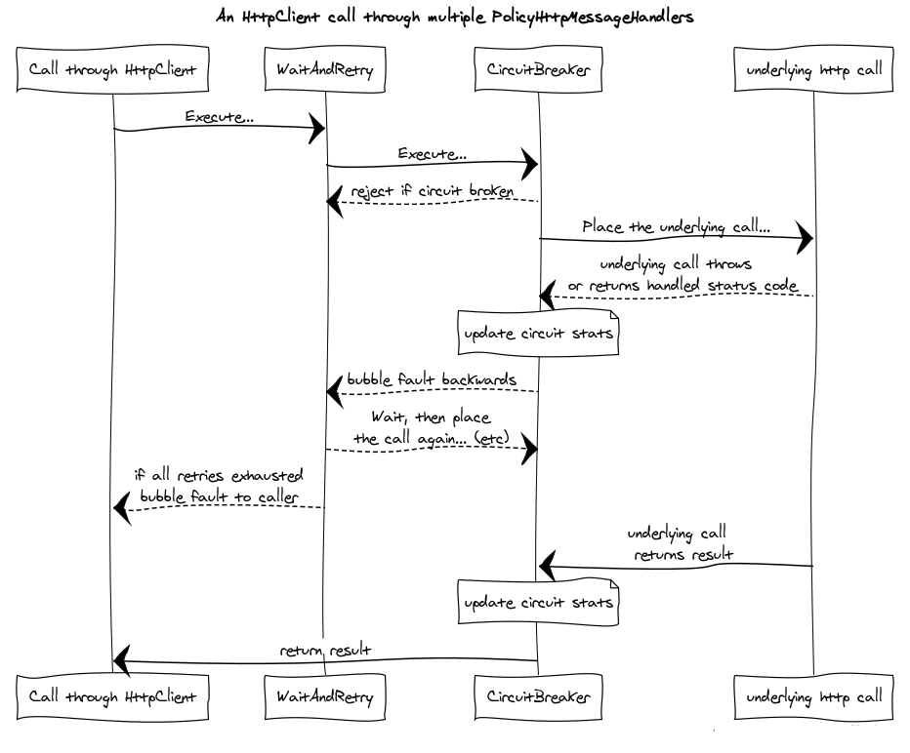
Policies
https://github.com/App-vNext/Polly

Slide 20
HttpClient factory
since .NET Core 2.1
Use case: Using HttpClient factory with Typed Clients
Central location
For configuring typed Http clients (aka. Service Agents) or named Http clients
For logging
Delegating handlers in HttpClient such as:
Resilient Http policies (Polly)
Auth token propagation
Validations, etc.
HttpClient lifetimes
Manage lifetime of HttpMessageHandler instances properly (Pool of handlers)
Client application/code
IHttpClientFactory
Dependency Injection
ClientService
Pool
(i.e. CatalogService)
HttpMessageHandler
instances
Http
endpoint
HttpClient
(Configured)
Controller or client code
Policies
Delegating
Handlers
Notes:
Docs: https://docs.microsoft.com/en-us/aspnet/core/fundamentals/http-requests?view=aspnetcore-2.1
Sample: https://github.com/aspnet/HttpClientFactory/blob/dev/samples/HttpClientFactorySample/Program.cs
Polly and HttpClient factory: https://github.com/App-vNext/Polly/wiki/Polly-and-HttpClientFactory
HttpClient factory benefits:
Provides a central location for naming and configuring logical HttpClient instances. For example, a "github" client can be registered and configured to access GitHub. A default client can be registered for other purposes.
Codifies the concept of outgoing “middleware” via delegating handlers in HttpClient and provides extensions for Polly-based middleware to take advantage of that.
Manages the pooling and lifetime of underlying HttpClientMessageHandler instances to avoid common DNS problems that occur when manually managing HttpClient lifetimes.
Adds a configurable logging experience (via ILogger) for all requests sent through clients created by the factory.
HttpClient lifetimes
Each time CreateClient is called on the IHttpClientFactory, a new instance of a HttpClient is returned. There will be a HttpMessageHandler per named client. IHttpClientFactory will pool the HttpMessageHandler instances created by the factory to reduce resource consumption. A HttpMessageHandler instance may be reused from the pool when creating a new HttpClient instance if its lifetime hasn't expired.
Pooling of handlers is desirable as each handler typically manages its own underlying HTTP connections; creating more handlers than necessary can result in connection delays. Some handlers also keep connections open indefinitely, which can prevent the handler from reacting to DNS changes.
The default handler lifetime is two minutes. The default value can be overridden on a per named client basis. To override it, call SetHandlerLifetime on the IHttpClientBuilder that is returned when creating the client:
services.AddHttpClient("extendedhandlerlifetime").SetHandlerLifetime(TimeSpan.FromMinutes(5));
Issues with old per-request HttpClient:
https://aspnetmonsters.com/2016/08/2016-08-27-httpclientwrong/
Issues with old singleton HttpClient
http://byterot.blogspot.co.uk/2016/07/singleton-httpclient-dns.html/

Slide 21
Demo 2
(2)
Resilient Http calls with HttpClientFactory and Polly policies with Retries with Exponential Backoff and Circuit Breaker
Guide section:
Use HttpClientFactory to implement resilient HTTP requests
https://docs.microsoft.com/en-us/dotnet/standard/microservices-architecture/implement-resilient-applications/use-httpclientfactory-to-implement-resilient-http-requests
Also in .PDF eBook: https://aka.ms/microservicesebook
Notes:
MIDDLEWARE:
http://localhost:5103/Failing?enable
http://localhost:5103/Failing?disable
Moving resilient patterns to the platform:
i.e. Service Fabric Mesh uses Envoy:
Service Mesh tools:
Envoy from Lyft Engineering
Linkerd from https://buoyant.io
Traefik from https://containo.us
These tools provide features such as:
Retry
Circuit-breaking
Latency and other metrics
Failure- and latency-aware load balancing
Distributed tracing
Protocol upgrade
Version-aware routing
Cluster failover, etc
If using those, you don’t need an implementation of retries and circuit breaker as part of every microservice. Instead, you will be using one as a sidecar pattern or host proxy.

Slide 22
Implementing API-Gateways with Ocelot
Notes:
(0)

Slide 23
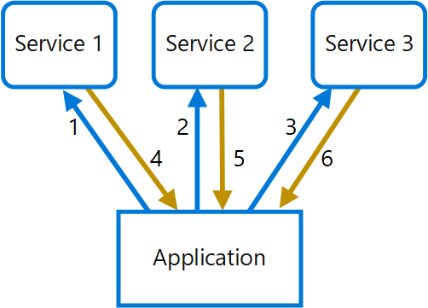
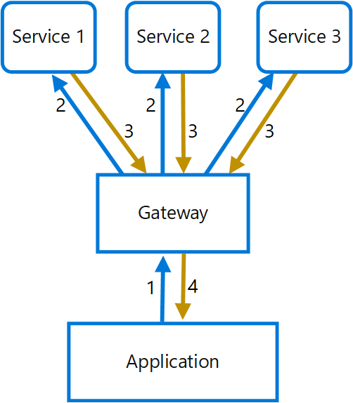
Direct communication vs the API Gateway pattern
Direct communication to microservices
(“NO API Gateway usage”)
Using the API Gateway pattern

Slide 24
https://github.com/dotnet-architecture/eShopOnContainers

Slide 25
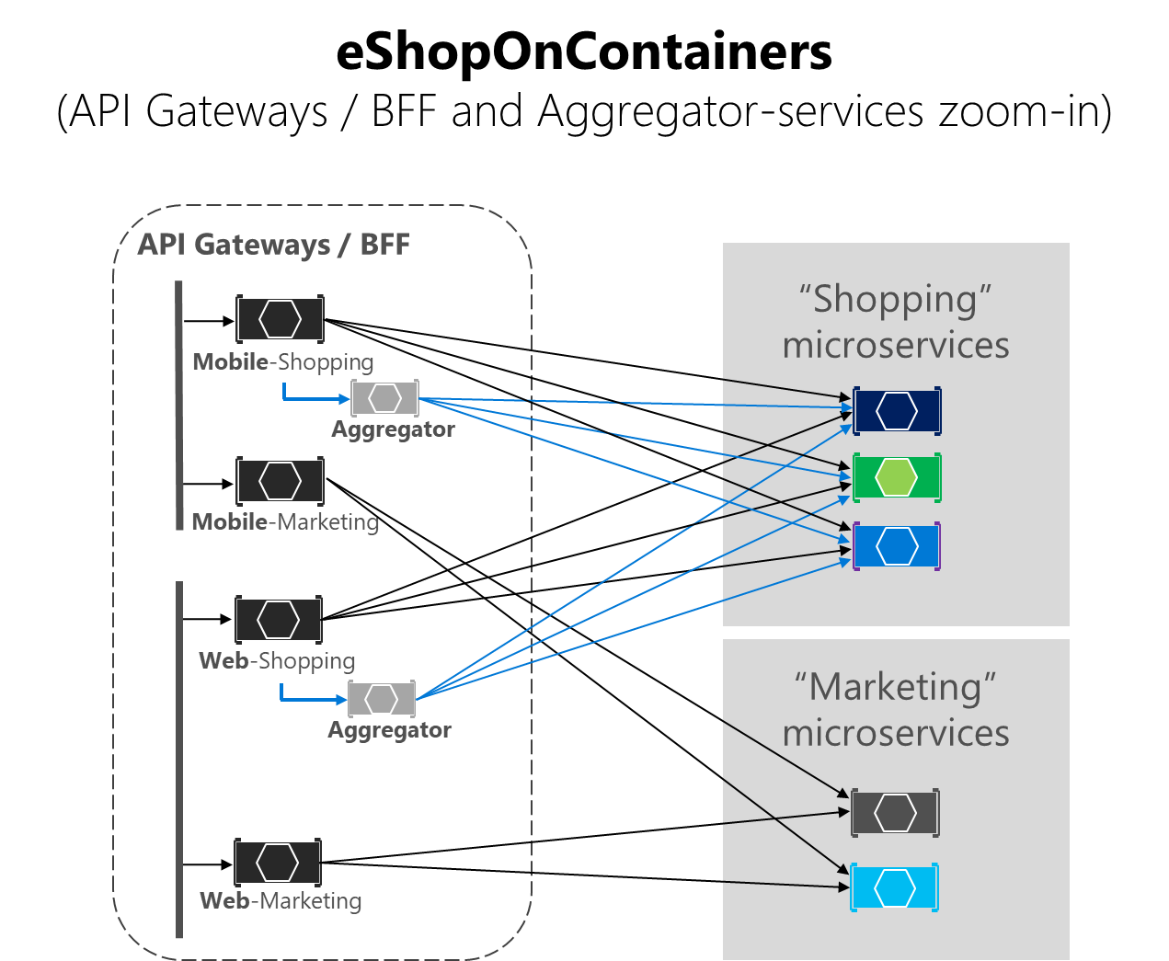
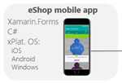

Slide 26
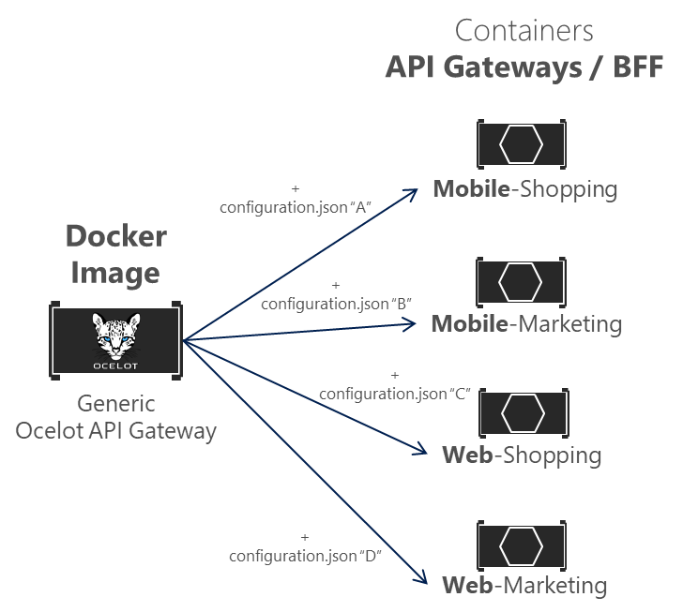
Using Ocelot API-Gateway with containers
https://github.com/ThreeMammals/Ocelot

Slide 27
Demo 3
(2)
API-Gateways demo
Ocelot code overview
Approach for Docker containers re-using the same image
Guide section:
Implementing API Gateways with Ocelot
https://docs.microsoft.com/en-us/dotnet/standard/microservices-architecture/multi-container-microservice-net-applications/implement-api-gateways-with-ocelot
Also in .PDF eBook: https://aka.ms/microservicesebook

Slide 28
Scaling-out microservices with
Orchestrators and Azure
Notes:
(0)

Slide 29



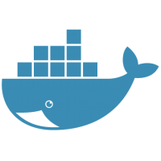

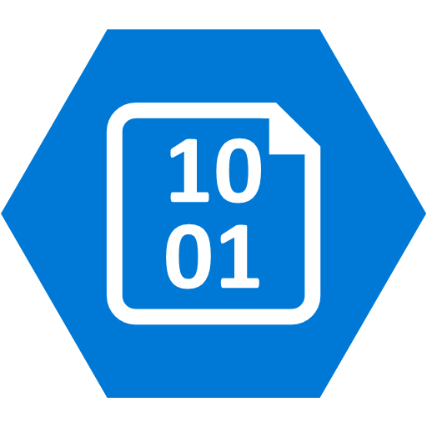


Dev environment
Production environment
Customized
eShopOnContainers on Azure
Foundational
Development technologies
Cloud infrastructure and
Specific Orchestrators
.NET Core
ASP.NET Core
Azure Kubernetes Service (AKS)
Development
Orchestrators
+
Azure Service Fabric
Service Bus
SQL Database
Linux Containers
Windows Containers
Other Cloud
Infrastructure
Deployment
BLOB Storage
Cosmos DB
Redis Cache
Key Vault
Exploring Microservices
Architecture/Design/Development
Infrastructure
Decisions
Production-Ready Microservices

Slide 30
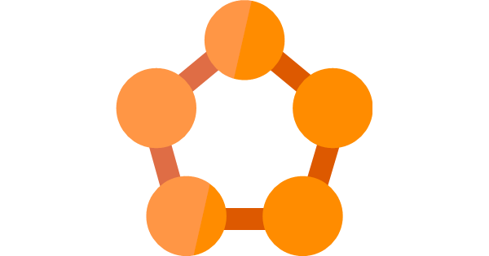
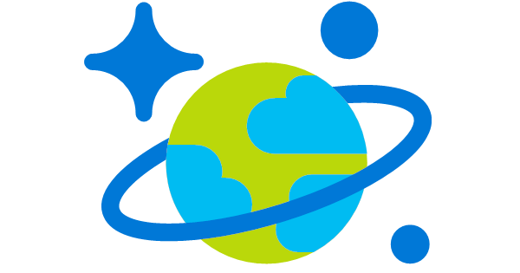
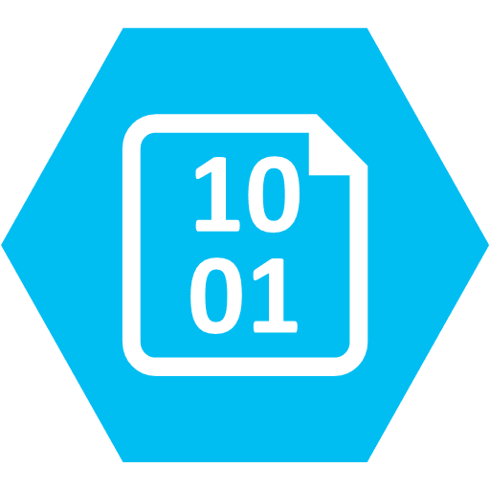

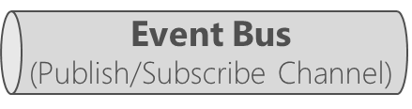
eShopOnContainers → in Azure
Client apps
Orchestrator in Azure
Identity microservice
(STS+users)
Azure – High Available application infrastructure as PaaS cloud
Azure Kubernetes Service (AKS)
Azure SQL Database
Azure Redis
eShop mobile app
or
Xamarin.Forms
C#
xPlat. OS:
iOS
Android
Windows
Azure Service Fabric
API Gateways/BFF
Catalog microservice
(Basket)
Mobile-Shopping
Ordering microservice
Azure Cosmos DB
Azure Storage - Blobs
Ordering.API
(Product
Images)
SignalR Hub
eShop traditional Web app
Mobile-Marketing
Ordering.BackgroundTasks
eShop WebApp MVC
Basket microservice
ASP.NET Core MVC
Other Azure infrastructure
HTML
Web-Shopping
Marketing microservice
Azure Container Registry
Azure Container Build
Application Insights
Azure Key Vault
Azure API Management
Azure Application Gateway
Azure Dev Spaces
…
eShop SPA Web app
Azure
Service Bus
Locations microservice
Web-Marketing
TypeScript/Angular

Slide 31

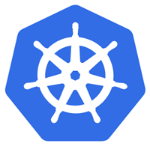






Orchestrator’s Cluster managing microservices/containers
App 1
App 2
My Docker Images
Clusters provide:
High scalability
Automatic High Availability and resiliency
High services density per host
My ASP.NET Core Services
For example:
Official Docker Images
Kubernetes
https://hub.docker.com
Service Fabric
Cluster of
Nodes/Hosts
VM
or
Notes:
For each service instance you use one container
Docker images/containers are “units of deployment”
A container is an instance of a Docker Image
A host (VM/server) handles many containers

Slide 32
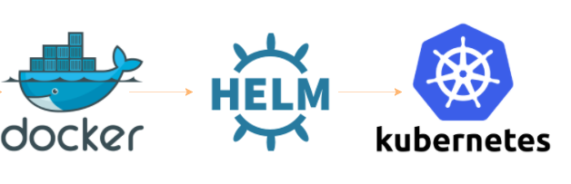
Kubernetes and Helm
Container
Images
Deploy
with
Orchestrator’s
cluster
Helm is THE package manager for Kubernetes:
…Kubernetes deployments with just Kubectl.exe and .yml files are not standard but custom & complex…
Helm improves:
Makes application deployment easy, standar and reusable
Easy application install, update, rollback & removal. Packages are declaratively defined in Helm Charts
Charts can be shared and publicly published (https://github.com/helm/charts/tree/master/stable)
Designed with versioning of packages in mind
You need Helm if you want to use Azure DevSpaces! :)
Notes:
https://docs.microsoft.com/en-us/azure/aks/kubernetes-helm#configure-helm
Sample:
INSTALL AN EXAMPLE CHART
To install a chart, you can run the helm install command. Helm has several ways to find and install a chart, but the easiest is to use one of the official stable charts.
$ helm repo update # Make sure we get the latest list of charts
$ helm install stable/mysql

Slide 33
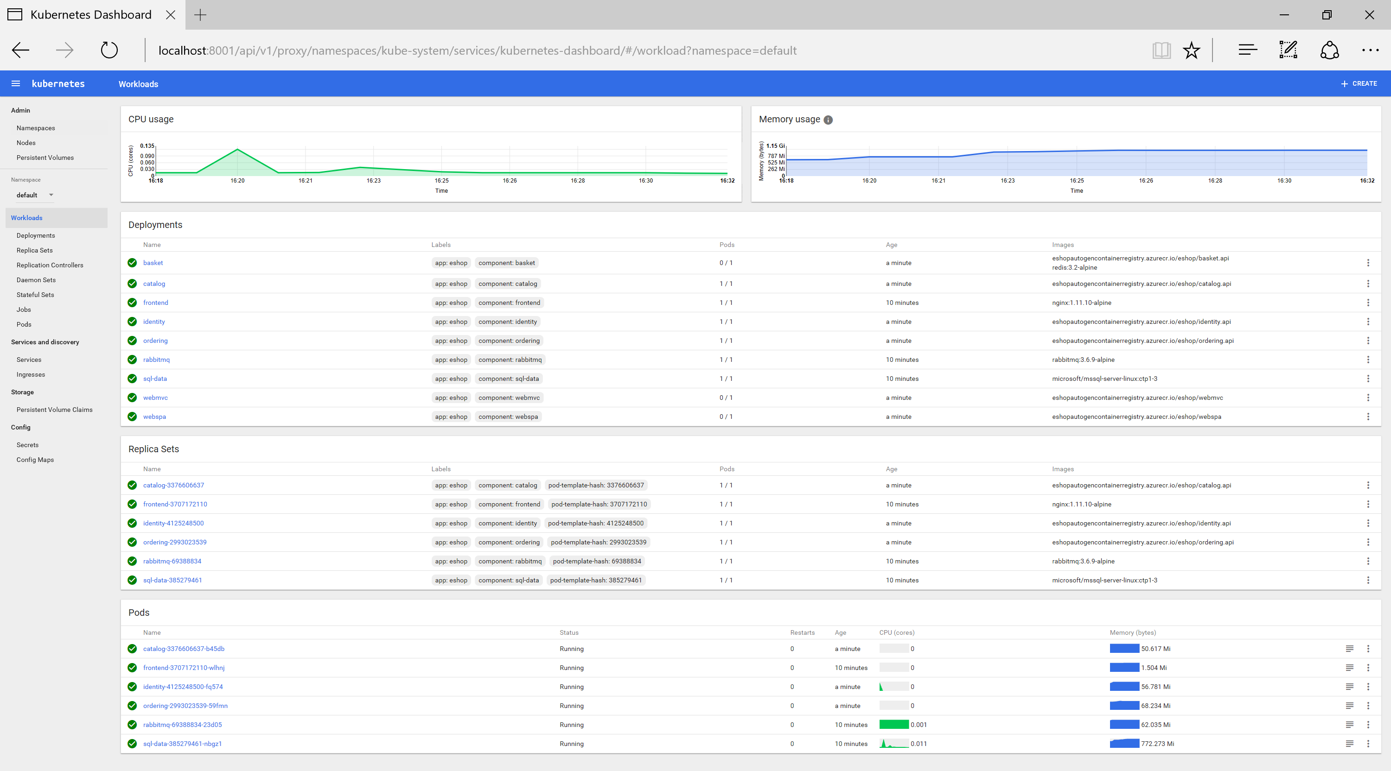
Demo 4
(5)
Scaling out with Orchestrators
AKS-Kubernetes
Overview
Scaling out
AKS step-by-step
Setup for eShopOnContainers:
https://github.com/dotnet-architecture/eShopOnContainers/wiki/10.-Setting-the-solution-up-in-AKS-(Azure-Kubernetes-Service)
Notes:
Overview:
Azure portal AKS
Images in ACR
Kubernetes Dashboard
Deploy?
Scaling out

Slide 34


Choosing orchestrators in Azure
Azure Product
Orchestrator / Engine | Description | Good for | Common workloads
 | Kubernetes is an open-source platform for automating deployment, scaling, and operations of application containers across clusters of hosts. AKS: You pay for VMs in cluster ACS Engine: IaaS container infrastructure |  | Microservices based on containers
 | Azure Service Fabric is a distributed systems platform that makes it easy to package, deploy, and manage scalable and reliable microservices. Mesh: PaaS/Serverless platform Cluster: You pay for VMs in cluster |  | Microservices based on containers Microservices based on plain processes Stateful services
Azure Kubernetes Service
(AKS)
Kubernetes
It’s an OSS ecosystem
More mature:
Less mature:
Azure Service Fabric
(Mesh and cluster)
Service Fabric
It’s a Microsoft ecosystem
and OSS
More mature:
Less mature:

Slide 35
Collaborative development environments for microservices
Notes:
(0)

Slide 36
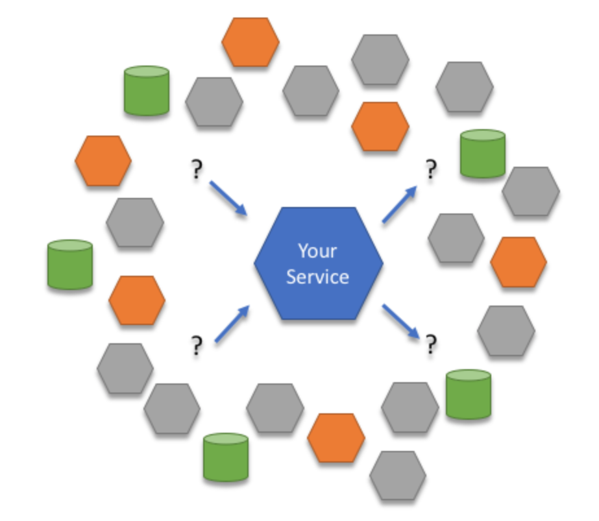
Challenges with developing microservices
Challenges
Do I need to run ALL the microservices in my PC?
  I can run it all on my laptop…
  Or, create mocks?
How do I iteratively develop and deploy my service to an orchestrator cluster easily (from VS, CLI, etc.)
How do I run/test my updated service in a final orchestrator with no risk of breaking the rest of the app in the orchestrator?
Single Docker Host?
Orchestrator?
Local env. with “all”?
Cloud environment?
Notes:
Your sample application isn't very complex at the moment. But in real-world development, challenges soon emerge as you add more services and the development team grows.
Picture yourself working on a service that interacts with dozens of other services.
It can become unrealistic to run everything locally for development. Your dev machine may not have enough resources to run the entire app. Or, perhaps your app has endpoints that need to be publicly reachable (for example, your app responds to a webhook from a SaaS app).
You can try to only run the services that you depend on, but this means you'd need know the full closure of dependencies (for example, dependencies of dependencies). Or, it's a matter of not easily knowing how to build and run your dependencies because you didn't work on them.
Some developers resort to simulating, or mocking up, many of their service dependencies. This can help sometimes, but managing those mocks can soon take on its own development effort. Plus, this leads to your dev environment looking different to production, and subtle bugs can creep in.
It follows that doing any type of end-to-end testing becomes difficult. Integration testing can only realistically happen after a commit, which means you see problems later in the development cycle.

Slide 37
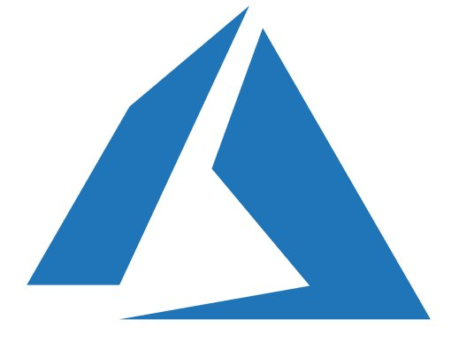
Azure Dev Spaces for Kubernetes/AKS
Fast, iterative development for cloud native apps
(Currently in public preview)
AKS cluster
with Dev Spaces
Azure
</>
Iterate fast, directly in Azure
Edit code with
your favorite editor/ID
Commit code
Deploy
SCC => CI/CD
Notes:
Get Started on Connected Environment with .NET Core and Visual Studio
https://docs.microsoft.com/en-us/visualstudio/connected-environment/get-started-netcore-visualstudio-01
Get Started on Connected Environment with .NET Core and VS Code
https://docs.microsoft.com/en-us/visualstudio/connected-environment/get-started-netcore-01
https://github.com/kubernetes/charts (Helm Charts)

Slide 38
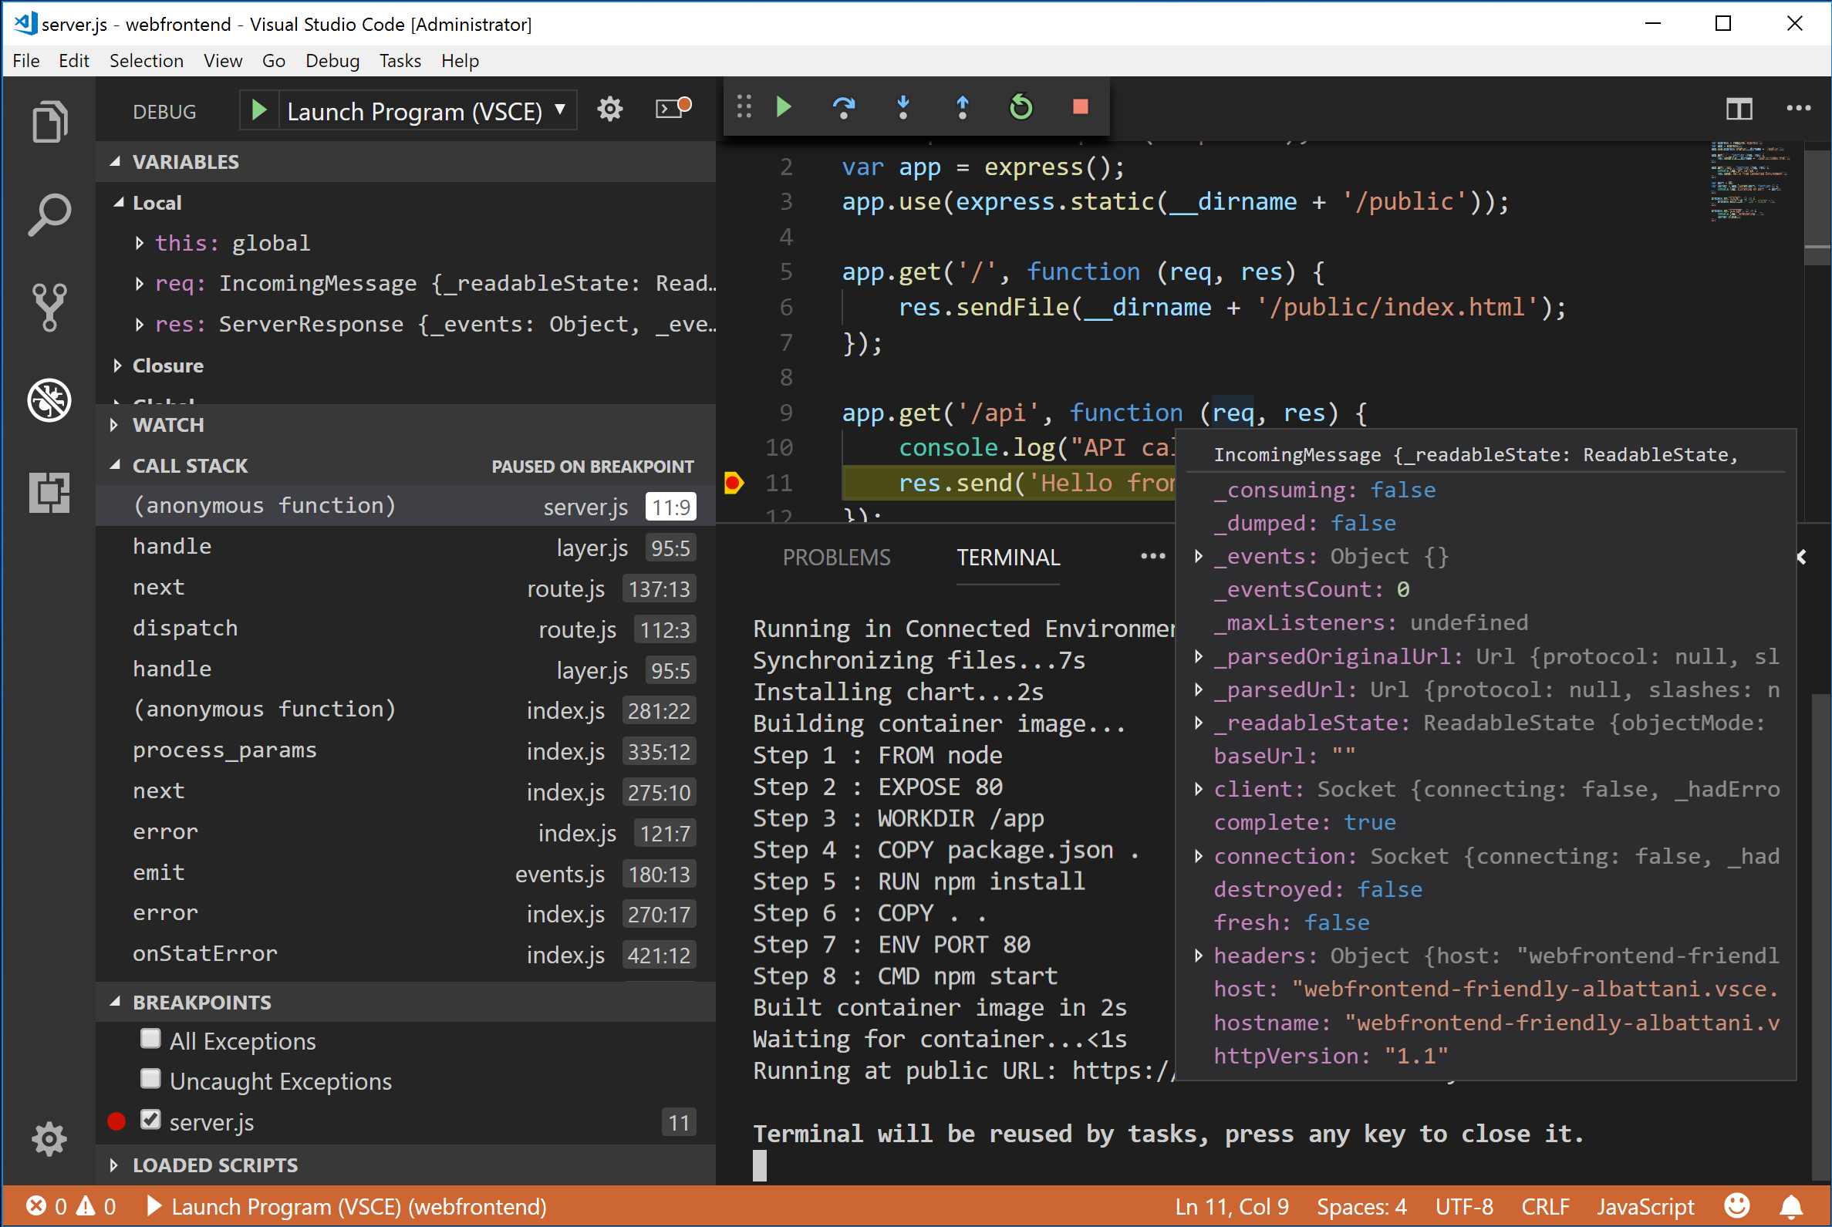
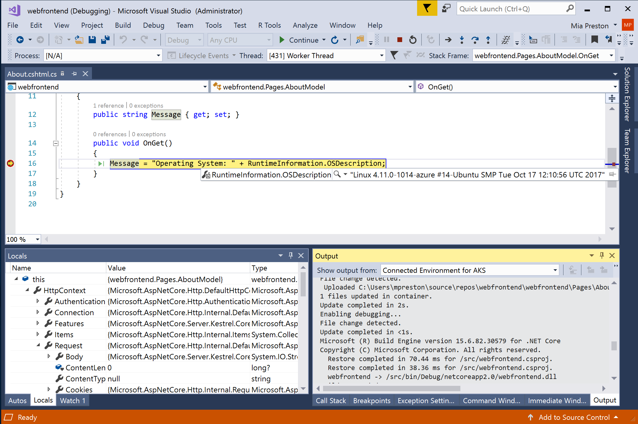
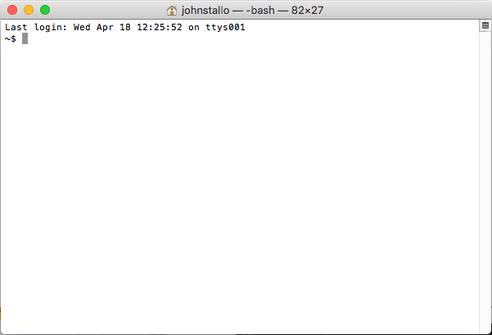

Azure Dev Spaces:
Rapidly iterate and debug Kubernetes in Azure (AKS)
(Aka. Visual Studio Connected Environment for AKS; Codename “Mindaro”)
(Currently in public preview)
Minimal local machine setup
The same Docker and Helm assets from development to production
Integrated with AKS http app routing
Run any language/framework
Windows, Mac, or Linux
$ az aks use-dev-spaces -g demo1 -n demo1
$ az ads prep
$ az ads up
Visual Studio Code
Visual Studio 2017
Command line
Notes:
Rapidly iterate and debug Kubernetes in AKS
Develop with Visual Studio 2017, VS Code, or command line
Windows, Mac, or Linux
Collaborate within a development team
Share an AKS cluster for team development
Test code end-to-end without replicating or simulating dependencies
Onboard new team members with minimal machine setup

Slide 39
Azure Dev Spaces: Collaborate in a shared AKS cluster
Team members can work in parallel on different parts of an app
Devs can use their own ‘spaces’ when testing particular deployments
Test apps end-to-end without replicating dependencies
http://eshop.bd0cfb25...aksapp.io
FrontEnd
API Gateway
Service-A
http://cesar.s.eshop.bd0cfb25...aksapp.io
Service-A
Cesar’s version
Cesar
Notes:
Work in a shared development environment
With Azure Dev Spaces, you can set up a shared development environment in Azure. Each developer can focus on just their part of the application, and can iteratively develop pre-commit code in an environment that already contains all the other services and cloud resources that their scenarios depend on. Dependencies are always up-to-date, and developers are working in a way that mirrors production.
As you develop code for your service, and before you're ready to check it in, code often won't be in a good state. You're still iteratively shaping it, testing it, and experimenting with solutions. Azure Dev Spaces provides the concept of a space, which allows you to work in isolation, and without the fear of breaking your team members.
Anyone who opens the public URL and navigates to the web app will invoke the code path you have written which runs through both services using the default default space. Now suppose you want to continue developing mywebapi - how can you do this and not interrupt other developers who are using the development environment? To do that, you'll set up your own space.

Slide 40
Demo 5
(3)
Demo on Azure Dev Spaces for Kubernetes and VS
(1)
Direct deployment from Visual Studio, VS Code or CLI
Debug across multiple services
(2)
Team Development with Dev Spaces
Notes:
(0)
Source code for demo: https://github.com/CESARDELATORRE/spike-azds/tree/master/SpikeAZDSNetCore21/
FOR DEMO on Azure DevSpaces:
https://docs.microsoft.com/en-us/azure/dev-spaces/quickstart-netcore-visualstudio

Slide 41

Lifecycle
(Azure Dev Spaces)
Source control
CI/CD pipeline
helm upgrade—install
values.int.yaml
helm upgrade—install
values.prod.yaml
git commit
git push
Container registry
Lisa
namespace
Integration
namespace
Production
namespace
'up' or F5 debug
values.dev.yaml
Lisa
Dev Spaces enabled
Cesar
namespace
Cesar
Dev Spaces enabled
John
namespace
Dev Spaces enabled
John
Dev Spaces enabled
AKS cluster
Notes:
DEVELOPER EXPERIENCE
Run or debug code prior to commiting in a production-like development environment running in Azure
Work with real upstream and downstream dependencies instead of mocks or simulators
Use a shared team environment with isolated spaces to avoid complex setup and enable live, ongoing discovery of integration issues

Slide 42
Infusing AI / Machine Learning into your Cloud Native applications
Notes:
(0)

Slide 43
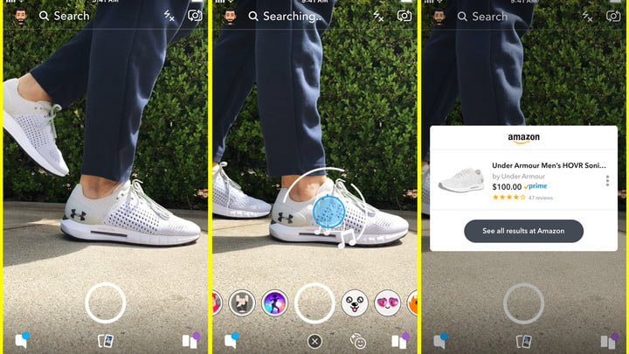
I saw this in the news this week…
“Soon you'll be able to use your Snapchat camera to buy Amazon products”
https://www.engadget.com/2018/09/24/snapchat-amazon-visual-search/
https://www.digitaltrends.com/social-media/snapchat-camera-shop-on-amazon/amp/
https://www.usatoday.com/videos/money/business/2018/09/25/soon-youll-able-use-your-snapchat-camera-buy-amazon-products/37933129/

Slide 44
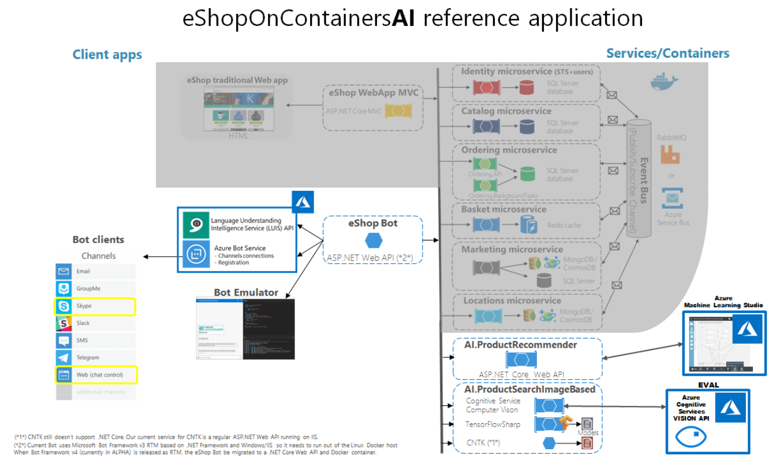
Demo 6
eShopOnContainersAI
AI/Machine Learning in Cloud Native apps
New!
Technologies:
ML.NET (Machine Learning .NET)
Cognitive Services (Custom Vision)
TensorFlow + TensorFlowSharp
Bot Framework v4
https://github.com/dotnet-architecture/eShopOnContainersAI

Slide 45
Guide/eBook and sample apps on microservices architecture
eBook/Guide
Additional subjects covered in the eBook
Domain Driven Design Patterns
Domain Models (Aggregates, Entity, Value-Objects, etc.)
Simplified CQRS
  Dapper MicroORM for queries
  Commands and Mediator patter
Domain Events (within the same microservice)
Microservices
Integration Events (across microservices)
Docker Multi-arch and multi-stage builds
Swagger with Swashbuckle
Security (Authentication/Authorization) with tokens from IdentityServer4 wrapping ASP.NET Identity
eShopOnContainers: Reference microservices application
Intended for .NET developers and solution architects
Prescriptive guidance on Microservices implementation with .NET Core and Docker
https://aka.ms/microservicesebook
https://github.com/dotnet-architecture/eShopOnContainers

Slide 46
Key takeaways
Microservices allow to evolve, deploy and scale parts of the
application independently
Microservices offer great benefits but also new challenges
(distributed software challenges)
Microservices are not suitable for all apps, but for large, scalable and long-term evolving applications with typically multiple autonomous development teams
But you can start extending your existing monolithic apps with new microservices, step-by-step

Slide 47

Please evaluate this session
Your feedback is important to us!
From your PC or Tablet visit MyIgnite
at http://myignite.microsoft.com
From your phone download and use the Ignite Mobile App
by scanning the QR code above or visiting https://aka.ms/ignite.mobileapp

Slide 48
Cesar de la Torre
Principal Program Manager
.NET Product Group
Microsoft Corp.
@cesardelatorre
cesardl@microsoft.com

Slide 50
Backup slides

Slide 51
Journey to the cloud

Slide 52
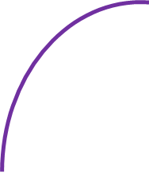
The Journey to the Cloud
Migrate
Modernize
Today’s session focus:
Cloud-Native apps and Microservices architecture
Containerize
+ cloud managed services
Existing
apps & services
.NET Framework
on-premises
Cloud
Infrastructure-
Ready
apps
Cloud
Optimized
apps
Rehost
Cloud-Native
apps
Rearchitect/Rebuild
On-Premises
Infrastructure Platform
IaaS
“Lift & shift”
No code changes
Containers
& PaaS
Minimal code changes
Microservices Architecture
& Serverless
Architected for the cloud
modernized/rewrite

Slide 53





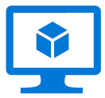
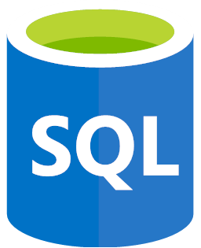


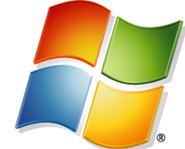

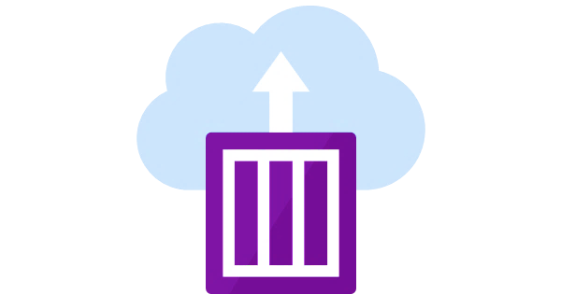
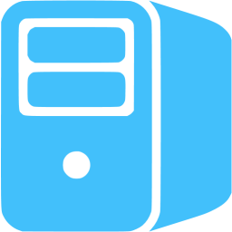
Maturity model for .NET application modernization
Existing apps
.NET web apps (on-premises)
Cloud
Infrastructure-Ready
Cloud-Optimized
PaaS
Cloud-Native
PaaS for microservices and serverless
Monolithic or N-Tier
architectures
Monolithic or N-Tier
architectures
Monolithic or N-Tier
architectures
Microservices and serverless architectures
Relational Database
IaaS
(Infrastructure as a Service)
Managed services
VMs
PaaS for containerized microservices
+ Serverless computing
+ Managed services
+
Windows Containers
On-premises
Azure
Azure
Azure
Base Cloud Environment and cross-cutting concerns: Network, Hybrid-cloud, Identity/Auth, Cost control and Operations model
Migrate / Rehost
Modernize
Minimal code changes
Architected for the cloud, needs new code

Slide 54

https://github.com/dotnet-architecture/eShopOnContainers

Slide 55
Docker

Slide 56
Docker Containers
Containers helps automating the deployment of applications as portable, self-sufficient containers that can run on any cloud or on-premises.
No more:
“It works in my dev machine!...
Why not in production?”
Now it is:
“If it works in Docker, it works in production”
Keywords about WHY containers?
Dependencies (self-sufficient)
Deployment
Notes:
Containers are a way to wrap up an application into its own isolated box.
The main characteristic of a container is that it makes the environment the same across different deployments
because the container itself already comes with all the dependencies it needs.
A container is an “instance” of a container image. A container image is a way to package an app or service
(like a snapshot) and deploy it in a reliable and reproducible way.
Containers are fast becoming the unit of deployment.
Docker is an open-source project for automating the deployment of applications as portable, self-sufficient
containers that can run on the cloud or on-premises.
Docker is also a company that promotes and evolves this technology, working in collaboration with cloud,
Linux, and Windows vendors, including Microsoft.

Slide 57



Docker and .NET
.NET Framework
container image:
  Windows Server Core
.NET Core
container images:
  xPlat. (Linux & Windows Nano Server)
Modernizing
for simpler
scenarios
Today’s session
Cloud-Native
& microservices
scenarios
https://hub.docker.com/r/microsoft/dotnet/
See at Docker Hub
Notes:
LIFT &SHIFT scenarios
Number of pulls for these containers…. If it supports our story ☺

Slide 58
Azure
Container ecosystem

Slide 59














Azure container ecosystem
OSBA
App Service
Azure Container Registry (ACR)
Partner services
Azure services
PaaS
OpenShift
SQL Database
Azure Kubernetes Service (AKS)
Service Fabric
(Mesh & cluster)
Batch
Pivotal Cloud Foundry
Redis Cache
ACS Engine
Service Fabric Engine
Managed
Docker Enterprise Edition
CosmosDB
Infrastructure
Virtual kubelet
Mesosphere
DC/OS
And more!
Azure Container
Instances (ACI)
Azure
Virtual Machines
Virtual Machine
Scale Sets (VMSS)
IaaS
Notes:
Run container applications on Azure Batch:
https://docs.microsoft.com/en-us/azure/batch/batch-docker-container-workloads

Slide 60




Choosing Azure Compute Platforms for container-based apps
 | Azure Virtual Machines (VMs) | Azure Container Instances (ACI) | Azure App Service | Azure Kubernetes Service (AKS/ACS) | Azure Service Fabric | Azure Functions | Azure Batch
Web apps (Monolithic architecture)
N-Tier apps (Coarse-grain services)
Cloud-Native (Microservices architecture)
Batch / Jobs (Background tasks)
(*)
(*)
Application
Architecture
Recommended
Recommended
(*)
Azure
event-driven
Recommended
Recommended
Recommended
Application’s
background tasks
Recommended
Large Batch scale
Recommended
Possible
(*)
Only certain scenarios
such as Dev/Test/QA or infrastructure for
other products such as Virtual Kubelet
Recommended
Notes:
Service Sweet spot
Azure Container Instances
Run individual containers with no VM management
Azure Web Apps
Deploy scalable web apps and services using containers
Service Fabric
Build microservice applications packaged in containers
Azure Container Service (AKS)
Use leading OSS orchestrator and associated CNCF tools to deploy and manage containers
Azure Batch
Schedule large scale batch processes deployed in containers

Slide 61
Async. comm. in microservices

Slide 62
Risk of Partial Failure Amplified by Microservices
HTTP request/response communication
Backend / Orchestrator
Multiple
Customers
Dependency
1
Dependency
2
Browser
Web App
Dependency
6
Multiple
HTTP requests
Dependency
3
Dependency
5
Submit Order page
Dependency
7
Dependency
4
Dependency
8
Anti-patterns

Slide 63
How to minimize exponential failures in microservices
Circuit-Breakers (i.e. Polly’s policies, etc.)
Avoid long Http call chains within the same request/response cycle

Slide 64

Synchronous vs. async communication across microservices
Anti-pattern
Synchronous
all req./resp. cycle
Client
Http sync.
request
Http sync.
request
Http sync.
request
Http sync.
request
Basket
Ordering
Catalog
Other
Http sync.
response
Http sync.
response
Http sync.
response
Http sync.
response
i.e. MVC app,
API Gateway, etc.
Same Http Request/Response cycle!
Asynchronous
Comm. across internal microservices
(EventBus: i.e. AMPQ)
Client
Http sync.
request
Basket
Ordering
Catalog
Other
Http sync.
response
i.e. MVC app,
API Gateway, etc.
“Asynchronous”
Comm. across internal microservices
(Polling: Http)
Client
Http sync.
request
Http
Polling
Http
Polling
Http
Polling
Basket
Ordering
Catalog
Other
Http sync.
response
i.e. MVC app,
API Gateway, etc.
Http
Polling

Slide 65
Asynchronous Event-Driven communication with an Event Bus
Backend
Basket Microservice
Database as
Cache
User-Profile Microservice
Service
1
Web API Service
3
UserUpdated event → Buyer info
UpdateUser
command
Event Bus
(Publish/Subscribe Channel)
UserUpdated event
(Publish Action)
4
2
UserUpdated event → Buyer info
DB update
Event Bus Abstractions/Interface
Ordering Microservice
Database
Event Bus Implementations
Azure
Service
Bus
Other:
NServiceBus
MassTransit
etc.
Database
RabbitMQ
Service
Eventual consistency across microservices’ data based on event-driven async communication

Slide 66
HealthChecks

Slide 67
Health Checks API
Microservice 1
/health
HealthChecks
WatchDog app
Microservice 2
/health

Slide 68
Health Checks API
Usually
Provided by the Orchestrator
(i.e. Service Fabric, Kubernetes, etc.)
API Gateway
Microservice 1
Consumer A
Router
/health
Microservice 2
Consumer B
query
/health
Service Registry

Slide 69
HttpClient factory

Slide 70

DelegatingHandlers in HttpClient factory

Slide 71
Moving resilient patterns to the platform (Retries/Circuit-Breaker):
Service Mesh tools:
Envoy from Lyft Engineering
Linkerd from https://buoyant.io
Traefik from https
For example, Service Fabric Mesh uses Envoy out-of-the-box and “transparently”:
You can also use with Kubernetes but you need to implement/deploy it:
These tools provide features such as:
Retry
Circuit-breaker
Latency and other metrics
Failure- and latency-aware load balancing
Distributed tracing
Protocol upgrade
Version-aware routing
Cluster failover, etc
If using those, you don’t need an implementation of retries and circuit breaker as part of every microservice. Instead, you will be using one as a sidecar pattern or host proxy.

Slide 72
CI/CD

Slide 73
CI/CD pipelines with
Docker containers and
Azure

Slide 74










Using CI/CD pipelines to automate build and deploy for microservices/containers
5.
Deployment choices
2.
3.
4.
Application
code repo
(SCC)
Build, CI
CD, deploy
Azure Container Instances (ACI)
Azure VM
Windows Server 2016
Docker Engine
VSTS
VSTS
docker push
Azure App Service
(Preview for Windows Containers)
Code Push
Docker Hub
or
Azure Container Registry
Service Fabric
(Mesh or cluster)
Custom
Image
Docker registry
git push
Azure Container Service
KUBERNETES
Inner loop
1.
Code,
run,
debug
(*) SQL Server in a container should only be used for dev/test environments.
Move to high available systems, like Azure SQL Database, for production environments
Dev environment
Notes:
Include “ACR Build” when the Preview supports WINDOWS CONTAINERS.
As of //BUILD 2018 it only supports LINUX containers

Slide 75
AKS

Slide 76


Slide 77


Slide 78


Slide 79
Azure Dev Spaces

Slide 80
Microservices are hard to develop locally
Azure
Traditional Integration Environment
Frontend
Hotels
Promotions
Promotions DB
*
SCC => CI/CD
Test
Staging
Production
Local Development Machine
Hotels
Promotions
Promotions DB
*
VS / VSCode / CLI

Slide 81
Microservices are hard to develop locally
Assumptions
I know the full dependency graph
I know how to build and run dependencies
I can run it all on my laptop
Or, create mocks?
Azure
Traditional Integration Environment
Frontend
Hotels
Promotions
Promotions DB
*
SCC => CI/CD
Test
Staging
Production
Local Development Machine
Hotels
Promotions
Promotions DB
*
VS / VSCode / CLI

Slide 82





Collaborate in a team’s AKS cluster
Azure
Team's AKS cluster
Frontend
Hotel
Promotions
Promotions DB
*
*
Dev-Space: John
Dev-Space: John
Lisa's “Space”
John's “Space”
Frontend
Hotel
Promotions
*
*
*
SCC => CI/CD
Test, Staging, Production
SCC => CI/CD
Lisa's Development Machine
John's Development Machine
VS / VSCode / CLI
VS / VSCode / CLI

Slide 83

Space routing requires forwarding HTTP headers
Helper function generated by az ads prep command
Sample usage:
Before
After

Slide 84
Peek Under the Hood
Client synchronizes code to Azure Dev Spaces
Helm chart is installed with instrumentation
Suppose browser calls hotels calls promotions:
GET http://cesar.s.sh360.abcd.aksapp.io/hotels-api
GET http://promotions/api/3
DNS resolves to promotions.mainline
Proxy notices “dev-space: cesar” and
retargets to IP of promotions.cesar
Proxy reports traces back to client
Proxy sees “cesar.s.” prefix in host name and adds “dev-space: cesar” HTTP header before forwarding the request to user code
GET /api/3 HTTP/1.1
Host: promotions
dev-space: cesar
Azure use this text to move Azure
Azure Kubernetes Service (AKS) thisas
“kube-system”
namespace
10.2.3.4
AKS
Ingress
(nginx)
routing/tracing proxy
routing/tracing proxy
hotels
mainline
promotions
mainline
“mainline”
namespace
inbound
outbound
inbound
outbound
Browser
GET /hotels-api
10.5.6.7
Development Client
Azure Dev Spaces
routing/tracing proxy
helm install
promotions
cesar
azds up
“lisa”
namespace
source code is
volume mounted
inbound
outbound
init
Init container builds the container image

Slide 85
Roadmap
Currently in private preview
(and expanding membership)
On our radar:
Custom VNet support
Java debugging
DevOps Projects integration
Azure Portal experience
Expand Azure regions
Sign up for private preview
aka.ms/devspaces

Slide 86
VSTS + Helm + K8s

Slide 87
Helm + VSTS + Kubernetes
https://helm.sh/
Use Helm with Azure Kubernetes Service (AKS)
https://docs.microsoft.com/en-us/azure/aks/kubernetes-helm
VSTS + Helm + AKS
http://blogs.msdn.microsoft.com/azuredev/2018/03/27/building-microservices-with-aks-and-vsts-part-1/
http://blogs.msdn.microsoft.com/azuredev/2018/04/03/building-microservices-with-aks-and-vsts-part-2/
http://blogs.msdn.microsoft.com/azuredev/2018/04/10/building-microservices-with-aks-and-vsts-part-3/
https://blogs.msdn.microsoft.com/azuredev/2018/04/17/building-microservices-with-aks-and-vsts-part-4/
https://azure.microsoft.com/en-us/resources/videos/use-helm-with-azure-container-service-and-kubernetes/
https://open.microsoft.com/2018/03/06/first-helm-summit-notes-recordings/
https://docs.microsoft.com/en-us/vsts/release-notes/2018/may-07-vsts

Slide 88
eShopOnContainers

Slide 89


Slide 90


Slide 91


