Slide 1


.NET OPEN SOURCE SUSTAINABILITY
Shaun Walker shaun.walker@siliqon.com

Slide 2
My Open Source Sustainability Journey
2001-2002 Created initial DNN framework as hobby project
2003 Released DNN as open source project
2004-2005 Microsoft sponsorship, sponsored product enhancements
2006-2008 Advertising, sponsorships, donations, consulting
2009-2014 Venture capital, commercial product, open core
2015-2017 No open source project participation, .NET Foundation
2018-2021 release Oqtane open source framework, .NET Foundation
Tried every possible open source business model, was able to support my family on solely open source for 11 years

Slide 3
Open Source Maintainers are INSANE!
Definition of Insanity:
“Doing the same thing over and over and expecting different results”

Slide 4
Open Source Sustainability
General
Open Source is based upon freedom
Freedom reduces leverage and control over usage
As a result monetization opportunities are more limited in Open Source
Advantages
Scalable distribution model
Low user acquisition cost
Disadvantages
No native business model
Vulnerable to imitation/competition
Golden Rule
Maintainers made a decision to give their work away for free
Users are not obligated to give anything
Maintainers are not entitled to receive anything
The responsibility is on maintainers, not users, to create sustainability

Slide 5
Open Source Fallacies
Open Source Fallacy #1
Increasing number of contributors will help prevent maintainer burnout
Opposite is actually true
More contributors = more community support = more burnout
Open Source Fallacy #2
Open source projects have unlimited contributors
95% of users of open source do not contribute
95% of contributions on GitHub are done by 5% of contributors
Open Source Fallacy #3
Open source follows different rules than commercial products
Governed by standard product/market viability criteria
Open Source Fallacy #4
A single business model exists which satisfies the needs of all open source projects
The sustainability needs of each open source project are different – there is no “one size fits all” solution
Open Source Fallacy #5
Sustainability is more difficult in the Microsoft ecosystem
Every open source ecosystem suffers from this problem – the “grass is not greener” elsewhere
In fact, monetization is even more difficult in idealistic ecosystems

Slide 6
Open Source Project Life Cycle
**Note that many open source projects do not follow this life cycle
Life Cycle
Stage
Hobby
Community
Professional
Enterprise
Downloads
Users Contributors
FTEs
100+
10+ 1+ 0
1000+
100+ 10+ 0-1
100,000+
10,000+ 100+ 1-10
10,000,000+
1,000,000+ 1000+ 10-100
Crossing this chasm is difficult
$ Donations, Sponsorship, Advertising, Grants (passive revenue, not scalable)
$$ Professional Services, Training (labor intensive, not scalable)
Success Probability Factors
0% 20%
Project Type Library Application Age (years) 1-3 3-10
Market Size Niche Large
Target Buyer SMB Enterprise
Competition Abundant Scarce
$$$ Commercial Product, Extensions, Managed Service
(requires capital)
$$$$ Venture Capital
(unicorn)

Slide 7
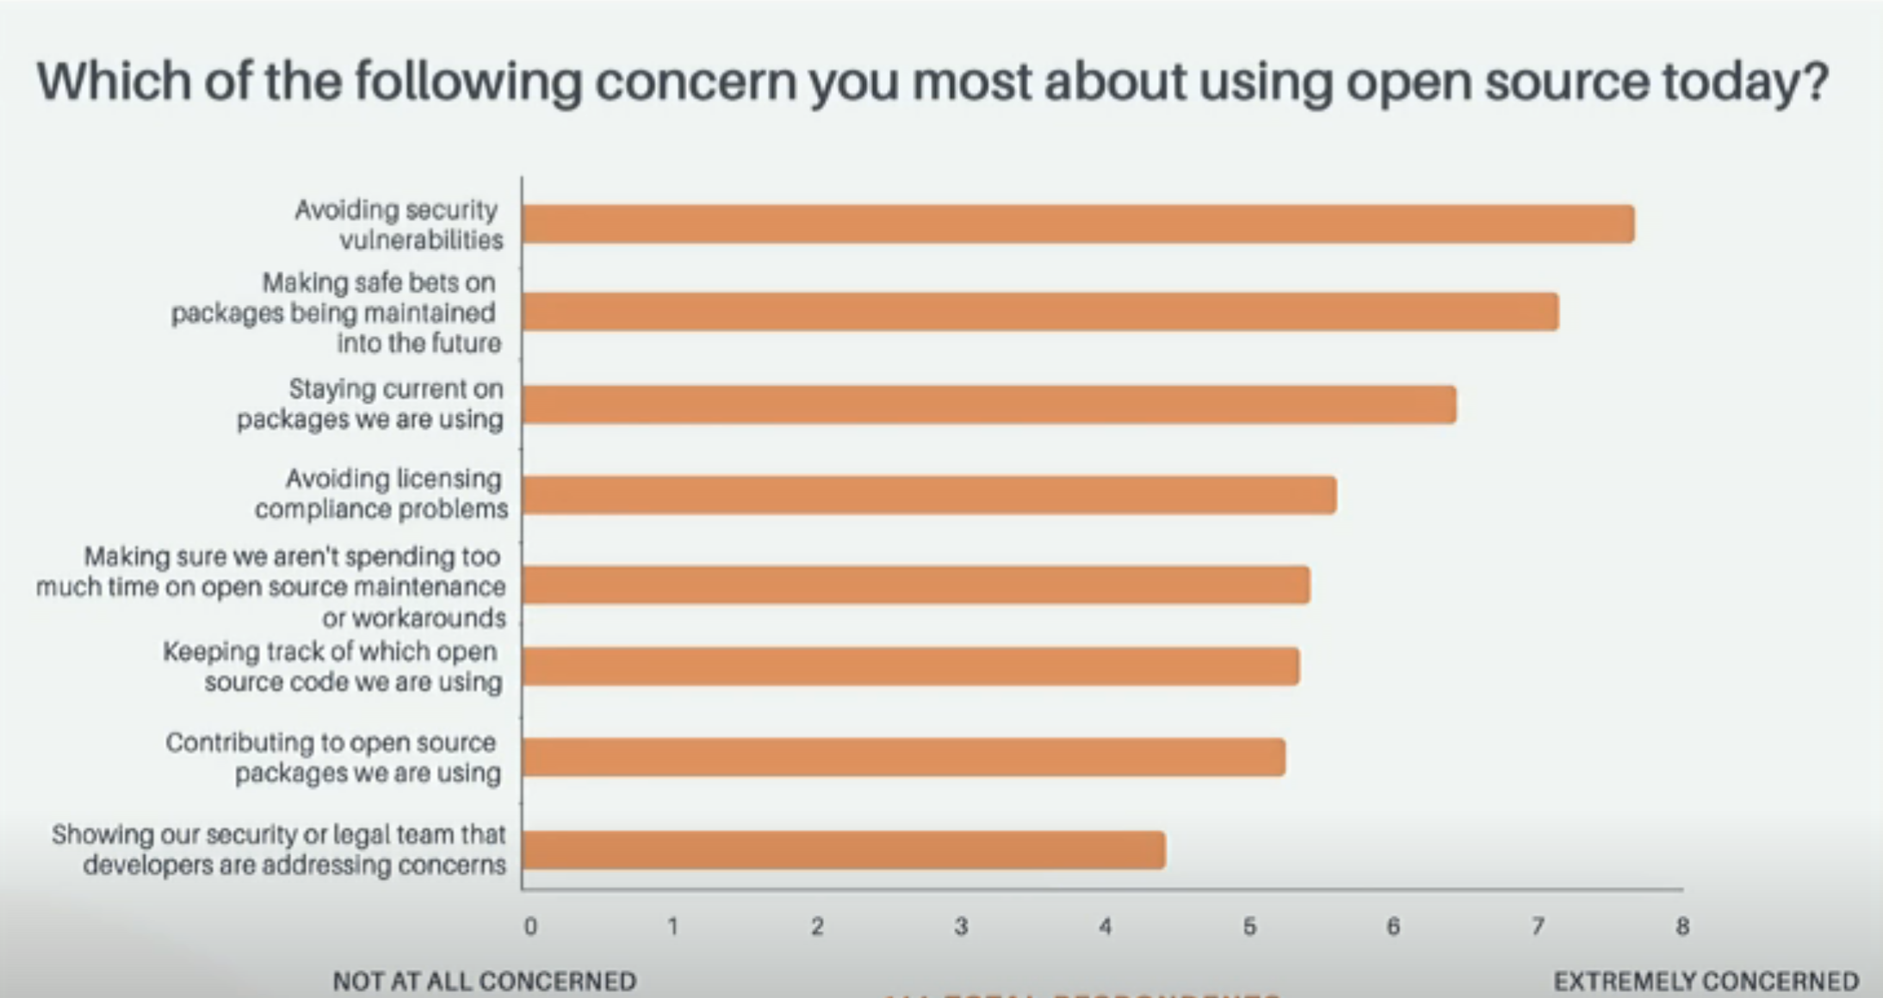
Open Source Risks
Users want to mitigate risks associated to open source software
A commercial product should provide benefits that satisfy these risks
The benefits must be clearly differentiated and compelling

Slide 8
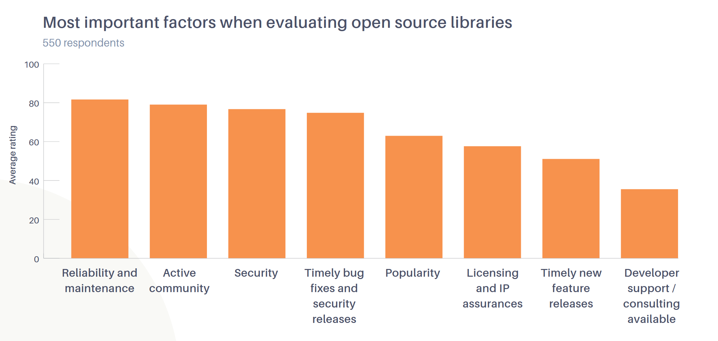
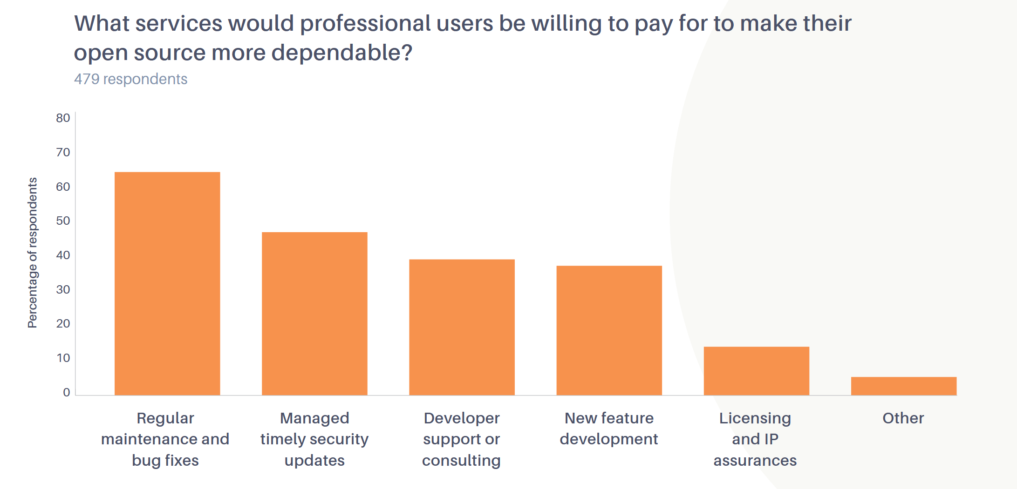
Open Source Monetization
Source: Tidelift Survey 2018

Slide 9
Commercial Open Source Product Benefits
Commercial license | Companies prefer to have a formal agreements with other companies which protects their interests and mitigate risk
A tested and certified build | Companies prefer to use “official” product releases – especially those which have gone through more thorough certification
Management of product dependencies and licenses | Companies are afraid of dependencies and license compliance. A commercial product should provide documentation of all dependencies and licenses.
Prioritized support with Service Level Agreement (SLA) | Companies like having a “throat to choke” and an insurance policy for unexpected complications which may jeopardize business continuity
Private knowledge base and communication channel | Companies want prioritized access so their issues can be escalated and resolved immediately
Full product documentation | Documentation is a valuable asset which companies are willing to pay for as it helps them offset internal training and support costs
Notifications of security updates | Companies want to ensure their infrastructure is secure and they want to be proactively notified so they can take action
Product updates with notifications of new releases | Companies want to ensure their infrastructure is reliable and they want to be proactively notified of new releases
Product copyright indemnification | Companies want to limit their risk and liability related to copyright infringement issues in the product
Commercial extensions | Companies may need additional functionality which is highly specialized, valuable, or not applicable to all users.
Integration consulting services | Companies may need integration or development assistance with implementation of the product

Slide 10
Commercial Open Source Product Infrastructure
Commercial Entity – register a company and set up a bank account
Product Usage Tracking – capture and understand your product installation and usage metrics
Marketing – website to describe your commercial product benefits and generate awareness through all channels – community, search, social, etc…
Lead Generation – capture contact information (ie. email address ) from your users. The easiest way is to offer a newsletter and use email automation software.
Sales Pipeline – qualify your leads and nurture them through the sales pipeline using drip marketing or direct sales engagement ( ie. use a CRM )
Purchase – mechanism to allow customers to pay for your product and get provisioned for services
License Agreement – create commercial license agreement ( you may need legal assistance )
Licensing – product licensing mechanism to restrict product usage
Support – online support ticket system and staffing plan for satisfying your SLA promises
Insurance – business insurance and product indemnification insurance

