Slide 1
Proposal on How to reward OSS contributors
By Eriawan Kusumawardhono

Slide 2
Known common (too general) misconceptions of “popular and active OSS” related to contributors/contributions measure
Number of stars and forks of the repo. But since there are many OSS repos that have quite large number of stars and forks but when they have issues and PRs that only active for long time ago (e.g., last active/merged PR is a year ago) then the repo can should not be considered popular.
Number of active contributors. This measure of number of active contributors depends on what are those quantifications, based on how the OSS maintainers judge them or we could have basic common quantification as starters. For example: usually PRs by contributors are the only metrics.
Those that submits feedbacks are often not counted as contributors. Most of the time, people that submits feedback are treated with lower trust and often ignored.

Slide 3
The realities?
Only focusing on PRs only often means not paying attention to those who submit feedback, especially those that has reproducible bug as part of feedback and feature feedback
Therefore active submission of PRs should not be the only factor considered for healthy project, as this is not quite fair for other contributors
Blurry lines of contributors and supporters. Sometimes OSS backers especially those that has financial backers are treated as contributors. In the simple way to recognize contributors, we should go back to the common meaning of contributions: those that directly interact with the repo. These include not just PRs, but also issue submissions.

Slide 4
..then contributors should be defined first.

Slide 5
Redefining contributors
Not the original maintainers.
Those that submit legit and good PRs
Those that submit good feedback
Those that provide answers to questions and feedback,
Those that provide helpful clarification to help other people that ask questions on submitted feedback.

Slide 6
Rewarding contributors

Slide 7
Basic (minimum) forms of the rewards
Fair Acknowledgments of contributions by mention them
Additional privilege on the repo given to those that earned trusts high enough

Slide 8
Reward prerequisite requirements
Should be generally inclusive as governed by .NET Foundation Code of Conduct.
Should be inclusive and fair for contributors as we have defined in previous section. Therefore, we should not only consider those that submit PRs only as sole contributors.
Should only include active contributors within predefined reasonable time, especially when measure active contributions and consider last contribution date. See the discussion on “encouraging basic sustainability of contributions” below.
Clearly acknowledge contributors by having a list of contributors, and this should be updated frequently.
Avoid meritocracy to avoid bias to always listen to frequent contributors with high quality bar.
Carefully giving additional rights/privilege on some contributors, based on easy to quantify trust.

Slide 9
Define list of contributors
List active contributors with clear definitions of how active
Always include those contributors that meet the definition of contributors
Optional: try to list the contributors with the detailed contributions types of each contributor

Slide 10
Contributor list generation/creation
Manual: error prone, often tedious, and may be bias and not objective
Automated: can use bot or call Github APIs periodically our own

Slide 11
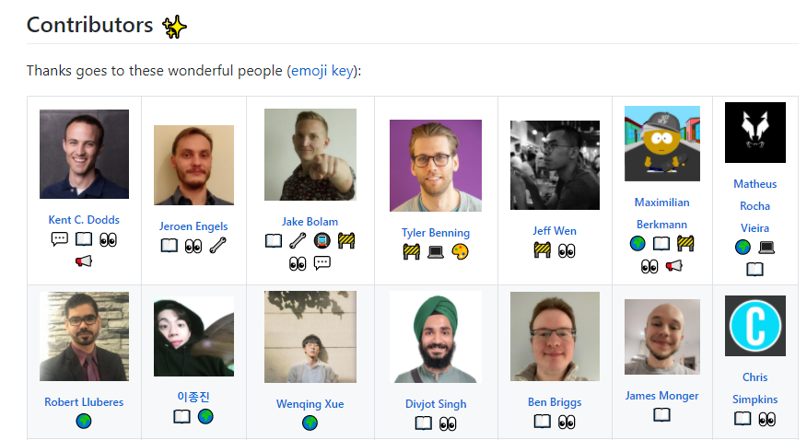
Sample list from All Contributors

Slide 12
Additional guidance
Manage the sustainability of the contributors and contributions. For example: always consider the list of contributors as dynamic list, not static list that always have additional contributors, and prepare for project ownership transfer. (see the doc for more samples)
Optional: manage the dynamics of the contributors, like having list of contributors that are no longer active but they were highly active and helpful for the collaboration and the development of the OSS repo. And we could acknowledge them in separate list. For example: using “emeritus model” of Project Eclipse committer emeritus and Eclipse Foundation emeritus

