Slide 1
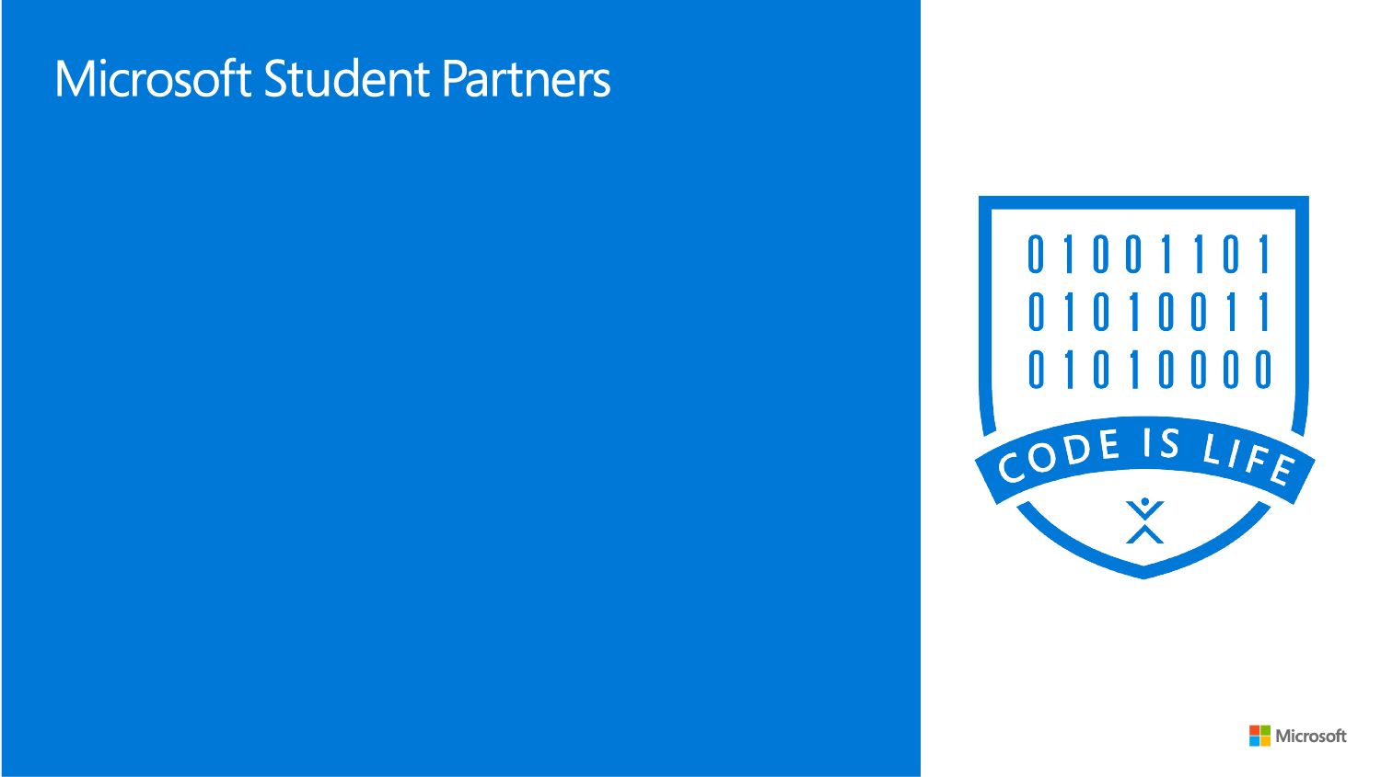
One storage to rule them all
Piotr Ładoński

Slide 2
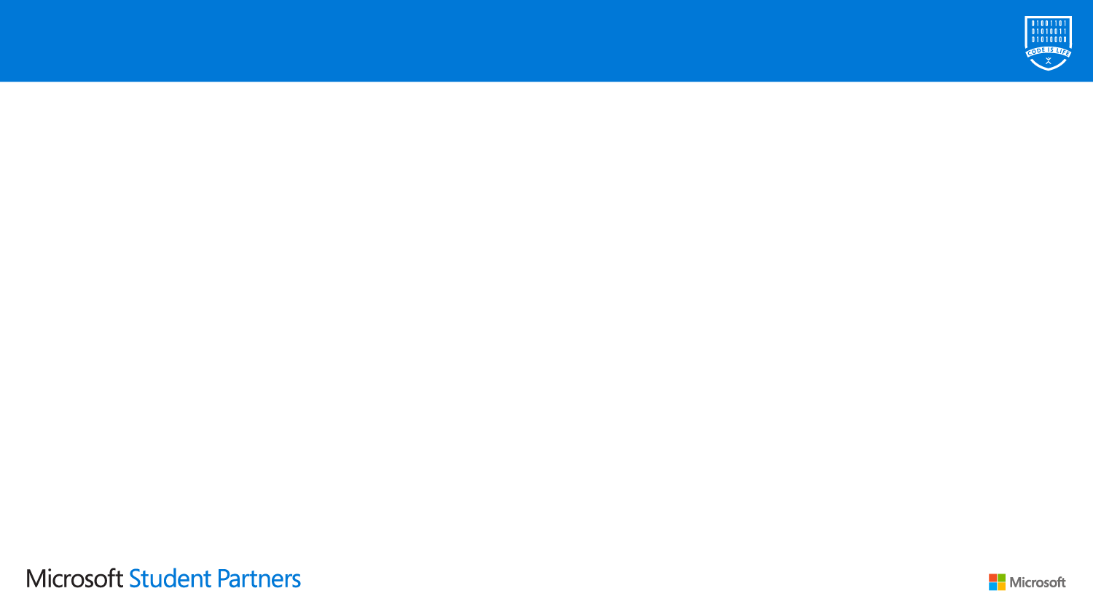
Agenda
General overview
SQL
Storage account (demo)
Tooling - Azure Storage Explorer & Emulator
Azure Tables
Blobs
Cosmos DB (demo)
Tooling – Azure Cosmos DB Emulator
MongoDB API

Slide 3
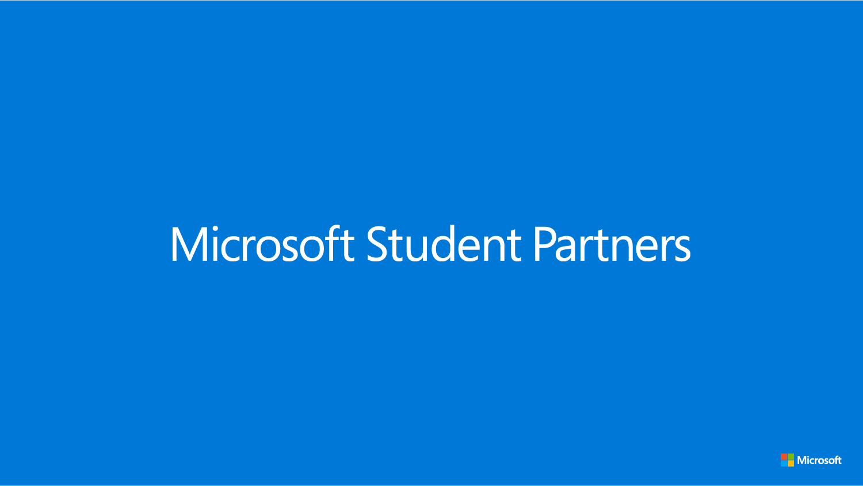
General overview

Slide 4
Why cloud storage?
Hackathon reasons
Quick setup
Easy access
Multiple APIs (SQL, NoSQL, blobs etc.)
General reasons
All hackathon reasons
High availability
Auto backup & recovery
Easily scalable
MS secured & updated

Slide 5


Azure storage options
SQL
Azure SQL Database
Azure Database for MariaDB/MySQL/PostgresSQL
Cosmos DB (SQL)
NoSQL
Azure Cache for Redis
Cosmos DB (MongoDB, Cassandra)
Other
Cosmos DB (Azure Table, Gremlin)
Azure Data Lake Storage
And more

Slide 6
Azure Storage Account

Slide 7
Azure Storage Account

Slide 8
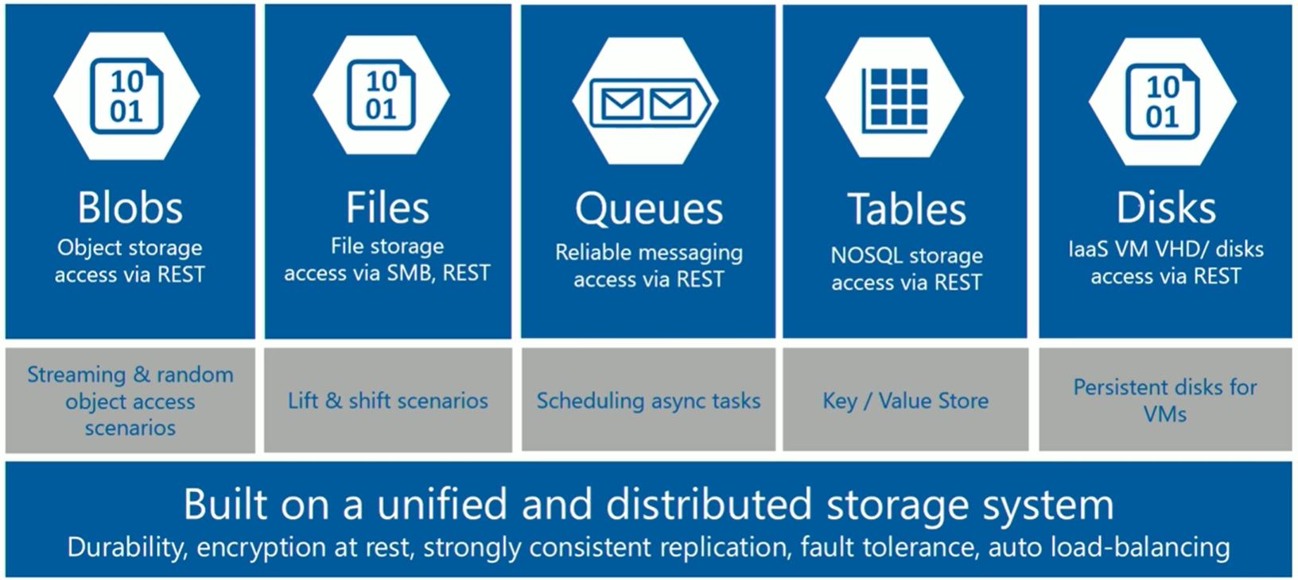
Azure Storage Account

Slide 9
Azure Storage Account

Slide 10
Azure Storage Account

Slide 11
Azure Storage Account

Slide 12
Azure Storage Account

Slide 13
Azure Storage Account

Slide 14
Azure Storage Account - tooling
Azure Storage Emulator
Part of MS Azure SDK in VS 2019
Supports Blob, Table and Queue
Has some minor differences (details)
Uses well-known credentials (shortcut, explicit)
Supports HTTP only
Has different resourcess addressing scheme (details)
Notes:
Alternative is Azurite

Slide 15
Azure Storage Account - tooling
Azure Storage Explorer
Runs on Windows, Linux, macOS
Supports Azure Storage Account & Cosmos DB
Can connect to local emulators
Notes:
VS Code + extension is also pretty okay

Slide 16
Azure Storage Account – Azure Tables
DEMO

Slide 17
Azure Storage Account – Blobs
DEMO

Slide 18
Cosmos DB

Slide 19





Azure Cosmos DB
Cosmos DB
Azure Cosmos DB
Core (SQL) API
Table API
MongoDB
Column-family
Document
Key-value
Graph
Guaranteed low latency at the 99th percentile
Elastic scale out
of storage & throughput
Five well-defined consistency models
Turnkey global distribution
Comprehensive SLAs

Slide 20
Cosmos DB - tooling
Azure Cosmos Emulator
„supports identical functionality as Azure Cosmos DB”
Some obvious limitations are listed here
Docker for Windows version is available
Also uses well-known credentials
Enabling endpoint for different APIs than SQL (ex. Mongo) requires launching from cmd with proper flag

Slide 21
Cosmos DB – MongoDB API
DEMO

