Slide 1

Presentation Saved As HTML Picture Target Resolution = 1024x786
HDoshi

Slide 2
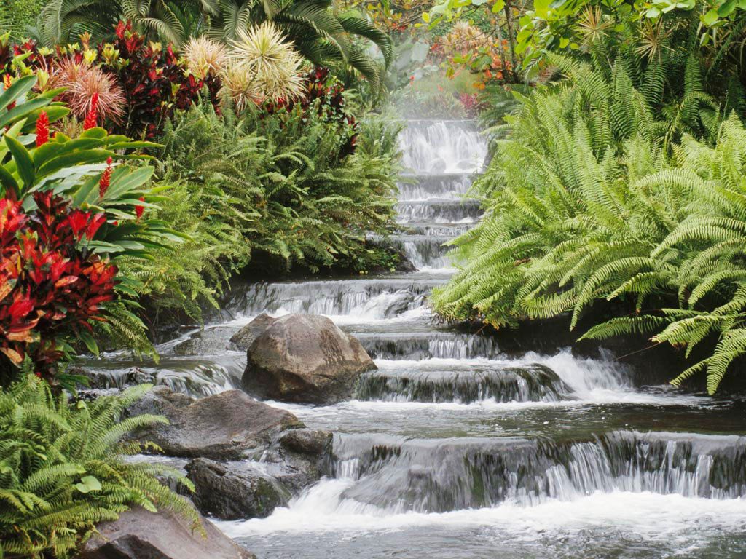
Waterfall

