Slide 1
Typical Presentation
PowerPoint 12
Created 03/15/2006

Slide 2
Text Only Slide
Many slides created in a typical PowerPoint presentation contain only text
The percentage of text-only slides has gone down as people use increasing amount of graphics
The title and bullet layout is one of the most popular layouts used

Slide 3
Graphics Usage
Photographs are extremely common in PowerPoint
JPEG is by far the most popular image format
ClipArt is much less popular than it once was

Slide 4
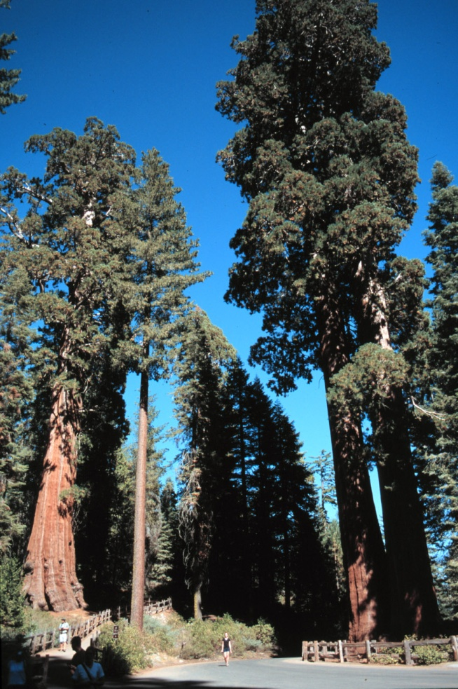
Content With Caption
This is a new layout in Office 12 that lets you insert any kind of content and provide a caption. It looks great with pictures, charts, tables and diagrams

Slide 5
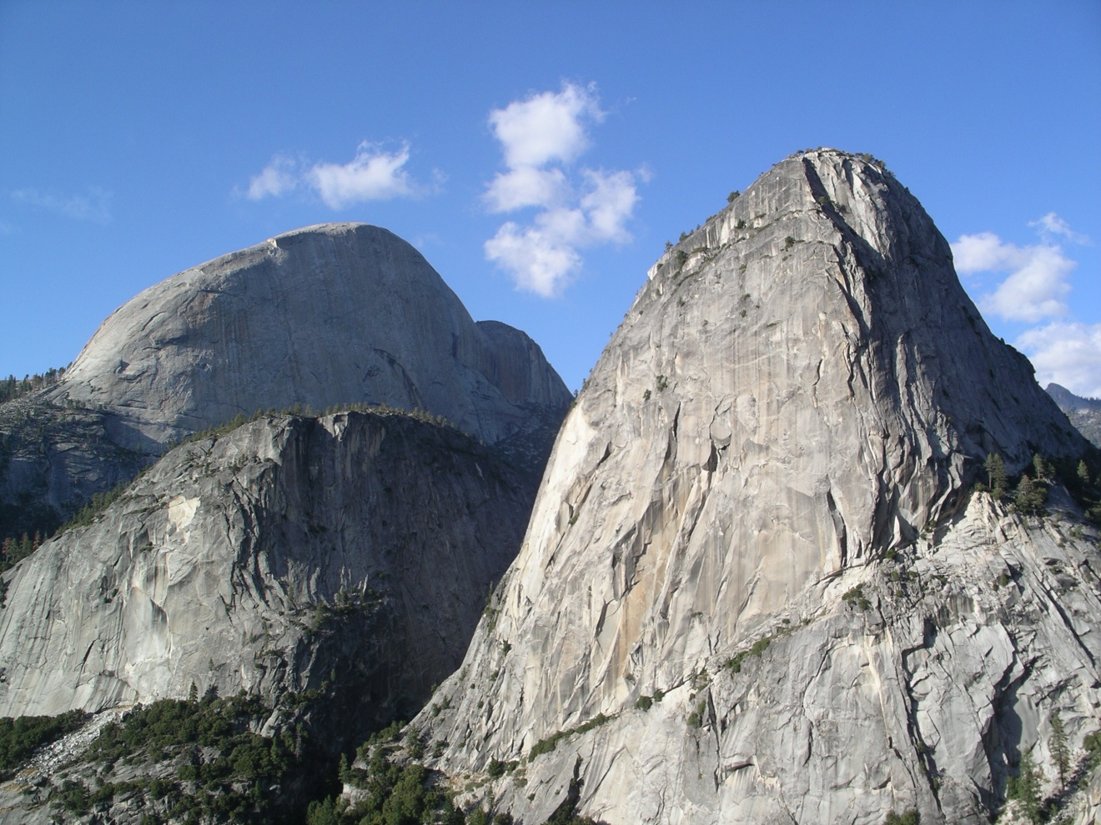
Picture With Caption
Pictures have become incredibly popular in PowerPoint and the rest of Office. Many slides consist of just a picture with a title or a caption and this layout provides a quick, easy way to do that.

Slide 6
Tables Have Come a Long Way
 | Q1 | Q2 | Q3 | Q4
North America | 55,000,000 | 67,000,000 | 69,000,000 | 81,000,000
Europe | 34,000,000 | 45,000,000 | 47,000,000 | 54,000,000
Asia | 29,000,000 | 35,000,000 | 32,000,000 | 30,000,000
Latin America | 11,000,000 | 9,000,000 | 15,000,000 | 17,000,000

Slide 7
Chart Usage
A lot of people use charts to show data graphically
Common chart styles include:
Bar charts
Pie charts

Slide 8
Gallup Poll 03-16-06

Slide 9
Comparing Content 1997 vs. 1995
1997 Study
1995 Study

Slide 10
Diagram Usage
Diagrams effectively illustrate many types of ideas, processes, structures
Most diagrams in PowerPoint were hand drawn
Powerful diagramming tools are now built into PowerPoint

Slide 11
Diagrams Are No Longer Hand Drawn
Meetings
Phone Calls
E-mail
Documents

Slide 12
Org. Charts Are Very Common
Fruit
Berries
Strawberry
Raspberry
Melons
Cantaloupe
Honeydew
Watermelon

Slide 13
Drawing On a Blank Slide
Star
Triangle
Circle
Square
Rounded Rectangle

Slide 14
Conclusion
PowerPoint is used for many different things
The most common types of content are:
Text
Pictures
Tables
Charts
Diagrams
Drawings
Richer presentations have sound and video but they are not as common
This deck contains only the things found in a typical presentation

