Slide 1
VSTO & Reflection Brownbag
Created in Office 12 build 4518.1014

Slide 2
Background
VSTO stands for Visual Studio Tools for Office
Enables developers to create managed code solutions in Office applications
ORCAS will provide VSTO support for other Office apps
Notes:
Take a look at this blog series as it unfolds over the next six weeks and discover the favorite features and tools of team members such as Eric Carter, Paul Stubbs, John Durant, and Kathleen McGrath, in addition to third-party VSTO experts such as Ken Getz, Paul Ballard, and Tim Huckaby.

Slide 3

VSTO
Visual Studio Tools for Office
Notes:
Visual Studio Tools for Office is the premiere development tool for building Office Business Applications. More features and RAD tools are added to VSTO as it evolves and some of these items are becoming fast favorites of the VSTO product team and third-party VSTO experts alike

Slide 4
What’s in Orcas?
Application level add-ins
Ribbon designer
Custom Task Pane support
Notes:
VSTO allows the user to create COM addins from with in Visual Studio
The ribbon designer can be used to create custom ribbon tabs
Custom task pane can host user controls created in VS

Slide 5
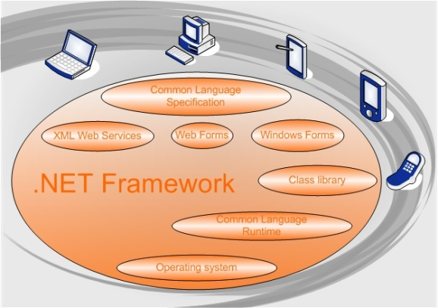

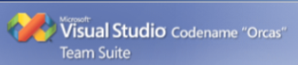
Requirements
.NET Framework 3.5
Office 2003 or 2007
Visual Studio “Orcas” Beta1
Notes:
Actually, the only requirements needed to run a vsto addin is the .NET Framework 3.5 & Office 2007

Slide 6
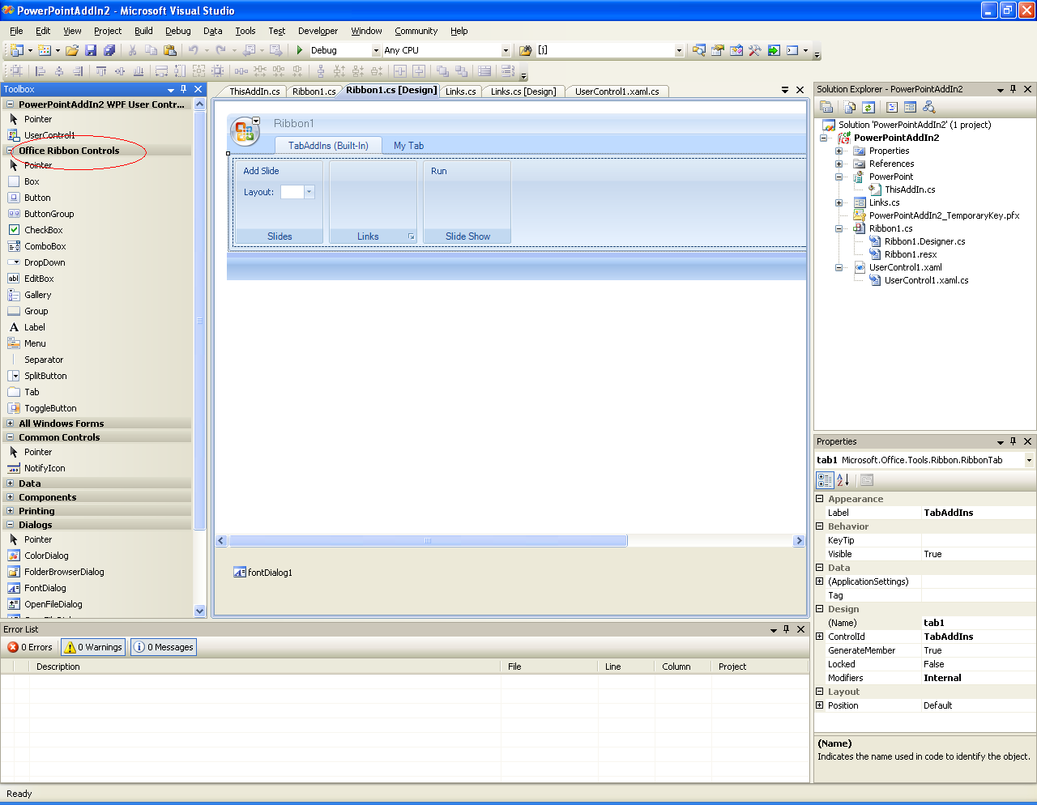
Demo
Creating a project
Using the custom task pane
Using the Ribbon Designer
Deploying a project
Sample Solutions

Slide 7
Resources
Installation Instructions: http://office/14/teams/powerpoint/test/Tools/Tools%20Wiki/VSTO%20InstallationInstructions.aspx

Slide 8
Reflection

Slide 9
Reflection
Definition (from Wikipedia) - Reflection is an activity in computation that allows an object to have information about its own structure and reason about its own computation.
What does this really mean?
Late binding – Load dlls and libraries that are unknown at compile time
Extracting metadata from classes – Read attributes, properties, method signatures, etc.
Self-modifying code – Can generate MSIL code. Used in regex implementations . *not covered in this brownbag
Notes:
This how-to video series is designed for all Visual Studio Tools for Office developers, from the novice to the professional. The series starts by demonstrating the basic ways of referring to a range in Excel using VSTO, and then demonstrates how to embed Windows Forms controls in an Excel worksheet.

Slide 10
Loading an Assembly
We can load an assembly at runtime:
System.Reflection.Assembly assm = Assembly.LoadFrom(@“c:\myDLL.dll”);
With this assembly object we can get the version number, types it contains, and more.
Get the version Number
Assm.GetName().Version.Major
Assm.GetName().Version.Minor
Get information about classes inside the assembly
Type[] types = assm.GetTypes();

Slide 11
Getting types
The class Type is the workhorse of reflection. Once we get the type information we can instantiate objects, get attributes, access properties, and call methods. Essentially anything .NET can do with an object, you can do with the Type class.
There are many ways to get a type.
From the assembly: assm.GetType(“TypeName”);
If you already have an object: o.GetType();
With the keyword typeof(PowerPoint.Shape)
Notes:
Webcast Series: Visual Studio Tools for Office Straight from the Experts
Don't miss these on-demand webcasts as Microsoft product manager, Mike Hernandez, interviews experts about Visual Studio 2005 Tools for Office. Experts share their experience using VSTO and provide an example of the solutions they have built. You'll also learn the top three things they think you should know when working with VSTO.

Slide 12
GetType() and System.__ComObject
Beware!, getType() won’t work for ComObjects. Link to KB article
Unfortunately, all our PowerPoint classes are of this type
Suggested workaround: attempt casting the object as different types until it is non null
O = PPT.Selection();
if( (o as PPT.Shape ) != null){ \\object is a shape }
else if( (o as PPT.Slide ) != null){ \\object is a slide }
…

Slide 13
Getting Information about types
The Type class information about the methods, properties, constructors, and more for that type
To get all the methods, given a type t:
MethodInfo[] mInfos = t.GetMethods();
To get all the properties
PropertyInfo[] pInfos = t.GetProperties();
To get all the constructors
ConstructorInfo[] cInfos = t.GetConstructors();

Slide 14
Instantiating a Type
By invoking the ConstructorInfo we can instantiate a type. The method accepts an array of objects for passing arguments to the constructor.
Object o = cInfo.Invoke(new object {“foo”,23});
The Activator class provides a shortcut to instantiating types.
Object o = Activator.CreateInstance(t,new object[]{“foo”,23});
Notes:
VSTO 2005 SE offers several new important new features to support Office programmability. Check out our new portal page and keep coming back for more great content.

Slide 15
Invoking Methods and Properties
Invoking a method using a methodinfo, given a previously instantiated object, o.
MethodInfo mInfo = t.GetMethod(“MethodName”);
minfo.Invoke(o, new object[]{});
Invoking a property
PropertyInfo pInfo = p.GetProperty(“PropName”);
Invoke the Get property. The second value is optional and is only used for indexing.
pInfo.GetValue(o,null);
Invoke the Set property. Again, we need a null for the optional indexer.
Pinfo.SetValue(o, “valueToSet”, null);

Slide 16
Demo
Create a console application that recursively prints out the property names and values for a shape in PowerPoint
Notes:
Find out how to take your Office solutions to the next level.

Slide 17
Resources
MSDN Reflection Overview: http://msdn2.microsoft.com/en-us/library/f7ykdhsy.aspx

Slide 18
Q&A

