Slide 1
Typical Performance Presentation
Created with Office 9
Notes:
Presentation will be more of an overview presentation. It will contain multiple PowerPoint features.
Used most of the slide layouts. Dad’s tie template applied

Slide 2
Text – different font applied to each bullet level
First indentation - TNR
2nd indentation - Arial
3rd indentation -Century
4th indentation - Verdana
Fifth and final level of indentation.

Slide 3
Two Charts

Slide 4
Inserted Objects
Image Document
Notes:
All objects on this slide inserted off the insert object dialog: image document, word pad, equation3.0, powerpoint slide

Slide 5
Some more text related features…
Bold, Italicized, shadow, emboss, underline
^{Superscript}
Formatted placeholder
_{subscript}

Slide 6
Clipart & Text Placeholder
Cag object inserted thru Placeholder
No formatting straight insertion

Slide 7
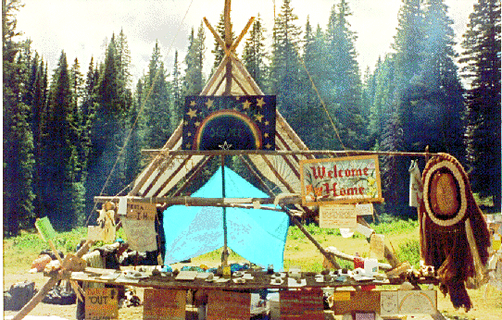


Rubber-Necking.jpg
Rainbow.gif
Autoshape formatted with
Goldengate.bmp
Notes:
Inserted rainbow.gif from :\\powerpoint1\projects\Filters97\GIF\TestSuite\Real World\Internet\Regular
Goldengate.bmp \\powerpoint1\projects\Filters97\bmp\from filters dir\AMERICA.24B
Rubber-Necking \\powerpoint1\projects\Filters97\rubber-necking.jpg

Slide 8

Handdrawn Diagram
Shadow applied to shape
ONE | Two
Three | Four

Slide 9
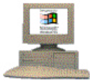
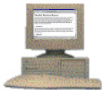
Tediously Drawn “Network” diagrams
Ovals and rectangles are used the most
Connector
Shadow
Text is
Popular
Inside
Shaded
Boxes
Workgroup Web
Workgroup Web
Notes:
Copied content of slide from a previous presentation

Slide 10
Often Slides Have Lots of Little Textboxes
Industry Sectors
Tailwind
Investment
Themes
Business
Services
Financial
Services
Health
Care
Media &
Telecom
Technology
Consumer
Online
Financial
Services
Web-Based
Diagnostics
New Media and Broadband
Web Software
Applications
Web
Consulting
Services
E-Retailing
and Consumer Services
Internet
Transaction
Processing
Clinical
Research
Labs
Tower
Management
Contract
Manufacturing
Staffing
Services
Sales
Management
Sub-Prime
Lending
Pharmacy
Benefits
CLECs
Outsourcing
Asset
Management
Elder
Care
PCS ESMR
Voice/Data
Integration
Service
Provider
Roll-Ups
Brand
Consolidations
Consolidation
Demographics
Web-Based
Services
Education
Travel &
Hospitality

Slide 11
Another Common Type of Slide
Large
Executive Information System,
Business Management Systems,
Accounts Payable, Accounts Receivable,
HR Management, Image Analysis,
Retail Management, Electronic Mail,
Constructional Loan Application,
Property Management
Portfolio Management, Foreign Exchange, Systems Management, Statistical Analysis, Financial Consolidation, General Ledger, CIM, Plant Control, Billing and Collection Management
Medium
Legal Workstation, Single station accounting, Stock Management, Dental Patient tracking,, Real Estate Office, Mail Merge, Contact Management, Utility Billing, Appointment Scheduling,
Traders Workstation, Branch Automation , Transaction Monitors, Account Entry Reconciliation, Inventory Management, Maintenance Support, MRP, Sales Force Automation, Point of Sale
Small

