Slide 1
Distributed .NET
Reuben Bond
Microsoft

Slide 2
Reuben Bond
Distributed systems nerd
Orleans team at Microsoft
@ReubenBond
OSS contributor → full-time

Slide 3
Orleans
Framework for distributed systems
Programming Model
Runtime
From Microsoft Research, Open Source under .NET Foundation
Built on .NET (Core), runs on:
Linux/Windows/macOS
Bare metal/Kubernetes/Service Fabric
Used by:
Microsoft (Azure, Xbox, Skype, others)
Halo, PlayFab, Gears of War, internal services
Honeywell, Gigya, Visa, NRK, TransUnion, Lebara, Drawboard, US NIST, others

Slide 4
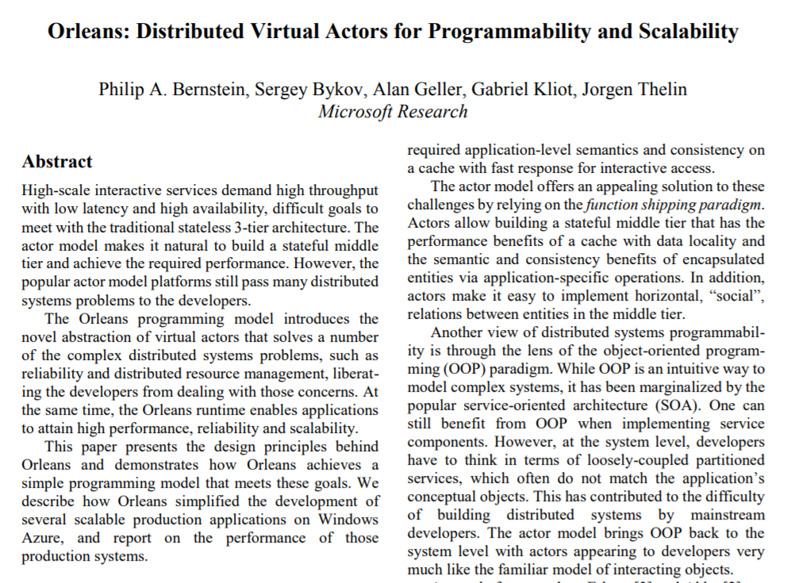
Grains
Fundamental building block
Virtual Actor
Effectively: Distributed Object
Unit of computation + state
Send/receive messages
React to incoming messages
https://aka.ms/orleans-paper-2014

Slide 5
Grains
Model objects in domain
IoT device twins, user profiles, game sessions, auction items, blog posts, …
Create graphs for computation/communication
Fan-out, Fan-in & other processing patterns
Concurrent workers, caches
Distributed system realities
Select an appropriate granularity

Slide 6
in-memory, persisted, or stateless
User/fabio
grain = identity + behavior [+ state]
class User : Grain, IUser

Slide 7
public interface IUser : IGrainWithStringKey
{
Task SendMessage(IUser sender, string body);
Task<List<Message>> GetMessages();
}

Slide 8
public class User : Grain, IUser
{
IGrainState<List<Message>> _messages;
public User([GrainState("messages")] IGrainState<List<Message>> messageState)
=> _messages = messageState;
async Task SendMessage(IUser sender, string body)
{
_messages.Value.Add(new Message { Sender = sender, Body = body });
await _messages.WriteStateAsync();
}
Task<List<Message>> GetMessages() => Task.FromResult(_messages.Value);
}
Methods are always single-threaded
We never loaded the state…

Slide 9
// Get grain references. Synchronous & cheap
IUser me = client.GetGrain<IUser>("reuben");
IUser friend = client.GetGrain<IUser>("fabio");
// Call a grain
await friend.SendMessage(sender: me, body: "happy days :)");
// Check my mail for the 45th time today...
var messages = await me.GetMessages();
foreach (var msg in messages)
{
Console.WriteLine($"{msg.Sender.GetPrimaryKeyString()} says: {msg.Body}");
}

Slide 10
Managed lifecycle

Slide 11
Frontends
Actor-based Middle Tier
Storage

Slide 12
Frontends
Actor-based Middle Tier
Storage
Cluster of servers
(silos)

Slide 13

Frontends
Actor-based Middle Tier
Storage
Cluster of servers
(silos)

Slide 14

"hi :)"
A
try
{
await friend.SendMessage(me, "hi :)");
}
catch (Exception exception)
{
Console.WriteLine(
$"Message failed, was I blocked?! {exception}");
}
!!!
"hi :)"
!!!
Distributed
asynchronous
try/catch
semantics!
B
"hi :)"
!!!
C

Slide 15
Summary: Grains
Grain = identity + behavior [+ state]
~“Distributed Object”
Communicate via interfaces
Managed lifecycle
try/catch for error handling
Location transparency
Single-threaded (Actors!)

Slide 16
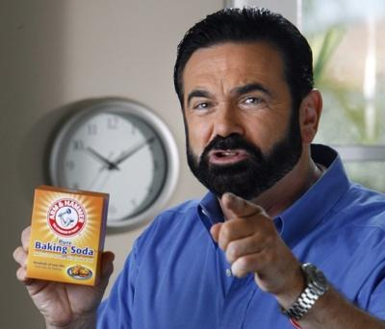
But wait, there’s more!
Declarative persistence
Plugins for storage services: CosmosDB, SQL, DynamoDB, etc
Virtual streams
Decouple producers & consumers
Backed by Azure EventHubs, Amazon SQS, in-memory, etc
Distributed ACID transactions
Between multiple grains
Timers & reminders (persistent timers)
Highly customizable via DI
Custom placement
Select where a grain is activated
Version-aware
Deploy anywhere
Azure, AWS, GCP, on-prem, k8s, Service Fabric, etc
And more! Geo-distributed clusters, event sourcing, interceptors…
tasty
grains

Slide 17
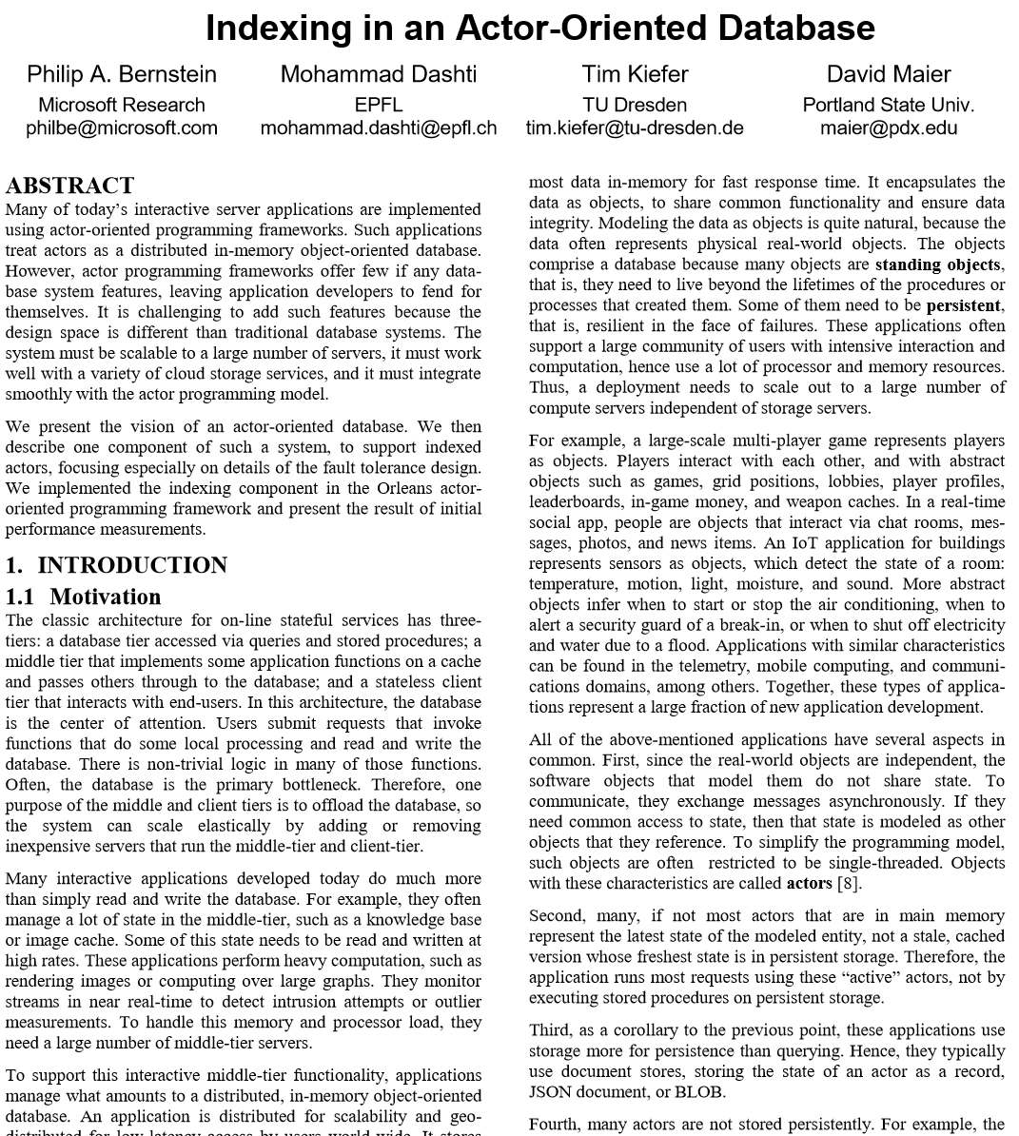
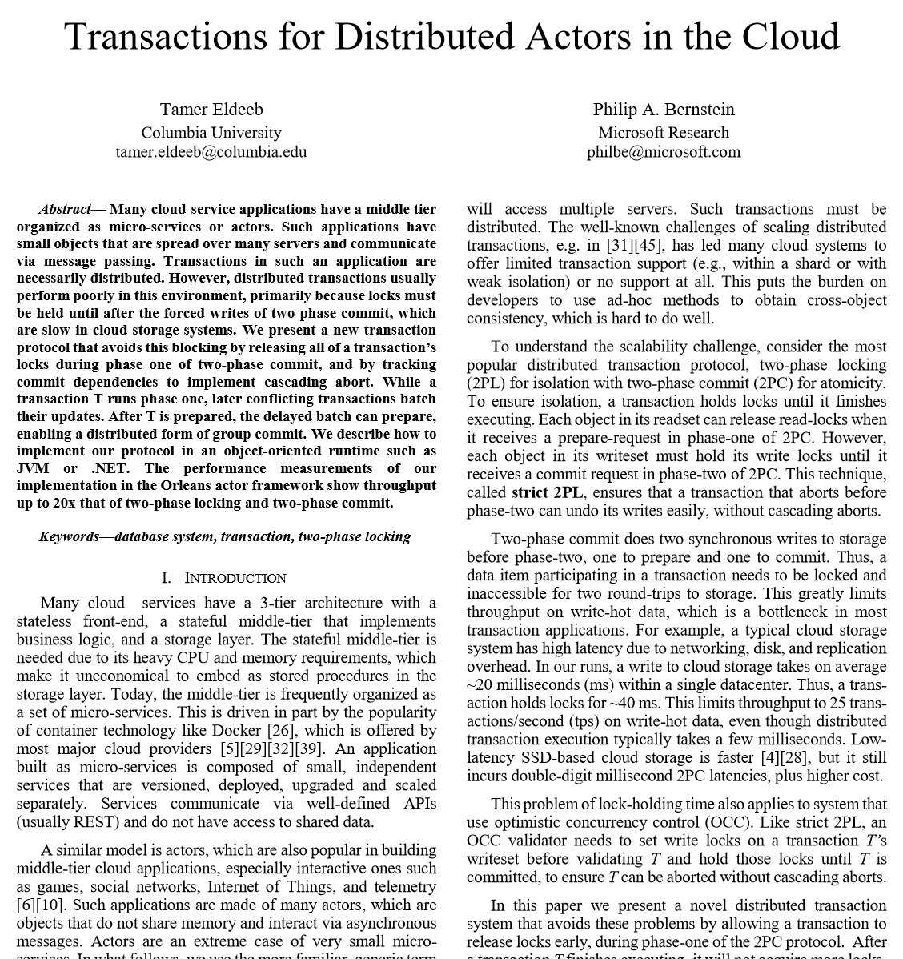
https://aka.ms/orleans-indexing
https://aka.ms/orleans-txns

Slide 18
Architectural/Design decisions
Focus on distributed
Versus single-node-first
Flexible placement
Rather than, eg, using consistent hashing
Distributed directory
Pluggable in upcoming 3.0!

Slide 19
Comparison to traditional actors
Grain activations have a managed lifecycle
No explicit, in-built create/destroy semantics
No supervision hierarchy
Failures are passed back up to the caller, familiar to C#/Java users
No explicit Restart/Stop/etc behaviors when a grain throws
Grains continue to operate (like POCOs)
Style: method call instead of message passing
Superficial…
Style: private state instead of Finite State Machine style
Superficial…

Slide 20
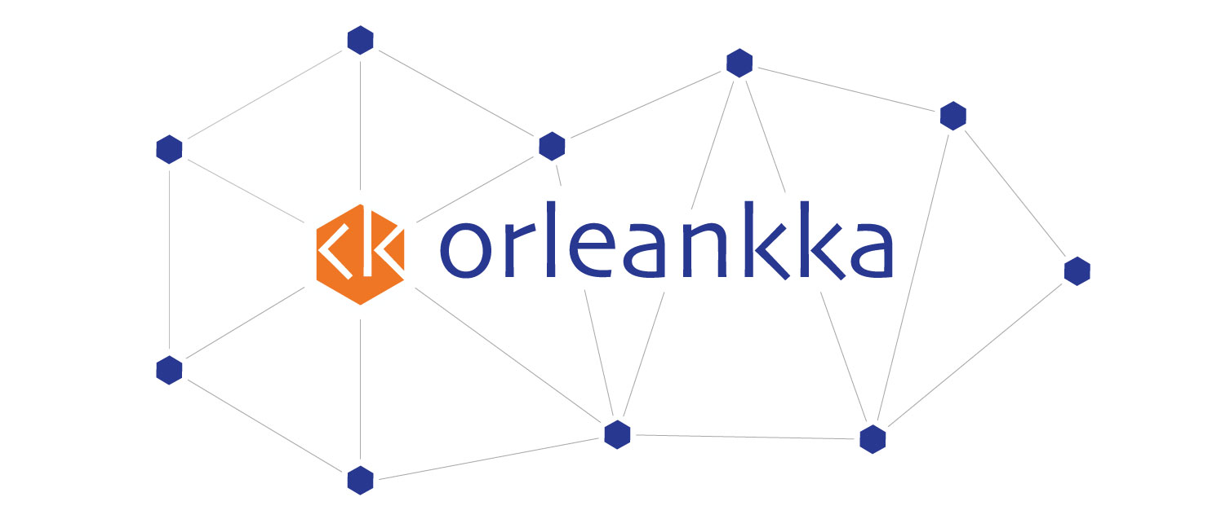
Orleankka
Orleans + Akka
Message-passing style
More idiomatic for F# users
State machine style (“become” for state transitions)
Active community
https://github.com/OrleansContrib/Orleankka

Slide 21
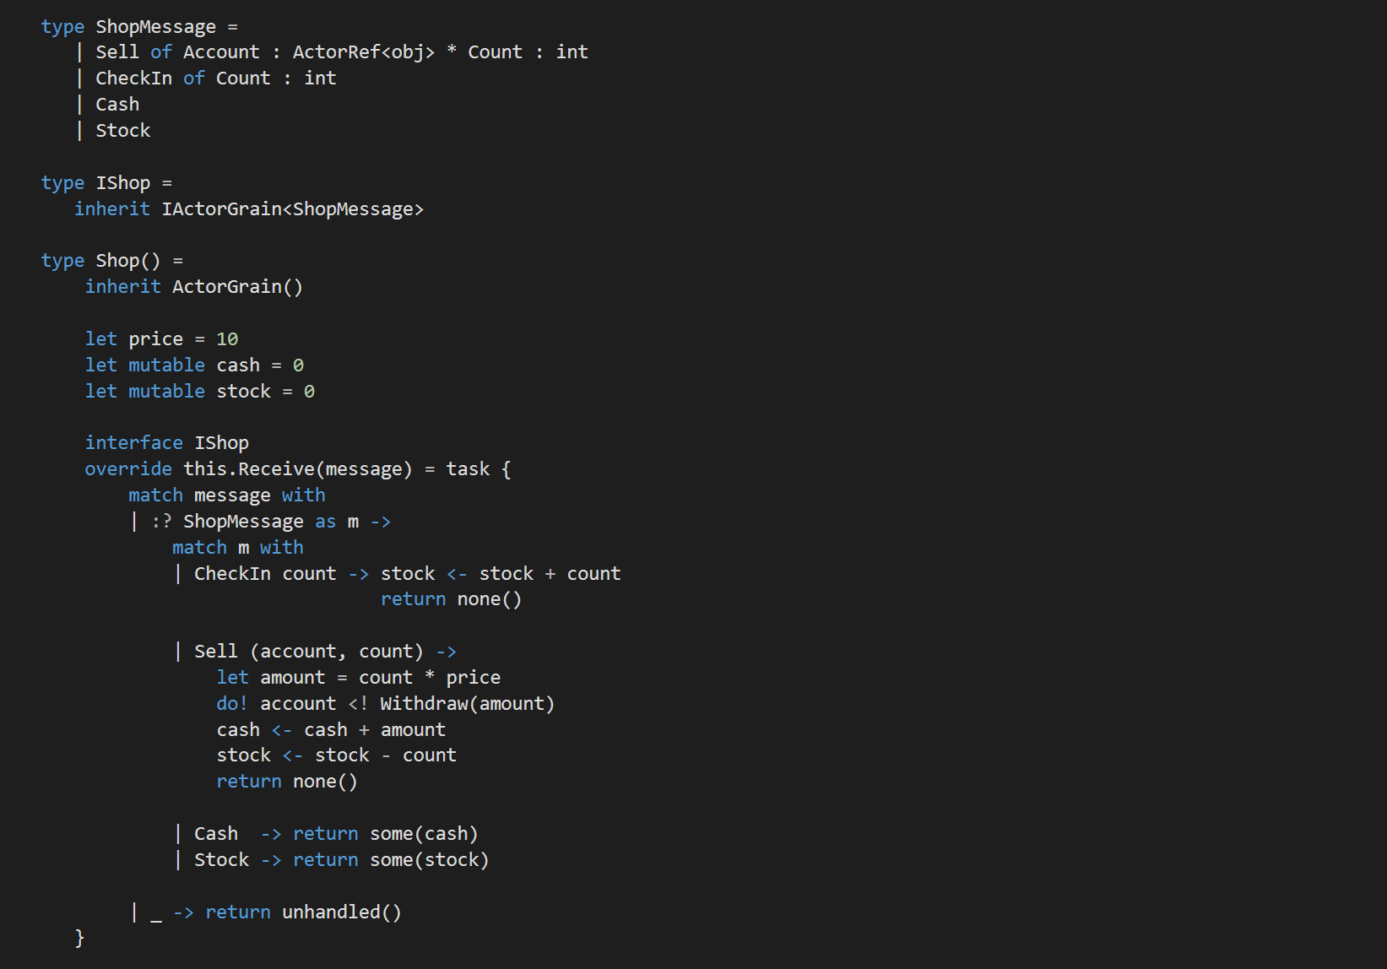

Slide 22
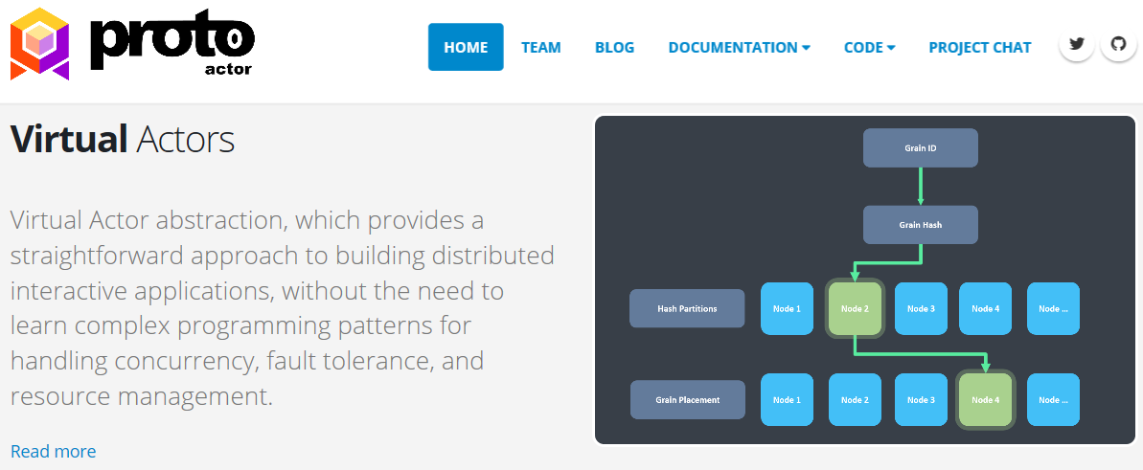
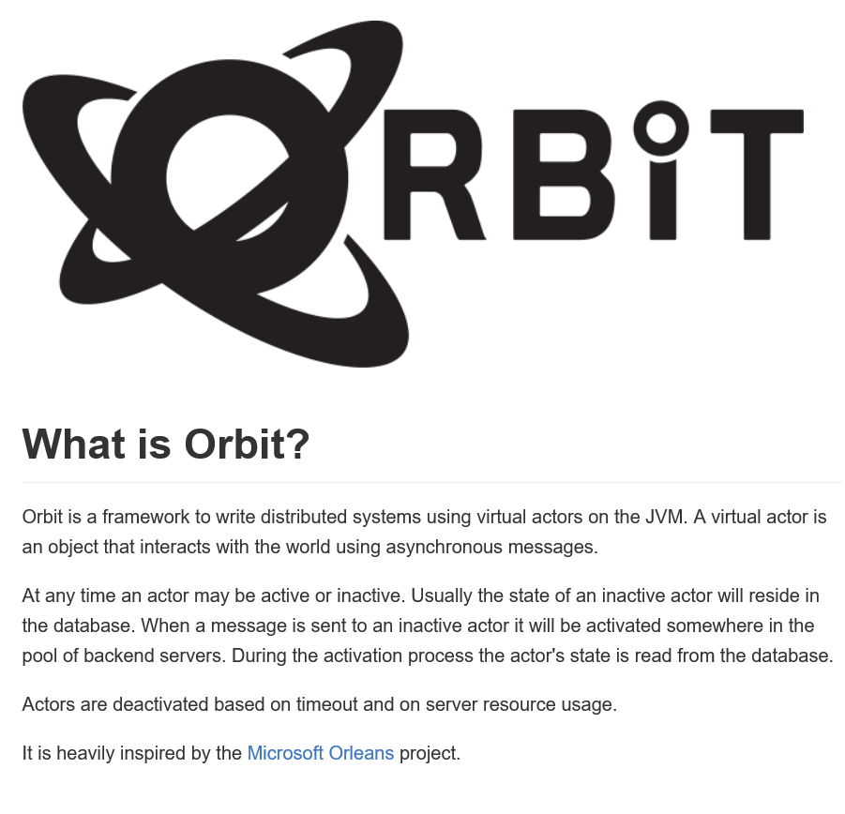
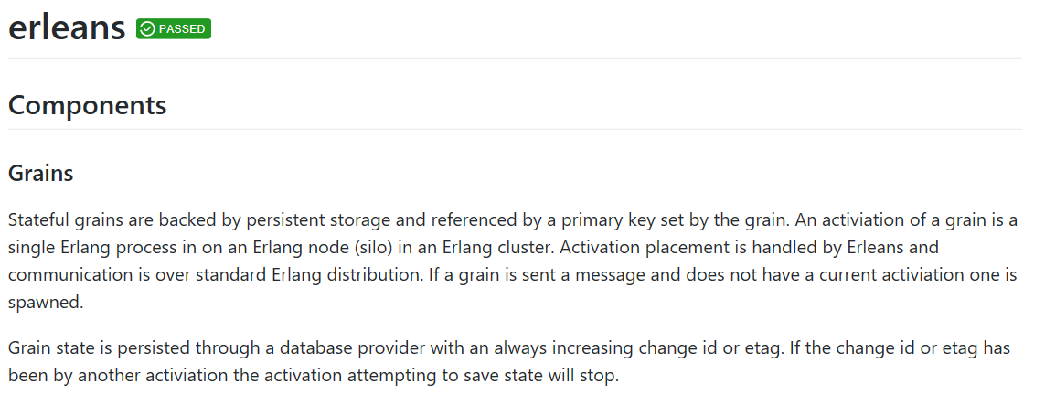

Slide 23
Thank you! Questions?
@ReubenBond / rebond@microsoft.com
gitter.im/dotnet/orleans
github.com/dotnet/orleans

Slide 24
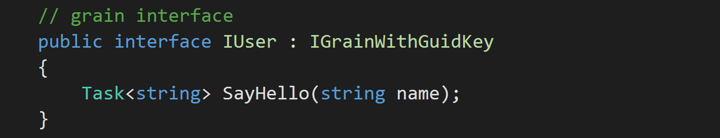
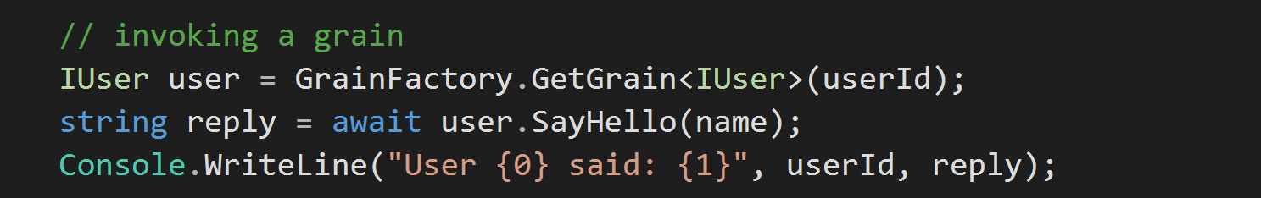
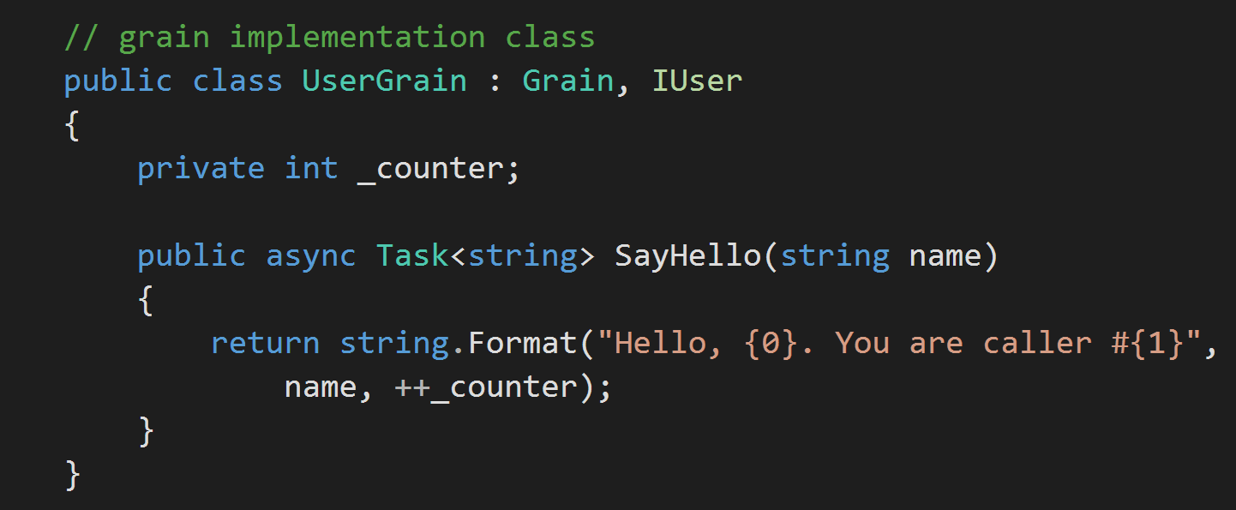
Methods are always single-threaded

Slide 25
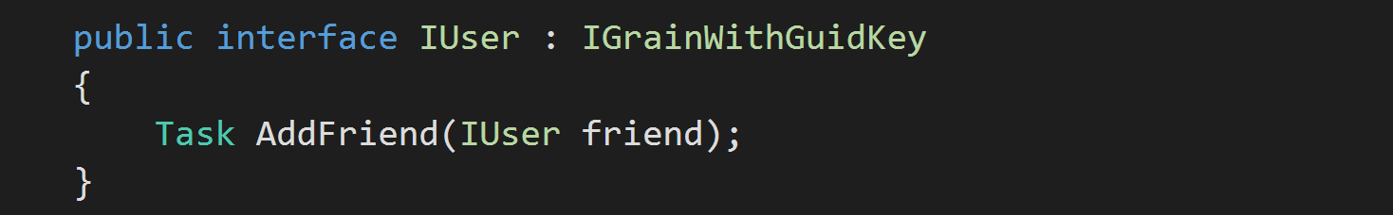
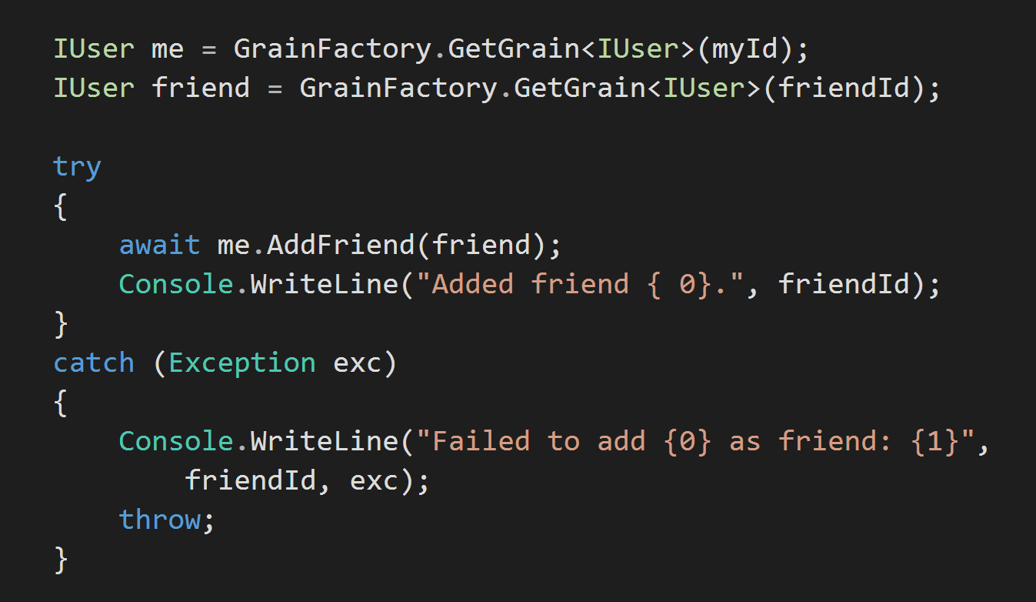
A
Grain reference as an argument
Distributed
asynchronous
try/catch
semantics!
B
Handle exceptions as if local
C

Slide 26
Challenges with distributed ‘objects’
Addressing
How can you identify an object to send it a message?
Asynchrony
Inherent asynchrony locally & over network
Lifecycle
Does the object [still] exist?
State
Often want some persistence, some notion of continuity

