Slide 1
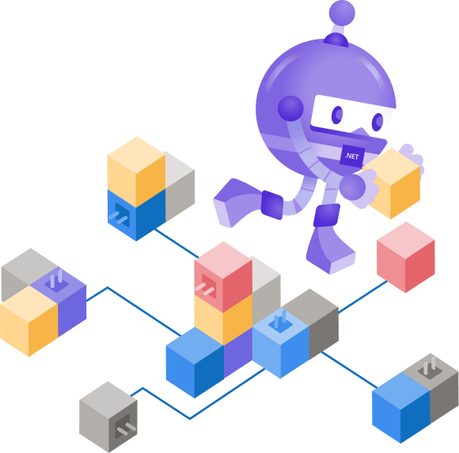
Beyond REST and RPC: Asynchronous Eventing and Messaging Patterns
Clemens Vasters Principal Architect – Azure Messaging, Microsoft @clemensv OASIS AMQP Technical Committee Chair OASIS MQTT TC Member CNCF CloudEvents Architect OPC UA PubSub Architect

Slide 2
Agenda
Asynchronous Communication Patterns
Principles and Standards
Projects, Products, and Services

Slide 3
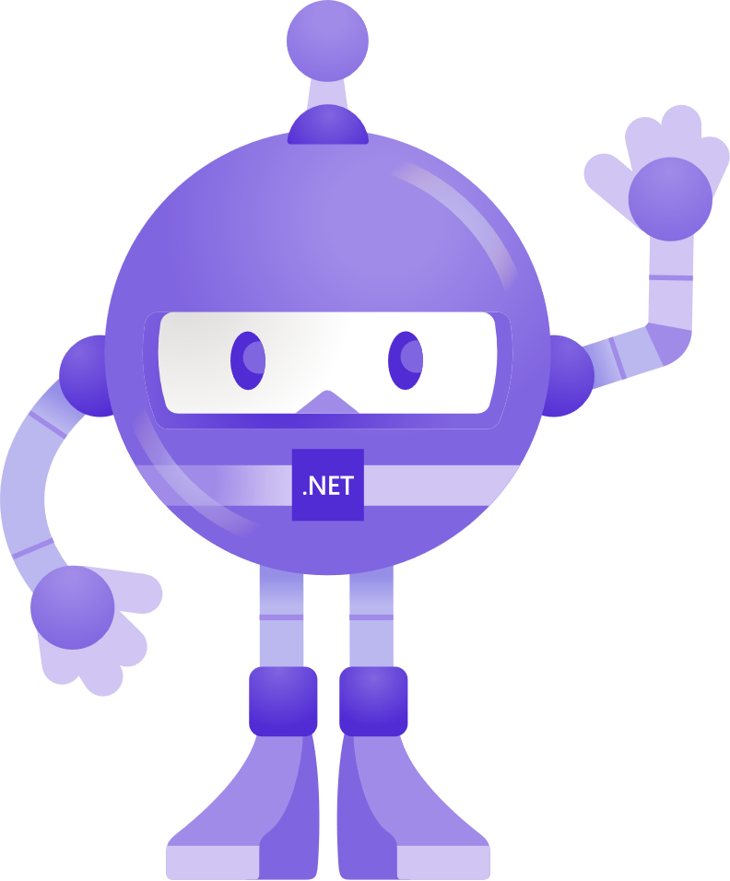
Demo ;)
receiver.RegisterMessageHandler( ( ) => { Console.WriteLine( Encoding.UTF8.GetString(m.Body)); });
m
m = new Message( Encoding.UTF8.GetBytes("Hello!")); await sender.SendAsync( );
m
m
m
m
do { m = receiver.Receive( ); if ( m != null ) { Console.WriteLine( Encoding.UTF8.GetString(m.Body)); } } while ( m != null );
m

Slide 4
Patterns

Slide 5
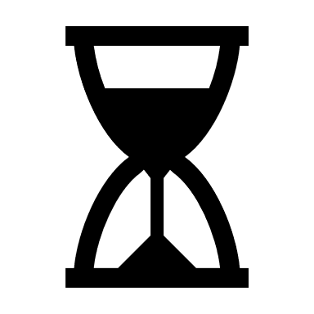
Synchronous vs. Asynchronous
Interaction duration: Microseconds to seconds
Interaction duration: Microseconds to years
Sender
Receiver
Sender
Receiver
Sender sends request and then waits for an immediate answer
May happen via asynchronous I/O, but the logical thread is preserved.
Correlation between request and reply is typically implicit, by order of requests.
Errors typically flow back on the same path.
Sender sends a message and proceeds to do other things.
Replies may flow back on a separate path.
Messages may be stored by intermediaries.
Message delivery may be attempted multiple times.
…

Slide 6


One-Way!?!
One-way reply channel(s)
Asynchronous flows are generally one-way.
The producer gets no initial answer other than the message having been accepted into the queue/buffer.
Remain seated. Stay calm!
Reply and error channels are explicit.
Correlation is flexible. Multiple replies may refer to one message.
in reply to
Push
Pull
Producer
Consumer
One-way error channel

Slide 7
Long-Running Work
reply queue
Processing at the consumer may take very long (minutes to hours)
Processing at the consumer may require reliable, one-time outcomes (like execution of payments).
Producers entrust jobs into a queue.
Consumers negotiate the outcome, including any required retries due to intermittent failures with the queue
Bad jobs are moved into a dead-letter queue for inspection.
Flow back to the producer is performed through a reply queue
correlationid:
replyto:
Producer
Consumer
Retry 1
Retry 2
dead-letter queue

Slide 8
Load Leveling
Queues/buffers act as an inbox for requests to a consumer.
Push/pull translation: Consumer pulls work when it has capacity for processing.
Consumer processes at its own pace, without ever getting overloaded.
No “too busy” errors, easier resource governance.
requests/sec
requests/sec
processing capacity
time
time
Producer
Producer
Producer
Consumer
Producer
Producer

Slide 9
Load Balancing and Auto Scaling
Multiple consumers compete for messages
Each consumer only pulls work when it has capacity for processing.
Truly load-aware job balancing
Queue-length can be observed; if rolling average crosses a threshold, more consumers can be added to auto-scale based on true load.
queue length rolling average
scale-up threshold
+1
scale-down threshold
Producer
time
Producer
Consumer
Producer
Consumer
Producer
Consumer
Producer

Slide 10
Publish-Subscribe
Directing one input message to zero or more interested parties (subscribers).
Every subscriber has the opportunity to obtain a copy of every published message.
Subscribers can often provide filters that select a subset of the published messages.
1
2
3
Consumer
filter
Producer
Topic
2
4
6
Consumer
filter
filter
1
3
5
Consumer

Slide 11
Partitioning
Stream
Partition 1
Partitioning is not the same as publish-subscribe
Partitions are chosen while publishing, not while subscribing
Partitioning serves to subdivide a stream such that
it can be stored reliably if the volume is enormous
it can be processed with multiple consumers in parallel and without overlaps
Pub-Sub can compose with partitioning by letting subscribers choose partition subsets.
a
a
a
Consumer
hash()
Partition 2
Producer
b
b
b
Consumer
Partition 3
c
c
c
Consumer

Slide 12
Multiplexing with Exclusive Consumers
Multiplexing funnels sequences of related messages concurrently through one route.
Exclusive consumers snap to sequences and the queue guarantees consistent routing of messages to the same consumer.
Provides first-in-first-out assurance on a per-sequence basis.
Can be provided without head-of-line blocking, i.e. each sequence acts like an independent sub-queue.
Often used with scenarios where huge numbers of contexts must be handled, e.g. in workflow processing.
Producer
Consumer
Producer
Consumer
Producer
Consumer

Slide 13
Stateful Processing
Partition 1
Stateful processing is simplified by pulling a stream stepwise towards a state aggregator (like calculating a rolling average).
Consumption can be easily suspended, the state moved, and consumption resumed elsewhere when needed.
Consumer
Producer
A
B
C
Consumer
State A+B+C
Partition 3
Consumer

Slide 14
Sparse Connectivity
Sparse connectivity is common with wireless applications, including IoT edge applications.
Mobile users switch networks, go out of range, hit bandwidth caps, etc.
Mobile applications get frequently suspended.
You can make communication paths more robust by making them strictly async and using a local store/forward queue setup.
store and forward queue
Producer
Push
move messages while online
Unreliable network boundary, e.g. mobile wireless networking
Pull
Consumer

Slide 15




Composite Edge and Cloud Patterns
Pub-Sub State Synchronization
Telemetry Capture for Analytics
Business Workflow Coordination
App
App
App
App
App
App
App
Broker
Broker
∑
Broker
Fn
Edge
DHCP, NAT, Firewalls
Cloud
App
∑
Fn
e.g. “Digital Twin“
Cloud Analytics

Slide 16
Protocols

Slide 17
Azure Messaging Protocol Principles
Protocols we prefer must be vendor-neutral, have a formal definition independent of any implementation, and must be under neutral governance.
We prefer formal standardization venues such that standards can be composed and be the basis of formal certification programs: W3C, OASIS, IETF, ISO, IEC
Multiple, competing implementations of the full protocol feature range must exist, not just clients.
Protocols must be secure, integrate with federated authorization models, and be compatible with common enterprise network policy practices.
Protocols must fit the target scenario and not require product-specific extensions for the scenario to work. Still, they must be extensible to allow for backwards-compatible evolution in the context of standards collaboration.

Slide 18
Azure Messaging Protocol Pillars
IETF HTTPS & WebSocket Protocol
Request-response application protocol
Azure Services: Azure Event Hubs, Azure Service Bus, Azure Event Grid, Azure Relay, Azure IoT Hub
OASIS AMQP 1.0
Vendor-independent and product-independent, symmetric, reliable message transfer protocol with support for multiplexing and flow control
Azure Services: Azure Event Hubs, Azure Service Bus, Azure IoT Hub
OSS: Apache ActiveMQ Classic, Apache ActiveMQ Artemis, Apache Qpid Broker-J, Apache Qpid C++, Apache Qpid Dispatch Router, Apache Camel, CNCF Strimzi Bridge, Eclipse Hono, Eclipse Ditto, Pivotal RabbitMQ
OASIS MQTT 3.x/5.x
Vendor-independent and product-independent, reliable publish-subscribe protocol for telemetry transfer and state synchronization
Azure Services: Azure IoT Hub
OSS: Apache ActiveMQ Classic, Apache ActiveMQ Artemis, Eclipse Hono, Pivotal RabbitMQ, Eclipse Mosquitto, HiveMQ, VerneMQ, etc.
CNCF CloudEvents
Vendor-independent and product-independent event data model with multiple bindings to protocols and encodings
Azure Services: Azure Event Grid, Azure Service Bus and Event Hubs via AMQP
We support other protocols as needed, in order to meet customers where they are.

Slide 19



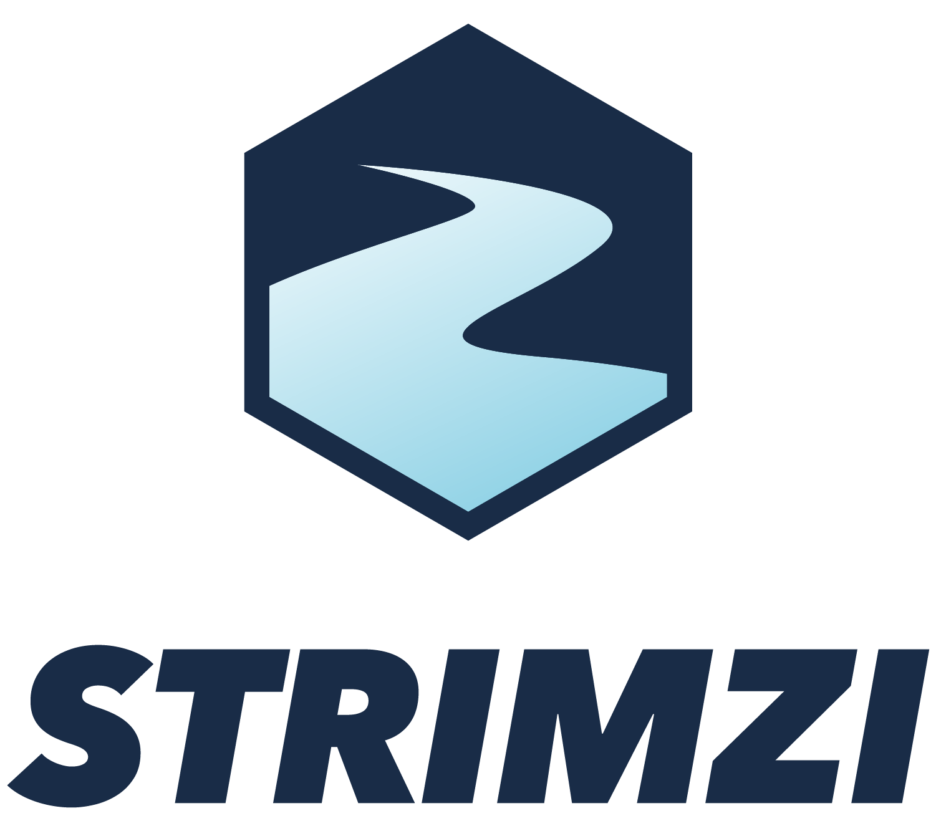





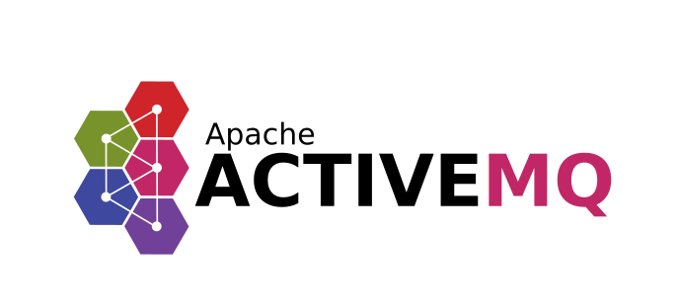


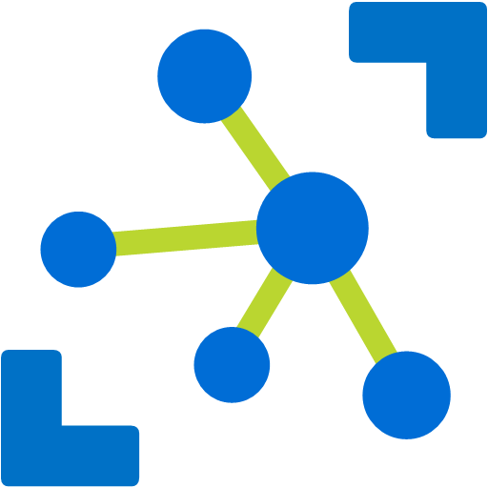

Some Interop Options with AMQP and MQTT
App
MQTT/AMQP
AMQP
App
Eclipse Hono IoT Connectivity Platform
App
Eclipse Ditto Twins
CNCF Strimzi
AMQP
AMQP
MQTT
Eclipse Mosquitto
RabbitMQ w/ AMQP 1.0 plugin
AMQP
MQTT
AMQP
Dispatch Router
AMQP
Apache Camel
MQTT
App
App
Apache ActiveMQ
App
AMQP
AMQP
Azure Service Bus
App
MQTT/AMQP
Azure IoT Hub
App
AMQP
Azure Event Hubs
App

Slide 20
Edge/cloud federation examples
Pub-Sub State Synchronization (MQTT, AMQP)
Telemetry Capture for Analytics (Kafka, AMQP)
Business Workflow Coordination (AMQP, HTTP)
App
App
App
App
App
App
∑
Fn
Apache ActiveMQ
RabbitMQ w/ AMQP 1.0 plugin
CNCF Strimzi
Edge
Dispatch Router
Dispatch Router
DHCP, NAT, Firewalls
Service Bus
Event Hubs
Service Bus
Service Bus
Azure Cloud
∑
Fn
App

Slide 21
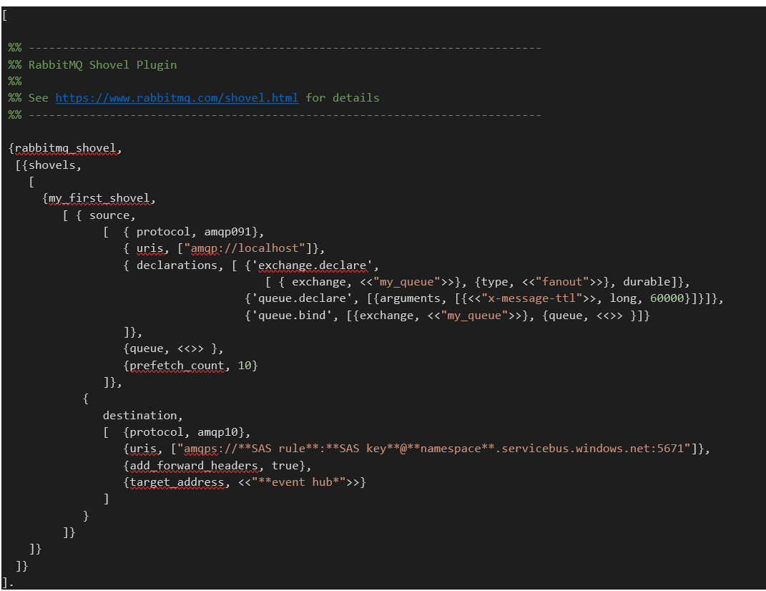

RabbitMQ Shovel Azure Service Bus

Slide 22
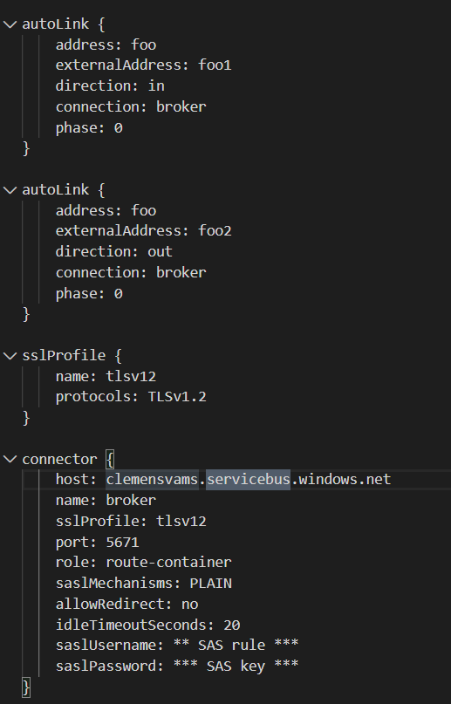
Cross-Site/Cross-Region Federation with Apache Qpid Dispatch
Dispatch Router
RabbitMQ w/ AMQP 1.0 plugin
RabbitMQ w/ AMQP 1.0 plugin
Apache ActiveMQ
Apache ActiveMQ
Azure Service Bus
Azure Service Bus
Azure Event Hubs
CNCF Strimzi

Slide 23
Azure Services

Slide 24
Azure Messaging Suite
Azure Service Bus
Azure Event Grid
Azure Event Hubs
Azure Relay

Slide 25



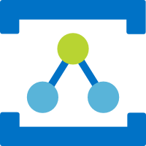
Why four services? Very different patterns.
Push-style distribution of discrete events to serverless workloads
Event Grid
HTTP (AMQP/WS)
Message Oriented Services
Pull-style, queue-based transfer of jobs and control via message queues and topics
Service Bus
HTTP AMQP/WS
Partitioned, high-volume, tape-drive-style sequential recording and unlimited, pull-style re-reads of event streams.
Event Hubs
HTTP AMQP/WS KRPC
Discovery and connectivity service for securely bridging streams across network boundaries in hybrid edge/cloud scenarios.
Connectivity Services
Relay
WS

Slide 26
Event Hubs Architectural Patterns
Ingestion and storage of large event streams
> 2 Gigabyte per second if required
Separation of event streams into partitions
Client-chosen offsets into event stream allow arbitrary reads and re-reads during retention
Retention of raw event data from 1 up to 90 days
Automated archival into Avro containers for subsequent batch-style processing
Publisher policies for data origin attestation and access control
Supports the Apache Kafka™ producer and consumer wire protocol to meet customers where they are
Event Hub
HTTP AMQP/WS KRPC (Kafka)
Event Hubs is a high-scale, high-availability, multi-protocol event stream engine used for collecting and consolidating events for real-time analytics and other high-throughput computations

Slide 27

Service Bus Architectural Patterns
Assignment of work with load-aware balancing
Load-leveling for “spiky” workload traffic shapes
Transactional, once-and-only-once processing
Multiplex handling of in-order message sequences
Deduplication, deferral, and “poison” handling
Queues
HTTP AMQP/WS
All of the above, plus:
Copies to 100s of concurrent subscribers
Filter rules and message markup
Message routing
Topics
HTTP AMQP/WS
Service Bus is a “swiss army knife” for messaging-driven workloads.

Slide 28
Event Grid Architectural Patterns
Ingestion and push-style distribution of discrete events (events not correlated into streams) to interested subscribers.
Per-subscriber application of simple and complex filters to select particular events of interest
Abuse protection for event publishers
Event schema mapping and support for CNCF CloudEvents 1.0 standard and bindings
Multitenancy support for SaaS applications.
Simple integration with a catalog of available event sources and sinks.
Event Grid
HTTP AMQP/WS
Event Grid is the Azure-wide eventing backplane for distributing and handling discrete events raised at the platform level, by custom applications, and by partner platforms.

Slide 29
Buffered Communication and Queues
Producers push messages in, consumers pull messages out.
Producers and consumers maintain independent security relationships with the intermediary.
Producers and consumers are temporally decoupled.
Order of arrival typically determines order of delivery
Queues manage which messages to deliver next. Buffers leave that to the client.
Most network communication is queue-based, at multiple levels:
Dispatch queues
Thread pool queues
Packet transfer queues
Push
Pull
Producer
Consumer
One-way flow!

Slide 30
Relay Architectural patterns
Expose (micro-) services, databases, and other endpoints from private networks on a public network endpoint without requiring VPN connectivity and/or DNS integration.
Ad-hoc discovery of endpoints with dynamic network addresses
Firewall and NAT traversal for one or both communicating parties
Endpoint-level bridging across Azure VNet
“Azure Bridge” runtime allows for bridging UDP, TCP, and Unix sockets
Relay
WS

Slide 31
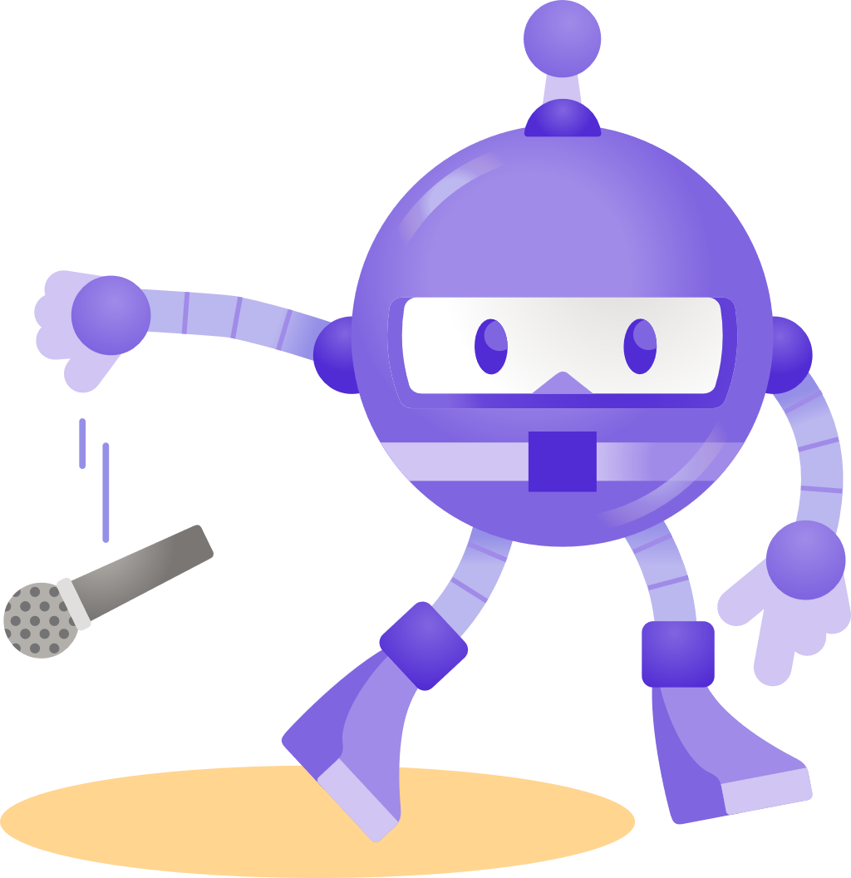
Thanks for joining ! @clemensv https://docs.microsoft.com/azure/messaging-services/

