Slide 1
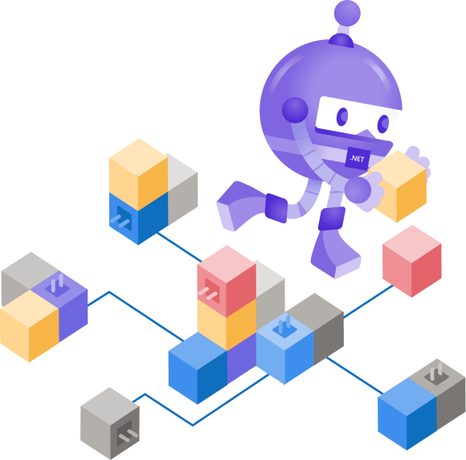
Building & Debugging Microservices with Kubernetes & Visual Studio
Principal Cloud Developer Advocate, .NET Shayne Boyer @spboyer

Slide 2
Microservices
What are they? How big should they be? Small right that’s micro… Tools? Do we have them?

Slide 3
Microservices: for faster app development
Monolithic
Microservices
Large, all-inclusive app
Small, independent services
Independent deployments
Improved scale and resource utilization per service
Smaller, focused teams
Avoids single points of failure
Increased velocity
App
App
App
Notes:
With the move to the cloud over the last few years, the industry has embraced an architectural pattern for building cloud-scale, reliable services.
Microservices are Independent, immutable deployments within containers
Small scalable services for improved resource utilization
Teams can focus on their own service without affecting other, use their own tools/stack
Avoid single points of failure, isolation to the one microservice with minimal effects to the rest of the application

Slide 4
Microservices
Microservices
Small, independent services
Consists of componentizing the application based on business capabilities
Components commonly communicate over the network using HTTP, gRPC, or event-driven messaging
Containers are often used as a way of packaging microservices
App
App
Notes:
- Consists of componentizing the application based on business capabilities
- Components commonly communicate over the network using HTTP, gRPC, or event-driven messaging
- They include everything that is needed to execute your code. Dependencies, libraries, and the code itself all running reliably regardless of the environment.

Slide 5

Demo
Microservice Debugging w/ Docker & Visual Studio
Notes:
Create a webapi service
Add razor pages app
Connect frontend to backend
Add Orchestration (Docker Compose) to both
F5 it, breakpoints on both apps
Talk to container tools in VS, show tabs

Slide 6
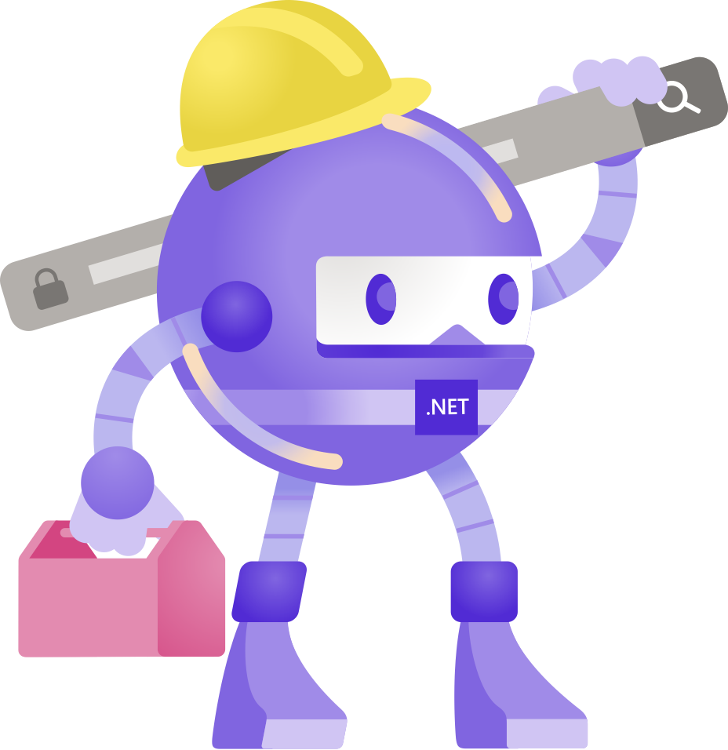
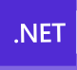
Azure Dev Spaces
Azure Dev Spaces is an add-on to Azure Kubernetes Service (AKS)
Generally available – May 2019
New preview experiences released June 2020
What’s the value here?
Test your changes in the context of the deployed application
Notes:
Dev Spaces is an iterative development tool for engineers working on microservice applications that target K8s.
Dev Spaces provides the capability of developing and testing microservice code in the context of the entire application in a high-fidelity environment.
Dev Spaces went Generally Available – May 2019
Recently release new feature capabilities as of June 2nd which is what I want to show you today

Slide 7



Bike Share Microservices Application
Users DB
Reservation DB
Azure Kubernetes Service
Users (Node.js)
Reservation
(go)
Frontend (React JS)
API Gateway
(.NET Core)
End user
Bikes (Node.js)
Reservation Engine
(.NET Core)
Billing
(go)
Bikes DB
Billing DB
Notes:
Here is an example of a more realistic microservice application. A Bike Sharing Web application.
As you can see from this application, there are a lot of moving parts.
Databases, .NET Core, Go, and Node services as well as a React web app.
I might only be responsible for one of the parts, for instance in my case the Reservation Engine.
Although there are many benefits to microservices development, there are also challenges. How do I test and debug my ONE service here?
What if my machine is not capable of getting all of this running due to RAM constraints.
How do you satisfy those dependencies during development time so that you can be confident that the code you’re writing will works as expected in the context of the entire application?
Maybe I do know how to do all of these language and can track of this, however this causes distractions and leads to tacking issues and other items getting me away from the task.

Slide 8
Development Approaches
LOCAL
REMOTE
HYBRID
 | Write code locally and satisfy microservice requirements locally E.g. Mocks, Stubs, Docker Compose | Write code locally and satisfy microservice requirements by deploying to Kubernetes E.g. Azure Dev Spaces, Skaffold | Write code locally and satisfy app requirements by connecting to dependencies in Kubernetes E.g. Local Process with Kubernetes
Fidelity to a deployed environment
Scales with # of app components
Ease of use e.g. maintainability, concept count
Approach
Characteristics
Fast build, test, debug cycle
Notes:
Go through the pro’s and con’s of both local and remote.
-Learnings-
Local
Containerization does help with the fidelity aspect
Changes are seen, post commit, in a specific environment
Scalability and component count leads to speed of development issues.
Ease of use is lacking
Remote
Needing to learn lots of the Kubernetes abstracts.
Scaling issues are solved,
File syncing and inner loop development velocity can slow down
Knowledge of Helm charts, deployment concepts can cause loss of focus and productivity
Hybrid
Allows you to write, run and debug your code locally but leverage the deployed environment
As the number of services increases and the application grows, it does not change. Developers only have to be concerned with their services.
Its easy to use, all I need is access to the cluster

Slide 9
Introducing Local Process with Kubernetes Running your service in the context of the larger Kubernetes application
Integrated experience in Visual Studio and Visual Studio Code
Lightweight – No permanent changes are made to the Kubernetes environment
Notes:
Local Process with Kubernetes allows you to run and debug code on your development computer, while still connected to your Kubernetes cluster with the rest of your application or services.
For example, if you have a large microservices architecture with many interdependent services and databases, replicating those dependencies on your development computer can be difficult.
Additionally, building and deploying code to your Kubernetes cluster for each code change during inner-loop development can be slow, time consuming, and difficult to use with a debugger.
What we’ve built is are extensions to VS and VSC IDE’s, that facilitate a connection to the Kubernetes cluster.
It allows a developer to work on a single service without the burden of standing up all of the local dependencies
It works with existing applications that are deployed to Kubernetes, and when a session is started using the normal F5 experience, we establish a connection to the cluster and replace the running service
The user starts by

Slide 10
Bike Share Microservices Application
Users DB
Reservation DB
Azure Kubernetes Service
Users (Node.js)
Reservation
(go)
Frontend
API Gateway
(.NET Core)
Developer
Bikes
(Node.js)
Reservation Engine
(.NET Core)
Billing
(go)
Developer Workstation
You
Reservation Engine (.NET Core)
Bikes DB
Billing DB
Notes:
Only run microservice code on machine.
Configuration from the cluster is pulled down to my service to use.

Slide 11
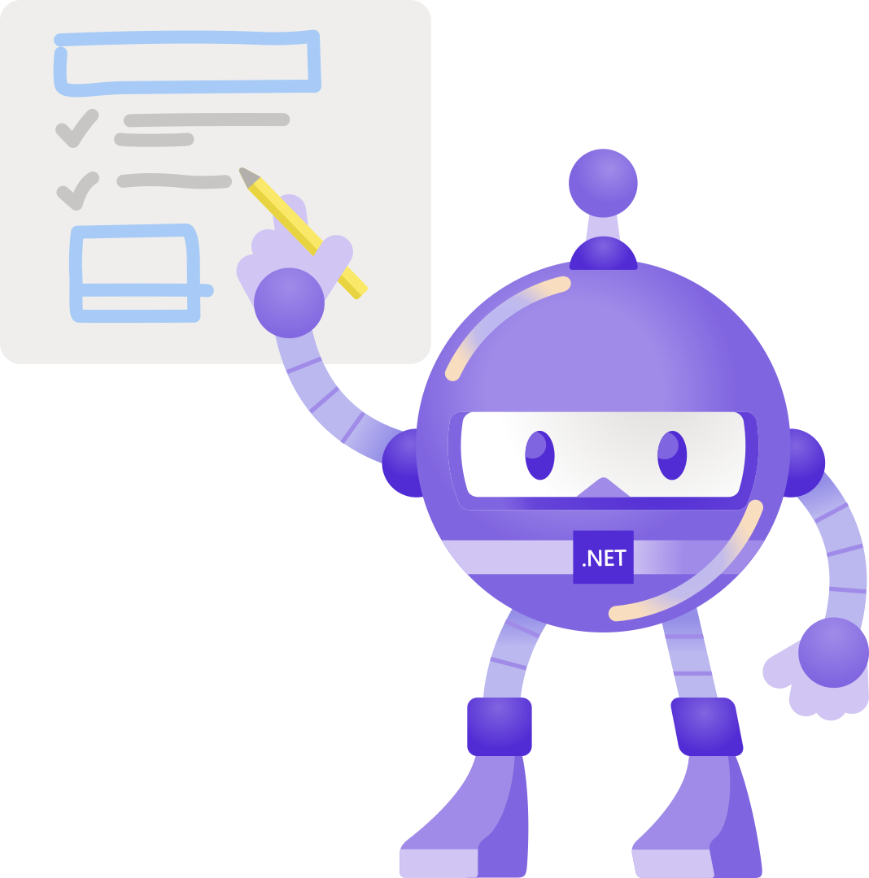
Demo
Visual Studio & Kubernetes

Slide 12
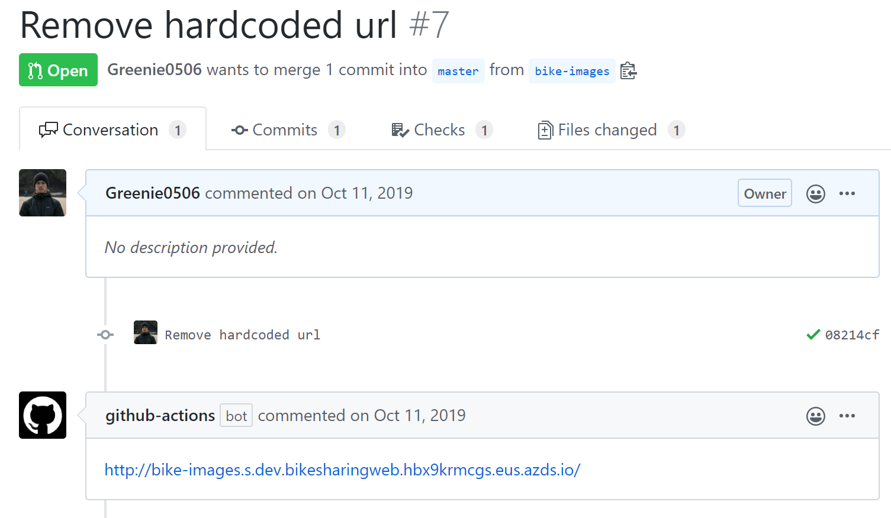

Increase Confidence in Pull Requests
Challenges with Pull Requests
Typically consists of static code diffs
Commonly limited to team members who have context
Minimal visibility of the end to end impact on the application
Pull Request Flow with GitHub Actions and Azure Dev Spaces
Test pull request code in the context of the larger application
Include team members e.g. Designers, Program Managers in the PR testing

Slide 13



ROADMAP
Local Kubernetes support (Docker Desktop, Minikube, Kind)
Developer specific routing, aka “working in isolation”
PR Flow v2
Pod identity and service endpoints
Service Mesh support

Slide 14
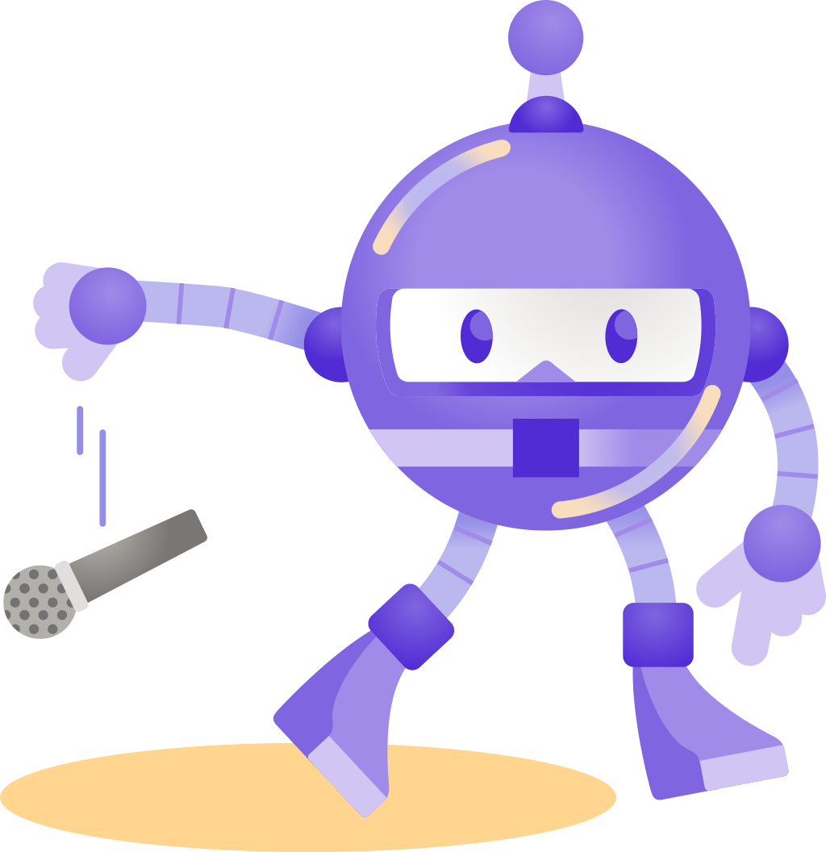
Thanks for joining!
Visual Studio 2019 + Docker Tooling Demo aka.ms/dotnet/vs2019/docker
Visual Studio 2019 + Local Process and Kubernetes Demo aka.ms/dotnet/vs2019/k8s
@spboyer for any questions!
#dotnetconf

Slide 15
Thanks for joining !

