Slide 1
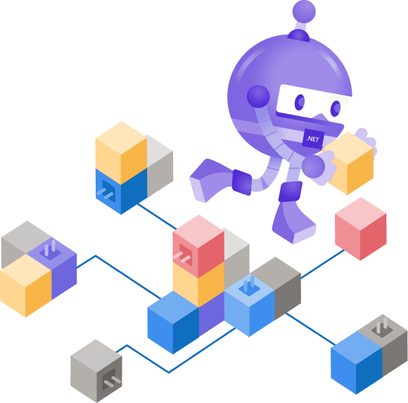
Developing and Deploying Microservices with Project Tye
Glenn Condron (@condrong)
Justin Kotalik (@justinkotalik)

Slide 2
Getting started: Today
Web
API

Slide 3
Getting started: Today
Multiple project startup
It’s slightly easier in VS.
Service Discovery
Configuring ports in each service for every service
Hard coded URLs
Fragile to change, touch every project
What about dependencies?
Redis, SQL, message queues, etc
Web
API

Slide 4
Getting started: Today
Is Docker Compose the solution to some of these problems?
Docker is the answer to dependencies,
The docker ecosystem only partially solves the other problems we showed
Steep learning/getting started curve.
Docker is heavy during development and can make debugging hard if you are trying to run in a container on your dev machine.

Slide 5
Getting started: Tomorrow
Tye
Service Discovery via configuration conventions
Understands .NET project files
Dashboard for logs, metrics, etc locally
Can run Docker dependencies
Can dockerize and deploy your services to AKS
“Hot Reload”: Watch support

Slide 6



The App: Voting
Internet
Internet
Votes
Results
Auth
Redis
Postgres
Worker

Slide 7

Demo Voting App

Slide 8
Deploying
Container Registry
Votes
Results
Redis
Postgres
Kubernetes
Worker
Auth

Slide 9
Deploying: Configure
Container Registry
Votes
Results
Redis
Postgres
Kubernetes
Worker
Auth
Secrets
Redis:ConnStr
Postgres:ConnStr

Slide 10
Deploying: Containerize
Local
Docker
Container Registry
Votes
Results
Kubernetes
Worker
Auth
Secrets
Redis:ConnStr
Postgres:ConnStr

Slide 11
Deploying: Push
Local
Docker
Container Registry
Kubernetes
Secrets
Redis:ConnStr
Postgres:ConnStr

Slide 12
Deploying: Deploy
Local
Docker
Container Registry
Kubernetes
Secrets
Redis:ConnStr
Postgres:ConnStr

Slide 13

Demo: Deploy

Slide 14

Extended features
Azure functions
Dapr
Ingress
Diagnostics with zipkin, seq, elastic stack
Multirepo scenarios
tye build / tye undeploy / tye push

Slide 15

Thanks for joining !
Tye survey: https://aka.ms/AA7q20u
Glenn Condron (@condrong)
Justin Kotalik (@JustinKotalik)

