Slide 1


Blazor in .NET 5
Steve Sanderson
Safia Abdalla
Notes:
Demo app: https://github.com/captainsafia/blazoract
Total time: 30 minutes (25 talk/5 QA)
Topics to cover:
CSS isolation (cell, menu bar styles, etc)
Lazy-loading (BlazorTable in view all notebooks route)
Virtualization (list of notebooks cells is virtualized)
Virtualize a list of elements in a CSV file
JS interop/isolation (notebook rename UI with contenteditable field)
dotnet watch
Change play button hover color and add ”title” attribute
Change font styles for title
debugging improvements
debug sending an execution request – show ExecuteRequest/Result objects
deploy client to static site
Set up GitHub action for deployment
Change `RunController` API to Azure C# Function
Storyline
Steve/Safia are remote devs on a team
Steve clones the repo and submits a PR with a CSS change (CSS isolation, dotnet watch, debugging)
Change from plain text area to Monaco editor
Safia reviews PR (virtualization, JS isolation, lazy-loading)
And merges (deploy to Azure SWA)
(3min) Intro
(18min) Demos (9 min each)
(5 mins) Slideware demos
Perf improvements (Steve)
Browser compat analyzer (Safia)
Protected browser storage (Safia)
WebAssembly prerendering (Safia)
Input File (Steve)
(4min) QA

Slide 2

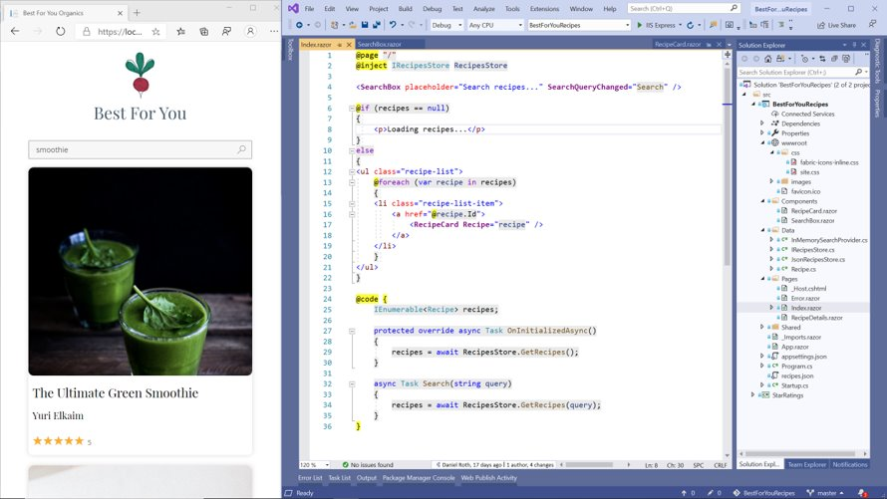
Blazor in .NET 5: Main themes
Improve developer experience
Improve performance on WebAssembly
Fill feature gaps

Slide 3
Demo: New for Blazor in .NET 5
CSS Isolation
Auto-refresh
Packages auto-add their own CSS/JS
Better debugging
InputFile support
Virtualization
Azure Static Web Apps Integration

Slide 4

Demo
github.com/captainsafia/blazoract
Notes:
Safia to segaway

Slide 5
But wait…there’s more!
Performance improvements
Protected browser storage
Browser compat analyzers
Pre-rendering improvements
Lazy-loading support
…and more!

Slide 6

Performance Improvements

Slide 7
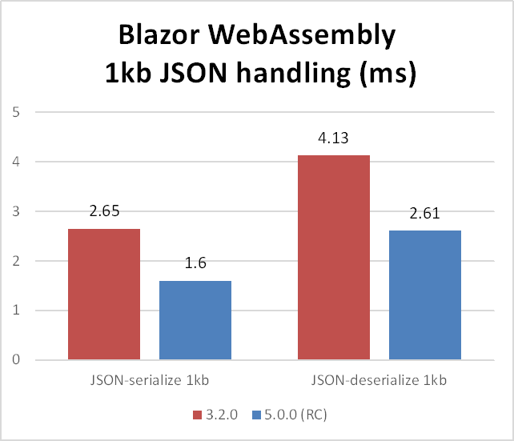
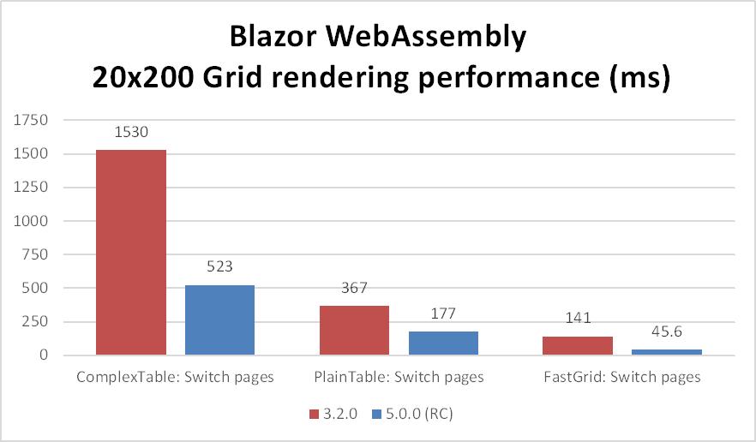
Improvements to JSON serialization and deserialization
Improvements to rendering for component-heavy UIs (e.g. grids)
Improvements to string comparisons, dictionary look-ups, etc.
Notes:
Steve to speak

Slide 8

Protected Browser Storage
@inject ProtectedLocalStorage storage
<p>Current count: @currentCount</p>
<button @onclick="IncrementCount">Increment</button>
@code {
int? count;
private async LoadCount() {
var result = await storage.GetAsync<int>("count");
count = result.Success ? result.Value : 0;
}
private async IncrementCount() {
await storage.SetAsync("count", ++count);
}
}
Notes:
Steve to speak

Slide 9
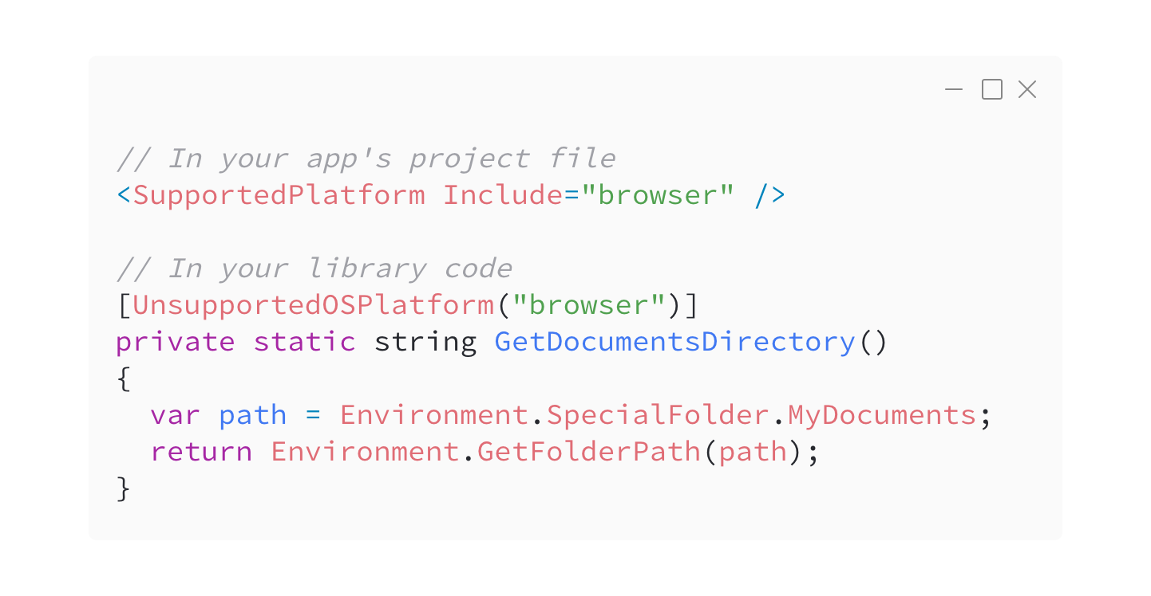
Browser compatibility analyzers
Notes:
Safia to speak
With the server and WebAssembly hosting models, you can run Blazor on a variety of targets: from Linux and Windows servers to inside modern web browsers. In .NET 5, we shipped support for compatability analyzers that allow you to decorate your library's project file or APIs with information about supported platforms for an API. Now, instead of getting errors about unsupported APIs during runtime once you're application has already been deployed, you can get those warnings during development. Gone are the days of having to deal with extra headaches in production.

Slide 10

Prerendering Improvements
Notes:
Safia to speak
Next in .NET 5, we shipped some improvements to the prerendering experience in Blazor. Pre-rendering is the process by which contents of a web page are compiled on the server and sent to the client as static HTML that is then made interactive later. Blazor currently supports a couple of render strategies that render pages statically then make them interactive via Blazor Server. In .NET 5, we shipped added some new render modes to the mix.

Slide 11
WebAssembly Prerendered
<component type="typeof(App)"
render-mode="WebAssemblyPrerendered" />
Prerenders a component as static HTML and allows a Blazor WebAssembly app to make the component interactive.
Notes:
Safia to speak
First, a WebAssemblyPrerendered mode which sents static HTML to the client, then makes it interactive later once Blazor WebAssembly has been loaded into the browser.

Slide 12
WebAssembly
<component type="typeof(App)" render-mode="WebAssembly" />
Enabled rendering Blazor WASM apps in MVC apps.
Notes:
Safia to speak
Second, a WebAssembly render mode which can be used to render Blazor WASM components into any existing MVC application. If this sounds like an intriguing idea to you, check out the Modern Web Development with Blazor & .NET 5 session with Javier and Dan later today to learn more.

Slide 13
Lazy-loading
<ItemGroup>
<BlazorWebAssemblyLazyLoad Include="BlazorTable.dll" />
</ItemGroup>
@inject LazyAssemblyLoader assemblyLoader
<Router AppAssembly="@typeof(Program).Assembly" OnNavigateAsync="@OnNavigateAsync">
...
</Router>
@code {
private async Task OnNavigateAsync(NavigationContext args) {
if (args.Path.EndsWith("notebooks")) {
await assemblyLoader.LoadAssembliesAsync(new List<string>() { "BlazorTable.dll" });
}
}
}
Notes:
Safia to speak
Prerendering is just one of the ways that you can improve startup performance for your application. Another is lazy-loading, which allows you to delay the loading of a particular assembly until it is needed, such as when a user visits a particular page. In .NET 5, we shipped support for lazy-loading via a new BlazorWebAssemblyLazyLoad build-time property that allows you to mark which assemblies to delay loading, a new LazyAssemblyLoader service which handles fetching the assemblies, computing integrity checks, and loading them into the debugger, and finally a new OnNavigateAsync API on the Router component that allows you to load assemblies via the service before loading the page. If this feature sounds useful to you, check out the Blazoract demo app and the official Blazor docs for getting started details.

Slide 14
Other improvements
New InputRadio component
FocusAsync API
Custom component instantiation with IComponentActivator
Support for custom validation class names with FieldCssClassProvider
JavaScript isolation
Support for disposing components asynchronously
Support for optional and catch-all route parameters
Support for auth code flow with MSAL v2
New OffsetX and OffsetY properties to MouseEventArgs
Notes:
Steve: JavaScript isolation, FocusAsync
Safia: optional/catch-all route params, auth code flow

Slide 15

Team work makes the dream work.
.NET Runtime, VS Debugger, VS Code JavaScript Debugger, VS Web Tools, Azure Static Web Apps, Azure Functions
… and the Blazor community

Slide 16
Visual Studio 2019 16.8 GA and 16.9 Preview
RELEASED
Dev environments in the cloud
.NET productivity
GitHub Codespaces available as a limited “preview” for ASP.NET Core, .NET Core and C++
Roslyn analyzers are now included in the .NET 5.0 SDK
.NET Code Style analyzers can now be enforced on build ^{Preview}
AI-assisted productivity
Linux diagnostics
Team Completions: Get C# contextual suggestions for your own types, through custom models shared with your team
.NET Core Debugging with WSL 2 using the Linux distro of your choice ^{Preview}
Debug managed Linux core dump
Automated CI/CD workflow ^{Preview}
XAML productivity
GitHub Actions workflow from within Visual Studio for your .NET Core apps
XAML Binding Failures diagnostic improvements
Git workflows
Easily execute your daily Git operations using the Git Changes window
Browse and manage your Git repository and stop worrying about merge conflicts
visualstudio.com/download aka.ms/vs-preview

Slide 17

Questions?

