Slide 1


Enhancing Tests Readability with Extension Methods and Fluent Interfaces
Nicolás Paez
@inicopaez

Slide 2

Motivation
Why test code matters?

Slide 3
In CD/CI contexts tests are first class citizens

Slide 4
In Agile/XP contexts tests are documentation

Slide 5
If you practice Test-Driven Development tests are a design tool

Slide 6
Application code is generic Test code is specific

Slide 7
Test code signals design smells

Slide 8
Test cases usually share structure

Slide 9

Techniques

Slide 10
Object Mother Pattern
https://wiki.c2.com/?ObjectMother Provides a simple methods create complete, valid and customtizable domain objects.
Notes:
http://citeseerx.ist.psu.edu/viewdoc/download?doi=10.1.1.18.4710&rep=rep1&type=pdf

Slide 11
Builder Pattern

Slide 12
Fluent Interface
https://martinfowler.com/bliki/FluentInterface.html

Slide 13
Tools

Slide 14

Fluent Assertions
https://fluentassertions.com/

Slide 15
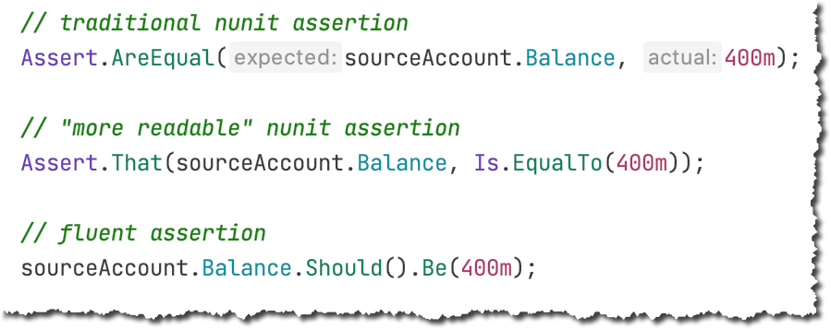
Assertion Styles

Slide 16
Extensions Methods

Slide 17
Demo
Coding time! https://github.com/nicopaez/csharp_test_readability

Slide 18
FundsTransfer
BankAccount
Customer
Branch
Address

Slide 19

Thanks for joining!
Nicolás Paez, @inicopaez
nicopaez@computer.org, https://blog.nicopaez.com

