Slide 1


Source Generators Writing code that writes code
David Wengier
@davidwengier

Slide 2
What is a source generator?
It lets you generate source code
This is a crappy slide
What does “generate source” mean?
Why isn’t he saying any of these bullet points?
So “source” I guess means source code
And “generate” means create
Wait.. Are source generators going to take our jobs?!

Slide 3
The C# Compiler
Your .cs
files
Project.dll
Parse
Compile
Emit
CST
Compilation
IL
CST
AST
CST
Source
Generator
Source
(string)

Slide 4
Potentially Frequently Asked Questions
Does the source you generate exist on disk?
Not by default, but there is an option: EmitCompilerGeneratedFiles
Can you have multiple source generators?
Yes, as many as you like, but they can’t rely on each other
Surely there is a better way that producing strings?
Yes, but also no
Can they change code?
No
How’s the IDE experience?
Good for consumers, getting better for authors
Notes:
Questions That Would Be Asked Frequently If You Had A Chance To Think About This Some More

Slide 5
What can you do with them?
Swap runtime reflection for compile time inspection
Automate processing of external files
Automate boring typing

Slide 6
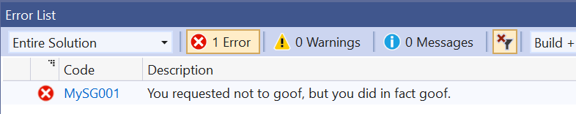
Diagnostics
context.ReportDiagnostic(Diagnostic.Create(new DiagnosticDescriptor("MySG001", "You done goofed!", "You requested not to goof, but you did in fact goof.", "Goofiness", DiagnosticSeverity.Error, true), Location.None));
(but don’t write analyzers 😛)

Slide 7
Additional Files
<ItemGroup> <AdditionalFiles Include=“settings.xml” /> </ItemGroup>
foreach (var file in context.AdditionalFiles) { // … }
https://github.com/ScottHolden/BFSourceGen/blob/master/src/BFSourceGen/BFSourceGenerator.cs

Slide 8
Partial methods
partial void Method();
private void Foo()
{
Method();
}
<auto-generated />
partial void Method()
{
Console.WriteLine(“Hello World”);
}
Can’t have return types
Can’t have out parameters
Can’t have access modifiers

Slide 9
Partial methods
public partial string Method(string name, out int age);
private void Foo()
{
Method();
}
<auto-generated />
public partial string Method(string name, out int age)
{
age = 21;
return “Hello “ + name;
}
Can have return types
Can have out parameters
Can have access modifiers
MUST have an implementation

Slide 10

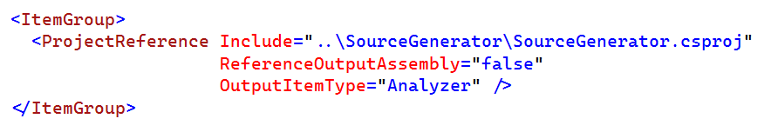
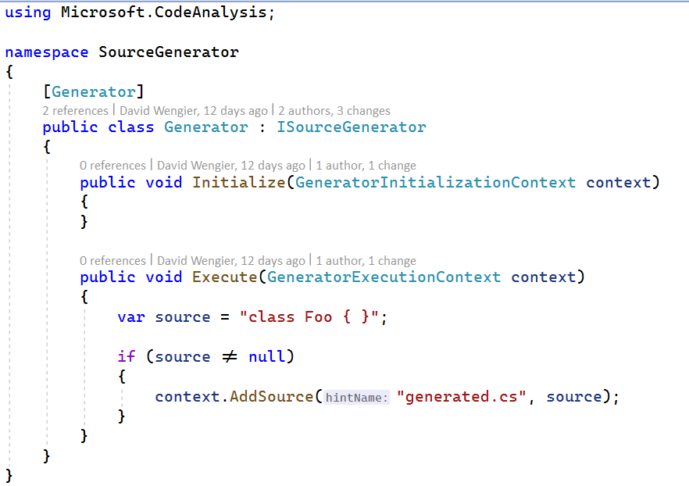
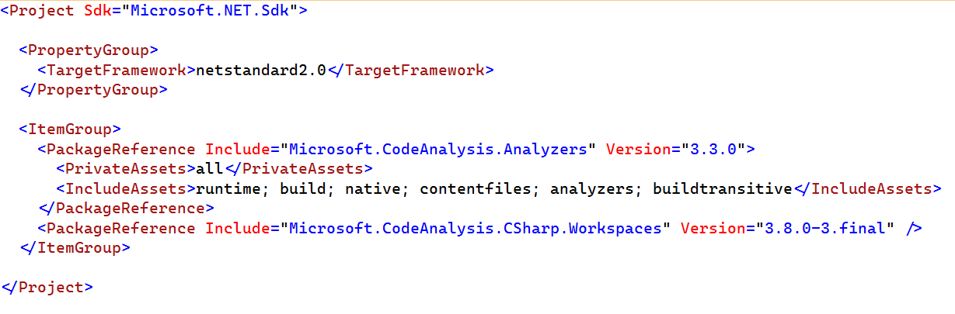
Referencing and Defining a Source Generator

Slide 11
Debugging a Source Generator
Debugger.Launch()
GeneratorDriver
Test console app
Unit tests
https://github.com/davidwengier/SourceGeneratorTemplate
https://github.com/chsienki/kittitas
https://sourcegen.dev/

Slide 12
Demo time!

Slide 13
Thank you!

