Slide 1


HTTP API Development with .NET, Azure, and OpenAPI: Paper Cuts Begone!
Brady Gaster
@bradygaster

Slide 2

Open API is On-by-default in .NET 5 Web API
Swashbuckle.AspNetCore reference
Startup.cs wire-up so it “just works”
Brand new F5 experience for HTTP APIs
HttpRepl has been updated for .NET 5
@bradygaster

Slide 3

Demo
The new .NET 5 Web API project template and F5 experience

Slide 4

Announcing Azure API Management Support
Publish-time import into API Management
Create new APIs in your Azure subscription
Update existing APIs or version during publish
@bradygaster

Slide 5

Demo
Integrating your HTTP APIs into Power Platform

Slide 6
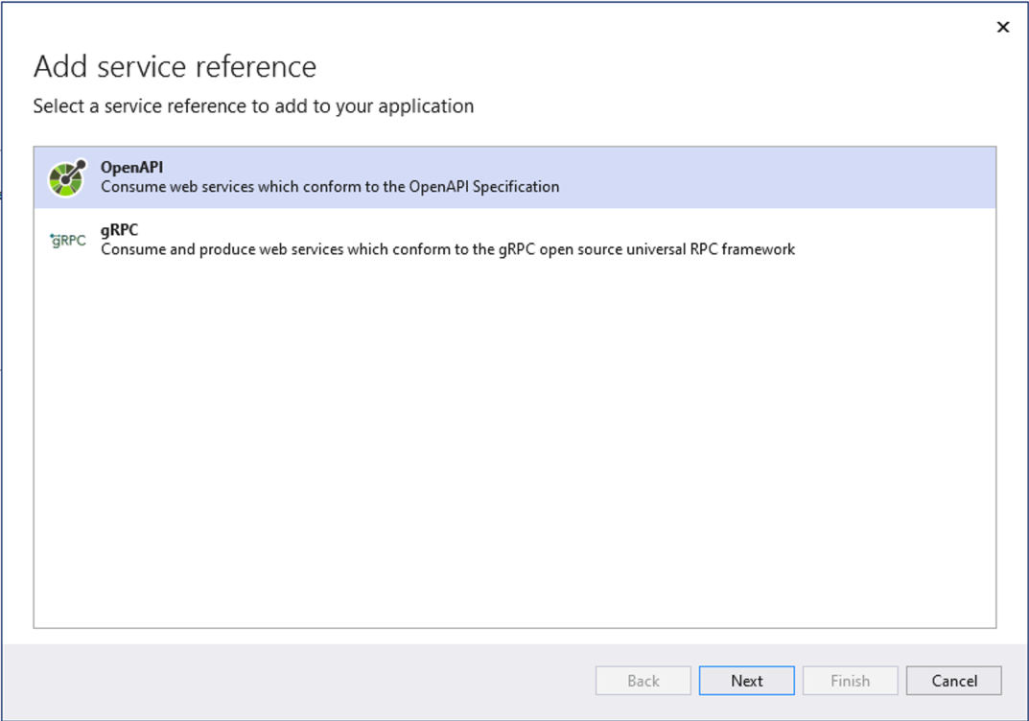
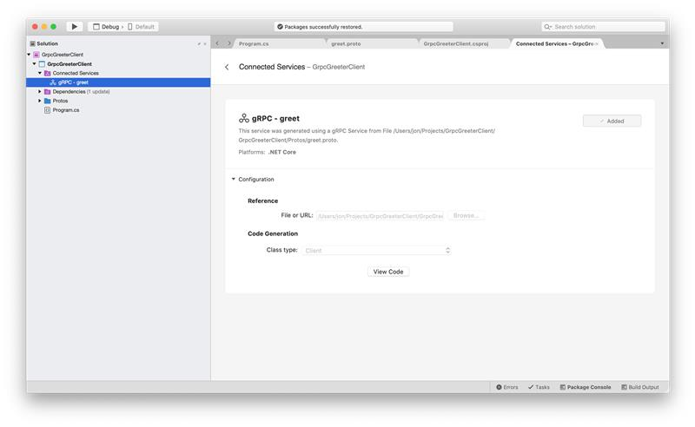
Generate Open API Clients in VS & VS4M

Slide 7

Calls to Action
Try out the new template
Debug using Swagger UI
Import your API into Azure
Try building a Power App with your API
@bradygaster

Slide 8

Thanks for joining!

