Slide 1
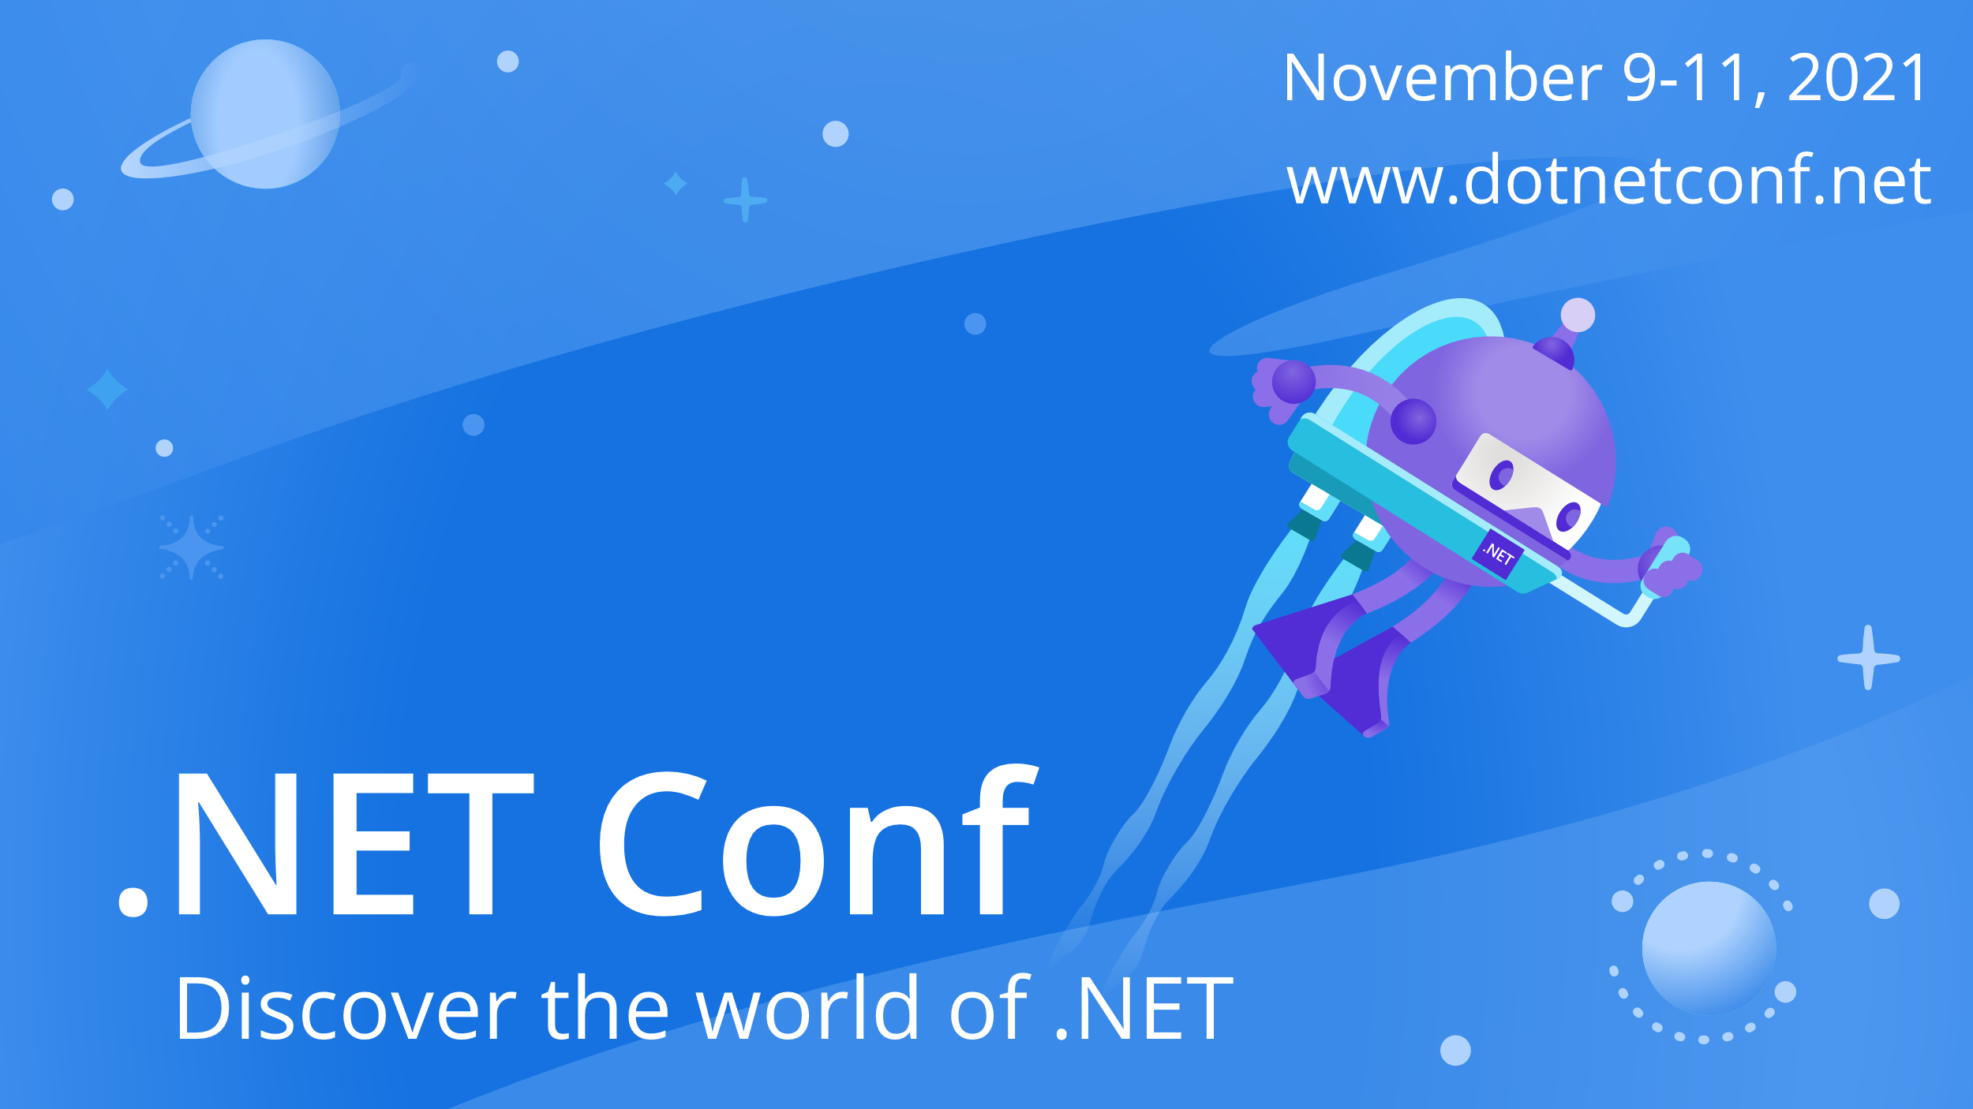

Slide 2


ML.NET: Machine learning from data to production in less than 30 minutes
Bri Achtman (@briacht)
Luis Quintanilla (@ljquintanilla)

Slide 3
Agenda
What is ML.NET?
Why ML.NET?
Machine Learning workflow
Challenges bringing an ML model to production
Demo
Roadmap

Slide 4

What is ML.NET?
An open-source and cross-platform machine learning framework for .NET

Slide 5
Why ML.NET?
Stay in .NET ecosystem to build, train, consume, and deploy custom ML models
No data science or ML experience needed
Easy to go from experimentation to production

Slide 6






Machine Learning Workflow
Get the data
Prepare the data
Train
Evaluate
Deploy
Inferencing
Model Training
Model Consumption
How do you go from model training to model consumption?

Slide 7
Challenges bringing ML models to production
AI budgets on rise (est. $28.5B spent on ML projects and tools in the 1st quarter of 2019), yet only 22% of companies using ML successfully deployed a machine learning model into production
Takes most companies between 31-90 days to deploy an ML model
Machine Learning = code + data
Scale
Version control
Model reproducibility
Notes:
Managing the machine learning workflow offers a multitude of challenges which cannot be solved with traditional DevOps techniques. Model training often has its own schedule, and the machine learning development lifecycle and artifacts are different than that of the software code.
Sources:
https://www.statista.com/chart/17966/worldwide-artificial-intelligence-funding/
https://info.algorithmia.com/hubfs/2019/Whitepapers/The-State-of-Enterprise-ML-2020/Algorithmia_2020_State_of_Enterprise_ML.pdf?utm_campaign=The%20Batch&utm_source=hs_email&utm_medium=email&utm_content=80984419&_hsenc=p2ANqtz--sz-e2gfqUeDvVSmjsXfvwOnLHB2ZkSdQsO1IRRAdnBIb0emf-JTh8NnwFxB-FeZberIw7_rI9ERTy8zFW8jvoTzjOfA&_hsmi=80984419
https://www.anaconda.com/state-of-data-science-2020?utm_medium=press&utm_source=anaconda&utm_campaign=sods-2020&utm_content=report

Slide 8
Demo
Bri Achtman & Luis Quintanilla

Slide 9
Roadmap
Now
ML.NET on .NET release schedule
Model Builder GA in Visual Studio 2022
Simplification of PFI API (model explainability)
November
Virtual ML.NET Hackathon (Nov 12 kick-off)
Add time series forecasting to Model Builder
January / February
Update AutoML API to new AutoML implementation
Add anomaly detection to Model Builder
Make ONNX consumption easier via ML.NET API
Beyond
Implement the rest of the deep learning plan
Define and implement plan for data prep (.NET DataFrames)
See more at aka.ms/mlnet-roadmap

Slide 10
Announcement
Model Builder GA in Visual Studio 2022
ML.NET 1.7 released – now on .NET release schedule

Slide 11
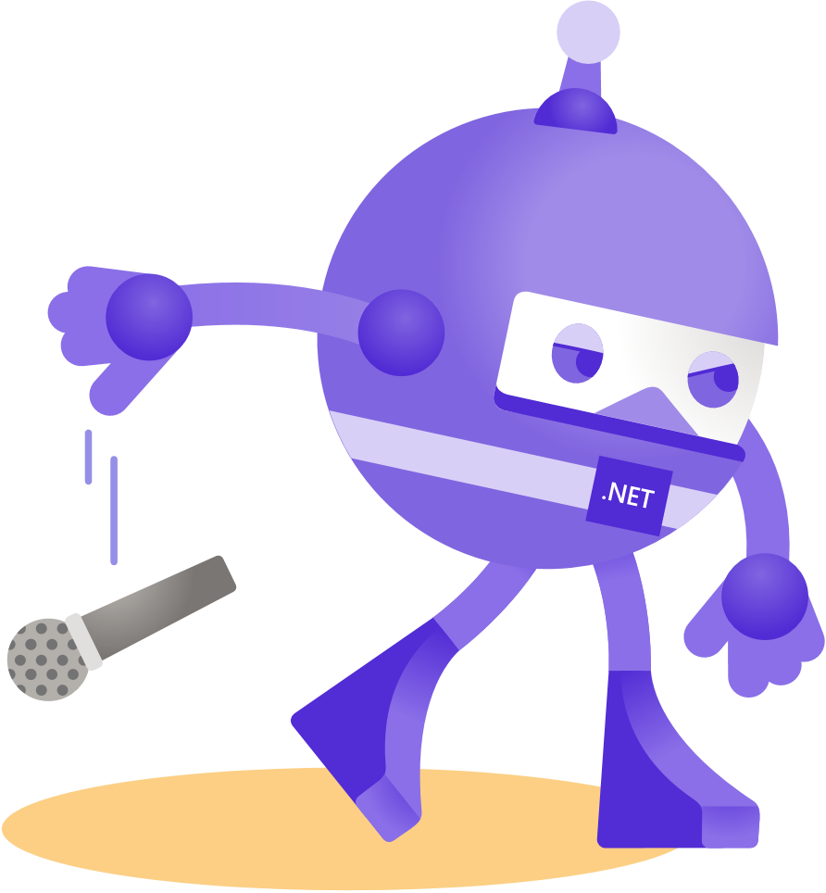
Thanks for joining!

