Slide 1
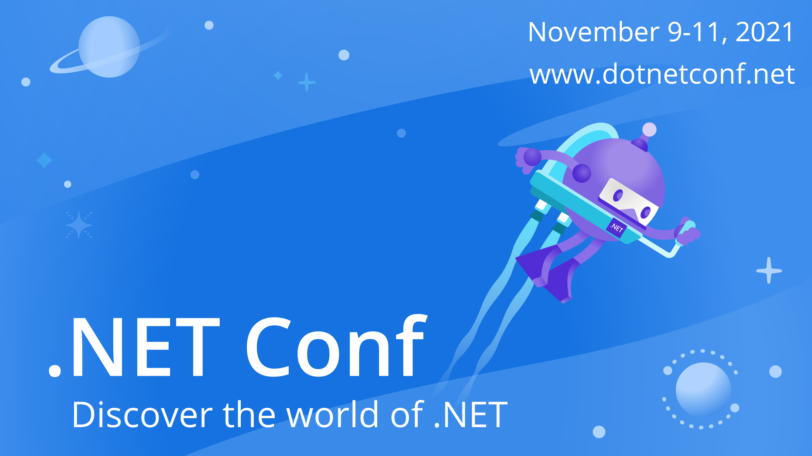

Slide 2

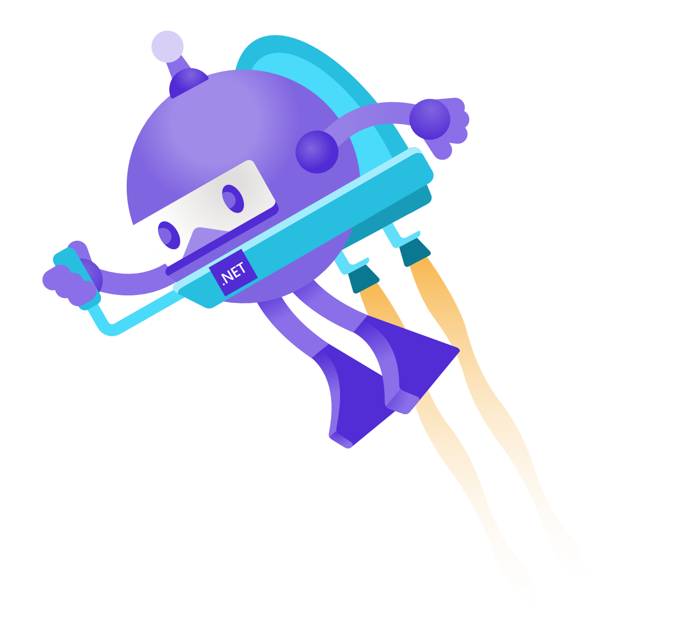
Not Thinking Small - My Journey to Learning .NET
Elahn Danee Harris

Slide 3
What would you do if you knew you could not fail?

Slide 4
What would you do if you knew you could not fail?
What makes you happy to be alive?
Fear
The importance of technology

Slide 5
August 9, 2020

Slide 6
August 9, 2020
Researched programming languages
Freedom and flexibility with C#

Slide 7
Getting Started

Slide 8
Getting Started
Udemy
Podcasts
YouTube

Slide 9
#CodeNewbie

Slide 10
#CodeNewbie
Community on Twitter
“Hello World”

Slide 11
Finding the C# and .NET Community: #CSharp

Slide 12
Finding the C# and .NET Community: #CSharp
Did not see a lot of C# and .NET developers
#CSharp
Met online friend, and then mentor

Slide 13
Blazor

Slide 14
Blazor
“What are we really building?”
Weather Forecast App
It finally made sense

Slide 15
#DotNetBookStudy

Slide 16
#DotNetBookStudy
New book study
Book study podcast
Embrace vulnerability

Slide 17
Imposter Syndrome

Slide 18
Imposter Syndrome
The sneaky yet obnoxious bully
“What If”
Redefine it and recognize the good in it

Slide 19
When You Stop Playing Small

Slide 20
When You Stop Playing Small
You find freedom
A continuous journey of small decisions
Stay compassionate

Slide 21
So What Makes You Happy To Be Alive?

Slide 22
So What Makes You Happy To Be Alive?
What makes you excited?
Explore
Pour into it

Slide 23
My Mission
Continue learning
Create content that encourages
Cultivate online community

Slide 24
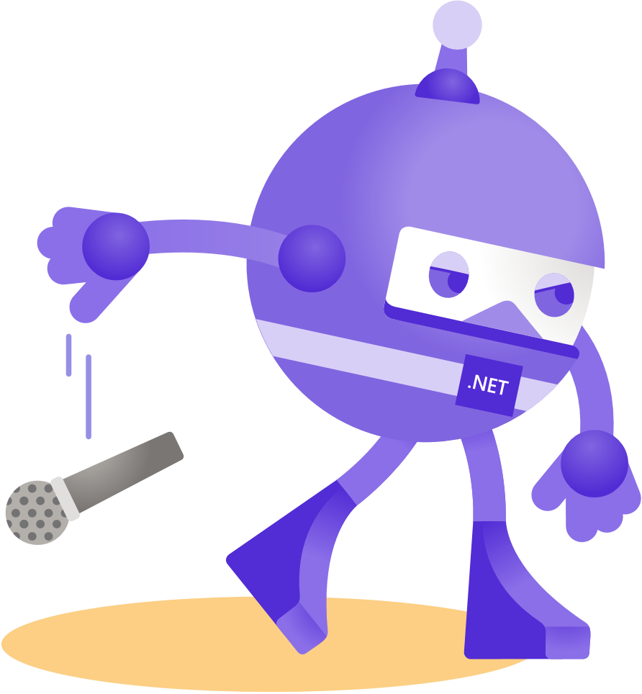
Thanks for joining!
Twitter- @CodeThLightning
YouTube- Elahn Danee Codes
GitHub- Elahn Danee Codes

