Slide 1
What’s new in .NET MAUI
for .NET 11
Gerald Versluis
Software Engineer, Microsoft

Slide 2
PR velocity across .NET MAUI repos
Merged PRs grew 4x in a year, and 80% are now Copilot-authored
Monthly merged PRs, .NET MAUI repos
2025
2026
Source: Agentic Engineers PR dashboard, https://agentic-engineers.net, data as of Nov 5, 2026. Copilot = PRs authored with GitHub Copilot.

Slide 3



.NET MAUI ecosystem
Partners are building the framework with us
Controls and fixes
Syncfusion
Engineers fixing issues and shipping features in dotnet/maui
Free, open-source Syncfusion Toolkit for .NET MAUI
Platform and runtime
Uno Platform
Helped deliver Android support in .NET 10 & .NET 11
Co-maintains SkiaSharp
Contributes to and reviews PRs on .NET for Android and .NET for iOS
New platforms
Avalonia
Building the backend that takes .NET MAUI to Linux and WebAssembly
In preview since March 2026
Now an option in the .NET MAUI project templates

Slide 4
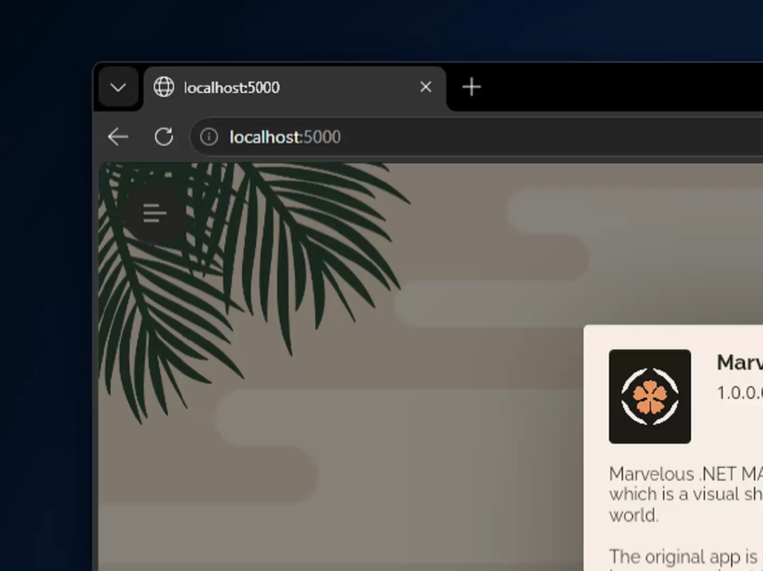
.NET MAUI on Web and Linux, using Uno Platform
.NET MAUI's handlers, now everywhere Uno Platform runs
3rd party ecosystem reused
More reach for .NET MAUI
More controls for Uno Platform - reuse any .NET MAUI control
Congrats Uno Platform on 7.0 release: https://platform.uno/blog

Slide 5














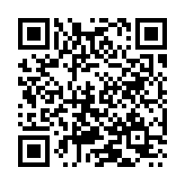





























































































github.com/dotnet/maui
Thank you,
community
contributors!
adrianknight89
rookiejava
pictos
myroot
albyrock87
dimonovdd
swharden
TanayParikh
Every pull request, issue and review makes .NET MAUI better for everyone.
jknaudt21
andreinitescu
bhavanesh2001
vividos
antonfirsov
kvpt
akihikodaki
BradChase2011
bmacombe
AdamEssenmacher
VladislavAntonyuk
alanmcgovern
Depechie
activa
alanag13
brunck
buyaa-n
bill2004158
bentmar
bruzkovsky
dhindrik
adamped
Cheesebaron
bares43
BrayanKhosravian
daltzctr
praeclarum
BioTurboNick
beeradmoore
aaronfranke
aheubusch
artemious7
artemvalieiev
Axemasta
BurningLights
BjornVanslembrouck
daniel-luberda
breyed
MichaelRumpler
DavidRoqueni
domagojmedo
Adam--
dartasen
campersau
dend
dmariogatto
cadsit
cschwarz
csteeg
Bobface
BitooBit
andres-fg
agaluzzi
appsourcers
ne0rrmatrix
Deadpikle
ChasakisD
CartBlanche
danielwilliamson
danielmarbach
danielchalmers
DamianMehers
dkarzon
Csaba8472
corvinsz
arpitjain099
ChummerUA
awaescher
AndersRasmussen
AlleSchonWeg
alfredmyers
AxelUser
cacti-acaprais
ahouben
adrianhall
APoukar
adamivancza
adambarath
1d0n7kn0w
1c3f0x84
CleanCodeDeveloper
csdinon
Choza-rajan
Chase-William
ChaseMarsh
breezy64
bkaankose
Brucepimenta
brainoffline
bradencohen
bbenetskyy
bwoebi
BinaryCraX
billvenhaus
baskren
BarryNolte
BaY1251
axelgorris
atsushieno
artemutin
adrianknight89
rookiejava
pictos
myroot
albyrock87
dimonovdd
swharden
TanayParikh
jknaudt21
andreinitescu
bhavanesh2001
vividos
antonfirsov
kvpt
akihikodaki
BradChase2011
bmacombe
AdamEssenmacher
VladislavAntonyuk
alanmcgovern
Depechie
activa
alanag13
brunck

Slide 6



.NET MAUI ecosystem
Thank you,
component
vendors!
Their control suites help .NET MAUI developers ship polished apps faster.

Slide 7
CoreCLR
01

Slide 8
The biggest change to
.NET MAUI you won’t see, but you will feel.
The biggest change to
.NET MAUI you won’t see, but you will feel.
The biggest change to
.NET MAUI you won’t see, but you will feel.

Slide 9
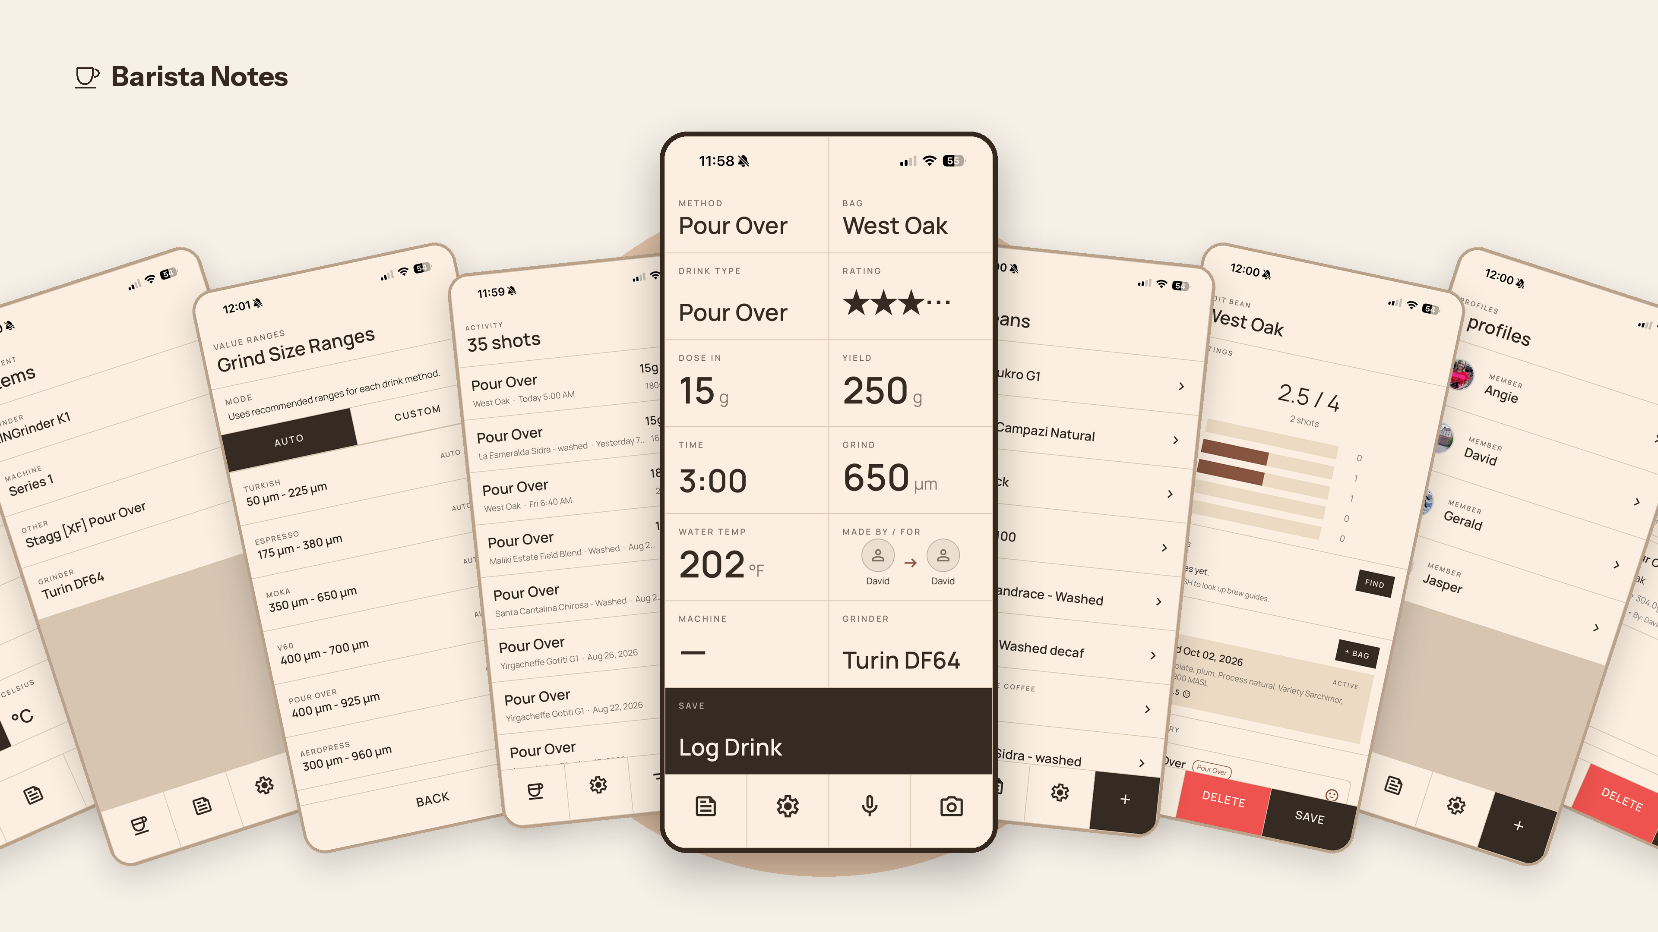

Slide 10
BaristaNotes: Android package size and startup
Pixel 5, Android 14 | .NET 11 RC2 | 1,000 drinks | 30 launches per cell
MAUI
C# Android Views
Signed package (MiB)
Median startup (ms)
90th percentile (ms)
Each panel has its own scale; zero baseline throughout.
Process-cold startup uses Android TotalTime. Signed benchmark packages include the fixture and probes. Android NativeAOT is experimental.

Slide 11
BaristaNotes: iOS package size and startup
iPhone 15 Pro, iOS 26.7.1 | .NET 11 RC2 | 1,000 drinks | 30 launches per cell
MAUI
C# UIKit
Signed package (MiB)
Median startup (ms)
90th percentile (ms)
Each panel has its own scale; zero baseline throughout.
Startup: kernel process start to New Drink readiness plus two frames. MAUI NativeAOT has an accepted compiler warning; measured routes only.

Slide 12
XAML improvements
02

Slide 13
20 years of XAML, from WPF to .NET MAUI.
Familiar syntax, brand-new tricks.
20 years of XAML, from WPF to .NET MAUI.
Familiar syntax, brand-new tricks.
20 years of XAML, from WPF to .NET MAUI.
Familiar syntax, brand-new tricks.

Slide 14
XAML source generation
Every XAML file now compiles to C# at build time
// Nothing to add in .NET 11
// MainPage.xaml -> MainPage.xaml.sg.cs
<!-- Need the old pipeline? Opt out -->
<PropertyGroup>
<MauiXamlInflator>XamlC</MauiXamlInflator>
</PropertyGroup>
<!-- ...or only for some files -->
<MauiXaml Update="Legacy/*.xaml"
Inflator="XamlC" />
How XAML gets inflated, by default
 | .NET 10 | .NET 11
Debug | Runtime | SourceGen
Release | XamlC | SourceGen
Faster builds and startup
No XAML parsing at runtime, in any configuration
Debug behaves like Release
One pipeline from F5 to the store build
Errors at build time
Not when the page first loads

Slide 15
Less XAML ceremony
No more xmlns boilerplate on every page
Before: every page declares its namespaces
.NET 11
<ContentPage
xmlns="http://schemas.microsoft.com/dotnet/2021/maui"
xmlns:x="http://schemas.microsoft.com/winfx/2009/xaml"
xmlns:vm="clr-namespace:MyApp.ViewModels"
xmlns:conv="clr-namespace:MyApp.Converters"
x:Class="MyApp.MainPage">
<vm:MainViewModel />
</ContentPage>
<ContentPage
x:Class="MyApp.MainPage">
<MainViewModel />
</ContentPage>
Map your own namespaces once per assembly: [assembly: XmlnsDefinition(...)]

Slide 16
C# expressions in XAML
Inline C# replaces most value converters
Before: a converter for one inverted bool
.NET 11
// 1. Write a converter class
public class InverseBoolConverter : IValueConverter
{
public object Convert(object v, Type t,
object p, CultureInfo c) => !(bool)v;
public object ConvertBack(object v, Type t,
object p, CultureInfo c) => !(bool)v;
}
// 2. Register it as a resource
<local:InverseBoolConverter x:Key="InverseBool" />
// 3. Reference it in the binding
<Button IsEnabled="{Binding IsBusy,
Converter={StaticResource InverseBool}}" />
<Button
IsEnabled="{!IsBusy}" />
// Same idea, other converters
{$'Hello {Name}!'}
{Price * Quantity}
{Title ?? 'Untitled'}
{IsAdmin || IsOwner}

Slide 17
Global XMLNS
// XAML namespace declarations in root and node prefixes
<ContentPage xmlns=
"http://schemas.microsoft.com/dotnet/2021/maui"
xmlns:x="http://schemas.microsoft.com/winfx/2009/xaml"
x:Class="MyApp.MainPage"
xmlns:vm="clr-namespace:MyApp.ViewModels"
xmlns:conv="clr-namespace:MyApp.Converters">
<vm:MainViewModel />
</ContentPage>
// Add your own namespaces to the global xmlns, once per assembly
[assembly: XmlnsDefinition("http://schemas.microsoft.com/dotnet/2021/maui/global",
"clr-namespace:MyApp.ViewModels;assembly=MyApp")]
[assembly: XmlnsDefinition("http://schemas.microsoft.com/dotnet/2021/maui/global",
"clr-namespace:MyApp.Converters;assembly=MyApp")]

Slide 18
Implicit XMLNS
// No more need for xmlns declarations
<ContentPage xmlns=
"http://schemas.microsoft.com/dotnet/2021/maui"
xmlns:x="http://schemas.microsoft.com/winfx/2009/xaml"
x:Class="MyApp.MainPage">
<MainViewModel />
</ContentPage>
// Implicit by default in .NET 11. On .NET 10, opt in from your .csproj:
<PropertyGroup>
<DefineConstants>$(DefineConstants);
MauiAllowImplicitXmlnsDeclaration</DefineConstants>
<EnablePreviewFeatures>true</EnablePreviewFeatures>
</PropertyGroup>

Slide 19
XmlnsDefinition vs. XmlnsPrefix
// No xmlns, no xmlns:x, no xmlns:mylib
<ContentPage x:Class="MyApp.MainPage">
<FancyButton /> <​!​-​- A: no prefix -​-​>
<mylib:FancyButton /> <​!​-​- B: prefix, nothing to declare -​-​>
</ContentPage>
// A. Map the library into the global xmlns
[assembly: XmlnsDefinition("http://schemas.microsoft.com/dotnet/maui/global",
"http://mylib.com/xaml")]
// B. Give it a global prefix, handy when names clash
[assembly: XmlnsPrefix("http://mylib.com/xaml", "mylib")]

Slide 20
Before: an InverseBoolConverter
// 1. Write a converter class
public class InverseBoolConverter : IValueConverter
{
public object Convert(object value, Type targetType,
object parameter, CultureInfo culture) => !(bool)value;
public object ConvertBack(object value, Type targetType,
object parameter, CultureInfo culture) => !(bool)value;
}
// 2. Register it as a resource
<ContentPage.Resources>
<local:InverseBoolConverter x:Key="InverseBool" />
</ContentPage.Resources>
// 3. Reference it in every binding
<Button IsEnabled="{Binding IsBusy, Converter={StaticResource InverseBool}}" />

Slide 21
After: C# expressions
// No converter class. No resource. No StaticResource.
<Button IsEnabled="{!IsBusy}" /> // InverseBoolConverter
// The same one-liners replace most other converters
<Label Text="{$'Hello {Name}!'}" /> // StringFormat
<Label Text="{Price * Quantity}" /> // MultiplyConverter
<Label Text="{Title ?? 'Untitled'}" /> // TargetNullValue
<Label IsVisible="{IsAdmin || IsOwner}" /> // MultiBinding + converter
<Button Clicked="{(s, e) => Count++}" /> // EventToCommandBehavior
// Compiled by XAML source generation, typed through x:DataType

Slide 22
New features & bugfixes
03

Slide 23
A lot more in .NET MAUI 11
Long press gesture
New recognizer for press-and-hold actions
Tab & toolbar badges
BadgeText on tabs and toolbar items
Passkeys
Face ID, Windows Hello and Android biometrics
Material 3
Android controls follow Material 3 design
Maps
Pin clustering, custom pin images, JSON styles
Animation control
Cancel one animation at a time
A stronger foundation
Quality, stability & performance
across all platforms
BoxView gradients
Fill accepts any brush, including gradients
C# UI template
Start a new app in C# with --ui csharp
System bar colors
Status and nav bars match your app
Themed splash screens
Separate images for light and dark mode
All changes in the release notes: learn.microsoft.com/dotnet/maui/whats-new/dotnet-11

Slide 24
A lot more in .NET MAUI 11
Long press gesture
New recognizer for press-and-hold actions
Tab & toolbar badges
BadgeText on tabs and toolbar items
Passkeys
Face ID, Windows Hello and Android biometrics
Material 3
Android controls follow Material 3 design
Maps
Pin clustering, custom pin images, JSON styles
Animation control
Cancel one animation at a time
3,500+
bugs fixed
in .NET 11
Estimate: ~40% of 8,900 merged PRs
BoxView gradients
Fill accepts any brush, including gradients
C# UI template
Start a new app in C# with --ui csharp
System bar colors
Status and nav bars match your app
Smaller apps
Unused CSS support is trimmed at publish

Slide 25
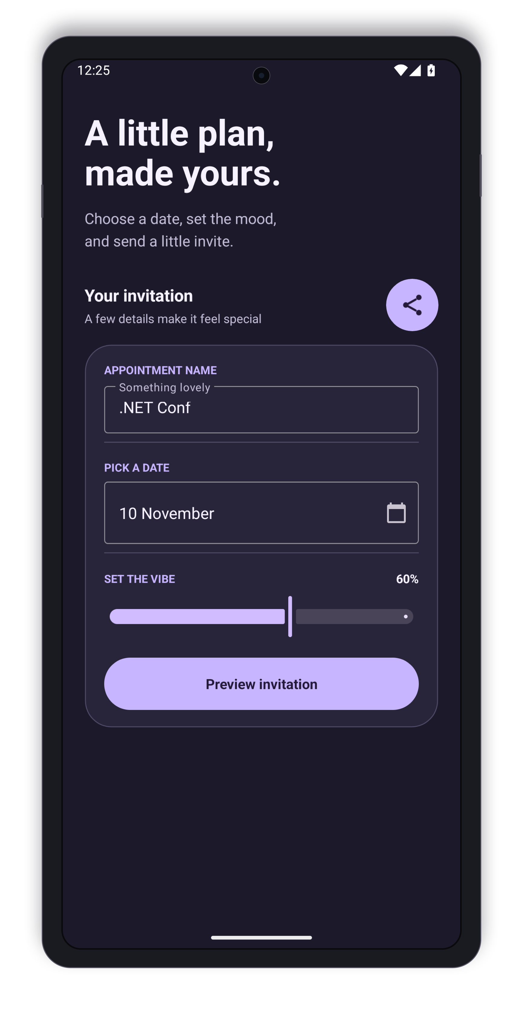
Material 3
One build property modernizes your Android controls
<!-- Opt in, in your .csproj -->
<PropertyGroup>
<UseMaterial3>true</UseMaterial3>
</PropertyGroup>
<!-- Your XAML stays the same -->
<Entry Placeholder="Email" />
<DatePicker />
<Slider Value="0.6" />
// .NET 11: Material 3 types are public
// for custom handlers
class MyEntry : MauiMaterialEditText

Slide 26
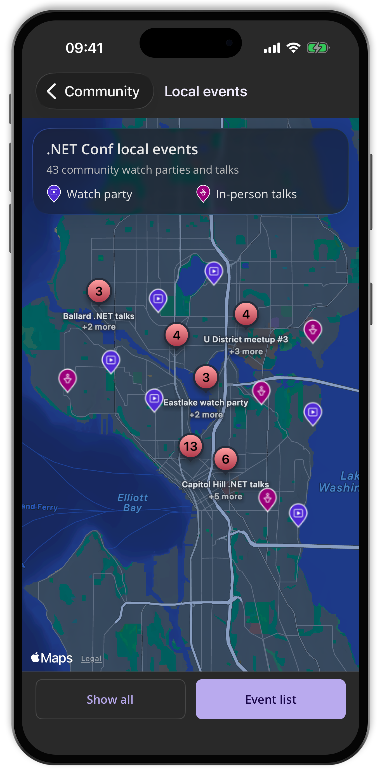
Maps
Hundreds of pins, still one readable map
<maps:Map IsClusteringEnabled="True"
ClusterClicked="OnClusterClicked">
<maps:Pin Label="Seattle"
Location="47.6062,-122.3321"
ClusteringIdentifier="stores"
ImageSource="store.png" />
</maps:Map>
The .NET Conf app, built with .NET MAUI 11, is on the App Store and Google Play
Source: github.com/jfversluis/dotnetconf-app

Slide 27
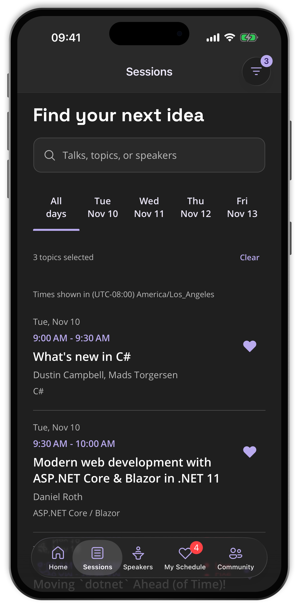
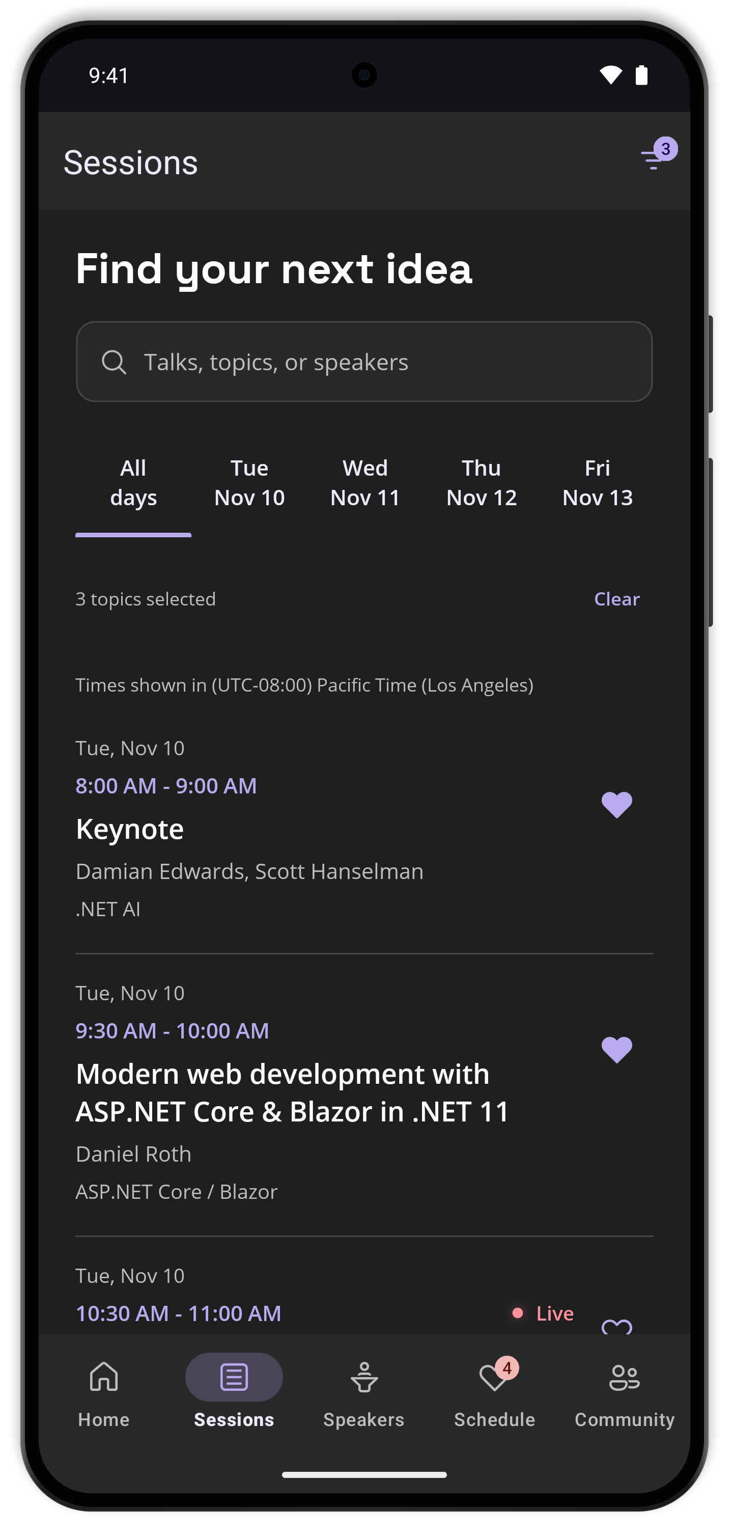
Badges on tabs and toolbar items
Counts and status dots with one property
// Toolbar item, bound to the view model
<ToolbarItem Text="Inbox"
BadgeText="{Binding UnreadCount}" />
// Tab on a TabbedPage
<ContentPage Title="Inbox"
TabbedPage.BadgeText="3"
TabbedPage.BadgeColor="Red" />
// "" shows a dot, null hides the badge
iOS
Android
Android
iOS

Slide 28
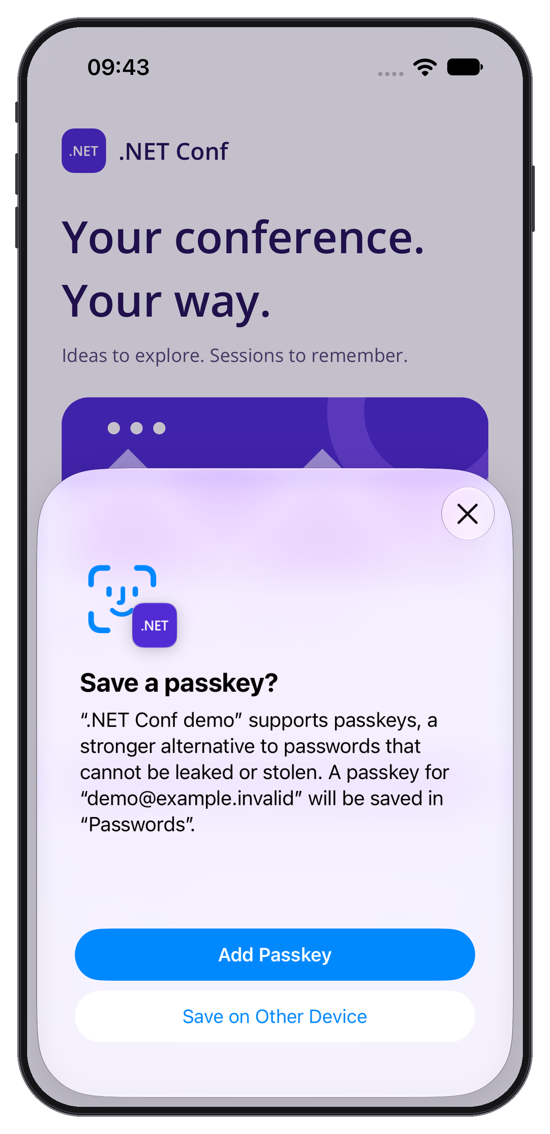
Passkeys
Sign in with Face ID, Windows Hello or a fingerprint
using Microsoft.Maui.Authentication;
if (Passkeys.IsSupported)
{
// Standard WebAuthn JSON in and out
var response = await Passkeys
.AssertAsync(optionsJson);
await server.VerifyAsync(response);
}

Slide 29
Tooling
04

Slide 30
dotnet run, test and watch
The .NET CLI now runs your app on devices
dotnet run
# Picks the target, then
# the device or emulator
# App output streams here
dotnet test
# Runs your tests in an
# app on the device
# Results come back here
dotnet watch
# Hot Reload on Android
# and iOS devices
# Ctrl+R restarts the app
DEEP DIVE · BRK016 · Tuesday, 4:30 PM PST
Bringing dotnet run, test, and watch to .NET MAUI with Jonathan Peppers

Slide 31
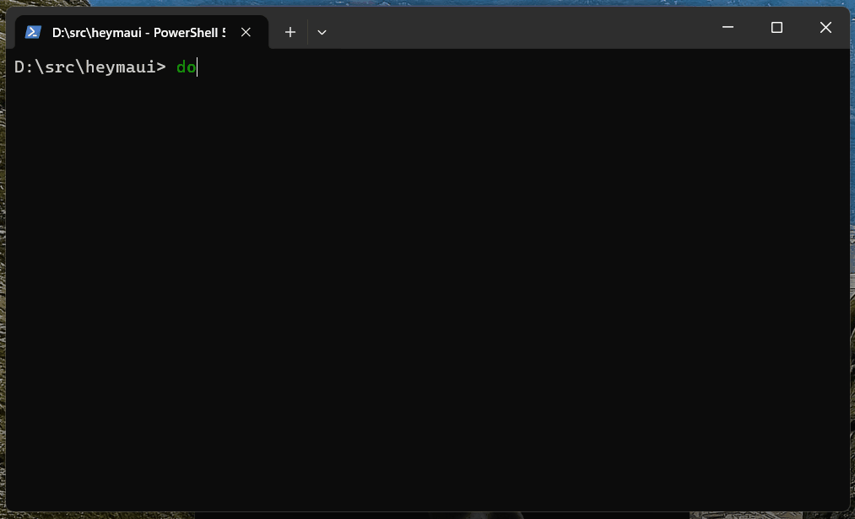
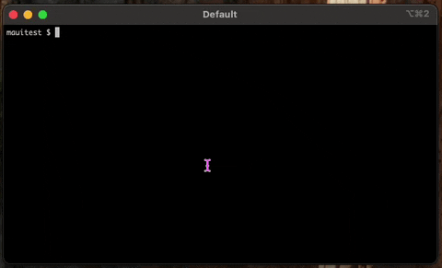
dotnet run
Pick a target and a device right in the terminal
# Multi-targeted MAUI project? Just run it
dotnet run
# Prompts for a target framework:
# net11.0-android, net11.0-ios, ...
# then for a device, emulator or simulator
# App output streams to the terminal;
# Ctrl+C stops the app
# Skip the prompts in scripts
dotnet run -f net11.0-android

Slide 32
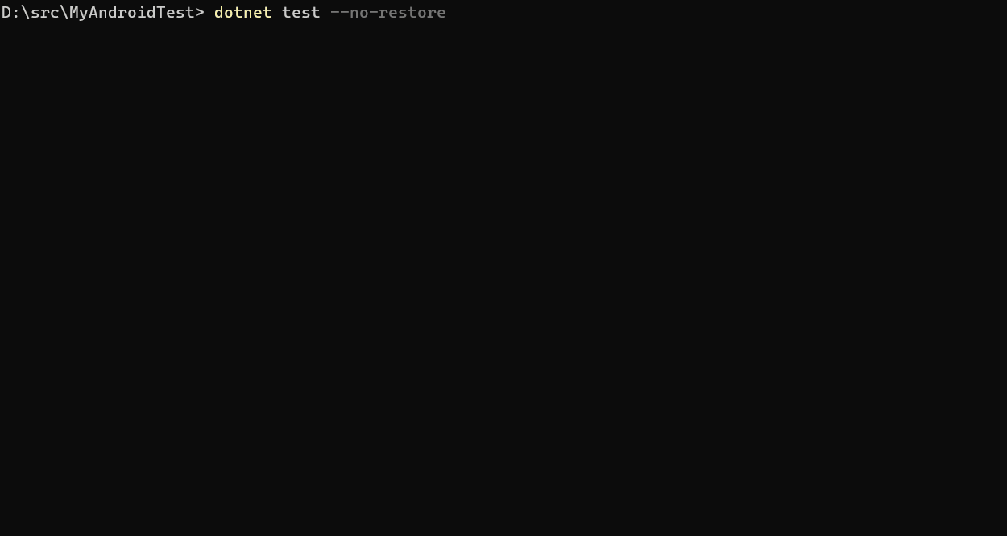
dotnet test
The same test workflow, now on devices and simulators
# New MSTest templates per platform
dotnet new androidtest -n MyTests
# also: iostest, macostest, maccatalysttest
cd MyTests
dotnet test
# Tests run in an app process on the device,
# emulator or simulator you pick
# Run-level controls
dotnet test --timeout 90s

Slide 33
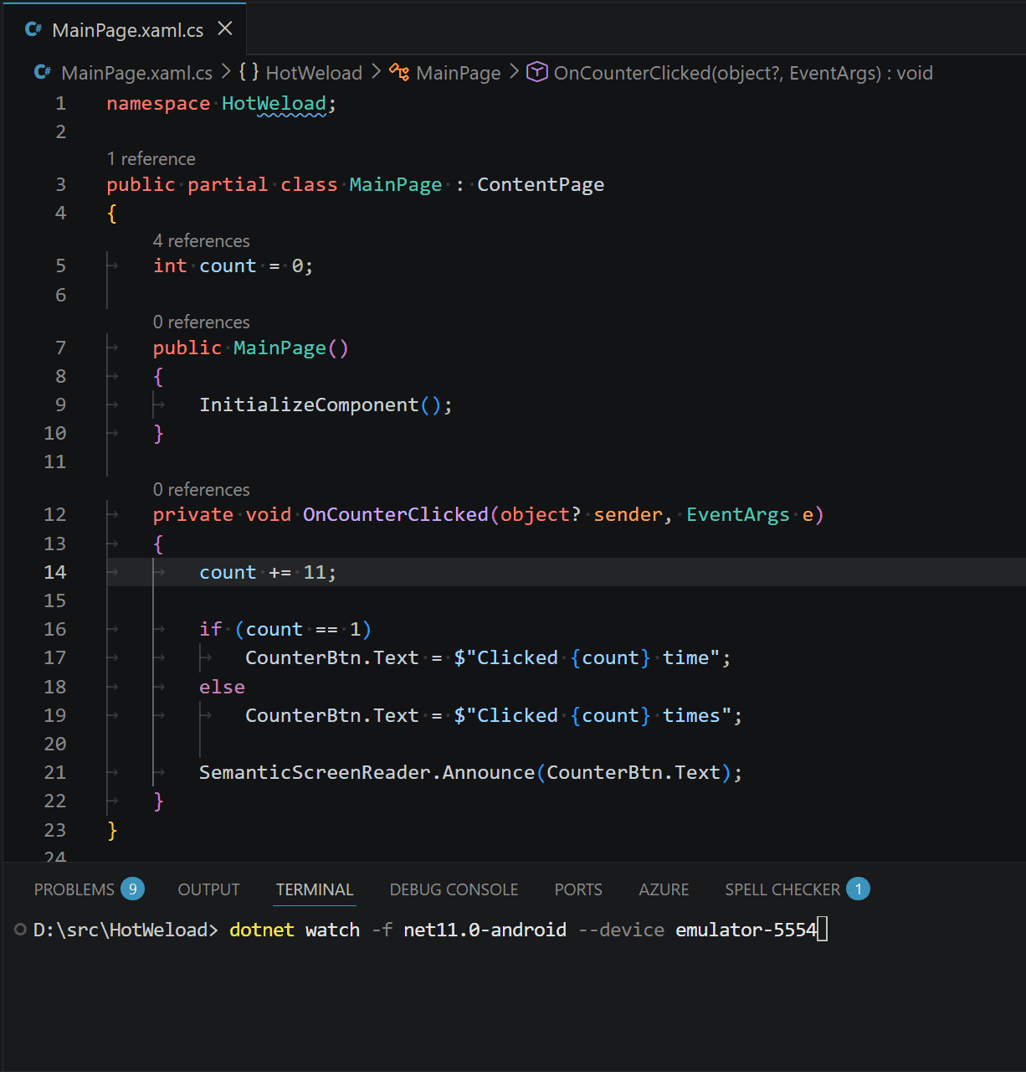
dotnet watch
Hot Reload from the terminal, now on Android and iOS
# Start the app with Hot Reload
dotnet watch
# same prompts as dotnet run
# Edit C# or XAML and save:
# changes apply to the running app
# Change Hot Reload can't apply?
# press Ctrl+R to restart the app
# Go straight to a platform
dotnet watch -f net11.0-ios

Slide 34
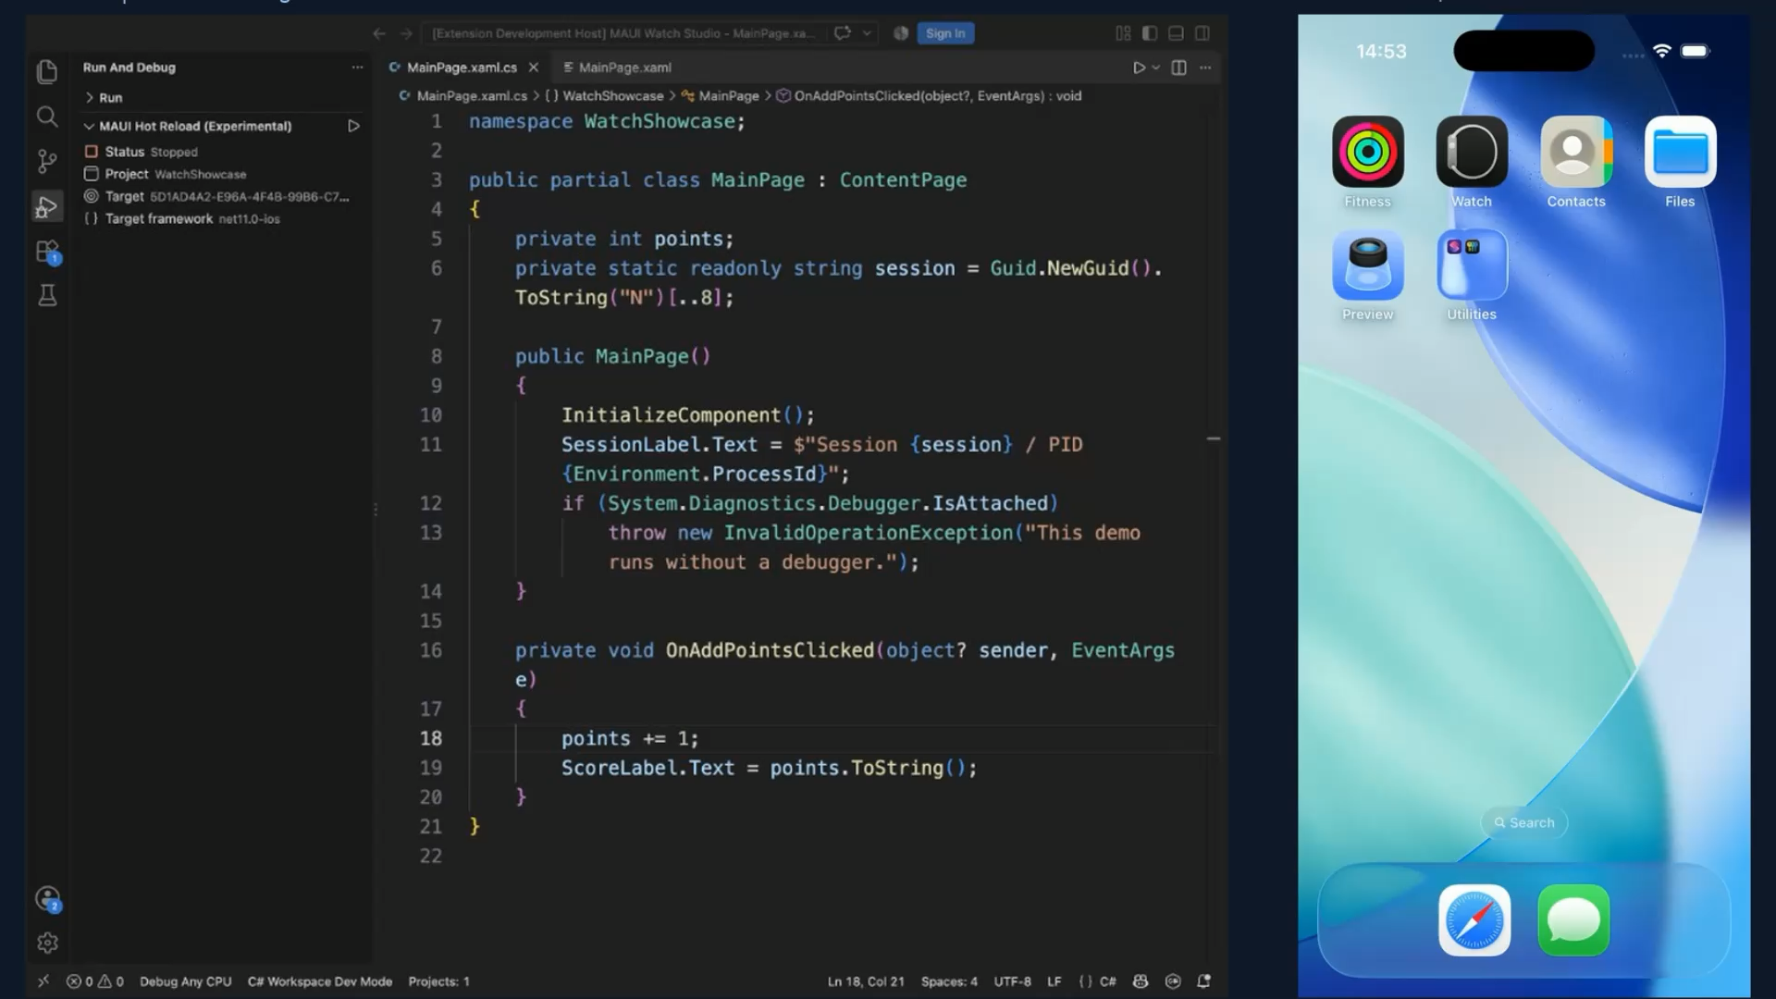
XAML Incremental Hot Reload
Edit XAML, keep your place in the app
# On by default in Debug
# Patches live pages:
# properties, bindings
# resources
# add, remove, reorder
# CollectionView keeps
# selection and scroll
# Visual Studio and
# dotnet watch
dotnet watch

Slide 35
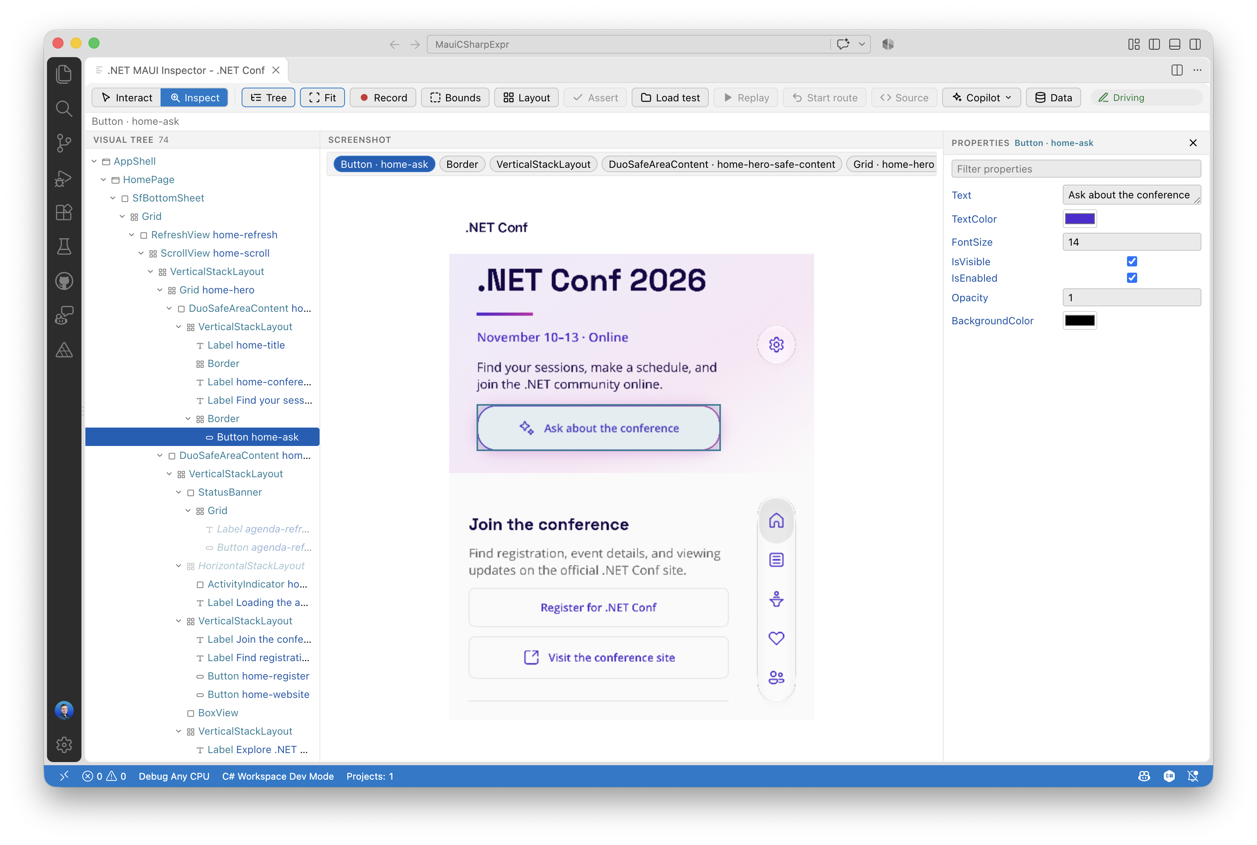
.NET MAUI Inspector
See inside your running app, and drive it
WHAT IT DOES
Live visual tree, properties and screenshot
Record, replay and assert UI flows
Copilot drives the same session through MCP tools
WHERE IT RUNS
VS Code
GitHub Copilot app
Copilot CLI
Any browser
Part of MAUI Labs: github.com/dotnet/maui-labs

Slide 36
MAUI Labs & AI
05

Slide 37
Experiments to try in .NET MAUI Labs
MAUI CLI
Setup, SDKs and emulators
DevFlow
Inspect, automate and debug running apps
Essentials.AI
On-device chat and embeddings
AI Extensions
Turn methods into AI tools
Agent skills
maui ai init sets up skills and MCP
Comet & Go
MVU UI in C# and single-file prototypes
10+
experimental projects
and more in the repo
Explore it all at github.com/dotnet/maui-labs
Linux backend
MAUI apps on Linux via GTK
WPF backend
22+ controls, Shell and Blazor on WPF
MAUI Testing
dotnet new mauitest for device tests
AppProjectRef
Consume .apk, .ipa and .msix in MSBuild

Slide 38
Four Labs tools worth trying first
MAUI CLI
One tool for setup and devices
maui doctor finds and fixes environment issues
Installs Android SDK, JDK and emulators
Manages Xcode, simulators and runtimes
--json output for CI pipelines
DevFlow
See and drive your running app
Visual tree, taps and screenshots via an in-app agent
Network monitoring and profiling
Blazor WebViews over Chrome DevTools
MCP server lets AI agents test your app
Essentials.AI
AI that runs on the device
Chat and embeddings through Microsoft.Extensions.AI
Apple Intelligence and NaturalLanguage underneath
Streaming, structured output and tool calling
Image input on supported systems
Agent skills
Set up your AI agent in one step
Installs MAUI and DevFlow skills
Adds Copilot agents and MCP config
Targets VS Code, Copilot CLI and Claude
--dry-run previews every change
maui doctor
maui devflow mcp
Microsoft.Extensions.AI
maui ai init

Slide 39
MAUI CLI
# Install (pre-release)
dotnet tool install -g Microsoft.Maui.Cli --prerelease
# Diagnose and auto-fix your environment
maui doctor
# Android SDK, JDK and emulators
maui android
maui android emulator
# Xcode, simulators and runtimes (macOS)
maui apple
# Every connected device, every platform
maui device list
# Machine-readable output for CI
maui doctor --json --ci
maui doctor checks your whole setup and fixes what it can.
Android SDKs, JDKs, emulators, Xcode and simulators are managed from one place.
--json and --ci make the same commands work in pipelines.

Slide 40
DevFlow
# 1. Add the in-app agent to your app
dotnet add package Microsoft.Maui.DevFlow.Agent
# 2. Inspect, tap, screenshot and profile
# the running app from your terminal
maui devflow
# 3. Hand the same tools to your AI agent
maui devflow mcp
# Or register the MCP server for Claude
maui ai add mcp maui-devflow --env Claude --yes
# Plain .NET Android and iOS apps, too
dotnet add package Microsoft.Maui.DevFlow.Agent.Native
An in-app agent exposes the visual tree, taps and screenshots of your running app.
Network, profiling, logs and sensors stream live, including Blazor WebViews.
The MCP server lets an AI agent test and debug the app for you.

Slide 41
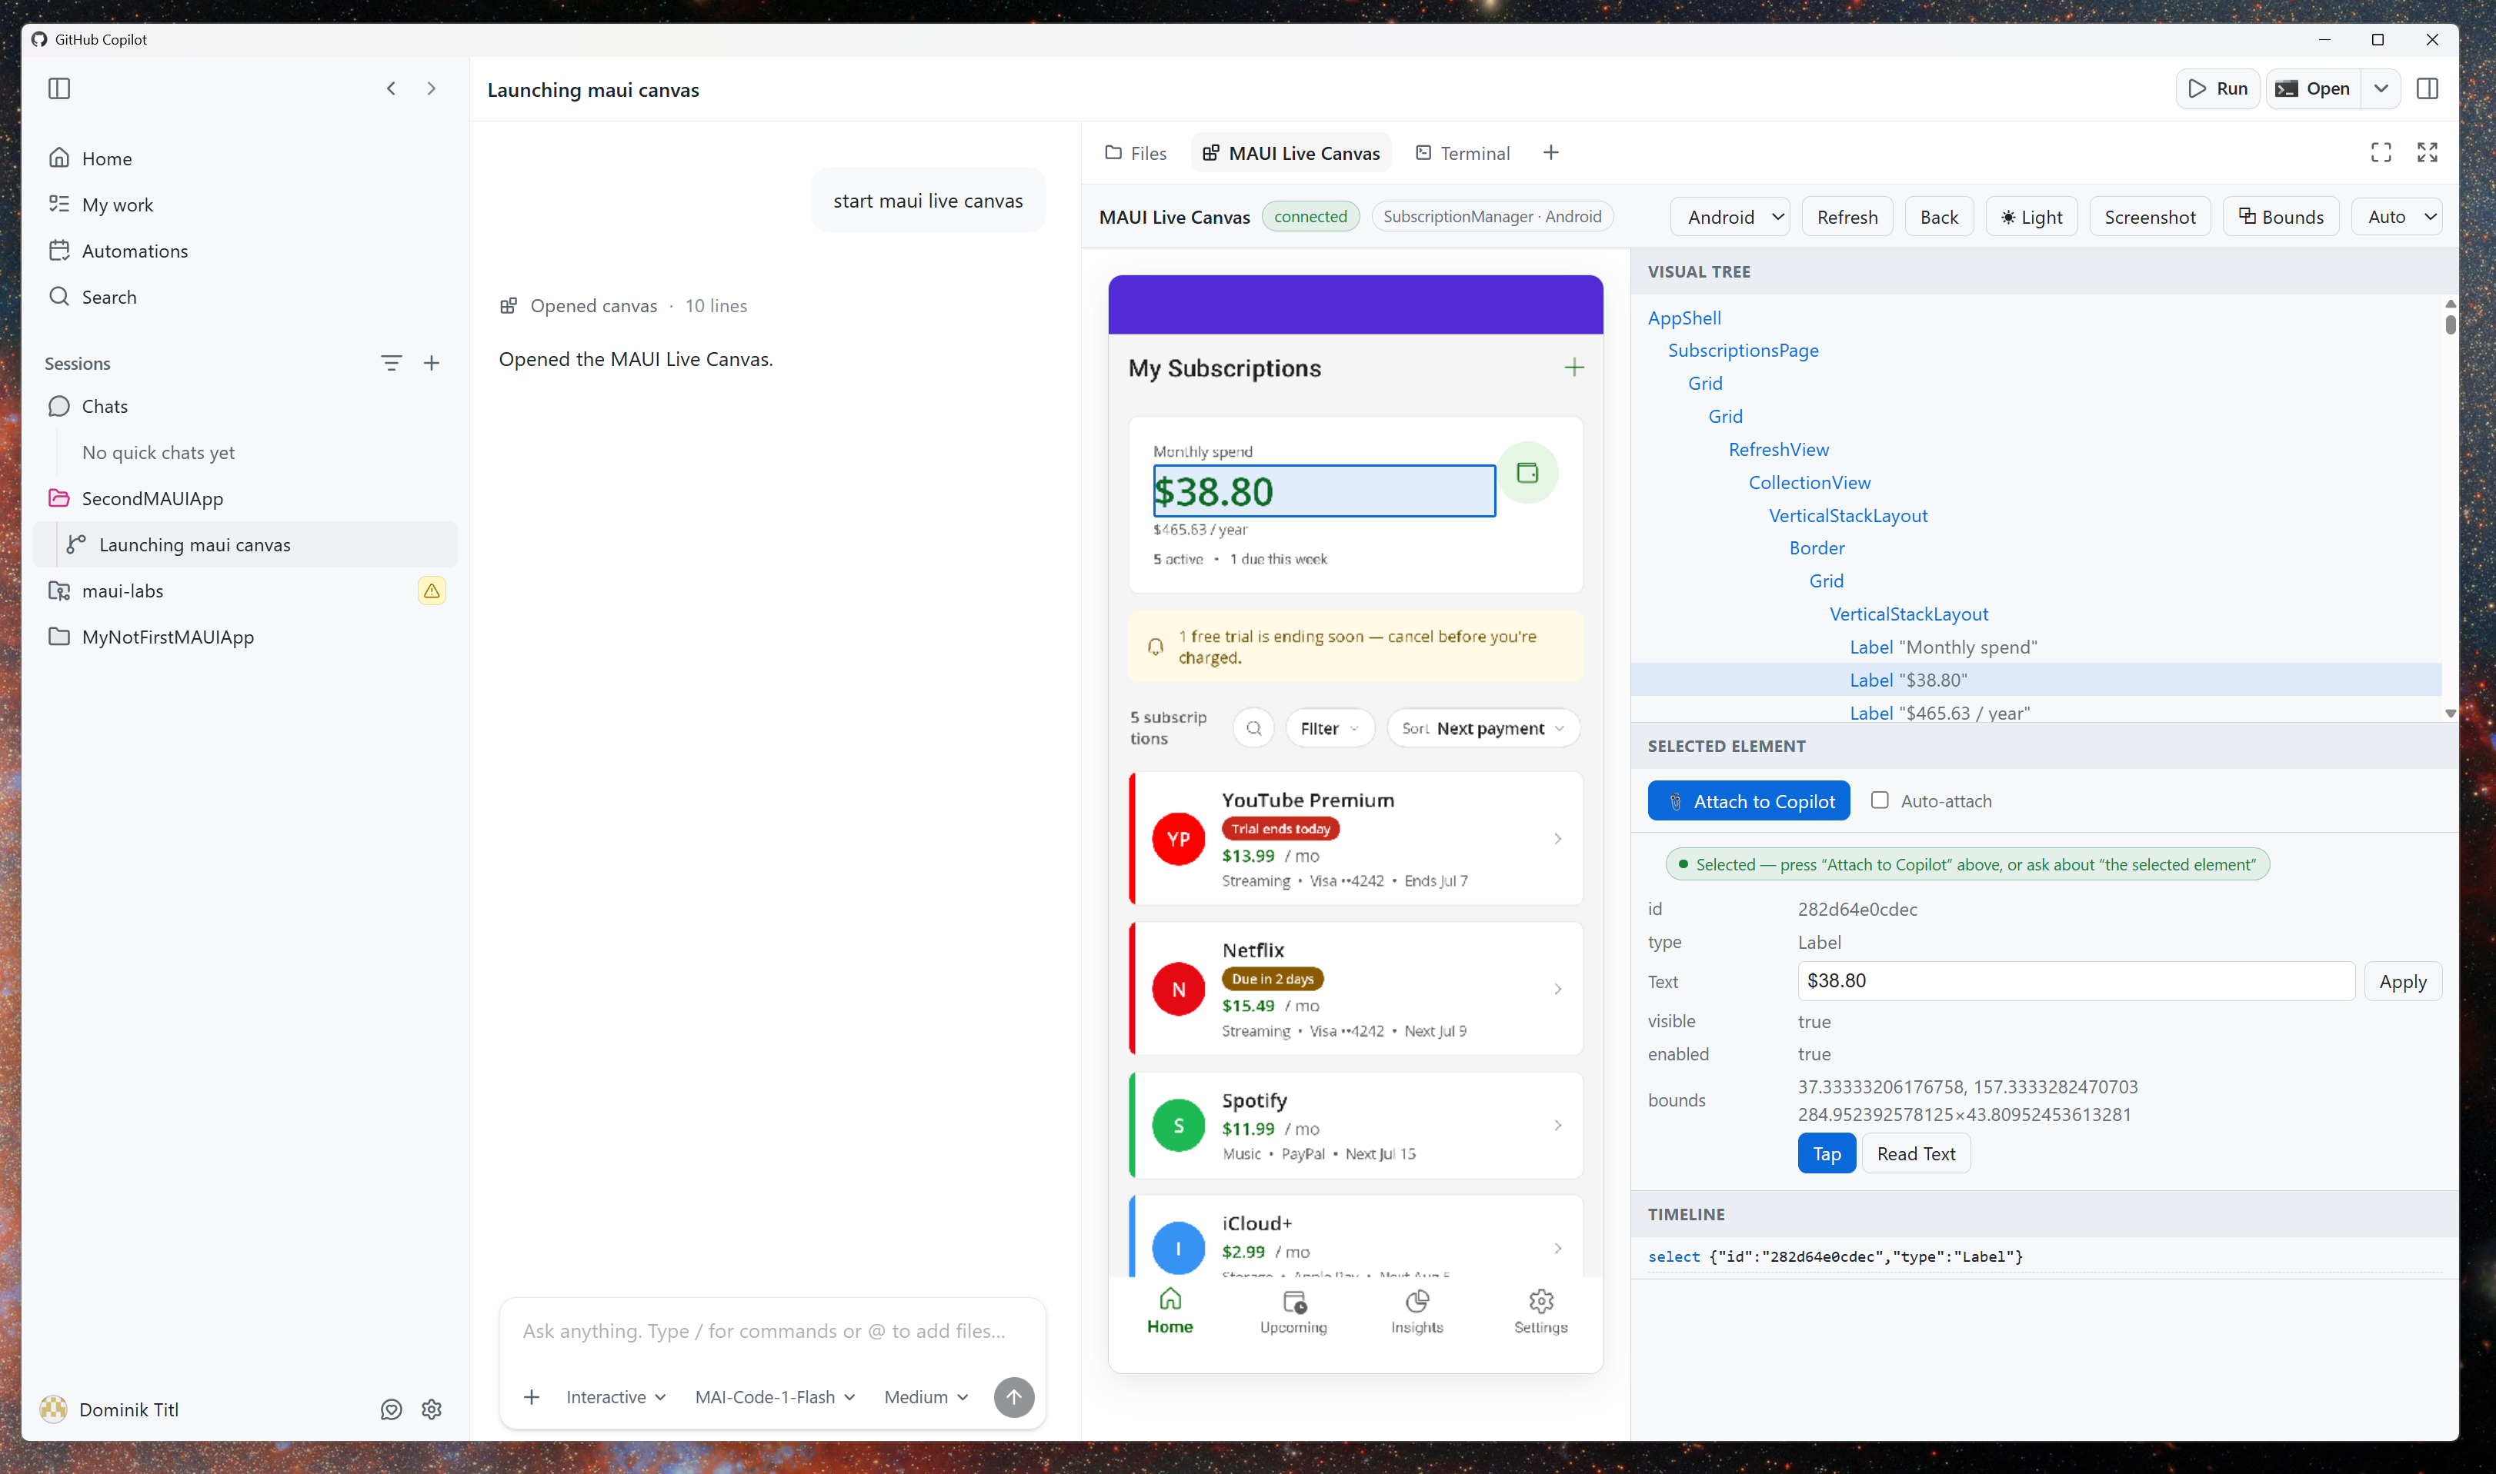
DevFlow Inspector
Pick an element in your app, hand it to Copilot

Slide 42
Essentials.AI
using Microsoft.Extensions.AI;
using Microsoft.Maui.Essentials.AI;
// On-device model: no key, no network
IChatClient chat = new AppleIntelligenceChatClient();
await foreach (var update in
chat.GetStreamingResponseAsync("Summarize my notes"))
{
Summary.Text += update.Text;
}
// Embeddings with Apple NaturalLanguage
var embedder = new NLEmbeddingGenerator();
The same IChatClient you use for cloud models, running on the device.
Apple Intelligence and NaturalLanguage do the work: no API key, no network.
Streaming, structured output, tool calling and image input are supported.

Slide 43
Agent skills
# Preview what would be installed
maui ai init --env VsCode --dry-run
# Set up this project for AI-assisted MAUI
maui ai init --env VsCode --yes
# See what's available and what's installed
maui ai list
maui ai status
# Refresh the skills you already have
maui ai update
# Or add one skill at a time
maui ai add skill maui-devflow-debug --env Claude --yes
maui ai init installs MAUI skills, DevFlow skills, Copilot agents and MCP config.
It detects your agent: VS Code, Copilot CLI or Claude.
--dry-run shows every change before anything is written.

Slide 44
Our vision for
.NET 12

Slide 45
Each .NET MAUI version is patched for 18 months
Release schedule, support and patching
2025
2026
2027
2028
.NET MAUI 9
Nov 2024
+6 mo
Ended May 2026
.NET MAUI 10
Nov 2025
+6 mo
May 2027
.NET MAUI 11
Nov 2026
+6 mo
May 2028*
Xcode
16
26
27
iOS 18
iOS 26
iOS 27
Android API
35
36
37
Android 15
Android 16
Android 17
aka.ms/maui-support-policy
Support ends 6 months after the next major version ships. *.NET MAUI 11 end of support assumes .NET 12 ships November 2027.

Slide 46
Go deeper with .NET MAUI
Native apps for every platform, from mobile to Windows.
TUESDAY, NOVEMBER 10
WEDNESDAY, NOVEMBER 11
BRK016
Bringing dotnet run, test, and watch to .NET MAUI
Jonathan Peppers
Tuesday • 4:30 PM PST
BRK022
Building great Windows apps with WinUI and agents
Morten Nielsen
Wednesday • 11:30 AM PST
PRERECORDED
BRK024
CsWinRT 3.0: Modernizing the Windows Projections for .NET
Manodasan Wignarajah
Wednesday • 12:30 PM PST
BRK033
Less Chat More Action: AI-Powered .NET MAUI Apps
Gerald Versluis
Prerecorded
BRK026
Beyond Code Generation: Give AI Eyes and Hands for .NET MAUI
Gerald Versluis
Wednesday • 1:30 PM PST
BRK034
How We Brought CoreCLR to .NET MAUI and Mobile
Jonathan Peppers
Prerecorded
BRK027
No XAML Required: Native Windows Apps in Pure C#
Alexandre Zollinger Chohfi
Wednesday • 2:00 PM PST

Slide 47
Download
.NET 11
get.dot.net

Slide 48
Thank you

Slide 49
Section title
01

Slide 50
Title
Subtitle
Keep each slide to one key idea
Use short phrases rather than full sentences
Keep text readable from the back of the room

Slide 51
Title
Subtitle
Item 1
Item 2
Subtitle
Subtitle
Description
Description

Slide 52
Code sample
// Minimal API with .NET
var builder = WebApplication.CreateBuilder(args);
var app = builder.Build();
app.MapGet("/launch", () => new { Mission = ".NET Conf 2026", Status = "Go" });
app.Run();

Slide 53
Pattern matching
// Records + pattern matching
public record Launch(string Name, int Fuel);
string Status(Launch l) => l switch
{
{ Fuel: >= 90 } => "Go for launch",
{ Fuel: >= 50 } => "Hold",
_ => "Scrub"
};
Records give you concise, immutable data types.
Switch expressions and property patterns turn branching logic into a readable table of rules.

Slide 54
Make awesome apps
// Compose a distributed app with .NET Aspire
var builder = DistributedApplication.CreateBuilder(args);
var api = builder.AddProject<Projects.Api>("api");
builder.AddProject<Projects.Web>("web")
.WithReference(api);
builder.Build().Run();

Slide 55
Demo title

Slide 56
A large statement looks great with 10 words or less

Slide 57
The Microsoft technology made it easy for us. It just works. We saved months of development time in the process.
Name and Last Name
System Administrator

Slide 58
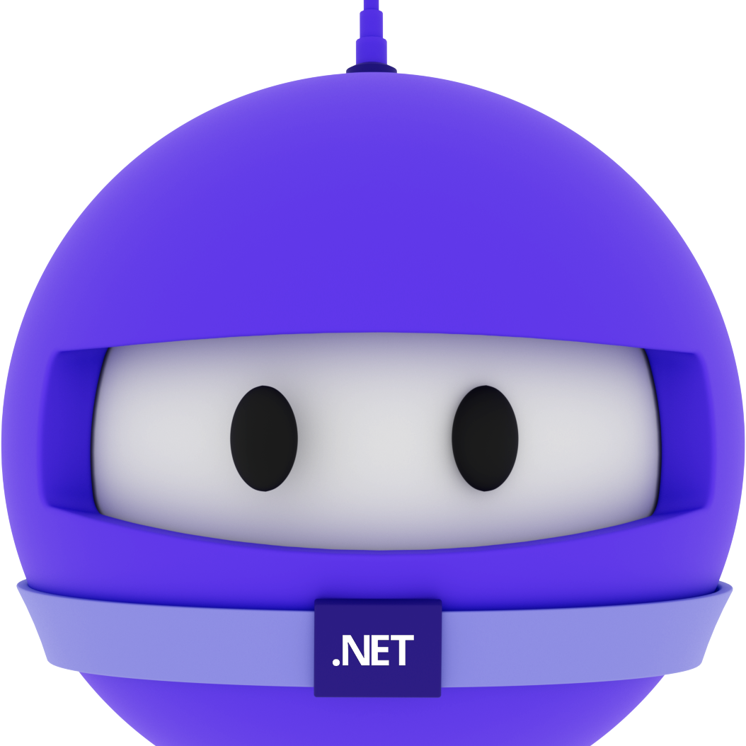
Speaker name
Title

Slide 59
Thank you

Slide 60
Color guidance
Dark or gradient backgrounds. Bright colors are for accents and large text only.
Core colors
Purple
#512BD4
Blue
#0B6CFF
Magenta
#D600AA
Teal
#28C2D1
Coral
#F65163
Gold
#F7B548
Primary brand color
White text OK
Tech, links, data
White text OK
Highlights, energy
White text OK
Data, success
Use dark text
Alerts, contrast
Use dark text
Callouts, sparingly
Use dark text
Text on dark backgrounds
Gradients
Body text and titles #FFFFFF
Space
#120838 > #2E1A9E > #3B5BEA
Blue-purple
#3A12B8 > #4A2BE0 > #2F6BFF
Emphasis #B9AAEE
De-emphasis, captions #A6A6A6
Magenta
#6A0FB8 > #B01ACB > #D600AA
Brand border
#D600AA > #512BD4
Body 18pt minimum, captions 16pt. White on blue gradients: large text only.

Slide 61
Title – 72pt
Space Grotesk + Open Sans
Title – 48pt
Title – 36pt
Font guidance
Headings: Space Grotesk Body: Open Sans Code: Cascadia Code
Install Space Grotesk (free from Google Fonts). Use the individual weight files, not the variable font.
Embed fonts when saving: File > Options > Save > Embed fonts, with all characters. Adds only a few hundred KB.
No Space Grotesk? Use Aptos Display for headings. It works on Windows and Mac.
Leave room in big headings, since a substituted font can wrap differently.
Title – 28pt
Text – 24pt
Text – 20pt
Text – 18pt minimum · 16pt for captions only

Slide 62
Your icon library
You can recolor these icons to match your theme.
Avoid using the icons too large.
Get more icons

Slide 63
Your icon library
You can recolor these icons to match your theme.
Avoid using the icons too large.
Get more icons

Slide 64
Make awesome apps

Slide 65
Announcing
.NET 11

Slide 66
Welcome to
.NET Conf

Slide 67
A platform
for your apps

Slide 68
Our vision for
.NET 11

