Slide 1
Less Chat, More Action
AI-Powered .NET MAUI Apps
Gerald Versluis
Software Engineer, Microsoft

Slide 2
Your users don't want another chatbot. They want the app to act.

Slide 3
The phone already has the context AI needs.
Camera
Microphone
Location
Calendar
Health
What you see, what you say, where you are and what's next

Slide 4
Find it, do it, take me there
The user brings the intent; the app does the work
Find
“Blazor talks on Thursday.”
Sessions opens, already filtered
Act
“Save all the Aspire sessions.”
Every heart fills in, My Schedule opens
Take me there
“Who’s giving the Blazor talk?”
The speaker page opens
find_sessions
save_sessions
open_speaker

Slide 5
Live demo
Plan my
conference

Slide 6
The building blocks
01

Slide 7
One API, any model
using Microsoft.Extensions.AI;
// Your code only ever sees IChatClient
public class SessionAssistant(IChatClient chat)
{
public async Task<string> AskAsync(string q)
{
var response = await chat.GetResponseAsync(q);
return response.Text;
}
}
// Add capabilities as middleware
var client = innerClient.AsBuilder()
.UseFunctionInvocation()
.UseOpenTelemetry()
.Build();
One IChatClient for cloud, local and on-device models.
Your view models depend on the interface, never on a provider.
Tool calling and telemetry plug in as middleware.

Slide 8
Three packages, one stack
Each layer can be swapped on its own
Your app
Pages, view models and services you already have
AI attributes
[ExportAIFunction] exposes app actions as tools
Microsoft.Extensions.AI
IChatClient, tool calling, telemetry
Essentials.AI
Cloud providers
On-device: Apple, Gemini Nano, Windows AI
Microsoft Foundry, OpenAI and more

Slide 9
Essentials.AI
02

Slide 10
Essentials, but for AI
What we did for sensors, now for models
2018
Xamarin.Essentials
One cross-platform API for device features: geolocation, battery, preferences, secure storage and more.
2022
Part of .NET MAUI
Essentials moved into .NET MAUI itself. No extra package, the same APIs on every platform.
Now
Essentials.AI
One API for the model already on the device: Apple Intelligence, Gemini Nano and Windows AI, behind IChatClient.

Slide 11
Get started
// 1. Add the package, opt in to preview
// dotnet add package
// Microsoft.Maui.Essentials.AI --prerelease
// <NoWarn>$(NoWarn);MAUIAI0001</NoWarn>
// 2. MauiProgram.cs: one #if, in one place
#if IOS || MACCATALYST
builder.Services.AddSingleton<IChatClient>(
new AppleIntelligenceChatClient());
#elif ANDROID
builder.Services.AddSingleton<IChatClient>(
new GeminiNanoChatClient());
#endif
// 3. Before offering AI: is the model ready?
var status = await AppleIntelligenceChatClient
.GetModelStatusAsync(); // or GeminiNano...
ShowAsk = status.Availability is
ChatModelAvailability.Available;
One package and one registration in MauiProgram.
The rest of your app only sees IChatClient.
Always check the model is ready. Not every device has one.

Slide 12
Bring your own model
Three ways to get a model, one IChatClient
Built into the OS
Apple Intelligence, Gemini Nano, Windows AI
Via Essentials.AI. Nothing to ship with your app, and nothing leaves the device.
Bundled model
Any ONNX model, like Phi or Llama
Via ONNX Runtime GenAI. Still on the device, but you ship or download the model.
In the cloud
Microsoft Foundry, OpenAI and more
The largest models. Needs a network and a backend you control for the key.
new AppleIntelligenceChatClient()
new OnnxRuntimeGenAIChatClient(…)
chatClient.AsIChatClient()
← More private, free per call
More capable →
All three implement IChatClient: swapping is one registration line

Slide 13
On-device or cloud: same code
Pick the trade-off per feature, not per app
On-device
Cloud
Essentials.AI
Microsoft Foundry, OpenAI
Private, offline, no API key and no per-token cost. Smaller model.
Larger models for harder tasks. Needs a network, a key and a budget.

Slide 14
On-device AI on every platform
One IChatClient, three native models
Platform | Chat | Tool calling
iOS, macOS, Mac Catalyst | Apple Intelligence | Yes
Android | Gemini Nano | Nano V4 models
Windows | Windows AI | Not yet
Needs a supported device with the model enabled. Windows: Copilot+ PC and an MSIX-packaged app. Embeddings: Apple only. Apple image input and token usage: OS 27.

Slide 15
AI attributes
03

Slide 16
Methods as tools
// AskTools.cs, from the app
[ExportAIFunction("open_speaker")]
[Description("Open a speaker profile. Use " +
"for 'who is giving' a talk, or opening " +
"a named person. Never invent a name. " +
"Call once.")]
public string OpenSpeaker(
[Description("Talk title/topic if asking " +
"who gives it; empty for a direct " +
"person name")] string query = "",
[Description("Weekday or date copied " +
"from the user, or empty")]
string day = "",
[Description("Person name copied from " +
"the user, or empty if unknown")]
string speaker = "") =>
RequestAction("open_speaker",
query, day, speaker);
[ExportAIFunction] turns a method into a tool.
[Description] is what the model reads: when to use it, and what not to do.
A source generator writes the calling code at compile time: no reflection when the tool runs.

Slide 17
Collect the tools, wire them up
// Collect every tool in AskTools into one context
[AIToolSource(typeof(AskTools))]
public partial class AskToolContext : AIToolContext;
// Offer only the tools this request needs (excerpt)
var functions = AskToolContext.Default.Tools.Cast<AIFunction>()
.Where(f => f.Name == "lookup_sessions" ||
AskRequest.CanOfferAction(request, f.Name switch {
"find_sessions" => AskAction.FindSessions,
"request_removal" => AskAction.RemoveSessions,
/* ...3 more mappings */ }));
using var client = chatClient.AsBuilder()
.UseFunctionInvocation(configure: invocation => {
invocation.AllowConcurrentInvocation = false;
invocation.MaximumIterationsPerRequest = 8; })
.Build(scope.ServiceProvider);

Slide 18
The app acts
// AskTools.cs (excerpt)
public string RequestAction(string action,
string query = "", string day = "",
string speaker = "")
{
var kind = action switch { /* ... */ };
// Search terms must appear in the request
var intent = AskRequest.Ground(GetDocument(),
request, new(kind, query, day, speaker));
AskRequest.ValidateIntent(GetDocument(),
request, intent);
// Resolve against the agenda the screens show
var next = AskRequest.Resolve(GetDocument(),
intent, zone, savedIds);
// ... conflicting-action checks omitted
Pending = next;
return "Action staged ... The application " +
"handles choices and confirmation.";
}
Every tool stages an action; it doesn't touch the UI itself.
The app then runs it through the same view models and services the screens use.
So the heart fills in and the page opens, exactly as if you tapped.

Slide 19
Live demo
Ask, and
it acts

Slide 20
Users in control
04

Slide 21
Propose, then confirm
[ExportAIFunction("request_removal",
ApprovalRequired = true)]
[Description("Request removal of saved sessions. " +
"The app must display an exact preview for " +
"user approval. Never confirm on behalf of " +
"the user.")]
public string RequestRemoval(string query = "",
string day = "", string speaker = "") => ...
// OnDeviceAsk.cs: the call comes back for approval
var approvals = response.Messages
.SelectMany(m => m.Contents)
.OfType<ToolApprovalRequestContent>().ToArray();
if (approvals.Length != 1 || approvals[0].ToolCall
is not FunctionCallContent call) throw ...;
tools.ReadRemovalPreview(call); // preview only
ApprovalRequired = true: the model can ask, never execute.
The app shows exactly what will be removed.
Confirming runs plain C#, with no further model turn.

Slide 22
Where to draw the line
Four rules for an assistant that acts
Validate every request
Treat tool arguments like user input: check IDs, ranges and permissions
Confirm destructive actions
ApprovalRequired on delete, pay, send and anything hard to undo
Say what you can't do
Return a clear message from the tool so the model doesn't guess
Expose only what's needed
Curate tools per feature with a tool context

Slide 23
Semantic search
// Example, not from the demo app (Apple only)
// Built-in English sentence embeddings
using var embedder = new NLEmbeddingGenerator();
// Index the session descriptions once
var vectors = await embedder.GenerateAsync(
sessions.Select(s => s.Description));
// Search by meaning, not keywords
var q = await embedder.GenerateVectorAsync(
"talks about AI on phones");
var best = sessions.Zip(vectors).MaxBy(p =>
TensorPrimitives.CosineSimilarity(
q.Span, p.Second.Vector.Span));
A built-in model turns text into vectors, on the device.
Similar meaning, nearby vectors, even without shared words.
Index once; each search compares vectors in memory.

Slide 24
Ideas we haven't built yet
Same pattern, very different experiences
Find any setting
“Where do I switch to dark mode?”
AI wayfinding (draft PR #495)
Snap a slide, find it
A photo from a watch party
On-device image input (OS 27, Android)
Settle a clash
“These two overlap. Which one live?”
Overlap check as a tool
Build a learning path
“New to Aspire. Where do I start?”
Topic tools, ordered by level
Brief me first
“What should I know before this talk?”
A summary of the abstract
Read it in my language
Abstracts and bios, translated
On-device, where the model supports it

Slide 25
What if the UI follows you?
Today the app knows what you want and opens the right screen. Next, it could build the screen you need: your view, for your intent.
First steps in maui-labs: AI wayfinding (draft PR #495)

Slide 26
Recap
An assistant that does more than talk
Microsoft.Extensions.AI: one IChatClient for every model
Essentials.AI: private, offline AI on the device
AI attributes: app actions become tools with one attribute
Propose, then confirm: keep users in control

Slide 27
Try it today
Experimental packages: APIs may change
Packages: Microsoft.Maui.Essentials.AI, Microsoft.Maui.AI.Attributes
Labs repo: github.com/dotnet/maui-labs
Demo app: github.com/jfversluis/dotnetconf-app
Garden sample: AIExtensions.Sample.Garden in the Labs repo
BaristaNotes: github.com/davidortinau/BaristaNotes
Docs: learn.microsoft.com/dotnet/maui/ai

Slide 28
Thank you

Slide 29
PowerPoint best practices
One idea per slide
Show, don’t tell
Speak to your slides
Minimal text, short phrases.
Use visuals, charts, and code instead of paragraphs.
Slides support your talk; they aren’t a script.
Stay consistent
Leave white space
Readable text
Use the template’s layouts, fonts, and colors.
Align content and keep generous white space.
Sentence case, 18pt minimum.
Find more in Resources
Color guidance, type sizes, icons, and optional title and section layouts are at the end of this deck.

Slide 30
Section title
01

Slide 31
Title
Subtitle
Keep each slide to one key idea
Use short phrases rather than full sentences
Keep text readable from the back of the room

Slide 32
Title
Subtitle
Item 1
Item 2
Subtitle
Subtitle
Description
Description

Slide 33
Code sample
// Minimal API with .NET
var builder = WebApplication.CreateBuilder(args);
var app = builder.Build();
app.MapGet("/launch", () => new { Mission = ".NET Conf 2026", Status = "Go" });
app.Run();

Slide 34
Pattern matching
// Records + pattern matching
public record Launch(string Name, int Fuel);
string Status(Launch l) => l switch
{
{ Fuel: >= 90 } => "Go for launch",
{ Fuel: >= 50 } => "Hold",
_ => "Scrub"
};
Records give you concise, immutable data types.
Switch expressions and property patterns turn branching logic into a readable table of rules.

Slide 35
Make awesome apps
// Compose a distributed app with .NET Aspire
var builder = DistributedApplication.CreateBuilder(args);
var api = builder.AddProject<Projects.Api>("api");
builder.AddProject<Projects.Web>("web")
.WithReference(api);
builder.Build().Run();

Slide 36
Demo title

Slide 37
A large statement looks great with 10 words or less

Slide 38
The Microsoft technology made it easy for us. It just works. We saved months of development time in the process.
Name and Last Name
System Administrator

Slide 39
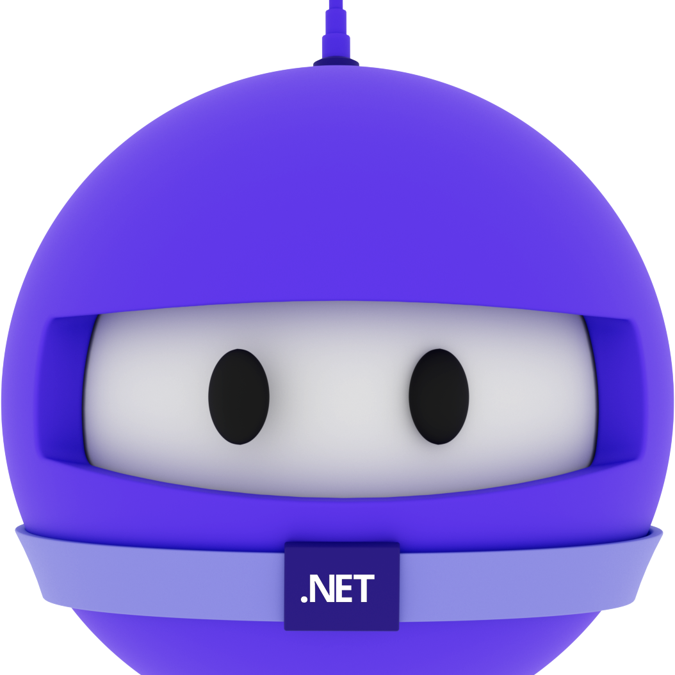
Speaker name
Title

Slide 40
Thank you

Slide 41
Color guidance
Dark or gradient backgrounds. Bright colors are for accents and large text only.
Core colors
Purple
#512BD4
Blue
#0B6CFF
Magenta
#D600AA
Teal
#28C2D1
Coral
#F65163
Gold
#F7B548
Primary brand color
White text OK
Tech, links, data
White text OK
Highlights, energy
White text OK
Data, success
Use dark text
Alerts, contrast
Use dark text
Callouts, sparingly
Use dark text
Text on dark backgrounds
Gradients
Body text and titles #FFFFFF
Space
#120838 > #2E1A9E > #3B5BEA
Blue-purple
#3A12B8 > #4A2BE0 > #2F6BFF
Emphasis #B9AAEE
De-emphasis, captions #A6A6A6
Magenta
#6A0FB8 > #B01ACB > #D600AA
Brand border
#D600AA > #512BD4
Body 18pt minimum, captions 16pt. White on blue gradients: large text only.

Slide 42
Title – 72pt
Space Grotesk + Open Sans
Title – 48pt
Title – 36pt
Font guidance
Headings: Space Grotesk Body: Open Sans Code: Cascadia Code
Install Space Grotesk (free from Google Fonts). Use the individual weight files, not the variable font.
Embed fonts when saving: File > Options > Save > Embed fonts, with all characters. Adds only a few hundred KB.
No Space Grotesk? Use Aptos Display for headings. It works on Windows and Mac.
Leave room in big headings, since a substituted font can wrap differently.
Title – 28pt
Text – 24pt
Text – 20pt
Text – 18pt minimum · 16pt for captions only

Slide 43
Your icon library
You can recolor these icons to match your theme.
Avoid using the icons too large.
Get more icons

Slide 44
Your icon library
You can recolor these icons to match your theme.
Avoid using the icons too large.
Get more icons

Slide 45
Make awesome apps

Slide 46
Announcing
.NET 11

Slide 47
Welcome to
.NET Conf

Slide 48
A platform
for your apps

Slide 49
Our vision for
.NET 11

