Slide 1
No XAML required
Native Windows apps
in pure C#
Alexandre Zollinger Chohfi
Windows Team, Microsoft

Slide 2
What if a whole Windows app was one C# file?

Slide 3
Microsoft.UI.Reactor
An experimental C# framework for WinUI
MVU for WinUI
Model-View-Update: your UI is a function of your state. The counterpart to MVVM, on the same platform.
Real WinUI controls
No new renderer, no fork. Button is a real WinUI Button, with the same theming and tools.
An open experiment
MIT and built in the open. No API guarantees yet, so your feedback still changes the design.

Slide 4
counter.cs: the whole app
#:package Microsoft.UI.Reactor@0.1.0-preview.17
#:package Microsoft.Windows.SDK.BuildTools.WinApp@0.8.0
#:property OutputType=WinExe
#:property TargetFramework=net10.0-windows10.0.22621.0
#:property UseWinUI=true
using Microsoft.UI.Reactor;
using Microsoft.UI.Reactor.Core;
using static Microsoft.UI.Reactor.Factories;
ReactorApp.Run<MyApp>("Hello Reactor", width: 340, height: 200);
class MyApp : Component
{
public override Element Render()
{
var (count, setCount) = UseState(0);
return VStack(
TitleBar("Hello Reactor"),
VStack(12,
Heading($"Count: {count}"),
HStack(8,
Button("-", () => setCount(count - 1)),
Button("+", () => setCount(count + 1))
.AccentButton()
)
).Padding(24)
).Backdrop(BackdropKind.Mica);
}
}

Slide 5
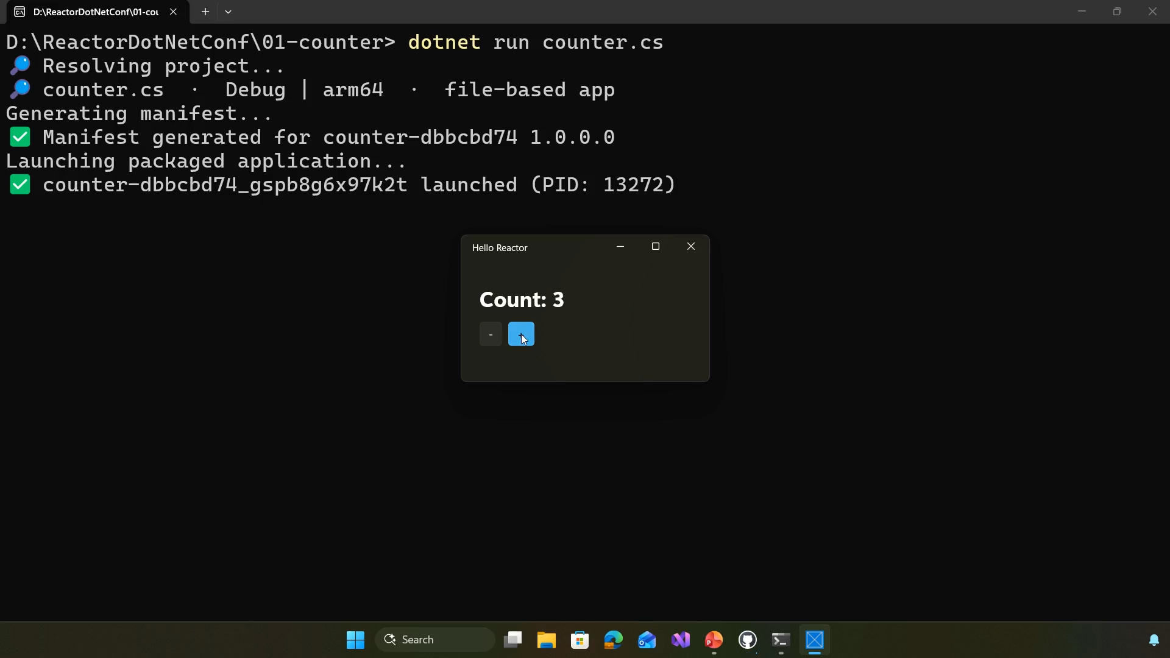
Demo: one file
dotnet run counter.cs
Live demo
01
02
03
Run a single .cs file
A real WinUI window
Count to three
Backup recording: click the video to play

Slide 6
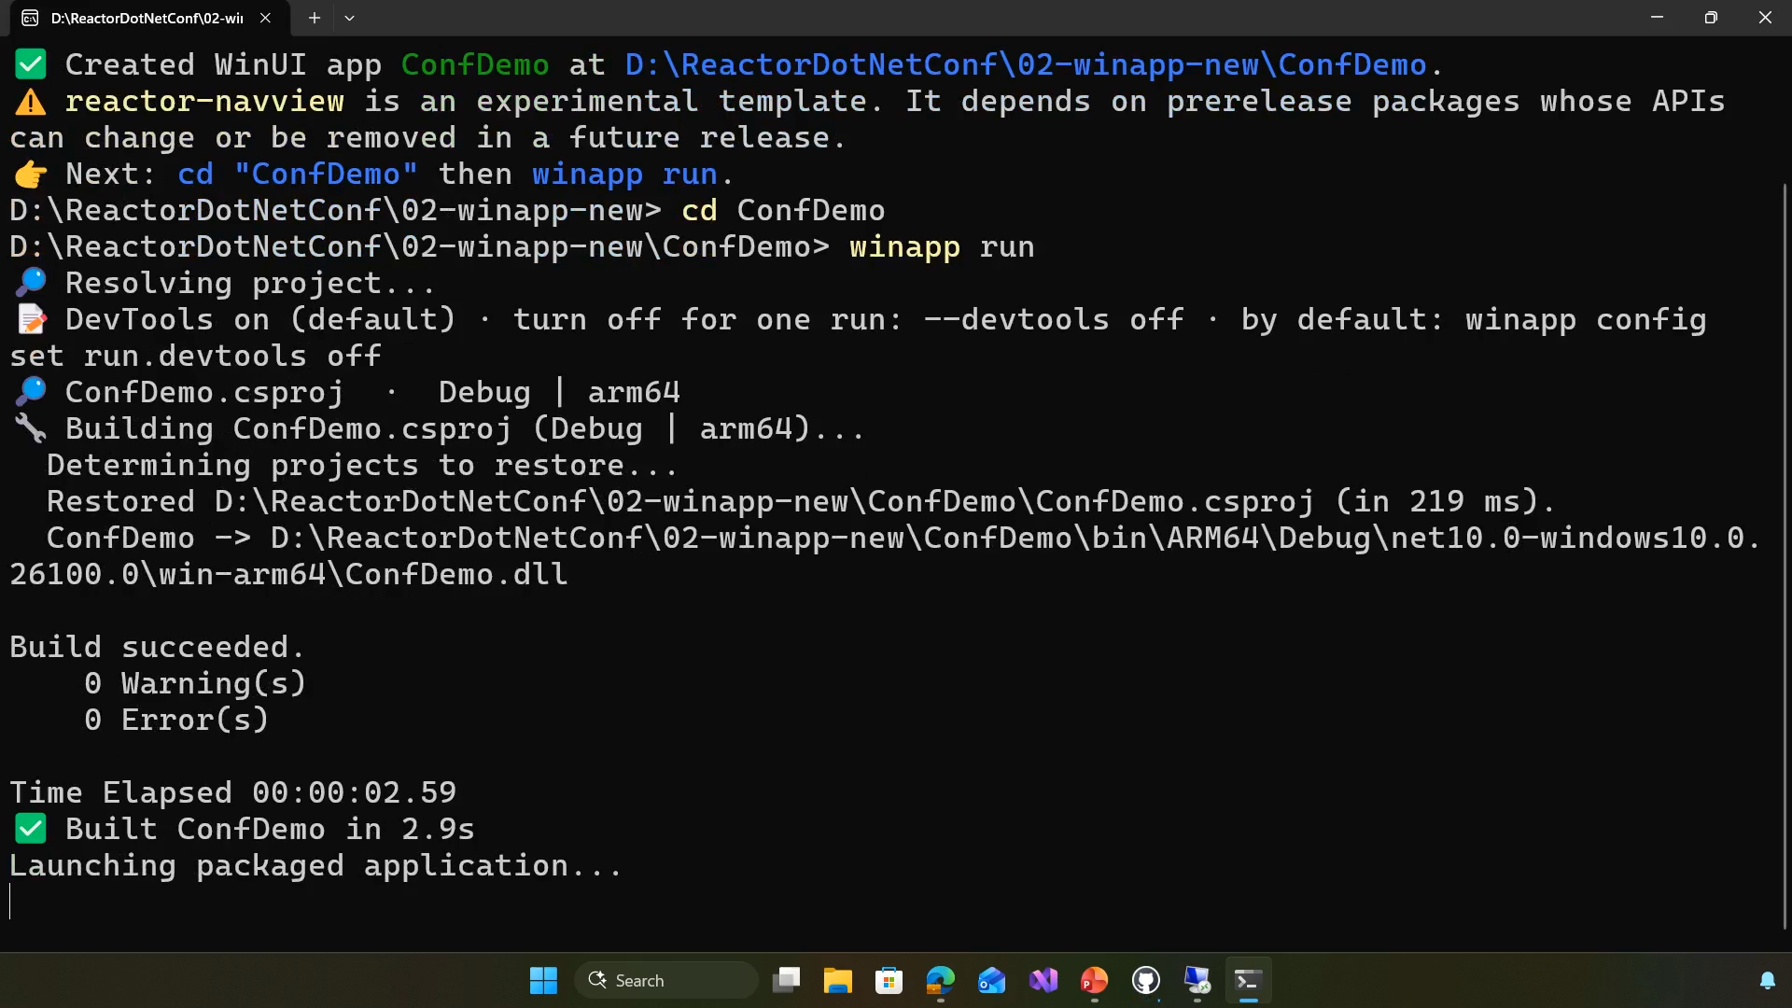
Demo: a real project
winapp new
Live demo
01
02
03
Pick a Windows App SDK template
Scaffold a packaged app
winapp run
Backup recording: click the video to play

Slide 7
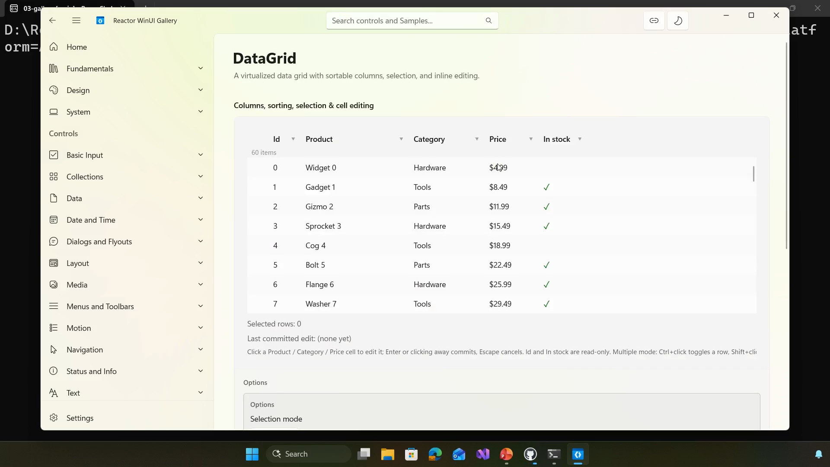
Demo: Reactor Gallery
93 pages, each with its C#
Live demo
01
02
03
Live samples with their C#
DataGrid, docking, navigation
Light and dark themes
Backup recording: click the video to play

Slide 8
State lives in hooks
01

Slide 9
UseState
var (count, setCount) = UseState(0);
// count: a plain int, for this render
// setCount: write the slot, render again
var (name, setName) = UseState("");
return VStack(
TextBox(name, setName,
placeholderText: "Your name"),
Button("Save", () => Save(name))
);
A value for this render. Nothing is watching it.
The setter is the announcement. It writes the slot and schedules a render.
Two-way binding, as a value and a callback.

Slide 10
UseReducer
record Cell(bool IsMine, bool IsRevealed,
bool IsFlagged, int AdjacentMines);
abstract record GameAction;
record Reveal(int X, int Y) : GameAction;
record ToggleFlag(int X, int Y) : GameAction;
record NewGame : GameAction;
var (state, dispatch) =
UseReducer<GameState, GameAction>(
GameReducer.Reduce,
GameState.New(16, 16, 40));
Button(label, () => dispatch(new Reveal(x, y)))
One state record.
Every move in one place. Each one is a record.
A pure function you can unit test, with no window.

Slide 11
The one rule
// No: the slot numbering shifts
if (isLoggedIn)
{
var (name, setName) = UseState("");
}
// Yes: call it every time,
// then branch on the value
var (name, setName) = UseState("");
if (isLoggedIn) { /* use name */ }
Hooks are tracked by call order.
Never call one conditionally: no ifs, loops or early returns.
The analyzer catches it as you type: REACTOR_HOOKS_001.

Slide 12
Lists, keys and analyzers
02

Slide 13
A board of 256 buttons
static Element Board(GameState state, Action<GameAction> dispatch) =>
FlexColumn(
ForEach(Enumerable.Range(0, state.Height), y => // 16 rows
FlexRow(
ForEach(Enumerable.Range(0, state.Width), x => // 16 columns
CellButton(state.Board[x, y], x, y, dispatch)
.WithKey($"{x},{y}")
)
).WithKey($"row-{y}")
)
);
static Element CellButton(Cell cell, int x, int y, Action<GameAction> dispatch) =>
Button(CellLabel(cell), () => dispatch(new Reveal(x, y)))
.Size(32, 32)
.AutomationName($"Row {y + 1}, column {x + 1}")
.OnRightTapped((_, _) => dispatch(new ToggleFlag(x, y)));

Slide 14
Why keys matter
Insert X at the top of A, B, C, D
Without keys matched by position
With keys .WithKey(item.Id)
Before
After
Before
After
A
X
rewritten
A
X
created
B
A
rewritten
B
A
kept
C
B
rewritten
C
B
kept
D
C
rewritten
D
C
kept
D
created
D
kept
4 rewritten, 1 created
1 created, 4 kept

Slide 15
60+ analyzers catch UI bugs as you type
REACTOR_HOOKS_001
A hook called conditionally
REACTOR_DSL_001
A list item missing .WithKey
REACTOR_THEME_001
A hard-coded color, not a theme token
REACTOR_A11Y_001
An icon-only button with no accessible name
REACTOR_DYM_003
Buton(...)? Did you mean Button?
REACTOR_THREAD_001
A UI-thread call from a background thread

Slide 16
Learning in public
03

Slide 17
What real apps taught us
Keys matter more than we said
Early samples looked fine and reconciled badly. Now: a keyed diff, and analyzers.
Allocation, not diffing
The profiler pointed at short-lived garbage from modifier chains, not at the diff.
Lists are the whole ballgame
Virtualized lists recycle their containers instead of rebuilding on scroll.
Docking beat the reconciler
Tear-off panes and layout restore took more design time than diffing.

Slide 18
XAML isn’t going away
<!-- Reactor inside your XAML page -->
<reactor:ReactorHostControl
ComponentType="local:Dashboard" />
XAML is first-class and still getting active investment.
Interop runs both ways, in one process and one visual tree.
Don’t migrate. Pick one small, new screen and add Reactor there.
// XAML inside your Reactor component
return VStack(
XamlPage(typeof(SettingsPage)),
XamlHost(() => new SignaturePad())
);

Slide 19
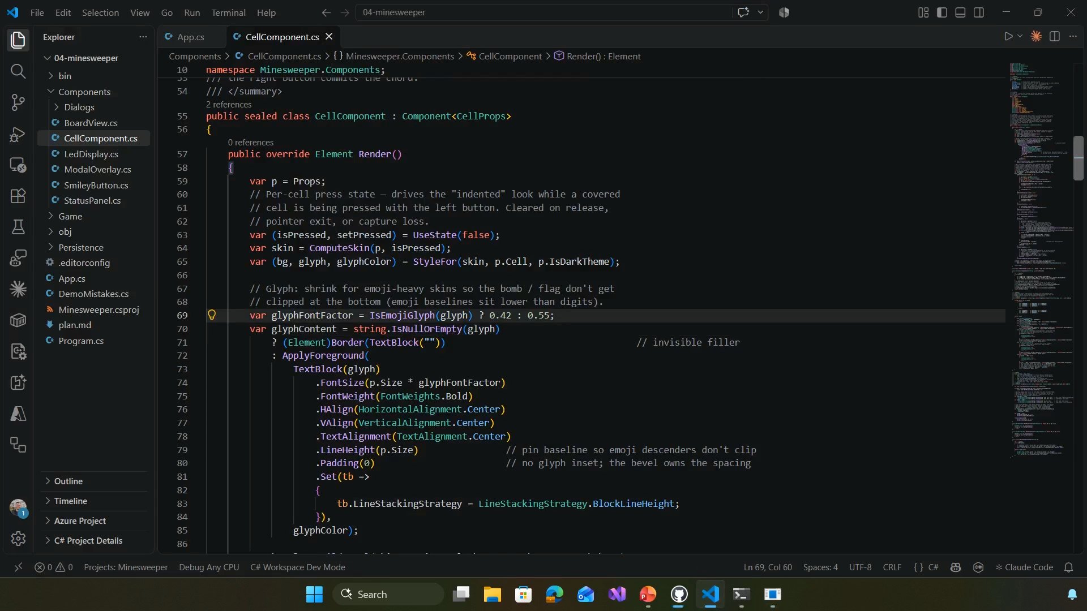
Demo: DevTools
winapp run . --watch
Live demo
01
02
03
Hot reload that keeps your state
Components and their C# lines
Live state, inspected
Backup recording: click the video to play

Slide 20
What DevTools sees
> winapp devtools inspect -a RxE2E
[stackpanel-9bec7a8478] <App> root Program.cs:7
[border-a5e0b88a83] <Counter> Program.cs:17
[button-baacfbdb21] Button #incrementButton Program.cs:33
> winapp devtools get-state "<Counter>" -a RxE2E
<Counter> class component · declared Program.cs:17
Hooks:
[0] count state int = 0 settable
[1] password state string = <redacted>

Slide 21
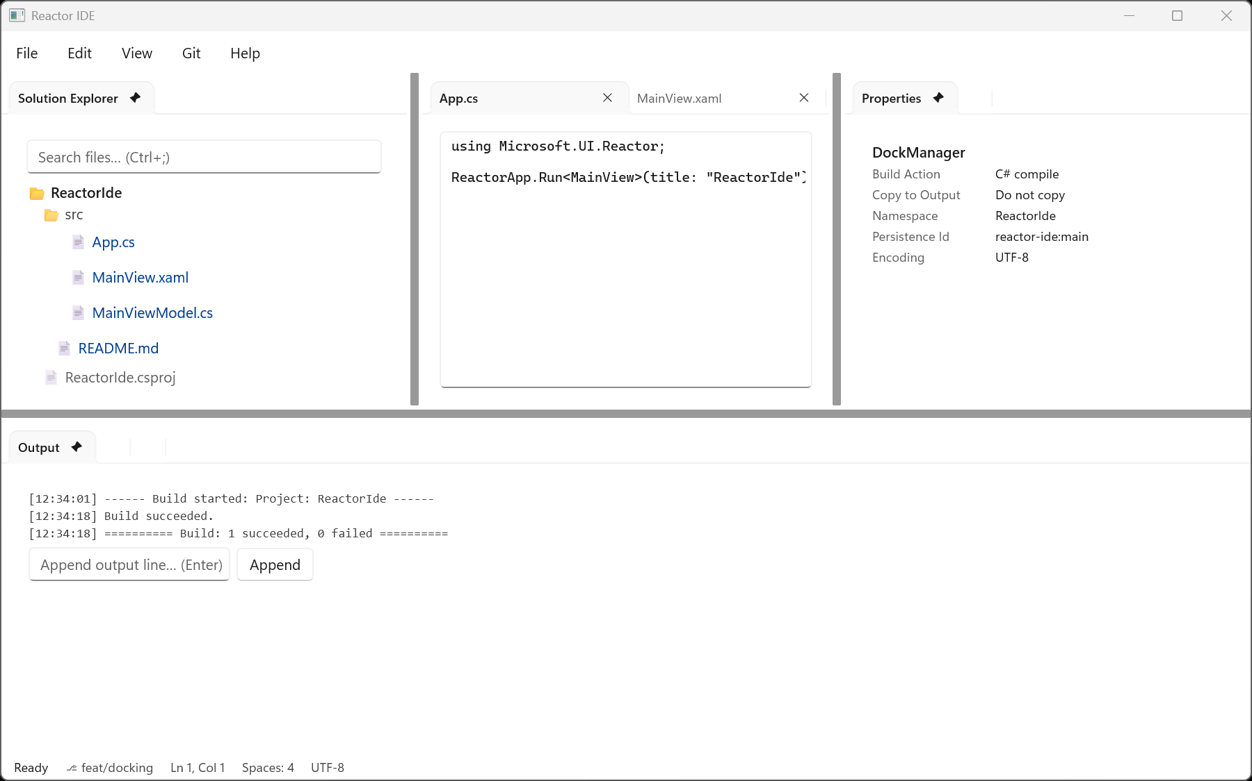
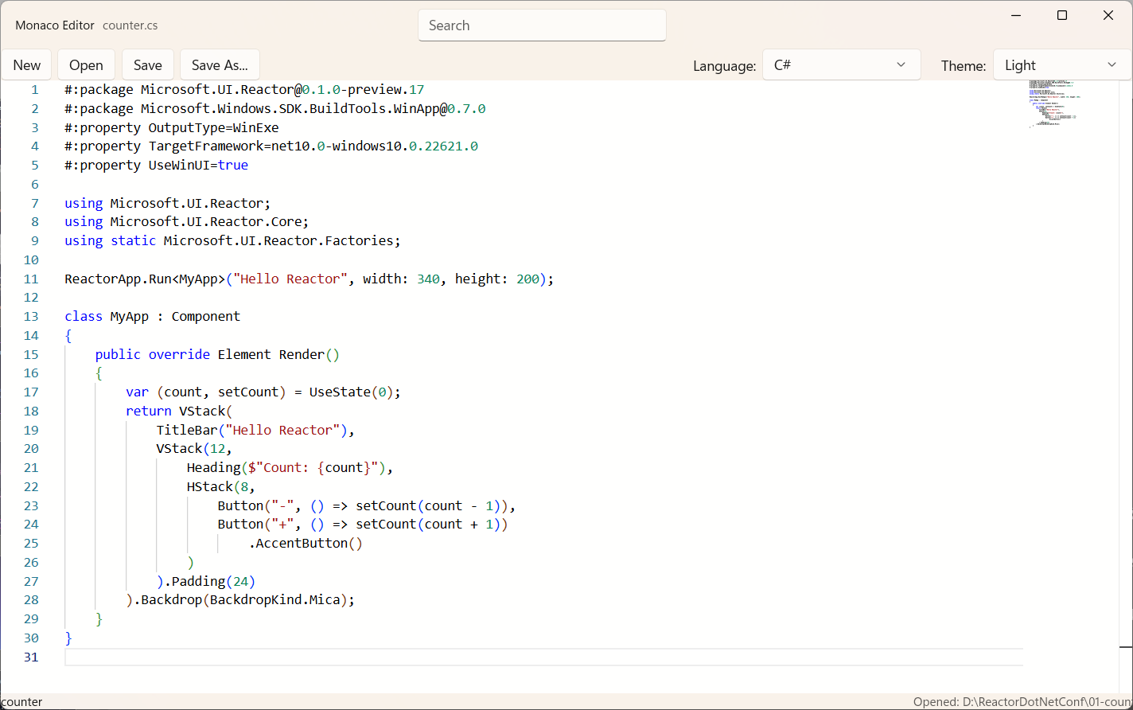
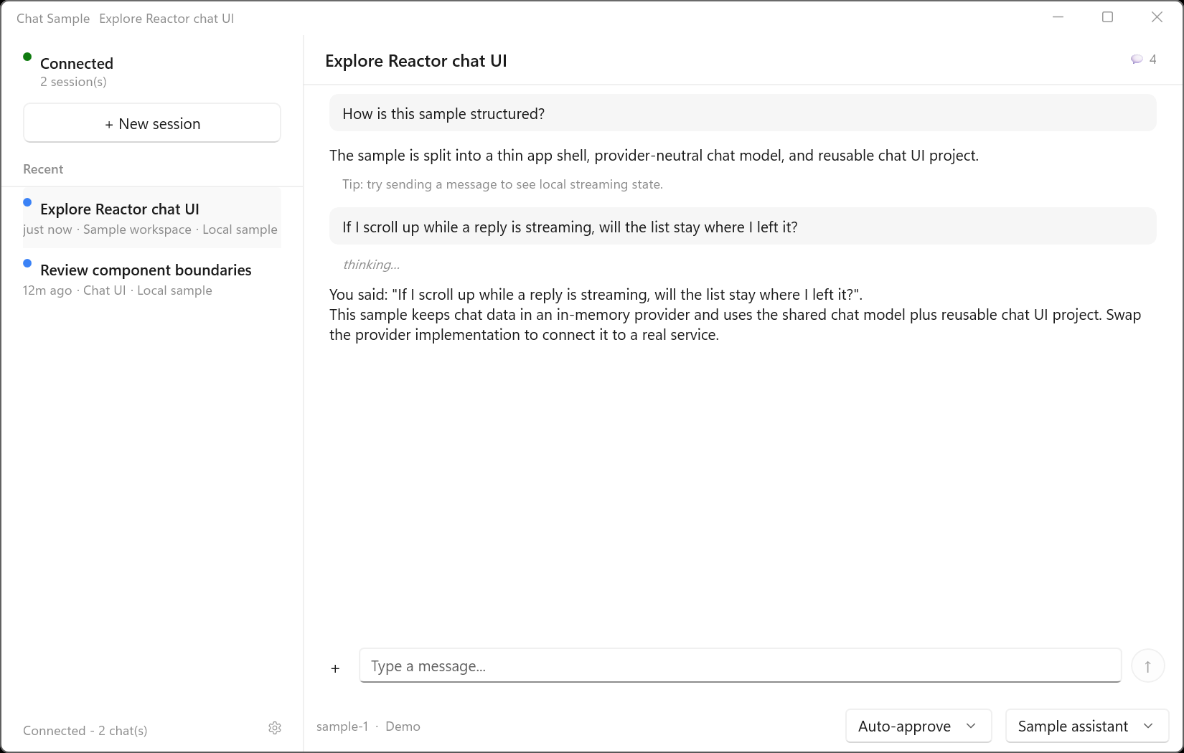
Built with Reactor
MIT licensed, built in the open
Reactor IDE
Monaco Editor
Chat
OpenClaw
Uno Platform
Prefer Rust?
In production: its Windows companion app ships Reactor chat, on by default.
Out now: Reactor on macOS, Linux, WebAssembly, Android and iOS.
windows-reactor runs the same experiment in windows-rs.

Slide 22
Try it
winget install Microsoft.WinAppCli
winapp new -t reactor -n MyApp
cd MyApp
winapp run
# Reactor templates: reactor, reactor-mvu,
# reactor-navview, reactor-tabview,
# reactor-singlefile

Slide 23


Thank you
Repo
Blog post
Repo: github.com/microsoft/microsoft-ui-reactor
Guide: microsoft.github.io/microsoft-ui-reactor

