Slide 1
Beyond Code Generation
Give AI Eyes and Hands for .NET MAUI
Gerald Versluis
Software Engineer, Microsoft

Slide 2
Your AI writes the XAML.
It has never seen the app run.

Slide 3
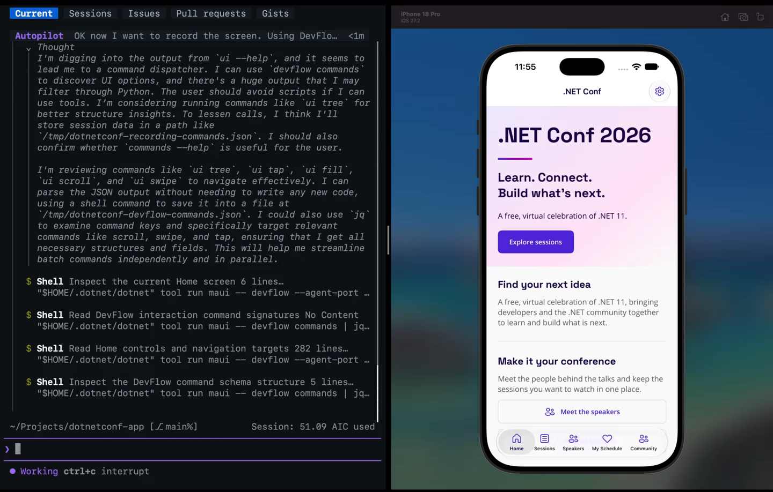
Demo: Copilot drives the .NET Conf app

Slide 4
Four tools from maui-labs
MAUI CLI
Sets up SDKs, emulators and devices
maui doctor finds and fixes environment issues
Installs Android SDK, JDK and emulators
Manages Xcode, simulators and runtimes
--json output for CI pipelines
AI skills
Teach your agent how MAUI works
Installs MAUI and DevFlow skills
Adds Copilot agents and MCP config
Targets VS Code, Copilot CLI and Claude
--dry-run previews every change
DevFlow
Lets the agent see and drive the app
Visual tree, taps and screenshots via an in-app agent
Network monitoring and profiling
Blazor WebViews over Chrome DevTools
MCP server lets AI agents test your app
Inspector
A live view you share with the AI
Live screenshot of the app
Visual tree of every control
Properties, layout and bindings
Logs, network and diagnostics
maui doctor
maui ai init
maui devflow
Browser·VS Code·Copilot

Slide 5
Set up
01

Slide 6
One tool, every device
# Install once
dotnet tool install -g Microsoft.Maui.Cli --prerelease
# Check and fix your environment
maui doctor
# See every device and emulator
maui device list
# Machine-readable output for agents
maui doctor --json
# Build and run stay with dotnet
dotnet run -f net11.0-android
Checks your machine and fixes what is missing.
Manages SDKs, emulators and simulators.
Your agent uses the same commands.
dotnet build, run, test and watch now work with MAUI too. See Jonathan Peppers' session.

Slide 7
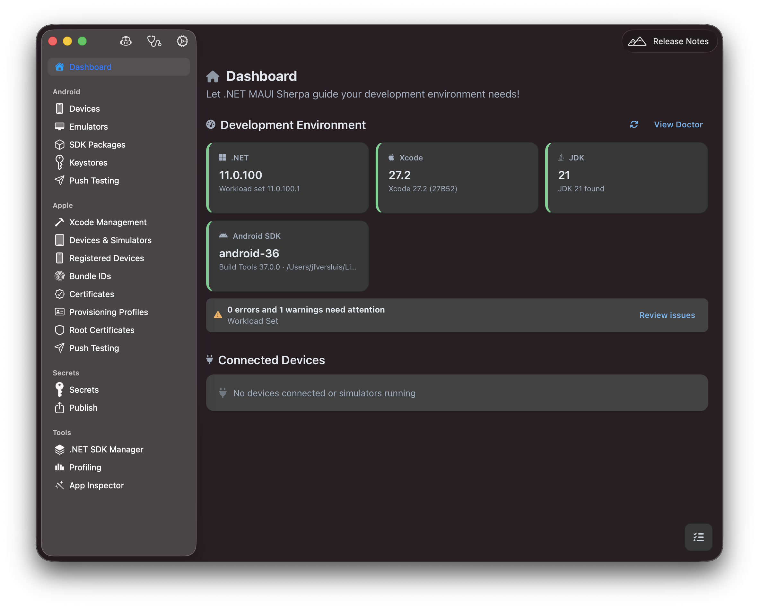
MAUI Sherpa
Your whole MAUI setup in one desktop app.
SDKs, emulators, simulators and certificates.
Browse a running app's visual tree, logs and network.
winget install Maui.Sherpa
brew install --cask redth/tap/maui-sherpa
redth.github.io/MAUI.Sherpa
Community tool by Redth (Jonathan Dick)

Slide 8
Skills for MAUI
# Preview what gets installed
maui ai init --env VsCode --dry-run
# Set up this project for AI
maui ai init --env VsCode --yes
# See what is installed, keep it fresh
maui ai status
maui ai update
# Or use the plugin marketplace
/plugin marketplace add dotnet/maui-labs
/plugin install dotnet-maui@dotnet-maui-labs
Teach layouts, accessibility and Blazor Hybrid.
Show how to run and debug with DevFlow.
One command sets it all up in your editor.

Slide 9
Works in the editor you already use
maui ai init sets up skills, agents and MCP for each one
Visual Studio
Agent mode uses your custom agents and MCP servers
VS Code
Pick the MAUI agent and its tools in Copilot Chat
Copilot CLI
The MAUI agent and DevFlow tools in your terminal
Copilot app
Plugins, plus canvases for the Inspector and devices
Agent (Preview)
--env VsCode
maui ai init
/plugin install

Slide 10
DEMO
MAUI CLI,
MAUI Sherpa and skills

Slide 11
DevFlow
02

Slide 12
DevFlow gives the agent eyes and hands
Your AI talks to the running app through MCP
Your AI agent
Copilot, Claude
MCP server
maui devflow mcp
Broker
devflow broker
In-app agent
Debug only
What the agent can do in your app
Read the visual tree
Tap controls by name
Read properties
Stream logs
Watch network calls
Read app storage
Profile performance
Debug Blazor Hybrid

Slide 13
The visual tree beats a screenshot
DevFlow reads the app from the inside
Screenshot only
DevFlow visual tree
Guesses coordinates from pixels
Taps controls by name
Breaks when the layout shifts
Knows properties and state

Slide 14
Connect your app in three steps
// 1. Add the in-app agent
dotnet add package Microsoft.Maui.DevFlow.Agent --prerelease
// 2. Register it in MauiProgram.cs, Debug only
#if DEBUG
builder.AddMauiDevFlowAgent();
#endif
// 3. Start the broker, run the app, check the connection
maui devflow broker start
maui devflow list
// Or ask your agent: the maui-devflow-onboard skill does all of this

Slide 15
DEMO
Set up DevFlow for an app

Slide 16
See it live
03

Slide 17
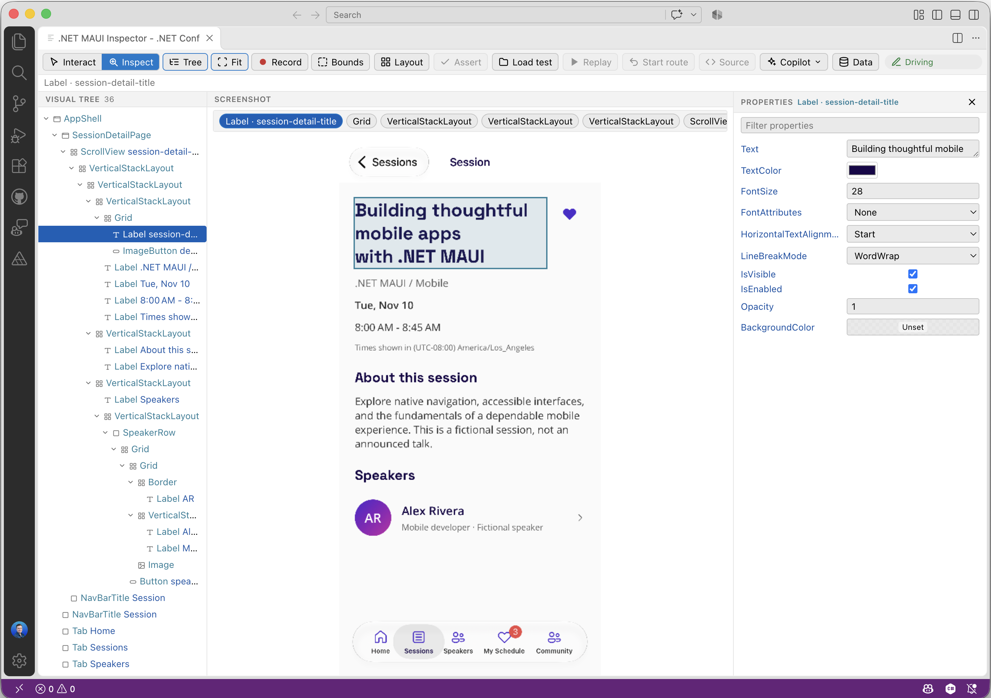
One live view for you and the AI
The Inspector shows what the agent sees
Visual tree
Every control on screen, by name
Live screenshot
Click a control to select it
Properties
Text, colors, layout and bindings

Slide 18
What the Inspector shows, and where
Open it wherever you already work
What you see
Live screenshot of the app
Visual tree of every control
Properties, layout and bindings
Logs, network and diagnostics
Where it opens
Browser localhost:19223/inspector
VS Code
GitHub Copilot desktop canvas
GitHub Copilot CLI canvas
Select a control, and the agent knows exactly which one you mean.

Slide 19
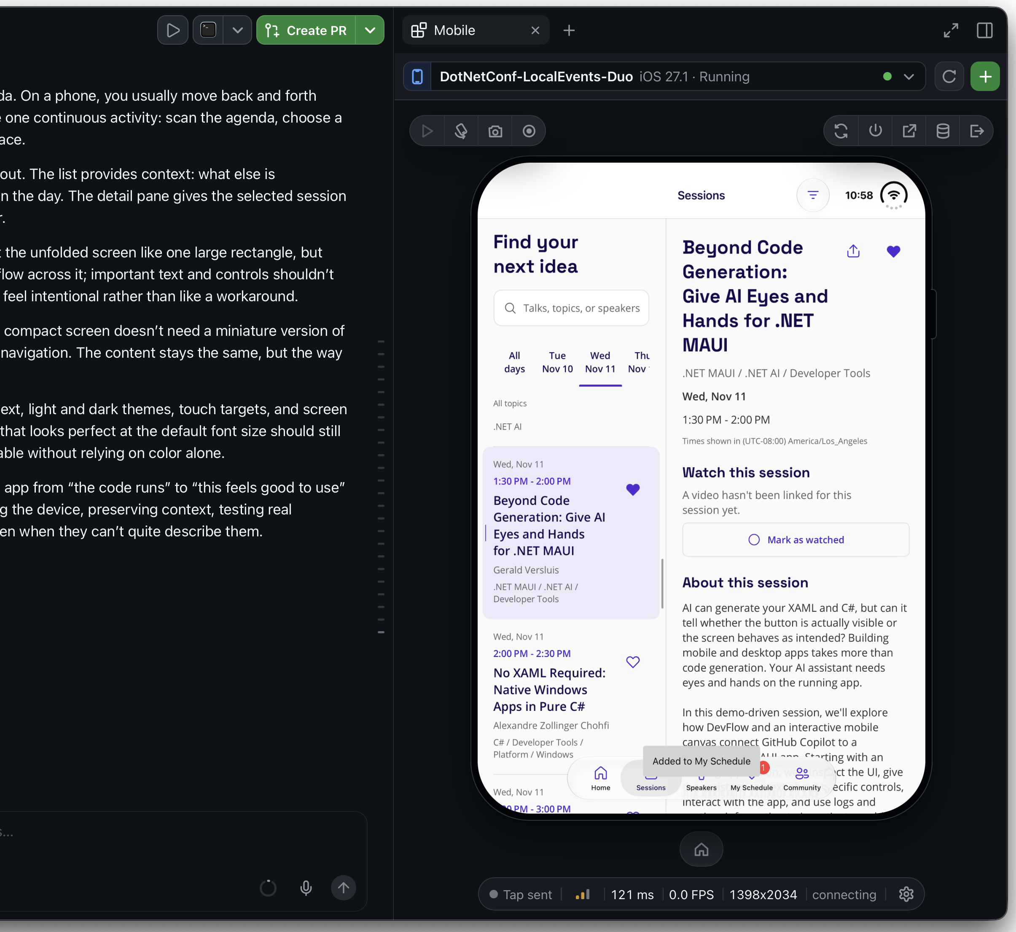
Mobile Canvas
A live simulator or emulator inside your editor.
You and Copilot drive the same device.
Reads the accessibility tree, not just pixels.
VS Code: Mobile Canvas extension
/plugin install mobile-canvas
github.com/Redth/mobile-canvas-ghcp
Community tool by Redth (Jonathan Dick)

Slide 20
All together
04

Slide 21
One loop ties the four tools together
Every step runs against the live app
01
Inspect
Agent reads the visual tree and logs
02
Point
You select the control that is wrong
03
Change
Agent edits XAML and C# the MAUI way
04
Replay
Agent taps through the flow again
05
Verify
The tree and logs confirm the fix
DevFlow
Inspector
AI skills
DevFlow
DevFlow + CLI
Repeat until the fix holds

Slide 22
Prompts that work
// Name the device, the symptom and the proof you want
“Run on Android. Save is missing on Profile. Fix it, then show me Save in the visual tree.”
// Point at the control instead of describing it
“Why is the control I selected in the Inspector 0 pixels wide?”
// Steer by name, not by coordinates
“Tap SaveButton, then read its IsEnabled and the bound command.”
// Ask it to check its own work
“Tap through sign-up again on iOS and check the logs for errors.”
// Set the boundaries
“Only change ProfilePage.xaml. Leave the view model alone.”

Slide 23
Habits that keep the agent useful
The agent does the legwork, you make the calls
Every session
Start from a running app
Ask for proof: the tree, logs or a replay
Review every diff before you commit
Every team
Commit the maui ai init setup
Keep DevFlow in Debug builds only
Test on real devices before you ship
Experimental previews: APIs and commands may change.

Slide 24
Get started
# 1. Install the MAUI CLI
dotnet tool install -g Microsoft.Maui.Cli --prerelease
# 2. Set up skills, agents and MCP in your project
maui ai init --env VsCode --yes
# 3. Ask your agent to add DevFlow, then open the Inspector
maui devflow broker start
http://localhost:19223/inspector/
# Docs, samples and issues
github.com/dotnet/maui-labs
# MAUI Sherpa and Mobile Canvas, by Redth
github.com/Redth

Slide 25
Resources
Everything from this session, in one place
Tools, docs and samples
github.com/dotnet/maui-labs
MAUI CLI (.NET tool)
Microsoft.Maui.Cli
Download .NET 11
get.dot.net
MAUI Sherpa
redth.github.io/MAUI.Sherpa
Mobile Canvas
github.com/Redth/mobile-canvas-ghcp
Try it, then tell us what breaks: open an issue on maui-labs.

Slide 26
Go deeper with .NET MAUI
Native apps for every platform, from mobile to Windows.
TUESDAY, NOVEMBER 10
WEDNESDAY, NOVEMBER 11
BRK016
Bringing dotnet run, test, and watch to .NET MAUI
Jonathan Peppers
Tuesday • 4:30 PM PST
BRK022
Building great Windows apps with WinUI and agents
Morten Nielsen
Wednesday • 11:30 AM PST
PRERECORDED
BRK024
CsWinRT 3.0: Modernizing the Windows Projections for .NET
Manodasan Wignarajah
Wednesday • 12:30 PM PST
BRK033
Less Chat More Action: AI-Powered .NET MAUI Apps
Gerald Versluis
Prerecorded
BRK026
Beyond Code Generation: Give AI Eyes and Hands for .NET MAUI
Gerald Versluis
Wednesday • 1:30 PM PST
BRK034
How We Brought CoreCLR to .NET MAUI and Mobile
Jonathan Peppers
Prerecorded
BRK027
No XAML Required: Native Windows Apps in Pure C#
Alexandre Zollinger Chohfi
Wednesday • 2:00 PM PST

Slide 27
Download
.NET 11
get.dot.net

Slide 28
Thank you

