Slide 1
What’s New in Aspire
for .NET Developers
Damian Edwards + Maddy Montaquila
Aspire Team, Microsoft

Slide 2
This time last year…

Slide 3
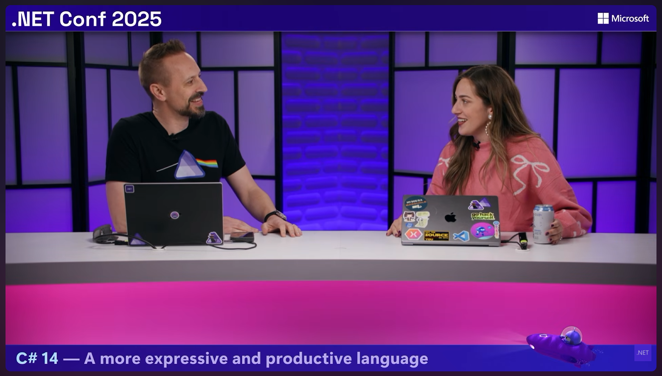
“Try the new Aspire CLI!”
“It’s just Aspire!”
“We just shipped aspire.dev!”
“Opus 4.5? Never heard of it.”

Slide 4
The way you use Aspire has changed
Monthly engaged developers, by tool
~90k
Aspire CLI
incl. coding agents
+40k
VS Code
~50k
VS Code
Visual Studio
Visual Studio
Nov 2025
Nov 2026
Notes:
VS Code skyrocketed for a while then slowly leveled
CLI skyrocketing now
VS flat??
Coding agents
53k –> 89k
Retention?

Slide 5
What you’re orchestrating with Aspire
Hosting integrations
Top 5 integrations
Other
Messaging
Cloud
services
#1
JavaScript
Databases
#2
SQL Server
#3
Redis
Caching
App
languages
#4
PostgreSQL
Storage
#5
Azure Storage
Logs &
traces
AI

Slide 6
Things you might have missed
.NET specific
File-based C# apps and AppHosts — lightweight .cs files without requiring a full project for every component.
CLI bundle for C# AppHosts — dashboard and DCP come from the Aspire CLI installation instead of per-AppHost platform-specific NuGet dependencies.
Blazor WebAssembly hosting and gateway support (preview) — model standalone WASM clients and their browser-facing gateway in the AppHost.
EF Core migration management (preview) — dashboard commands to add/remove migrations, update/reset databases, and inspect migration status, with on-demand tool acquisition.
HTTPS certificate configuration — apply developer or explicit certificates to project, executable, and container resources.
dotnet run >>>> aspire run

Slide 7
Things you might have missed
Other big stuff
The way the agent talks to your app is different – its CLI based
MCP Gateway
Much richer CLI — detached runs, start/stop/ps, resource inspection, logs, OpenTelemetry queries, environment diagnostics, secrets, and documentation lookup.
Isolated runs — support parallel development without every instance competing for the same configuration and ports.
Persistent dashboard telemetry and run history — inspect logs, traces, metrics, and resource state after restarting the application.
Native AOT dashboard — faster startup and a dashboard executable that doesn’t depend on a separately installed .NET runtime.
Interactive terminals and database REPLs (experimental/preview) — interact with console applications and query databases directly from the dashboard.
Richer resource commands and interactions — command arguments, prompts, uploads, progress, and notifications for custom workflows.
Browser observability (preview integration) — frontend console output, network activity, and screenshots alongside backend telemetry.
AI coding-agent integration — MCP access to application state and diagnostics, agent setup, and Aspire skills.
Expanded VS Code experience — resource views, commands, CodeLens, and multi-language debugging.
Deployment and broader application support
Code-first build/publish/deploy pipelines — aspire do, deployment state, and teardown with aspire destroy.
More deployment options — Docker Compose, Helm-based Kubernetes/AKS, Azure improvements, and preview Radius and Azure Container Apps Sandboxes support.
Better container workflows — container-based build artifacts, host/container connectivity, portable volume paths, and persistent Kubernetes storage.
Broader language support — Python and JavaScript from last fall, followed by TypeScript AppHosts, Go, Java, Rust, and expanded JavaScript runtime/framework support.

Slide 8
Things coming in hot
Aspire 17 overhauls the dotnet expereince
Stable .NET hosting integration / Project Resource v2 — Aspire.Hosting.Dotnet moves to stable versioning in 17; legacy AddProject and AddCSharpApp are deprecated, not removed.
Migration off Aspire.AppHost.Sdk — use the standard .NET SDK, explicit hosting packages, path-based resources, and the CLI bundle.
NuGet overhaul — consistent discovery/restore policy, inherited feeds and mappings, authentication settings, safer channel updates, and no copying machine-specific NuGet configuration into generated projects.
Attach debugging for running .NET resources in VS Code — start debugging an already-running service from the Aspire view or the corresponding Copilot tool.
Maybe… watch?
Launch groups + tags
And ----
Experimental dashboard redesign — a home summary, persistent resource selection, grouping/tags, richer metrics views, and an option to return to the previous experience.
Reusable team configuration and templates — Git-backed project configuration sources, directory/Git templates, and configurable skill sources.
Stable Kubernetes hosting packages and core pipeline APIs — graduation of previously experimental deployment surfaces.
Entra
WSLc

Slide 9
So, what is Aspire today?
One code-first model for your whole app
01
Compose
AppHost
Model any service, with prebuilt integrations or fully custom
02
Run
aspire run
Start the whole app with endpoints and config already wired
03
Observe
Dashboard
Logs, traces, and metrics from every resource in one place
04
Deploy
aspire deploy
Ship one model to Docker Compose, Kubernetes, Azure, and more
Any language
Author your AppHost in C# or TypeScript, then run any language or workload from it
Agent-ready
Aspire skills and MCP give coding agents live context from your app

Slide 10
Aspire is .NET at its core
Shipped for .NET developers this year
File-based AppHosts
An AppHost can be a single .cs file, no project required
Bundled and in sync
Dashboard and DCP ship in the CLI, so every machine runs one version
Native AOT dashboard
Built on the latest .NET: faster startup, no separate runtime to install
Blazor WebAssembly
Model standalone WASM clients and their gateway in the AppHost (preview)
EF Core migrations
Add, apply, and reset migrations from the dashboard (preview)

Slide 11
An improved VS Code experience
Every action runs through the Aspire CLI
aspire extension
One F5 for the whole app
Pick your AppHost and press F5. Aspire starts every resource in order and attaches the right debuggers.
Debug every language
C#, JavaScript, Python, Go, Java, and Rust in one session
Live apphost state in your sidebar
Health and restart actions beside each resource
Debug your deploy
Step through publish, deploy, and aspire do pipeline steps
Agents drive the editor
Coding agents run your AppHost through the editor

Slide 12
Demo
A year in Aspire

Slide 13
Coming next week
Aspire 17

Slide 14
Faster starts, easier upgrades
Aspire 17, shipping soon
A plain .NET project
AppHosts use Microsoft.NET.Sdk, so upgrading is a package bump, not an SDK pin
Projects by path
No project references, so the dashboard starts without waiting on the MSBuild graph
Your NuGet setup, as is
Inherited feeds, consistent restore, no machine-specific config in new projects
Attach to running apps
Debug a running service in VS Code, right from the Aspire view

Slide 15
Demo
Upgrading to Aspire 17

Slide 16
So… where will we be
next year?

Slide 17
Thank you
docs
aspire.dev
code
github.com/microsoft/aspire
community
aka.ms/aspire-discord
follow
@DamianEdwards · @maddymontaquila

Slide 18
Section title
01

Slide 19
Title
Subtitle
Keep each slide to one key idea
Use short phrases rather than full sentences
Keep text readable from the back of the room

Slide 20
Title
Subtitle
Item 1
Item 2
Subtitle
Subtitle
Description
Description

Slide 21
Code sample
// Minimal API with .NET
var builder = WebApplication.CreateBuilder(args);
var app = builder.Build();
app.MapGet("/launch", () => new { Mission = ".NET Conf 2026", Status = "Go" });
app.Run();

Slide 22
Pattern matching
// Records + pattern matching
public record Launch(string Name, int Fuel);
string Status(Launch l) => l switch
{
{ Fuel: >= 90 } => "Go for launch",
{ Fuel: >= 50 } => "Hold",
_ => "Scrub"
};
Records give you concise, immutable data types.
Switch expressions and property patterns turn branching logic into a readable table of rules.

Slide 23
Make awesome apps
// Compose a distributed app with .NET Aspire
var builder = DistributedApplication.CreateBuilder(args);
var api = builder.AddProject<Projects.Api>("api");
builder.AddProject<Projects.Web>("web")
.WithReference(api);
builder.Build().Run();

Slide 24
Demo title

Slide 25
A large statement looks great with 10 words or less

Slide 26
The Microsoft technology made it easy for us. It just works. We saved months of development time in the process.
Name and Last Name
System Administrator

Slide 27

Speaker name
Title

Slide 28
Thank you

Slide 29
Color guidance
Dark or gradient backgrounds. Bright colors are for accents and large text only.
Core colors
Purple
#512BD4
Blue
#0B6CFF
Magenta
#D600AA
Teal
#28C2D1
Coral
#F65163
Gold
#F7B548
Primary brand color
White text OK
Tech, links, data
White text OK
Highlights, energy
White text OK
Data, success
Use dark text
Alerts, contrast
Use dark text
Callouts, sparingly
Use dark text
Text on dark backgrounds
Gradients
Body text and titles #FFFFFF
Space
#120838 > #2E1A9E > #3B5BEA
Blue-purple
#3A12B8 > #4A2BE0 > #2F6BFF
Emphasis #B9AAEE
De-emphasis, captions #A6A6A6
Magenta
#6A0FB8 > #B01ACB > #D600AA
Brand border
#D600AA > #512BD4
Body 18pt minimum, captions 16pt. White on blue gradients: large text only.

Slide 30
Title – 72pt
Space Grotesk + Open Sans
Title – 48pt
Title – 36pt
Font guidance
Headings: Space Grotesk Body: Open Sans Code: Cascadia Code
Install Space Grotesk (free from Google Fonts). Use the individual weight files, not the variable font.
Embed fonts when saving: File > Options > Save > Embed fonts, with all characters. Adds only a few hundred KB.
No Space Grotesk? Use Aptos Display for headings. It works on Windows and Mac.
Leave room in big headings, since a substituted font can wrap differently.
Title – 28pt
Text – 24pt
Text – 20pt
Text – 18pt minimum · 16pt for captions only

Slide 31
Your icon library
You can recolor these icons to match your theme.
Avoid using the icons too large.
Get more icons

Slide 32
Your icon library
You can recolor these icons to match your theme.
Avoid using the icons too large.
Get more icons

Slide 33
Make awesome apps

Slide 34
Announcing
.NET 11

Slide 35
Welcome to
.NET Conf

Slide 36
A platform
for your apps

Slide 37
Our vision for
.NET 11

