Slide 1
How Aspire uses .NET
to build an agent-first, cross-language toolchain
Maddy Montaquila + Jose Perez Rodriguez
Aspire team, Microsoft

Slide 2
The problem we're building for
Aspire is a distributed-app toolchain
Describe relationships
Which services, resources, and dependencies make up the app
Cross language boundaries
Expose the same operations to C#, TypeScript, and more
Process telemetry
Ingest logs, traces, and metrics while the app runs
Present live state
Show what is running and what just changed
Distribute the tools
Ship one toolchain to Windows, macOS, and Linux

Slide 3
.NET is your platform for building anything

Slide 4
.NET as a polyglot host
01

Slide 5
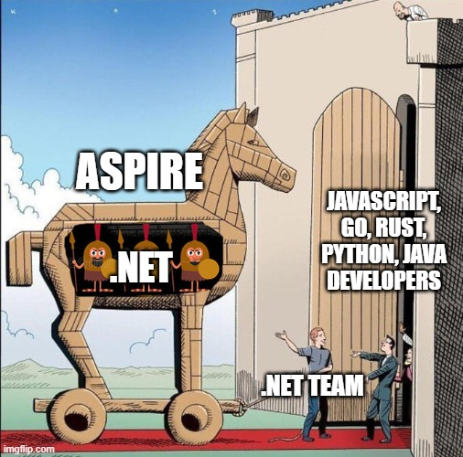
Why Aspire went polyglot
The problems Aspire solves are universal, but people are still picky
01
Project-based AppHost
A .csproj and Program.cs: natural for .NET teams, foreign to everyone else
02
File-based apphost.cs
One C# file, no project. Simpler, but frontend teams still balked at C#
03
AppHosts in other languages
TypeScript, Go, Python, and more: now every C# API has to reach them

Slide 6
Transpiling to C# worked, until callbacks
Builder calls mapped 1:1, but a callback is code that has to run
apphost.ts
apphost.cs (sourcegen output)
const builder = await createBuilder();
const api = await builder
.addProject('api', '../api');
await api.withEnvironmentCallback(
async (ctx) => {
await ctx.environmentVariables
.set('MODE', getMode());
});
var builder = CreateBuilder(args);
var api = builder
.AddProject("api", "../api");
api.WithEnvironment(
async ctx => {
ctx.EnvironmentVariables["MODE"]
= ???;
});
Builder calls translate line for line
getMode() is TypeScript, so there is no C# to generate

Slide 7
One API, many languages
Can one C# declaration enable authoring in other languages?
We write
C# API
.NET provides
Roslyn + runtime
We define
Aspire Type System
We generate
Guest language SDKs
We execute
Capability calls

Slide 8
One API, many languages
One C# declaration becomes a contract, guest SDKs, and a dispatch table
We write
C# API
.NET provides
Roslyn + runtime
We define
ATS contract
We generate
Guest language SDKs
Extension methods and types marked [AspireExport]
Roslyn reads types and docs. The runtime is a proven, cross-platform base.
Aspire Type System: capability IDs, type mappings, and handle rules
TypeScript is GA, more languages in preview
We execute
Capability calls
The .NET host runs each C# method, called over JSON-RPC

Slide 9
Demo
C# to any language
Notes:
5 min demo

Slide 10
Step 1: the C# API
Show c# apphost code
// Aspire.Hosting: written once, in C#
[AspireExport("withEnvironmentCallback")]
public static IResourceBuilder<T>
WithEnvironment<T>(
this IResourceBuilder<T> builder,
Func<EnvironmentCallbackContext, Task> cb)
where T : IResourceWithEnvironment
=> builder.WithAnnotation(
new EnvironmentCallbackAnnotation(cb));
[AspireExport]
public class EnvironmentCallbackContext
{
[AspireExport]
public Dictionary<string, object>
EnvironmentVariables { get; }
}
Three things must cross the boundary: a generic builder, an async callback, and a context object that lives in .NET.

Slide 11
Step 2: the TypeScript
Flip code snippet order
// .aspire/modules/aspire.mjs (generated)
withEnvironmentCallback(
callback: (ctx: EnvironmentCallbackContext)
=> Promise<void>
): ResourceBuilderPromise<T>;
// apphost.mts (written by the developer)
const api = await builder
.addNodeApp("api", "./api", "server.js")
.withEnvironmentCallback(async (ctx) => {
const env = await ctx.environmentVariables();
await env.set("FEATURE_FLAG", "on");
});
Preserved: Task becomes Promise, callbacks stay callbacks, docs carry over.
Imposed: .NET objects stay in .NET. TypeScript holds a handle.

Slide 12
Step 3: the dispatch
// TypeScript to AppHost server, over JSON-RPC
{ "capability": "withEnvironmentCallback",
"target": { "$handle": "builder:42" },
"args": { "callback": "cb:7" } }
// Generated C# dispatch (simplified)
case "withEnvironmentCallback":
var b = handles.Get<IResourceBuilder<
IResourceWithEnvironment>>(target);
b.WithEnvironment(async ctx =>
await client.InvokeCallbackAsync(
"cb:7", handles.Add(ctx)));
return handles.Add(b);
Every call names a capability ID. Generated code maps it to the C# method at build time, so nothing is discovered at runtime.

Slide 13
Idiomatic in every language
We author once in C#; generation makes it native to each language
For Aspire CONTRIBUTORS
Write every integration once
One codebase for every guest language
Roslyn gives us types and docs
.NET runtime runs the orchestration
For guest language developers
An SDK that feels native
Native naming per language
Typed clients with IntelliSense + LSP
Native features, method signatures, and syntax
C# AddRedis → TypeScript addRedis → Python add_redis

Slide 14
C# overloads become one TS method
// Public C# overloads: hidden from TypeScript
[AspireExportIgnore(Reason = "Polyglot AppHosts use the internal ...")]
public static IResourceBuilder<T> WithEnvironment<T>(..., string? value)
// One internal dispatcher is exported instead
[AspireExport]
internal static IResourceBuilder<T> WithEnvironment<T>(..., string name,
[AspireUnion(typeof(string), typeof(ReferenceExpression),
typeof(EndpointReference), ...)] object value) {
return value switch {
string s => builder.WithEnvironment(name, s),
EndpointReference e => builder.WithEnvironment(name, e), ... }; }
// TypeScript: one method, many value types
const endpoint = await redis.getEndpoint("tcp");
await api.withEnvironment("REDIS_HOST", endpoint);
await api.withEnvironment("REDIS_URL", refExpr`redis://${endpoint}:6379`);

Slide 15
Preview in Aspire 17
Go AppHosts
Python, Java, and Rust also available
behind feature flags

Slide 16
.NET as a real-time application platform
02

Slide 17
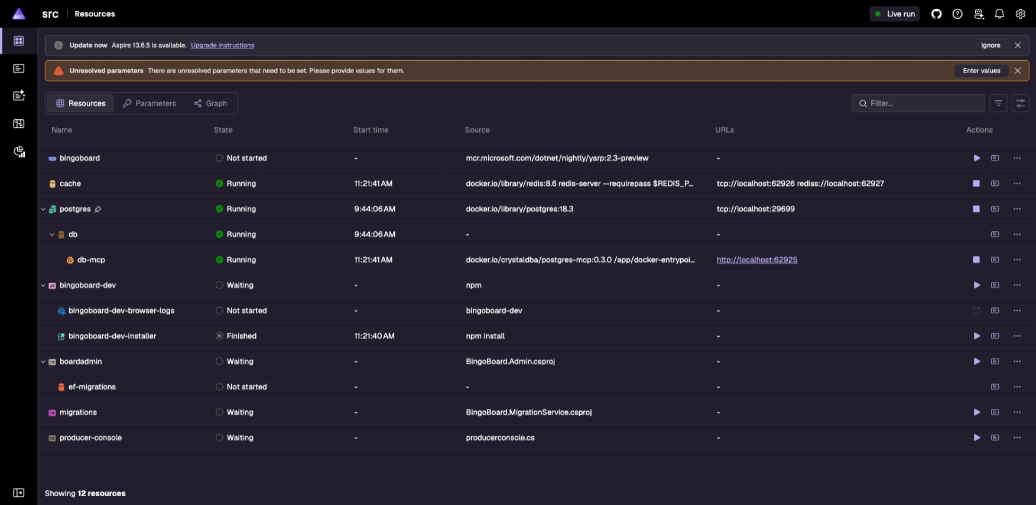
The dashboard is your control center
The Aspire CLI shows the same resources, logs, and state
5
1
DCP
Starts containers and processes, allocates endpoints
4
2
1
2
Resource service
AppHost streams state changes over gRPC
3
3
OTLP receiver
Apps send logs, traces, and metrics
4
Interaction service
AppHost prompts for missing parameters
5
Blazor Server
Re-renders and pushes DOM diffs over SignalR

Slide 18
Blazor simplifies our dev loop
No API drift between the data and UI
Typical web dashboard
Telemetry store
REST API
JSON DTOs
Client models
UI
Three layers to build and keep in sync
Aspire dashboard (Blazor Server)
Telemetry store
Razor components
read telemetry in-process, same C# types
Browser
Only rendered diffs cross the wire, over SignalR

Slide 19
Fluent underneath, Aspire’s brand on top
Unified, performant, accessible foundation
Our UI stack
Aspire brand
Colors, type, and components, added over time
Fluent UI Blazor v5
Razor components with APIs aligned to Fluent UI React
Fluent UI Web Components 3
Lighter JavaScript, more work done in the browser
Fluent 2 design system
Tokens, accessibility, and shared patterns

Slide 20
AOT dashboard: 3x faster, 40% smaller
A custom Blazor build, done with the Blazor team
What it took
Startup time
Custom Blazor build
Built with the Blazor team to prove Blazor Server can compile with Native AOT
Source-generated JSON
Trimming can remove types that reflection looks for, so every serialized type gets generated metadata
Deployment size, including runtime
Source: devblogs.microsoft.com/aspire/aspire-dashboard-native-aot

Slide 21
.NET as a native toolchain
03

Slide 22
The craziest part:
You don't even have to install .NET

Slide 23
Aspire used to run on your .NET install
We ship latest-only, but your machine could have any SDK
Your machine
Aspire CLI
Native AOT
Or, dotnet CLI and dotnet aspire tool
Your .NET install
Any SDK and runtime on disk
Back-compat
Grew every release
Each release had to work with every setup users still had
.NET 8 SDK
.NET 9 SDK
.NET 10 SDK
Previews
DCP
Fetched with CLI
global.json pins
No SDK at all

Slide 24
Native CLI still launched managed code
Most of the toolchain ran on a bundled .NET runtime
Aspire bundle
Aspire CLI
Native AOT
Invokes the bundle
aspire-managed
JIT on a bundled .NET runtime
DCP
Already native
Written in Go (we’re polyglot, after all!)
Dashboard
NuGet operations
Terminal host
AppHost Server
Integration loading
SDK generation

Slide 25
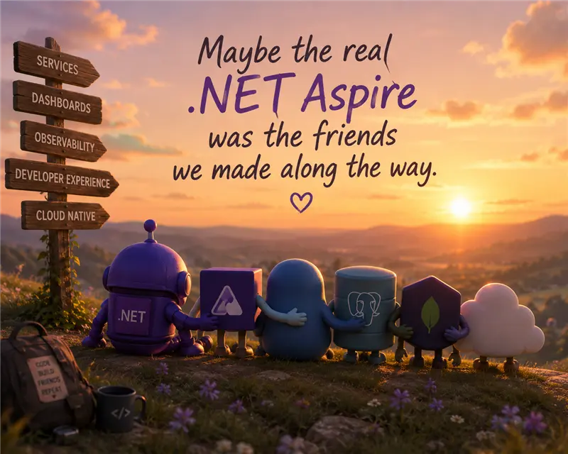
Demo
Native AOT
Bundle
Notes:
2-3min

Slide 26
Piece-by-piece moving to native
Each move waited on our code and its dependencies
Aspire bundle
Aspire CLI
Native AOT
Invokes the bundle
Dashboard
Native AOT
1,429 → 491 ms
AppHost Server
Native AOT JSON-RPC
DCP
Already native
Separate from .NET; not part of the AOT work
aspire-managed JIT
Terminal host
Native AOT
Integration loading
NuGet operations
SDK generation

Slide 27
Aspire is a .NET customer
And we love it!!!
01
Compiler infrastructure
for cross-language contracts
02
Application framework
for live experiences
03
Native compilation
for distribution
James Newton-King 4:16 PM
The best language will always be the best language for aspire
JN

Slide 28
Thank you!
Docs aspire.dev
Community aka.ms/aspire-discord
Source github.com/microsoft/aspire

Slide 29
Section title
01

Slide 30
Title
Subtitle
Keep each slide to one key idea
Use short phrases rather than full sentences
Keep text readable from the back of the room

Slide 31
Title
Subtitle
Item 1
Item 2
Subtitle
Subtitle
Description
Description

Slide 32
Code sample
// Minimal API with .NET
var builder = WebApplication.CreateBuilder(args);
var app = builder.Build();
app.MapGet("/launch", () => new { Mission = ".NET Conf 2026", Status = "Go" });
app.Run();

Slide 33
Pattern matching
// Records + pattern matching
public record Launch(string Name, int Fuel);
string Status(Launch l) => l switch
{
{ Fuel: >= 90 } => "Go for launch",
{ Fuel: >= 50 } => "Hold",
_ => "Scrub"
};
Records give you concise, immutable data types.
Switch expressions and property patterns turn branching logic into a readable table of rules.

Slide 34
Make awesome apps
// Compose a distributed app with .NET Aspire
var builder = DistributedApplication.CreateBuilder(args);
var api = builder.AddProject<Projects.Api>("api");
builder.AddProject<Projects.Web>("web")
.WithReference(api);
builder.Build().Run();

Slide 35
Demo title

Slide 36
A large statement looks great with 10 words or less

Slide 37
The Microsoft technology made it easy for us. It just works. We saved months of development time in the process.
Name and Last Name
System Administrator

Slide 38
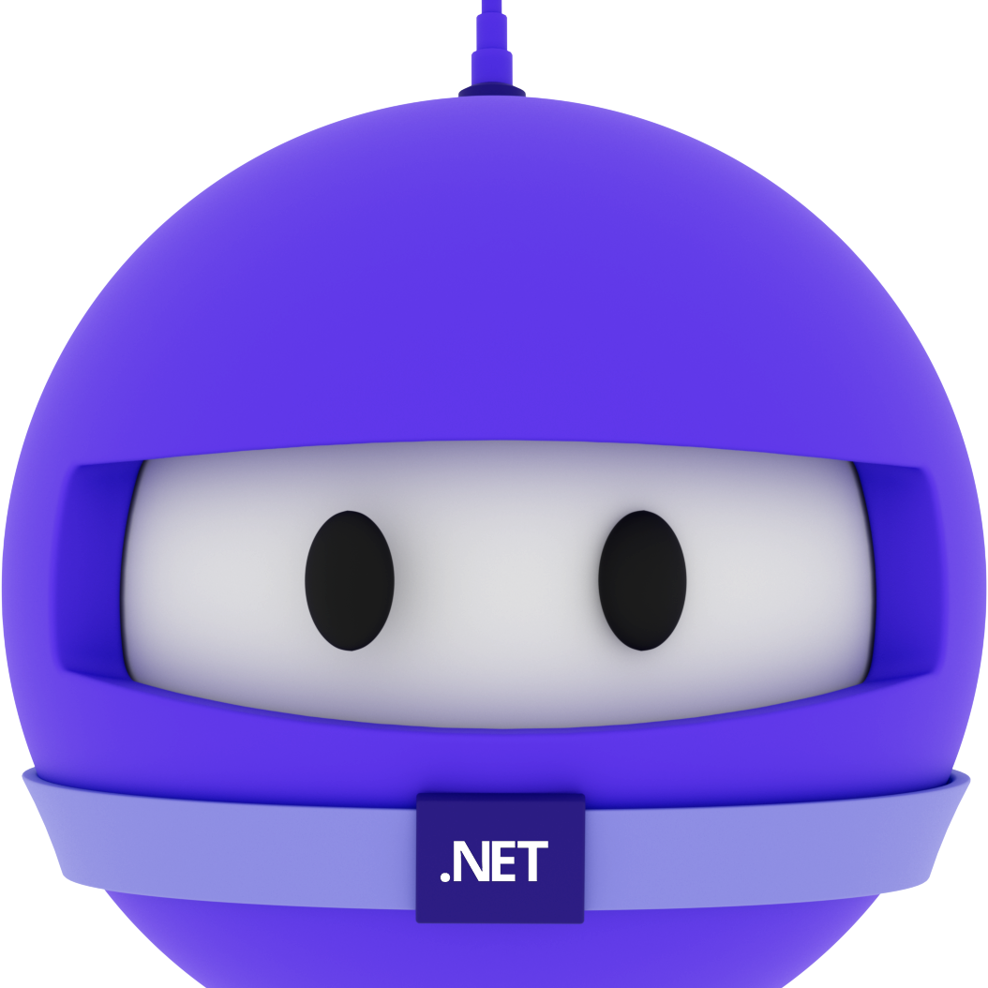
Speaker name
Title

Slide 39
Thank you

Slide 40
Color guidance
Dark or gradient backgrounds. Bright colors are for accents and large text only.
Core colors
Purple
#512BD4
Blue
#0B6CFF
Magenta
#D600AA
Teal
#28C2D1
Coral
#F65163
Gold
#F7B548
Primary brand color
White text OK
Tech, links, data
White text OK
Highlights, energy
White text OK
Data, success
Use dark text
Alerts, contrast
Use dark text
Callouts, sparingly
Use dark text
Text on dark backgrounds
Gradients
Body text and titles #FFFFFF
Space
#120838 > #2E1A9E > #3B5BEA
Blue-purple
#3A12B8 > #4A2BE0 > #2F6BFF
Emphasis #B9AAEE
De-emphasis, captions #A6A6A6
Magenta
#6A0FB8 > #B01ACB > #D600AA
Brand border
#D600AA > #512BD4
Body 18pt minimum, captions 16pt. White on blue gradients: large text only.

Slide 41
Title – 72pt
Space Grotesk + Open Sans
Title – 48pt
Title – 36pt
Font guidance
Headings: Space Grotesk Body: Open Sans Code: Cascadia Code
Install Space Grotesk (free from Google Fonts). Use the individual weight files, not the variable font.
Embed fonts when saving: File > Options > Save > Embed fonts, with all characters. Adds only a few hundred KB.
No Space Grotesk? Use Aptos Display for headings. It works on Windows and Mac.
Leave room in big headings, since a substituted font can wrap differently.
Title – 28pt
Text – 24pt
Text – 20pt
Text – 18pt minimum · 16pt for captions only

Slide 42
Your icon library
You can recolor these icons to match your theme.
Avoid using the icons too large.
Get more icons

Slide 43
Your icon library
You can recolor these icons to match your theme.
Avoid using the icons too large.
Get more icons

Slide 44
Make awesome apps

Slide 45
Announcing
.NET 11

Slide 46
Welcome to
.NET Conf

Slide 47
A platform
for your apps

Slide 48
Our vision for
.NET 11

