Slide 1
.NET CONF 2026
Experiences
The .NET AI Stack
Agents
Tools
What's New, What's Next,
and How It Fits Together
Multimodal
Context
Luis Quintanilla
Decisions
Models
Notes:
MAIN IDEA: The .NET AI stack - what's new, what's next, and how the pieces fit together.
• Introduce yourself.
• The promise: build one real app, a studio that turns a research paper into a narrated explainer film, and use it to walk the whole stack.
• The colored layers on the right are the map for the talk: Models, Decisions, Context, Multimodal, Tools, Agents, Experiences.
TAKEAWAY: One app, end to end, built from .NET AI building blocks.

Slide 2
Building blocks. A growing ecosystem.
Build across the stack. Connect through shared foundations.
170M+ package downloads | Hundreds of dependent packages
User
experiences
Agents
Models
Data
Tools
Evaluation
AG-UI for .NET
Microsoft Agent
Framework
OpenAI .NET SDK
Community Toolkit
for .NET AI
MCP C# SDK
Microsoft.Extensions.
AI.Evaluation
Blazor AI
Components
GitHub Copilot
SDK for .NET
Anthropic C# SDK
DocumentExtraction
Client
AgentEval
OllamaSharp
Collaborative interfaces
Blazor components:
experimental
Orchestration +
agent-powered apps
Cloud + local models
through .NET integrations
Vector connectors
and the broader toolkit
Connect application tools
to agents + other apps
Response quality +
agent behavior
AgentEval: community
SHARED FOUNDATIONS
Microsoft.Extensions.AI
Microsoft.Extensions.VectorData
Microsoft.Extensions.DataIngestion
Model interaction + embeddings
Tool definitions + invocation
Vector storage + search abstractions
Optional MEAI embedding generation
Document ingestion pipelines (preview)
Compose readers, processors + writers
Accents show selected shared-library integrations, including adapters; not exhaustive dependencies. Metrics: Nov 3, 2026.
Notes:
MAIN IDEA: You don't start from scratch when you add AI to a .NET app.
• Building blocks exist across the stack: experiences, agents, models, data, tools and evaluation.
• They connect through shared foundations:
- Microsoft.Extensions.AI: model interaction, embeddings, tool definitions and invocation.
- Microsoft.Extensions.VectorData: vector storage and search abstractions.
- Microsoft.Extensions.DataIngestion (preview): document ingestion pipelines.
• No need to walk every logo; the demo shows where the pieces show up.
• Accuracy: the demo app uses Microsoft.Extensions.AI and DataIngestion, not VectorData, because it works on a single document. VectorData is the next step when you search across many.
TAKEAWAY: Shared abstractions let libraries, providers and apps plug together.

Slide 3
What's new in .NET + AI
New capabilities. More choice. Familiar .NET skills.
Official OpenAI / Anthropic
SDK MEAI integrations
DocumentExtractionClient
RoutingChatClient
Use familiar MEAI contracts with the official SDKs. Reuse application code while retaining provider choice.
Bring documents into your workflow.
Use a common extraction contract
with a choice of providers.
Different tasks need different
intelligence. Choose chat models
using your own application policies.
TRY STARTER KIT | aka.ms/meai/start
PREVIEW / EXPERIMENTAL
EXPERIMENTAL API
OpenAI Decisions API
AG-UI +
Blazor AI Components
MCP C# SDK 2.0
Sometimes you need a decision, not a conversation. Get probabilities, choices and scores.
Move beyond a chat box.
Build interactive experiences where
users and agents work together.
Connect application tools to agents
and other apps. Put existing capabilities
to work in new workflows.
EXPERIMENTAL
EXTENSIONS AI DECISION API (coming soon)
BLAZOR AI COMPONENTS: EXPERIMENTAL
MCP C# SDK | 2.0 MAJOR MILESTONE
Experimental APIs may change.
Notes:
MAIN IDEA: New capabilities, more choice, familiar .NET skills.
• Official OpenAI and Anthropic SDKs plug into the Microsoft.Extensions.AI contracts: reuse app code, keep provider choice. Starter kit: aka.ms/meai/start.
• DocumentExtractionClient: one contract to bring PDFs, images and tables into your app, with a choice of providers.
• RoutingChatClient: pick the chat model for each request using your own application policies.
• OpenAI Decisions API: when you need a decision, not a conversation - choices, probabilities and scores. Decision abstractions in Microsoft.Extensions.AI are coming soon.
• AG-UI + Blazor AI Components: move beyond a chat box; users and agents work together in real UI.
• MCP C# SDK 2.0: connect application tools to agents and other apps.
• Several of these are preview or experimental; APIs may change.
TAKEAWAY: Every one of these shows up, working together, in the demo app.

Slide 4
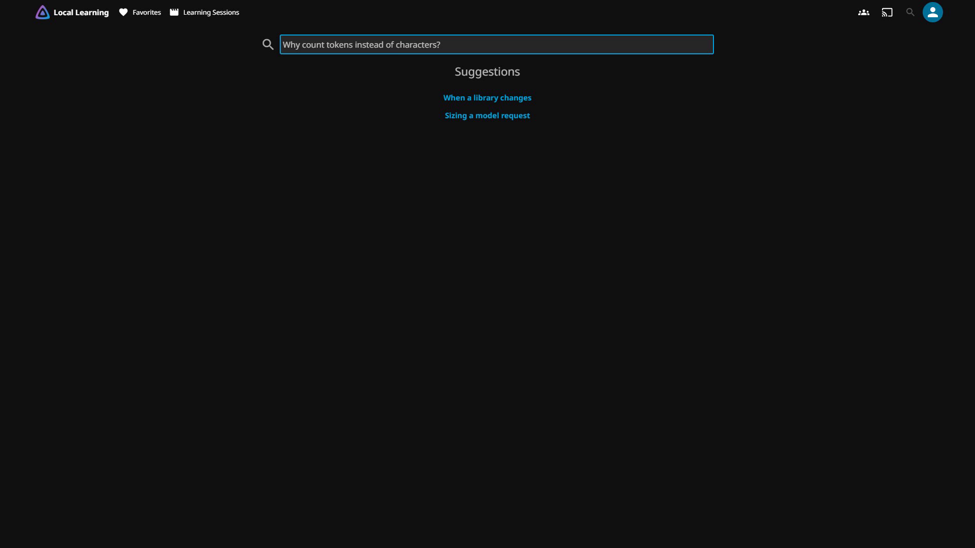
Your app. New possibilities.
Add intelligence without starting over.
Keep the application
Jellyfin stays Jellyfin
Add a new capability
Search by meaning
Existing application + a new capability. Click the authentic search/playback clip.
Notes:
MAIN IDEA: Add intelligence to the app you already have, without starting over.
• Presenter tip: click the video to play it (about 20 seconds, no audio).
• Jellyfin is an open-source media server. We added search by meaning: a natural-language question ("Why count tokens instead of characters?") finds and plays the lesson that answers it.
• Nothing in the existing app was rebuilt; one capability was added.
TAKEAWAY: AI is another building block in your existing app.

Slide 5
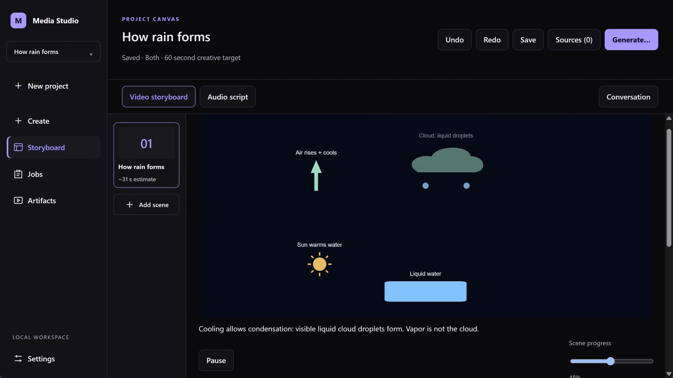
Beyond chat. From intent to action.
Compose capabilities. Collaborate with users.
Rich, collaborative UX
AG-UI + Blazor AI Components
Review, edit and approve
Choose the right chat model
Local/cloud chat models
RoutingChatClient + your policies
Storyboarding | Narration | Captions + transcription
Animations | Thumbnails | Rendering
Microsoft.Extensions.AI + app-owned services. Code for deterministic steps.
Blazor AI Components + RoutingChatClient are experimental; capability/API availability varies.
Notes:
MAIN IDEA: AI apps don't have to be chat boxes. Go from intent to action.
• Presenter tip: click the video to play it.
• Media Studio is a sample app: you give it an idea, and it helps produce a short explainer video - storyboard, narration, captions, animations, thumbnails, rendering.
• The person stays in the loop: the agent and the user work on the same storyboard (AG-UI + Blazor AI Components).
• The app chooses which model answers each request (RoutingChatClient + your policies), cloud or local.
• AI is used where it adds value; deterministic steps are plain app code.
• Blazor AI Components and RoutingChatClient are experimental.
TAKEAWAY: Compose capabilities and collaborate with users.

Slide 6
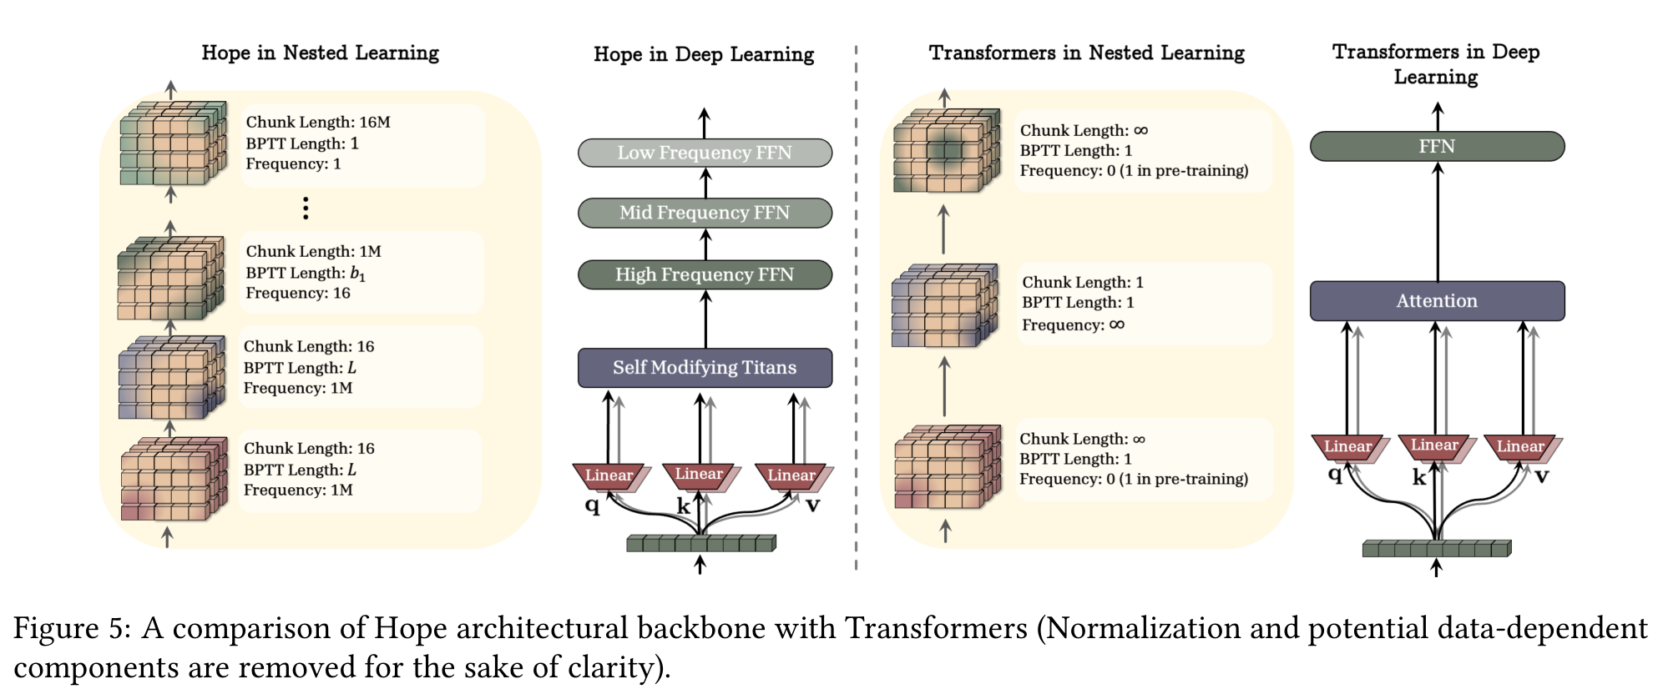
Let's build one.
A research paper in. A narrated explainer out. One .NET app.
1
Bring the paper
PDF + figures + tables
2
Read it
Sections, tables, Figure 5
3
Draft with an agent
Typed, cited scenes
4
Fix it and save
A person stays in charge
5
Produce
Voice, cover, motion, film
Behrouz et al., Nested Learning, arXiv:2512.24695v1, CC BY 4.0. Figure 5, original page 30.
.NET AI STACK / DEMO
Notes:
MAIN IDEA: A research paper in, a narrated explainer out, in one .NET app.
• Input: "Nested Learning" (Behrouz et al., arXiv:2512.24695v1, CC BY 4.0). A 4-page excerpt: original pages 1, 30 (Figure 5), 37 and 38 (results tables). The results are the authors' own.
• Five steps:
1. Bring the paper: attach the PDF.
2. Read it: extraction returns sections page by page, Figure 5 as an image described by a vision model, and the tables as Markdown text.
3. Draft with an agent: typed scenes with citations back to pages in the paper. Point out where the AI misread the direction of the Figure 5 diagram.
4. Fix it and save: a person corrects that sentence. Nothing is saved until the person presses Save, and production shows exactly what will run and asks for approval.
5. Produce: voice, cover, motion and the final film.
• Presenter tip: prepare each step ahead of time (cooking-show style) so the audience never watches progress bars; producing the film takes several minutes. If a live demo isn't possible, walk these steps and play the finished film on the next slide.
TAKEAWAY: Every step is a .NET building block, and a person stays in charge.

Slide 7
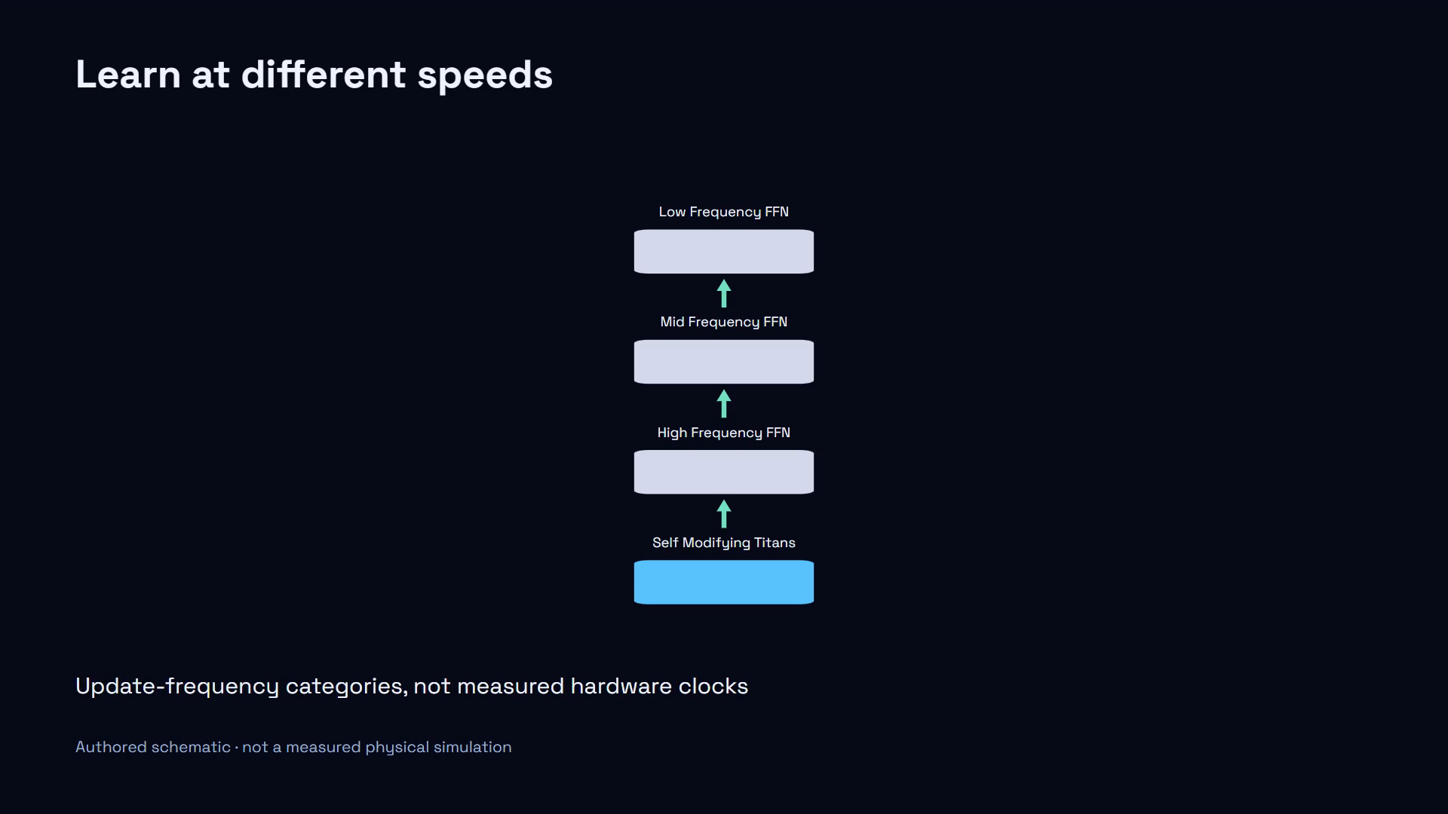
Done. Paper to explainer.
Prepared from the same project you just watched.
.NET AI STACK / DEMO
Notes:
MAIN IDEA: Paper in, narrated explainer out.
• Presenter tip: the film starts on its own with sound (about 96 seconds). Play the first scene or two, then advance.
• The story: why does your assistant forget? The paper proposes letting parts of a model learn at different speeds - fast for new things, slower for long-term memory. The Figure 5 scene is the one corrected in the demo. It closes with why it matters and its limits: a research proposal, not a product guarantee.
• Accuracy: the voice is local text-to-speech, the cover is an SVG drawn by a chat model, and the diagrams are authored animations, not AI-generated video. The findings belong to the paper's authors.
TAKEAWAY: A handful of .NET building blocks made this. Next, take it apart.

Slide 8
How it fits together.
Each contract does one job. Pink = new.
Experiences
AgentBoundary
AG-UI
PROVIDERS
NEW
Hosts the agent in a Blazor page
Streams agent events and state to the
UI
CLOUD
OpenAI (chat + Decisions)
Anthropic Claude (chat)
OpenAI Realtime (voice input)
Mistral OCR
GitHub Copilot SDK
Agents + tools
AIAgent
AIFunction
Runs the multi-step authoring task
Lets the model call your C# method
Multimodal
ITextToSpeechClient
IRealtimeClient
IImageGenerator
LOCAL
Reads each scene aloud
Streams your voice into a
brief
Makes the cover
PdfPig
Kokoro (voice-over)
Whisper.net (voice backup)
ONNX decision model
Context
DocumentExtractionClient
IngestionDocumentReader
NEW
Turns PDFs and images into pages,
sections, tables
Feeds them to token-sized chunking
APP
WPF + Blazor Hybrid
Aspire AppHost
Policy, state, approval
Models + decisions
IChatClient
RoutingChatClient
Decisions API
NEW
Talks to any model
Picks the model for each
request
Answers a typed question
with probabilities
Same contract.
Your choice of provider.
Shared Contracts: Microsoft.Extensions.AI · Microsoft.Extensions.DataIngestion
Core .NET: Microsoft.ML.Tokenizers · System.Numerics.Tensors
.NET AI STACK / MAP
Notes:
MAIN IDEA: Each contract does one job. Pink = new.
• Read each row by its job:
- Models + decisions: IChatClient talks to any model; RoutingChatClient picks the model per request; the Decisions API answers a typed question with probabilities.
- Context: DocumentExtractionClient turns PDFs and images into pages, sections and tables; IngestionDocumentReader feeds them to token-sized chunking.
- Multimodal: ITextToSpeechClient reads each scene aloud; IRealtimeClient streams your voice into the brief; IImageGenerator makes the cover.
- Agents + tools: AIFunction lets the model call your C# method; AIAgent runs the multi-step authoring task.
- Experiences: AgentBoundary hosts the agent in a Blazor page; AG-UI streams agent events and state to the UI.
• Underneath: shared contracts (Microsoft.Extensions.AI, Microsoft.Extensions.DataIngestion) and core .NET libraries (Microsoft.ML.Tokenizers, System.Numerics.Tensors).
• Right side: cloud and local providers, all behind the same contracts. The app decides which one to use.
TAKEAWAY: Same contract, your choice of provider.

Slide 9
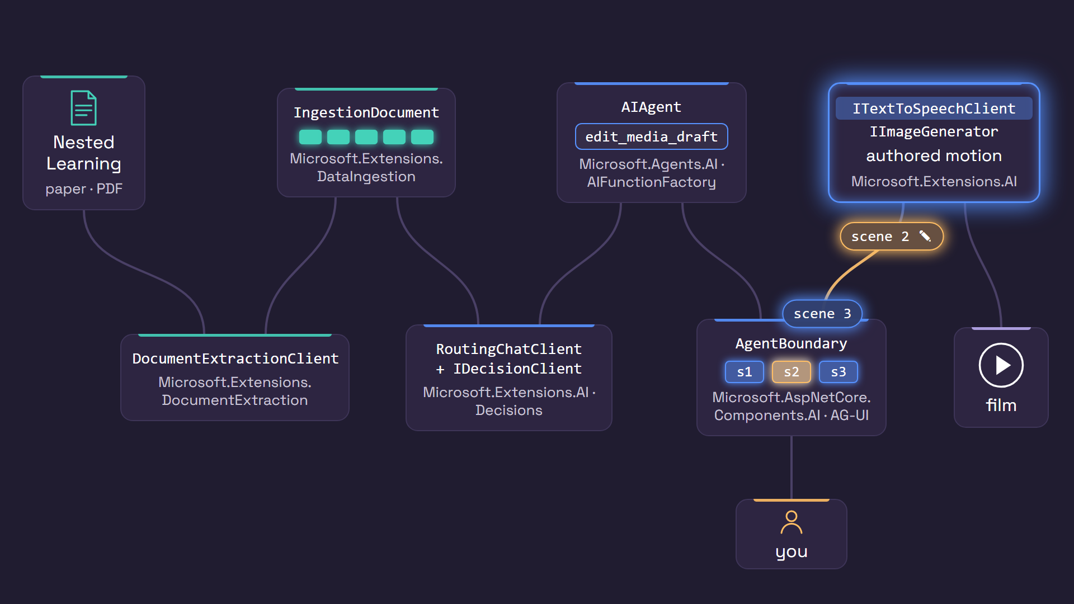
Follow one request.
PDF in, film out: every hop is a .NET contract.
Models
Decisions
Context
Multimodal
Tools
Agents
Experiences
.NET AI STACK / MAP
Notes:
MAIN IDEA: PDF in, film out - every hop is a .NET contract.
• Presenter tip: the animation loops; talk over it.
• The PDF goes into a DocumentExtractionClient and comes out as sections, which become an IngestionDocument.
• A RoutingChatClient, with help from a Decisions model, picks which model to use.
• The agent calls a tool to edit the draft, and typed, cited scenes come back.
• A person fixes a scene in the Blazor UI. Then speech, a cover and motion become the film.
• Accuracy: in the demo, the paper draft ran on the agent directly; routing is used by the storyboard planner and cover in the same app.
TAKEAWAY: Next, go block by block.

Slide 10
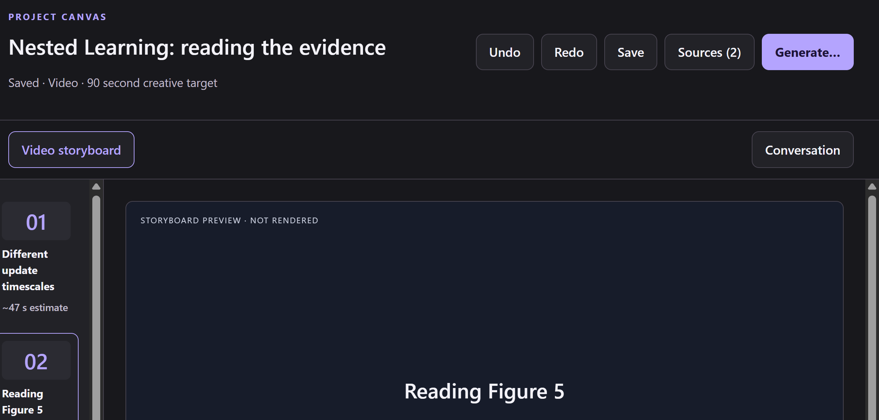
Talk to any model.
GPT or Claude: each SDK hands back the same IChatClient.
YOU SAW THIS
SOURCE / simplified from Planning.cs + FoundryAnthropic.cs
YOU SAW THIS
// Each official SDK has an AsIChatClient adapter
IChatClient gpt = new OpenAIClient(...)
.GetResponsesClient().AsIChatClient("gpt-6.1-sol");
IChatClient claude = new AnthropicClient(...)
.AsIChatClient("claude-sonnet-5-5");
// Same call, either model
var a = await gpt.GetResponseAsync(prompt);
var b = await claude.GetResponseAsync(prompt);
INPUT
INPUT
A prompt, plus provider + model from config
A prompt, plus provider + model from config
OUTPUT
OUTPUT
IChatClient: no OpenAI or Anthropic types
downstream
IChatClient: no OpenAI or Anthropic types
downstream
PACKAGES
Microsoft.Extensions.AI
Microsoft.Extensions.AI.OpenAI
Anthropic
Models
Decisions
Context
Multimodal
Tools
Agents
Experiences
.NET AI STACK / B1 MODELS + DECISIONS
Notes:
MAIN IDEA: Block one, Models. GPT or Claude - each official SDK hands back the same IChatClient.
• The OpenAI and Anthropic SDKs each provide an AsIChatClient adapter.
• After that, the call is the same for either model: GetResponseAsync.
• In the app, configuration picks the provider and model; nothing downstream sees OpenAI or Anthropic types.
• Adding a provider is one more case in one factory.
TAKEAWAY: Code against IChatClient; switch providers with configuration.

Slide 11
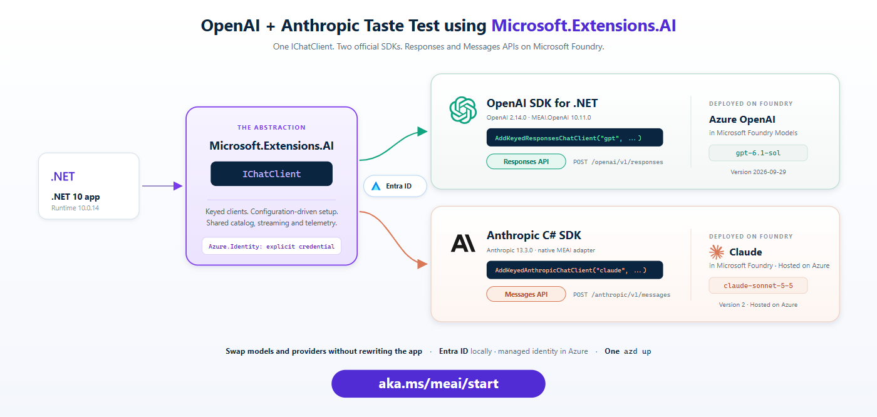
Try it: GPT and Claude, side by side.
NEW SAMPLE
NEW sample: one IChatClient, two official SDKs.
Ask once. Both models answer. Vote blind, then reveal.
Models
Decisions
Context
Multimodal
Tools
Agents
Experiences
.NET AI STACK / B1 MODELS + DECISIONS
Notes:
MAIN IDEA: A new sample shows one IChatClient over two official SDKs.
• Find it at aka.ms/meai/start.
• It's a blind taste test: ask once, GPT and Claude both answer, vote without knowing which is which, then reveal.
TAKEAWAY: One contract, your choice of model.

Slide 12
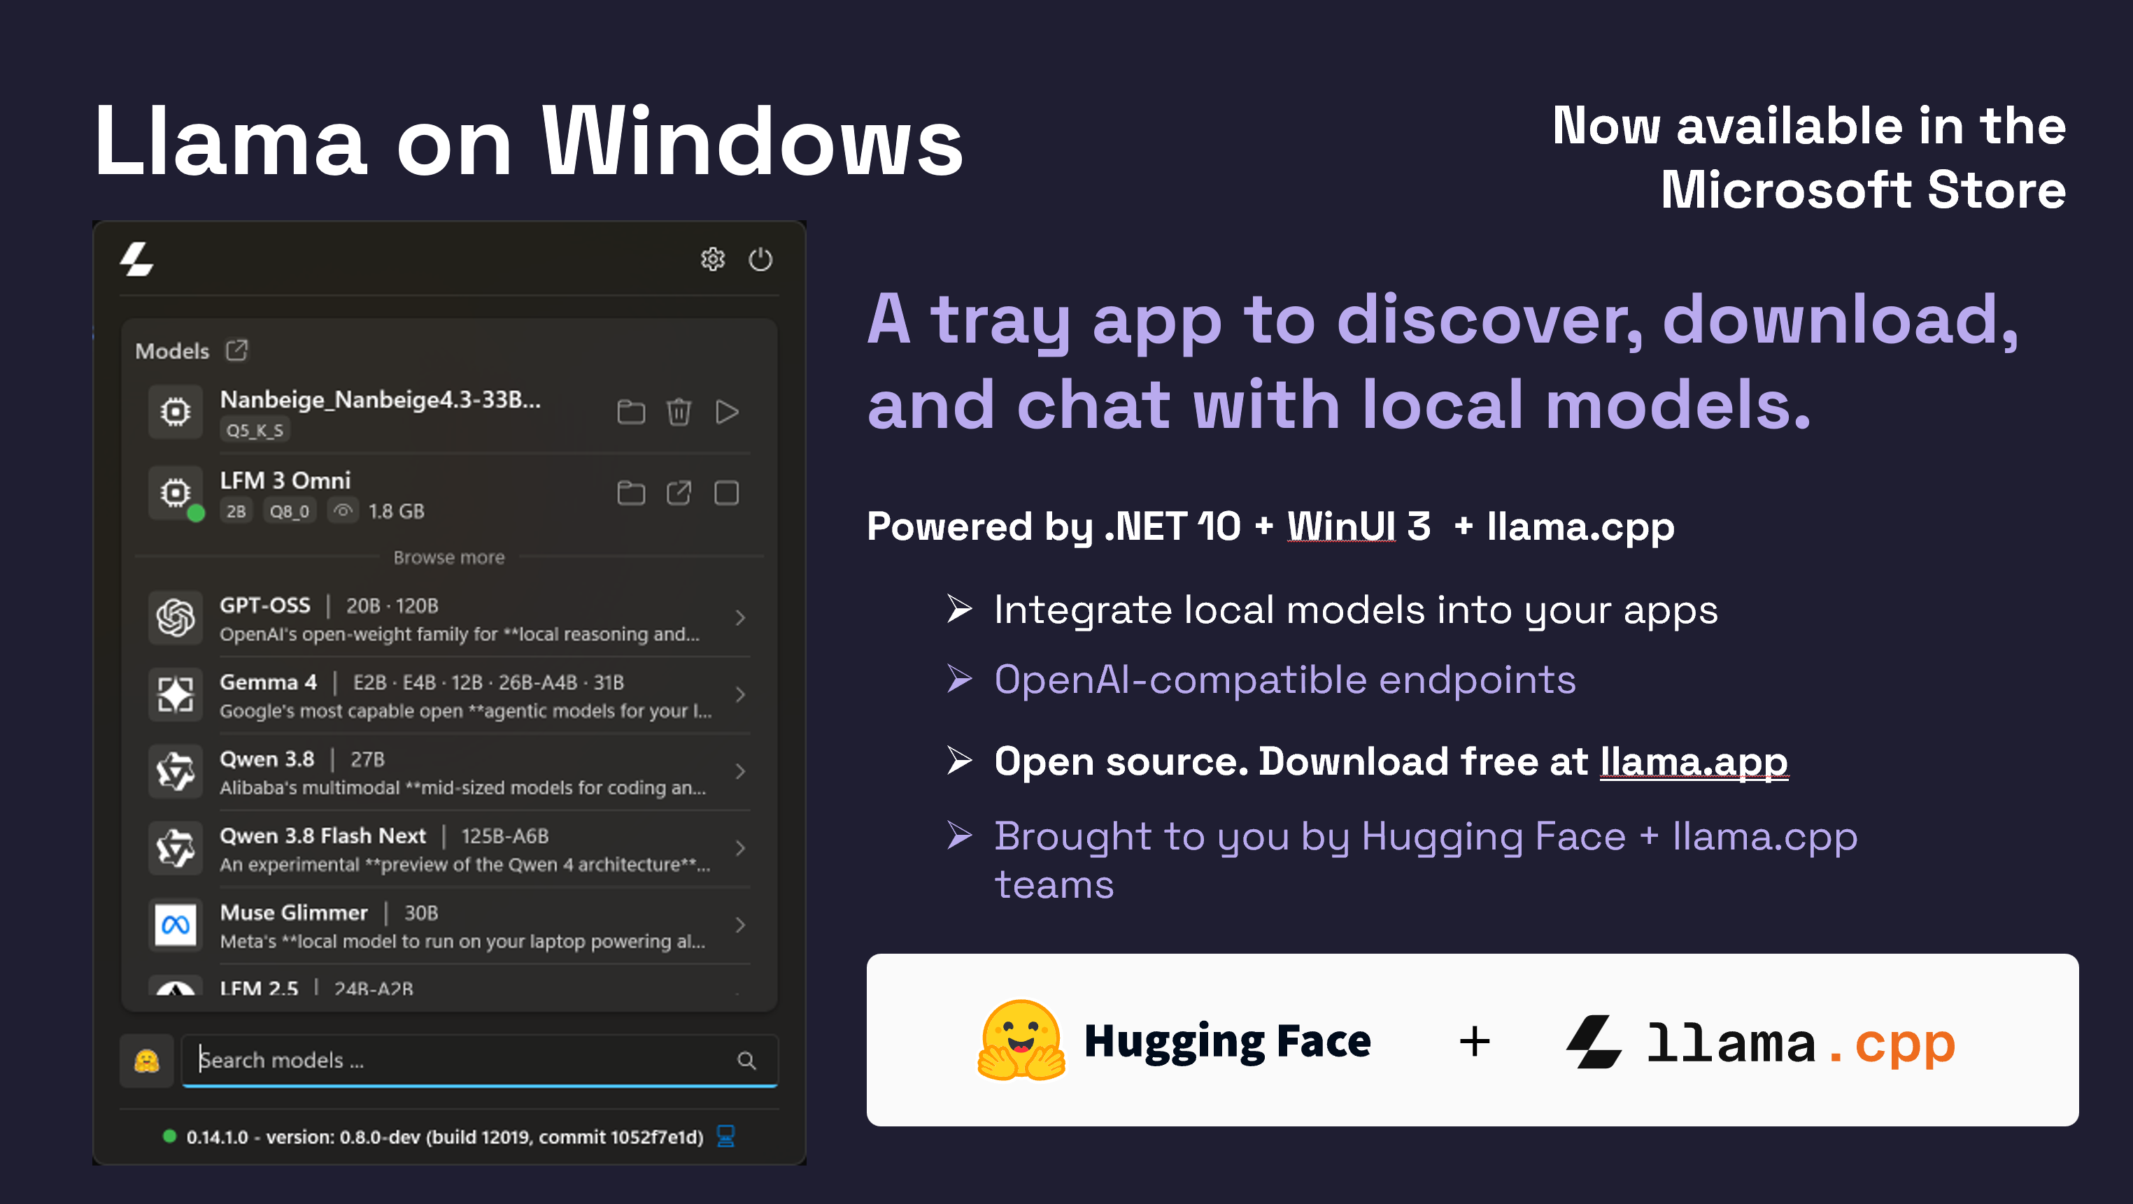
Notes:
MAIN IDEA: Local models are just another provider. Llama on Windows.
• A tray app to discover, download and chat with local models, now in the Microsoft Store.
• Built with .NET 10, WinUI 3 and llama.cpp. Open source; download free at llama.app. Brought to you by the Hugging Face and llama.cpp teams.
• It exposes OpenAI-compatible endpoints, so your app can call local models with the same client code it uses for the cloud.
TAKEAWAY: Cloud or local, you integrate models the same way.

Slide 13
Which model should answer?
NEW: RoutingChatClient. Your policy picks from a pool of IChatClients.
THE POLICY: A PLAIN RECORD / ChatRouting.cs
THE POOL: NAMED ROUTES
public sealed record ChatRoutePolicy(
string Version, string DevelopmentEvidenceSha256,
bool LocalOnly = true, bool RequireJson = false, bool AllowTools = false,
int MaxInputCharacters = 24000, int MaxOutputTokens = 4096,
double MinimumProbability = .7, double MinimumMargin = .2,
string? UncertainRoute = null);
{ "name": "gpt",
"model": "gpt-6.1-sol" },
{ "name": "claude",
"provider": "anthropic",
"model": "claude-sonnet-5-5" }
THE ROUTER: STILL JUST AN ICHATCLIENT
NEW · HOW IT DECIDES
router = RoutingChatClient.Create(async (context, ct) =>
{
var receipt = await Select(context.Messages,
context.ChatOptions, ct);
var route = Routes.Single(r => r.Name == receipt.SelectedRoute);
return new SelectedChatClient(clients[route.Name].Value, ...);
});
1
The policy filters the pool:
approved, local, JSON, tools, size.
2
Decisions scores
what's left.
3
Not sure enough?
Named fallback, or stop.
PACKAGES
Same router plans the video and draws the cover.
Microsoft.Extensions.AI
Models
Decisions
Context
Multimodal
Tools
Agents
Experiences
.NET AI STACK / B1 MODELS + DECISIONS
Notes:
MAIN IDEA: Block two, Decisions. New: RoutingChatClient - your policy picks from a pool of IChatClients.
• Not every request needs your biggest model.
• RoutingChatClient takes a callback that returns the client to use for each request. To the rest of your code, it's still just an IChatClient.
• The pool is a set of named routes (for example, a GPT route and a Claude route). The same router plans the video and draws the cover.
• The policy is a plain record: local-only or not, JSON or tools required, size limits, and how confident the model must be before its pick is trusted.
• How it decides:
1. The policy filters the pool.
2. Decisions scores what's left.
3. Not confident enough? Use a named fallback route, or stop and call nothing.
• Every choice records a receipt, so a retry uses the same route.
TAKEAWAY: Your app owns the routing rules; the router is just another IChatClient.

Slide 14
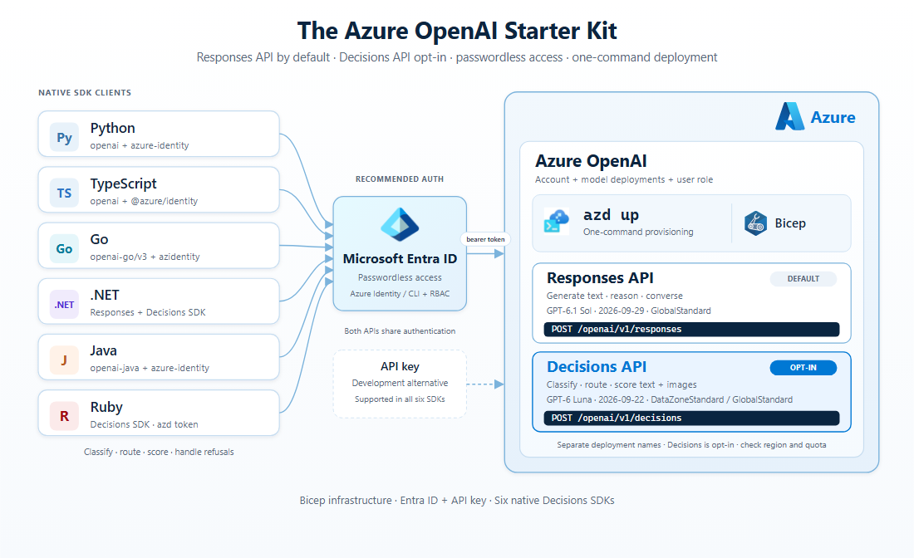
Ask a typed question. Get a typed answer.
NEW: OpenAI Decisions API. Same contract, cloud or local.
SOURCE / src/VideoProduction.Providers/ChatRouting.cs
var question = new ChoiceDecisionQuestion("route", "Choose the best eligible provider...",
domain.Select(r => new DecisionCandidate(r.Name, r.Description)).ToArray());
var response = await decision.Value.GetResponseAsync(state, ..., [question], cancellationToken: ct);
var answer = response.Answers.Single() as ChoiceDecisionAnswer; // choice + probabilities
aka.ms/openai/start
CLOUD / OpenAiDecisionClient.cs
TRY IT
class OpenAiDecisionClient(DecisionsClient client, ...) : IDecisionClient
await client.CreateDecisionAsync(creation, ct);
OpenAI
LOCAL / Julia/JuliaDecisionClient.cs
class JuliaDecisionClient : IDecisionClient // local ONNX model
class JuliaTokenizer : Microsoft.ML.Tokenizers.Tokenizer
_inner.Encode(input, ...) // Tokenizers.HuggingFace inside
Microsoft.ML.OnnxRuntime
Microsoft.ML.Tokenizers
System.Numerics.Tensors
Models
Decisions
Context
Multimodal
Tools
Agents
Experiences
.NET AI STACK / B1 MODELS + DECISIONS
Notes:
MAIN IDEA: New: the OpenAI Decisions API. Ask a typed question, get a typed answer.
• Example: "Which of these routes?" The answer is the choice plus the probabilities - no text parsing.
• In the app, it sits behind one small interface with two implementations:
- Cloud: OpenAI Decisions.
- Local: a small ONNX model. Its tokenizer plugs in behind the Microsoft.ML.Tokenizers Tokenizer base class, and System.Numerics.Tensors does the math.
• Same calling code, cloud or local.
• Decision abstractions in Microsoft.Extensions.AI are coming soon; this previews the shape.
• Try it: the Azure OpenAI Starter Kit at aka.ms/openai/start.
TAKEAWAY: Sometimes you need a decision, not a conversation.

Slide 15
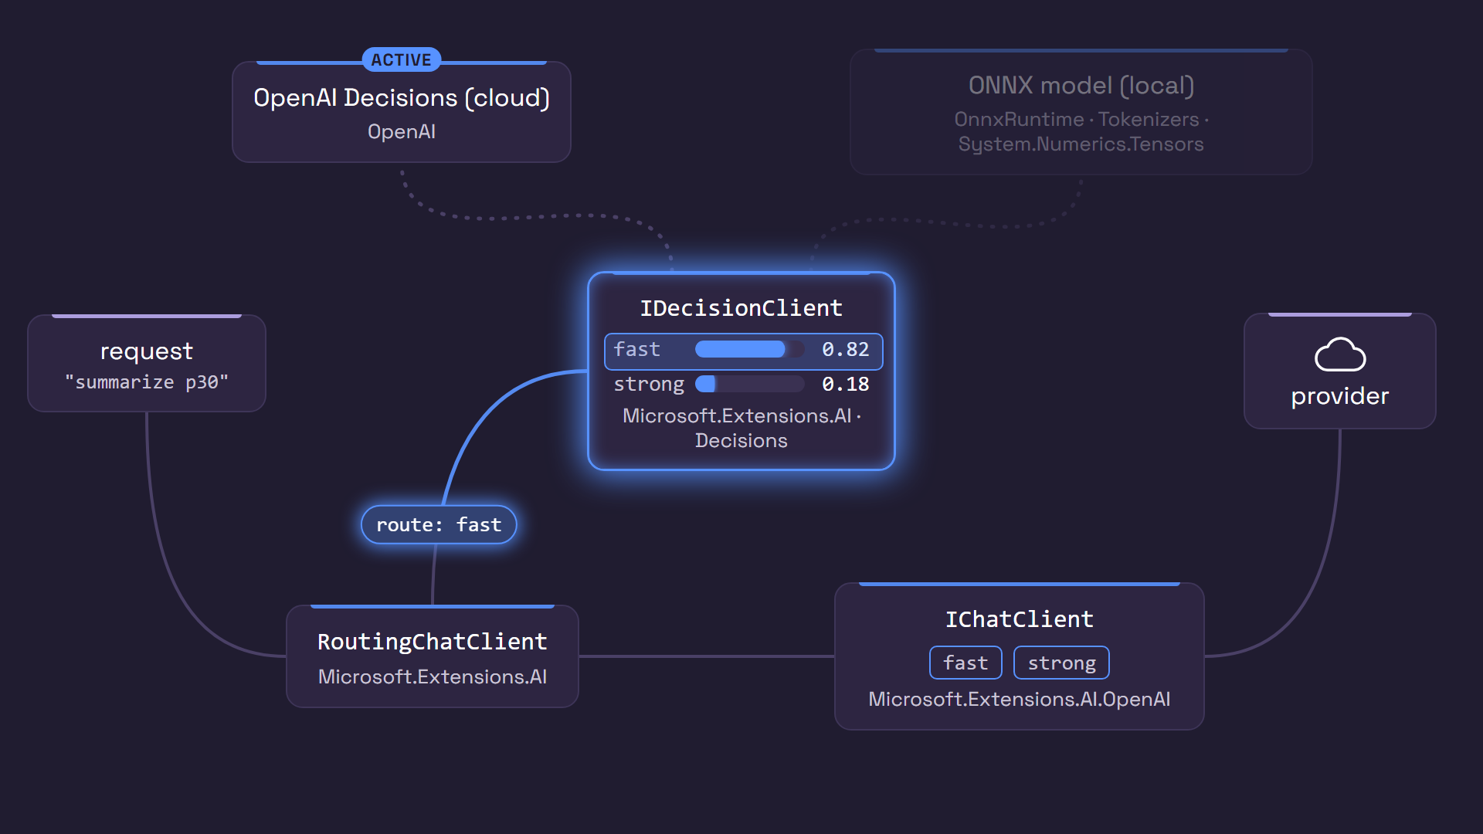
Decisions, in motion.
Policy filters. Decisions scores. RoutingChatClient routes.
Models
Decisions
Context
Multimodal
Tools
Agents
Experiences
.NET AI STACK / B1 MODELS + DECISIONS
Notes:
MAIN IDEA: Policy filters, Decisions scores, RoutingChatClient routes.
• Presenter tip: the animation loops; talk over it.
• A request comes in, and the policy filters the routes.
• The decision client scores the eligible routes, and the winner is selected.
• The call goes through IChatClient to that provider.
TAKEAWAY: Rules first, then a scored choice, then the call.

Slide 16
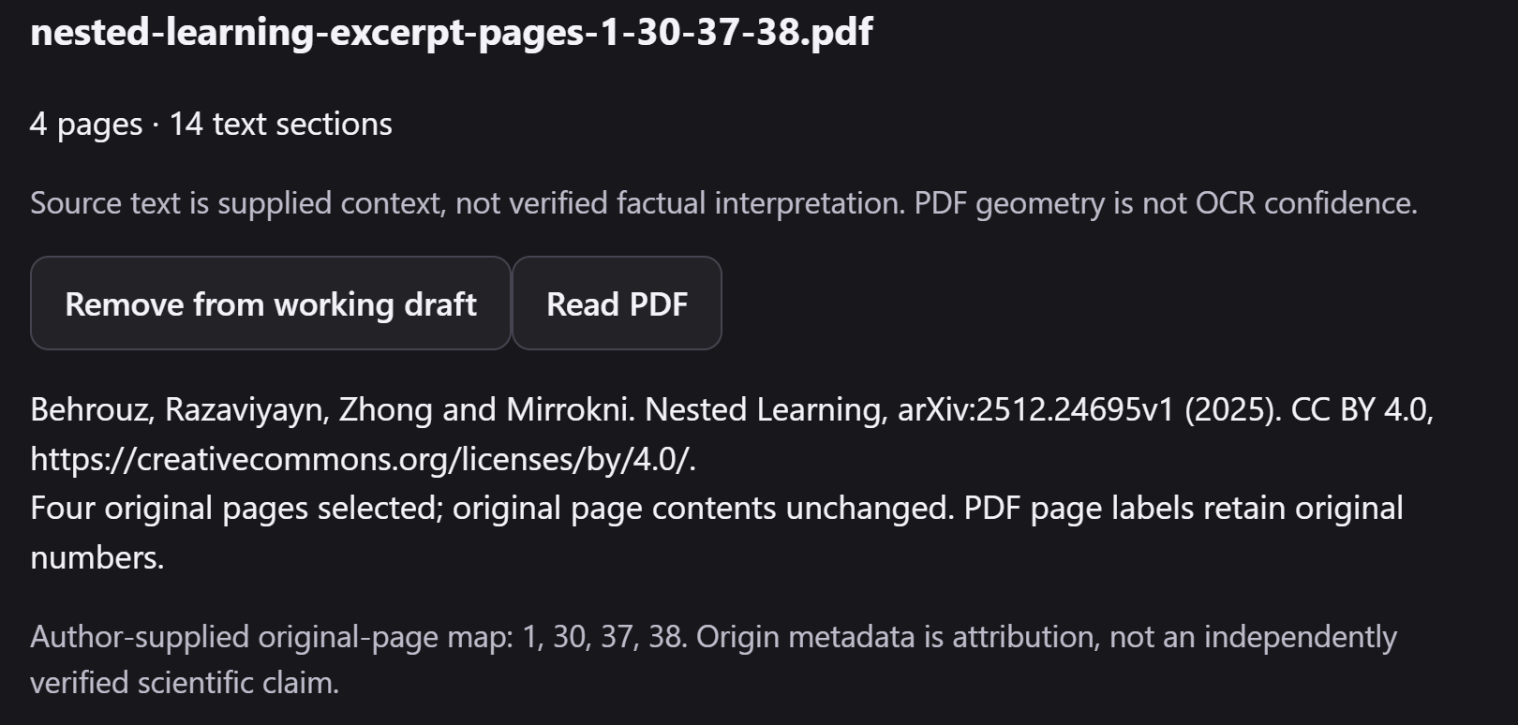
Bring your context.
NEW: DocumentExtractionClient. One contract, three readers.
SOURCE / src/MediaStudio.Sources/DocumentSources.cs
YOU SAW THIS
this.pdf = pdf ?? new PdfPigDocumentExtractionClient(); // local
ocr = nativeOcr // Mistral OCR (cloud)
?? new VisionLanguageModelDocumentExtractionClient(ocrChat!,
new() { UseStructuredOutput = ocrCapabilities.StructuredOutput });
imageReader = new VisionLanguageModelDocumentExtractionClient(ocrChat,
new() { Prompt = ImageReadingPrompt }); // any vision IChatClient
NEW · WHAT IT IS
One contract for reading documents: a file goes in,
pages, sections, tables and images come out. Swap
the reader, keep your code.
INPUT
4-page PDF excerpt (original pages 1, 30, 37, 38)
OUTPUT
4 pages, 14 sections, Figure 5, tables as Markdown
PACKAGES
Microsoft.Extensions.DocumentExtraction
CommunityToolkit.DocumentExtraction.{PdfPig, Mistral, VisionLanguageModel}
Models
Decisions
Context
Multimodal
Tools
Agents
Experiences
.NET AI STACK / B2 CONTEXT
Notes:
MAIN IDEA: Block three, Context. New: DocumentExtractionClient - one contract, three readers.
• Its job: a file goes in; pages, sections, tables and images come out.
• Swap the reader, keep your code:
- PdfPig: local, reads the text already in the PDF.
- Mistral OCR: cloud.
- Vision-language model reader: wraps any IChatClient that can see images.
• For the paper: 4 pages, 14 sections, Figure 5 as an image, and tables as Markdown text (not structured cells).
• Packages: Microsoft.Extensions.DocumentExtraction, with readers from CommunityToolkit.DocumentExtraction.
TAKEAWAY: Any IChatClient that can see can read your documents.

Slide 17
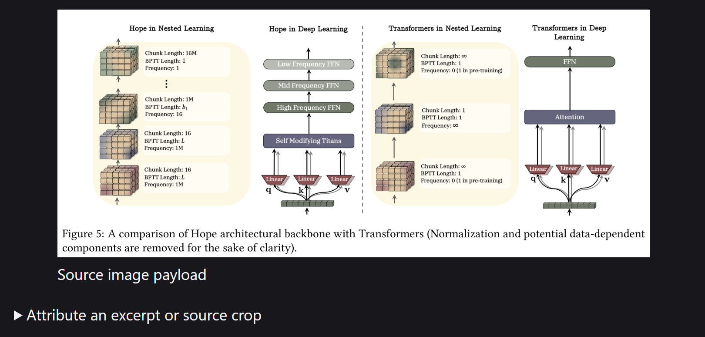
From pages to knowledge.
Extraction feeds Microsoft.Extensions.DataIngestion.
YOU SAW THIS
SOURCE / src/MediaStudio.Sources/DocumentSources.cs
YOU SAW THIS
class ExtractionIngestionReader(DocumentExtractionClient client, ...)
: IngestionDocumentReader
{
public override async Task<IngestionDocument> ReadAsync(Stream source,
string identifier, string mediaType, CancellationToken ct = default)
{
LastExtraction = await client.ExtractAsync(
source, identifier, mediaType, options, ct);
return Bridge(LastExtraction); // -> IngestionDocument
}
}
INPUT
INPUT
Extraction graph: pages, sections, figure bytes
Extraction graph: pages, sections, figure bytes
OUTPUT
OUTPUT
IngestionDocument for chunking; Figure 5 as
DataContent to a vision model
IngestionDocument for chunking; Figure 5 as
DataContent to a vision model
PACKAGES
Microsoft.Extensions.DataIngestion
Microsoft.Extensions.DocumentExtraction
Microsoft.ML.Tokenizers
Models
Decisions
Context
Multimodal
Tools
Agents
Experiences
.NET AI STACK / B2 CONTEXT
Notes:
MAIN IDEA: Extraction feeds Microsoft.Extensions.DataIngestion.
• A small adapter turns any extraction client into an IngestionDocumentReader.
• That unlocks the whole ingestion pipeline: chunking, enriching and writing to your store.
• Figure 5 goes to a vision model as DataContent. It described the panels and flagged where it wasn't sure; a person then checked it and corrected the direction.
TAKEAWAY: Reading isn't understanding, and understanding isn't checking. Keep those steps separate.

Slide 18
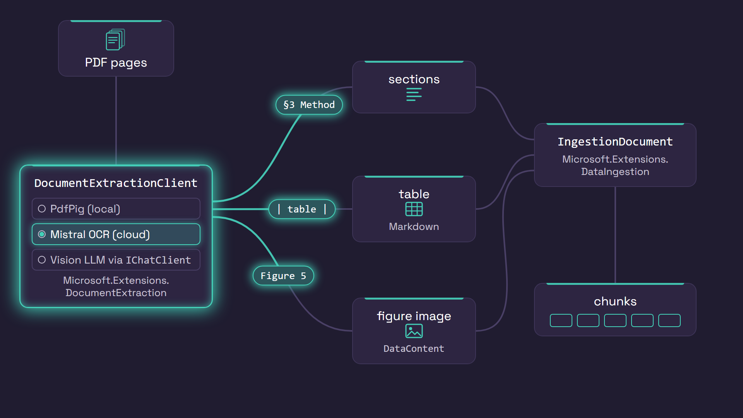
Context, in motion.
Swap the reader. Keep the contract.
Models
Decisions
Context
Multimodal
Tools
Agents
Experiences
.NET AI STACK / B2 CONTEXT
Notes:
MAIN IDEA: Swap the reader, keep the contract.
• Presenter tip: the animation loops; talk over it.
• Pages go in; the reader can be PdfPig, Mistral OCR or a vision model.
• Sections, tables and figures come out the other side, ready for ingestion.
TAKEAWAY: The extraction contract stays the same whichever reader you choose.

Slide 19
Multimodal: hear it.
A voice for every scene, captions timed to it, and your voice as input.
SOURCE / src/Media.Narration/Speech.cs · StudioHybrid.Wpf/CloudSpeechInput.cs, RealtimeDictation.cs
LISTEN
response = await client.GetAudioAsync(displayText, new TextToSpeechOptions
{
VoiceId = request.Voice, Language = request.Language,
Speed = request.Speed, Volume = 1, AudioFormat = "wav"
}, ct); // client = Kokoro, local
var session = await realtime.CreateSessionAsync(new RealtimeSessionOptions {
SessionKind = RealtimeSessionKind.Transcription,
TranscriptionOptions = new() { ModelId = "gpt-live-transcribe" } });
await session.SendAsync(new InputAudioBufferAppendRealtimeClientMessage(
new DataContent(pcm, "audio/pcm"))); // words stream back as you talk
WHAT THEY DO
Text-to-speech: scene text in, voice-over out;
captions are timed to that voice. Realtime: you talk,
the brief types itself.
INPUT
Scene narration text · your live mic audio
OUTPUT
WAV narration (captions timed from it) · live brief
PACKAGES
Microsoft.Extensions.AI
Kokoro (local)
OpenAI Realtime
Models
Decisions
Context
Multimodal
Tools
Agents
Experiences
.NET AI STACK / B3 MULTIMODAL
Notes:
MAIN IDEA: Block four, Multimodal. Going beyond text in a chat box: a voice for every scene, captions timed to it, and your voice as input.
• Text-to-speech (ITextToSpeechClient): scene text in, narration out, once per scene. In the demo, Kokoro runs locally.
• Captions are timed from the narration the app already has; no speech recognition is needed.
• Voice input (IRealtimeClient): you talk, and the brief types itself as you speak, using OpenAI Realtime transcription. A local Whisper model can serve as an offline backup.
• Everything sits behind Microsoft.Extensions.AI interfaces, so providers can be swapped.
• Text-to-speech and realtime APIs are experimental.
TAKEAWAY: Speech in and out uses the same contract-first approach as chat.

Slide 20
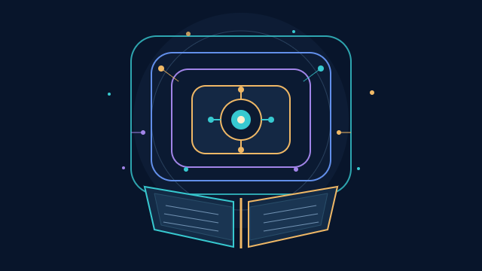
Multimodal: see it.
A chat model draws the cover, behind IImageGenerator.
SOURCE / src/VideoProduction.Providers/ChatSvgImageGenerator.cs
COVER
class ChatSvgImageGenerator(IChatClient chat, ...) : IImageGenerator
{
// 1. ask a chat model for a picture, as SVG text
response = await chat.GetResponseAsync(
[new(ChatRole.System, "Return bare SVG only ..."),
new(ChatRole.User, request.Prompt)], ...);
// 2. check it, 3. render it to PNG with a pinned font
var svg = SafeSvg.Validate(response.Text, size.Width, size.Height);
return new ImageGenerationResponse([new DataContent(bytes, "image/png")]);
}
NO IMAGE MODEL HERE
IImageGenerator is the contract. Behind it, a chat
model writes SVG; the app checks and renders it. A
native image model can drop in later.
INPUT
Project title -> cover prompt
OUTPUT
One PNG cover, with the SVG kept as evidence
PACKAGES
Microsoft.Extensions.AI
Microsoft.Extensions.AI.OpenAI
Models
Decisions
Context
Multimodal
Tools
Agents
Experiences
.NET AI STACK / B3 MULTIMODAL
Notes:
MAIN IDEA: A chat model draws the cover, behind IImageGenerator.
• There's no image model here: a chat model is asked for an SVG drawing, as text.
• The app validates that the SVG is safe, renders it to PNG, and returns a normal image response.
• The rest of the app can't tell the difference. A native image model can drop in later behind the same interface.
• The motion in the film is different again: authored diagrams, not generated video.
TAKEAWAY: The contract is the boundary; what's behind it can change.

Slide 21
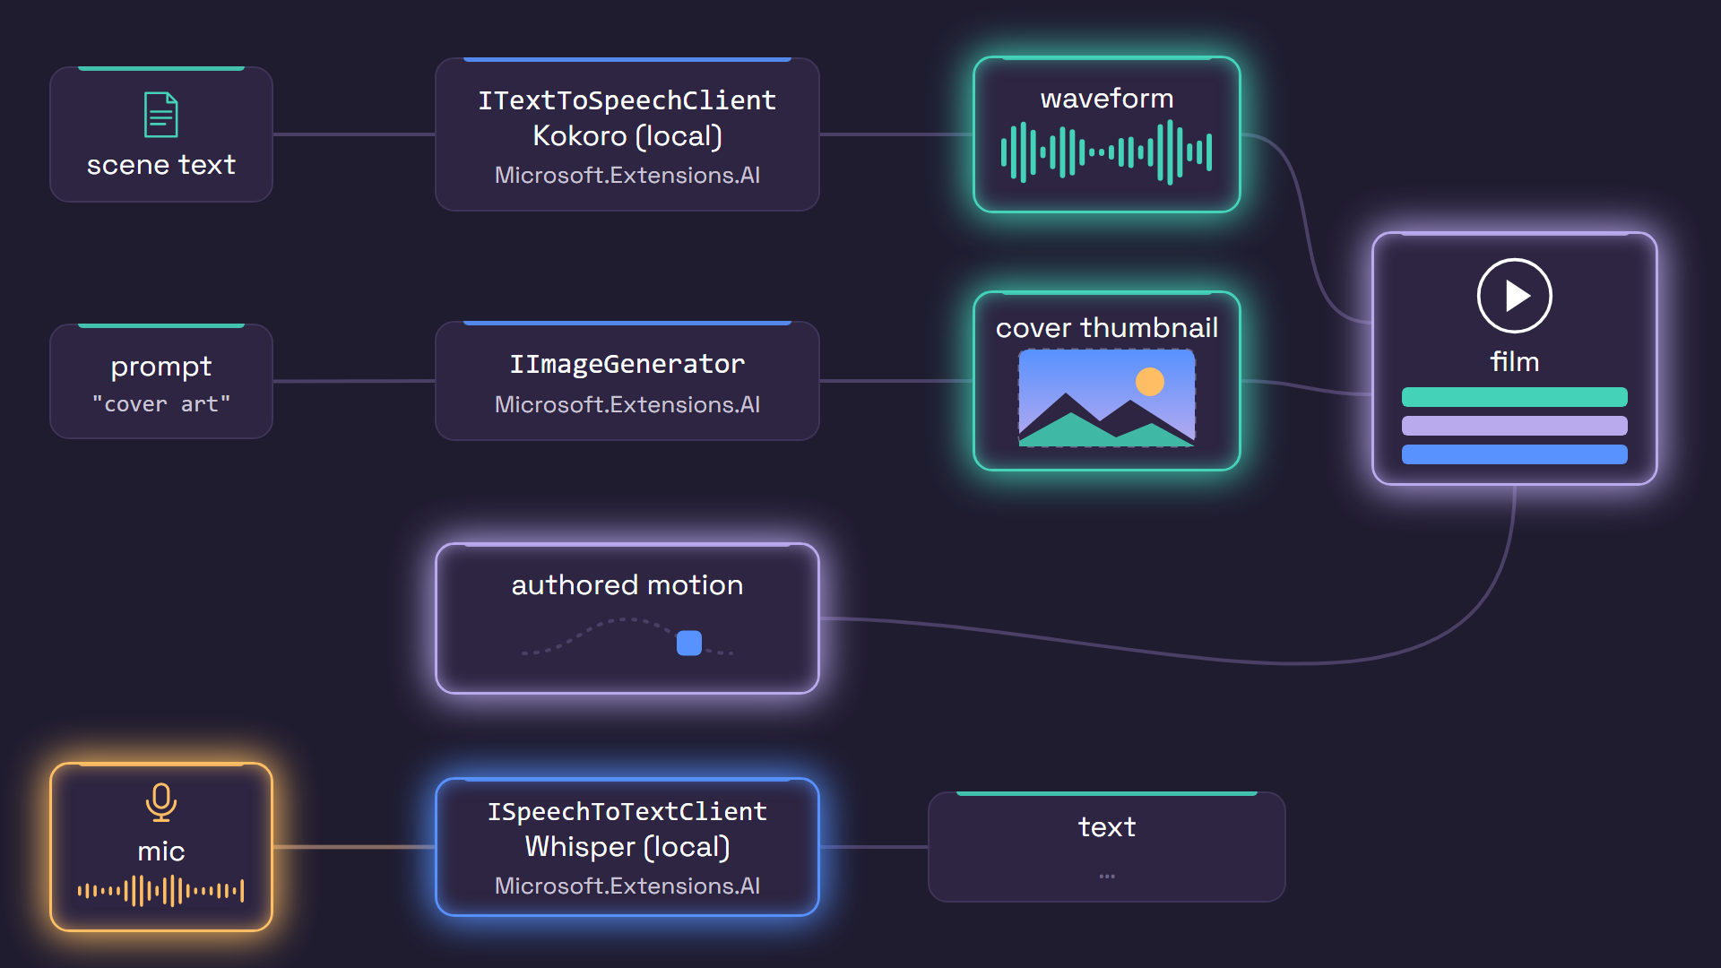
Multimodal: how it becomes a film.
AI makes the parts. Plain app code puts them together.
1
Storyboard
IChatClient: scene text
2
Cover + scene images
IImageGenerator
3
Narration
ITextToSpeechClient
4
Captions
timed from the narration
5
Motion frames
HTML + GSAP, rendered
6
Film
FFmpeg encodes the MP4
AI CONTRACT
APP CODE, NOT AI
Models
Decisions
Context
Multimodal
Tools
Agents
Experiences
.NET AI STACK / B3 MULTIMODAL
Notes:
MAIN IDEA: AI makes the parts; plain app code puts them together.
• Presenter tip: the animation loops; talk over it.
• AI contracts: a chat model writes the storyboard (scene text); IImageGenerator makes the cover and scene images; ITextToSpeechClient narrates each scene.
• App code, not AI: captions timed from the narration; motion frames rendered from HTML and GSAP; FFmpeg encodes the MP4, and the app checks the result.
TAKEAWAY: No AI-generated video. AI makes the ingredients; your code assembles them.

Slide 22
Give the model a tool.
AIFunctionFactory turns a .NET method into a typed tool.
YOU SAW THIS
SOURCE / experiments/StudioHybrid.ApiProbe/MediaDraftTool.cs
YOU SAW THIS
static AIFunction Create(Delegate method, string name, string description) =>
AIFunctionFactory.Create(method, new AIFunctionFactoryOptions {
Name = name, Description = description,
SerializerOptions = Json.Options });
tools.Add(Create(SetItemTarget, "set_item_target",
"Set a creative duration target in seconds for one existing item."));
INPUT
INPUT
A C# method and a description
A C# method and a description
OUTPUT
OUTPUT
AIFunction with a JSON schema; returns a typed
acknowledgement
AIFunction with a JSON schema; returns a typed
acknowledgement
PACKAGES
Microsoft.Extensions.AI
Models
Decisions
Context
Multimodal
Tools
Agents
Experiences
.NET AI STACK / B4 TOOLS, AGENTS, EXPERIENCES
Notes:
MAIN IDEA: Block five, Tools. AIFunctionFactory turns a .NET method into a typed tool.
• A regular C# method plus a description becomes an AIFunction with a JSON schema.
• In the app, the tool proposes one change to an exact version of the draft. The model never touches files; the app checks the change, applies it and returns a typed acknowledgement rather than text to parse.
• To make tools available to any agent or app, use MCP and the MCP C# SDK 2.0.
TAKEAWAY: Tools let the model act - through your code and your checks.

Slide 23
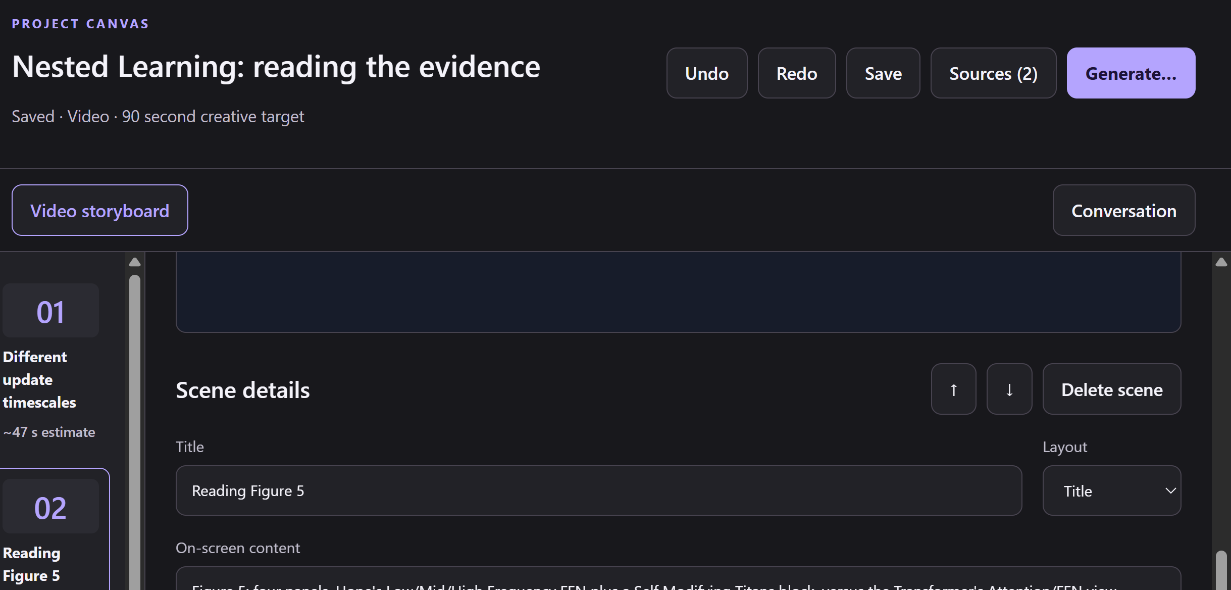
Make it an agent.
Microsoft Agent Framework: any IChatClient, or the GitHub Copilot SDK.
YOU SAW THIS
SOURCE / experiments/StudioHybrid.ApiProbe/CopilotAuthoringAgent.cs
YOU SAW THIS
public sealed class CopilotAuthoringAgent : AIAgent, IAsyncDisposable
if (chatClient is not null) // any IChatClient
backend = chatClient.AsAIAgent(
instructions: configuration.SystemMessage!.Content, name: Name);
else // GitHub Copilot SDK
backend = copilot.AsAIAgent(configuration, ownsClient: false);
var session = await backend.CreateSessionAsync(cancellationToken);
INPUT
INPUT
Brief + sources + the tools
Brief + sources + the tools
OUTPUT
OUTPUT
An agent session that streams tool calls and text
An agent session that streams tool calls and text
PACKAGES
Microsoft.Agents.AI
Microsoft.Agents.AI.GitHub.Copilot
GitHub.Copilot.SDK
Models
Decisions
Context
Multimodal
Tools
Agents
Experiences
.NET AI STACK / B4 TOOLS, AGENTS, EXPERIENCES
Notes:
MAIN IDEA: Block six, Agents. Microsoft Agent Framework with any IChatClient, or the GitHub Copilot SDK.
• The authoring agent is an AIAgent.
• Behind it: either any IChatClient (one call to AsAIAgent) or the GitHub Copilot SDK.
• Input: the brief, the sources and the tools. Output: an agent session that streams tool calls and text.
• In the demo, the paper draft - its scenes and citations - came from this agent.
TAKEAWAY: Swap the agent's backend without changing the app.

Slide 24
New: put an agent in your UI.
NEW
Two new pieces. One protocol, one set of components.
THE PROTOCOL
THE UI
AG-UI for .NET
Blazor AI components
Agent streams typed events
Run, text, tool call, state change
Works with any front end
<AgentBoundary> hosts an agent
Components render live state
The person edits; Save persists
AGUI.Server
AGUI.Client
Microsoft.AspNetCore.Components.AI
Agent ⇄ AG-UI events ⇄ Blazor UI: the agent proposes, the person decides.
Models
Decisions
Context
Multimodal
Tools
Agents
Experiences
.NET AI STACK / B4 TOOLS, AGENTS, EXPERIENCES
Notes:
MAIN IDEA: Block seven, Experiences. Two new pieces: one protocol, one set of components.
• Most apps need the agent in the UI, next to a person - not in a console.
• AG-UI for .NET is a protocol: while the agent works, it streams typed events (run started, text, tool call, state change, run finished). Any front end can listen.
• Blazor AI components speak that protocol: AgentBoundary hosts an agent on a page, and your components render its live state.
• The agent and the person edit the same thing, live.
TAKEAWAY: The agent proposes; the person decides.

Slide 25
Put the agent in the UI.
NEW: AG-UI for .NET + Blazor AI components.
SOURCE / VideoStudio.Client/Pages/Home.razor · StudioHybrid.Wpf/MediaWorkspace.cs
YOU SAW THIS
<AgentBoundary Agent="agent" @key="agent">
<AuthorActivity @ref="activity" />
</AgentBoundary>
agentClient = new(new AGUIChatClientOptions
{ Transport = transport, JsonSerializerOptions = Json.Options });
var agent = new UIAgent<MediaDraftState>(agentClient, options => ...);
NEW · HOW IT CONNECTS
The client reads AG-UI events from the agent.
UIAgent keeps the draft as typed state that both
the agent and the person can change.
INPUT
AG-UI events: run, tool call, state delta
OUTPUT
Live scene cards a person edits and saves
PACKAGES
Microsoft.AspNetCore.Components.AI
AGUI.Server
AGUI.Client
Models
Decisions
Context
Multimodal
Tools
Agents
Experiences
.NET AI STACK / B4 TOOLS, AGENTS, EXPERIENCES
Notes:
MAIN IDEA: New: AG-UI for .NET + Blazor AI components, in the app.
• In the Razor page, AgentBoundary wraps the activity panel.
• An AG-UI client connects to the agent, and UIAgent keeps the draft as typed state that both the agent and the person can change.
• When the agent changes a scene, the card updates; when the person edits it, the agent sees that too.
• Nothing is saved until the person presses Save.
• Both pieces are new and experimental.
TAKEAWAY: Shared, typed state keeps the person and the agent in sync.

Slide 26
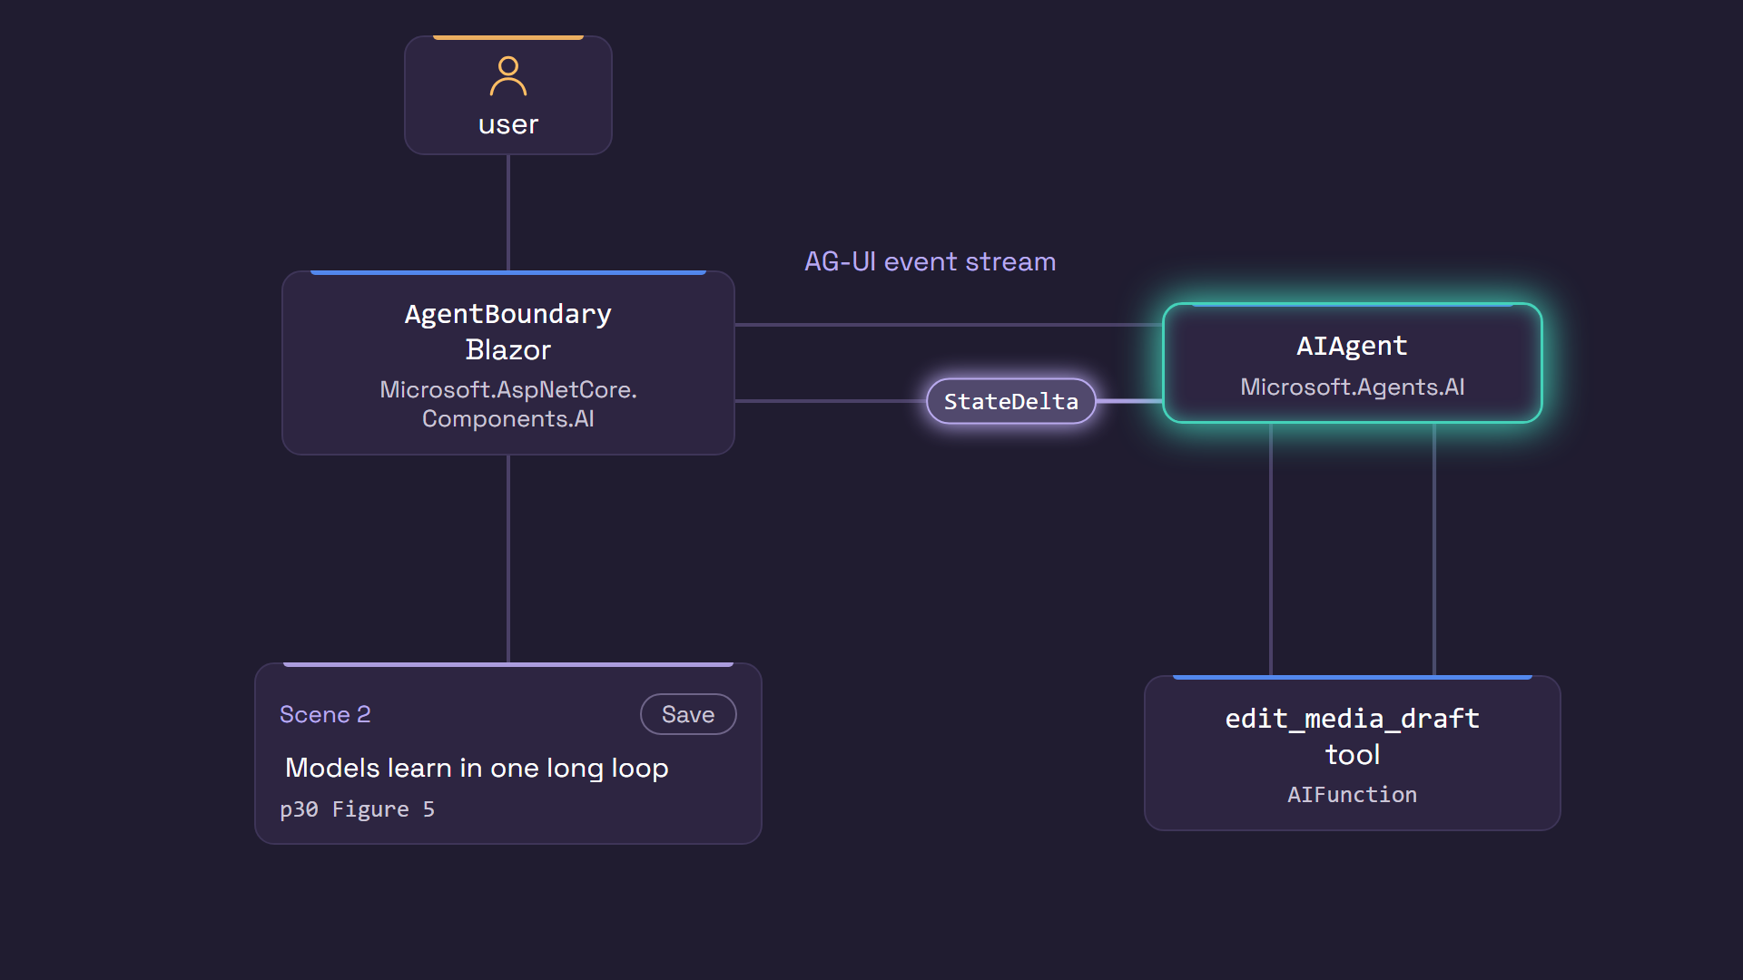
The agent and the UI, in motion.
Propose, show, fix, save: the person stays in charge.
Models
Decisions
Context
Multimodal
Tools
Agents
Experiences
.NET AI STACK / B4 TOOLS, AGENTS, EXPERIENCES
Notes:
MAIN IDEA: Propose, show, fix, save - the person stays in charge.
• Presenter tip: the animation loops; talk over it.
• The user asks, events stream in, and the agent calls the tool.
• The scene card updates; the person fixes a line and saves.
TAKEAWAY: Human approval is part of the design, not an afterthought.

Slide 27
Shared foundations.
Contracts, ingestion, and core .NET primitives underneath.
MICROSOFT.EXTENSIONS.AI
EXTRACTION + DATAINGESTION
CORE .NET PRIMITIVES
The contracts
Read + chunk the paper
Count, encode, compute
IChatClient
RoutingChatClient
ITextToSpeechClient
IRealtimeClient
IImageGenerator
AIFunction
DataContent
DocumentExtractionClient reader = new
VisionLanguageModelDocumentExtractionClient(chat);
var doc = await reader.ExtractAsync(pdf, ...);
tokenizer = TiktokenTokenizer
.CreateForEncoding("cl100k_base");
new DocumentTokenChunker(
new IngestionChunkerOptions(tokenizer)
{ MaxTokensPerChunk = 512 });
tokenizer.CountTokens(chunk.Content);
class JuliaTokenizer : Tokenizer
// softmax, local decision model
TensorPrimitives.Subtract<double>(values,
TensorPrimitives.Max<double>(values), p);
TensorPrimitives.Exp<double>(p, p);
TensorPrimitives.Divide<double>(p,
TensorPrimitives.Sum<double>(p), p);
Microsoft.Extensions.DocumentExtraction
Microsoft.ML.Tokenizers
System.Numerics.Tensors
Contracts over providers
Typed results over parsed
text
The app owns policy and
state
People approve
Swap models, readers, voices.
Tools, decisions, extraction.
Routes, bounds, receipts.
Edit, then explicitly save.
.NET AI STACK / FOUNDATIONS
Notes:
MAIN IDEA: Contracts, ingestion and core .NET primitives underneath everything.
• Top: Microsoft.Extensions.AI - the same small set of contracts in every block (IChatClient, RoutingChatClient, ITextToSpeechClient, IRealtimeClient, IImageGenerator, AIFunction, DataContent).
• Middle: reading and chunking the paper. DocumentExtractionClient reads the PDF (here, with a vision-language model reader); DataIngestion chunks it into 512-token chunks, counting tokens with a tokenizer.
• Bottom: core .NET. Microsoft.ML.Tokenizers counts and encodes tokens and is the base class for the local model's tokenizer; System.Numerics.Tensors (TensorPrimitives) does the math, like the softmax in the local decision model.
• Not needed here: a vector store, because it's one document. VectorData is the next step when searching across many.
• Four patterns for any app:
1. Contracts over providers: swap models, readers and voices.
2. Typed results over parsed text: tools, decisions, extraction.
3. The app owns policy and state: routes, bounds, receipts.
4. People approve: edit, then explicitly save.
TAKEAWAY: Small, shared building blocks all the way down.

Slide 28
One app. The whole stack.
Small contracts. Real providers. You stay in charge.
NEW STARTER KIT
EXPERIMENTAL
PREVIEW
Talk to any model
Make the right decision
Bring your context
IN THE DEMO
IN THE DEMO
IN THE DEMO
Every model call in the app
Picked the model per request
Read the paper and Figure 5
IChatClient · OpenAI + Anthropic SDKs
RoutingChatClient · Decisions
DocumentExtraction · DataIngestion
EXPERIMENTAL
NEW
Go multimodal
Tools and agents
Put it in the UI
IN THE DEMO
IN THE DEMO
IN THE DEMO
Voice, captions, cover, film
Drafted 4 cited scenes
You fixed a scene and saved
ITextToSpeechClient · IImageGenerator
AIFunction · Agent Framework
AG-UI · Blazor AI components
Try it: aka.ms/meai/start GPT + Claude starter kit aka.ms/openai/start Azure OpenAI Starter Kit + Decisions
Models
Decisions
Context
Multimodal
Tools
Agents
Experiences
.NET AI STACK / RECAP
Notes:
MAIN IDEA: Small contracts. Real providers. You stay in charge.
• Talk to any model: every model call went through IChatClient (new starter kit for OpenAI + Anthropic).
• Make the right decision: RoutingChatClient and Decisions picked the model per request (experimental; Decisions in Microsoft.Extensions.AI coming soon).
• Bring your context: DocumentExtraction and DataIngestion read the paper and Figure 5 (preview).
• Go multimodal: voice, captions, cover and film via ITextToSpeechClient and IImageGenerator (experimental).
• Tools and agents: AIFunction and Agent Framework drafted the cited scenes.
• Put it in the UI: AG-UI and Blazor AI components let a person fix a scene and save (new).
• Try it: aka.ms/meai/start (GPT + Claude starter kit) and aka.ms/openai/start (Azure OpenAI Starter Kit + Decisions).
TAKEAWAY: If you remember one thing - small contracts, real providers, and you stay in charge.

Slide 29
Go deeper with .NET + AI
From building intelligent apps to building apps with AI.
.NET + Foundry: Better Together
Building the future of agentic UI with Blazor
Bruno Capuano
Daniel Roth
What's new in the MCP C# SDK
Beyond the Agent Trace: Operating Foundry Agents with .NET Aspire
Stephen Halter
Shweta Iyer
Beyond Autocomplete: Getting the Most from GitHub Copilot for .NET
Modernize .NET Applications with GitHub Copilot
Wendy Breiding
Mika Dumont
dot.net/conf | aka.ms/meai/start | aka.ms/openai/start
Selected follow-on sessions. Titles from the live agenda; subject to change.
Notes:
MAIN IDEA: Where to go next - from building intelligent apps to building apps with AI.
• Building intelligent apps: .NET + Foundry (Bruno Capuano); agentic UI with Blazor (Daniel Roth); what's new in the MCP C# SDK (Stephen Halter); operating Foundry agents with .NET Aspire (Shweta Iyer).
• Building apps with AI: getting the most from GitHub Copilot for .NET (Wendy Breiding); modernizing .NET apps with GitHub Copilot (Mika Dumont).
• These are .NET Conf 2026 sessions; recordings and more at dot.net/conf.
• Presenter tip: if you deliver this talk at another event, swap in relevant local sessions or resources.
TAKEAWAY: Each block in this talk has a deeper dive available.

Slide 30
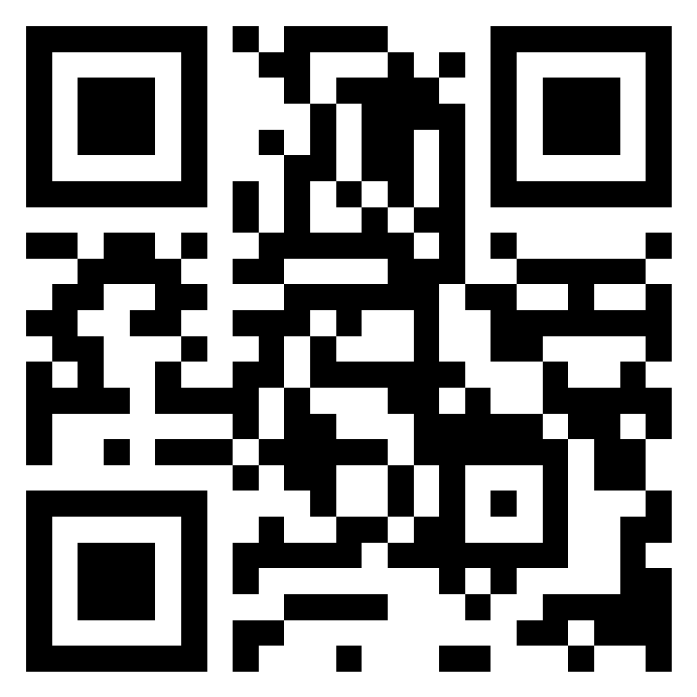
Keep going with .NET 11
Download it. Read what's new. Tell us what you think.
DOWNLOAD
SURVEY
Download .NET 11
2026 .NET Developer Survey
get.dot.net
Scan to take it
now
WHAT'S NEW
About 15 minutes. Helps
shape the future of .NET.
What's new in .NET 11
aka.ms/dotnet/11/whatsnew
SWAG
.NET Conf digital swag
aka.ms/dotnet/
developer-survey
aka.ms/dotnetconf/swag
From this session: aka.ms/meai/start GPT + Claude starter kit aka.ms/openai/start Azure OpenAI + Decisions
.NET AI STACK / NEXT STEPS
Notes:
MAIN IDEA: Next steps.
• Download .NET 11: get.dot.net.
• What's new in .NET 11: aka.ms/dotnet/11/whatsnew.
• Take the .NET Developer Survey: scan the QR code or go to aka.ms/dotnet/developer-survey (about 15 minutes; it helps shape the future of .NET).
• .NET Conf digital swag: aka.ms/dotnetconf/swag.
• From this session: aka.ms/meai/start and aka.ms/openai/start.
• Presenter tip: the survey and swag links are time-bound; confirm they're still active before presenting.
TAKEAWAY: Try it, and tell the .NET team what you think.

Slide 31
Backup: the app decides what's eligible.
Policy runs before any model is asked.
SOURCE / src/VideoProduction.Providers/ChatRouting.cs
var reason = !route.Approved ? "not-approved" : !route.Available ? "unavailable"
: !validOrigin ? "invalid-origin"
: !uri!.IsLoopback && (Policy.LocalOnly || !c.AllowRemote || uri.Scheme != "https")
? "remote-not-approved"
: state.Json && !route.SupportsJson ? "json-not-supported"
: state.Tools && !route.SupportsTools ? "tools-not-supported"
: route.MaxInputCharacters < state.InputCharacters ? "input-capacity"
: route.MaxOutputTokens < state.MaxOutputTokens ? "output-capacity" : "eligible";
Guard.Require(domain.Length > 0, "routing.no-eligible", ...); // nothing is called
if (domain.Length == 1) return new(..., domain[0].Name, "sole-eligible", ...);
var uncertain = selected.Probability < Policy.MinimumProbability
|| selected.Probability - other < Policy.MinimumMargin;
var route = uncertain ? Policy.UncertainRoute : selected.Name; // null: stop
.NET AI STACK / BACKUP
Notes:
BACKUP SLIDE - use only if someone asks how routes are chosen.
MAIN IDEA: Policy runs in plain code before any model is asked.
• Each route is checked: approved and available? Allowed to reach the cloud? Supports JSON and tools if needed? Does the request fit, in and out?
• Only eligible routes go to the decision model.
• One eligible route: picked without calling a model. None: nothing is called.
• If the model isn't confident enough (probability or margin too low), use the policy's fallback route, or stop.
TAKEAWAY: Deterministic rules first; the model only chooses among safe options.

Slide 32
Backup: what we're careful to say.
• The paper's results are the authors' own; we explain, we don't verify them.
• Tables came out of OCR as Markdown, not addressed cells.
• The vision model described Figure 5; a person corrected one reversed flow.
• The live paper-authoring turn used the Copilot agent directly, not the router.
• Motion visuals are authored schematics, not generative video; the cover is SVG drawn by a chat model.
• Decisions in MEAI are coming soon; Studio's IDecisionClient previews the shape.
• Speech, image and Blazor AI types are experimental; Studio pins preview builds.
.NET AI STACK / BACKUP
Notes:
BACKUP SLIDE - short, honest answers to common questions.
• Is the paper right? Those are the authors' results; the app explains them, it doesn't verify them.
• The tables? OCR returned Markdown text, not structured cells.
• Figure 5? A vision model described it, and a person corrected one reversed flow.
• Was routing used for the paper draft? No; that draft ran on the agent directly.
• Is the video AI-generated? No. The voice is text-to-speech, the diagrams are authored, and the cover is an SVG drawn by a chat model.
• Is Decisions in Microsoft.Extensions.AI? Coming soon; the app's interface previews the shape.
• Speech, image and Blazor AI APIs are experimental, and the app uses preview builds.
TAKEAWAY: Be precise about what AI did and what code or people did.

