Slide 1




.NET Community Austria
April 2026
Presented by DotNetDevs.at
https://go.dotnetdevs.at/youtube
https://go.dotnetdevs.at/bluesky
https://go.dotnetdevs.at/twitch
https://go.dotnetdevs.at/linkedin

Slide 2
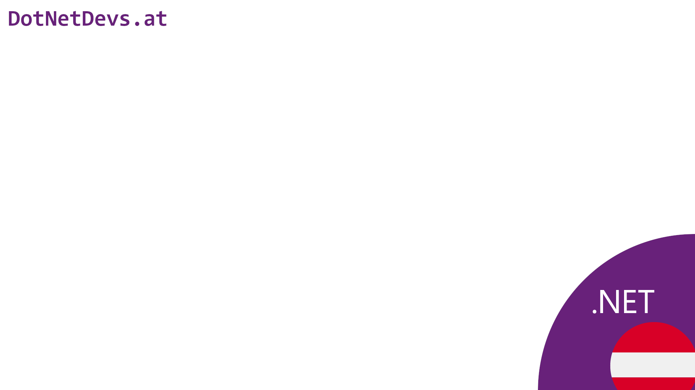
Thank you for joining!

Slide 3
Thanks for hosting!

Slide 4
We need your help!

Slide 5
https://go.dotnetdevs.at/helpus

Slide 6

Our Sponsors

Slide 7
How to take part in the raffle?
Type #jetbrains in the chat

Slide 8
Community News

Slide 9
Next meetups
May 2026
TBD
TBD
TBD
June 2026
TBD
TBD
TBD
July 2026
TBD
TBD
TBD

Slide 10
If you want host a meetup?
team@dotnetdevs.at

Slide 11
Kafka through the lens of .NET
Shahab Ganji

Slide 12
Thank you!

Slide 13
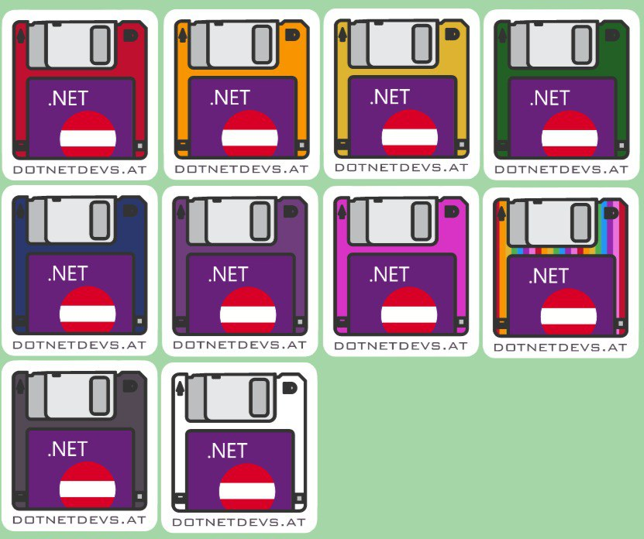
Thank you for joining!

Slide 14
Thank you for joining!

Slide 15
Our Sponsors

Slide 16
JetBrains Raffle
Contact us at team@dotnetdevs.at

Slide 17
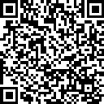
We want to hear your feedback
https://go.dotnetdevs.at/feedback-202503

Slide 18
See you next Month!

