Slide 1

October 2021 Meetup
Presented by DotNetDevs.at

Slide 2
Thank you for joining!

Slide 3





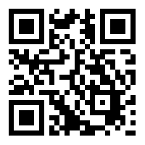
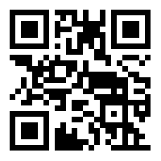
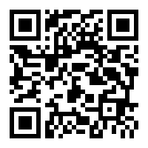
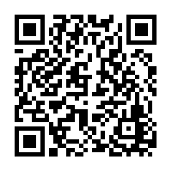
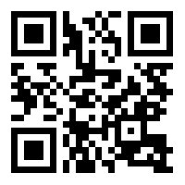
DotNetDevs.at
Notes:
DotNetDevs.at is an non- profit association, whose purpose is to spread of knowledge and experience about usage of .NET technologies.
Our goals are:
making it easier for new participants to find existing communities
offering existing members more choices
promoting the exchange between the different communities

Slide 4
Thanks to our sponsors!

Slide 5





Slide 6
News from the Community

Slide 7

Independent. Innovative. And always open source.
dotnetfoundation.org

Slide 8
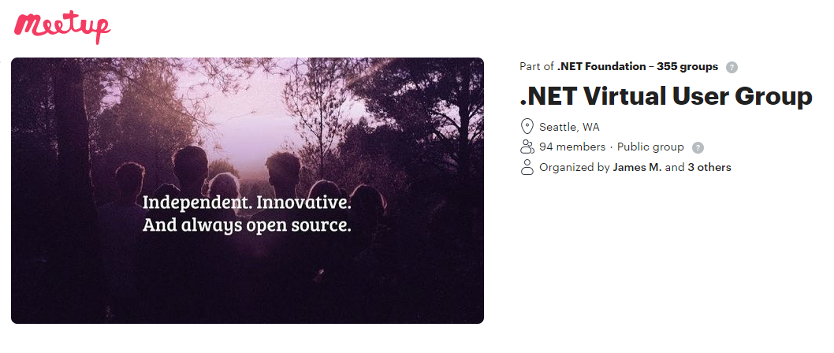
.NET Foundation Virtual User Group
Find virtual user groups happening around the globe!
meetup.com/dotnet-virtual-user-group

Slide 9
Interesting Events

Slide 10
The State of Test Automation in .NET by Andreas Willich

Slide 11
The State of Test Automation in .NET

Slide 12
About which tests are we talking about today?
Unit Tests
Integration Tests
Functional Tests
End-to-End Testing
Acceptance Testing

Slide 13
About what we are not talking today?
Performance Tests
Accessibility Tests
Smoke Testing

Slide 14
Questions I want to answer today!
How to run tests?
How to define a test?
How to check if a test result is valid?
How to handle internal dependencies?
How to handle external dependencies?
How to automate a desktop/web/mobile app?
How to make your live easier
How to run my app locally for tests?

Slide 15
How to run tests?

Slide 16
How to define a test?

Slide 17
More about differences of the test runners
NUnit, MSTest and xUnit - What is similar? What is different?
https://www.youtube.com/watch?v=rLbF8u46tfE

Slide 18
How to check if a test result is valid?

Slide 19
How to automate a desktop/web/mobile app?

Slide 20


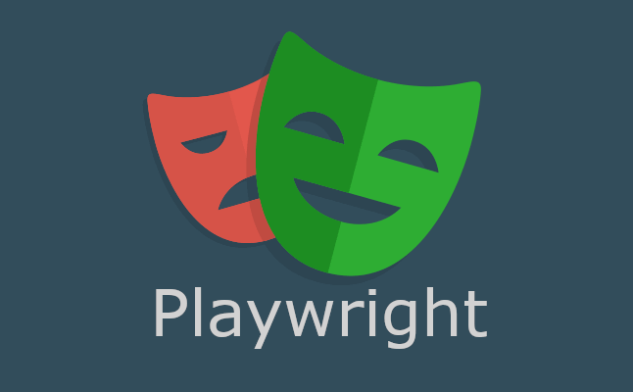
There is a tool for everything

Slide 21



Slide 22
How to handle internal dependencies?

Slide 23
How to handle external dependencies?

Slide 24
Now it gets hard!
Try not to call the external dependency in the first place
Setup new instance for every testrun/test
Docker with FluentDocker (https://github.com/mariotoffia/FluentDocker)

Slide 25
How to run my app locally for tests?

Slide 26
Depends on your App
Desktop: Process.Start
Web: running with Kestrel
Mobile: Appium handles it for Device and Emulator

Slide 27
How to make your live easier

Slide 28
Code Coverage
Coverlet
Included in VS Enterprise

Slide 29
Use Plain language for describing Behavior
SpecFlow

Slide 30
Code Examples
https://github.com/SabotageAndi/StateOfTestAutomationInDotNet

Slide 31
Q&A

Slide 32
Thank you Andreas!

Slide 33
Thank you for joining!

Slide 34
Thanks to our sponsors!

Slide 36
Do your company or you want to sponsor us?

Slide 37
Do you want to host a Meetup?

Slide 38
Talk with us!
General Information:
https://dotnetdevs.at/sponsoring/

Slide 39
Next meetups
November 9th 2021
Building developer tooling with Roslyn by Will Fuqua
December 7th 2021
Build Connected Things with Meadow and C#
by Jorge Ramirez

Slide 40
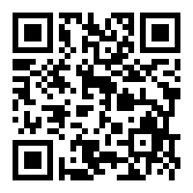
Requested Topics for future Meetups:
Blazor
Paket
NodaTime
...
All under https://github.com/dotnetdevsaustria/topic-requests
Please enter your requests!

Slide 41

Spread the word!
Invite colleagues
Invite friends
Invite customers
Tweet! @DotNetDevsAT
Invite everyone that has to do with .NET

Slide 42
DotNetDevs.at
Notes:
DotNetDevs.at is an non- profit association, whose purpose is to spread of knowledge and experience about usage of .NET technologies.
Our goals are:
making it easier for new participants to find existing communities
offering existing members more choices
promoting the exchange between the different communities

Slide 43
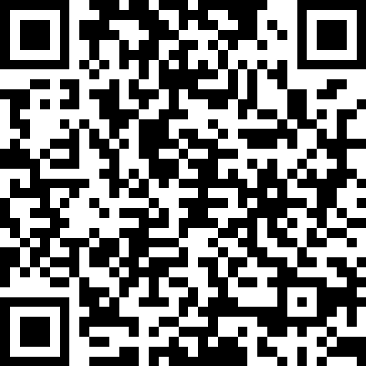
We want to hear your feedback
https://go.dotnetdevs.at/feedback-202110

